Slide 1
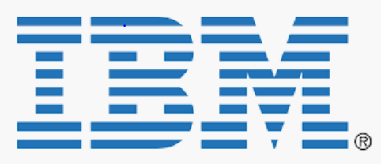
Introduction- Web Development with Python & Flask-Restful
Sudhanshu Satyam
Email : susatyam@in.ibm.com
Slack : @sudhanshu

Slide 2

Contents
Why Flask ?
Flask-Restful
Mongo Engine & Flask-JWT
Let’s Code !!!
References
Questionnaire

Slide 3
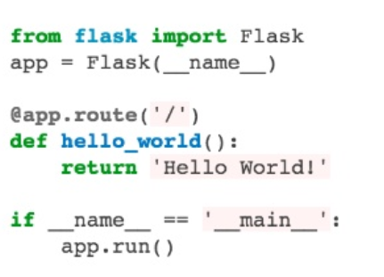
Why Flask ?
Light, Simple & Extensible
Pythonic, easy to learn
Import only when you need
Easily integrable with relational/non-relational database
Development ready
Testable
Production ready by extending with WSGI toolkit.

Slide 4
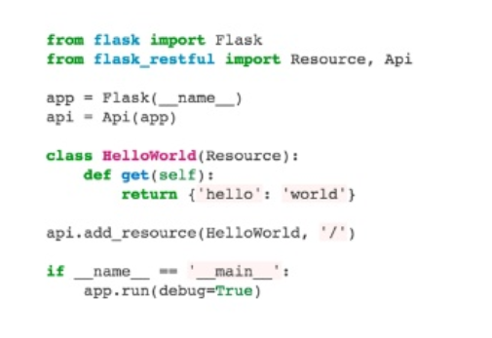
Flask-Restful
Supports Rest-architecture
Scalable & Secure
Good designed Interface
Operational ready with Rest verbs
( GET, POST, PUT, DELETE etc.)
Easily Integrable with Web applications
Supports HTTP protocol, supports various implementation standards like json, xml, yml etc.

Slide 5
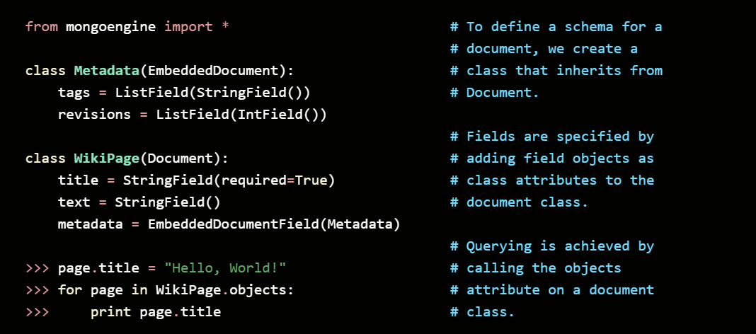
Mongo Engine & Flask-JWT
MongoEngine : Document-Object mapper for rapid Python-app development with MongoDB
Falsk-JWT : JWT based authentication for application

Slide 6

Let’s code !!!
Please visit following GitHub URL for Source code reference :
https://github.com/ssatyam2302/python-web-app.git

Slide 7
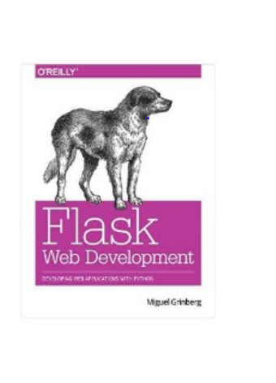
References
https://flask.palletsprojects.com/en/1.1.x/
https://blog.miguelgrinberg.com/post/designing-a-restful-api-with-python-and-flask
https://pythonhosted.org/Flask-JWT/
http://docs.mongoengine.org/

Slide 8

Thank you

