Slide 1
Project name
Your name

Slide 2
Project overview
The product:
Insert a few sentences about the app, website, or other product that you designed and the target users
Preview of selected polished designs.
Project duration:
Insert the time that you worked on this design project - e.g., Month Year to Month Year

Slide 3
Project overview
The problem:
Insert one to two sentences about the problem(s) you were trying to solve.
The goal:
Insert one to two sentences about the goal of the project.

Slide 4
Project overview
My role:
Identify your role in the project - e.g., lead UX designer, UX researcher, etc.
Responsibilities:
List the responsibilities you had throughout the project - e.g., user research, wireframing, prototyping, etc.

Slide 5
User research
Personas
Problem statements
User journey maps
Understanding
the user

Slide 6
User research: summary
Write a short paragraph describing your user research.
This can include the type of research you conducted, assumptions that you made going into the research, and how your assumptions changed after conducting research.

Slide 7
User research: pain points
1
2
3
4
Pain point
Pain point
Pain point
Pain point
Write one to two sentences reflecting on the pain point listed above and how it will guide designs moving forward.
Write one to two sentences reflecting on the pain point listed above and how it will guide designs moving forward.
Write one to two sentences reflecting on the pain point listed above and how it will guide designs moving forward.
Write one to two sentences reflecting on the pain point listed above and how it will guide designs moving forward.

Slide 8
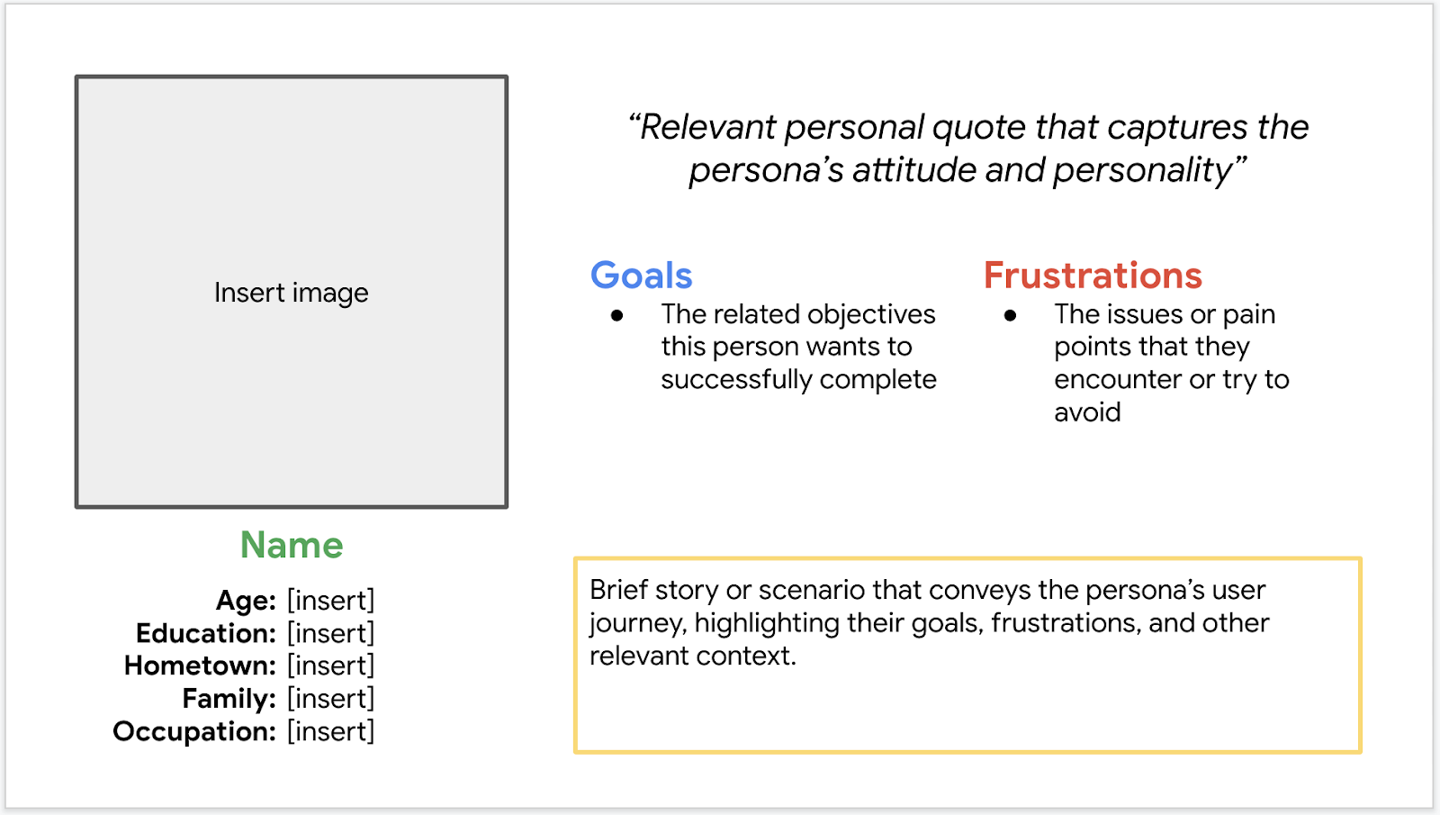
Persona: Name
Problem statement:
[User name] is a [user characteristics]
who needs [user need]
because [insight].

Slide 9
User journey map
[Your notes about goals and thought process]
Image of user journey map

Slide 10
Sitemap
Paper wireframes
Digital wireframes
Low-fidelity prototype
Usability studies
Starting
the design

Slide 11
Sitemap
[Your notes about goals and thought process]
Image of sitemap/IA

Slide 12
Paper wireframes
[Your notes about goals and thought process]
Image of paper wireframes

Slide 13
Paper wireframe
screen size variation(s)
[Your notes about goals and thought process]
Image of paper wireframe screen size variation(s)

Slide 14
Digital wireframes
[Your notes about goals and thought process + how you responded to and implemented peer feedback]
Insert first wireframe example that demonstrates design thinking aligned with user research
Description of the element and its benefit to the user
Description of the element and its benefit to the user

Slide 15
Digital wireframe
screen size variation(s)
[Your notes about goals and thought process + how you responded to and implemented peer feedback]
Insert wireframe example that showcases
different screen size variations

Slide 16
Low-fidelity prototype
[Links to low-fidelity prototypes of different screen variations and brief description of the user flow + how you responded to and implemented peer feedback]
Screenshot of prototype with connections or prototype GIF

Slide 17
Usability study: parameters
Study type:
Unmoderated usability study
Location:
United States, remote
Participants:
5 participants
Length:
20-30 minutes

Slide 18
Usability study: findings
Insert a one to two sentence introduction to the findings shared below.
1
2
3
Finding
Finding
Finding
Insert usability study finding 1.
Insert usability study finding 2.
Insert usability study finding 3.

Slide 19
Refining
the design
Mockups
High-fidelity prototype
Accessibility

Slide 20
Mockups
[Your notes about goals and thought process + how you responded to and implemented peer feedback]
Before usability study
After usability study
Mockup 1 before
Mockup 1 after

Slide 21
Mockups
[Your notes about goals and thought process + how you responded to and implemented peer feedback]
Before usability study
After usability study
Mockup 2 before
Mockup 2 after

Slide 22
Mockups: Original screen size
Main mockup screen for display
Main mockup screen for display
Main mockup screen for display
Main mockup screen for display

Slide 23
Mockups: Screen size variations
Main mockup screen for different screen size variations
Main mockup screen for different screen size variations
Main mockup screen for different screen size variations
Main mockup screen for different screen size variations

Slide 24
High-fidelity prototype
[Links to low-fidelity prototypes of different screen variants and brief description of the user flow + how you responded to and implemented peer feedback]
Screenshot of prototype with connections or prototype GIF

Slide 25
Accessibility considerations
1
2
3
Insert one to two sentence summaries describing each accessibility consideration applied in your designs.
Insert one to two sentence summaries describing each accessibility consideration applied in your designs.
Insert one to two sentence summaries describing each accessibility consideration applied in your designs.

Slide 26
Going forward
Takeaways
Next steps

Slide 27
Takeaways
Impact:
Insert one to two sentences summarizing the impact of your designs. In the real world, you’d include data like number of downloads or sign ups, but since this is a course project, you can include a positive quote from a peer or study participant.
What I learned:
Insert a few sentences summarizing what you learned throughout the project.

Slide 28
Next steps
1
2
3
Insert a few sentences summarizing the next steps you would take with this project and why.
Insert a few sentences summarizing the next steps you would take with this project and why.
Insert a few sentences summarizing the next steps you would take with this project and why.

Slide 29
Insert a few sentences summarizing the next steps you would take with this project and why. Feel free to organize next steps in a bullet point list.
Let’s connect!
Insert a brief sentence or two about contacting you and/or reviewing more of your work.
Provide your contact information here. This might include your email address, phone number, and website or link to other professional platforms.

