Slide 1
GUI Calculator using python tinkther
By Sudhanhsu Sharma

Slide 2
Introduction
This project is a Graphical User Interface (GUI) Calculator developed using Python and its built-in Tkinter library.
The main objective of this project is to demonstrate how Python can be used to create interactive desktop applications with an easy-to-use interface.
Ther are many library available but I use Tkinter library because it provides a simple yet powerful way to design GUI applications without requiring external libraries.
Through this project, we aim to understand event-driven programming and layout management in Python.

Slide 3
This is a scientific calculator because I have added advanced functions. I am making an advanced calculator in this program I want to make this calculator suitable for daily life use and user-friendly.
The calculator can perform arithmetic operations such as addition, subtraction, multiplication, and division as well as Scientific operation like sin, cos, tan, log, pi etc.
I want to make this calculator suitable for daily life use and user-friendly. I do not add too many options and functions so that it does not seem crowded.
When I was making this calculator, I faced many challenges which I resolved through various means.

Slide 4
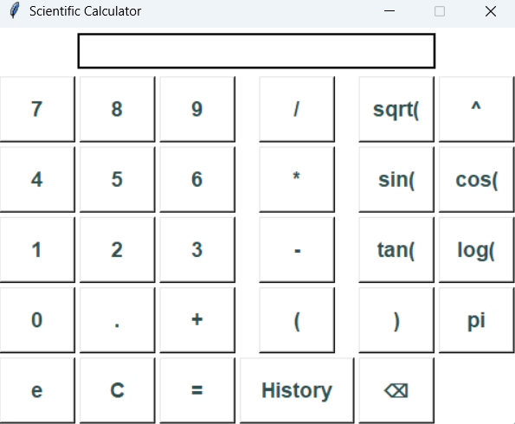
Layout of scientific calculator

Slide 5
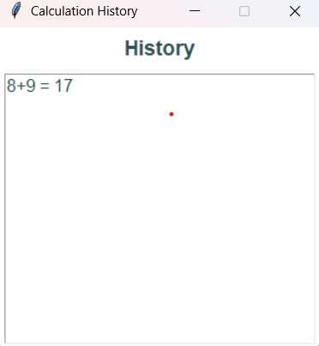
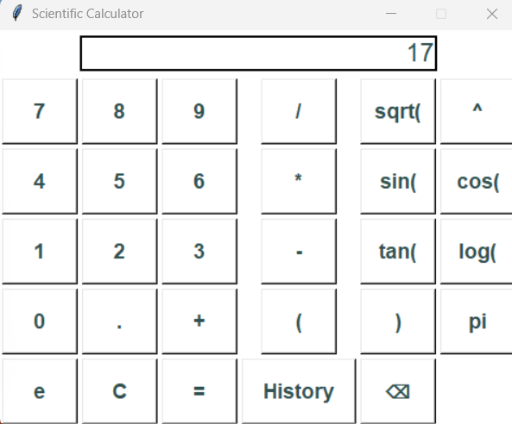
This shows the history when we click on the history button.

Slide 6
Conclusion
When I was making this calculator, my focus was on adding design and operations that could perform daily tasks.
I want to make this calculator suitable for daily life use and user-friendly. We can use both the keyboard and the mouse for the user's convenience.

