Slide 1
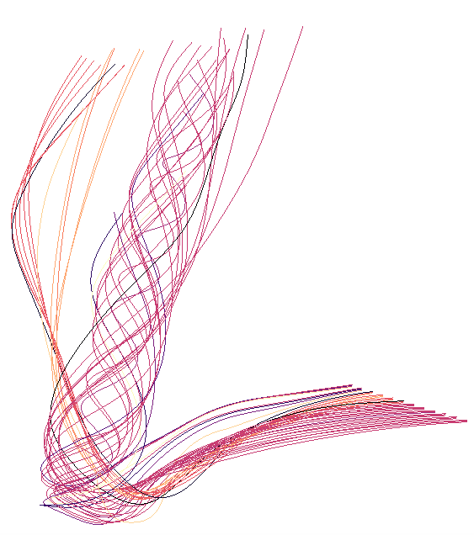
SIMULATION CODE
IN SITU PROCESSING
POST HOC EXPLORATION
Lagrangian Analysis Routine
New Vector Field
Store Lagrangian Representation
Load Lagrangian Representation
Sampling Strategy
Advance Simulation
Particle Advection
Particle Management
Data
Storage
Interpolate Data

