Slide 1


Slide 2
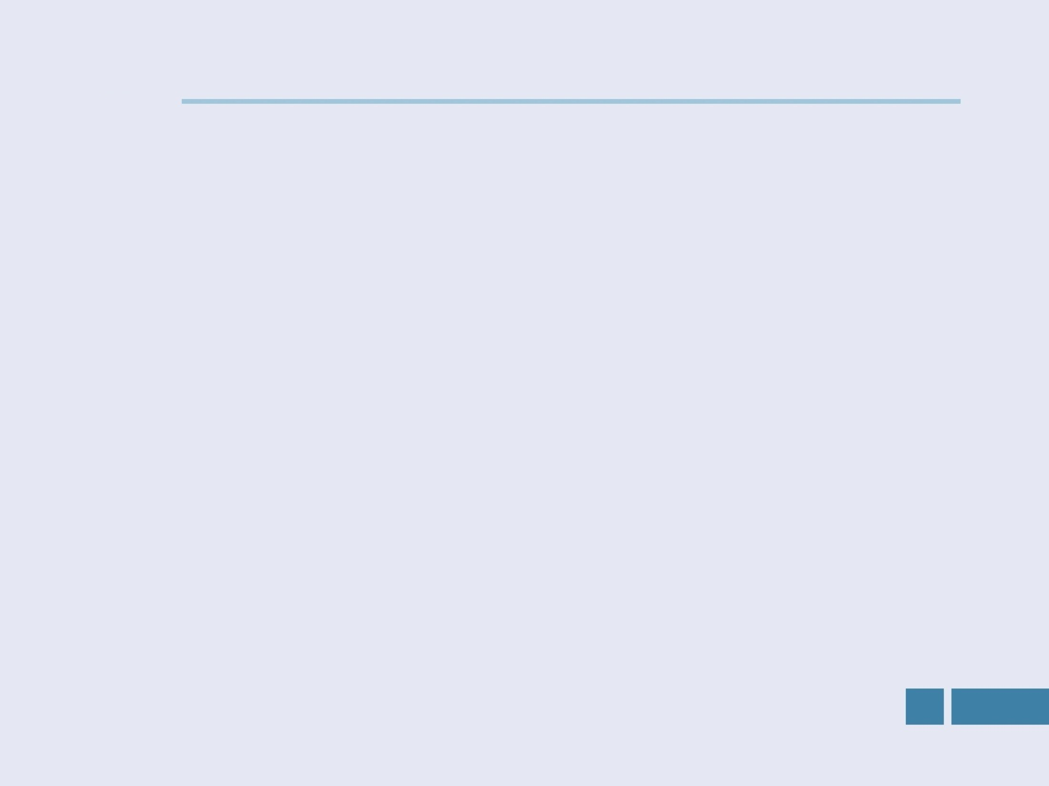


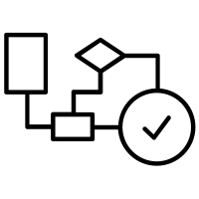

DEFINITION

Slide 3




Problem Statement
In this project we aim to determine the type of network congestion occurring in a network in the context of the telecommunication industry. | We are required to train machine learning models that use cell tower statistics and information pertaining to both tower level activity and user-level activity in order to perform a multiclass classification to predict the type of network congestion that might occur | Evaluation of the output is based on the Matthews correlation coefficient also abbreviated as MCC.

Slide 4

Evaluation Metrics
+1
coefficient of +1 represents a perfect prediction
MCC
Score
coefficient of 0 is no better than random prediction
0
coefficient of -1 indicates total disagreement between prediction and observation
-1
It is regarded as a balanced measure which can be used even if the data has class imbalance, which can very well be the case if we are doing the network congestion type prediction on a complete industrial dataset and not on a handpicked subset of that data.
As in our problem statement, we are doing multiclass classification therefore we use the generalized form of MCC score for multiclass classification

Slide 5
ANALYSIS

Slide 6
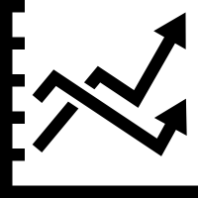
Variables
The two types of statistical data available are Numerical and Categorical.
Target Variable Name is “Congestion_Types” and it is of Categorical type.
There are 4 unique categories of target variable.
NC(Non-Congestion)
3G_Backhaul_Congestion
4G_Backhaul_Congestion
4G_Ran_Congestion

Slide 7
Variables
First 8 columns gives information about some important variables
Next 26 columns gives information about usage of data for different tasks like web browsing, file sharing, social networking, etc.
Further next 4 columns gives information about tilt, beam direction , range of tower and the service provider(‘categorical feature’).

Slide 8
Additional Variables
We divided the hours into time zones of 5 intervals and label encoded each time-zone.
We took the sum of all bytes consumed through the tower and created a new feature for sum_total_bytes consumed.
We divided the ‘par_days’ feature by 7 and created a new feature of days_of_week, and assigned the value 1 to Monday and so on.
Due to high skewness in data of Bytes consumption, we apply log transformation to obtain Gaussian like Distribution.
We created new features by squaring values to capture any hidden pattern

Slide 9

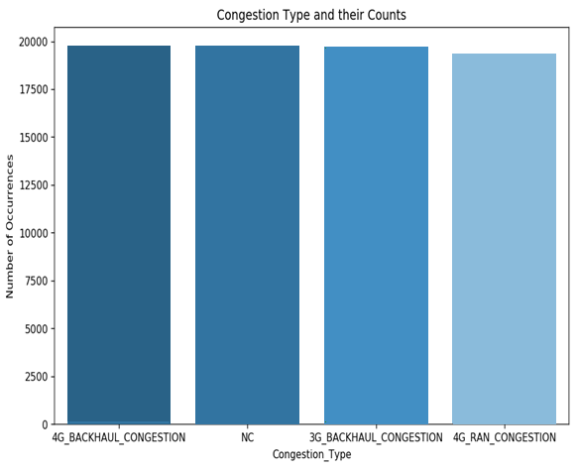
Visual Interpretation
Class distribution between the 4 congestion types is almost similar in the training set.

Slide 10
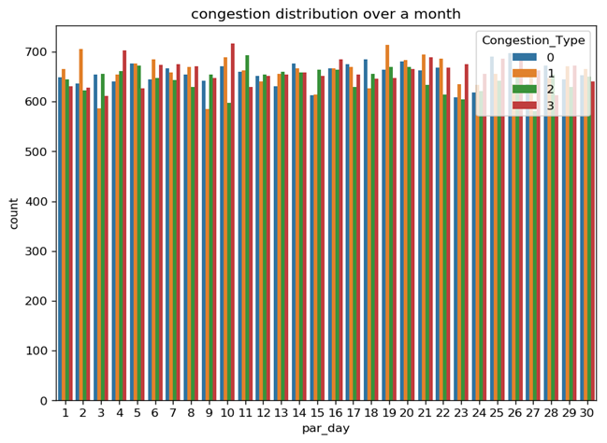
Visual Interpretation
The distribution is fairly even and there is no specific pattern.

Slide 11
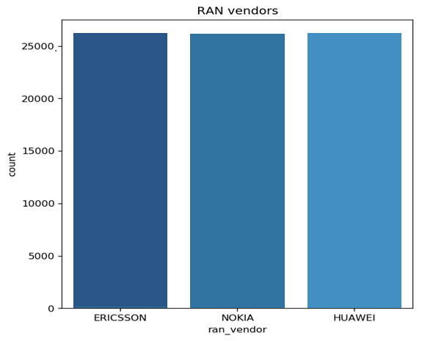
Visual Interpretation
There is no preference given to any specific vendor and this feature may give us detailed hindsight in this data.

Slide 12
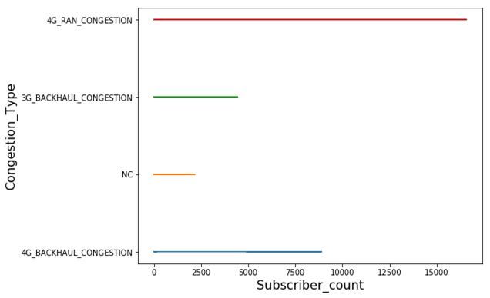
Visual Interpretation
This clearly indicates that there is always congestion existing beyond 2177 subscribers and after 8890 subscribers, only 4G_Ran_Congestion existed.

Slide 13
ALGORITHMS
&
TECHNIQUES

Slide 14

Data Preprocessing
Data Preprocessing consisted of appropriate logical steps as explained below :
Removal of “Cell_name” column
Removal “Par_Year” and “Par_Month” column also because both are fixed and their variance is zero
Division of day into 5 intervals according to general usage pattern as follows :
1:00 AM - 7:00 AM | 7:00 AM- 11:00 AM | 11:00 AM - 4:00 PM | 4:00 PM - 8:00 PM | 8:00 PM - 1:00 AM

Slide 15
Data Preprocessing
Two data types : Numerical and categorical
Target Variable is also of Categorical type.
Label Encode Categorical variables into numerical because models for training takes only numerical data.
Initially values of data usage(bytes) are skewed.
To remove skewness in data , used several methods were used
Taking logarithm of data
Squaring of each feature
Also added all the types of data usage and made new feature “Total_bytes”

Slide 16

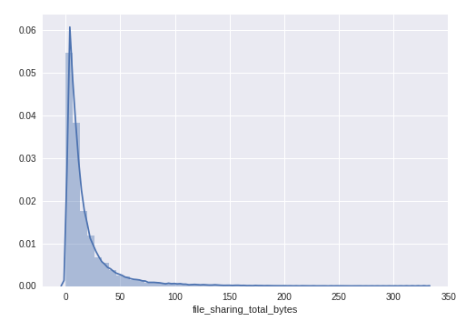
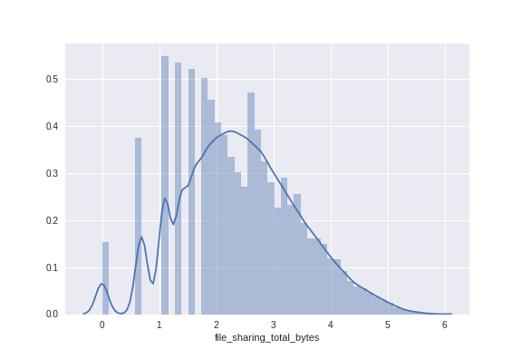
Transformation of data
Transformation
x’ = log(1+x)
As observed from the left plot, the data for ‘file_sharing_total_bytes’ feature is skewed to a considerable extent. The same is the case with all other types of bytes features.
We hence will apply a log transform to obtain a Gaussian-like distribution as shown on the right.

Slide 17

Approach for model
Various different models are used such as :
Grid search is applied to find the optimum hyper parameter for some of the computationally less expensive classifiers:
Random Forest Classifier | AdaBoost Classifier | Extra Trees Classifier | Logistic Regression
Decision Tree Classifier | MLP Classifier | XGBoost Classifier | Gradient Boosting Classifier
Logistic Regression | Random Forest Classifier | MLP classifier

Slide 18
Approach for model
We arranged all the classifiers in descending order according to their MCC score and the chose the top 4 models whose MCC score was greater than 0.7.
We used Voting classifier to ensemble our model with these 4 models:
MLP Classifier
XGBoost Classifier
Gradient Boosting Classifier.
Logistic Regression

Slide 19

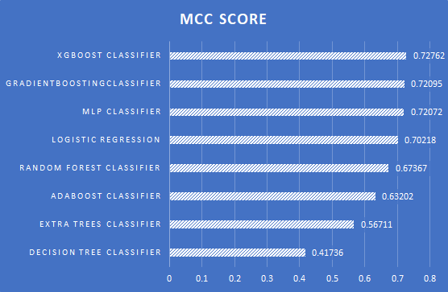
Results

Slide 20
RESULTS
&
CONCLUSION

Slide 21

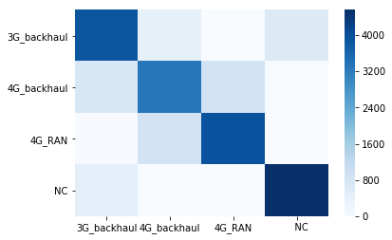
Output Interpretation
Final MCC after ensembling: 0.732
Hurdles we faced:
Reducing the false positives and true negatives between ‘4G_BACKHAUL_CONGESTION’ and ‘4G_RAN_CONGESTION’
Constructing features that were closely correlated to the congestion classes.
Finding a relation between the various time patterns
Notes:
Put red boundary over the number
Reduce the font size for hurdles, not same size as Final MCC

Slide 22



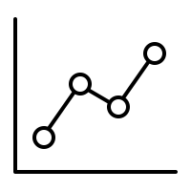
Estimation of uncertainty
OVERFITTING
Used K-fold cross-validation (K=10) with training mean MCC of 0.78 and validation mean MCC of 0.74 which shows model is not overfitting.
REFINEMENT
Removed par_min feature because time series feature is not useful as data is given for one particular time for distinct cell tower.
UNCERTAINITY
Constructed a 90% Cl, with p mean = 0.732, z=1.28, n=15. Used K-fold cross-validation with k=15.
Current MCC Score = 0.732 ± 0.14638

Slide 23




Problems faced
The data observed in intervals of 5 minutes was irregular and hence the implementation of time series analysis was not feasible.
Cell tower names were unique so we couldn’t make clusters of data values of a particular cell tower and thereafter construction of a Time Series was impractical
Amongst the 4G backhaul and the 4G RAN, the features were extensively overlapping, hence the error depicted in the confusion matrix was comparatively high

Slide 24

Improvements
Using Grid search for tuning hyperparameters of various models such as XGBoost, AdaBoost etc.
Using Deep Learning models with efficient number of layers, nodes, and hyper-parameters.

Slide 25
Thank you
We are open to questions.

