Slide 1

Steel Plate Faults Detection
SUDHANSHU KUMAR SINGH
IIT KHARAGPUR
TEAM = DHAASU

Slide 2
PROBLEM STATEMENT
Develop a model to predict faults for the provided measurements of the Steel plate samples.
Decide Best Metric for Judging the models used

Slide 3

Why Solving The Problem
Fault Diagnosis (FD) has a major
importance to enhance the quality of manufacturing and to lessen the cost of product testing

Slide 4
ATTRIBUTE INFORMATION
27 independent variables:
X_Minimum
X_Maximum
Y_Minimum
Y_Maximum
Pixels_Areas
X_Perimeter
Y_Perimeter
Sum_of_Luminosity
Minimum_of_Luminosity
Maximum_of_Luminosity
Length_of_Conveyer
TypeOfSteel_A300
TypeOfSteel_A400
Steel_Plate_Thickness
Edges_Index
Empty_Index
Empty_Index
Square_Index
Outside_X_Index
Edges_X_Index
Edges_Y_Index
Outside_Global_Index
LogOfAreas
Log_X_Index
Log_Y_Index
Orientation_Index
Luminosity_Index
SigmoidOfAreas

Slide 5
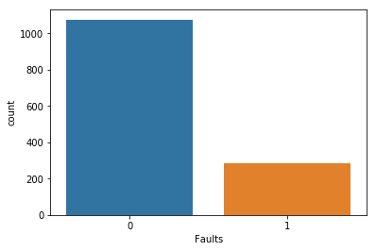
DATA PREPROCESSING
Class imbalance present ( class 0 = 1075, class 1 = 283 )
Random Up-Sampling of Minority class (class 1) to 1075

Slide 6
DATA PREPROCESSING
No missing values in the data
70 % of data is for training and 30 % for testing (Held- out test)
TypeOfSteel_A400 has high correlation with TypeOfSteel_A300
Drop TypeOfSteel_A400 attribute

Slide 7
APPROACH
K neighbors classifier
Random Forest classifier
AdaBoost with Decision Tree classifier
Support Vector Machine

Slide 8
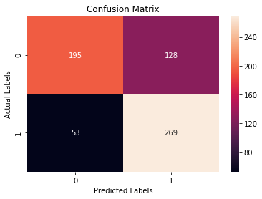
K-NEIGHBORS CLASSIFIER
Best Accuracy of 85.58% obtained for k=1 ( i.e. linearly separable data points )

Slide 9
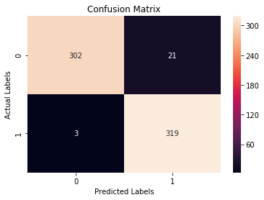
RANDOM FOREST CLASSIFIER
Best Accuracy of 96.27% is achieved for Number of Trees = 38

Slide 10

ADABOOST CLASSIFIER WITH DECISION TREES
Best Accuracy of 82.63% is achieved for n_estimators = 176

Slide 11
SVM CLASSIFIER
Grid Search algorithm for Parameter Optimisation
Best Accuracy of 92.05% is achieved for C= 1 and Gamma = 0.001
SVM excels in high-dimension problem and Less samples

Slide 12
CONCLUSION
Random Forest have the great impact on the problem of steel plates fault diagnosis
Recall is Used as best Measurement criteria because Class Imbalance
Better not Classify Faulty as No-Faulty

Slide 13
REFERENCE
https://www.researchgate.net/publication/265124971_Steel_Plates_Faults_Diagnosis_with_Data_Mining_Models?_esc=publicationCoverPdf&el=1_x_3&enrichId=rgreq-211f3c99ade621ac088eedc6bf24f43c-XXX&enrichSource=Y292ZXJQYWdlOzI2NTEyNDk3MTtBUzozNTY2MzQ2Mjc5ODU0MDhAMTQ2MjAzOTcyOTQ2NQ%3D%3D
https://www.sciencedirect.com/science/article/pii/S0925231214012193
http://archive.ics.uci.edu/ml/datasets/steel+plates+faults

Slide 14


