Slide 1
CSAAS
Coal Sample Anti-Adulteration System
VL Access Pvt Ltd · May 2026
Tamper-Evident · Verifiable · Audit-Ready

Slide 2
The Problem
Coal quality disputes cost millions. The root cause is sample adulteration and until now, it has been nearly impossible to prove.
01
02
03
Sample Adulteration
No Chain of Custody
Audit Gaps
Coal samples are physically tampered with during transit from the collection point to the laboratory, distorting quality measurements and financial settlements.
Manual handoffs between personnel create gaps where accountability is lost. There is no verifiable record linking each sample to its handler.
Paper-based processes leave no digital evidence trail, exposing the plant to disputes, compliance failures and financial losses.

Slide 3
Our Solution
A fully integrated 6-stage chain-of-custody platform - from consignment receipt at the DVC plant to laboratory authentication.
01
02
03
04
05
Consignment
Receipt
Sample
Collection
In-Transit
VMS Tracking
Prep Room
Pulverisation
Division &
Lab Receiving
Verifiable
Transparent
Audit-Ready
Every handoff timestamped
Full movement audit trail
Instant evidence export

Slide 4
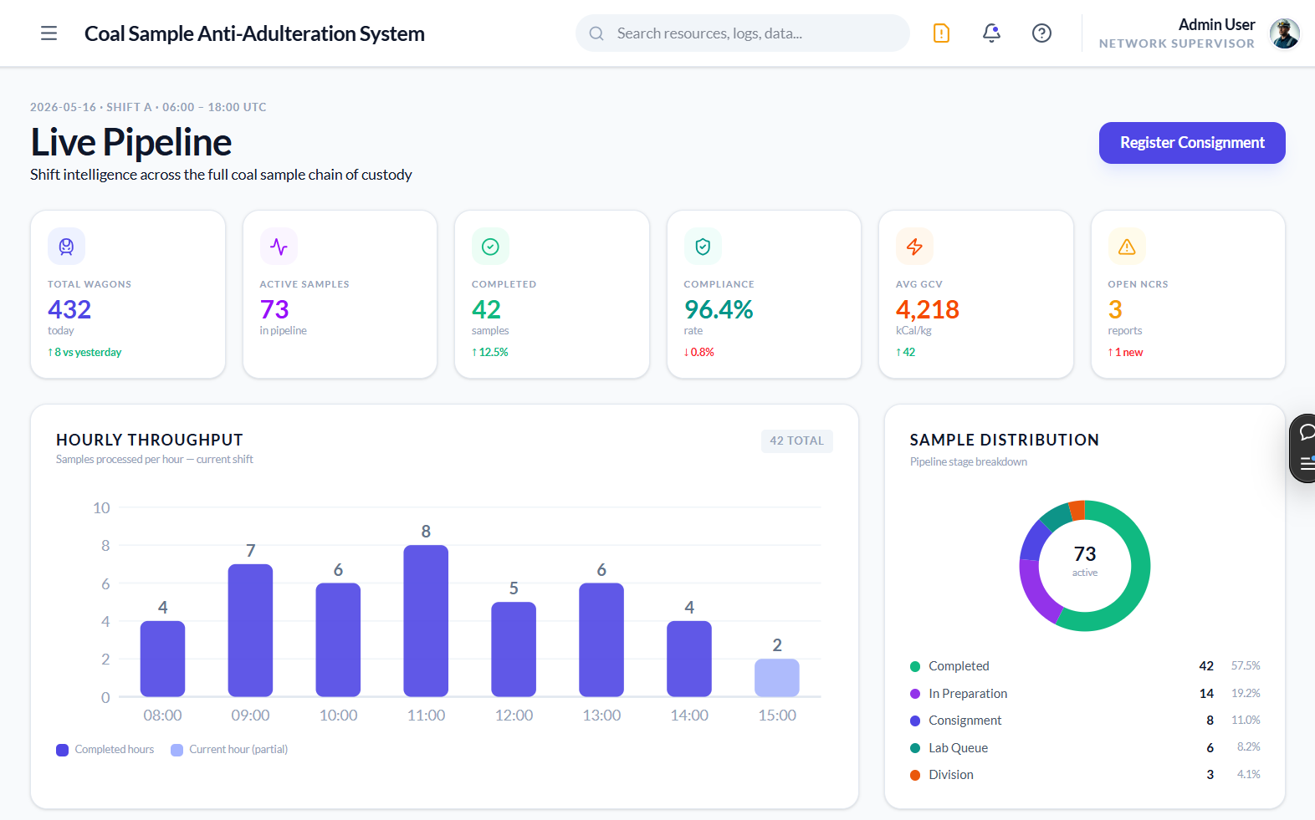
Feature Demo - Live Pipeline Dashboard
[ Screenshot Placeholder ]
Live Pipeline Dashboard
Attach screenshot here
6 KPI Cards - Total Wagons, Active Samples, Compliance Rate, Avg GCV, Open NCRs
Hourly throughput chart, sample distribution donut & shift performance gauge
Live activity feed, active NCR table & clickable pipeline flow navigator
Shift supervisor command centre for real-time coal sample pipeline visibility
01 - Live Pipeline Dashboard

Slide 5
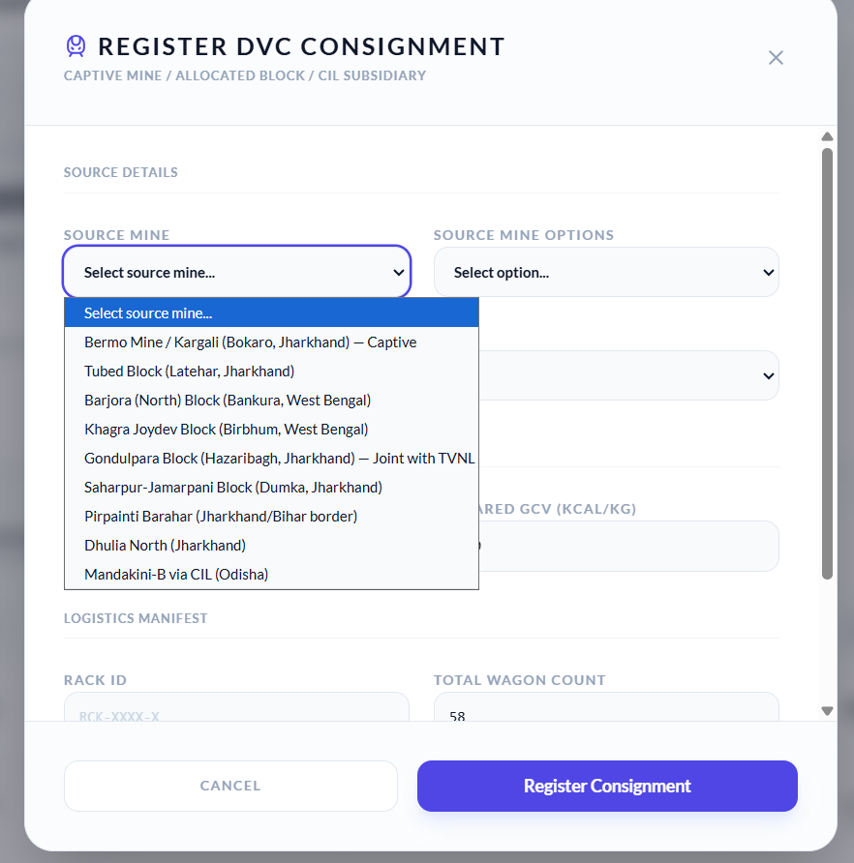
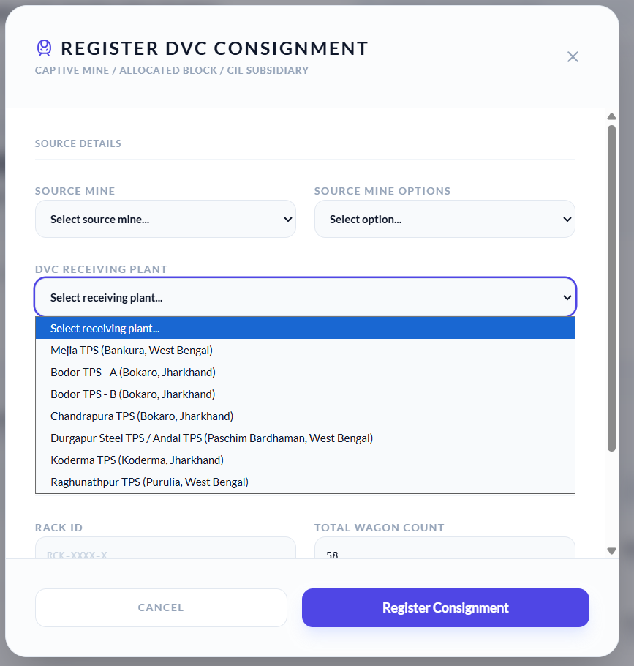
Feature Demo - Consignment Registration
[ Screenshot Placeholder ]
Consignment Registration
Attach screenshot here
Inbound rack manifest ledger - Rack ID, Source Mine, DVC Plant, Wagon count, Status
Supplier registration modal - Source Mine, Grade (G6–G17), GCV, Rack ID, ETA
Live status tracking: UNLOADING, IN_TRANSIT, QUEUED, READY across 9 DVC mines
Manages inbound coal from DVC captive mines, allocated blocks & CIL subsidiaries
02 - DVC Consignments & Registration

Slide 6
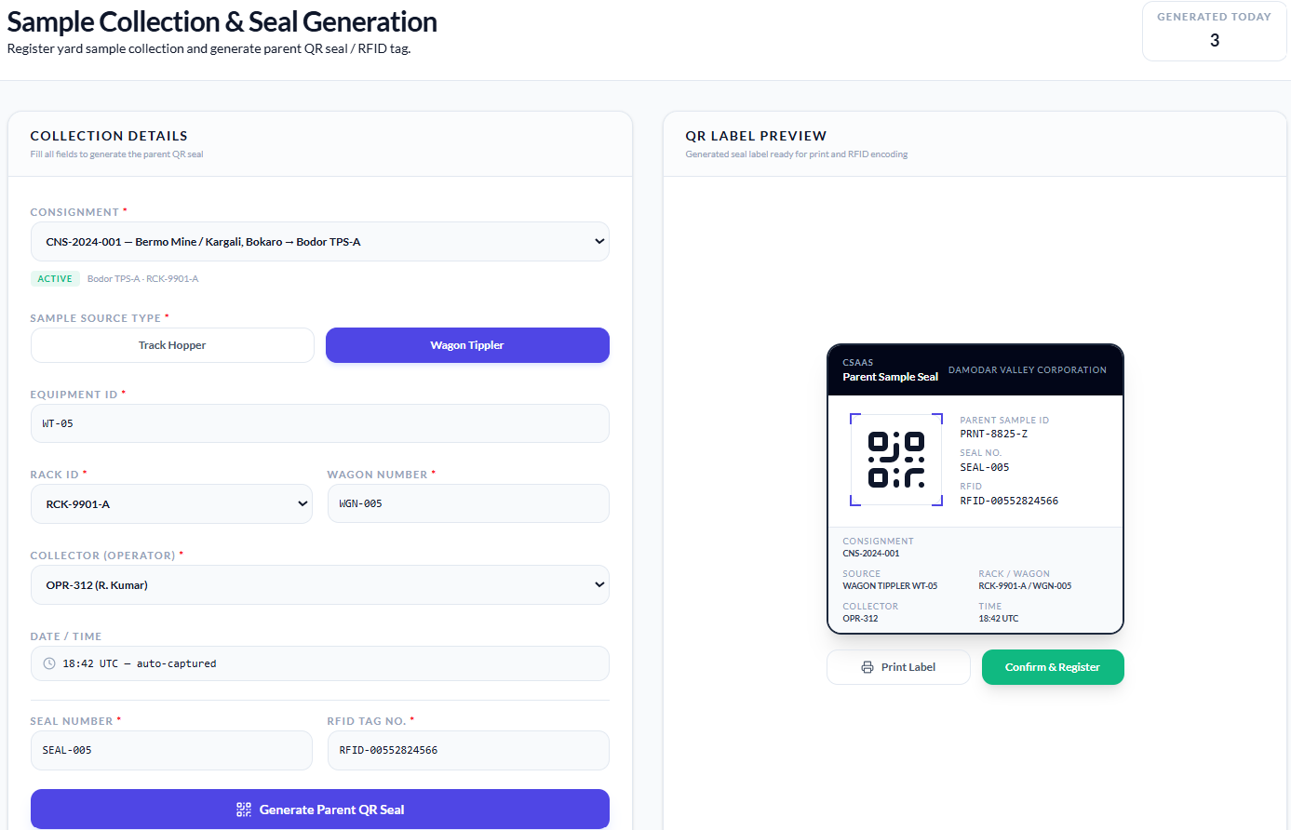
Feature Demo - Sample Collection & QR Seal
[ Screenshot Placeholder ]
Sample Collection & QR Seal
Attach screenshot here
Collection form - Consignment, Track Hopper / Wagon Tippler toggle, Equipment ID
QR Label Preview - generates parent seal with CSAAS/DVC branding, QR code, RFID tag
Every parent sample uniquely bound to its source consignment, wagon & collector
03 - Sample Collection & QR Seal Generation
Core anti-adulteration entry point - tamper-evident QR + RFID tag at the source

Slide 7
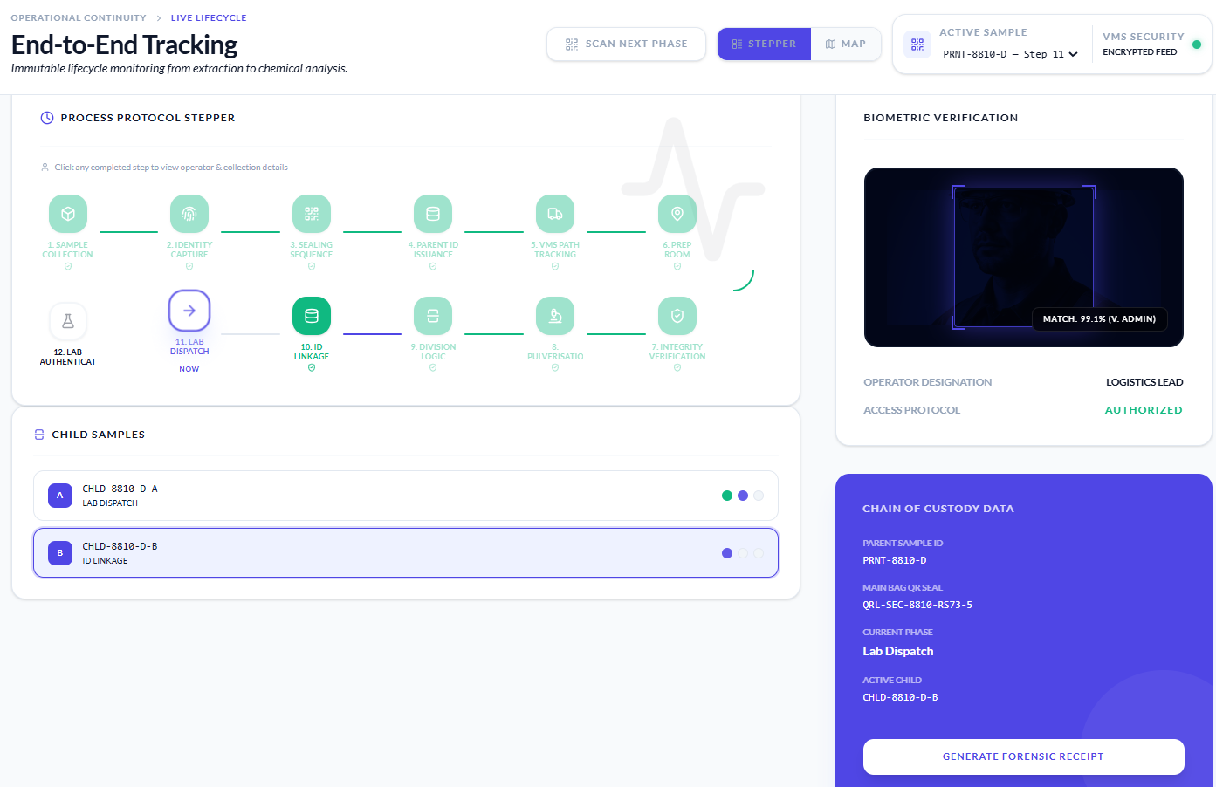
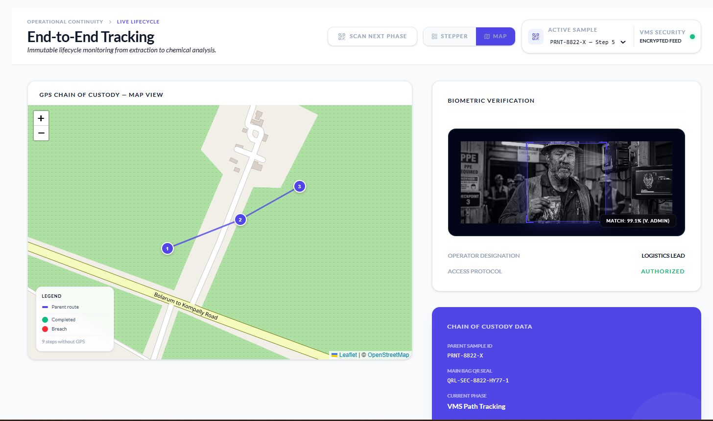
Feature Demo - Chain-of-Custody Tracker
[ Screenshot Placeholder ]
Chain-of-Custody Tracker
Attach screenshot here
12-step protocol stepper - Collection → Identity Capture → Sealing → VMS Tracking → Lab Authentication
CCTV FRS step popup — face image, match %, camera ID, operator, location per checkpoint
QR scan verification → Verified (advance) or Compromised (auto-raise NCR)
Immutable lifecycle monitoring - every handoff biometrically verified & CCTV-tagged
04 - End-to-End Sample Tracking

Slide 8
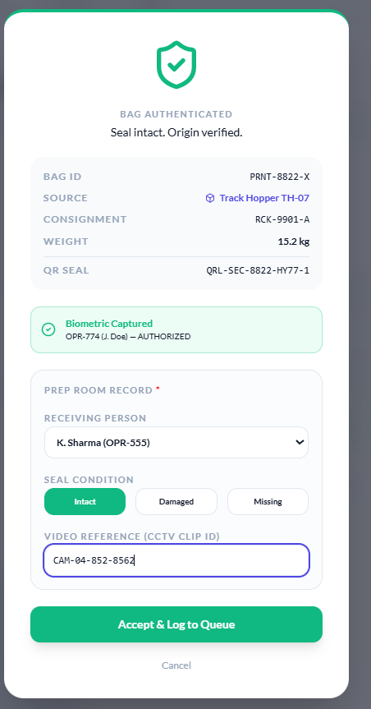
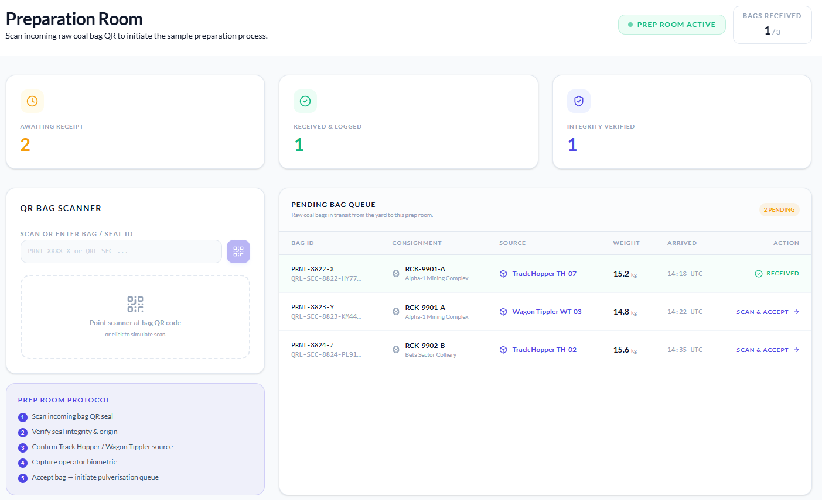
Feature Demo - Prep Room Receipt
[ Screenshot Placeholder ]
Prep Room Receipt
Attach screenshot here
QR bag scanner with animated scan overlay — Verified (bag details) or Failed (raise NCR)
Seal condition log (Intact / Damaged / Missing) + CCTV video clip ID reference
Pending bag queue with accept actions; 5-step visual protocol guide
Biometric operator capture at gate; all bags verified before entering pulverisation queue
05 - Preparation Room

Slide 9
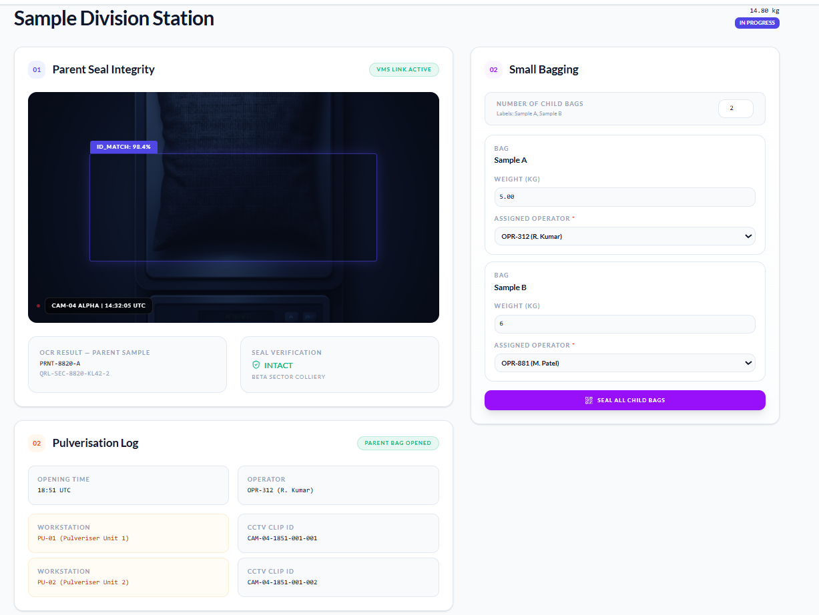
Feature Demo – Sample Division Station
[ Screenshot Placeholder ]
Sample Division Station
Attach screenshot here
3-phase workflow - Parent Seal Integrity → Pulverisation Log → Small Bagging
Live CCTV feed with face ID overlay during splitting; OCR & seal verification status
Child QR seal generation for Sample A, B, Referee, D, E - weight + operator per bag
Parent sample mathematically linked to all child bags - every split recorded & sealed
06 - Division Station (Splitting)

Slide 10
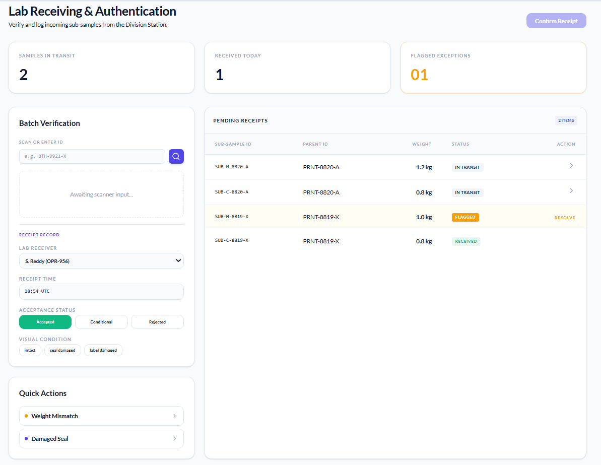
Feature Demo - Lab Receiving & Authentication
[ Screenshot Placeholder ]
Lab Receiving & Authentication
Attach screenshot here
Scan sub-sample ID; Receipt Record — Lab Receiver, Receipt Time, Acceptance Status
Visual Condition check: Intact / Seal-Damaged / Label-Damaged before confirmation
Pending receipts table; quick actions for Weight Mismatch & Damaged Seal flags
Final verification gate - sub-sample confirmed ready for analysis only after full check
07 - Lab Receiving & Authentication

Slide 11
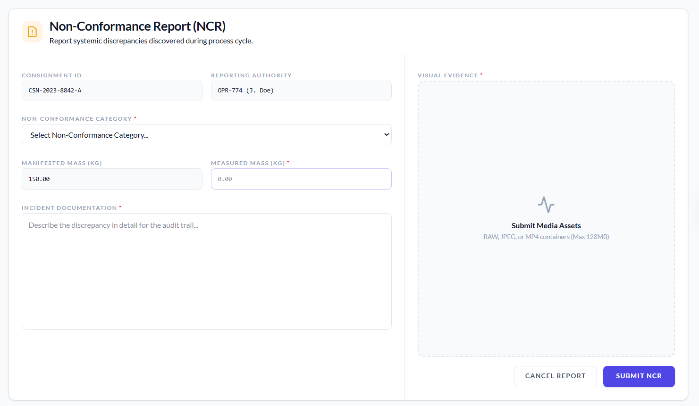
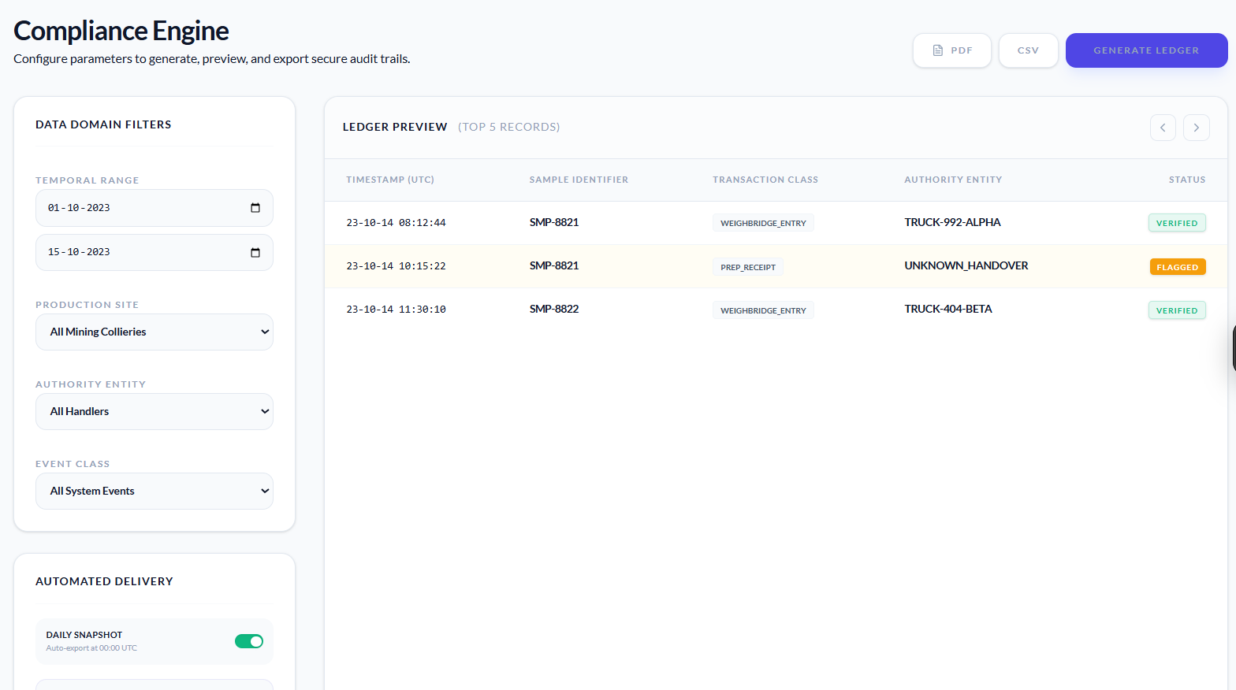
Feature Demo - NCR, Audit Trail & Reports
[ Screenshot Placeholder ]
NCR, Audit Trail & Reports
Attach screenshot here
NCR form - Consignment ID, Reporting Authority, Category (Seal / Mass / Foreign / Admin)
Inline NCR modal raisable from any screen - auto-detects current stage & consignment
Audit History & Report Builder - full event log with operator, timestamp, location
Zero-gap exception handling - every violation captured, tagged & traceable to source
08 - Quality & Compliance (NCR / Audit)

Slide 12
Key Features
1
Tamper-Evident QR Seals
Unique, one-time-use QR codes affixed at the collection point. Physical tampering breaks the seal and invalidates the code instantly.
Complete
Anti-Adulteration
Coverage
2
Multi-Point Checkpoint Scanning
Designated scan stations record every custody handoff with timestamps and personnel IDs throughout the sample journey.
3
VMS Face Analytics
The video management system automatically identifies and logs personnel who come into contact with each sample.
6 Stages
4
End-to-End Movement Tracking
Every location the sample passes through — from pit to lab — is mapped and logged in a tamper-proof audit record.
5
Non-Conformance Reports (NCR)
Raise an NCR from any screen at any stage — auto-tagged to the consignment, phase, and operator responsible.

Slide 13
Roadmap
Phase 1
Phase 2
Phase 3
Phase 4
UI Prototype
Validation
Backend &
VMS Integration
CCTV & FRS
Live Deployment
Analytics
Dashboard
Beyond Phase 4: API integration with government regulatory portals, CIL subsidiary systems, and third-party coal quality certification bodies.

Slide 14
Thank You
Questions & Discussion
VL Access Pvt Ltd
C S A A S

