Slide 1
Requirements Engineering
Main issues:
• What do we want to build
• How do we write this down
©2008 John Wiley & Sons Ltd.
www.wileyeurope.com/college/van vliet

Slide 2
Requirements Engineering
the first step in finding a solution for a data processing problem
the results of requirements engineering is a requirements specification
requirements specification
  contract for the customer
  starting point for design
©2008 John Wiley & Sons Ltd.
www.wileyeurope.com/college/van vliet

Slide 3
Natural language specs are dangerous
“All users have the same control field”
the same value in the control field?
the same format of the control field?
there is one (1) control field for all users?
©2008 John Wiley & Sons Ltd.
www.wileyeurope.com/college/van vliet

Slide 4
Requirements engineering, main steps
1. understanding the problem: elicitation
2. describing the problem: specification
3. agreeing upon the nature of the problem: validation
4. agreeing upon the boundaries of the problem: negotiation
This is an iterative process
©2008 John Wiley & Sons Ltd.
www.wileyeurope.com/college/van vliet

Slide 5
Framework for RE process
specification
elicitation
validation
doc & mgt
negotiation
©2008 John Wiley & Sons Ltd.
www.wileyeurope.com/college/van vliet

Slide 6
Conceptual modeling
you model part of reality: the Universe of Discourse (UoD)
this model is an explicit conceptual model
people in the UoD have an implicit conceptual model of that UoD
making this implicit model explicit poses problems:
  analysis problems
  negotiation problems
©2008 John Wiley & Sons Ltd.
www.wileyeurope.com/college/van vliet

Slide 7
Requirements engineering is difficult
Success depends on the degree with which we manage to properly describe the system desired
Software is not continuous!
Tsjechow vs Chekhov vs ЦЕХОВ
©2008 John Wiley & Sons Ltd.
www.wileyeurope.com/college/van vliet

Slide 8

Beware of subtle mismatches
a library employee may also be a client
there is a difference between `a book` and `a copy of a book`
status info `present` / `not present` is not sufficient; a (copy of a) book may be lost, stolen, in repair, ...
©2008 John Wiley & Sons Ltd.
www.wileyeurope.com/college/van vliet

Slide 9

Humans as information sources
different backgrounds
short-term vs long-term memory
human prejudices
limited capability for rational thinking
©2008 John Wiley & Sons Ltd.
www.wileyeurope.com/college/van vliet

Slide 10
Negotiation problems
existing methods are “Taylorian”
they may work in a “technical” environment, but many UoDs contain people as well, and their models may be irrational, incomplete, inconsistent, contradictory
as an analyst, you cannot neglect these aspects; you participate in shaping the UoD
©2008 John Wiley & Sons Ltd.
www.wileyeurope.com/college/van vliet

Slide 11
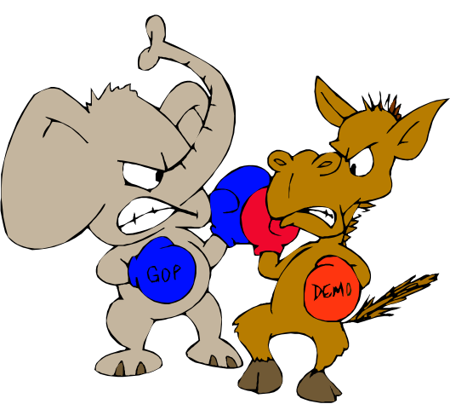
Point to ponder #1
how do you handle conflicts during requirements engineering?
©2008 John Wiley & Sons Ltd.
www.wileyeurope.com/college/van vliet

Slide 12
How we study the world around us
people have a set of assumptions about a topic they study (paradigm)
this set of assumptions concerns:
  how knowledge is gathered
  how the world is organized
this in turn results in two dimensions:
  subjective-objective (wrt knowledge)
  conflict-order (wrt the world)
which results in 4 archetypical approaches to requirements engineering
©2008 John Wiley & Sons Ltd.
www.wileyeurope.com/college/van vliet

Slide 13
Four approaches to RE
functional (objective+order): the analyst is the expert who empirically seeks the truth
social-relativism (subjective+order): the analyst is a `change agent’. RE is a learning process guided by the analyst
radical-structuralism (objective+ conflict): there is a struggle between classes; the analyst chooses for either party
neohumanism (subjective+conflict): the analyst is kind of a social therapist, bringing parties together
©2008 John Wiley & Sons Ltd.
www.wileyeurope.com/college/van vliet

Slide 14

Point to ponder #2
how does the London Ambulance System example from chapter 1 relate to the different possible approaches to requirements engineering?
©2008 John Wiley & Sons Ltd.
www.wileyeurope.com/college/van vliet

Slide 15
Elicitation techniques
interview
Delphi technique
brainstorming session
task analysis
scenario analysis
ethnography
form analysis
analysis of natural language descriptions
synthesis from existing system
domain analysis
Business Process Redesign (BPR)
prototyping
©2008 John Wiley & Sons Ltd.
www.wileyeurope.com/college/van vliet

Slide 16
Task Analysis
Task analysis is the process of analyzing the way people perform their jobs: the things they do, the things they act on and the things they need to know.
The relation between tasks and goals: a task is performed in order to achieve a goal.
Task analysis has a broad scope.
©2008 John Wiley & Sons Ltd.
www.wileyeurope.com/college/van vliet

Slide 17
Task Analysis (cntd)
Task analysis concentrates on the current situation. However, it can be used as a starting point for a new system:
  users will refer to new elements of a system and its functionality
  scenario-based analysis can be used to exploit new possibilities
See also the role of task analysis as discussed in the context of user interface design (chapter 16)
©2008 John Wiley & Sons Ltd.
www.wileyeurope.com/college/van vliet

Slide 18
Scenario-Based Analysis
Provides a more user-oriented view perspective on the design and development of an interactive system.
The defining property of a scenario is that it projects a concrete description of an activity that the user engages in when performing a specific task, a description sufficiently detailed so that the design implications can be inferred and reasoned about.
©2008 John Wiley & Sons Ltd.
www.wileyeurope.com/college/van vliet

Slide 19
Scenario-Based Analysis (example)
first shot:
  check due back date
  if overdue, collect fine
  record book as being available again
  put book back
as a result of discussion with library employee:
  what if person returning the book is not registered as a client?
  what if the book is damaged?
  how to handle in case the client has other books that are overdue, and/or an outstanding reservation?
©2008 John Wiley & Sons Ltd.
www.wileyeurope.com/college/van vliet

Slide 20
Scenario-Based Analysis (cntd)
The scenario view
concrete descriptions
focus on particular instances
work-driven
open-ended, fragmentary
informal, rough, colloquial
envisioned outcomes
The standard view
abstract descriptions
focus on generic types
technology-driven
complete, exhaustive
formal, rigorous
specified outcomes
©2008 John Wiley & Sons Ltd.
www.wileyeurope.com/college/van vliet

Slide 21
Scenario-Based Analysis (cntd)
Application areas:
  requirements analysis
  user-designer communication
  design rationale
  sofware architecture (& its analysis)
  software design
  implementation
  verification & validation
  documentation and training
  evaluation
  team building
Scenarios must be structured and managed
©2008 John Wiley & Sons Ltd.
www.wileyeurope.com/college/van vliet

Slide 22
Form analysis (example
Proceedings request form:
Client name ……………
Title ……………
Editor ……………
Place ……………
Publisher ……………
Year ……………
Certainty vs uncertainty
©2008 John Wiley & Sons Ltd.
www.wileyeurope.com/college/van vliet

Slide 23
Types of links between customer and developer
facilitated teams
intermediary
support line/help desk
survey
user interface prototyping
requirements prototyping
interview
usability lab
observational study
user group
trade show
marketing & sales
©2008 John Wiley & Sons Ltd.
www.wileyeurope.com/college/van vliet

Slide 24
Direct versus indirect links
lesson 1: don’t rely too much on indirect links (intermediaries, surrogate users)
lesson 2: the more links, the better - up to a point
value add. link
# of links
©2008 John Wiley & Sons Ltd.
www.wileyeurope.com/college/van vliet

Slide 25
Structuring a set of requirements
Hierarchical structure: higher-level reqs are decomposed into lower-level reqs
Link requirements to specific stakeholders (e.g. management and end users each have their own set)
In both cases, elicitation and structuring go hand in
hand
©2008 John Wiley & Sons Ltd.
www.wileyeurope.com/college/van vliet

Slide 26
Goal-driven requirements engineering
serving
cust.
why?
how?
search
search
book
why?
search
book
search
news
©2008 John Wiley & Sons Ltd.
www.wileyeurope.com/college/van vliet

Slide 27
Conflicting viewpoints
cash fines asap
John
Pos A
supports
Arg A
response-to
issue:
fine
Pos B
Arg B
taken-by
Mary
cash fines later
©2008 John Wiley & Sons Ltd.
www.wileyeurope.com/college/van vliet

Slide 28
Prioritizing requirements (MoSCoW)
Must haves: top priority requirements
Should haves: highly desirable
Could haves: if time allows
Won’t haves: not today
©2008 John Wiley & Sons Ltd.
www.wileyeurope.com/college/van vliet

Slide 29
Prioritizing requirements (Kano model)
Attractive: more satisfied if +, not less satisfied if –
Must-be: dissatisfied when -, at most neutral
One-dimensional: satisfaction proportional to number
Indifferent: don’t care
Reverse: opposite of what analist thought
Questionable: preferences not clear
©2008 John Wiley & Sons Ltd.
www.wileyeurope.com/college/van vliet

Slide 30
Kano diagram
satisfied
one-dimensional
attractive
dysfunctional
functional
must-be
dissatisfied
©2008 John Wiley & Sons Ltd.
www.wileyeurope.com/college/van vliet

Slide 31

COTS selection
COTS: Commercial-Off-The-Shelf
Iterative process:
  Define requirements
  Select components
  Rank components
  Select most appropriate component, or iterate
Simple ranking: weight * score (WSM – Weighted Scoring Method)
©2008 John Wiley & Sons Ltd.
www.wileyeurope.com/college/van vliet

Slide 32
Crowdsourcing
Go to LEGO site
Use CAD tool to design your favorite castle
Generate bill of materials
Pieces are collected, packaged, and sent to you
Leave your model in LEGO’s gallery
Most downloaded designs are prepackaged
No requirements engineers needed!
Gives rise to new business model
©2008 John Wiley & Sons Ltd.
www.wileyeurope.com/college/van vliet

Slide 33
Requirements specification
readable
understandable
non-ambiguous
complete
verifiable
consistent
modifiable
traceable
usable
…
...
©2008 John Wiley & Sons Ltd.
www.wileyeurope.com/college/van vliet

Slide 34
IEEE Standard 830
1. Introduction
1.1. Purpose
1.2. Scope
1.3. Definitions, acronyms and abbreviations
1.4. References
1.5. Overview
2. General description
2.1. Product perspective
2.2. Product functions
2.3. User characteristics
2.4. Constraints
2.5. Assumptions and dependencies
3. Specific requirements
©2008 John Wiley & Sons Ltd.
www.wileyeurope.com/college/van vliet

Slide 35
IEEE Standard 830 (cntd)
3. Specific requirements
3.1. External interface requirements
3.1.1. User interfaces
3.1.2. Hardware interfaces
3.1.3. Software interfaces
3.1.4. Comm. interfaces
3.2. Functional requirements
3.2.1. User class 1
3.2.1.1. Functional req. 1.1
3.2.1.2. Functional req. 1.2
...
3.2.2. User class 2
…
3.3. Performance requirements
3.4. Design constraints
3.5. Software system attributes
3.6. Other requirements
©2008 John Wiley & Sons Ltd.
www.wileyeurope.com/college/van vliet

Slide 36
Requirements management
too early
freeze
requirements stability
requirements
creep
time
©2008 John Wiley & Sons Ltd.
www.wileyeurope.com/college/van vliet

Slide 37
Requirements management
Requirements identification (number, goal-hierarchy numbering, version information, attributes)
Requirements change management (CM)
Requirements traceability:
  Where is requirement implemented?
  Do we need this requirement?
  Are all requirements linked to solution elements?
  What is the impact of this requirement?
  Which requirement does this test case cover?
Related to Design Space Analysis
©2008 John Wiley & Sons Ltd.
www.wileyeurope.com/college/van vliet

Slide 38

The 7 sins of the analyst
noise
silence
overspecification
contradictions
ambiguity
forward references
wishful thinking
©2008 John Wiley & Sons Ltd.
www.wileyeurope.com/college/van vliet

Slide 39
Functional vs. Non-Functional Requirements
functional requirements: the system services which are expected by the users of the system.
non-functional (quality) requirements: the set of constraints the system must satisfy and the standards which must be met by the delivered system.
  speed
  size
  ease-of-use
  reliability
  robustness
  portability
©2008 John Wiley & Sons Ltd.
www.wileyeurope.com/college/van vliet

Slide 40
Validation of requirements
inspection of the requirement specification w.r.t. correctness, completeness, consistency, accuracy, readability, and testability.
some aids:
  structured walkthroughs
  prototypes
  develop a test plan
  tool support for formal specifications
©2008 John Wiley & Sons Ltd.
www.wileyeurope.com/college/van vliet

Slide 41
Summary
goal: a maximally clear, and maximally complete, description of WHAT is wanted
RE involves elicitation, specification, validation and negotiation
modeling the UoD poses both analysis and negotiation problems
you must realize that, as an analyst, you are more than an outside observer
a lot is still done in natural language, with all its inherent problems
©2008 John Wiley & Sons Ltd.
www.wileyeurope.com/college/van vliet

Slide 42
One final lesson
Walking on water
and
developing software from a specification
are easy
if they are frozen
(E.V. Berard, Essays on object-oriented software engineering)
©2008 John Wiley & Sons Ltd.
www.wileyeurope.com/college/van vliet

Slide 43
Modeling
Main issues:
• What do we want to build
• How do we write this down
©2008 John Wiley & Sons Ltd.
www.wileyeurope.com/college/van vliet

Slide 44

System Modeling Techniques
Classic modeling techniques:
  Entity-relationship modeling
  Finite state machines
  Data flow diagrams
  CRC cards
Object-oriented modeling: variety of UML diagrams
©2008 John Wiley & Sons Ltd.
www.wileyeurope.com/college/van vliet

Slide 45
Entity-Relationship Modeling
entity: distinguishable object of some type
entity type: type of a set of entities
attribute value: piece of information (partially) describing an entity
attribute: type of a set of attribute values
relationship: association between two or more entities
©2008 John Wiley & Sons Ltd.
www.wileyeurope.com/college/van vliet

Slide 46
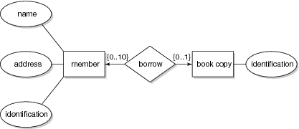
Example ER-diagram
©2008 John Wiley & Sons Ltd.
www.wileyeurope.com/college/van vliet

Slide 47
Finite state machines
Models a system in terms of (a finite number of) states, and transitions between those states
Often depicted as state transition diagrams:
  Each state is a bubble
  Each transition is a labeled arc from one state to another
Large system ⇒ large diagram hierarchical diagrams: statecharts⇒
©2008 John Wiley & Sons Ltd.
www.wileyeurope.com/college/van vliet

Slide 48
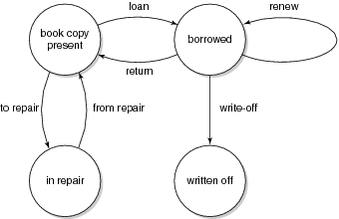
Example state transition diagram
©2008 John Wiley & Sons Ltd.
www.wileyeurope.com/college/van vliet

Slide 49
Data flow diagrams
external entities
processes
data flows
data stores
©2008 John Wiley & Sons Ltd.
www.wileyeurope.com/college/van vliet

Slide 50
Example data flow diagram
client
management
request
report
direction
prelim.
doc
log data
prelim.
doc
borrow
request
return
request
log data
acknowledgement
borrow
title
prelim.
doc
log file
title
title
catalog adm.
©2008 John Wiley & Sons Ltd.
www.wileyeurope.com/college/van vliet

Slide 51
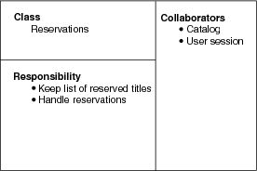
CRC: Class, Responsibility, Collaborators
©2008 John Wiley & Sons Ltd.
www.wileyeurope.com/college/van vliet

Slide 52
Intermezzo: what is an object?
Modeling viewpoint: model of part of the world
  Identity+state+behavior
Philosophical viewpoint: existential absractions
  Everything is an object
Software engineering viewpoint: data abstraction
Implementation viewpoint: structure in memory
Formal viewpoint: state machine
©2008 John Wiley & Sons Ltd.
www.wileyeurope.com/college/van vliet

Slide 53
Objects and attributes
Object is characterized by a set of attributes
  A table has a top, legs, …
In ERM, attributes denote intrinsic properties; they do not depend on each other, they are descriptive
In ERM, relationships denote mutual properties, such as the membership of a person of some organization
In UML, these relationships are called associations
Formally, UML does not distinguish attributes and relationships; both are properties of a class
©2008 John Wiley & Sons Ltd.
www.wileyeurope.com/college/van vliet

Slide 54
Objects, state, and behavior
State = set of attributes of an object
Class = set of objects with the same attributes
Individual object: instance
Behavior is described by services, a set of responsibilities
Service is invoked by sending a message
©2008 John Wiley & Sons Ltd.
www.wileyeurope.com/college/van vliet

Slide 55
Relations between objects
Specialization-generalization, is-a
  A dog is an animal
  Expressed in hierarchy
Whole-part, has
  A dog has legs
  Aggregation of parts into a whole
  Distinction between ‘real-world’ part-of and ‘representational’ part of (e.g. ‘Publisher’ as part of ‘Publication’)
Member-of, has
  A soccer team has players
  Relation between a set and its members (usually not transitive)
©2008 John Wiley & Sons Ltd.
www.wileyeurope.com/college/van vliet

Slide 56
Specialization-generalization relations
Usually expressed in hierarchical structure
  If a tree: single inheritance
  F a DAG: multiple inheritance
Common attributes are defined at a higher level in the object hierarchy, and inherited by child nodes
Alternative view: object hierarchy is a type hierarchy, with types and subtypes
©2008 John Wiley & Sons Ltd.
www.wileyeurope.com/college/van vliet

Slide 57
Unified Modeling Language (UML)
Controlled by OMG consortium: Object Management Group
Latest version: UML 2
UML 2 has 13 diagram types
  Static diagrams depict static structure
  Dynamic diagrams show what happens during execution
Most often used diagrams:
  class diagram: 75%
  Use case diagram and communication diagram: 50%
  Often loose semantics
©2008 John Wiley & Sons Ltd.
www.wileyeurope.com/college/van vliet

Slide 58
UML diagram types
Static diagrams:
Class
Component
Deployment
Interaction overview
Object
Package
Dynamic diagrams:
Activity
Communication
Composite structure
Sequence
State machine
Timing
Use case
©2008 John Wiley & Sons Ltd.
www.wileyeurope.com/college/van vliet

Slide 59
UML class diagram
depicts the static structure of a system
most common example: subclass/superclass hierarchy
also mutual properties between two or more entities (ER relationships, often called associations in OO)
©2008 John Wiley & Sons Ltd.
www.wileyeurope.com/college/van vliet

Slide 60
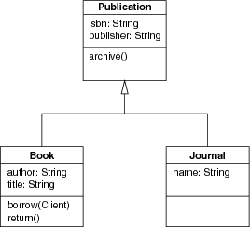
Example class diagram (1): generalization
©2008 John Wiley & Sons Ltd.
www.wileyeurope.com/college/van vliet

Slide 61
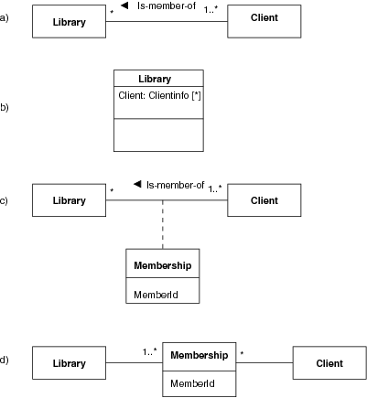
Example class diagram (2) association
©2008 John Wiley & Sons Ltd.
www.wileyeurope.com/college/van vliet

Slide 62
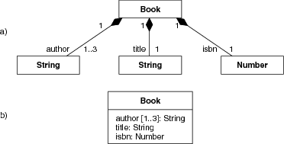
Example class diagram (3): composition
©2008 John Wiley & Sons Ltd.
www.wileyeurope.com/college/van vliet

Slide 63
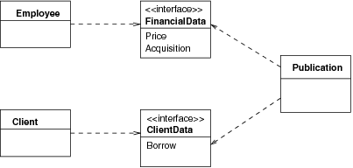
Interface: class with abstract features
©2008 John Wiley & Sons Ltd.
www.wileyeurope.com/college/van vliet

Slide 64
State machine diagram
Resembles finite state machines, but:
Usually allows for local variables of states
Has external inputs and outputs
Allows for hierarchical states
©2008 John Wiley & Sons Ltd.
www.wileyeurope.com/college/van vliet

Slide 65
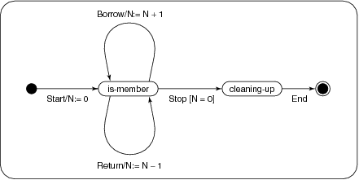
Example state machine diagram
©2008 John Wiley & Sons Ltd.
www.wileyeurope.com/college/van vliet

Slide 66
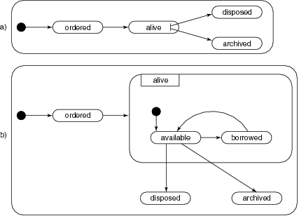
Example state machine diagram: global and expanded view
©2008 John Wiley & Sons Ltd.
www.wileyeurope.com/college/van vliet

Slide 67
Interaction diagram
Two types: sequence diagram and communication diagram
Sequence diagram: emphasizes the ordering of events, using a lifeline
Communication diagram emphasizes objects and their relationships
©2008 John Wiley & Sons Ltd.
www.wileyeurope.com/college/van vliet

Slide 68
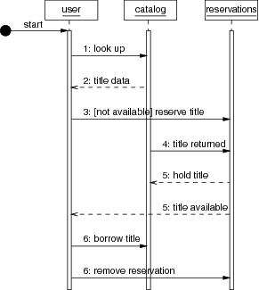
Example sequence diagram
©2008 John Wiley & Sons Ltd.
www.wileyeurope.com/college/van vliet

Slide 69
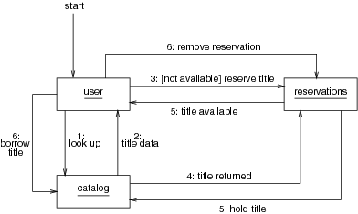
Example communication diagram
©2008 John Wiley & Sons Ltd.
www.wileyeurope.com/college/van vliet

Slide 70
Component diagram
Class diagram with stereotype <<component>>
Way to identify larger entities
One way to depict a module view (see Software Architecture chapter)
Components are connected by interfaces
©2008 John Wiley & Sons Ltd.
www.wileyeurope.com/college/van vliet

Slide 71
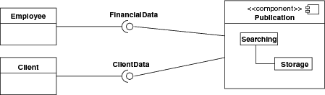
Example component diagram
©2008 John Wiley & Sons Ltd.
www.wileyeurope.com/college/van vliet

Slide 72
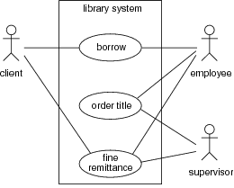
Use case diagram
©2008 John Wiley & Sons Ltd.
www.wileyeurope.com/college/van vliet

Slide 73

Summary
Classic notations:
  Entity-relationship diagrams
  Finite state machines
  Data flow diagrams
  CRC cards
Unified Modeling Language (UML)
  evolved from earlier OO notations
  13 diagram types
  widely used
©2008 John Wiley & Sons Ltd.
www.wileyeurope.com/college/van vliet

Slide 74
Software Tools
Main issues:
wide variety of tools
role of tools in development process
a tool is a tool, not a solution to a problem
©2008 John Wiley & Sons Ltd.
www.wileyeurope.com/college/van vliet

Slide 75

Classification of tools
Tool: supports one task
Workbench: supports limited set of activities (e.g. design)
Environment: supports entire process
  Toolkit: just a bunch of tools
  Language-centered: e.g. around Java
  Integrated: centered around central repository with artifacts
  Process-centered: based on model of the software process
©2008 John Wiley & Sons Ltd.
www.wileyeurope.com/college/van vliet

Slide 76
Dimensions for classification of tools
Breadth: tool, workbench, …
Problem class: embedded, business, …
System size: small … large
User scale: individual, city, state, …
Number of sites
Process: product, people, or both
Process support: none, fixed, variable
Execution paradigm: state machine, Petri nets, …
©2008 John Wiley & Sons Ltd.
www.wileyeurope.com/college/van vliet

Slide 77

Toolkits
Prime example: UNIX
Tools know little to nothing of the objects they manipulate
Mutual alignment of tools is an issue
©2008 John Wiley & Sons Ltd.
www.wileyeurope.com/college/van vliet

Slide 78
Language-centered environments
Often programming environment, and visual,
Present-day examples: Studio .NET, Eclipse
Long learning curve
©2008 John Wiley & Sons Ltd.
www.wileyeurope.com/college/van vliet

Slide 79
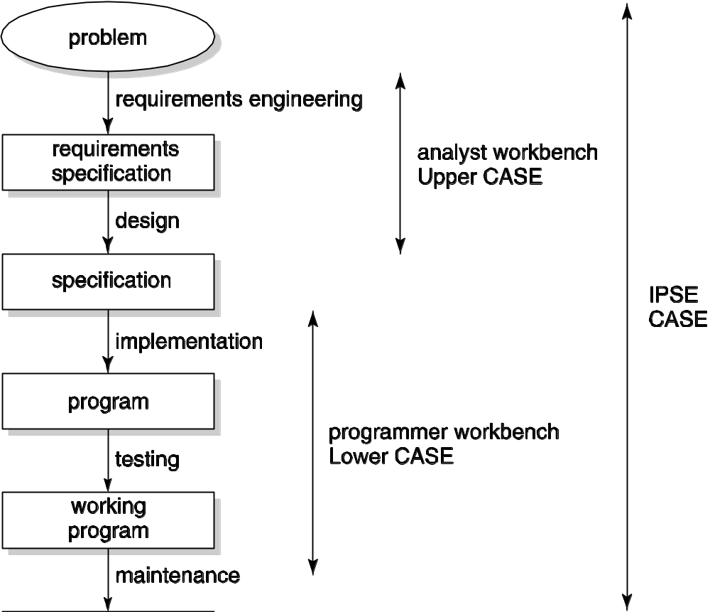
Scope of integrated environments
©2008 John Wiley & Sons Ltd.
www.wileyeurope.com/college/van vliet

Slide 80
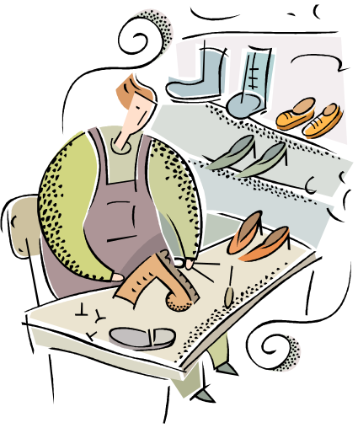
Analyst workbench
Focus on early phases: requirements and design
(“syntax-directed”) drawing of pictures
Analysis support, e.g. consistency
Managing information, e.g. set of requirements
Report generation
©2008 John Wiley & Sons Ltd.
www.wileyeurope.com/college/van vliet

Slide 81

Programmer workbench
Editing, analyzing, code
Debugging and instrumentation tools
Test coverage tools
Central tool: configuration control
©2008 John Wiley & Sons Ltd.
www.wileyeurope.com/college/van vliet

Slide 82

Management workbench
Configuration control, including management of change requests
Work assignment
Effort estimation tools
©2008 John Wiley & Sons Ltd.
www.wileyeurope.com/college/van vliet

Slide 83
Process-centered environment (PSEE)
Based on a model of the process, e.g. in the form of a Petri net
Resemble workflow management systems
Formal models are rigid, can be stiffling
©2008 John Wiley & Sons Ltd.
www.wileyeurope.com/college/van vliet

Slide 84
Summary
Wide variety of tools, with different scope
Impediment: rigidity of tools
  They should support collaboration, not just automation
Tool adoption:
  Do they really help?
  Learning curve
A tool is a tool, not a solution to a problem
©2008 John Wiley & Sons Ltd.
www.wileyeurope.com/college/van vliet

Slide 85
User Interface Design
Main issues:
• What is the user interface
• How to design a user interface
©2008 John Wiley & Sons Ltd.
www.wileyeurope.com/college/van vliet

Slide 86

Where is the user interface?
Seeheim model: separate presentation and dialog from application
More recently: MVC – Model-View-Controller
©2008 John Wiley & Sons Ltd.
www.wileyeurope.com/college/van vliet

Slide 87
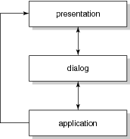
Seeheim model
©2008 John Wiley & Sons Ltd.
www.wileyeurope.com/college/van vliet

Slide 88
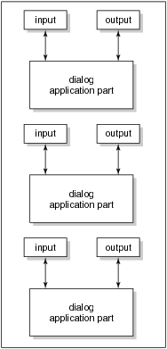
Model-View-Controller (MVC)
©2008 John Wiley & Sons Ltd.
www.wileyeurope.com/college/van vliet

Slide 89
What is the user interface?
User interface: all aspects of a system that are relevant to the user
Also called: User Virtual Machine (UVM)
A system can have more than one UVM, one for each set of tasks or roles
An individual may also have more than one user interface to the same application, e.g. on a mobile phone and a laptop
©2008 John Wiley & Sons Ltd.
www.wileyeurope.com/college/van vliet

Slide 90
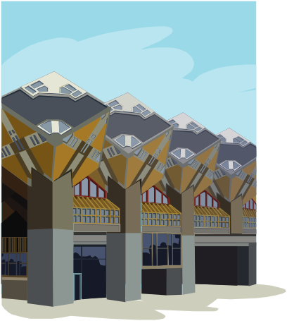
Two ways to look at a user interface
Design aspect: how to design everything relevant to the user?
Human aspect: what does the user need to understand?
©2008 John Wiley & Sons Ltd.
www.wileyeurope.com/college/van vliet

Slide 91
Human factors
Humanities
  Psychology: how does one perceive, learn, remember, …
  Organization and culture: how do people work together, …
Artistic design
  Graphical arts: how doe shapes, color, etc affect the viewer
  Cinematography: which movements induce certain reactions
  Getting attractive solutions
Ergonomics
  Relation between human characteristics and artifacts
  Especially cognitive ergonomics
©2008 John Wiley & Sons Ltd.
www.wileyeurope.com/college/van vliet

Slide 92

Models in HCI
Internal models (‘models for execution’)
  Mental model (model of a system held by a user)
  User model (model of user held by a system)
External models (‘for communication’)
  Model of human information processing
  Conceptual models (such as Task Action Grammar)
©2008 John Wiley & Sons Ltd.
www.wileyeurope.com/college/van vliet

Slide 93
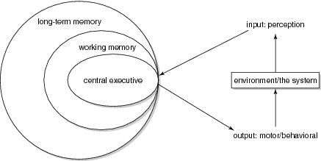
Model of human information processing
©2008 John Wiley & Sons Ltd.
www.wileyeurope.com/college/van vliet

Slide 94
Use of mental models
Planning the use of technology
  First search by author name
Finetuning user actions while executing a task
  Refine search in case of too many hits
Evaluate results
  Keep the titles on software engineering
Cope with events while using the system
  Accept slow response time in the morning
©2008 John Wiley & Sons Ltd.
www.wileyeurope.com/college/van vliet

Slide 95
Characteristics of mental models (Norman)
They are incomplete
They can only partly be ‘run’
They are unstable
They have vague boundaries
They are parsimonious
They have characteristics of superstition
©2008 John Wiley & Sons Ltd.
www.wileyeurope.com/college/van vliet

Slide 96
Conceptual model
All that is modeled as far as it is relevant to the user
Formal models
  Some model the user’s knowledge (competence model)
  Others focus on the interaction process
  Others do both
©2008 John Wiley & Sons Ltd.
www.wileyeurope.com/college/van vliet

Slide 97
Viewpoints of conceptual models
Psychological view: definition of all the user should know and understand about the system
Linguistic view: definition of the dialog between the user and the system
Design view: all that needs to be decided upon from the point of view of user interface design
©2008 John Wiley & Sons Ltd.
www.wileyeurope.com/college/van vliet

Slide 98
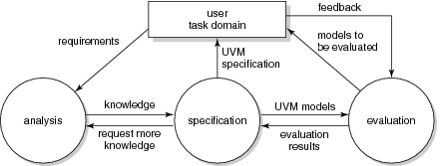
Design of the user interface
©2008 John Wiley & Sons Ltd.
www.wileyeurope.com/college/van vliet

Slide 99
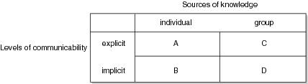
Dimensions of task knowledge
©2008 John Wiley & Sons Ltd.
www.wileyeurope.com/college/van vliet

Slide 100
Gathering task knowledge (cnt’d)
Cell A (individual, explicit): interviews, questionnaires, etc
Cell B (individual, implicit): observations, interpretation of mental representations
Cell C (group, explicit): study artifacts: documents, archives, etc
Cell D (group, implicit): ethnography
©2008 John Wiley & Sons Ltd.
www.wileyeurope.com/college/van vliet

Slide 101
Guidelines for user interface design
Use a simple and natural dialog
Speak the user’s language
Minimize memory load
Be consistent
Provide feedback
Provide clearly marked exits
Provide shortcut
Give good error messages
©2008 John Wiley & Sons Ltd.
www.wileyeurope.com/college/van vliet

Slide 102
Summary
Central issue: tune user’s mental model (model in memory) with the conceptual model (model created by designers)
User interface design requires input from different disciplines: cognitive psychology, ethnography, arts, …
©2008 John Wiley & Sons Ltd.
www.wileyeurope.com/college/van vliet

Slide 103
Software Reusability
Main issues:
• Why is reuse so difficult
• How to realize reuse
©2008 John Wiley & Sons Ltd.
www.wileyeurope.com/college/van vliet

Slide 104

Reuse dimensions
Things being reused: components, concepts, …
Scope: horizontal vs vertical
Approach: systematic or opportunistic
Technique: compositional or generative
Use: black-box or white-box
Product being reused: source code, design, …
©2008 John Wiley & Sons Ltd.
www.wileyeurope.com/college/van vliet

Slide 105
Success criteria for component libraries
Well-developed field, standard terminology
Small interfaces
Standardized data formats
©2008 John Wiley & Sons Ltd.
www.wileyeurope.com/college/van vliet

Slide 106

Requirements for component libraries
Searching for components
Understanding/evaluating components found
Adapt components if necessary
Compose systems from components
©2008 John Wiley & Sons Ltd.
www.wileyeurope.com/college/van vliet

Slide 107
Component evaluation, useful information
Quality information
Administrative information (name developer, modification history, etc)
Documentation
Interface information
Test information
©2008 John Wiley & Sons Ltd.
www.wileyeurope.com/college/van vliet

Slide 108
Reuse process models
Software development with reuse
  Passive
  Component library evolves haphazardly
Software development for reuse
  Active
  Reusable assets are developed, rather than found by accident
©2008 John Wiley & Sons Ltd.
www.wileyeurope.com/college/van vliet

Slide 109
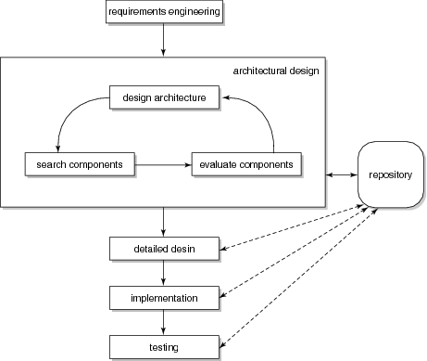
Software development with reuse
©2008 John Wiley & Sons Ltd.
www.wileyeurope.com/college/van vliet

Slide 110
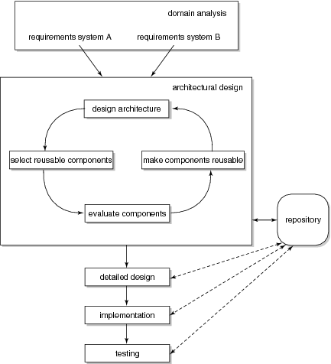
Software development for reuse
©2008 John Wiley & Sons Ltd.
www.wileyeurope.com/college/van vliet

Slide 111
Software development for reuse
Often two separate development processes:
  Development of components (involving domain analysis)
  Development of applications, using the available components
Specific forms hereof:
  Component-based software development
  Software factory
  Software product lines
©2008 John Wiley & Sons Ltd.
www.wileyeurope.com/college/van vliet

Slide 112

Reuse tools and techniques
Languages to describe compositions
  Module Interconnection Language (MIL)
  Architecture Description Language (ADL)
Middleware (CORBA, JavaBeans, .NET)
©2008 John Wiley & Sons Ltd.
www.wileyeurope.com/college/van vliet

Slide 113
Characteristics of successful reuse programs
Extensive management support
Organizational support structure
Incremental implementation
Significant success
High incentives
Domain analysis done
Attention to architectural issues
©2008 John Wiley & Sons Ltd.
www.wileyeurope.com/college/van vliet

Slide 114
Non-technical aspects of software reuse
Economics: it is a long term investment
Management: it does not happen spontaneously
Psychology: people do not want to reuse someone else’s code
©2008 John Wiley & Sons Ltd.
www.wileyeurope.com/college/van vliet

Slide 115
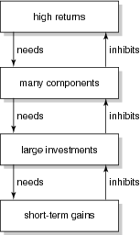
Reuse devil’s loop
©2008 John Wiley & Sons Ltd.
www.wileyeurope.com/college/van vliet

Slide 116
Summary
We can reuse different things: code, design, …
Reuse can be systematic (software development for reuse), or opportunistic (software development with reuse)
Reuse does not just happen; it needs to be planned
©2008 John Wiley & Sons Ltd.
www.wileyeurope.com/college/van vliet

Slide 117
Component-Based Software Engineering
Main issues:
• assemble systems out of (reusable) components
• compatibility of components

Slide 118

LEGO analogy
Set of building blocks in different shapes and colors
Can be combined in different ways
Composition through small stubs in one and corresponding holes in another building block
⇒ LEGO blocks are generic and easily composable
LEGO can be combined with LEGO, not with Meccano
©2008 John Wiley & Sons Ltd.
www.wileyeurope.com/college/van vliet

Slide 119
Why CBSE?
CBSE increases quality, especially evolvability and maintainability
CBSE increases productivity
CBSE shortens development time
©2008 John Wiley & Sons Ltd.
www.wileyeurope.com/college/van vliet

Slide 120

Component model
Defines the types of building block, and the recipe for putting them together
More precisely, a component model defines standards for:
  Properties individual components must satisfy
  Methods and mechanisms for composing components
Consequently, a component has to conform to some component model
©2008 John Wiley & Sons Ltd.
www.wileyeurope.com/college/van vliet

Slide 121

A software component:
Implements some functionality
Has explicit dependencies through provides and required interfaces
Communicates through its interfaces only
Has structure and behavior that conforms to a component model
©2008 John Wiley & Sons Ltd.
www.wileyeurope.com/college/van vliet

Slide 122
A component technology
Is the implementation of a component model, by means of:
  Standards and guidelines for the implementation and execution of software components
  Executable software that supports the implementation, assembly, deployment, execution of components
Examples: EJB, COM+, .NET, CORBA
©2008 John Wiley & Sons Ltd.
www.wileyeurope.com/college/van vliet

Slide 123
Component forms
Component goes through different stages: development, packaging, distribution, deployment, execution
Across these stages, components are represented in different forms:
  During development: UML, e.g.
  When packaging: in a .zip file, e.g.
  In the execution stage: blocks of code and data
©2008 John Wiley & Sons Ltd.
www.wileyeurope.com/college/van vliet

Slide 124
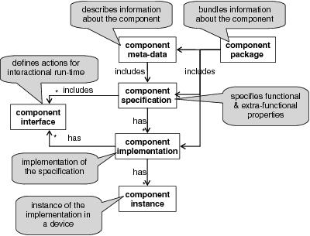
Characterization of component forms
©2008 John Wiley & Sons Ltd.
www.wileyeurope.com/college/van vliet

Slide 125
Component specification vs component interface
Interface describes how components interact: usage contract
Specification is about the component as a whole, while an interface might be about part of a component only
©2008 John Wiley & Sons Ltd.
www.wileyeurope.com/college/van vliet

Slide 126
Hiding of component internals
Black box: only specification is known
Glass box: internals may be inspected, but not changed
Grey box: part of the internals may be inspected, limited modification is allowed
While box: component is open to inspection and modification
©2008 John Wiley & Sons Ltd.
www.wileyeurope.com/college/van vliet

Slide 127
Managing quality in CBSE
Who manages the quality: the component, or the execution platform
Scope of management: per-collaboration, or system-wide
©2008 John Wiley & Sons Ltd.
www.wileyeurope.com/college/van vliet

Slide 128
Common features of component models
Infrastructure mechanisms, for binding, execution, etc
Instantiation
Binding (design time, compile time, …)
Mechanisms for communication between components
Discovery of components
Announcement of component capabilities (interfaces)
Development support
Language independence
Platform independence
Analysis support
Support for upgrading and extension
Support for quality properties
©2008 John Wiley & Sons Ltd.
www.wileyeurope.com/college/van vliet

Slide 129
Development process in CBSE
Two separate development processes:
  Development of components
  Development of systems out of components
Separate process to assess components
©2008 John Wiley & Sons Ltd.
www.wileyeurope.com/college/van vliet

Slide 130
CBSE system development process
Requirements: also considers availability of components (like in COTS)
Analysis and design: very similar to what we normally do
Implementation: less coding, focus on selection of components, provision of glue code
Integration: largely automated
Testing: verification of components is necessary
Release: as in classical approaches
Maintenance: replace components
©2008 John Wiley & Sons Ltd.
www.wileyeurope.com/college/van vliet

Slide 131

Component assessment
Find components
Verify components
Store components in repository
©2008 John Wiley & Sons Ltd.
www.wileyeurope.com/college/van vliet

Slide 132
Component development process
Components are intended for reuse
⇒
Managing requirements is more difficult
More effort required to develop reusable components
More effort in documentation for consumers
©2008 John Wiley & Sons Ltd.
www.wileyeurope.com/college/van vliet

Slide 133
Component development process
Requirements: combination of top-down (from system) and bottom-up (generality)
Analysis and design: generality is an issue, assumptions about system (use) must be made
Implementation: largely determined by component technology
Testing: extensive (no assumptions of usage!), and well-documented
Release: not only executables, also metadata
©2008 John Wiley & Sons Ltd.
www.wileyeurope.com/college/van vliet

Slide 134
Component maintenance
Who is responsible: producer or consumer?
Blame analysis: relation between manifestation of a fault and its cause, e.g.
  Component A requires more CPU time
  As a consequence, B does not complete in time
  As required by C, so
  C issues a time-out error to its user
  Analysis: goes from C to B to A to input of A
  Who does the analysis, if producers of A,B,C are different?
©2008 John Wiley & Sons Ltd.
www.wileyeurope.com/college/van vliet

Slide 135

Architecture and CBSE
Architecture-driven: top-down: components are identified as part of an architectural design
Product line: family of similar products, with 1 architecture
COTS-based: bottom-up, architecture is secondary to components found
©2008 John Wiley & Sons Ltd.
www.wileyeurope.com/college/van vliet

Slide 136
Summary
To enable composition, components must be compatible: achieved by component model
Separation of development process for components from that of assembling systems out of components
Architectural plan organizes how components fit together and meet quality requirements
©2008 John Wiley & Sons Ltd.
www.wileyeurope.com/college/van vliet

Slide 137
Service Orientation
Main issues:
• What’s special about services?
• Essentials of service-oriented SE
©2008 John Wiley & Sons Ltd.
www.wileyeurope.com/college/van vliet

Slide 138
Overview
Services, service description, service communication
Service-Oriented Architecture (SOA)
Web services
SOSE: Service-Oriented Software Engineering
©2008 John Wiley & Sons Ltd.
www.wileyeurope.com/college/van vliet

Slide 139
Italian restaurant analogy
Restaurant provides food: a service
After the order is taken, food is produced, served, …: service may consist of other services
The menu indicates the service provided: a service description
The order is written down, or yelled at, the cook: services communicate through messages
©2008 John Wiley & Sons Ltd.
www.wileyeurope.com/college/van vliet

Slide 140
Main ingredients
Services
Service descriptions
Messages
Implementation: through web services
©2008 John Wiley & Sons Ltd.
www.wileyeurope.com/college/van vliet

Slide 141
Other example
Citizen looking for a house:
  Check personal data ⇒ System X
  Check tax history ⇒ System Y
  Check credit history ⇒ System Z
  Search rental agencies ⇒ System A,B
  …
©2008 John Wiley & Sons Ltd.
www.wileyeurope.com/college/van vliet

Slide 142
What’s a service
Platform-independent computational entity that can be used in a platform-independent way
Callable entities or application functionalities accessed via exchange of messages
Component capable of performing a task
Often just used in connection with something else: SOA, Web services, …
©2008 John Wiley & Sons Ltd.
www.wileyeurope.com/college/van vliet

Slide 143
What’s a service, cnt’d
Shift from producing software to using software
  You need not host the software
  Or keep track of versions, releases
  Need not make sure it evolves
  Etc
Software is “somewhere”, deployed on as-needed basis
SaaS: Software as a Service
©2008 John Wiley & Sons Ltd.
www.wileyeurope.com/college/van vliet

Slide 144
Key aspects
Services can be discovered
Services can be composed to form larger services
Services adhere to a service contract
Services are loosely coupled
Services are stateless
Services are autonomous
Services hide their logic
Services are reusable
Services use open standards
Services facilitate interoperability
©2008 John Wiley & Sons Ltd.
www.wileyeurope.com/college/van vliet

Slide 145
Service discovery
Service
registry
lookup
publish
Service
requestor
Service
provider
bind
©2008 John Wiley & Sons Ltd.
www.wileyeurope.com/college/van vliet

Slide 146
Service discovery
Rental agency 1
Rental agency 2
Rental agency 1
Apartment
(immediate, cheap)
publish
Agency 1
Municipality
system
Apartment?
Rental agency 2
Rental agency 1
Rental agreement
©2008 John Wiley & Sons Ltd.
www.wileyeurope.com/college/van vliet

Slide 147
Service discovery
Discovery is dynamic, each invocation may select a different one
Primary criterion in selection: contract
Selection may be based on workload, complexity of the question, etc ⇒ optimize compute resources
If answer fails, or takes too long ⇒ select another service ⇒ more fault-tolerance
©2008 John Wiley & Sons Ltd.
www.wileyeurope.com/college/van vliet

Slide 148
Is discovery really new?
Many design patterns loosen coupling between classes
Factory pattern: creates object without specifying the exact class of the object.
©2008 John Wiley & Sons Ltd.
www.wileyeurope.com/college/van vliet

Slide 149
Services can be composed
Service can be a building block for larger services
Not different from CBSE and other approaches
©2008 John Wiley & Sons Ltd.
www.wileyeurope.com/college/van vliet

Slide 150
Services adhere to a contract
Request to registry should contain everything needed, not just functionality
For “normal” components, much is implicit:
  Platform characteristics
  Quality information
  Tacit design decisions
Trust promises?
Quality of Services (QoC), levels thereof
Service Level Agreement (SLA)
©2008 John Wiley & Sons Ltd.
www.wileyeurope.com/college/van vliet

Slide 151
Service discovery
Rental agency 1
Rental agency 2
Apartment
(immediate, cheap)
Agency 1
Municipality
system
Apartment?
Rental agency 1
Rental agreement
©2008 John Wiley & Sons Ltd.
www.wileyeurope.com/college/van vliet

Slide 152
Services are loosely coupled
Rental agencies come and go
No assumptions possible
Stronger than CBSE loose coupling
©2008 John Wiley & Sons Ltd.
www.wileyeurope.com/college/van vliet

Slide 153
Services are stateless
Rental agency cannot retain information: it doesn’t know if and when it will be invoked again, and by whom
©2008 John Wiley & Sons Ltd.
www.wileyeurope.com/college/van vliet

Slide 154
Services are autonomous, hide their logic
Rental agency has its own rules on how to structure its process
Its logic does not depend on the municipality service it is invoked by
This works two ways: outside doesn’t know the inside, and vice versa
©2008 John Wiley & Sons Ltd.
www.wileyeurope.com/college/van vliet

Slide 155
Services are reusable
Service models a business process:
  Not very fine grained
  Collecting debt status from one credit company is not a service, checking credit status is
Deciding on proper granularity raises lots of debate
©2008 John Wiley & Sons Ltd.
www.wileyeurope.com/college/van vliet

Slide 156
Service use open standards
Proprietary standards ⇒ vendor lockin
There are lots of open standards:
  How services are described
  How services communicate
  How services exchange data
  etc
©2008 John Wiley & Sons Ltd.
www.wileyeurope.com/college/van vliet

Slide 157
Services facilitate interoperability
Because of open standards, explicit contracts and loose coupling
Classical CBSE solutions pose problems:
  Proprietary formats
  Platform differences
  Etc
Interoperability within an organization (EAI) and between (B2B)
©2008 John Wiley & Sons Ltd.
www.wileyeurope.com/college/van vliet

Slide 158
Overview
Services, service description, service communication
Service-Oriented Architecture (SOA)
Web services
SOSE: Service-Oriented Software Engineering
©2008 John Wiley & Sons Ltd.
www.wileyeurope.com/college/van vliet

Slide 159
Overview
Services, service description, service communication
Service-Oriented Architecture (SOA)
Web services
SOSE: Service-Oriented Software Engineering
©2008 John Wiley & Sons Ltd.
www.wileyeurope.com/college/van vliet

Slide 160
Web services
Implementation means to realize services
Based on open standards:
  XML
  SOAP: Simple Object Access Protocol
  WSDL: Web Services Description Language
  UDDI: Universal Description, Discovery and Integration
  BPEL4WS: Business Process Execution Language for Web Services
Main standardization bodies: OASIS, W3C
©2008 John Wiley & Sons Ltd.
www.wileyeurope.com/college/van vliet

Slide 161
XML
Looks like HTML
Language/vocabulary defined in schema: collection of trees
Only syntax
Semantic Web, Web 2.0: semantics as well: OWL and descendants
©2008 John Wiley & Sons Ltd.
www.wileyeurope.com/college/van vliet

Slide 162
SOAP
Message inside an envelope
Envelop has optional header (~address), and mandatory body: actual container of data
SOAP message is unidirectional: it’s NOT a conversation
©2008 John Wiley & Sons Ltd.
www.wileyeurope.com/college/van vliet

Slide 163
WSDL
Four parts:
  Web service interfaces
  Message definitions
  Bindings: transport, format details
  Services: endpoints for accessing service. Endpoint = (binding, network address)
©2008 John Wiley & Sons Ltd.
www.wileyeurope.com/college/van vliet

Slide 164
UDDI
Three (main) parts:
  Info about organization that publishes the services
  Descriptive info about each service
  Technical info to link services to implementation
©2008 John Wiley & Sons Ltd.
www.wileyeurope.com/college/van vliet

Slide 165
UDDI (cnt’d)
Original dream: one global registry
Reality: many registries, with different levels of visibility
  Mapping problems
©2008 John Wiley & Sons Ltd.
www.wileyeurope.com/college/van vliet

Slide 166
Overview
Services, service description, service communication
Service-Oriented Architecture (SOA)
Web services
SOSE: Service-Oriented Software Engineering
©2008 John Wiley & Sons Ltd.
www.wileyeurope.com/college/van vliet

Slide 167
SOSE life cycle
Service oriented
analysis
Service
development
Service
deployment
Service oriented
design
Service
testing
Service
administration
©2008 John Wiley & Sons Ltd.
www.wileyeurope.com/college/van vliet

Slide 168
Terminology
service oriented environment (or service oriented ecosystem)
business process + supporting services
  application (infrastructure) service
  business service
    Task-centric business service
    Entity-centric business service
  hybrid service
©2008 John Wiley & Sons Ltd.
www.wileyeurope.com/college/van vliet

Slide 169
Terminology
entity centric
hybrid services
order
fulfilment
service
entity-centric
hybrid services
task centric
task-centric
business services
purchase
order
service
customer
profile
service
verify
PO
service
business services
infrastructure services
wrapper
service
send
utility
service
notification
service
infrastructure services
©2008 John Wiley & Sons Ltd.
www.wileyeurope.com/college/van vliet

Slide 170
Strategies for life cycle organization
Top-down strategy
Bottom-up strategy
Agile strategy
©2008 John Wiley & Sons Ltd.
www.wileyeurope.com/college/van vliet

Slide 171
Top-down strategy
Service oriented
analysis
Service
development
Service
deployment
Service oriented
design
Service
testing
©2008 John Wiley & Sons Ltd.
www.wileyeurope.com/college/van vliet

Slide 172
Top-down SO analysis
step 1
step 2
step 1
step 2
Define enterprise
business models
Compose SOA
Service oriented
design
step 3
step 4
step 3
step 4
Define enterprise
service model
Perform service
oriented analysis
....
©2008 John Wiley & Sons Ltd.
www.wileyeurope.com/college/van vliet

Slide 173
Bottom-up strategy
Model application
services
Develop
application
services
Deploy
services
Design application
service
Test
services
application service = infrastructure service
©2008 John Wiley & Sons Ltd.
www.wileyeurope.com/college/van vliet

Slide 174
Agile strategy
Top-down
analysis
SO analysis
align with
current state
business
models
SO design
Develop services
Test service operations
Deploy services
Revisit business
(and process) services
align with
current state
business
models
on-going
©2008 John Wiley & Sons Ltd.
www.wileyeurope.com/college/van vliet

Slide 175
Service oriented analysis
The process of determining how business automation requirements can be represented through service orientation
©2008 John Wiley & Sons Ltd.
www.wileyeurope.com/college/van vliet

Slide 176
Goals of SO analysis
  Service operation
  candidates
  Service candidates
  (logical contexts)
Appropriateness for intended use
Identify preliminary issues that may challenge required service autonomy
Define known preliminary composition models
©2008 John Wiley & Sons Ltd.
www.wileyeurope.com/college/van vliet

Slide 177
3 Analysis sub-steps
step 1
Service oriented
analysis
Define
analysis scope
step 2
Identify
automation
systems
Service oriented
design
step 3
Model
candidate services
...
©2008 John Wiley & Sons Ltd.
www.wileyeurope.com/college/van vliet

Slide 178
Step 1: Define analysis scope
  Mature and understood business requirements
    S = ∑i Si, where smaller services may still be quite complex
  Can lead to
    process-agnostic services/service operations (generic service portfolio)
    services delivering business-specific tasks
  Models: UML use case or activity diagrams
©2008 John Wiley & Sons Ltd.
www.wileyeurope.com/college/van vliet

Slide 179
Order Fulfillment Process
start
receive PO
Transform
PO
validate PO
Import
PO
PO
valid
yes
Send PO
to queue
no
Send
notification
stop
©2008 John Wiley & Sons Ltd.
www.wileyeurope.com/college/van vliet

Slide 180
Step 2: Identify automation systems
What is already implemented?
  encapsulate
  replace
Models: UML deployment diagram, mapping tables
©2008 John Wiley & Sons Ltd.
www.wileyeurope.com/college/van vliet

Slide 181
Order Fulfillment Process
already
automated
by
Order
fulfillment
service
start
(XML -> native format)
(currently custom
component)
service candidate
receive PO
Transform
PO
same as
previous
validate PO
(into accounting sys.)
service candidate
(currently custom legacy)
service candidate
Import
PO
PO
valid
yes
same as
previous
Send PO
to queue
(to accounting clerk's
work queue)
same as previous
no
Send
notification
stop
©2008 John Wiley & Sons Ltd.
www.wileyeurope.com/college/van vliet

Slide 182
Step 3: Model candidate services
How to compose services?
Service (candidates) conceptual model
  operations + service contexts
  SO principles
Focus on task- and entity-centred services
Models: BPM, UML use case or class diag.
©2008 John Wiley & Sons Ltd.
www.wileyeurope.com/college/van vliet

Slide 183
Example service operation candidates
Receive PO document
<<include>>
Validate PO document
PO processing
service
...
(If PO document is invalid,)
send rejection notification
(and end process)
<<include>>
Transform PO document
into native
electronic PO format
©2008 John Wiley & Sons Ltd.
www.wileyeurope.com/college/van vliet

Slide 184
Example business process logic
Not service operation candidates
  if PO document is valid, proceed with the transform PO document step
  if the PO document is invalid, end process
©2008 John Wiley & Sons Ltd.
www.wileyeurope.com/college/van vliet

Slide 185
Task- versus entity-centred services
Task-centred
  (+) direct mapping of business requirements
  (-) dependent on specific process
Entity-centred
  (+) agility
  (-) upfront analysis
  (-) dependent on controllers
©2008 John Wiley & Sons Ltd.
www.wileyeurope.com/college/van vliet

Slide 186
Benefits of business-centric SOA
introduce agility
prepare for orchestration
enable reuse
©2008 John Wiley & Sons Ltd.
www.wileyeurope.com/college/van vliet

Slide 187
Modeling
identify agnostic service candidates
filter out process-specific logic
apply SO principles
identify candidate service compositions
identify application service operation/service candidates
apply SO principles
revise operation candidates grouping
step 1
Define
analysis scope
step 2
Identify
automation
systems
step 3
Model
candidate services
©2008 John Wiley & Sons Ltd.
www.wileyeurope.com/college/van vliet

Slide 188
Entity Models
Invoice
*
1
PO
*
1
1
*
1
*
1
1
Employee
Order
*
1
*
1
Customer
1
©2008 John Wiley & Sons Ltd.
www.wileyeurope.com/college/van vliet

Slide 189
Service modeling guidelines
task-centric business service candidates
  reusability of encapsulated logic across processes
©2008 John Wiley & Sons Ltd.
www.wileyeurope.com/college/van vliet

Slide 190
Service modeling guidelines
task-centric business service candidates
  reusability of encapsulated logic within a process
...
©2008 John Wiley & Sons Ltd.
www.wileyeurope.com/college/van vliet

Slide 191
Service modeling guidelines
identify logical units of work with explicit boundaries
  SO principle about autonomous services (hiding logic)
...
©2008 John Wiley & Sons Ltd.
www.wileyeurope.com/college/van vliet

Slide 192
Service-oriented design: design sub-steps
Service oriented
analysis
step 1
Compose SOA
Service oriented
design
step 2
Design entity-centric
business services
step 3
Design infrastructure services
...
step 4
Design task-centric
business services
step 5
Design SO
business process
©2008 John Wiley & Sons Ltd.
www.wileyeurope.com/college/van vliet

Slide 193
Entity-centric business services
    Goal: entity-centric business service layer + parent orchestration layer
Invoice
1
PO
Receive PO document
*
*
...
<<include>>
Customer
Hours billed
*
Validate PO document
1
*
PO processing
service
1
*
...
Order
1
1
Employee
(If PO document is invalid,)
send rejection notification
(and end process)
*
Email
Weekly hours
...
<<include>>
1
Transform PO document
into native
electronic PO format
*
Customer
1
1
...
©2008 John Wiley & Sons Ltd.
www.wileyeurope.com/college/van vliet

Slide 194
Infrastructure services
PO
processing
service
Orchestration/coordination layer
Verify
PO
service
PO
service
Business service layer
Notification
service
Transform
service
Infrastructure service layer
©2008 John Wiley & Sons Ltd.
www.wileyeurope.com/college/van vliet

Slide 195
Task-centric business services
UML sequence diagram
  express and refine order of invocations implicit in the UML use case diagram
Receive PO document
Verify PO
service
PO
service
Notification
service
<<include>>
Validate PO document
get_PO
PO processing
service
[PO data]
...
(If PO document is invalid,)
send rejection notification
(and end process)
verify
<<include>>
Transform PO document
into native
electronic PO format
send_reject
©2008 John Wiley & Sons Ltd.
www.wileyeurope.com/college/van vliet

Slide 196
Summary
Services have a long history (telephony)
Most important characteristic: dynamic discovery of services
SOA as architectural style
Today’s Web services mostly syntax-based
Key design decisions in SOSE concern service layering, industry standards, and relevant SO principles
SOSE differentiates from traditional life cycles mainly in the analysis and design phases
©2008 John Wiley & Sons Ltd.
www.wileyeurope.com/college/van vliet

Slide 197
Global Software Development
Main issue:
distance matters
©2008 John Wiley & Sons Ltd.
www.wileyeurope.com/college/van vliet

Slide 198

Collocated versus global/multisite
Collocated: housed within walking distance
  People reinvent the wheel if they have to walk more than 30 meters, or climb the stairs
Main question: how to overcome distance in global projects:
  Communication
  Coordination
  Control
©2008 John Wiley & Sons Ltd.
www.wileyeurope.com/college/van vliet

Slide 199
Arguments for global software development
Cost savings
Faster delivery (“follow the sun”)
Larger pool of developers
Better modularization
Little proof that these advantages materialize
©2008 John Wiley & Sons Ltd.
www.wileyeurope.com/college/van vliet

Slide 200

Challenges
distance
temporal
geographical
sociocultural
communication
X
X
X
coordination
X
X
control
X
X
©2008 John Wiley & Sons Ltd.
www.wileyeurope.com/college/van vliet

Slide 201
Temporal distance challenges
Communication:
  Being effective (asynchronous is less effective, misunderstandings, …)
Coordination:
  Cost is larger (travels, infrastructure cost, …)
Control:
  Delays (wait for next teleconference meeting, send email and wait, search for contact, …)
©2008 John Wiley & Sons Ltd.
www.wileyeurope.com/college/van vliet

Slide 202

Geographical distance challenges
Communication:
  Effective information exchange (less informal exchange, different languages, different domain knowledge, …)
  Build a team (cohesiveness, “them and us” feelings, trust, …)
Coordination:
  Task awareness (shared mental model, …)
  Sense of urgency (perception, …)
Control:
  Accurate status information (tracking, blaming, …)
  Uniform process (different tools and techniques, …)
©2008 John Wiley & Sons Ltd.
www.wileyeurope.com/college/van vliet

Slide 203
Geographical distance: awareness
Activity awareness:
  What are the others doing?
Availability awareness:
  When can I reach them?
Process awareness:
  What are they doing?
Perspective awareness:
  What are the others thinking, and why?
Improving awareness and familiarity with other members helps!
©2008 John Wiley & Sons Ltd.
www.wileyeurope.com/college/van vliet

Slide 204
Sociocultural distance challenges
Communication:
  Cultural misunderstandings (corporate, technical, national, …)
Coordination:
  Effectiveness (vocabulary, communication style, …)
Control:
  Quality and expertise (CMM level 5 does not guarantee quality)
©2008 John Wiley & Sons Ltd.
www.wileyeurope.com/college/van vliet

Slide 205

National culture
American managers have a hamburger style of management. They start with sweet talk – the top of the bun. Then the criticism is slipped in – the meat. Finally, some encouraging words – the bottom bun.
With the Germans, all one gets is the meat.
With the Japanese, all one gets is the bun; one has to smell the meat.
©2008 John Wiley & Sons Ltd.
www.wileyeurope.com/college/van vliet

Slide 206
Hofstede’s dimensions
#
Power distance
  status is important versus individuals are equal
Collectivism versus individualism
  Individuals are part of a group, or everyone looks after himself
Femininity versus masculinity
  Earnings, challenges, recognition (masculine) versus good relationships, cooperation, security (feminine)
Uncertainty avoidance
  Strict rules that mitigate uncertainty versus more flexible
Long-term versus short-term orientation
  Persistence in pursuing goals, order (LT) versus protecting one’s face, tradition (ST)
#
#
©2008 John Wiley & Sons Ltd.
www.wileyeurope.com/college/van vliet

Slide 207

Power distance
North America, Europe: managers have to convince their team members
Asia: people respect authority
©2008 John Wiley & Sons Ltd.
www.wileyeurope.com/college/van vliet

Slide 208
Collectivism versus individualism
Asia: personal relationships are more important than the task at hand
North-America, Europe: very task-oriented
IDV (Individualism Index) differs
©2008 John Wiley & Sons Ltd.
www.wileyeurope.com/college/van vliet

Slide 209
Uncertainty avoidance
Low uncertainty avoidance (UAI): can better cope with uncertainty: they can deal with agile approaches, il-defined requirements, etc.
High uncertainty avoidance: favor waterfall, contracts, etc.
Latin America, Japan: high UAI
North America, India: low UAI
©2008 John Wiley & Sons Ltd.
www.wileyeurope.com/college/van vliet

Slide 210

How to overcome distance?
Common ground
Coupling of work
Collaboration readiness
Technology readiness
©2008 John Wiley & Sons Ltd.
www.wileyeurope.com/college/van vliet

Slide 211

Common ground
How much common knowledge members have, and are aware of
Common ground has to be established:
  Traveling, especially at start of project
  Socialization (kick-off meetings)
Intense interaction is more important for success than CMM level
©2008 John Wiley & Sons Ltd.
www.wileyeurope.com/college/van vliet

Slide 212
Coupling of work
Tasks that require much collaboration: at same site
Little interaction required: different sites
  E.g., testing or implementing relatively independent subsystems
©2008 John Wiley & Sons Ltd.
www.wileyeurope.com/college/van vliet

Slide 213
Collaboration readiness
Transition to global development organization:
  Requires changing work habits
  Learning new tools
  Needs incentives for individuals to cooperate
©2008 John Wiley & Sons Ltd.
www.wileyeurope.com/college/van vliet

Slide 214
Technology readiness
Project management tools (workflow management)
Web-enabled versions of tools
Remote control of builds and tests
Web-based project repositories
Real-time collaboration tools (simple media for simple messages, rich media for complex ones)
Knowledge management technology (codification AND personalization)
©2008 John Wiley & Sons Ltd.
www.wileyeurope.com/college/van vliet

Slide 215
Organizing work in global software development
Reduce the need for informal communication
  Usually through organizational means, e.g.:
    Put user interface people together
    Use gross structure (architecture) to divide work (Conway’s Law)
    Split according to life cycle phases
Provide technologies that ease informal communication
©2008 John Wiley & Sons Ltd.
www.wileyeurope.com/college/van vliet

Slide 216

Summary
Distance matters
Main challenges:
  Deal with lack of informal communication
  Handle cultural differences
©2008 John Wiley & Sons Ltd.
www.wileyeurope.com/college/van vliet

