Slide 1
Normalization
https://t4tutorials.com/z-score-normalization-data-mining/

Slide 2
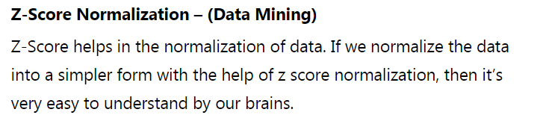
Z Score Normalization

Slide 3
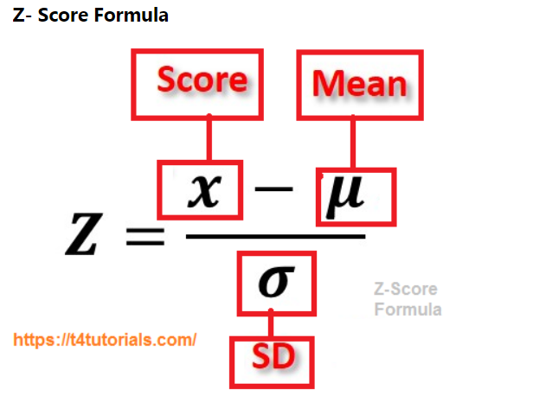

Slide 4
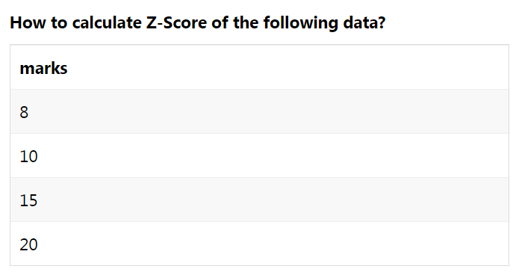
Example

Slide 5
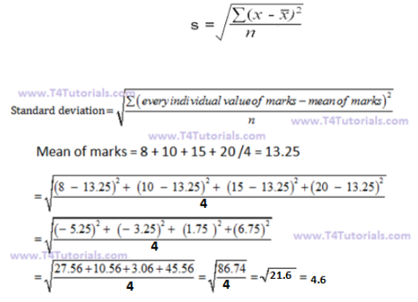

Slide 6
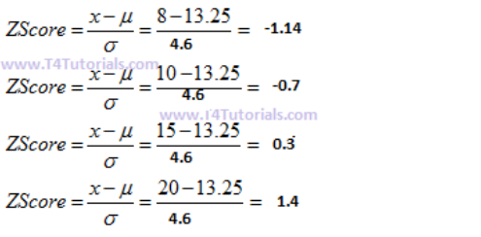

Slide 7
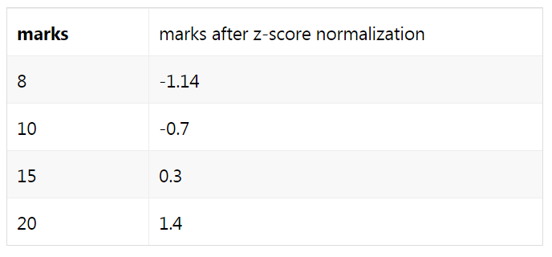

Slide 8
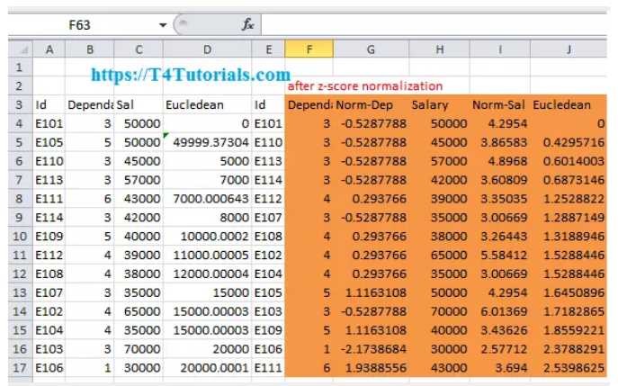
Download Excel File Calculations
https://t4tutorials.com/z-score-normalization-data-mining/

Slide 9

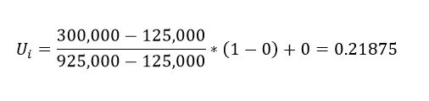
Min-Max Normalization
Min-Max normalization performs the linear transformation on original data. Let (X1, X2) be a min and max boundary of an attribute and (Y1, Y2) be the new scale at which we are normalizing, then for Vi value of the attribute, the normalized value Ui is given as,
Special thing about min-max normalization is that preserves the relationship between the original data values. If in future the input values come to be beyond the limit of normalization, then it will encounter an error known as “out-of-bound error.”
Example: Suppose the minimum and maximum values for the price of the house be $125,000 and $925,000 respectively. We need to normalize that price range in between (0,1). We can use min-max normalization to transform any value between them (say, 300,000). In this case, we use the above formula to find U_{i} with,
V_{i}=300,000
X₁= 125,000
X₂= 925,000
Y₁= 0
Y₂= 1

Slide 10
FAQ about Z Score Normalization
How do you use a z score table?
Advantages of the z score
Is a higher or lower Z score better?
What does a negative and a positive z score mean?
Why is the mean of Z scores is 0?
What is the meaning of the high Z score and low Z score?
https://t4tutorials.com/z-score-normalization-data-mining/
https://t4tutorials.com/z-score-normalization-data-mining/

Slide 11
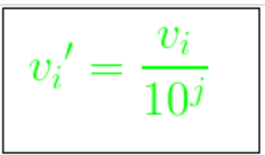
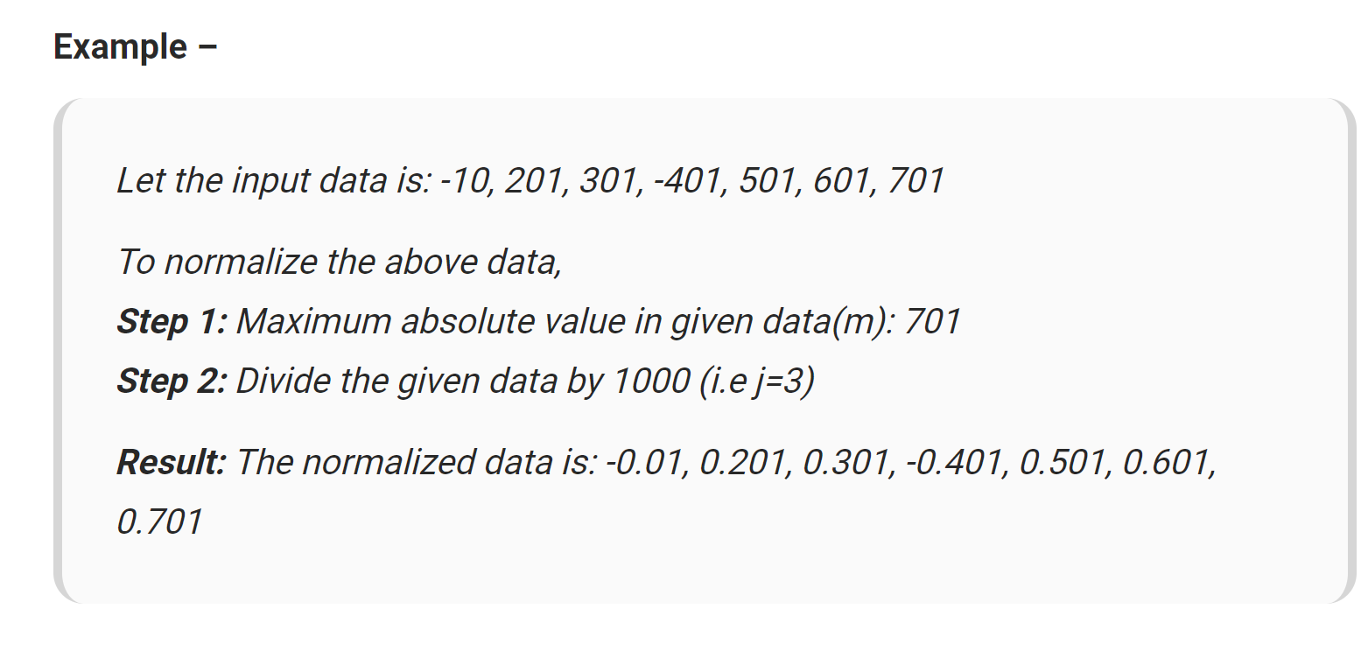
Decimal Scaling
where j is the smallest integer such that max(|v_{i}‘|)<1.

Slide 12
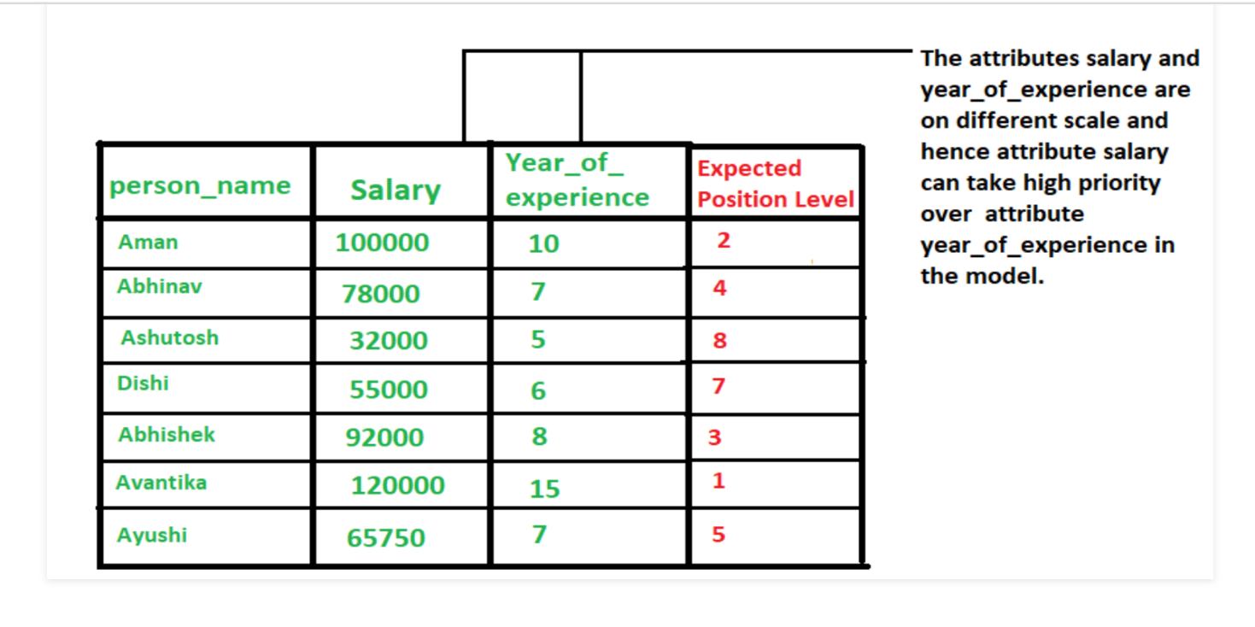
Decimal Scaling
It normalizes by moving the decimal point of values of the data. To normalize the data by this technique, we divide each value of the data by the maximum absolute value of data. The data value, v_{i}, of data is normalized to v_{i}‘ by using the formula below –

Slide 13
References:
https://t4tutorials.com/z-score-normalization-data-mining/
https://www.geeksforgeeks.org/data-normalization-in-data-mining/
https://kraj3.com.np/blog/2019/10/min-max-normalization-with-example/
https://www.statisticshowto.datasciencecentral.com/normalized/

