Slide 1
Anomaly Detection
Lecture Notes for Chapter 9
Introduction to Data Mining, 2nd Edition
by
Tan, Steinbach, Karpatne, Kumar

Slide 2
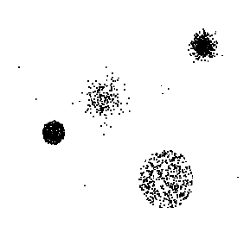
Anomaly/Outlier Detection
What are anomalies/outliers?
The set of data points that are considerably different than the remainder of the data
Natural implication is that anomalies are relatively rare
One in a thousand occurs often if you have lots of data
Context is important, e.g., freezing temps in July
Can be important or a nuisance
10 foot tall 2 year old
Unusually high blood pressure

Slide 3
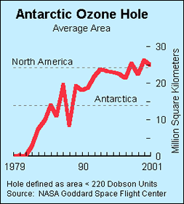
Importance of Anomaly Detection
Ozone Depletion History
In 1985 three researchers (Farman, Gardinar and Shanklin) were puzzled by data gathered by the British Antarctic Survey showing that ozone levels for Antarctica had dropped 10% below normal levels
Why did the Nimbus 7 satellite, which had instruments aboard for recording ozone levels, not record similarly low ozone concentrations?
The ozone concentrations recorded by the satellite were so low they were being treated as outliers by a computer program and discarded!
Sources: http://exploringdata.cqu.edu.au/ozone.html http://www.epa.gov/ozone/science/hole/size.html

Slide 4
Causes of Anomalies
Data from different classes
Measuring the weights of oranges, but a few grapefruit are mixed in
Natural variation
Unusually tall people
Data errors
200 pound 2 year old

Slide 5
Distinction Between Noise and Anomalies
Noise is erroneous, perhaps random, values or contaminating objects
Weight recorded incorrectly
Grapefruit mixed in with the oranges
Noise doesn’t necessarily produce unusual values or objects
Noise is not interesting
Anomalies may be interesting if they are not a result of noise
Noise and anomalies are related but distinct concepts

Slide 6
General Issues: Number of Attributes
Many anomalies are defined in terms of a single attribute
Height
Shape
Color
Can be hard to find an anomaly using all attributes
Noisy or irrelevant attributes
Object is only anomalous with respect to some attributes
However, an object may not be anomalous in any one attribute

Slide 7
General Issues: Anomaly Scoring
Many anomaly detection techniques provide only a binary categorization
An object is an anomaly or it isn’t
This is especially true of classification-based approaches
Other approaches assign a score to all points
This score measures the degree to which an object is an anomaly
This allows objects to be ranked
In the end, you often need a binary decision
Should this credit card transaction be flagged?
Still useful to have a score
How many anomalies are there?

Slide 8
Other Issues for Anomaly Detection
Find all anomalies at once or one at a time
Swamping
Masking
Evaluation
How do you measure performance?
Supervised vs. unsupervised situations
Efficiency
Context
Professional basketball team

Slide 9
Variants of Anomaly Detection Problems
Given a data set D, find all data points x ∈ D with anomaly scores greater than some threshold t
Given a data set D, find all data points x ∈ D having the top-n largest anomaly scores
Given a data set D, containing mostly normal (but unlabeled) data points, and a test point x, compute the anomaly score of x with respect to D

Slide 10
Model-Based Anomaly Detection
Build a model for the data and see
Unsupervised
Anomalies are those points that don’t fit well
Anomalies are those points that distort the model
Examples:
Statistical distribution
Clusters
Regression
Geometric
Graph
Supervised
Anomalies are regarded as a rare class
Need to have training data

Slide 11
Additional Anomaly Detection Techniques
Proximity-based
Anomalies are points far away from other points
Can detect this graphically in some cases
Density-based
Low density points are outliers
Pattern matching
Create profiles or templates of atypical but important events or objects
Algorithms to detect these patterns are usually simple and efficient

Slide 12
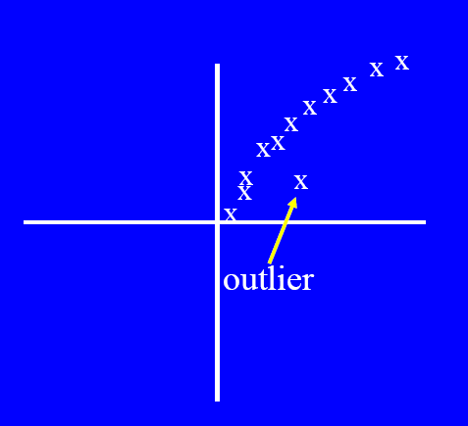
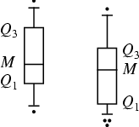
Visual Approaches
Boxplots or scatter plots
Limitations
Not automatic
Subjective

Slide 13
Statistical Approaches
Probabilistic definition of an outlier: An outlier is an object that has a low probability with respect to a probability distribution model of the data.
Usually assume a parametric model describing the distribution of the data (e.g., normal distribution)
Apply a statistical test that depends on
Data distribution
Parameters of distribution (e.g., mean, variance)
Number of expected outliers (confidence limit)
Issues
Identifying the distribution of a data set
Heavy tailed distribution
Number of attributes
Is the data a mixture of distributions?

Slide 14
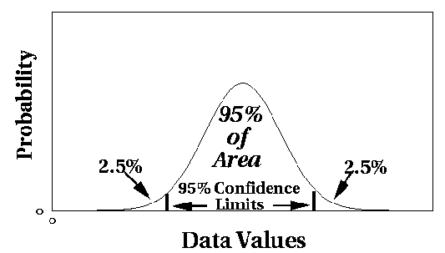
Normal Distributions
One-dimensional Gaussian
Two-dimensional Gaussian

Slide 15
Grubbs’ Test
Detect outliers in univariate data
Assume data comes from normal distribution
Detects one outlier at a time, remove the outlier, and repeat
H₀: There is no outlier in data
H_{A}: There is at least one outlier
Grubbs’ test statistic:
Reject H₀ if:

Slide 16
Statistical-based – Likelihood Approach
Assume the data set D contains samples from a mixture of two probability distributions:
M (majority distribution)
A (anomalous distribution)
General Approach:
Initially, assume all the data points belong to M
Let L_{t}(D) be the log likelihood of D at time t
For each point x_{t} that belongs to M, move it to A
Let L_{t+1} (D) be the new log likelihood.
Compute the difference, Δ = L_{t}(D) – L_{t+1} (D)
If Δ > c (some threshold), then x_{t} is declared as an anomaly and moved permanently from M to A

Slide 17
Statistical-based – Likelihood Approach
Data distribution, D = (1 – λ) M + λ A
M is a probability distribution estimated from data
Can be based on any modeling method (naïve Bayes, maximum entropy, etc)
A is initially assumed to be uniform distribution
Likelihood at time t:

Slide 18
Strengths/Weaknesses of Statistical Approaches
Firm mathematical foundation
Can be very efficient
Good results if distribution is known
In many cases, data distribution may not be known
For high dimensional data, it may be difficult to estimate the true distribution
Anomalies can distort the parameters of the distribution

Slide 19
Distance-Based Approaches
Several different techniques
An object is an outlier if a specified fraction of the objects is more than a specified distance away (Knorr, Ng 1998)
Some statistical definitions are special cases of this
The outlier score of an object is the distance to its kth nearest neighbor

Slide 20
One Nearest Neighbor - One Outlier
Outlier Score

Slide 21
One Nearest Neighbor - Two Outliers
Outlier Score

Slide 22
Five Nearest Neighbors - Small Cluster
Outlier Score

Slide 23
Five Nearest Neighbors - Differing Density
Outlier Score

Slide 24
Strengths/Weaknesses of Distance-Based Approaches
Simple
Expensive – O(n²)
Sensitive to parameters
Sensitive to variations in density
Distance becomes less meaningful in high-dimensional space

Slide 25
Density-Based Approaches
Density-based Outlier: The outlier score of an object is the inverse of the density around the object.
Can be defined in terms of the k nearest neighbors
One definition: Inverse of distance to kth neighbor
Another definition: Inverse of the average distance to k neighbors
DBSCAN definition
If there are regions of different density, this approach can have problems

Slide 26
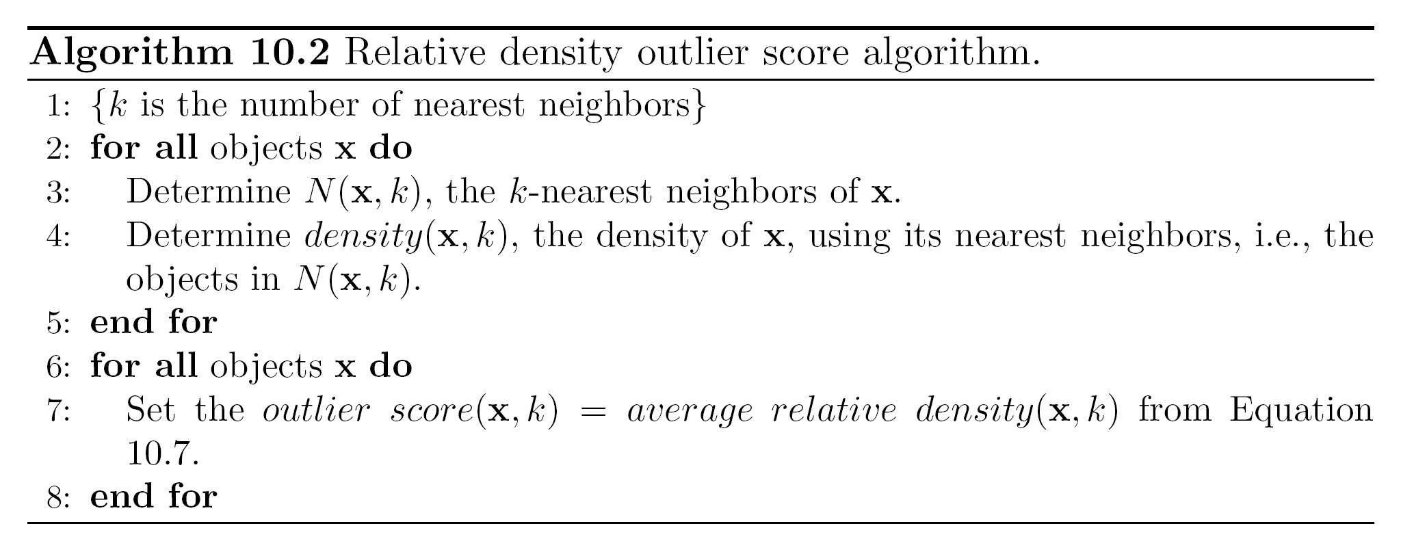
Relative Density
Consider the density of a point relative to that of its k nearest neighbors

Slide 27
Relative Density Outlier Scores
Outlier Score

Slide 28
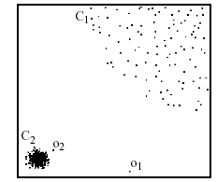
Density-based: LOF approach
For each point, compute the density of its local neighborhood
Compute local outlier factor (LOF) of a sample p as the average of the ratios of the density of sample p and the density of its nearest neighbors
Outliers are points with largest LOF value
In the NN approach, p₂ is not considered as outlier, while LOF approach find both p₁ and p₂ as outliers
p₂
×
p₁
×

Slide 29
Strengths/Weaknesses of Density-Based Approaches
Simple
Expensive – O(n²)
Sensitive to parameters
Density becomes less meaningful in high-dimensional space

Slide 30
Clustering-Based Approaches
Clustering-based Outlier: An object is a cluster-based outlier if it does not strongly belong to any cluster
For prototype-based clusters, an object is an outlier if it is not close enough to a cluster center
For density-based clusters, an object is an outlier if its density is too low
For graph-based clusters, an object is an outlier if it is not well connected
Other issues include the impact of outliers on the clusters and the number of clusters

Slide 31
Distance of Points from Closest Centroids
Outlier Score

Slide 32
Relative Distance of Points from Closest Centroid
Outlier Score

Slide 33
Strengths/Weaknesses of Distance-Based Approaches
Simple
Many clustering techniques can be used
Can be difficult to decide on a clustering technique
Can be difficult to decide on number of clusters
Outliers can distort the clusters

