Slide 1
SEMANTIC UNDERSTANDING OF AN IMAGE USING
MULTI REGION LABEL ANNOTATION
UNDER THE GUIDANCE OF
DR.S.CHITRAKALA
Group 10
MOHANA PRIYA K - 2013103552
SUDHARSAN S - 2013103566
GAYATHRI DEVI K - 2013013579

Slide 2
ABSTRACT
The aim of this project is to understand a given image and provide a short description about the various objects in the image.
This textual description can then serve as an input to any Text-to-Speech converter.
Multi Label annotation is performed for better understanding of the relationship between the various objects in an image and to provide a contextually better textual description of the given image.

Slide 3
INTRODUCTION
Image processing is a rapidly growing field of research. .
Common people can easily understand the image on seeing the image with their naked eyes but that is not the case with the blind people.
This project is intended to help such people.
Given an image , the image is converted to textual description of that image which can be given as a input .
The process involved in image to textual description includes image processing like Pre-Processing, Image Segmentation, Edge Detection, Segmentation, Feature Extraction.
In addition to this , Multi Label Annotation is involved for better understanding of image.

Slide 4
LITERATURE SURVEY-1
“Multi-Instance Multi-label Learning Combining Hierarchical Context and Its Application to Image Annotation ”, Xinmiao Ding, Bing Li, Weihua Xiong, Wen Guo, Weiming Hu, Bo Wang , IEEE Transactions on Multimedia, Volume: 18, Issue:8,Pages: 1616 - 1627,2016.
MERITS:
It is easier to label all possible objects in the image by identifying their features.
It gives a better view and is often easier to read than paragraphs.
It helps the blind in understanding an image.
DEMERITS:
Multi-Instance Multi-Label (MIML) is sometimes less efficient than Context-aware Multi-Instance Multi-Label (CMIML)

Slide 5
LITERATURE SURVEY-2
“An Automatic Approach for Translating Simple Images into Text Descriptions and Speech for Visually Impaired People ”, Mrunmayee Patil, Ramesh Kagalkar , International Journal of Computer Applications, Volume 118- May 2015.
MERITS:
Helps blind and physically disabled people to know what is there in an Image.
DEMERITS:
It cannot convert Dynamic Images into its Textual description.

Slide 6
LITERATURE SURVEY - 3
“Multiple Bernoulli Relevance Models for Image and Video Annotation“, S. L. Feng, R. Manmatha and V. Lavrenko, Multimedia Indexing and Retrieval Group Center for Intelligent Information Retrieval.
MERITS:
The process of a human annotating images.
DEMERITS:
No extensive retrieval task with this model

Slide 7
LITERATURE SURVEY - 4
“A survey on automatic image annotation and trends of the new age “, Feichao Wang, Procedia Engineering,2011.
MERITS:
Automatically annotate large amount of Images.
DEMERITS:
Time complexity and space complexity are always high

Slide 8
LITERATURE SURVEY - 5
“PLSA based Image Auto Annotation: Constraining the Latent Space“, Florent Monay, Daniel GaticaPerez, IDIAP Research Institute.
MERITS:
PLSA-based image auto-annotation system, which uses two linked PLSA models to represent the textual and visual modalities of an annotated image.
DEMERITS:
No annotation accuracy measures.

Slide 9
LITERATURE SURVEY - 6
“A Model for Learning the Semantics of Pictures“, V. Lavrenko, R. Manmatha, J. Jeon, Center for Intelligent Information Retrieval Computer Science Department.
MERITS:
Significantly better than a number of other models for image annotation and retrieval.
DEMERITS:
Need better coverage and an evaluation of how such algorithms extend to large data sets.

Slide 10
LITERATURE SURVEY - 7
“Automatic Image Annotation and Retrieval using CrossMedia Relevance Models“, J. Jeon, V. Lavrenko and R. Manmatha, Center for Intelligent Information Retrieval Computer Science Department.
MERITS:
Cross-Media Relevance Models are a good choice for annotating and retrieving images.
DEMERITS:
Performance and evaluation is needed.

Slide 11
PROPOSED SYSTEM
To semantically understand a given image and to convert into its Textual Description, by using Multi-Label (ML)Annotation.
The overall system is intended
  To achieve multi label annotation to understand the images better and to provide a short description based on the spatial relationship of objects in an image.

Slide 12
OVERALL ARCHITECTURE DIAGRAM
The overall architecture diagram gives a clear idea about the flow of the process through every module from the input to the expected output.

Slide 13
DATABASE
POPULATE
PRE-PROCESSING
REGION SEGMENTATION
FEATURE
EXTRACTION
NOISE REMOVAL
DATABASE
EDGE
DETECTION
SEGMENTATTION
PRE-PROCESSING
REGION SEGMENTATION
INPUT
IMAGE
FEATURE
EXTRACTION
NOISE REMOVAL
EDGE
DETECTION
SEGMENTATION
IMAGE ANNOTATION
SIMILARITY
COMPUTATION
Spatial relationship
between the labels
SPATIAL
RELATIONSHIP DETERMINATION
LABEL 1
MULTI LABEL ANNOTATION
LABEL 2
LABEL N

Slide 14
DETAILED MODULE DESIGN
The list of modules involved in the entire process are as follows:
Pre-Processing
Edge Detection
Region Segmentation
Feature Extraction
Multi Label Image Annotation
Spatial Relationship Determination

Slide 15
PRE-PROCESSING: (Gaussian Removal algorithm)
INPUT:
Input image.
OUTPUT:
Noise removed image.
ALGORITHM:
Begin
Img = I; % Input image
A = imnoise(Img,'Gaussian',0.04,0.003); %Add noise to the Input image
H = fspecial('Gaussian',[9 9],1.76); %Symmetric Gaussian
GaussF = imfilter(A,H); % Image filter
End

Slide 16


PRE-PROCESSING
INPUT:
OUTPUT:

Slide 17
EDGE DETECTION: (Sobel Edge Detection Algorithm)
INPUT:
Noise removed image.
OUTPUT:
Image in which all possible edges detected.
ALGORITHM:
Begin
for i=1:size(C,1)-2
for j=1:size(C,2)-2
Gx=((2*C(i+2,j+1)+C(i+2,j)+C(i+2,j+2))-(2*C(i,j+1)+C(i,j)+C(i,j+2))); % Sobel mask for x-direction
Gy=((2*C(i+1,j+2)+C(i,j+2)+C(i+2,j+2))-(2*C(i+1,j)+C(i,j)+C(i+2,j))); % Sobel mask for y-direction
B(i,j)=sqrt(Gx.^2+Gy.^2); %The gradient of the image
end
end
End

Slide 18
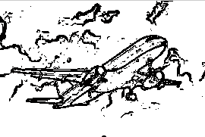
EDGE DETECTION
INPUT:
OUTPUT:

Slide 19
REGION SEGMENTATION:
INPUT:
Image in which all possible edges detected.
OUTPUT:
Object in the image are segmented.
ALGORITHM:
Begin
for i=1:M
for j=1:N
d=sqrt((i-n1)^2+(j-n2)^2);
h=1*exp(-1/2*(d^2/d0^2));
sB(i,j)=h*sB(i,j);
end
end
End

Slide 20
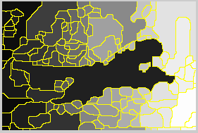
Region SEGMENTATION
INPUT:
OUTPUT:

Slide 21
FEATURE EXTRACTION:
INPUT:
Object in the image are segmented .
OUTPUT:
Features are extracted from the Image.
ALGORITHM:
Begin
gm1 = graycomatrix(D11);
gprops1 = graycoprops(gm1);
F1(1) = gprops1.Contrast; F1(2) = gprops1.Correlation;
F1(3) = gprops1.Energy; F1(4) = gprops1.Homogeneity;
End

Slide 22
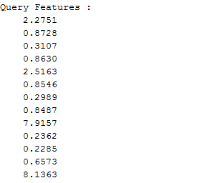
FEATURE EXTRACTION
INPUT:
OUTPUT:

Slide 23
MULTI LABEL IMAGE ANNOTATION:
INPUT:
Features are extracted from the Image.
OUTPUT:
Object in the image are labeled.
ALGORITHM:
Begin
for k = 1:numel(s)
c = s(k).Centroid;
text(c(1), c(2), sprintf('%d', k), ... 'HorizontalAlignment', 'center', ... 'VerticalAlignment', 'middle');
end
End

Slide 24
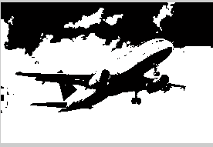
MULTI LABEL IMAGE ANNOTATION
INPUT:
OUTPUT:

Slide 25





SIMILARITY COMPUTATION:
The feature similarity measurement between f1(x) and f2(x) into two components, the FSIM index between f1 and f2 is defined as
Where,

Slide 26

SPATIAL RELATIONSHIP DETERMINATION:
This module involves finding out the relationship between the identified labels.
The relationship is Spatial, since it is a static image.
Where
Ø shows the angle of straight line between the centres of two objects.

Slide 27
SPATIAL RELATIONSHIP DETERMINATION
INPUT:
OUTPUT:
OBJECT 1 POSITION OBJECT 2
Flight mid position sky

Slide 28
Performance metrics
  Precision
  Recall
  F-score
  Signal to Noise Ratio (SNF)

Slide 29

Performance metrics
PRECISION
Precision (also called positive predictive value) is the fraction of retrieved textual description that are relevant.
Where,
N_{c} : number of correctly found textual description of the image.
N_{f} : number of false positives.

Slide 30

Performance metrics
RECALL
Recall (also known as sensitivity) is the fraction of relevant textual description that are retrieved.
Where,
N_{c} : number of correctly found textual description of the image.
N_{f} : number of false positives.

Slide 31
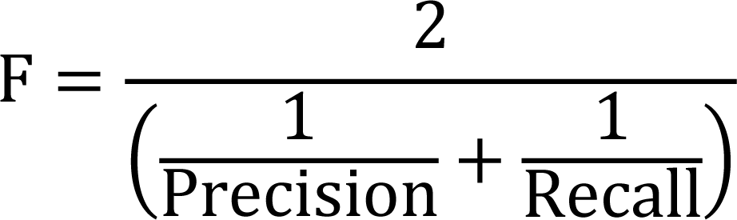
Performance metrics
F-SCORE
F-score is computed as the harmonic mean of precision and recall. Recall measures how well the system can retrieve the true ground truth partition points, and high precision ensures that it does not over predict the true topic partitions.

Slide 32


Performance metrics
  SIGNAL TO NOISE RATIO (SNR)
SNR is used to evaluate preprocessing algorithms in small target images.
Where,
SNR_{in} : Input image for the preprocessing algorithm
SNR_{out} : Output image obtained as the result of the preprocessing algorithm
It : Mean gray value of the target region
Ib : Mean gray value of background
Cb : Standard deviation of the background.

Slide 33
REFERENCES
“Multi-Instance Multi-label Learning Combining Hierarchical Context and Its Application to Image Annotation ”, Xinmiao Ding, Bing Li, Weihua Xiong, Wen Guo, Weiming Hu, Bo Wang , IEEE Transactions on Multimedia, Volume: 18, Issue:8,Pages: 1616 - 1627, 2016.
“An Automatic Approach for Translating Simple Images into Text Descriptions and Speech for Visually Impaired People ”, Mrunmayee Patil, Ramesh Kagalkar , International Journal of Computer Applications, Volume 118- May 2015.
“Multiple Bernoulli Relevance Models for Image and Video Annotation“, S. L. Feng, R. Manmatha and V. Lavrenko, Multimedia Indexing and Retrieval Group Center for Intelligent Information Retrieval.
“A survey on automatic image annotation and trends of the new age “, Feichao Wang, Procedia Engineering,2011.
“PLSA based Image AutoAnnotation: Constraining the Latent Space“, Florent Monay, Daniel GaticaPerez, IDIAP Research Institute.
“A Model for Learning the Semantics of Pictures“, V. Lavrenko, R. Manmatha, J. Jeon, Center for Intelligent Information Retrieval Computer Science Department.
“Automatic Image Annotation and Retrieval using CrossMedia Relevance Models“, J. Jeon, V. Lavrenko and R. Manmatha, Center for Intelligent Information Retrieval Computer Science Department.

