Slide 1
Blogging Website
MERNSTACK PROJECT
FINAL REVIEW
SUDHARSAN K K
22EC171

Slide 2
Introduction
The blog web app is designed to provide a dynamic platform for users to create, share, and engage with blog posts on a diverse array of topics and by offering an intuitive and user-friendly interface.
The platform empowers users to express their thoughts, share their expertise, and tell their stories in a meaningful way, enriched with multimedia content and interactive features.
The primary objective of blog web app is to foster a vibrant community of writers and readers. Its a space where individuals can connect, engage in thoughtful discussions, and build relationships based on shared interests and knowledge.
By facilitating the exchange of insights and ideas, this platform seeks to create a supportive environment that encourages creativity, learning, and collaboration among its users.

Slide 3
Existing System
Limited customization
User Authentication
Existing blogging systems lack integration and usability, making content management and customization challenging for users..
Existing systems often have inadequate user authentication and security, leading to decreased user trust.
MultiMedia Integration
Community features
Current blogging platforms lack robust multimedia and interactive features, leading to static user experiences.
Community engagement features are often basic or missing, limiting meaningful connections and user interactions.

Slide 4
Proposed System
Our Proposed System leverages the MERN Stack MongoDB for database Management, Express.js for server-side development, React.js for building the user interface, and Node.js for the runtime environment.
Multimedia Embedding
This platform allows users to embed multimedia like images.
Customization
More customization features has been included for better User Interface

Slide 5
Tech Stack
FRONTEND
DATABASE
BACKEND
React.js
HTML
CSS
MongoDB
Mongoose
Express.js
Node.js

Slide 6
Key Features
User Authentication
Implementing user authentication is crucial for ensuring that only registered users can upload and manage their images and boards.
JWT (JSON Web Tokens) for secure session management and bcrypt for password hashing, providing a secure and seamless user experience.
Media Upload
Users will be able to upload media to the platform
This media will be stored in the Database

Slide 7
MODULES
User Registration
User Authentication
View homepage
View Post
View Post
Edit Post

Slide 8
Module Description
User Registration
Users can register themselves by just providing the username and a password.
User Authentication
Users will be able to login themselves to the website by authenticating using Username and password.
View homepage
Users will be able to view the summary of the posts in the home page (login not required).
View Post
In this page users will be able to read the blog in the detailed manner.
Create Post
Upon login users can create blog by giving Title, Summary, media and description.
Edit Post
logged in users can edit their blogs by changing the content or adding information.

Slide 9
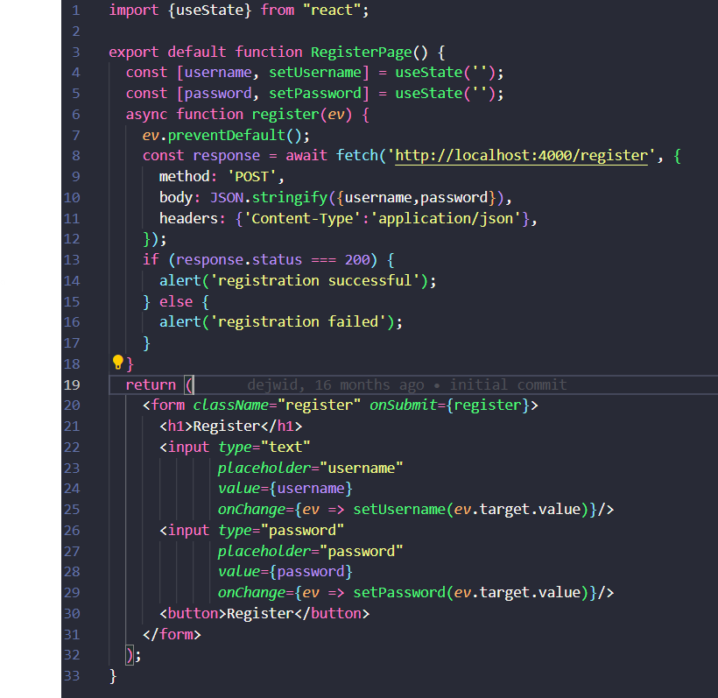
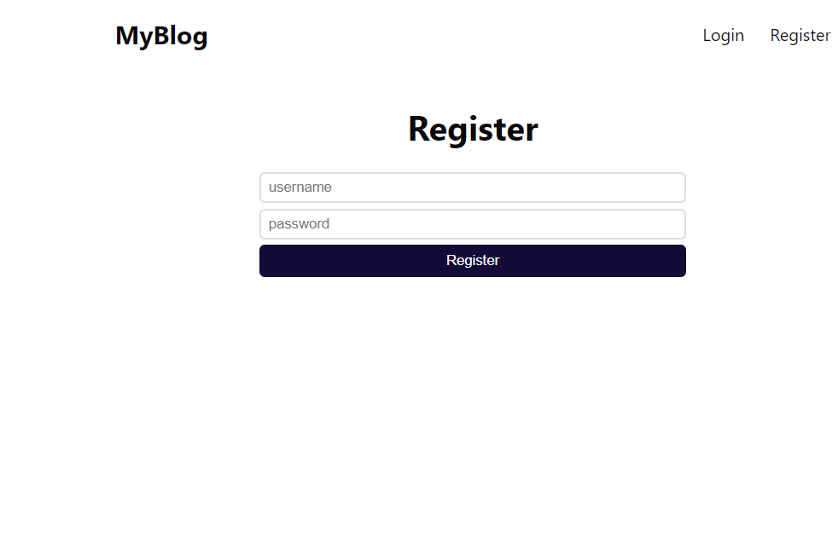
OUTPUT SCREENSHOTS
REGISTRATION PAGE

Slide 10
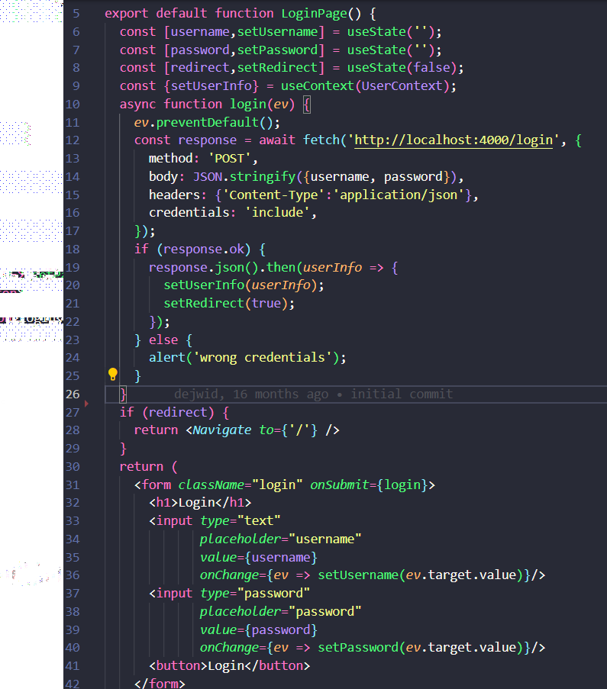
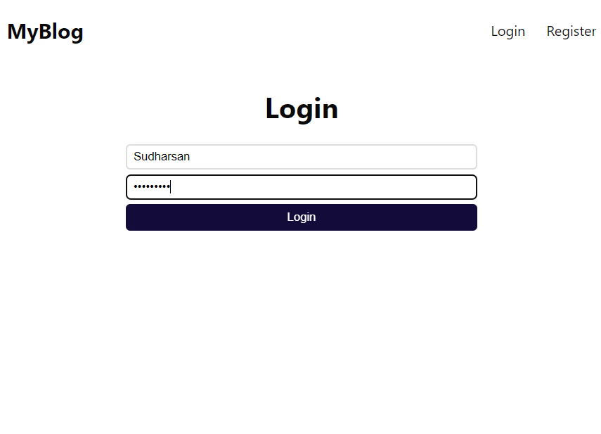
OUTPUT SCREENSHOTS
LOGIN PAGE

Slide 11
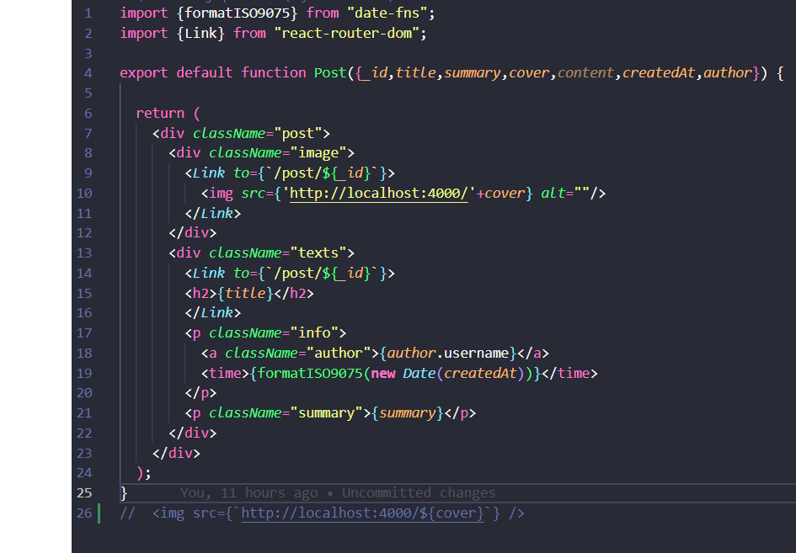
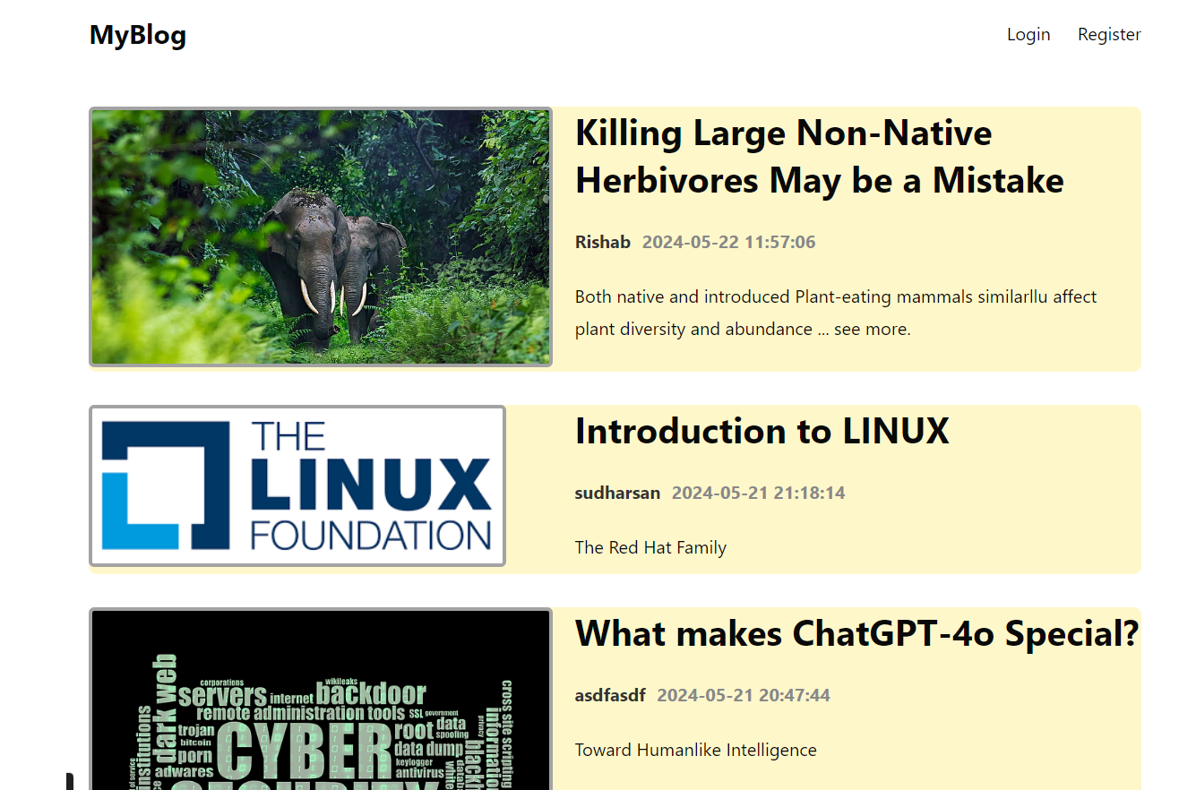
OUTPUT SCREENSHOTS
HOME PAGE

Slide 12
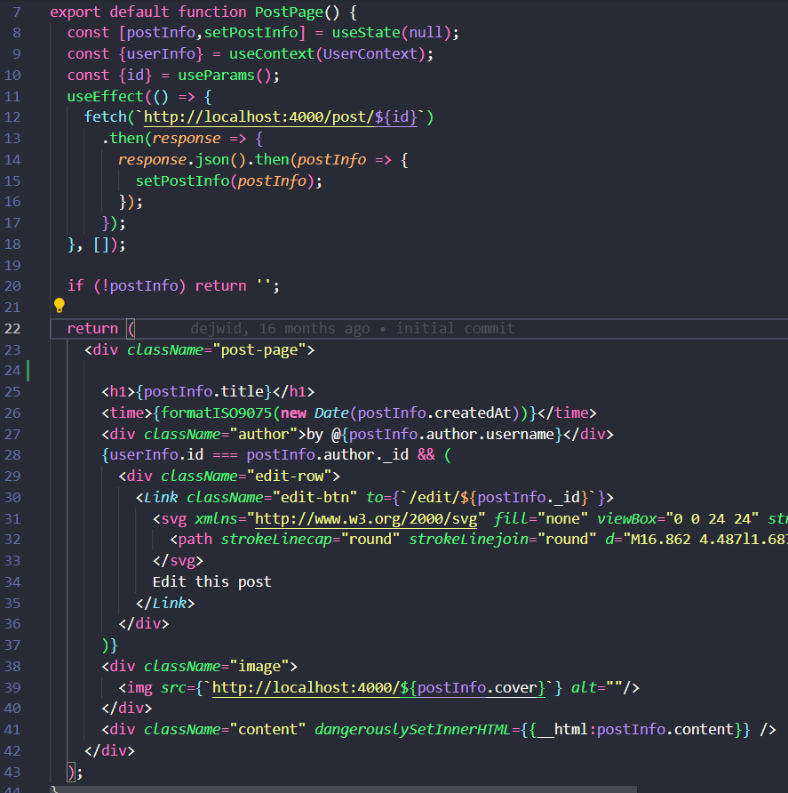
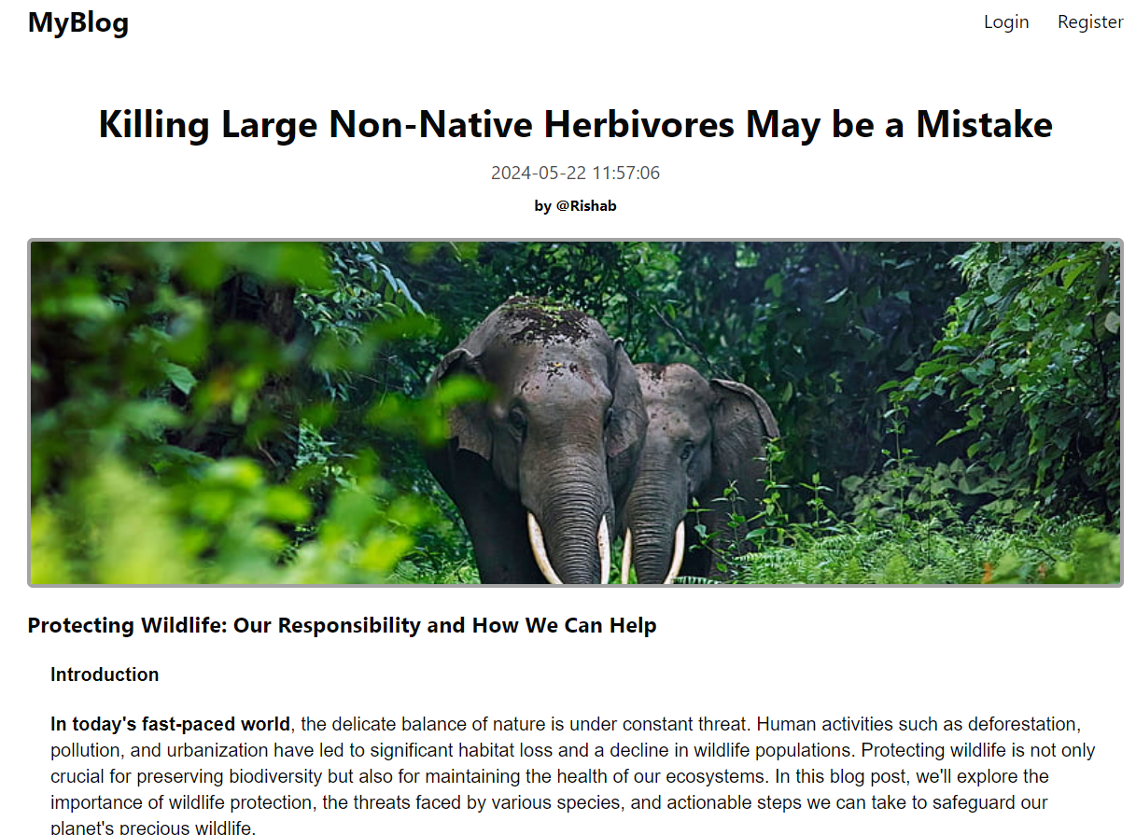
OUTPUT SCREENSHOTS
VIEW POST PAGE

Slide 13
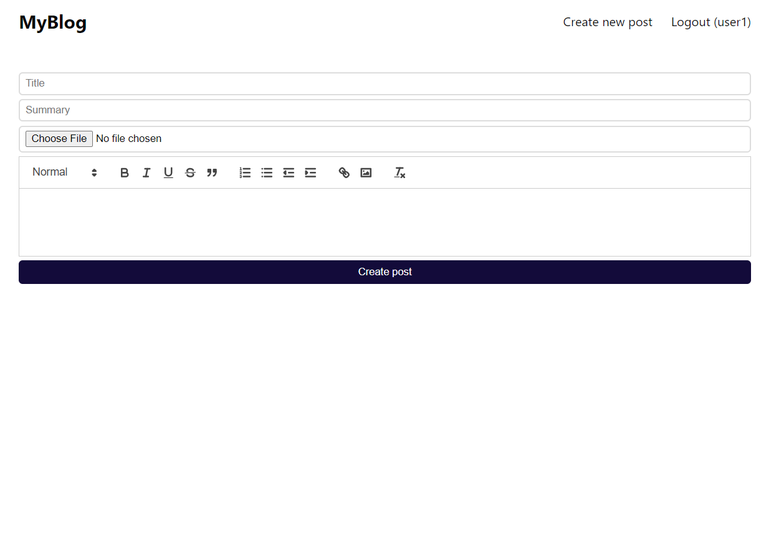
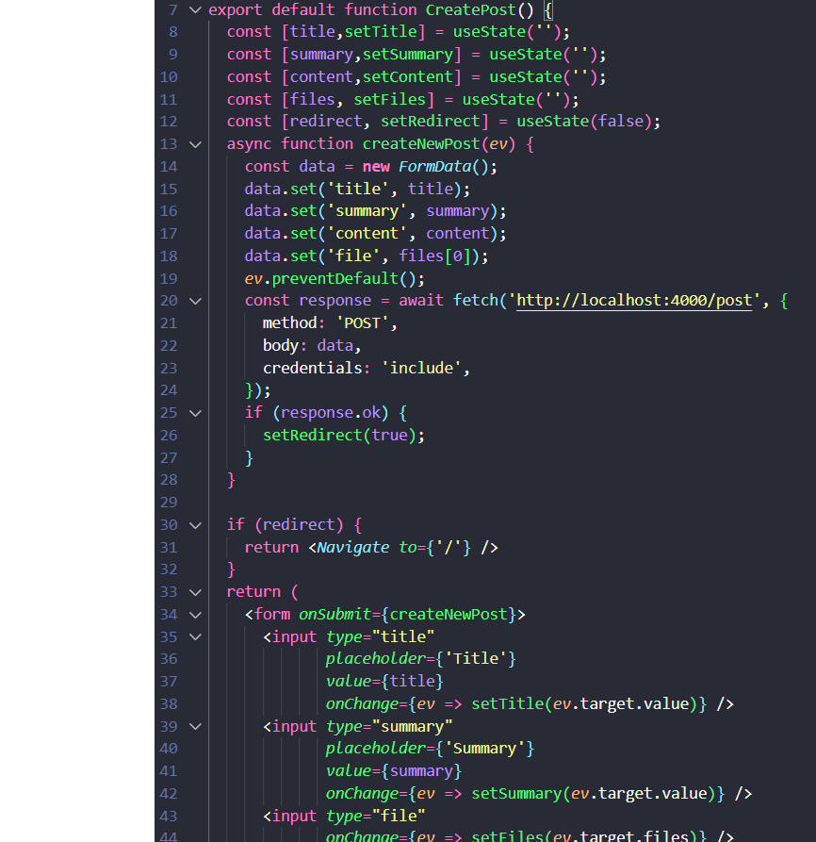
OUTPUT SCREENSHOTS
CREATE NEW POST PAGE

Slide 14
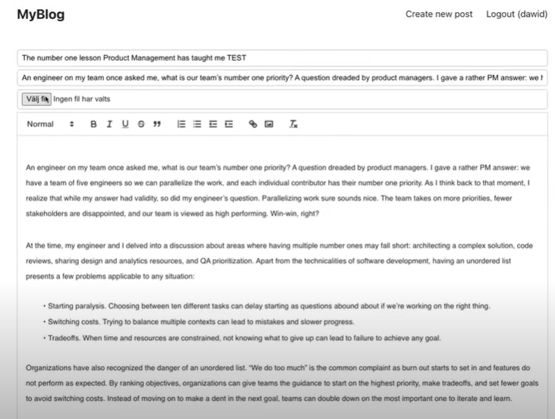
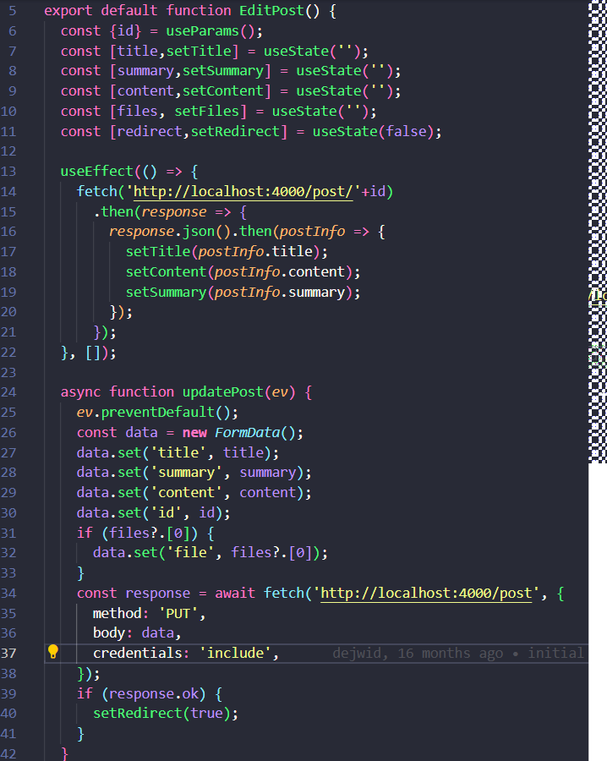
OUTPUT SCREENSHOTS
EDIT POST PAGE

Slide 15
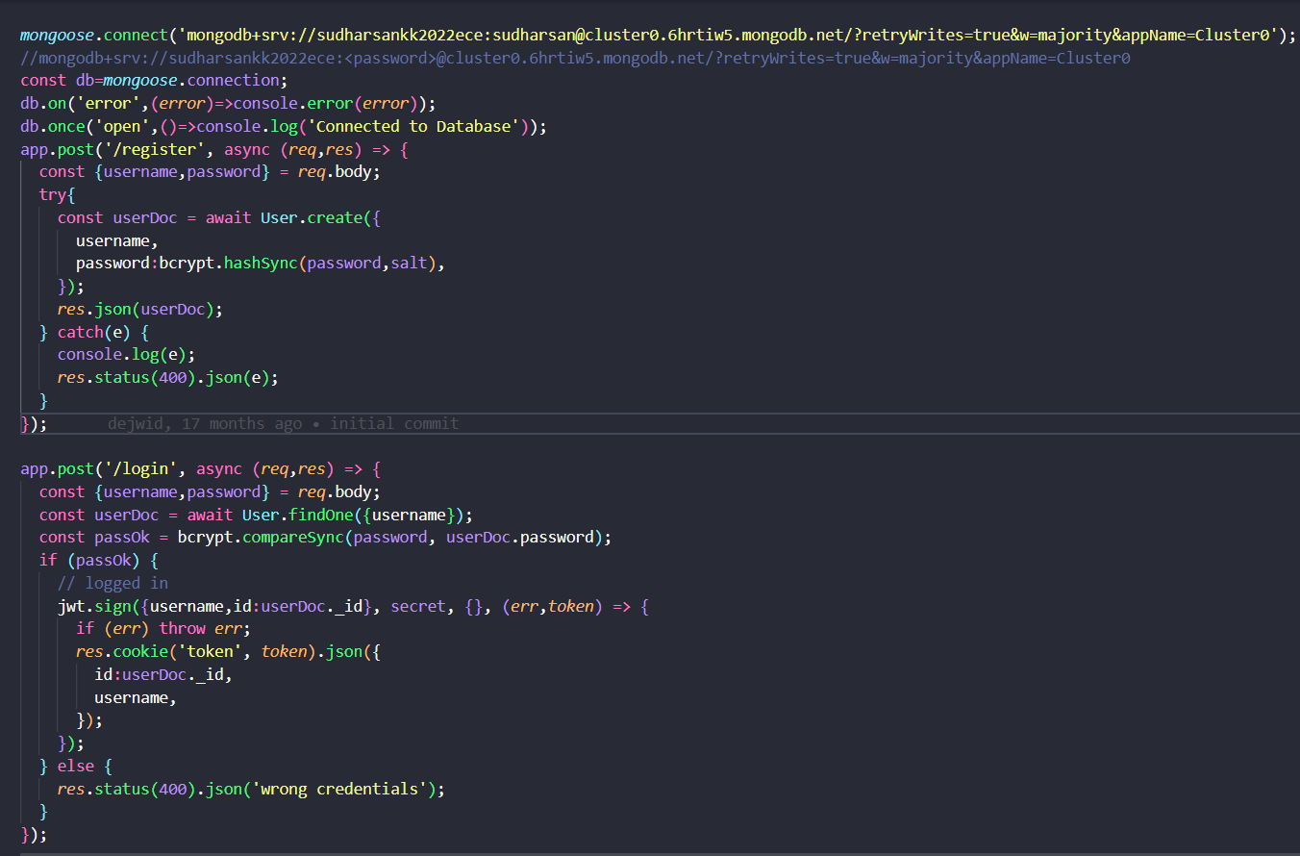
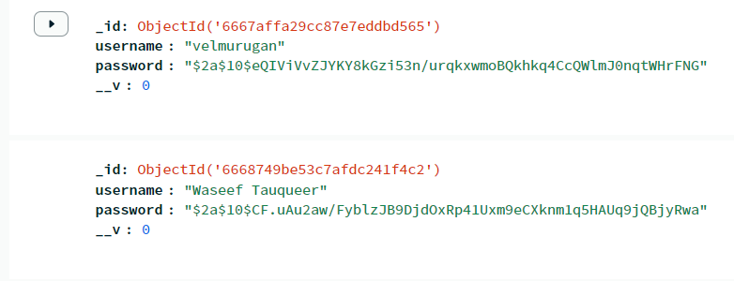
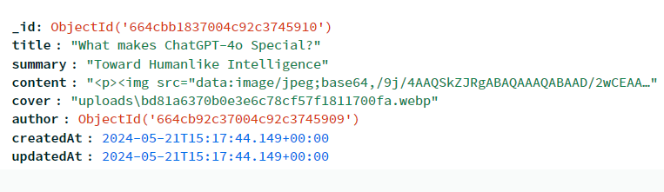
OUTPUT SCREENSHOTS
BACKEND CODE

Slide 16
Conclusion
I've showcased a full-stack blog application built using the MERN stack.
This application demonstrates the power of combining MongoDB, Express.js, React.js, and Node.js to create a dynamic and interactive web application.
This blog app allows users to create, read, update, and delete blog posts, providing a user-friendly platform for content creation and sharing. The MERN stack provided a robust and efficient development environment, enabling rapid prototyping and development.

