Slide 1
INTRODUCTION TO ELECTRONICS

Slide 2
BREAD BOARD CONNECTION
Outer rails are connected along the vertical lines
Inner rails are connected in horizontal fashion

Slide 3
ELECTRONIC COMPONENTS
ACTIVE
Transistor
MicroController
PASSIVE
Resistor
Capacitor
Inductor

Slide 4
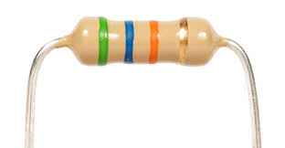
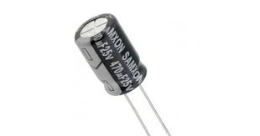
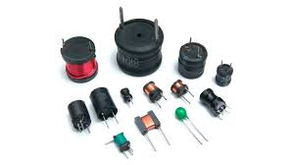
Resistors:It is an electrical component that reduces the electric current. The resistor's ability to reduce the current is called resistance and is measured in units of ohms (symbol: Ω).
Capacitor:A capacitor is a device that stores electrical energy in an electric field. It is a passive electronic component with two terminals. The effect of a capacitor is known as capacitance.
Inductor:An inductor, also called a coil, choke, or reactor, is a passive two-terminal electrical component that stores energy in a magnetic field when electric current flows through it.

Slide 5
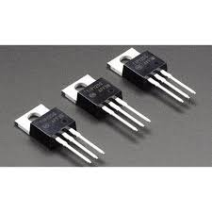
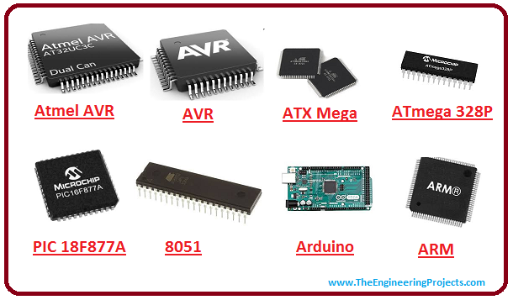
Transistor
A transistor is a semiconductor device used to amplify or switch electronic signals and electrical power. It is composed of semiconductor material usually with at least three terminals for connection to an external circuit.
MicroController
A microcontroller is a compact integrated circuit designed to govern a specific operation in an embedded system. A typical microcontroller includes a processor, memory and input/output (I/O) peripherals on a single chip.

Slide 6
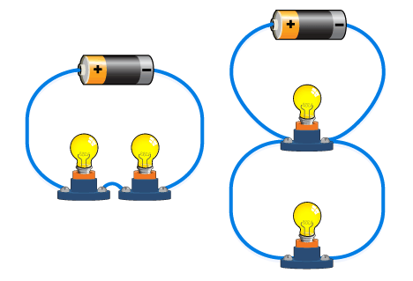
SERIES AND PARALLEL CIRCUITS

Slide 7

WORLD OF MICROCONTROLLER

Slide 8
MICROCONTROLLER
A microcontroller is a small, low-cost and self contained computer-on-a-chip that can be used as an embedded system. A few microcontrollers may utilize four-bit expressions and work at clock rate frequencies, which usually include:
An 8 or 16 bit microprocessor.
A little measure of RAM.
Programmable ROM and flash memory.
Parallel and serial I/O.
Timers and signal generators.

Slide 9
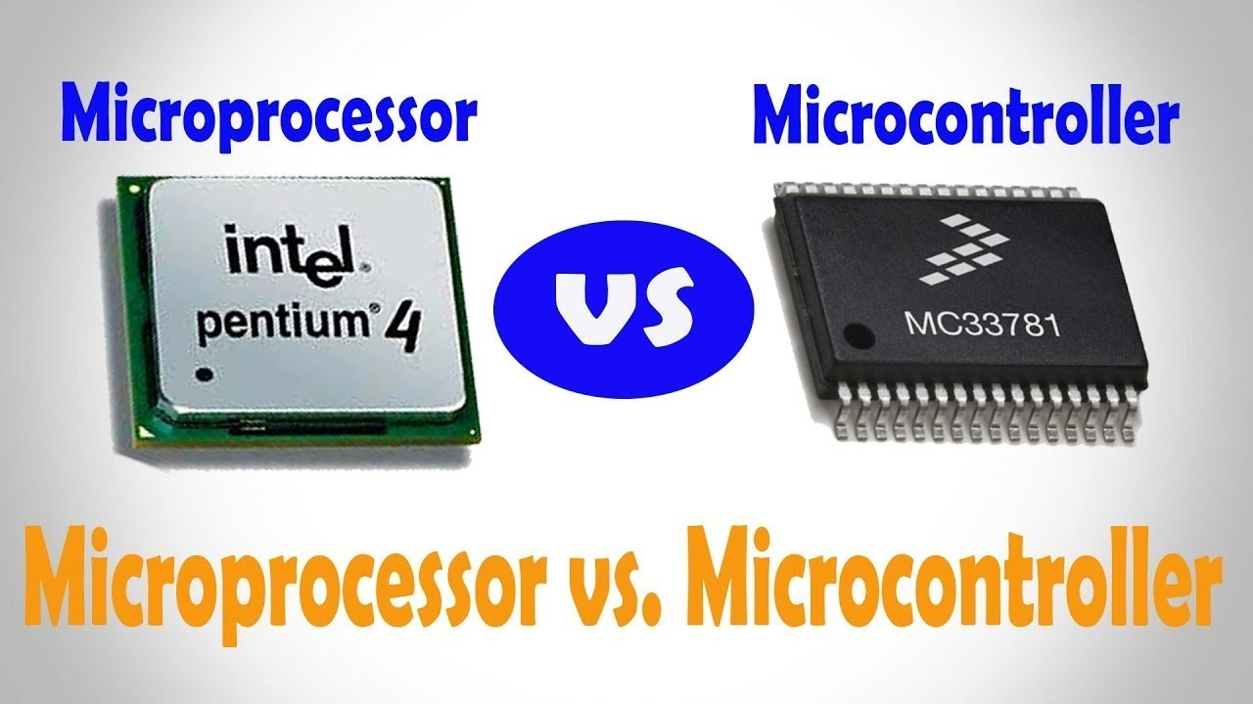
Difference between Microcontroller and Microprocessor
•Microprocessors contain only the CPU part. All other elements like RAM , ROM , Clock etc have to be externally added by designing engineer. Also they operate at much higher speed (>1GhZ) and are aimed for a wide array of tasks. e.g Intel Pentium , i3, i5 etc
•Microcontrollers on the other hand are designed for specific tasks , they have their own RAM , ROM , Clock embedded along with the microprocessor on a single chip. Also known as System on Chip (SOC); e.g. Atmel , Microchip , Raspberry Pi , Beaglebone , Intel 8051 etc.

Slide 10
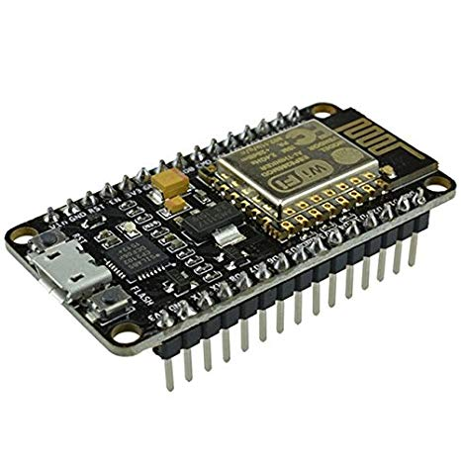
Node MCU
NodeMCU is an open source LUA based firmware developed for ESP8266 wifi chip
Why NodeMCU?
It’s open source
It’s wifi-enabled
It’s comparatively cheap

Slide 11
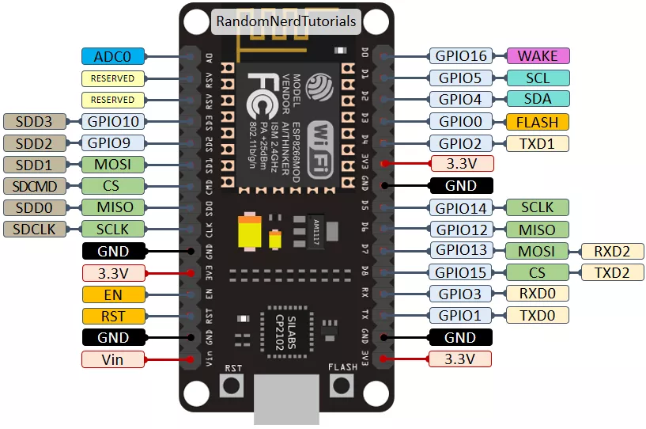
PINOUT DIAGRAM

Slide 12
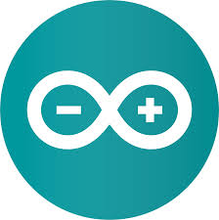
ARDUINO IDE

Slide 13
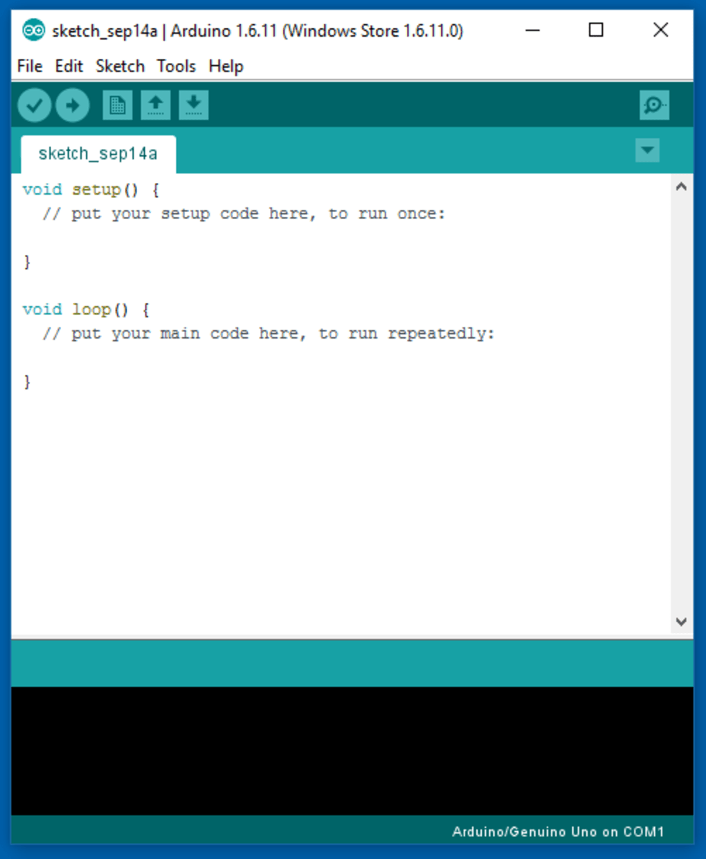
BASIC SYNTAX
void setup()
{
//this is for initializing the code
//this executes only ones }
void loop()
{ //this loop executes as long as
//the device is powered
}

Slide 14
if(condition)
{
//statements here are executed if the condition is true
}
else
{
//statements here are executed if condition is false
}
while(condition)
{
//statements here are executed repeatedly till condition is true
}

Slide 15
FUNCTIONS
In c, we can divide a large program into the basic building blocks known as function. The function contains the set of programming statements enclosed by {}.
A function can be called multiple times to provide reusability and modularity to the C program.
Syntax :
return_type function_name(data_type parameter...){
//code to be executed
}
Example:
void data(int a)
{
//statements
}

Slide 16
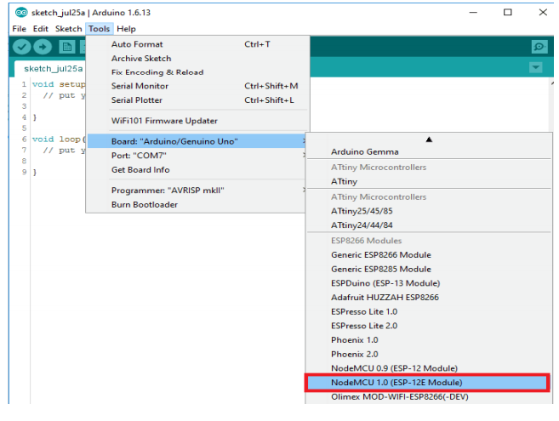

Slide 17
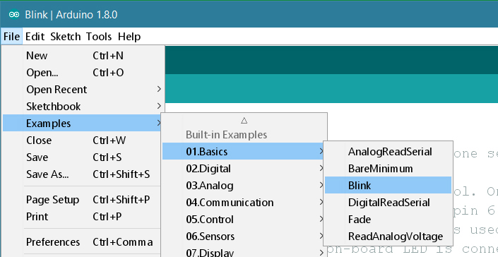
Opening the blink program

Slide 18
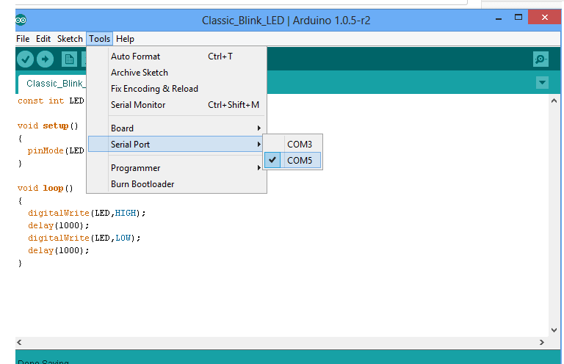

Slide 19
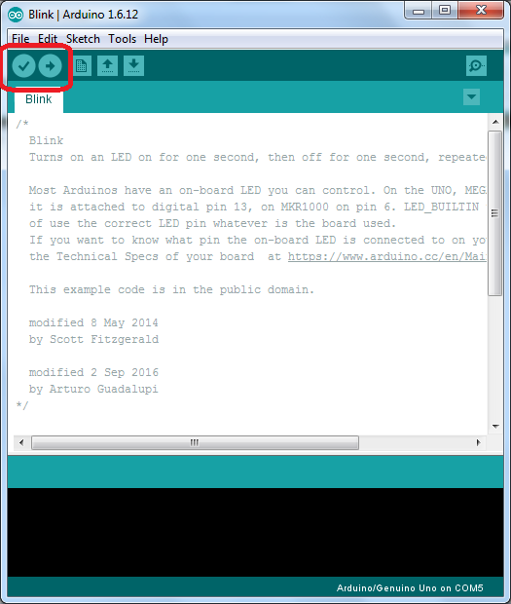
Uploading the program

Slide 20
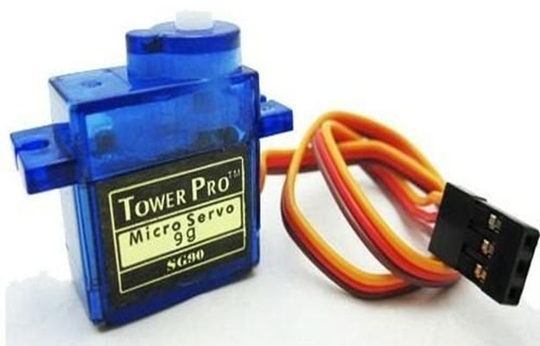
What is a Servo Motor?
A servo motor is an electrical device which can push or rotate an object with great precision. If you want to rotate and object at some specific angles or distance, then you use servo motor. It is just made up of simple motor which run through servo mechanism

Slide 21
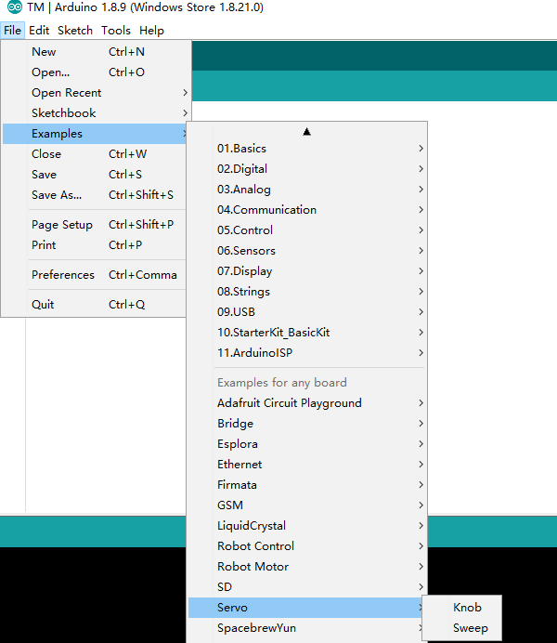

Slide 22
Servo Sweep
#include <Servo.h> Servo myservo; // create servo object to control a servo // twelve servo objects can be created on most boards void setup() { myservo.attach(D2); // attaches the servo on GIO2 to the servo object } void loop() { int pos; for (pos = 0; pos <= 180; pos += 1) { // goes from 0 degrees to 180 degrees | // in steps of 1 degree myservo.write(pos); // tell servo to go to position in variable 'pos' delay(1); // waits 15ms for the servo to reach the position } delay(1000); for (pos = 180; pos >= 0; pos -= 1) { // goes from 180 degrees to 0 degrees myservo.write(pos); // tell servo to go to position in variable 'pos' delay(1); // waits 15ms for the servo to reach the position } delay(1000); }

Slide 23
Task of the session: Build a railway gate!!
Make a railway gate like system where, servo acts as the railway gate and an LED to indicate if the gate is closed or open.

