Slide 1

COMPLAINT
MANAGEMENT SYSTEM
Developed Using Salesforce Platform
Presented by:
SUDHARSAN A
Salesforce CRM Platform | Customer Service Domain | 2024

Slide 2




Introduction
Cloud Platform
Centralized Process
Faster Resolution
Improved Visibility
Built on the Salesforce cloud — accessible anywhere, anytime with enterprise security.
All complaints routed through a single, trackable system for full visibility.
Automated workflows eliminate manual steps and speed up complaint closure.
Real-time reports and dashboards give management instant insight into issues.
Complaint Management System | Salesforce

Slide 3

Problem Statement
01
Manual Delays
Manual complaint handling creates bottlenecks, causing significant resolution delays and poor customer experience.
02
Poor Record Monitoring
Without a central system, complaint records are scattered and difficult to track or audit effectively.
03
No Centralized Tracking
Lack of centralized tracking means issues fall through the cracks and accountability is unclear.
04
Missing Automation
Without automated notifications, high-priority complaints may go unnoticed, escalating unresolved.
Complaint Management System | Salesforce

Slide 4

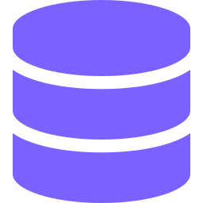


Aim of the Project
Efficient Management
Centralized Storage
Manage customer complaints efficiently with structured workflows and clear ownership at every stage.
Store all complaint information in a single Salesforce object, ensuring easy retrieval and consistency.
Automated Notifications
Process Improvement
Trigger automatic email alerts for high-priority complaints using Apex Triggers, ensuring zero missed cases.
Continuously improve the complaint management lifecycle with data-driven insights from reports and dashboards.
Complaint Management System | Salesforce

Slide 5

01
Customer Issue Handling
All customer complaints are captured, categorized, and routed to the right team instantly.
02
Service Quality Support
Continuous complaint data helps identify service gaps and drive quality improvements.
Project
Domain
03
Better Support Management
Managers gain full visibility with dashboards to track status, volume, and resolution time.
Customer Service

Slide 6
Tools & Technologies Used
Custom Objects
& Fields
Lookup
Relationship
Apex
Trigger
Apex
Class
Reports
Dashboards
Complaint Management System | Salesforce

Slide 7
System Workflow
1
2
3
4
User Creates Complaint
Record Stored in Salesforce
Priority Assigned
High Priority Detected
5
6
7
Apex Trigger Executes
Email Notification Sent
Reports & Dashboard Updated
Complaint Management System | Salesforce

Slide 8





Key Features
Record Management
Priority Management
User Assignment
Full CRUD on complaint records with custom fields for all key attributes.
Priority field drives automated escalation for urgent complaints.
Lookup relationship links each complaint directly to a responsible user.
Email Notifications
Report Generation
Dashboard Visualization
Apex Trigger sends instant email alerts when high-priority cases are created.
Pre-built report highlights all high-priority complaints for management review.
Interactive dashboard delivers live KPIs and complaint volume at a glance.
Complaint Management System | Salesforce

Slide 9
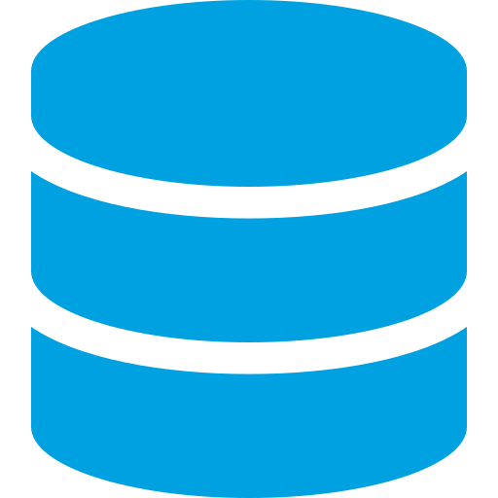
Objects and Fields
Field Name
Type
Description
Complaint ID
Auto Number
Unique identifier
Complaint Name
Text
Short title
Description
Long Text
Full complaint details
Complaint
Object
Priority
Picklist
High / Medium / Low
Status
Picklist
Open / In Progress / Closed
Resolution Notes
Long Text
Notes from resolution
Complaint Management System | Salesforce

Slide 10


Reports & Dashboard
Reports
Dashboard
High: 35%
KPI
Med: 45%
Low: 20%
High
Med
Low
High Priority Complaints Report
✓ Better monitoring
Tracks volume by priority level for quick escalation decisions
✓ Data analysis
✓ Quick identification
Complaint Management System | Salesforce

Slide 11
Conclusion
1
Developed a complete Salesforce-based complaint management solution
2
Implemented Apex automation for smart, priority-driven email notifications
3
Gained practical experience in Salesforce development and CRM architecture
Future Scope
Approval Process — Structured multi-level approval workflows for complaint escalations.
Advanced Analytics
— Predictive insights and trend analysis for proactive service improvements.
Thank You | Sudharsan A | Salesforce CMS Project

