Slide 1
TITLE : IPL Data Analysis Project NAME: M.SUDHARSANAN

Slide 2
Introduction
This project focuses on analyzing IPL cricket match data.
The dataset contains detailed information about teams, players, and match outcomes.
Objective: To build predictive models to analyze IPL outcomes and player performance.

Slide 3
Data Understanding
The dataset includes columns like:
- Match_ID
- Team1, Team2
- Toss Winner
- Match Winner
- Player of the Match
- Venue
Sample data gives insight into match results and performance metrics.

Slide 4
Data Cleaning
Steps Taken:
- Removed missing/null values
- Encoded categorical features (e.g., team names)
- Removed duplicates and inconsistent entries

Slide 5
Exploratory Data Analysis (EDA)
Key Visualizations:
- Match wins per team
- Toss impact on match outcome
- Player of the match analysis
Insights:
- Teams winning toss have slight advantage
- Top players dominate player of the match awards

Slide 6
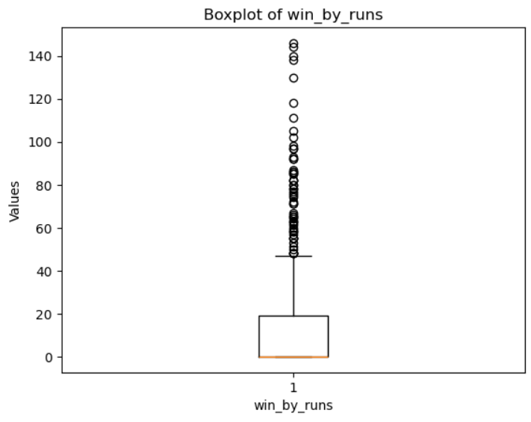
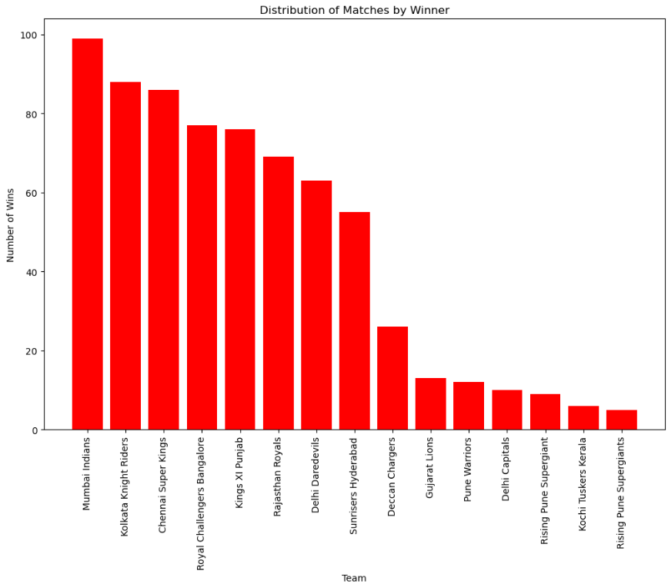
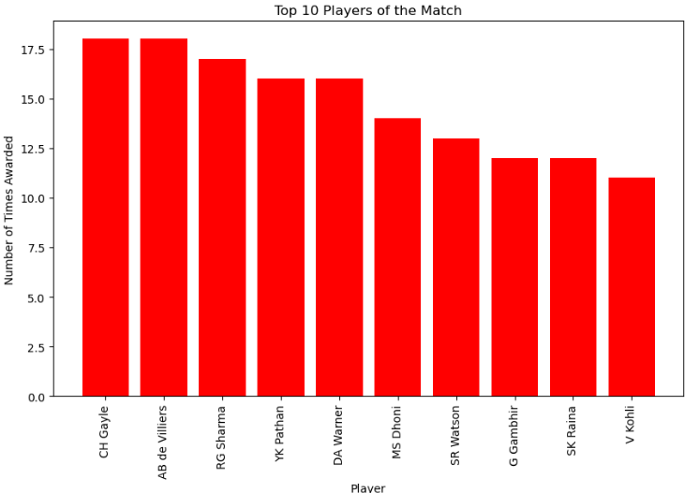
BOX PLOT:

Slide 7
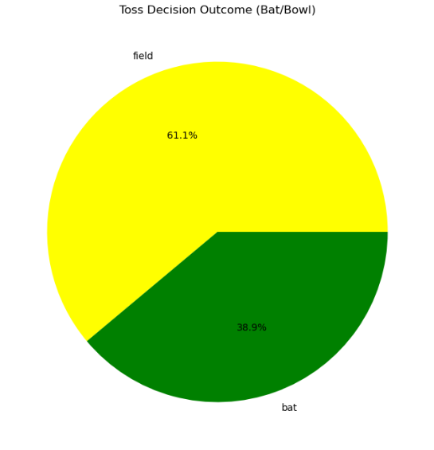
PIE CHART:

Slide 8
Modeling Process
Models Used:
- Logistic Regression
- K-Nearest Neighbors (KNN)
- Support Vector Machine (SVM)
Hyperparameter Tuning:
- Used Grid Search CV for tuning
Evaluation Metrics:
- Accuracy, Precision, Recall

Slide 9
Model Comparison
Comparison of Model Performance:
- Logistic Regression: Accuracy 76%
- KNN: Accuracy 72%
- SVM: Accuracy 78%
Best Model: SVM
Justification: Highest accuracy with balanced precision and recall

Slide 10
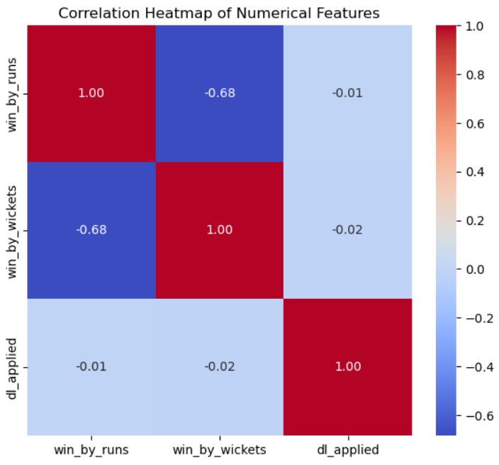
HEATMAP:

Slide 11
Conclusion
Future Improvements:
- Include player stats for deeper analysis
- Integrate more recent match data
Potential Next Steps:
- Build a real-time match predictor
- Deploy as a web app

