Slide 1
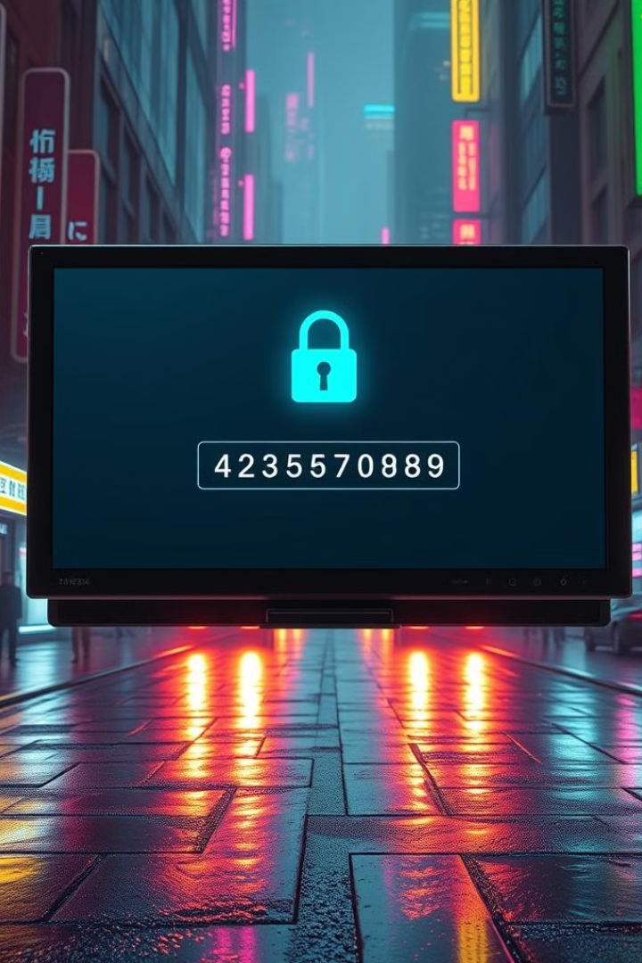
Password Validator
M.Sudharsanan
Submission Date:22/10/2024

Slide 2
AIM OF THE PROJECT
To create a secure and user-friendly tool that ensures users choose strong and complex passwords. The program validates passwords based on key criteria like length, use of uppercase and lowercase letters, digits, and special characters. It provides detailed feedback to help users improve their password strength while implementing robust error handling and exception handling to maintain a seamless experience. Additionally, it is designed with scalability in mind, allowing for future enhancements like blacklist checks and password history management.

Slide 3
Project Objective
1
Strong Passwords
The goal is to ensure that users create strong and secure passwords. A strong password typically includes a mix of
uppercase and lowercase letters, numbers, and special characters, making it harder for unauthorized
access through guessing or brute-force attacks.
2
User Feedback
This involves providing users with immediate and clear feedback about the strength of their passwords.
For instance, the program could indicate if a password is "weak," "moderate," or "strong,"
helping users understand what improvements are needed for better security.
3
Enhanced Security
This objective aims to enforce specific password rules and align with security standards.
This could include requirements for minimum password length, complexity, and the avoidance
of common words or easily guessable patterns, thus increasing overall system security.

Slide 4
Problem Statement
Weak Passwords
Weak passwords are a significant vulnerability that can lead to digital security breaches. Simple or predictable passwords make it easier for attackers to gain unauthorized access, posing a risk to user accounts and sensitive data.
Easy to Guess
Many users tend to create simple and easy-to-guess passwords, like "123456" or "password." Such passwords are vulnerable to brute-force attacks and guessing attempts, making accounts less secure.
Security Risks
Due to the prevalence of weak and guessable passwords, there's a need for a more robust system to enhance security. A password validation mechanism can enforce stronger password standards, thus reducing risks associated with poor password practices.

Slide 5
Project Overview
Python-based Validator
This project is built using Python and employs regular expressions to assess the strength of passwords.
Regular expressions are a powerful tool for pattern matching, allowing the validator to efficiently check if a
password meets certain criteria, such as length and character variety.
Key Features
Length Validation: The validator checks if the password meets a minimum length requirement, essential for creating strong passwords.
Character Type Checks: The system ensures that passwords include a mix of uppercase letters, lowercase letters, digits, and special characters, contributing to overall password strength.
Feedback: Users receive immediate feedback on the validity and strength of their passwords, enabling them to make necessary adjustments before final submission.
Error Handling: The validator includes error handling mechanisms to catch and manage errors gracefully. This ensures that users are informed of input mistakes without crashing the program.
Exception Handling: By utilizing exception handling, the validator can manage unexpected situations, such as invalid input formats or system errors, enhancing the robustness and reliability of the application.
\

Slide 6
Main Functionalities
1
Length Check
Minimum length requirement of 8 characters
2
Uppercase & Lowercase Letters
Verifies presence of both upper and lower case letters
3
Digit Requirement
At least one number required in the password
4
Special Character Check
Ensures inclusion of at least one special character

Slide 7



Additional Functionalities
Strength Rating
Rates passwords as Weak, Medium, or Strong
Detailed Feedback
Provides specific error messages if the password fails criteria
Secure Input
Uses getpass to hide password input

Slide 8



Input Handling & Error Handling
Password Input
Criteria Checks
Clear Feedback
The validator is designed to accept
various types of passwords, allowing
users to input passwords of different
lengths and character combinations.
This flexibility caters to diverse user
needs and preferences.
Each password is rigorously evaluated against multiple criteria, including minimum length requirements, the inclusion of uppercase and lowercase letters, digits, special characters, and the avoidance of common or easily guessable passwords.
The system provides specific error messages and constructive suggestions when a password does not meet the criteria. This clear feedback helps users understand what adjustments are needed to create a stronger password.

Slide 9
Code Implementation
The code defines a Password Validator class that assesses the strength of a user-provided password based on criteria such as minimum length, uppercase and lowercase letters, digits, and special characters. It uses a validate() method to manage validation and exceptions, while the internal _validate_password() method performs the checks and provides feedback. The overall password strength is categorized by the _determine_strength(score) method. User input is securely captured using the getpass module. The results, including strength assessments and suggestions, are printed to assist users in creating secure passwords.

Slide 10
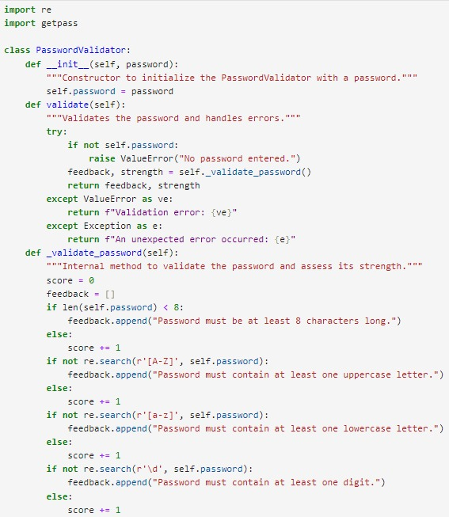
Code Implementation

Slide 11
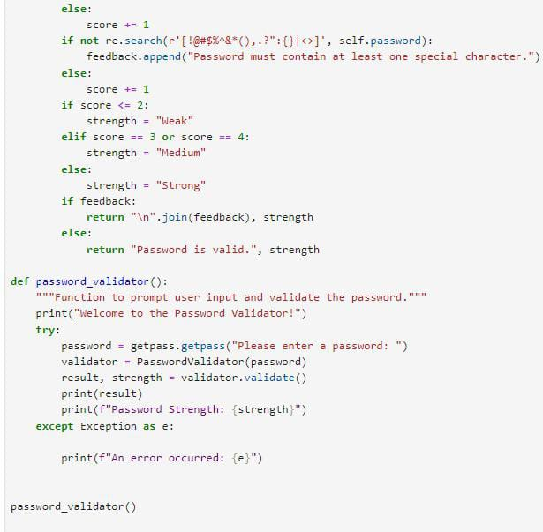
Code Implementation

Slide 12
Project Results & Outcome
1
Password Enforcement
Enforces password rules, improving password strength
2
User Feedback
Provides valuable feedback to improve password quality
3
Enhanced Security
Contributes to improved password security for users

Slide 13
Key Points & Future Improvements
Key Points
Future Improvements
The password validation program enhances security
by ensuring strong, complex passwords through
object-oriented design and clear user feedback.
With robust exception handling, it offers a scalable
and user-friendly solution that can adapt to changing
security needs.
Future enhancements include implementing password history checks and blacklisting common passwords, along with real-time feedback and customizable password policies. These updates aim to further strengthen security and provide a more seamless user experience.

Slide 14
Thank You

