Slide 1

Java Full Stack Web Development
KAYAM SUDHARSHAN REDDY 24302A040005
Under the Guidance of
Ms. I.Sravani
Assistant Professor,CSE
Department of Computer Science and Engineering
School of Computing
Mohan Babu University
Sree Sainath Nagar, A. Rangampet, Tirupati – 517 102
2026-2027

Slide 2
Table of Contents
Internship Completion Certificate
Abstract
Introduction
3.1 Description of the Company
3.2 Overview of the Project
3.3 Technology Stack
Summary of Experience
Reflection on Learning
Conclusion

Slide 3
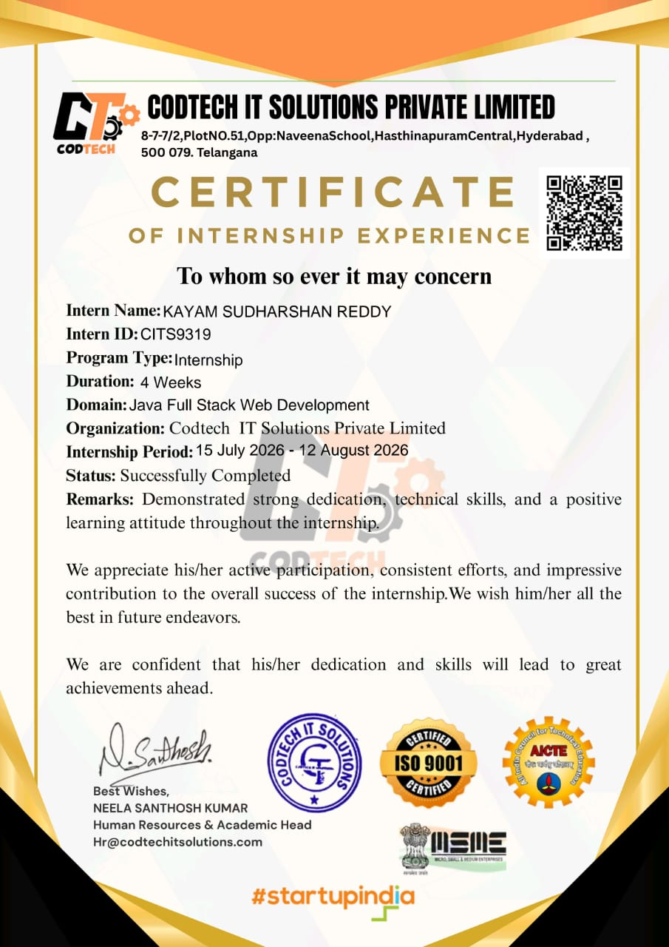
1. Internship Completion Certificate

Slide 4
2. Abstract
The four-week internship in Java Full Stack Web Development at CodTech IT Solutions Private Limited was conducted from 15 July 2026 to 12 August 2026. It focused on designing and implementing an enterprise-style web application using Java and modern web technologies.
The learning scope included Core Java and object-oriented programming, Spring Boot, RESTful APIs, Spring Data JPA/Hibernate, relational database design, frontend development, Git/GitHub, Maven, and API testing with Postman.
The internship provided practical exposure to multi-tier application architecture, frontend-backend integration, data persistence, debugging, testing, and structured software development practices.
4
Weeks
120
Hours
6
Learning objectives met
4.7 / 5
Performance: Excellent

Slide 5
3 Introduction
Internship Title
Java Full Stack Web Development
Learning Objectives
LO1
Understand Software Development
Organization
CodTech IT Solutions Private Limited, Telangana, India
LO2
Explore Full-Stack Technologies
LO3
Apply Programming Concepts
Duration
4 Weeks | 240 Hours
LO4
Understand Application Architecture
LO5
Understand Application Architecture
Industry Guide
Internship focus: Enterprise Java Full Stack Web Application
LO6
Perform Software Testing

Slide 6
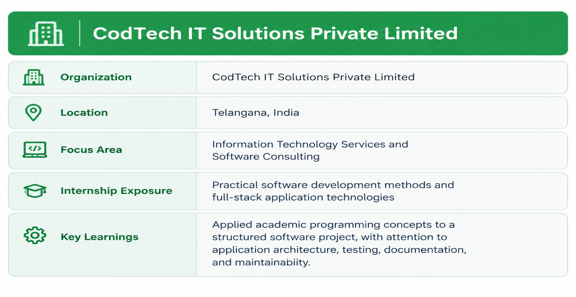
3.1 Description of the Company
CodTech IT Solutions Private Limited is an information technology services and software consulting organization based in Telangana, India. The internship offered exposure to practical software development methods and full-stack application technologies.
The internship emphasized applying academic programming concepts to a structured software project, with attention to application architecture, testing, documentation, and maintainability.

Slide 7
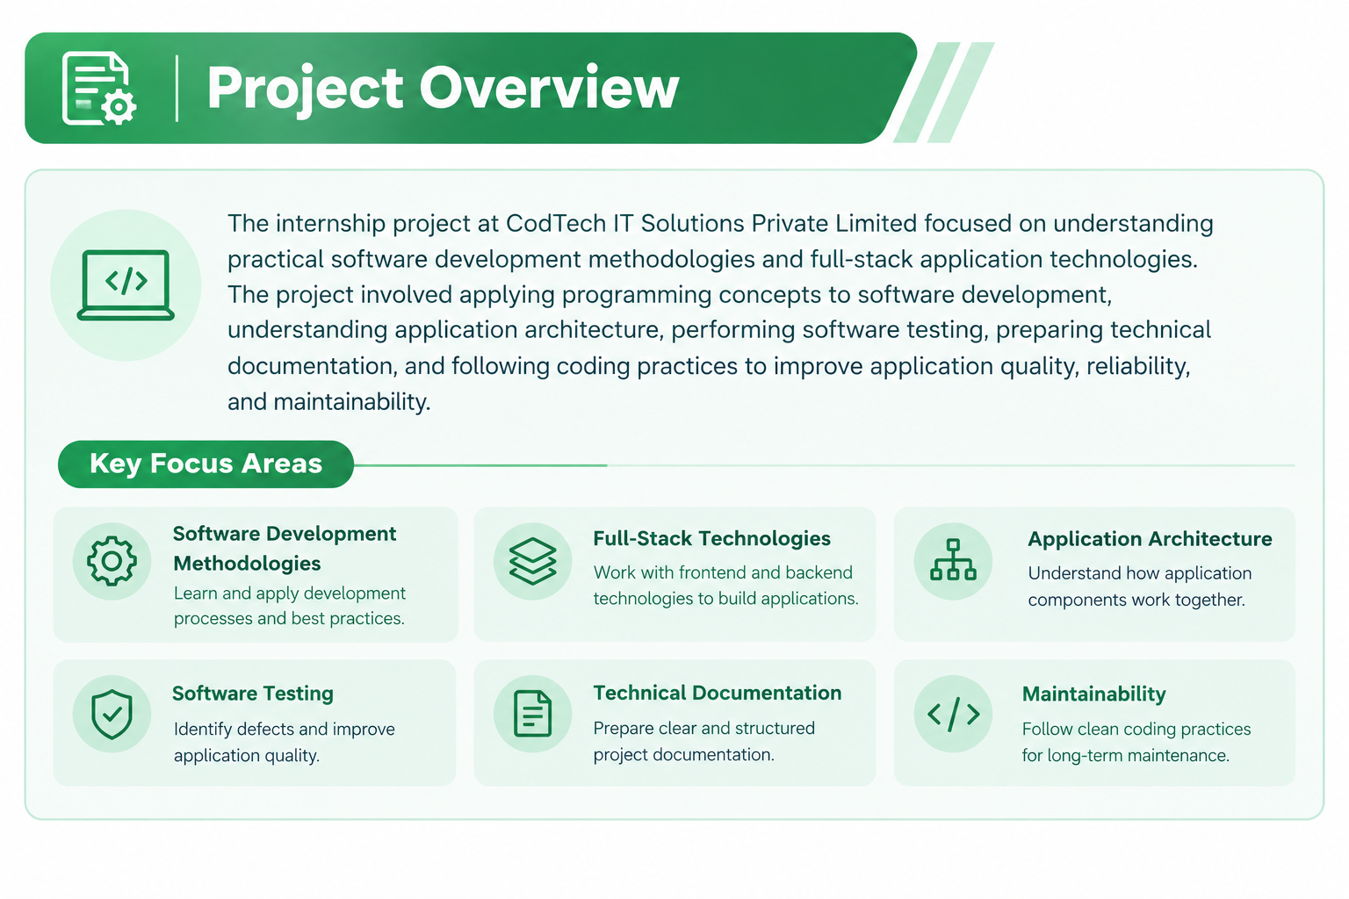
3.2 Overview of the Project
Project focus: Design and Implementation of an Enterprise Java Full Stack Web Application, using a layered architecture to separate the user interface, backend business logic, and database persistence.
Multi-tier
Architecture
REST API
Integration
End-to-end
Application Flow

Slide 8
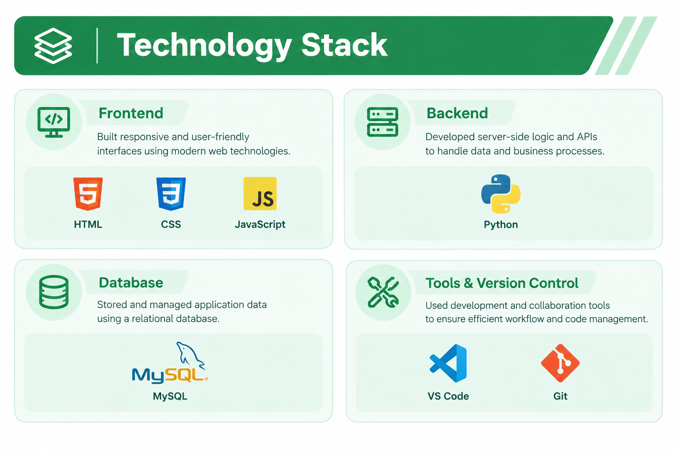
3.3 Technology Stack

Slide 9
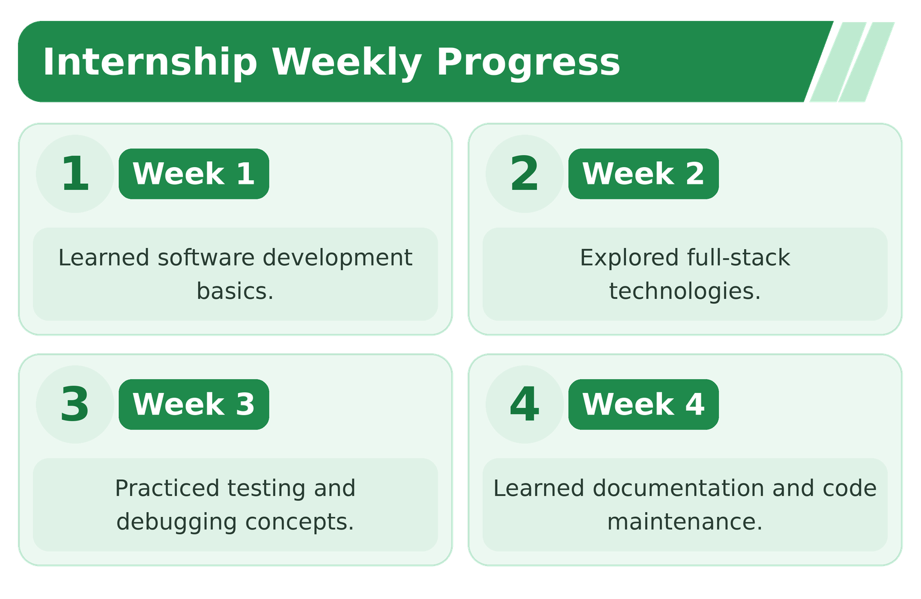
4. Summary of Experience
A four-week learning journey through Java full-stack development:

Slide 10
4. Summary of Experience – Key Results
Core Java
OOP concepts, collections and exception handling
REST APIs
Spring Boot controllers and HTTP methods
Persistence
JPA/Hibernate and relational database mapping
Testing & Build
Postman validation and Maven packaging
60%
Model size reduction
TFLite, <2% accuracy loss
>90%
Test coverage
AI Smart Assistant

Slide 11
5. Reflection on Learning
Technical Skills
Java full-stack development — Core Java, Spring Boot, REST APIs, JPA/Hibernate, database design, and frontend integration.
Managerial Skills
Worked through weekly milestones, task prioritization, iterative development, and project packaging.
Communication
Improved technical documentation, API testing, debugging, and explaining application flow.
Teamwork
Practiced Git/GitHub version control, structured coding, and integration across frontend, backend, and database layers.
Work Environment
Well-equipped R&D lab, daily stand-ups and weekly reviews, strong culture of learning.
Professional Growth
Confidence to explain AI to technical and non-technical audiences.

Slide 12
5. Reflection – Technology Practices Observed
1
Structured Software Development
Observed the importance of following a systematic software development lifecycle.
2
Full-Stack Technologies
Understood how frontend and backend technologies work together to build applications.
3
Code Quality and Standards:
earned the importance of writing clean, reusable, and maintainable code.
4
Software Testing and Debugging
Recognized the role of testing and debugging in identifying errors and improving application reliability.
5
Documentation and Collaboration
Understood the importance of technical documentation, version control, and teamwork in software projects.

Slide 13
6. Conclusion
The four-week Java Full Stack Web Development internship connected academic concepts with practical software engineering workflows.
The project covered Java, Spring Boot, RESTful APIs, relational database persistence, frontend integration, and application testing.
Problem-solving, debugging, documentation, version control, and iterative development practices were strengthened.
The experience provides a foundation for further learning and future projects in enterprise application and full-stack software development.
Thank You

