Slide 1
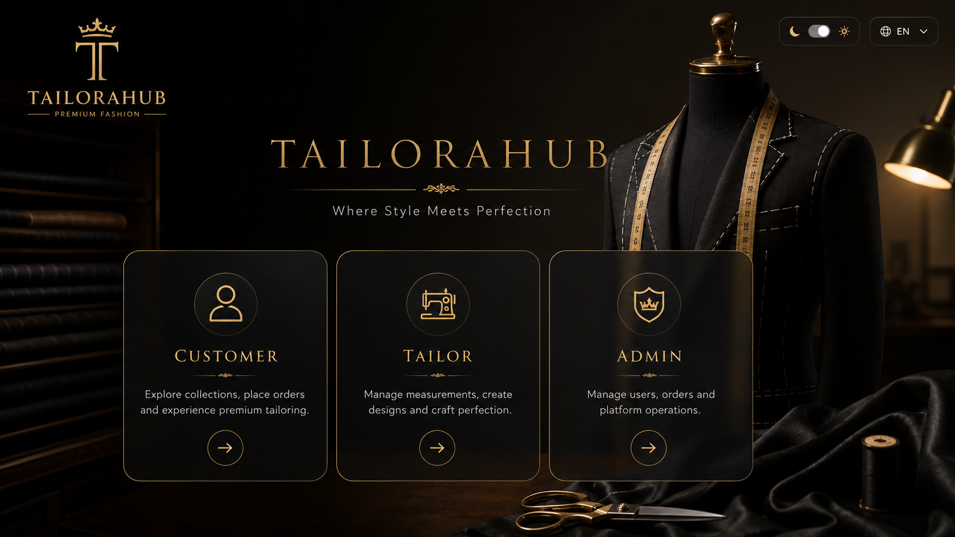
TAILORAHUB
A trusted operating system for custom tailoring
Funding proposal and pilot approval deck | 14 August 2026
3
AWS
OTP
Role-specific dashboards
Production path live
Payment-gated handover
01

Slide 2
INVESTMENT THESIS
TailoraHub turns informal tailoring into a governed digital service.
The product is not only a booking screen: it is a trusted system for discovery, location, payment, tracking, fulfillment, reviews, and platform finance.
Customers
Tailors
Admins
Find nearby verified tailors, compare services/prices, book with exact location, track orders, pay, confirm handover, and review.
Operate profile, availability, services, media, offers, followers, requests, queue, orders, wallet, and withdrawals.
Approve, manage, audit, resolve disputes, monitor finance, configure platform settings, and manage referral trees.
Trust infrastructure
Operational control
Monetization readiness
02

Slide 3
PROBLEM
Custom tailoring has high demand, but low digital trust.
Customers and tailors still rely on calls, memory, manual status messages, unclear pricing, and informal payment/fulfillment handover.
Discovery
Verification
Coordination
Payments
Operations
Hard to find reliable nearby specialists.
No consistent approval, profile, or review trail.
Measurement, stitching, and delivery statuses are not structured.
No protected payment-before-handover gate.
Admins lack finance, dispute, and audit controls.
Sources: IBEF textile industry overview; NPCI UPI product statistics; Udyam Registration portal.
03

Slide 4
PLATFORM MAP
Three dashboards connect through one transaction core.
Each role has separate permissions and workflows, while every booking moves through the same trusted order, payment, OTP, and review spine.
TailoraHub core
Customer app
Auth + RBAC Booking engine Tracker + OTP Wallet ledger Finance settings
Tailor app
Search, book, pay, OTP, feedback
Services, orders, wallet, offers
Admin console
Approvals, disputes, finance, audit
04

Slide 5
CUSTOMER JOURNEY
Discovery-to-delivery is built as a guided trust loop.
The customer can see profile proof, exact location, tracker stages, payment state, delivery OTP, and final feedback after completion.
1
2
3
4
5
6
7
8
Search
Profile
Book
Map pin
Tracker
Pay
OTP
Feedback
Strict gate
Customer control
Location accuracy
Delivery OTP is generated only after payment_status == paid.
Feedback appears only after completion.
Booking-specific draggable pin.
05

Slide 6
TAILOR OPERATING SYSTEM
Tailors get a digital storefront plus a daily workbench.
The system gives tailors demand visibility and operational discipline without forcing them into a complex enterprise tool.
Profile and media
Availability
Services/pricing
DP, cover, photos, videos, public proof
Available, few slots, busy, unavailable
Blouse, shirt, pant, saree, combo, custom
Orders and queue
Wallet
Followers/offers
Requests, waiting list, tracker updates
QR token, balance, withdrawals with OTP
In-app updates for customers who follow
06

Slide 7
GOVERNANCE
The admin console makes the marketplace governable from day one.
Funding does not only buy software screens; it funds the control layer needed to operate safely at scale.
Approvals
Finance
Risk
Growth
Tailor approval before public listing; customer/tailor management; role controls.
Commission, GST/platform fee settings, admin wallet, transaction log, date filters.
Disputes, complaints, support, audit trails, operational escalation.
Referral trees, follower activity, offers, ratings, and pilot KPIs.
07

Slide 8
TRUST SYSTEM
Payment-before-OTP protects both customer and tailor.
The delivery OTP flow is server-enforced, so it cannot be bypassed by changing the frontend.
Ready
Pay
OTP
Verify
Close
Order reaches ready_for_delivery
Customer pays in-app
Backend sends delivery OTP
Tailor verifies at handover
Order becomes completed
After completion
Auditability
Tracker/OTP/update actions disappear from the tailor dashboard; customer can submit optional rating and feedback.
Payment, OTP, stage updates, disputes, and wallet movements remain traceable.
08

Slide 9
MAPS AND LOCATION
Rapido-style pin confirmation removes address ambiguity.
Tailor location is fixed and customer home location is booking-specific, which keeps privacy and delivery accuracy in balance.
Tailor fixed location
Stored once with controlled update flow; shared after booking.
PIN
Customer home location
Captured per booking only when tailor visits customer.
API protection
Google key restricted by authorized website referrers.
09

Slide 10
MONETIZATION
Revenue is built into the transaction workflow, not bolted on later.
Admin-configurable percentages create a transparent finance engine for each completed order.
Tailor commission
GST/platform charge
Growth levers
Deducted from tailor wallet after completed delivery based on platform settings.
Shown to the customer at payment time and logged separately in admin wallet transactions.
Premium profiles, featured offers, referral campaigns, boutique partnerships.
100%
Ledger
Reviews
Referrals
Settings-driven finance
Traceable wallet flow
Quality flywheel
Low-cost acquisition
10

Slide 11
TECHNOLOGY
The current deployment path is practical and investor-review ready.
The build is separated by concern: React frontend, FastAPI backend, PostgreSQL database, HTTPS, and cloud-managed deployment surfaces.
React
FastAPI
PostgreSQL
AWS
Customer, tailor, admin dashboards
RBAC APIs, OTP, booking, finance, wallet
Users, orders, wallets, referrals, feedback
Amplify + EC2/Nginx + RDS + HTTPS
Security posture
Secrets outside code, HTTPS API, restricted Maps key, role-separated endpoints, OTP purpose separation, server-side payment gate.
11

Slide 12
PILOT GTM
A city pilot can prove supply quality before broad acquisition spend.
The strongest first wedge is a curated group of verified tailors with portfolio media, prices, availability, and first-order support.
Onboard
Activate
Convert
Retain
Verify and train tailors
Profiles, media, services, offers
Search, maps, booking, payment
Feedback, follow, referral, repeat
Measure
Improve
Scale
Orders/tailor, completion rate, on-time rate, ratings
Support scripts, UI refinements, operational rules
Area-by-area rollout and partner ecosystem
12

Slide 13
FUNDING USE
Funding should move the product from working pilot to reliable operation.
The ask is phased so officials can release support against concrete technical and operating milestones.
0-30 days Hardening
31-90 days Closed pilot
3-6 months Market launch
6-12 months Scale
QA, security, deployment, backups, logs
Tailor onboarding, first paid orders, support desk
Referral campaigns, reviews, offers, admin reporting
Partner network, mobile packaging, premium monetization
13

Slide 14
DECISION
Approve the funded pilot and turn TailoraHub into a repeatable local-commerce platform.
The project has the core software foundation. The next step is funded execution: harden, pilot, measure, and expand.
Approve
Launch
Measure
Phased funding envelope, pilot geography, operational owner, and integration budget.
Verified tailor group, customer acquisition, support playbook, and admin operating cadence.
Bookings, paid completions, ratings, repeat rate, disputes, wallet flow, commission.
tailorahub.com | api.tailorahub.com
Sources: IBEF textile industry overview; NPCI UPI product statistics; Udyam Registration portal.
14

