Slide 1
[ TITLE LOGO ]
Wells Fargo + Mphasis
The Next Applied
(drop logo here)
Accelerating Mainframe Modernization with Devin
Plastic Issuance & Settlement — an autonomous build-and-migrate demo
Wells Fargo + Mphasis · The Next Applied
[ LOGO ]
Wells Fargo + Mphasis
The Next Applied
(drop logo here)

Slide 2
Agenda
1
What Devin is and how its delivery loop works
2
Why Devin is more efficient than autocomplete assistants
3
Valuable Devin capabilities
4
How we apply them to this migration
5
The demo application architecture
6
Act 1 — build the mainframe app
7
Act 2 — migrate to .NET + React + PostgreSQL
8
Business-language prompting, precautions & safe shortcuts
9
Demo runbook
Accelerating Mainframe Modernization with Devin
2
[ LOGO ]

Slide 3
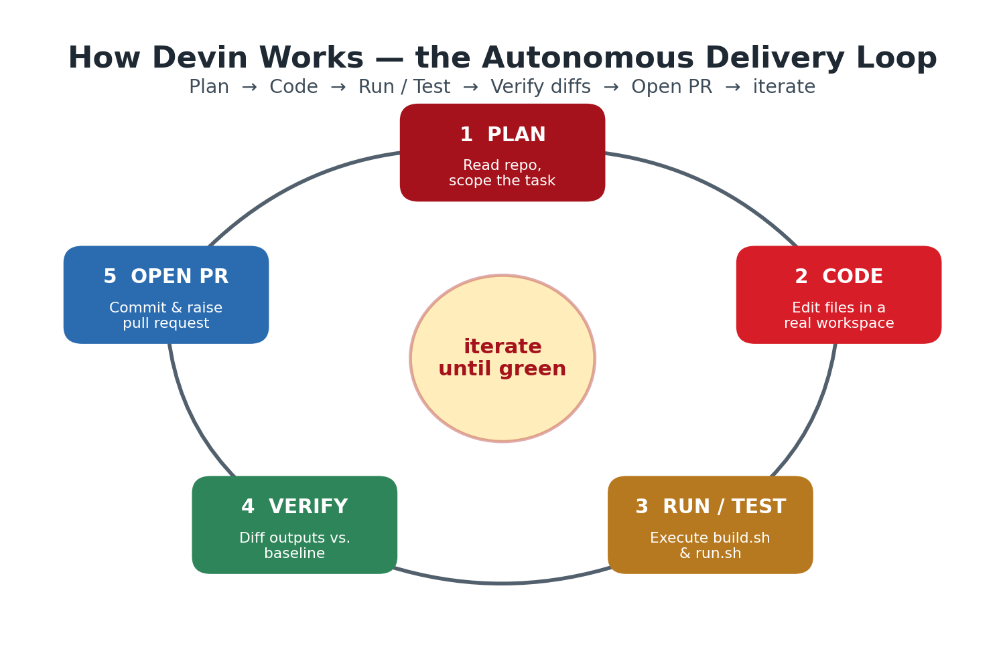
What Is Devin?
Devin is an autonomous AI software engineer: give it a goal and it plans, writes and runs code on its own machine, verifies the results, and opens a pull request — iterating until the work is correct.
Accelerating Mainframe Modernization with Devin
3
[ LOGO ]

Slide 4
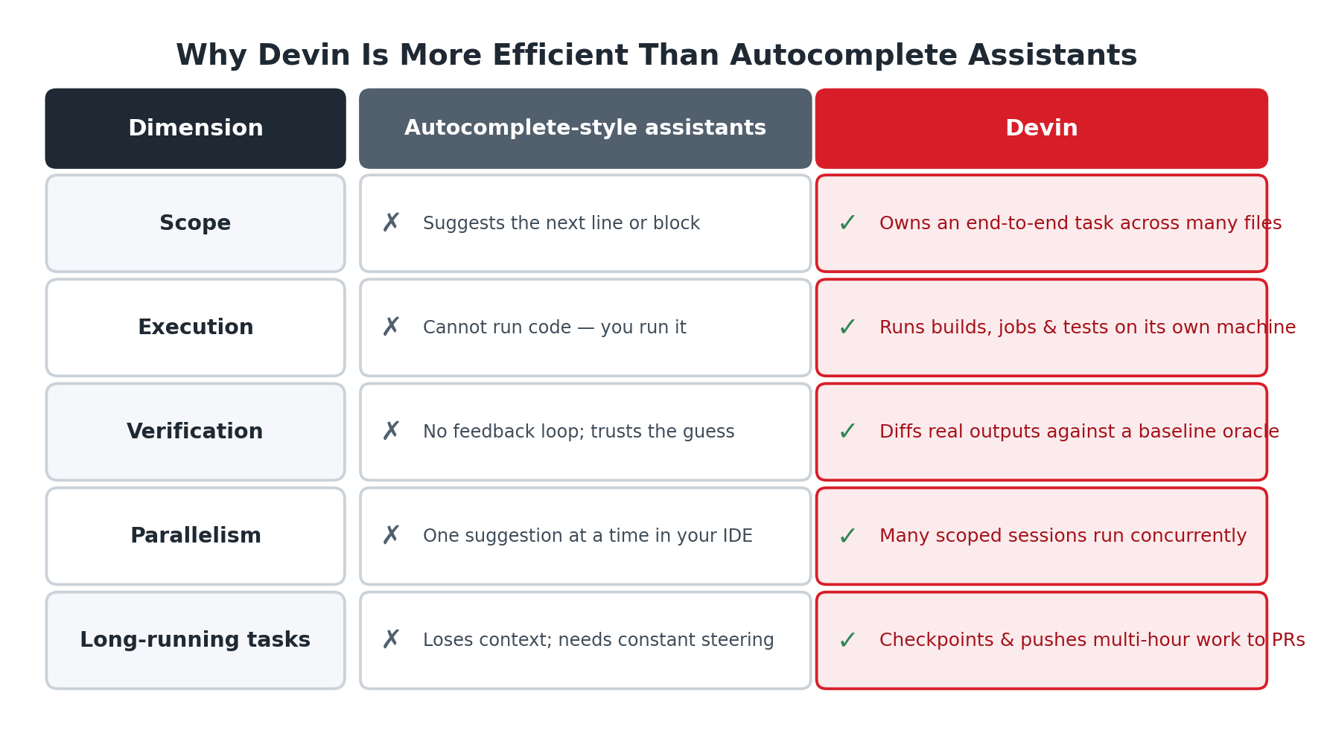
Why Devin Is More Efficient
■ Owns whole tasks, not just the next line
■ Runs, tests and verifies its own work
■ Closes the loop by diffing real outputs
■ Runs many scoped sessions in parallel
Accelerating Mainframe Modernization with Devin
4
[ LOGO ]

Slide 5
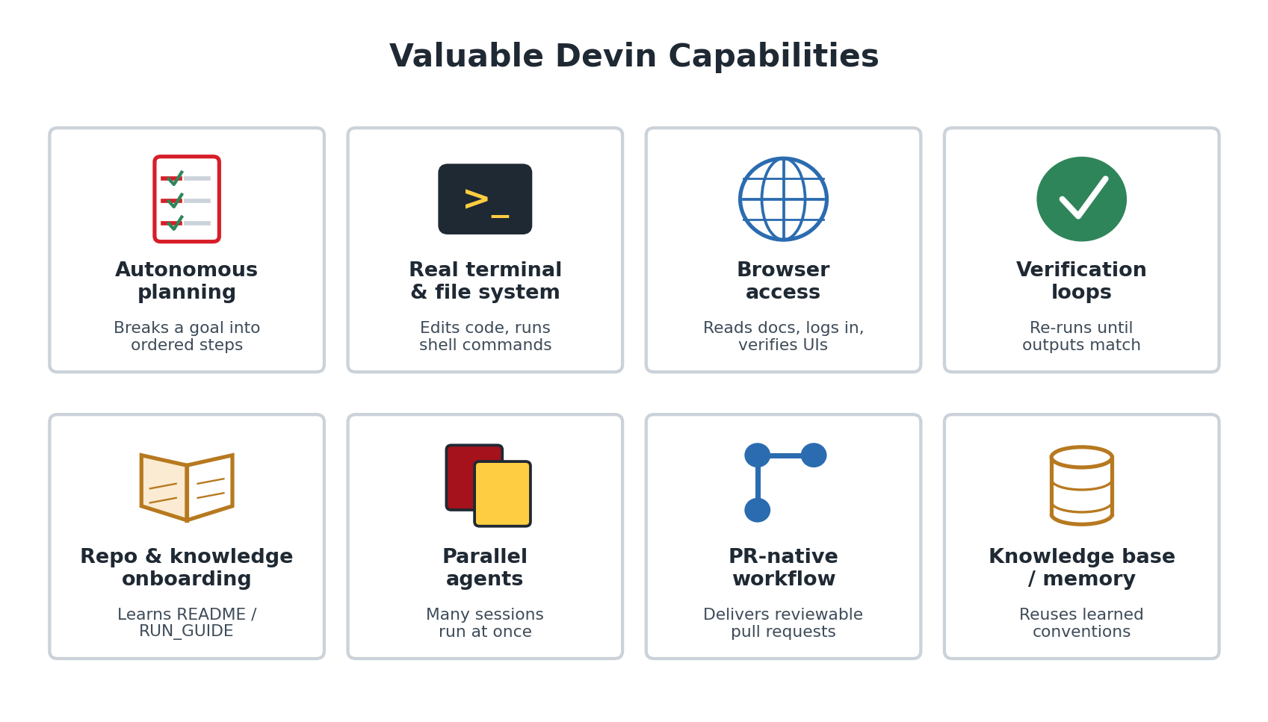
Valuable Devin Capabilities
Accelerating Mainframe Modernization with Devin
5
[ LOGO ]

Slide 6
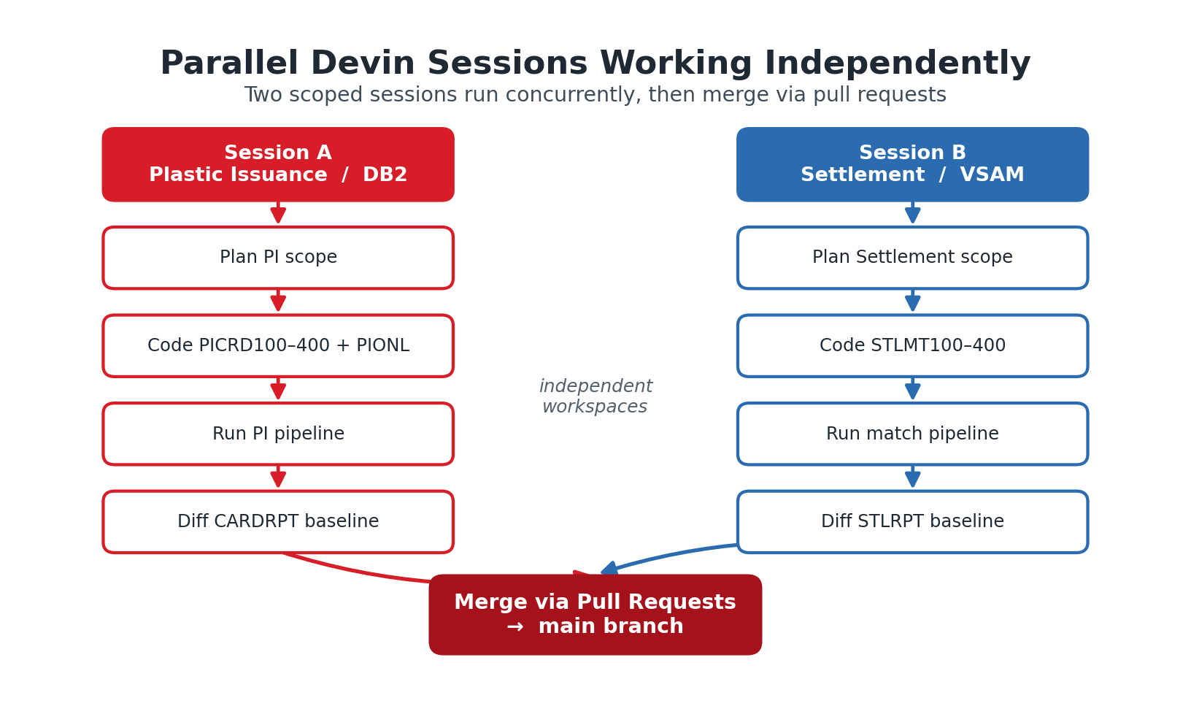
How We Use These Features Here
■ Scoped sessions per program area (PI vs. Settlement)
■ Verification via LOCAL/run.sh output diffs
■ Knowledge onboarding from README.md & DOC/RUN_GUIDE.md
■ Parallel PI and Settlement sessions
■ Copybook → DTO automation
■ CI acts as the regression oracle
Accelerating Mainframe Modernization with Devin
6
[ LOGO ]

Slide 7
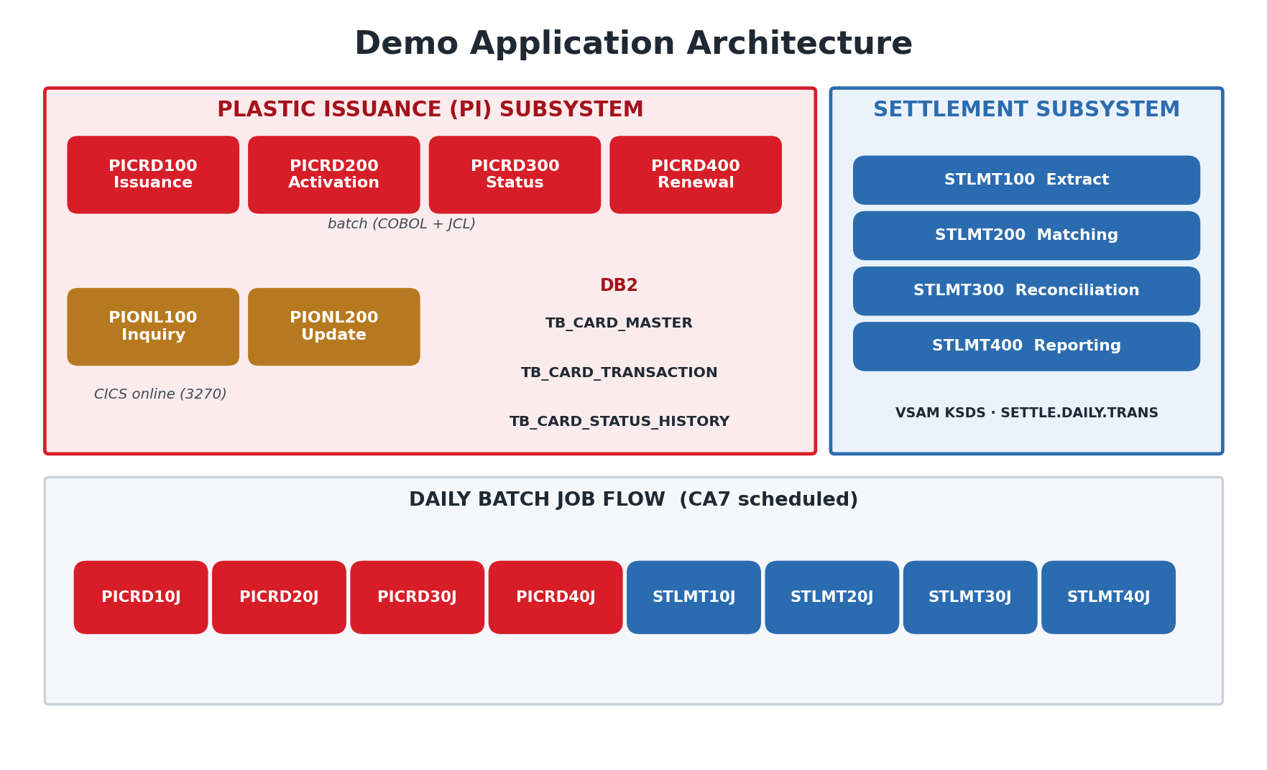
Demo Application Architecture
Accelerating Mainframe Modernization with Devin
7
[ LOGO ]

Slide 8
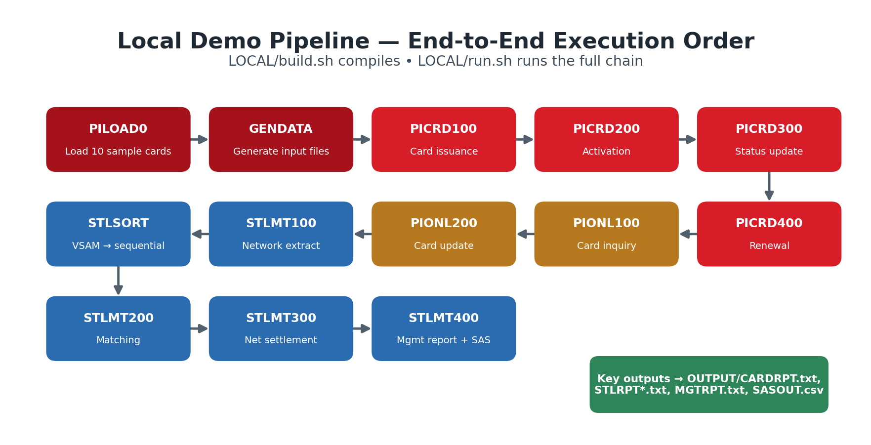
Act 1 — Build the Mainframe App
Devin builds and runs the full pipeline locally
Accelerating Mainframe Modernization with Devin
8
[ LOGO ]

Slide 9
Act 2 — Data Store → PostgreSQL + .NET
Exact decimal precision — no float/double drift
MAINFRAME
MODERN
■ DB2 relational tables
■ VSAM KSDS files
■ Packed-decimal money fields
■ Fixed record layouts
■ .NET data services
■ PostgreSQL
■ DECIMAL columns (exact to the cent)
■ Row-count & total verification vs. source
Precaution: amounts stored as DECIMAL, never float/double. Devin reconciles row counts and totals to the cent after migration.
Accelerating Mainframe Modernization with Devin
9
[ LOGO ]

Slide 10
Act 2 — Batch Job → .NET Background Service
Prove output equivalence line-for-line
MAINFRAME
MODERN
■ COBOL batch programs
■ JCL job steps & COND codes
■ SYSOUT reports
■ Sequential read-process-write
■ .NET background services
■ Same validation & rejection rules
■ Same summary reports
■ Outputs diffed against baseline
The existing OUTPUT/*.txt reports are the reference oracle: the new service must reproduce them exactly on the same input.
Accelerating Mainframe Modernization with Devin
10
[ LOGO ]

Slide 11
Act 2 — CICS Green Screen → REST + React
Stateless APIs · Wells Fargo-themed UI
MAINFRAME
MODERN
[ LOGO ]
Card Inquiry
■ CICS 3270 green screens
■ Pseudo-conversational COMMAREA state
■ Stateless REST endpoints
■ React screens on a shared theme
Card Number
4000 12** **** 0017
Customer
J. RIVERA
Card Type
Debit
STATUS
ACTIVE
Submit
■ React screens are built from a shared Wells Fargo design system / component library (ThemeProvider, AppHeader with logo, Button/Card/Table/StatusBadge)
■ Status shown as coloured badges: green = Active, red = Blocked, grey = Closed
Accelerating Mainframe Modernization with Devin
11
[ LOGO ]

Slide 12
Act 2 — Settlement → Service + Dashboard
Wells Fargo-themed reconciliation dashboard
MAINFRAME
MODERN
[ LOGO ]
Settlement Reconciliation Dashboard
■ Batch matching over VSAM
■ Easytrieve / SAS reports
■ Per-network reconciliation totals
■ .NET settlement service
■ React dashboard
■ Same matched/disputed/unmatched totals
Matched
Disputed
Unmatched
18,204
126
342
Network
Matched
Disputed
Unmatched
VISA
9,880
54
121
MC
6,102
48
150
STAR
2,222
24
71
Matched / disputed / unmatched totals per network must equal today's reconciliation output before the legacy job is retired.
Accelerating Mainframe Modernization with Devin
12
[ LOGO ]

Slide 13
Business-Language Prompting
Plain functional prompts — no code or file names
Business-language prompt | Why it works
A · Issue cards with an industry-standard card-number checksum; reject-and-report bad records, don't fail the run. | Points at Luhn without naming it; captures batch resilience.
A · Match daily settlement into matched / disputed / unmatched, efficiently for large files. | Yields the sorted-merge algorithm and per-network totals.
B · Migrate one business area at a time, run in parallel, prove equivalence; rules unchanged. | Sets a safe, verifiable incremental strategy.
B · Store money exactly — no floating point; verify totals to the cent. | Locks in decimal precision as an acceptance test.
B · Build a reusable Wells Fargo React design system first (theme, header, badges). | Every screen inherits one brand-accurate look.
Accelerating Mainframe Modernization with Devin
13
[ LOGO ]

Slide 14
Precautions
$
=
Money & decimal precision
Fixed-width file offsets
Stateless APIs
Job-failure dependency gating
Parallel-run reconciliation
Use exact DECIMAL; never float/double.
Preserve byte positions when parsing records.
No hidden session state between screens.
Never run a step if the prior one failed.
Compare old vs. new outputs before cutover.
Accelerating Mainframe Modernization with Devin
14
[ LOGO ]

Slide 15
Safe Shortcuts & Automations
Local pipeline as CI regression oracle
LOCAL/build.sh + run.sh give a laptop-runnable baseline; wire it into CI so every change is diffed against known-good outputs.
Layout-to-DTO generation
Turn fixed-width record layouts into typed DTOs automatically — preserving field offsets and decimal scale.
Schedule dependency-graph extraction
Read the batch schedule and derive the success-gated dependency graph the orchestration must preserve.
Accelerating Mainframe Modernization with Devin
15
[ LOGO ]

Slide 16
Demo Runbook
Exact commands for the local end-to-end demo
1 Build all programs
$ cd LOCAL && bash build.sh
2 Run the full pipeline
$ cd LOCAL && bash run.sh
3 Inspect key outputs
$ ls OUTPUT/ # CARDRPT.txt, STLRPT*.txt, MGTRPT.txt, SASOUT.csv
4 Prove equivalence (old vs. new)
$ diff OUTPUT/CARDRPT.txt NEW/OUTPUT/CARDRPT.txt
Accelerating Mainframe Modernization with Devin
16
[ LOGO ]

Slide 17
Thank You
Questions & Discussion
[ LOGO ]
Wells Fargo + Mphasis
The Next Applied
(drop logo here)
Wells Fargo + Mphasis · The Next Applied

