Slide 1
Additional Topics
Refer
Chapter 16 of the text book
Raghu Ramakrishnan’s book
Notes:
The slides for this text are organized into several modules. Each lecture contains about enough material for a 1.25 hour class period. (The time estimate is very approximate--it will vary with the instructor, and lectures also differ in length; so use this as a rough guideline.) This covers Lecture 1A in Module (6); it is a 1-lecture overview of the material, and is an alternative to Lectures 1 through 4 in this module, which provide more detailed coverage. Note that the text contains enough material for an even more detailed treatment than Lectures 1 through 4, e.g., view serializability, B-tree CC, non-locking approaches.)
Module (1): Introduction (DBMS, Relational Model)
Module (2): Storage and File Organizations (Disks, Buffering, Indexes)
Module (3): Database Concepts (Relational Queries, DDL/ICs, Views and Security)
Module (4): Relational Implementation (Query Evaluation, Optimization)
Module (5): Database Design (ER Model, Normalization, Physical Design, Tuning)
Module (6): Transaction Processing (Concurrency Control, Recovery)
Module (7): Advanced Topics

Slide 2
Unsophisticated users (Customers,
Travel agents)
Sophisticated users, application
Programmers, DB Administrators
Application Front Ends
Web Forms
SQL Interface
SQL COMMANDS
Plan Executer
Parser
Query
Evaluation
Egine
Operator Evaluator
Optimizer
Transaction
Manager
Files and Access Methods
Recovery
Manager
Lock
Manager
Buffer Manager
Concurrency Control
Disk Space Manager
Architecture
Of
DBMS
Index Files
System Catalog
Data Files

Slide 3
Outline
Parallel Databases
Distributed Databases
Object-database systems
Deductive database systems
Data warehousing and decision support
Data mining
Information Retrieval and XML data
Spatial data management
Other topics:
  Advanced transaction processing,
  Mobile databases
  Main Memory databases
  Multimedia databases
  GIS
  Temporal databases
  Biological databases
  Information visualization

Slide 4
Parallel databases
Why Parallel Access To Data?
At 10 MB/s
1.2 days to scan
1,000 x parallel
1.5 minute to scan.
1 Terabyte
Bandwidth
1 Terabyte
10 MB/s
Parallelism:
divide a big problem
into many smaller ones
to be solved in parallel.
Notes:
56

Slide 5
Parallel DBMS: Intro
Parallelism is natural to DBMS processing
  Pipeline parallelism: many machines each doing one step in a multi-step process.
  Partition parallelism: many machines doing the same thing to different pieces of data.
  Both are natural in DBMS!
Any
Any
Sequential
Sequential
Pipeline
Program
Program
Sequential
Any
Any
Partition
Sequential
Sequential
Sequential
Sequential
Sequential
Program
Program
outputs split N ways, inputs merge M ways

Slide 6
DBMS: The || Success Story
DBMSs are the most (only?) successful application of parallelism.
  Teradata, Tandem vs. Thinking Machines, KSR..
  Every major DBMS vendor has some || server
  Workstation manufacturers now depend on || DB server sales.
Reasons for success:
  Bulk-processing (= partition ||-ism).
  Natural pipelining.
  Inexpensive hardware can do the trick!
  Users/app-programmers don’t need to think in ||
Notes:
55

Slide 7
Some || Terminology
Ideal
Xact/sec.
(throughput)
Speed-Up
  More resources means proportionally less time for given amount of data.
Scale-Up
  If resources increased in proportion to increase in data size, time is constant.
degree of ||-ism
Ideal
sec./Xact
(response time)
degree of ||-ism

Slide 8
Architecture Issue: Shared What?
Shared Memory
(SMP)
Shared Disk
Shared Nothing
(network)
CLIENTS
CLIENTS
CLIENTS
Processors
Memory
Easy to program
Expensive to build
Difficult to scaleup
Hard to program
Cheap to build
Easy to scaleup
Sequent, SGI, Sun
VMScluster, Sysplex
Tandem, Teradata, SP2
Notes:
101

Slide 9
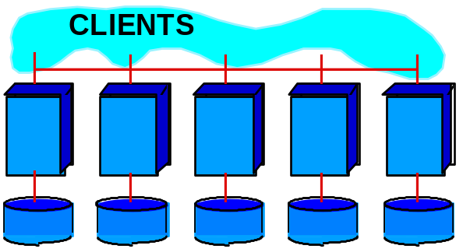

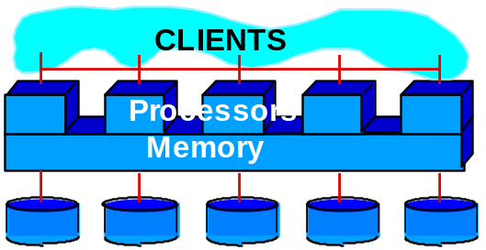
What Systems Work This Way
(as of 9/1995)
Shared Nothing
  Teradata: 400 nodes
  Tandem: 110 nodes
  IBM / SP2 / DB2: 128 nodes
  Informix/SP2 48 nodes
  ATT & Sybase ? nodes
Shared Disk
  Oracle 170 nodes
  DEC Rdb 24 nodes
Shared Memory
  Informix 9 nodes
  RedBrick ? nodes
Notes:
102

Slide 10
Different Types of DBMS ||-ism
Intra-operator parallelism
  get all machines working to compute a given operation (scan, sort, join)
Inter-operator parallelism
  each operator may run concurrently on a different site (exploits pipelining)
Inter-query parallelism
  different queries run on different sites

Slide 11
Parallelizing Individual Operations
Bulk loading
Parallel scanning
Parallel Sorting
Joins:
  Parallel Nested loop join
  Parallel Sort merge join
  Parallel Hash join
Parallel query optimization
Transaction logging and concurrency control
is additional issue

Slide 12
Outline
Parallel Databases
Distributed Databases
Object-database systems
Deductive database systems
Data warehousing and decision support
Data mining
Information Retrieval and XML data
Spatial data management
Other topics:
  Advanced transaction processing,
  Mobile databases
  Main Memory databases
  Multimedia databases
  GIS
  Temporal databases
  Biological databases
  Information visualization

Slide 13
Introduction to distributed database system
Data is stored at several sites, each managed by a DBMS that can run independently.
Distributed Data Independence: Users should not have to know where data is located (extends Physical and Logical Data Independence principles).
Distributed Transaction Atomicity: Users should be able to write Xacts accessing multiple sites just like local Xacts.

Slide 14
Recent Trends
Users have to be aware of where data is located, i.e., Distributed Data Independence and Distributed Transaction Atomicity are not supported.
These properties are hard to support efficiently.
For globally distributed sites, these properties may not even be desirable due to administrative overheads of making location of data transparent.

Slide 15



Types of Distributed Databases
Homogeneous: Every site runs same type of DBMS.
Heterogeneous: Different sites run different DBMSs (different RDBMSs or even non-relational DBMSs).
Gateway
DBMS1
DBMS2
DBMS3

Slide 16
Distributed DBMS Architectures
  QUERY
Client-Server
Client ships query
to single site. All query
processing at server.
- Thin vs. fat clients.
- Set-oriented
communication,
client side caching.
CLIENT
CLIENT
SERVER
SERVER
SERVER
SERVER
Collaborating-Server
SERVER
Query can span multiple
sites.
SERVER
  QUERY
Middleware

Slide 17
Storing Data
TID
t1
t2
t3
t4
Fragmentation
  Horizontal: Usually disjoint.
  Vertical: Lossless-join; tids.
Replication
  Gives increased availability.
  Faster query evaluation.
  Synchronous vs. Asynchronous.
    Vary in how current copies are.
R1
R3
SITE A
SITE B
R1
R2

Slide 18
DDBMS topics
Distributed catalog management
Distributed query processing
  Semi-joins, Bloomjoins (bitvector is shipped)
Distributed query optimization
  Cost-based optimization (Include communication cost)
Updating/transaction processing on distributed data
  Synchronous replication: all copies are updated together
  Asynchronous replication: only primary copy is updated secondary copies are updated later.
Distributed concurrency control
  Centralized
  Primary copy
  Fully distribued
  Distributed deadlock
Distributed recovery
  Two-phase commit/three phase commit

Slide 19
Outline
Parallel Databases
Distributed Databases
Object-database systems
Deductive database systems
Data warehousing and decision support
Data mining
Information Retrieval and XML data
Spatial data management
Other topics:
  Advanced transaction processing,
  Mobile databases
  Main Memory databases
  Multimedia databases
  GIS
  Temporal databases
  Biological databases
  Information visualization

Slide 20
Object Database Systems
Relational database model (integers, dates and string data types) is inadequate for several applications
  CAD/CAM, multimedia, document management
So, DBMS should support for complex data types.
Object-database systems have developed along two district lines.
  Object-oriented database systems
    Object Database Management Group has developed a standard data model (ODM) and object query language (OQL)
  Object-relational database systems
    Extend relational database systems to support complex data types
    Provide as a bridge between relational and object oriented paradigms.
    SQL:1999 standard incorporates support for object-relational model of data.
    Storing and retrieving of BLOOBs

Slide 21
New Data Types
User-defined data types
Inheritance
Object Identity

Slide 22
Outline
Parallel Databases
Distributed Databases
Object-database systems
Deductive database systems
Data warehousing and decision support
Data mining
Information Retrieval and XML data
Spatial data management
Other topics:
  Advanced transaction processing,
  Mobile databases
  Main Memory databases
  Multimedia databases
  GIS
  Temporal databases
  Biological databases
  Information visualization

Slide 23
Motivation
SQL-92 cannot express some queries:
  Are we running low on any parts needed to build a ZX600 sports car?
  What is the total component and assembly cost to build a ZX600 at today's part prices?
Can we extend the query language to cover such queries?
  Yes, by adding recursion.

Slide 24
Datalog
SQL queries can be read as follows:
“If some tuples exist in the From tables that satisfy the Where conditions,
then the Select tuple is in the answer.”
Datalog is a query language that has the same if-then flavor:
  New: The answer table can appear in the From clause, i.e., be defined recursively.
  Prolog style syntax is commonly used.

Slide 25
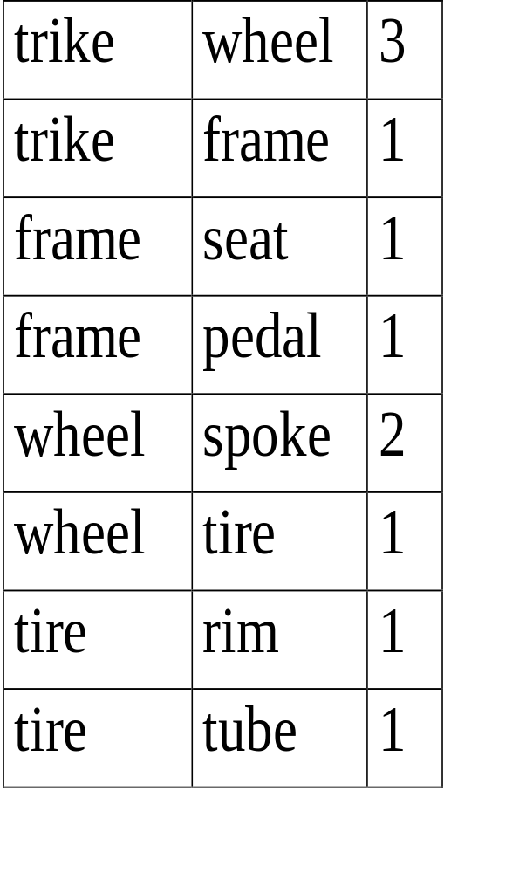
Example
trike
3
1
subpart
number
part
wheel frame
2
1
1
1
spoke tire seat pedal
1
1
rim tube
Find the components of a trike?
We can write a relational algebra query to compute the answer on the given instance of Assembly.
But there is no R.A. (or SQL-92) query that computes the answer on all Assembly instances.
Assembly instance

Slide 26
The Problem with R.A. and SQL-92
Intuitively, we must join Assembly with itself to deduce that trike contains spoke and tire.
  Takes us one level down Assembly hierarchy.
  To find components that are one level deeper (e.g., rim), need another join.
  To find all components, need as many joins as there are levels in the given instance!
For any relational algebra expression, we can create an Assembly instance for which some answers are not computed by including more levels than the number of joins in the expression!

Slide 27
A Datalog Query that Does the Job
Comp(Part, Subpt) :- Assembly(Part, Subpt, Qty).
Comp(Part, Subpt) :- Assembly(Part, Part2, Qty),
Comp(Part2, Subpt).
head of rule
implication
body of rule
Can read the second rule as follows:
“For all values of Part, Subpt and Qty,
if there is a tuple (Part, Part2, Qty) in Assembly
and a tuple (Part2, Subpt) in Comp,
then there must be a tuple (Part, Subpt) in Comp.”

Slide 28
Outline
Parallel Databases
Distributed Databases
Object-database systems
Deductive database systems
Data warehousing and decision support
Data mining
Information Retrieval and XML data
Spatial data management
Other topics:
  Advanced transaction processing,
  Mobile databases
  Main Memory databases
  Multimedia databases
  GIS
  Temporal databases
  Biological databases
  Information visualization

Slide 29
Introduction
Increasingly, organizations are analyzing current and historical data to identify useful patterns and support business strategies.
Emphasis is on complex, interactive, exploratory analysis of very large datasets created by integrating data from across all parts of an enterprise; data is fairly static.
  Contrast such On-Line Analytic Processing (OLAP) with traditional On-line Transaction Processing (OLTP): mostly long queries, instead of short update Xacts.

Slide 30
Three Complementary Trends
Data Warehousing: Consolidate data from many sources in one large repository.
  Loading, periodic synchronization of replicas.
  Semantic integration.
OLAP:
  Complex SQL queries and views.
  Queries based on spreadsheet-style operations and “multidimensional” view of data.
  Interactive and “online” queries.
Data Mining: Exploratory search for interesting trends and anomalies. (Another lecture!)

Slide 31
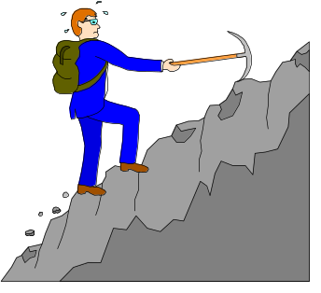
Data Warehousing
EXTERNAL DATA
SOURCES
Integrated data spanning long time periods, often augmented with summary information.
Several gigabytes to terabytes common.
Interactive response times expected for complex queries; ad-hoc updates uncommon.
EXTRACT
TRANSFORM
LOAD
REFRESH
Metadata
Repository
DATA
WAREHOUSE
SUPPORTS
DATA
MINING
OLAP

Slide 32
Warehousing Issues
Semantic Integration: When getting data from multiple sources, must eliminate mismatches, e.g., different currencies, schemas.
Heterogeneous Sources: Must access data from a variety of source formats and repositories.
  Replication capabilities can be exploited here.
Load, Refresh, Purge: Must load data, periodically refresh it, and purge too-old data.
Metadata Management: Must keep track of source, loading time, and other information for all data in the warehouse.

Slide 33
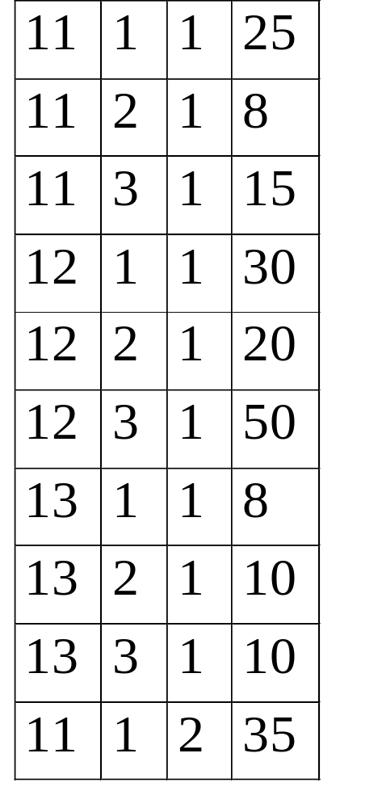
Multidimensional Data Model: Data cube
timeid
locid
pid
sales
Collection of numeric measures, which depend on a set of dimensions.
  E.g., measure Sales, dimensions Product (key: pid), Location (locid), and Time (timeid).
Slice locid=1
is shown:
8 10 10
pid
11 12 13
30 20 50
25 8 15
locid
1 2 3
timeid

Slide 34
MOLAP vs ROLAP
Multidimensional data can be stored physically in a (disk-resident, persistent) array; called MOLAP systems. Alternatively, can store as a relation; called ROLAP systems.
The main relation, which relates dimensions to a measure, is called the fact table. Each dimension can have additional attributes and an associated dimension table.
  E.g., Products(pid, pname, category, price)
  Fact tables are much larger than dimensional tables.

Slide 35
OLAP Queries
Drill-down: The inverse of roll-up.
  E.g., Given total sales by state, can drill-down to get total sales by city.
  E.g., Can also drill-down on different dimension to get total sales by product for each state.
Pivoting: Aggregation on selected dimensions.
  E.g., Pivoting on Location and Time yields this cross-tabulation:
WI CA Total
1995
63 81 144
Slicing and Dicing: Equality
and range selections on one
or more dimensions.
1996
38 107 145
1997
75 35 110
Total
176 223 339

Slide 36
Summary
Decision support is an emerging, rapidly growing subarea of databases.
Involves the creation of large, consolidated data repositories called data warehouses.
Warehouses exploited using sophisticated analysis techniques: complex SQL queries and OLAP “multidimensional” queries (influenced by both SQL and spreadsheets).
New techniques for database design, indexing, view maintenance, and interactive querying need to be supported.

Slide 37
Outline
Parallel Databases
Distributed Databases
Object-database systems
Deductive database systems
Data warehousing and decision support
Data mining
Information Retrieval and XML data
Spatial data management
Other topics:
  Advanced transaction processing,
  Mobile databases
  Main Memory databases
  Multimedia databases
  GIS
  Temporal databases
  Biological databases
  Information visualization

Slide 38
Definition
Data mining is the exploration and analysis of large quantities of data in order to discover valid, novel, potentially useful, and ultimately understandable patterns in data.
Valid: The patterns hold in general.
Novel: We did not know the pattern beforehand.
Useful: We can devise actions from the patterns.
Understandable: We can interpret and comprehend the patterns.

Slide 39
Why Use Data Mining Today?
Human analysis skills are inadequate:
  Volume and dimensionality of the data
  High data growth rate
Availability of:
  Data
  Storage
  Computational power
  Off-the-shelf software
  Expertise

Slide 40
An Abundance of Data
Supermarket scanners, POS data
Preferred customer cards
Credit card transactions
Direct mail response
Call center records
ATM machines
Demographic data
Sensor networks
Cameras
Web server logs
Customer web site trails

Slide 41
Evolution of Database Technology
1960s: IMS, network model
1970s: The relational data model, first relational DBMS implementations
1980s: Maturing RDBMS, application-specific DBMS, (spatial data, scientific data, image data, etc.), OODBMS
1990s: Mature, high-performance RDBMS technology, parallel DBMS, terabyte data warehouses, object-relational DBMS, middleware and web technology
2000s: High availability, zero-administration, seamless integration into business processes
2010: Sensor database systems, databases on embedded systems, P2P database systems, large-scale pub/sub systems, ???

Slide 42
Much Commercial Support
Many data mining tools
  http://www.kdnuggets.com/software
Database systems with data mining support
Visualization tools
Data mining process support
Consultants

Slide 43
Why Use Data Mining Today?
Competitive pressure!
“The secret of success is to know something that nobody else knows.”
Aristotle Onassis
Competition on service, not only on price (Banks, phone companies, hotel chains, rental car companies)
Personalization, CRM
The real-time enterprise
“Systemic listening”
Security, homeland defense

Slide 44
The Knowledge Discovery Process
Steps:
Identify business problem
Data mining
Action
Evaluation and measurement
Deployment and integration into businesses processes

Slide 45
Preprocessing and Mining
Knowledge
Patterns
Preprocessed
Data
Target
Data
Interpretation
Model
Construction
Original Data
Preprocessing
Data
Integration
and Selection

Slide 46
Data Mining Techniques
Supervised learning
  Classification and regression
Unsupervised learning
  Clustering
Dependency modeling
  Associations, summarization, causality
Outlier and deviation detection
Trend analysis and change detection

Slide 47
Outline
Parallel Databases
Distributed Databases
Object-database systems
Deductive database systems
Data warehousing and decision support
Data mining
Information Retrieval and XML data
Spatial data management
Other topics:
  Advanced transaction processing,
  Mobile databases
  Main Memory databases
  Multimedia databases
  GIS
  Temporal databases
  Biological databases
  Information visualization

Slide 48
Introduction
1940
  We have vast amount of text information
  Speedy access is becoming difficult
  Relevant information gets ignored
    Duplication of work and effort
  IR is simple: library
    Given the store of the documents and person formulates a question
    The answer is a set of documents satisfying the information need expressed by his question
    Solution: Read all the documents in the store and retain the relevant documents and discard all the others.
    However, where is the Time ?
Notes:
The growth of the Web implies the crawling problem. Generic crawler suffers from above mentioned Web changes.
In 1999 the biggest crawlers covered only 30-40% of the Web

Slide 49
Introduction
After the advent of computers
  Many thought that computers will read the entire document collection to extract the relevant documents
    Storing the documents is easy
  But, reading like human is difficult
      Attempt to duplicate the human with software process.
Why
  Reading by human being involves attempting to extract information both syntactic and semantic and using it to determine the relevance of the document.
  Knowing to extract information is not sufficient.
  But, we should know how to use it to decide relevance.
    Slow progress in modern linguistics
    Machine translation
Notes:
The growth of the Web implies the crawling problem. Generic crawler suffers from above mentioned Web changes.
In 1999 the biggest crawlers covered only 30-40% of the Web

Slide 50
Introduction
Important notion in IR
  Retrieve all the relevant documents; at the same time retrieve as few of the non-relevant as possible.
Intellectually it is possible for a human to establish the relevance of a document to a query.
For a computer to do this, we need to construct a model within which relevant decisions can be quantified.
Research in IR
  Model building to identify relevant documents
Notes:
The growth of the Web implies the crawling problem. Generic crawler suffers from above mentioned Web changes.
In 1999 the biggest crawlers covered only 30-40% of the Web

Slide 51
Information Retrieval System
An information retrieval system does not inform (I.e., change the knowledge of) the user on the subject of his inquiry. It merely informs on the existence (or non existence) and whereabouts of documents relating to his request.
Distinguishing properties of data retrieval (DBMS) and information retrieval
 | Data Retrieval | Information Retrieval
Matching | Exact match | Partial match, best match
Inference | Deduction | Induction
Model | Deterministic | Probabilistic
Classification | Monothetic | Polythetic
Query language | Artificial | Natural
Query specification | Complete | Incomplete
Items wanted | Matching | Relevant
Error response | Sensitive | Insensitive
Notes:
The growth of the Web implies the crawling problem. Generic crawler suffers from above mentioned Web changes.
In 1999 the biggest crawlers covered only 30-40% of the Web

Slide 52
Introduction to Semistructured Data and XML
Notes:
The slides for this book are organized by chapter. This lecture covers material
from Chapter 27, but goes well beyond it in depth of coverage.

Slide 53
How the Web is Today
HTML documents
  often generated by applications
  consumed by humans only
  easy access: across platforms, across organizations
No application interoperability:
  HTML not understood by applications
    screen scraping brittle
  Database technology: client-server
    still vendor specific

Slide 54
New Universal Data Exchange Format: XML
A recommendation from the W3C
XML = data
XML generated by applications
XML consumed by applications
Easy access: across platforms, organizations

Slide 55
Paradigm Shift on the Web
From documents (HTML) to data (XML)
From information retrieval to data management
For databases, also a paradigm shift:
  from relational model to semistructured data
  from data processing to data/query translation
  from storage to transport

Slide 56
Semistructured Data
Origins:
Integration of heterogeneous sources
Data sources with non-rigid structure
  Biological data
  Web data

Slide 57
The Semistructured Data Model
Bib
Object Exchange
Model (OEM)
&o1
complex object
paper
paper
book
references
&o12
&o24
&o29
references
references
author
year
author
author
page
title
http
author
title
publisher
title
author
author
&o43
&96
&25
1997
firstname
last
lastname
firstname
lastname
first
&243
&206
“Serge”
“Abiteboul”
“Victor”
“Vianu”
122
133
atomic object

Slide 58
Syntax for Semistructured Data
Bib: &o1 { paper: &o12 { … },
book: &o24 { … },
paper: &o29
{ author: &o52 “Abiteboul”,
author: &o96 { firstname: &243 “Victor”,
lastname: &o206 “Vianu”},
title: &o93 “Regular path queries with constraints”,
references: &o12,
references: &o24,
pages: &o25 { first: &o64 122, last: &o92 133}
}
}
Observe: Nested tuples, set-values, oids!

Slide 59
Syntax for Semistructured Data
May omit oids:
{ paper: { author: “Abiteboul”,
author: { firstname: “Victor”,
lastname: “Vianu”},
title: “Regular path queries …”,
page: { first: 122, last: 133 }
}
}

Slide 60
Characteristics of Semistructured Data
Missing or additional attributes
Multiple attributes
Different types in different objects
Heterogeneous collections
Self-describing, irregular data, no a priori structure

Slide 61
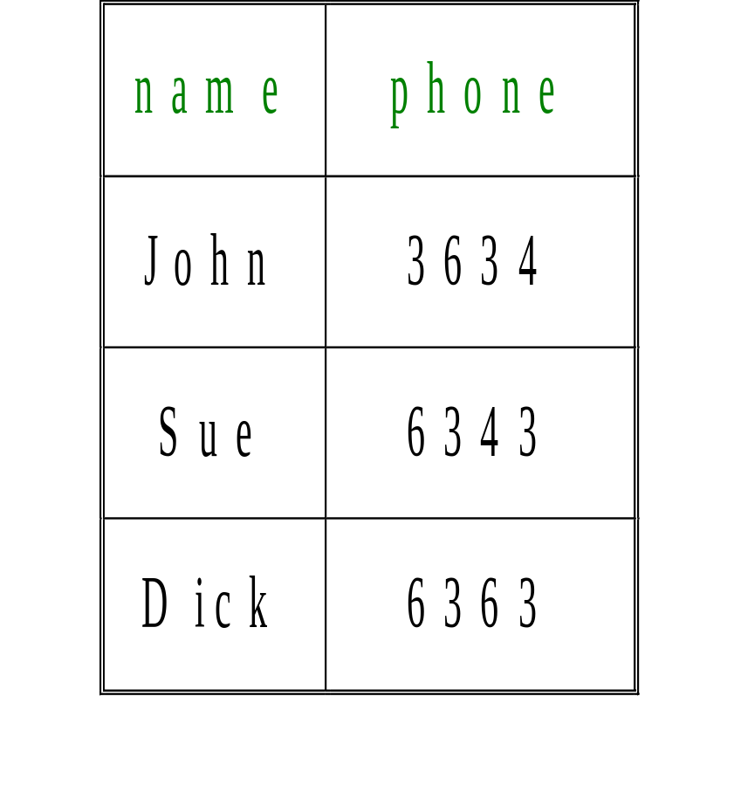
Comparison with Relational Data
row
row
row
name
phone
name
phone
name
phone
“John”
3634
“Sue”
6343
“Dick”
6363
{ row: { name: “John”, phone: 3634 },
row: { name: “Sue”, phone: 6343 },
row: { name: “Dick”, phone: 6363 }
}

Slide 62

XML
A W3C standard to complement HTML
Origins: Structured text SGML
  Large-scale electronic publishing
  Data exchange on the web
Motivation:
  HTML describes presentation
  XML describes content
http://www.w3.org/TR/2000/REC-xml-20001006 (version 2, 10/2000)

Slide 63
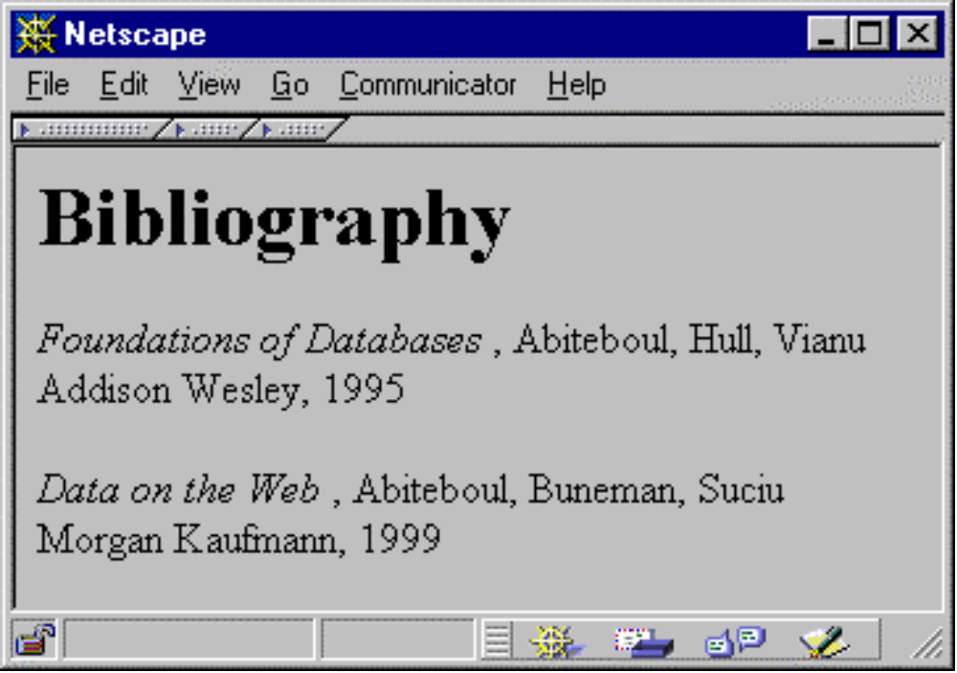
From HTML to XML
HTML describes the presentation

Slide 64
HTML
<h1> Bibliography </h1>
<p> <i> Foundations of Databases </i>
Abiteboul, Hull, Vianu
<br> Addison Wesley, 1995
<p> <i> Data on the Web </i>
Abiteboul, Buneman, Suciu
<br> Morgan Kaufmann, 1999

Slide 65
XML
<bibliography>
  <book> <title> Foundations… </title>
  <author> Abiteboul </author>
  <author> Hull </author>
  <author> Vianu </author>
  <publisher> Addison Wesley </publisher>
  <year> 1995 </year>
  </book>
  …
</bibliography>
XML describes the content

Slide 66
Why are we DB’ers interested?
It’s data.
Proof by Google:
  database+XML – 1,940,000 pages.
Database issues:
  How are we going to model XML? (graphs).
  How are we going to query XML? (XQuery)
  How are we going to store XML (in a relational database? object-oriented? native?)
  How are we going to process XML efficiently? (many interesting research questions!)

Slide 67
Outline
Parallel Databases
Distributed Databases
Object-database systems
Deductive database systems
Data warehousing and decision support
Data mining
Information Retrieval and XML data
Spatial data management
Other topics:
  Advanced transaction processing,
  Mobile databases
  Main Memory databases
  Multimedia databases
  GIS
  Temporal databases
  Biological databases
  Information visualization

Slide 68
Types of Spatial Data
Point Data
  Points in a multidimensional space
  E.g., Raster data such as satellite imagery, where each pixel stores a measured value
  E.g., Feature vectors extracted from text
Region Data
  Objects have spatial extent with location and boundary
  DB typically uses geometric approximations constructed using line segments, polygons, etc., called vector data.

Slide 69
Types of Spatial Queries
Spatial Range Queries
  Find all cities within 50 miles of Madison
  Query has associated region (location, boundary)
  Answer includes ovelapping or contained data regions
Nearest-Neighbor Queries
  Find the 10 cities nearest to Madison
  Results must be ordered by proximity
Spatial Join Queries
  Find all cities near a lake
  Expensive, join condition involves regions and proximity

Slide 70
Applications of Spatial Data
Geographic Information Systems (GIS)
  E.g., ESRI’s ArcInfo; OpenGIS Consortium
  Geospatial information
  All classes of spatial queries and data are common
Computer-Aided Design/Manufacturing
  Store spatial objects such as surface of airplane fuselage
  Range queries and spatial join queries are common
Multimedia Databases
  Images, video, text, etc. stored and retrieved by content
  First converted to feature vector form; high dimensionality
  Nearest-neighbor queries are the most common

Slide 71
Multi-dimensional Indexing:
The R-Tree
The R-tree is a tree-structured index that remains balanced on inserts and deletes.
Each key stored in a leaf entry is intuitively a box, or collection of intervals, with one interval per dimension.
Example in 2-D:
Root of
R Tree
Y
Leaf
level
X

Slide 72
R-Tree Properties
Leaf entry = < n-dimensional box, rid >
  This is Alternative (2), with key value being a box.
  Box is the tightest bounding box for a data object.
Non-leaf entry = < n-dim box, ptr to child node >
  Box covers all boxes in child node (in fact, subtree).
All leaves at same distance from root.
Nodes can be kept 50% full (except root).
  Can choose a parameter m that is <= 50%, and ensure that every node is at least m% full.

Slide 73
Example of an R-Tree
Leaf entry
Index entry
R1
R4
R11
Spatial object
approximated by
bounding box R8
R3
R5
R13
R9
R8
R14
R10
R12
R7
R18
R6
R17
R16
R19
R15
R2

Slide 74
Example R-Tree (Contd.)
R1
R2
R3
R4
R5
R6
R7
R8
R9
R10
R11
R12
R13
R14
R15
R16
R17
R18
R19

Slide 75
Outline
Parallel Databases
Distributed Databases
Object-database systems
Deductive database systems
Data warehousing and decision support
Data mining
Information Retrieval and XML data
Spatial data management
Other topics:
  Advanced transaction processing,
  Mobile databases
  Main Memory databases
  Multimedia databases
  GIS
  Temporal databases
  Biological databases
  Information visualization

Slide 76
Other Topics
TP monitors
  Glues together the services of several resource managers and provides application programmers ACID properties.
New Transaction Models
  Multi-level transactions
  Nested transactions
  Example: Transaction in CAD environment
Real-time DBMS
  Transactions must be executed within a deadline (Soft and hard).
Data integration
  Users wants to access data from more than one resource
    XML is used
Mobile databases
  Different from distributed DBMS
  Bandwidth is 10 times less than Internet
  User’s locations constantly change
  Can access multiple database severs using single transaction

Slide 77
Other Topics…
Main Memory databases
  Can buy enough main memory to hold entire database.
  For recovery, DISK should be involved.
  All optimization algorithms change.
  Page-oriented data structures become less important
Multimedia databases
  Data is very large collections of multiple media: image, audio, video, text, sequence data
  Content-based retrieval.
    Users should specify selection conditions based on the contents of multimedia objects.
    Example: Find all other images similar to the given image.
  Managing the repositories of large objects
    Objects are very large; compressions techniques should be employed.
  Video on demand
    Video must be deliveed to the user’s computer in real time, reliably and inexpensively.

Slide 78
Other Topics…
GIS
  GIS contain spatial information about states, countries, streets, lakes, rivers and other features support applications to combine such spatial information with non-spatial data
  Applications
    Vehicle navigation aids.
    With GPS the car’s location can be pin-pointed by accessing the database of local maps.
Temporal databases
  Data record have a valid time (valid in the real world) period.
  From transactions and to flields
Biological databases
  Bioinformatics
    Intersection of biology and Computer Science
  Data has two interesting characteristics
    Loosely structured data
    Sequence data
      DNS sequences
Information Visualization
  Present big results visually

Slide 79
Unsophisticated users (Customers,
Travel agents)
Sophisticated users, application
Programmers, DB Administrators
Application Front Ends
Web Forms
SQL Interface
SQL COMMANDS
Plan Executer
Parser
Query
Evaluation
Egine
Operator Evaluator
Optimizer
Transaction
Manager
Files and Access Methods
Recovery
Manager
Lock
Manager
Buffer Manager
Concurrency Control
Disk Space Manager
Architecture
Of
DBMS
Index Files
System Catalog
Data Files

