Slide 1
Concurrency Control
Presented by
P.Krishna Reddy

Slide 2
Introduction
Interactions among the transactions can cause the database state inconsistent.
Each transaction
  Individually ensures consistent state with no system failure.
When several transactions are processed in parallel, inconsistency may occur.
  Needs regulation
    Scheduler controls the accesses
    Scheduler is a protocol
      Question: how to design a protocol ?

Slide 3
Review: The ACID properties
Atomicity: All actions in the Xact happen, or none happen.
Consistency: If each Xact is consistent, and the DB starts consistent, it ends up consistent.
Isolation: Execution of one Xact is isolated from that of other Xacts.
Durability: If a Xact commits, its effects persist.
Question: which ones does the Transaction Manager help with?
Isolation

Slide 4
Scheduler
Transaction passes reads and write requests to scheduler
Scheduler executes directly, if the elements are present in the buffer.
  Otherwise, data is brought to memory.
Scheduler may delay or abort the transaction.
  What is the criteria ?
    Read Uncommitted, Read committed, Repeatable read, Serializability.
  What is the protocol ?
    No locking, Locking, optimistic, timestamp, and so on
Transaction Manager
Scheduler
buffers

Slide 5
Dirty read, non-repeatable read and phantom problems
Dirty read problem: No locks: dirty read problem occurs
  A dirty read occurs when a transaction is allowed to read data from a row that has been modified by another running transaction and not yet committed.
Non repeatable read problem: No read locks.
  A non-repeatable read occurs, when during the course of a transaction, a row is retrieved twice and the values within the row differ between reads.
Phantom problem: read locks are released as soon as possible
  Execution two similar queries give different results.

Slide 6
Isolation levels (or correctness criteria) and read phenomena
Isolation level | Dirty reads | Non-repeatable reads | Phantoms
Read Uncommitted | X | X | X
Read Committed | - | X | X
Repeatable Read | - | - | X
Serializable | - | - | -
Note: "X" means that the isolation level suffers that phenomenon, while "-"
means that it does not suffer it.
Refer: http://en.wikipedia.org/wiki/Isolation_(database_systems)

Slide 7
Outline
Serial and serializable schedules
Conflict serializability
Enforcing serializability by locks
Locking system with several lock modes
An architecture of a locking scheduler
Managing hierarchies of database elements
The tree protocol
Concurrency control by timestamps
Concurrency control by validation

Slide 8
Serial and Serializable Schedules.
Correctness principle.
  If executed alone, it starts in a consistent state and leaves the database in a consistent state, when the transaction ends.
Two issues
  What is the correctness principle if several transactions are executed concurrently ?
  What are the protocols which are to be followed by scheduler to ensure the correctness ?

Slide 9
Schedules (or History)
A schedule is a time-ordered sequence of the important actions taken by one or more transactions.
  We consider read and write operations that occur in the buffer.
  Ignore INPUT and OUTPUT operations

Slide 10
Serial Schedules
A schedule is serial, if its actions consist of all the actions of one transaction, another transaction and so on.
  A schedule S is serial if any two transactions T1, and T2, if any action of T1 precedes any action of T2, then all the actions of T1 precede all actions of T2.

Slide 11
Example:
T1: Read(A) T2: Read(A)
A ← A+100 A ← A×2
Write(A) Write(A)
Read(B) Read(B)
B ← B+100 B ← B×2
Write(B) Write(B)
Constraint: A=B

Slide 12
Schedule A
T1 T2
Read(A); A ← A+100
Write(A);
Read(B); B ← B+100;
Write(B);
Read(A);A ← A×2;
Write(A);
Read(B);B ← B×2;
Write(B);

Slide 13
Schedule A
A B
25 25
125
125
250
250
250 250
T1 T2
Read(A); A ← A+100
Write(A);
Read(B); B ← B+100;
Write(B);
Read(A);A ← A×2;
Write(A);
Read(B);B ← B×2;
Write(B);
Serial Schedule in which T1 precedes T2

Slide 14
Schedule B
T1 T2
Read(A);A ← A×2;
Write(A);
Read(B);B ← B×2;
Write(B);
Read(A); A ← A+100
Write(A);
Read(B); B ← B+100;
Write(B);
Another serial schedule: T2 precedes T1

Slide 15
Schedule B
A B
25 25
50
50
150
150
150 150
T1 T2
Read(A);A ← A×2;
Write(A);
Read(B);B ← B×2;
Write(B);
Read(A); A ← A+100
Write(A);
Read(B); B ← B+100;
Write(B);

Slide 16
Serializable Schedules
Correctness principle
  Every serial schedule ensures the correctness.
Are there other schedules which preserve the consistency ?
  These are called serializable schedules which are equivalent to a serial schedule.

Slide 17
Schedule C
T1 T2
Read(A); A ← A+100
Write(A);
Read(A);A ← A×2;
Write(A);
Read(B); B ← B+100;
Write(B);
Read(B);B ← B×2;
Write(B);

Slide 18
Schedule C
A B
25 25
125
250
125
250
250 250
T1 T2
Read(A); A ← A+100
Write(A);
Read(A);A ← A×2;
Write(A);
Read(B); B ← B+100;
Write(B);
Read(B);B ← B×2;
Write(B);
Serializable, but not serial

Slide 19
Schedule D
T1 T2
Read(A); A ← A+100
Write(A);
Read(A);A ← A×2;
Write(A);
Read(B);B ← B×2;
Write(B);
Read(B); B ← B+100;
Write(B);
Not serial not serializable

Slide 20
Schedule D
A B
25 25
125
250
50
150
250 150
T1 T2
Read(A); A ← A+100
Write(A);
Read(A);A ← A×2;
Write(A);
Read(B);B ← B×2;
Write(B);
Read(B); B ← B+100;
Write(B);

Slide 21
The effect of transaction semantics
The details of transactions matter (see the next example).
  But it is very difficult to analyze the semantics.

Slide 22
Schedule E
Same as Schedule D
but with new T2’
T1 T2’
Read(A); A ← A+100
Write(A);
Read(A);A ← A×1;
Write(A);
Read(B);B ← B×1;
Write(B);
Read(B); B ← B+100;
Write(B);
A schedule is serializable due to behavior of transactions

Slide 23
Schedule E
Same as Schedule D
but with new T2’
A B
25 25
125
125
25
125
125 125
T1 T2’
Read(A); A ← A+100
Write(A);
Read(A);A ← A×1;
Write(A);
Read(B);B ← B×1;
Write(B);
Read(B); B ← B+100;
Write(B);

Slide 24
Notations
r_{T}(X): transaction T reads database element X
w_{T}(X): transaction T writes database element X
r_{i}(X) is same as r_{Ti}(X):
w_{i}(X) is same as w_{Ti}(X):
Example
T1=r1(A); w1(A); r1(B); w1(B);
T2=r2(A); w2(A); r2(B); w2(B);
Serial Schedule: <T1, T2> or <T2,T1>
r1(A); w1(A); r1(B); w1(B); r2(A); w2(A); r2(B); w2(B) or
r2(A); w2(A); r2(B); w2(B); r1(A); w1(A); r1(B); w1(B);

Slide 25
Want schedules , regardless of
  initial state and
  transaction semantics
Only look at order of read and writes
Example: Consider serializable schedule
Sc=r1(A); w1(A); r2(A); w2(A); r1(B); w1(B); r2(B); w2(B)

Slide 26
Notation for Transactions and Schedules
An action is ri(X) or wi(X)
Ti is a sequence of actions with subscript “i”.
A schedule S of a set of transactions T is a sequence of actions, in which for each T_{i} in T, the actions of T_{i} appear in S in the same order as in the definition of “T_{i}” itself.
Example:
Sc=r1(A); w1(A); r2(A); w2(A); r1(B); w1(B); r2(B); w2(B);

Slide 27
Example:
Sc=r1(A)w1(A)r2(A)w2(A)r1(B)w1(B)r2(B)w2(B)
Sc’=r1(A)w1(A) r1(B)w1(B)r2(A)w2(A)r2(B)w2(B)
T1 T2

Slide 28
However, for Sd:
Sd=r1(A)w1(A)r2(A)w2(A) r2(B)w2(B)r1(B)w1(B)
as a matter of fact,
T2 must precede T1
in any equivalent schedule,
i.e., T2 → T1

Slide 29
Conflict Serializability
Scheduler ensures that schedules are serializable by ensuring a condition conflict-serializability.
It is based on the idea of conflict
Conflict: Let Ti and Tj are transactions
  ri(X); rj(Y) is never conflict even X=Y as they do not change any value
  ri(X); wj(Y) is not a conflict provided that X≠Y.
  wi(X); rj(Y) is not a conflict if X≠Y.
  Wi(X); wj(Y) is not a conflict if X≠Y
The actions of the same transaction conflict.; ri(X); wi(Y) conflict; order is fixed by a transaction. DBMS can not reorder!
Two writes of different transaction on the same element conflict: wi(X), wj(X) conflict.
Read and write of the same database element by different transactions also conflict. ri(X); wj(X) conflict. Also, wi(X) and ri(X) conflict.

Slide 30
Conflict Serializability
Two actions of different transactions may be swapped unless
  They involve the same database element, and
  at least one of them is write.
Carry out the non conflicting swaps and try to convert the schedule into a serial schedule.
Conflict-equivalent
  Two schedules are conflict equivalent if they can be turned one into other by a sequence of non-conflicting swaps of ADJACENT ACTIONS.
Conflict serializable
  If a schedule is conflict equivalent to a serial schedule.
Conflict serializable schedule is a serializable schedule.
Note:
  Conflict serializability is not required for a schedule to be serializable.
  But many commercial system use serializability criteria to guarantee serializabilty

Slide 31
Precedence Graphs and a test for conflict serializability
Nodes: transactions in S
Arcs: Ti → Tj whenever
- pi(A), qj(A) are actions in S
- pi(A) <_{S} qj(A)
- at least one of pi, qj is a write
Insert the edge
  ri(X), wj(X)
  wj(X), ri(X)
  wi(X), wj(X)
  wj(X), wi(X)

Slide 32
Exercise:
What is P(S) for
S = w3(A) w2(C) r1(A) w1(B) r1(C) w2(A) r4(A) w4(D)
Is S serializable?

Slide 33
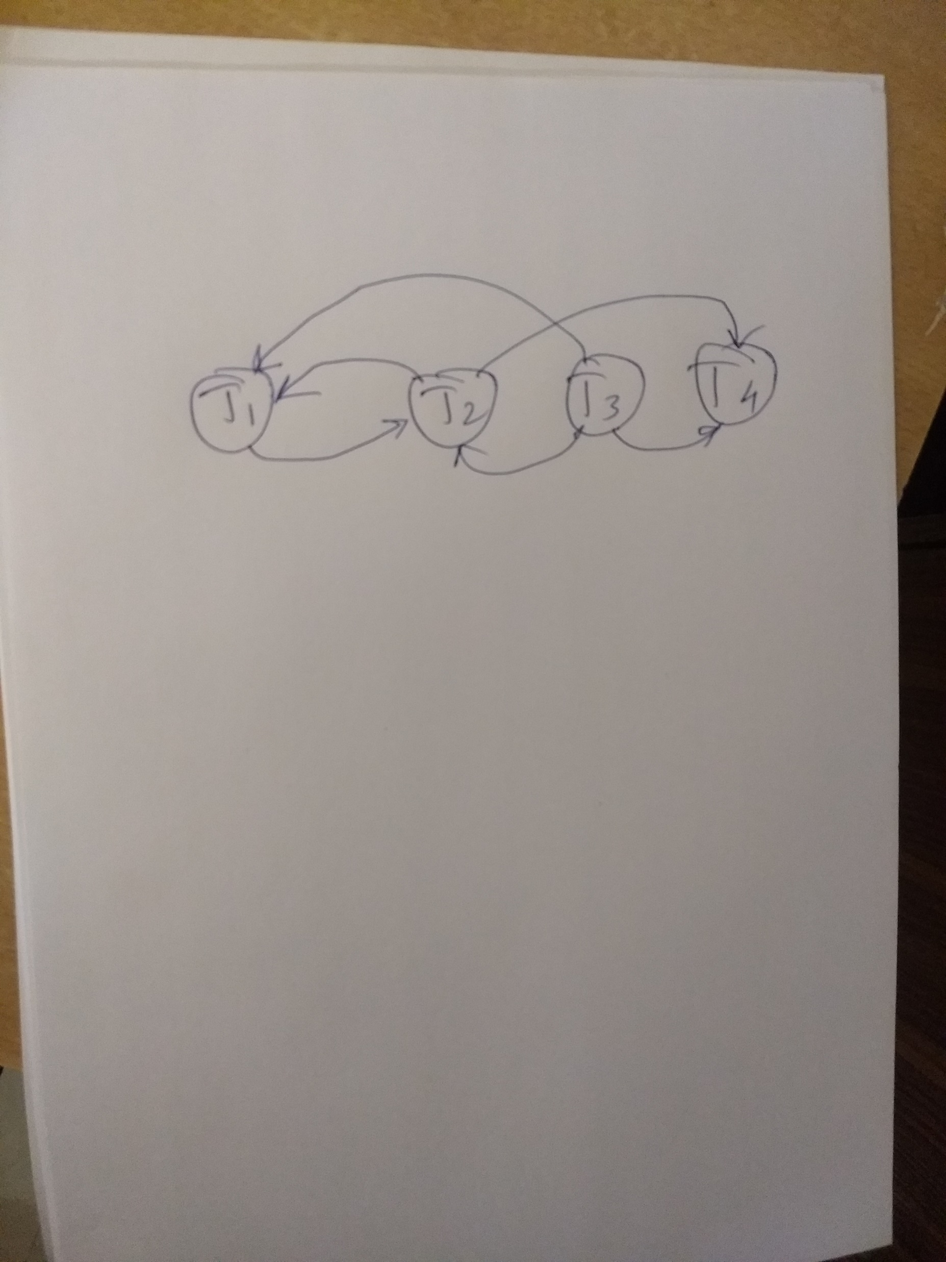

Slide 34
Another Exercise:
What is P(S) for
S = w1(A) r2(A) r3(A) w4(A) ?

Slide 35
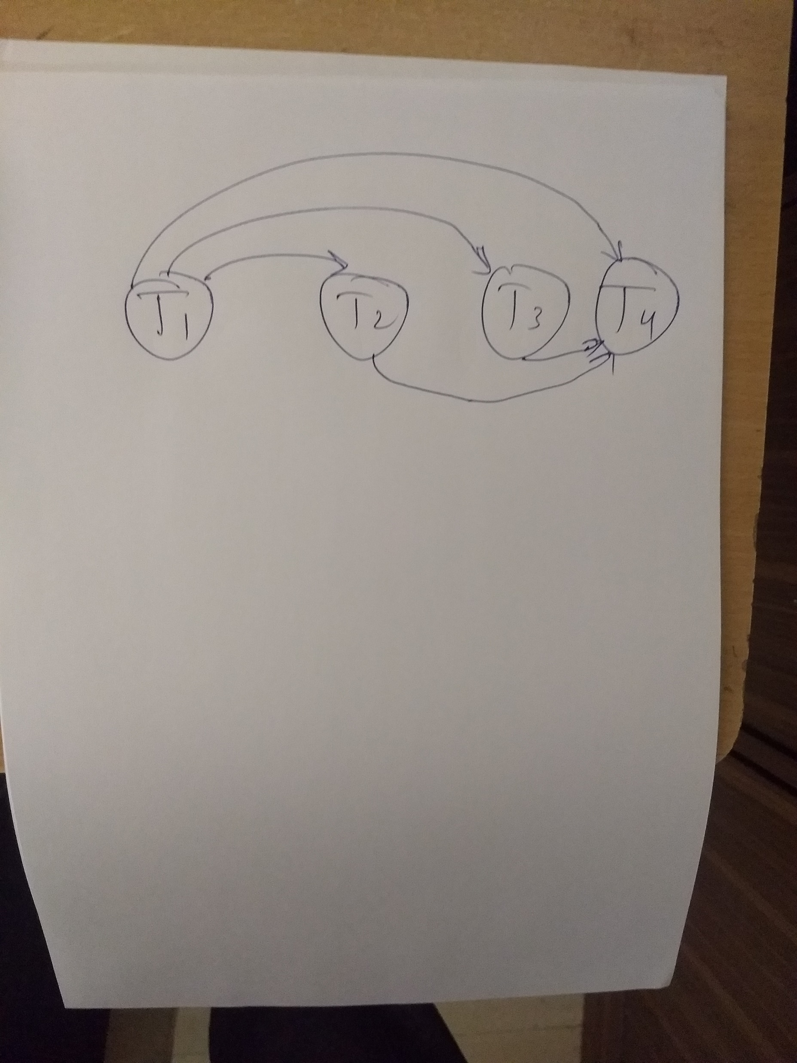

Slide 36
Enforcing serializability by locks
How to enforce serializable schedules?
Option 1: run system, recording P(S); at end of day, check for P(S) cycles and declare if execution was good

Slide 37
How to enforce serializable schedules?
Option 2: prevent P(S) cycles from occurring
T1 T2 ….. Tn
Scheduler
Lock Table
DB

Slide 38
Serializability with Locks
Arbitrary execution may result into non-serializable schedule.
Job of scheduler is to prevent orders of actions that lead to an non-serializable schedule.
We first discuss the lock-based scheduler with single lock
  Lock must be obtained for a database element before accessing it.

Slide 39
Proper use of locks: Legal schedule
Consistency of transactions
  Transaction can only read/write an element if it has previously has requested the lock.
  If transaction locks an element, it must unlock that element.
No two transactions must not lock the given object simultaneously. Lock can be given after the first transaction unlocking it.

Slide 40
A locking protocol
(with one kind of lock)
Two new actions:
lock (exclusive): li (A) Ti requests a lock
unlock: ui (A) Ti releases the lock
T1 T2
lock
table
scheduler
Serializable
Schedule of
actions

Slide 41
Consistency Condition for transactions
If there are actions li(X) followed by lj(X) in a schedule, there should be ui(X) action between these actions.

Slide 42
Rule #1: Well-formed transactions: transaction should request a lock and release the lock
Ti: … li(A) … pi(A) … ui(A) ...

Slide 43
Rule #2 Legal scheduler: No two transactions should not lock the element without the first unlocked it.
S = …….. li(A) ………... ui(A) ……...
no lj(A)

Slide 44
Exercise:
What schedules are legal?
What transactions are well-formed?
  S1 = l1(A)l1(B)r1(A)w1(B)l2(B)u1(A)u1(B)
  r2(B)w2(B)u2(B)l3(B)r3(B)u3(B)
  S2 = l1(A)r1(A)w1(B)u1(A)u1(B)
  l2(B)r2(B)w2(B)l3(B)r3(B)u3(B)
  S3 = l1(A)r1(A)u1(A)l1(B)w1(B)u1(B)
  l2(B)r2(B)w2(B)u2(B)l3(B)r3(B)u3(B)

Slide 45
Exercise:
What schedules are legal?
What transactions are well-formed?
  S1 = l1(A)l1(B)r1(A)w1(B)l2(B)u1(A)u1(B)
  r2(B)w2(B)u2(B)l3(B)r3(B)u3(B)
  S2 = l1(A)r1(A)w1(B)u1(A)u1(B)
  l2(B)r2(B)w2(B)l3(B)r3(B)u3(B)
  S3 = l1(A)r1(A)u1(A)l1(B)w1(B)u1(B)
  l2(B)r2(B)w2(B)u2(B)l3(B)r3(B)u3(B)

Slide 46
Schedule F
T1 T2
l1(A);Read(A)
A A+100;Write(A);u1(A)
l2(A);Read(A)
A Ax2;Write(A);u2(A)
l2(B);Read(B)
B Bx2;Write(B);u2(B)
l1(B);Read(B)
B B+100;Write(B);u1(B)

Slide 47
Schedule F
A B
T1 T2 25 25
l1(A);Read(A)
A A+100;Write(A);u1(A) 125
l2(A);Read(A)
A Ax2;Write(A);u2(A) 250
l2(B);Read(B)
B Bx2;Write(B);u2(B) 50
l1(B);Read(B)
B B+100;Write(B);u1(B) 150
250 150

Slide 48
Schedule F
A B
T1 T2 25 25
l1(A);Read(A)
A A+100;Write(A);u1(A) 125
l2(A);Read(A)
A Ax2;Write(A);u2(A) 250
l2(B);Read(B)
B Bx2;Write(B);u2(B) 50
l1(B);Read(B)
B B+100;Write(B);u1(B) 150
250 150
Note: Schedule F is a legal schedule of consistent transactions, but it is not serializable.

Slide 49
Two-phase locking
Rule #3: In every transaction, all lock requests precede all unlock requests.

Slide 50
Rule #3 Two phase locking (2PL) for transactions
Ti = ……. li(A) ………... ui(A) ……...
no unlocks no locks

Slide 51
# locks
held by
Ti
Time
Growing Shrinking
Phase Phase

Slide 52
Schedule G
T1 T2
l1(A);Read(A)
A A+100;Write(A)
l1(B); u1(A)
l2(A);Read(A)
A Ax2;Write(A);l2(B)
delayed

Slide 53
Schedule G
T1 T2
l1(A);Read(A)
A A+100;Write(A)
l1(B); u1(A)
l2(A);Read(A)
A Ax2;Write(A);l2(B)
Read(B);B B+100
Write(B); u1(B)
delayed

Slide 54
Schedule G
T1 T2
l1(A);Read(A)
A A+100;Write(A)
l1(B); u1(A)
l2(A);Read(A)
A Ax2;Write(A);l2(B)
Read(B);B B+100
Write(B); u1(B)
l2(B); u2(A);Read(B)
B Bx2;Write(B);u2(B);
delayed

Slide 55
Schedule H (T2 reversed)
T1 T2
l1(A); Read(A) l2(B);Read(B)
A A+100;Write(A) B Bx2;Write(B)
l1(B) l2(A)
delayed
delayed
Deadlock !

Slide 56
Assume deadlocked transactions are rolled back
  They have no effect
  They do not appear in schedule
E.g., Schedule H =
This space intentionally
left blank!

Slide 57
Next step:
Show that rules #1,2,3 ⇒ conflict-
serializable
schedules

Slide 58
Conflict rules for li(A), ui(A):
li(A), lj(A) conflict
li(A), uj(A) conflict
Note: no conflict < ui(A), uj(A)>, < li(A), rj(A)>,...

Slide 59
Theorem Rules #1,2,3 ⇒ conflict
(2PL) serializable
schedule

Slide 60
Theorem Rules #1,2,3 ⇒ conflict
(2PL) serializable
schedule
To help in proof:
Definition Shrink(Ti) = SH(Ti) = first unlock action of Ti

Slide 61
Lemma
Ti → Tj in S ⇒ SH(Ti) <_{S} SH(Tj)

Slide 62
Lemma
Ti → Tj in S ⇒ SH(Ti) <_{S} SH(Tj)
Proof of lemma:
Ti → Tj means that
S = … pi(A) … qj(A) …; p,q conflict
By rules 1,2:
S = … pi(A) … ui(A) … lj(A) ... qj(A) …

Slide 63
Lemma
Ti → Tj in S ⇒ SH(Ti) <_{S} SH(Tj)
Proof of lemma:
Ti → Tj means that
S = … pi(A) … qj(A) …; p,q conflict
By rules 1,2:
S = … pi(A) … ui(A) … lj(A) ... qj(A) …
By rule 3: SH(Ti) SH(Tj)
So, SH(Ti) <_{S} SH(Tj)

Slide 64
Theorem Rules #1,2,3 ⇒ conflict
(2PL) serializable schedule
Proof:
(1) Assume P(S) has cycle
T1 → T2 →…. Tn → T1
(2) By lemma: SH(T1) < SH(T2) < ... < SH(T1)
(3) Impossible, so P(S) acyclic
(4) ⇒ S is conflict serializable

Slide 65
2PL subset of Serializable
Serializable
2PL

Slide 66
Locking Systems with Several Lock Modes
In one lock scheme even “reading” action also requires a lock.
  Several transactions can read X in parallel.
We can use two kinds of locks
  Shared lock or read lock
  Exclusive lock or write lock
sli(X): requests a shared lock on X
xli(X): requests an exclusive lock on X
ui(X): relinquishes the locks.

Slide 67
Requirements
1. For writing, exclusive lock is required and for reading any lock is OK.
  ri(X) must be preceded by sli(X) or xli(X) with no intervening ui(X).
  wi(X) must be preceded by xli(X) with no intervening ui(X).
2: Two phase rule: locking must precede unlocking
  No action sli(X) or xli(X) can be preceded by an action ui(X)
3. An object can be locked by several on a shared mode or exclusively by one transaction.
  If xli(X) appears in a schedule, there will be no xlj(X) or slj(X) for some j other than i, without an intervening ui(X).
  If sli(X) appears in a schedule, then there can not be following xlj(X) without intervening ui(X).

Slide 68
Example
T1: sl1(A);r1(A);xl1(B);r1(B);w1(B);u1(A);u1(B)
T2: sl2(A);r2(A);sl2(B);r2(B);u2(A);u2(B);
T1 T2
-----------------------------------------------
sl1(A);r1(A);
sl2(A);r2(A)
sl2(B); r2(B)
xl1(B) denied
u2(A);u2(B)
xl1(B); r1(B), w1(B);
u1(A); u2(B);
Note: If T1 would have requested exclusive lock initially,
it would have been rejected.

Slide 69
Compatible matrix
S X
S true false
X false false
Lock Requested Tj
Lock Held
Ti

Slide 70
Upgrading Locks
If Ti has a shared lock on X can upgrade to exclusive lock.
Earlier, a transaction which has requested shared lock is friendly to other transaction’s read request.
It can be friendlier to it’s write request .

Slide 71
Example
T1: sl1(A); r1(A); xl1(B); r1(B); w1(B); u1(A); u1(B)
T2: sl2(A); r2(A); sl2(B); r2(B); u2(A); u2(B);
T1 T2
-----------------------------------------------
sl1(A);r1(A)
sl2(A);r2(A)
sl2(B); r2(B)
sl1(B); r1(B);
xl1(B) denied
u2(A);u2(B)
xl1(B); w1(B);
u1(A); u2(B)
Note: If T1 would have requested exclusive lock initially,
it would have been rejected.

Slide 72
Upgrading locks: deadlock
T1 T2
-----------------------------------------------------------------------
sl1(A)
sl2(A)
xl1(A) denied
xl2(A) denied

Slide 73
More concurrency Update locks
To avoid deadlock problem
Update lock can only read and not to write
Only update lock will be upgraded to write lock later.
We can grant update lock even though transactions have shared lock on X but, Once we have an update lock, other locks (shared, excusive, update) are denied.

Slide 74
Update Locks: Compatibility Matrix
S X U
-----------------------------------------------
S Yes No Yes
X No No No
U No No No

Slide 75
Upgrading locks: No deadlock Problem
T1: ul1(A); r1(A); xl1(A); w1(A); u1(A);
T2: ul2(A); r2(A); xl2(A); w2(A); u2(A);
T1 T2
-----------------------------------------------------------------------
ul1(A); r1(A);
ul2(A) denied
xl1(A), w1(A); u1(A)
ul2(A); r2(A);
xl2(A); w2(A); u2(A);

Slide 76
Increment Locks
For operations that commute each other; two transactions add constants to each other; it does not matter which goes first.

Slide 77
Example: Increment lock
Atomic increment action: INi(A)
{Read(A); A ← A+k; Write(A)}
INi(A), INj(A) do not conflict!
A=7
A=5 A=17
A=15
INi(A)
+2
INj(A)
+10
+10
INj(A)
+2
INi(A)

Slide 78
Increment Locks: Compatibility Matrix
S X I
-----------------------------------------------
S Yes No No
X No No No
I No No Yes

Slide 79
Increment locks:
T1 T2
-----------------------------------------------------------------------
sl1(A); r1(A);
sl2(A);r2(A);
il2(B);inc2(B);
il1(B), inc1(B);
u2(A); u2(B);
u1(A); u1(B);

Slide 80
Architecture of a Lock Scheduler
(1) Don’t trust transactions to request/release locks
(2) Hold all locks until transaction commits
#
locks
time

Slide 81
Principles
Transactions do not request locks
  Lock scheduler should insert the locks
Transactions do not release the locks, the scheduler releases the locks based on commit or abort command.

Slide 82
        Ti
        Read(A),Write(B)
        l(A),Read(A),l(B),Write(B)…
        Read(A),Write(B)
Scheduler, part I
lock
table
Scheduler, part II
DB

Slide 83
Scheduler
Part I selects appropriate mode of lock requests
Part II executes the operations.
When part I receives commit/abort by transaction manager, it releases the lock held by T. When a transaction is waiting for a lock, part I notifies part II.
Part II starts executing waiting transactions.

Slide 84
Lock table Conceptually
If null, object is unlocked
A
Λ
B
Lock info for B
C
Lock info for C
Λ
Every possible object
...

Slide 85
But use hash table:
...
A
If object not found in hash table, it is unlocked
A
Lock info for A
H
...

Slide 86
Lock info for A - example
tran mode wait? Nxt T_link
Object:A
Group mode:U
Waiting:yes
List:
T1
S
no
T2
U
no
T3
X
yes
Λ
To other T3
records

Slide 87
Selecting the list of requested locks
FCFS
Priority to shared locks
Priority to upgrading

Slide 88
Managing hierarchies of database elements
Two kinds of hierarchies
  Hierarchy of lockable elements
B-tree indexes

Slide 89
What are the objects we lock?
?
Relation A
Tuple A
Disk
block
A
Tuple B
Relation B
Tuple C
Disk
block
B
...
...
...
DB
DB
DB

Slide 90
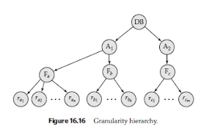

Slide 91
Locking works in any case, but should we choose small or large objects?

Slide 92
Locks with multiple granularity
What is database element ?
  One lock for each relation
  One lock for each tuple
  One lock for each page

Slide 93
Warning locks
Hierarchy Locking Protocol
Relations are largest lockable elements
Each relation consists of blocks
Each block consists of tuples.
The rules for managing hierarchy locking protocol involves warning locks and ordinary locks.

Slide 94
Warning protocol
To place an ordinary S or X lock on any element begin from the root
If we are at the element request S or X.
If the element is further down in the hierarchy, place a warning on this node.
  If we want to request S lock further down, place IS lock on this node.
    Here, “IS” means intention to obtain shared lock on the sub-element.
  If we want to request X lock further down, place IX lock on this node. After grating the lock, proceed further and repeat 1,2, or 3.

Slide 95
Warning protocol: Compatibility matrix
IS IX S X
-----------------------------------------------------
IS Yes Yes Yes No
IX Yes Yes No No
S Yes No Yes No
X No No No NO

Slide 96
Phantoms and Handling insertions Correctly
We can only lock the existing elements!
Find all Disney movies.
But new Disney movie is inserted, in between. Does not require the lock.
Solution: lock the relation.

Slide 97
The Tree Protocol
So far we have discussed about the elements organized in an hierarchical order
Linked pattern of trees
  Btrees
Btrees allows the locking of individual nodes.
  Treating entire B-tree as one element reduces the concurrency.
  If we use S,X,Update, we can not design a CC protocol for Btree.
If the transaction moves to child, and observes that split does not propagate upward, we can release the locks of higher level nodes.
  Violates 2PL, but ensures serializability.

Slide 98
Example
all objects accessed
through root,
following pointers
A
B
C
D
E
F

Slide 99
Example
all objects accessed
through root,
following pointers
T1 lock
A
B
C
T1 lock
T1 lock
D
E
F

Slide 100
Example
all objects accessed
through root,
following pointers
T1 lock
A
B
C
T1 lock
T1 lock
D
E
F
 can we release A lock
if we no longer need A??

Slide 101
Idea: traverse like “Monkey Bars”
A
B
C
D
E
F

Slide 102
Idea: traverse like “Monkey Bars”
T1 lock
A
B
C
T1 lock
D
E
F

Slide 103
Idea: traverse like “Monkey Bars”
A
T1 lock
B
C
T1 lock
D
E
F

Slide 104
Why does this work?
Assume all Ti start at root; exclusive lock
Ti → Tj ⇒ Ti locks root before Tj
Actually works if we don’t always
start at root
Root
Q
Ti → Tj

Slide 105
Rules: tree protocol (exclusive locks)
(1) First lock by Ti may be on any item
(2) After that, item Q can be locked by Ti only if parent(Q) locked by Ti
(3) Items may be unlocked at any time
(4) After Ti unlocks Q, it cannot relock Q, even it has a lock on node’s parent.

Slide 106
Tree-like protocols are used typically for B-tree concurrency control
E.g., during insert, do not release parent lock, until you are certain child does not have to split
Root

Slide 107
Concurrency Control By Timestamps
Optimistic protocols
Two methods
  Timestamping
    Serial schedule is according to timestamps.
  Validation
    Serial schedule is according to validation times.
These are Optimistic protocols
  Assume that conflicts are rare
Locking protocols are pessimistic protocols
  Assume that conflicts are frequent.

Slide 108
Timestamps
It is a unique number
  Transaction which starts later has higher timestamp.
Each object X has two time stamps
  RT(X): read time of X: highest timestamp of the transaction which has read X.
  WT(X): write time of X: highest timestamp of the transaction which has written X.
  C(X), commit bit of X, true only most recent transaction to write X has already committed.
    Suppose U writes X and aborts; dirty read problem can be avoided.

Slide 109
Timestamp-based Scheduling: Rules
Suppose the scheduler receives r_{T}(X)
  If TS(T) >= WT(X), read is possible
    If C(X) is true, grant the request
    If TS(T) > RT(X), set RT(X):=TS(T); otherwise do not change RT(X).
    If C(X) is false, delay T until C(X) becomes true or the transaction which wrote X aborts
  If TS(T) < WT(X) rollback T and restrat with new time stamp
Suppose the scheduler receives w_{T}(X)
  If TS(T) >= RT(X) and TS(T) >= WT(X), write is possible
    Write X
    Set WT(X) := TS(T)
    Set C(X) is false.
  If TS(T) >= RT(X) and TS(T) < WT(X), write is possible, but there is a later value of X. If C(X) is true, ignore T. Otherwise delay T.
  If TS(T) < RT(X) then write is not possible
If the scheduler receives Commit(T), make C(X) true.
If the scheduler receives Abort(T), take appropriate action.

Slide 110
Thomas Write Rule
Writes can be skipped, when a write with a later write-time is already in place.
Example:
  T1 has read X and then T2 has read X and written X. (T1 has lesser timestamp than T2). Then, write by T1 can be skipped.

Slide 111
Multiversion Timestamping
Store the old versions
Allow reads r_{T}(X) that otherwise cause transaction T to abort

Slide 112
Multiversion Protocol
When a new w_{T}(X) occurs, new version of X is created. It write time is TS(T), let it be Xt.
When a rT(X) occurs, the scheduler finds version Xt of X such that t <= TS(T)
Write times are associated with the versions and they do not change
Read times are associated with versions. Certain writes are rejected one whose time is less than the read time of the previous version.
If there is no active transaction less than t, delete any version of X previous to Xt.

Slide 113
Timestamps and locking
Timestamp is better of most of the transactions are read only.
Locking is better in high conflict situations.
Approach followed by commercial systems
  Read only transactions are executed using multi-version timestamping.
  Read/write transactions are executed using 2PL.

Slide 114
Concurrency Control by validation
It is another type of optimistic control.
Different from timestamping
  Scheduler maintains the record of active transactions (not the timestamps of elements)
  Before writing, a transaction goes through validation phase.
    The items it wants to write are compared with write sets of other active transactions. If there is any problem, the transaction is rolled back.

Slide 115
Optimistic protocol: phases
Read: reads the all the elements in read-set and computes the result in local memory.
Validate: validates the transaction by comparing read and write sets with those of other transactions. If the validation fails, the transaction is rolled back.
Write: transaction writes the values in the write set.

Slide 116
Sets maintained by Scheduler for validation
START: set of transactions that have started, but not yet completed validation.
VAL: set of transactions validated and not finished the writing.
FIN: set of transactions that have completed in Phase 3.
For each transaction, the scheduler maintains START(T), VAL(T) and FIN(T) timestamp.
FIN is frequently purged.

Slide 117
Validation Rules for T
When we are trying to validate T
Suppose there is U
  If U is in VAL or FIN; that is, U has validated.
  FIN(U) > START(T); U did not finish before T started.
  RS(T) ∩ WS(U) not empty. Risky, So rollback T.
Suppose there is U
  U is in VAL, U is successfully validated
  FIN(U) > VAL(T), U did not finish before T entered its validation phase.
  WS(T) ∩ WS(U) not empty. Risky, So rollback T.

Slide 118
Comparison of Three CC protocols
Locks:
  Space is proportional to the number of database elements locked.
  Delays transactions but avoids rollbacks
Timestamps:
  Space is needed for timestamps (naïve implementation)
  Similar to the lock table, we can store the timestamps.
  Rollback problem (detects earlier than validation)
Validation
  Space is used for timestamps and read/write sets.
  Roll back problem

Slide 119
Summary
Have studied C.C. mechanisms used in practice
- 2 PL
- Multiple granularity
- Tree (index) protocols
- Timestamping
- Multiversion
- Validation

Slide 120
System Structure
Strategy Selector
Query Parser
User
User Transaction
Transaction Manager
Concurrency Control
Buffer Manager
Recovery Manager
Lock Table
File Manager
M.M. Buffer
Log
Statistical Data
Indexes
User Data
System Data

