Slide 1
CS4.401- Data Systems
P.Krishna Reddy
pkreddy@iiit.ac.in

Slide 2
Courses You Have Completed
Digital logic design
Programming language
Computer System Organization
Scripting/IT workshop
Operating Systems
Introduction to databases/SQL/database design

Slide 3
Computer System Components
1. Hardware – provides basic computing resources (CPU, memory, I/O devices).
2. Operating system – controls and coordinates the use of the hardware among the various application programs for the various users.
3. Applications programs – define the ways in which the system resources are used to solve the computing problems of the users (compilers, database systems, video games, business programs).
4. Users (people, machines, other computers).

Slide 4

Abstract View of Computer System

Slide 5
Applications
SQL
DBMS
Operating system
Hardware

Slide 6
Outline
About the course
Database Systems: background
  About data science
  Database, Three schema architecture
  ER Models
  Relational Data Model
  Relational Algebra
  SQL
  Functional Dependencies & Normalization

Slide 7
Objectives
Databases have become essential part of every business. To store data, a specialized software called database management system (DBMS) or database system or (SQL framework) has been developed over several decades.
  A database system can be used to manage large amounts of data in a persistent manner.
  It also facilitates the development of data-based applications in a cost-effective and efficient manner.
Currently, massive data based systems are built to store huge data and provide data based services to extract the same to serve millions of users across the globe in parallel.
  Facebook, google, youtube, Instagram, twitter
The objective of this course is to study the methods/frameworks that have been evolved to build DBMS software. We also study about the frameworks to develop data based systems. The topics include storage management, indexing, query processing and transaction management.

Slide 8
Course topics
Introduction (3 hours)
Storage management and Indexing
  Data storage ( 3 hours)
  Representing data elements (3 hours)
  Index structures (3 hours)
  Multidimensional indexes (4.5 hours)
Query processing
  Query execution (4.5 hours)
  The query compiler (4.5 hours)
Concurrency control and Recovery
  Coping with system failures (3 hours)
  Concurrency control (4.5 hours)
  More about transaction management (4.5 hours)
NoSQL and big data systems (4.5 hours)

Slide 9
References
Main book
  Database System Implementation, Hector Garcia-Molina, Jeffrey D. Ullman and Jennifer Widon, Pearson Education, 2003
Other books
  Elmasri & Navathe, Fundamentals of Database Systems, Pearson Education, 5th Education.
  Raghu Ramakrishnan and Johannes Gehrke, Database Management Systems, Third edition, Mc Graw Hill, 2003.
  Abraham Silberschatz, Henry F.Korth, S.Sudarshan, Database system concepts, fifth edition, Mc Graw Hill, 2006.
  Research papers
Tutorials
  1.5 hours per week

Slide 10
Course Outcomes
After completion of this course successfully, the students will be able to..
  CO-1. Develop the tree-based and hash-based indexing algorithms to improve efficiency of the retrieval
  CO-2. Tune the optimizer module of DBMS to meet the performance demands of diverse applications, including distributed applications.
  CO-3: Design the recovery sub-system of any given information system
  CO-4. Design archival strategy for any given information system
  CO-5. Develop a concurrency control algorithm for any given database system
  CO-6. Develop a framework for building a large scale big data system.

Slide 11
Prerequisite Course / Knowledge:
Basic principles of Operating systems, Structured Query Language, Relational Data Model, Data structures, Programming language, Algorithms,

Slide 12
References
Main:
  Hector Garcia-Molina, Jeffrey D. Ullman and Jennifer Widom , Database System Implementation, Pearson Education, 2003
Other
  Elmasri & Navathe, Fundamentals of Database Systems, 6th Edition, Pearson Education, 2013
  Raghu Ramakrishnan and Johannes Gehrke ,Database Management Systems, Third edition, Mc Graw Hill, 2017
  Abraham Silberschatz, Henry F.Korth, S.Sudarshan, Database system concepts, fifth edition, Mc Graw Hill, 2006
  Research papers

Slide 13
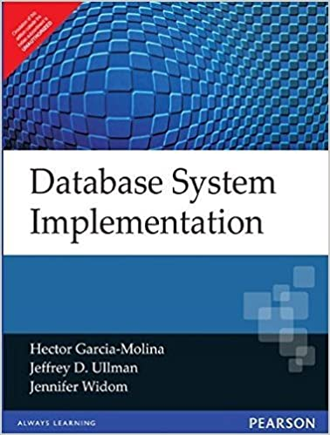

Slide 14
List of Some Research Papers
Overview of SciDB, Large Scale Array Storage, Processing and Analysis
Aurora: A New Model and Architecture for Data Stream Management.
Pregel: A System for Large-scale Graph Processing.
C-Store: A column oriented DBMS
Classic Parallel Database Systems
A Flexible Image Database System for Content-Based Retrieval
Rule-Based Spatio-Temporal Query Processing for Video Databases
On k-Path Covers and their Applications
The Skyline Operator
Provenance Management in Curated Databases
EMU-SDMS: Advanced speech database management and analysis in R

Slide 15
Mini Projects (Labs)
Lab assignments
  Implementation of relational operators, indexing algorithms, optimization algorithms and concurrency control protocols.
Reading assignments

Slide 16
GRADING
Type of Evaluation | Weightage (in %)
Class room test 1 | 5%
Mid Sem Exam | 20%
Class room test 2 | 5%
End Sem Exam | 40%
Mini-Projects+Research Papers | 30%

Slide 17
OUTCOME
The course will help the students in understanding the fundamental concepts of several database management systems like ORACLE, DB2, SYBASE and so on.
The students will also understand the frameworks to build large scale data systems.
Most important, the students will be exposed to internal design of DBMSs and data systems and able to tune the data based systems to meet the performance demands of diverse applications.
Overall, the students will understand the solutions/options to interesting problems which have been encountered by the designers of preceding DBMSs.

Slide 18
Outline
About the course
Database Systems: background
  About data science
  Database, Three schema architecture
  Data independence
  ER Models
  Relational Data Model
  Relational Algebra, SQL
  Functional Dependencies & Normalization

Slide 19
About Data and information
Data
  Symbols
  Collection of facts
  It simply exists and has no significance beyond its existence.
  It does not have any meaning of itself
  Example: It is raining
Information:
  Data that are processed to be useful, provides answers to who, what, and when questions.
  Processed data
  Data that has been given meaning by relational connection
    Ex: If temperature drops 15 degrees and then it started raining.

Slide 20
Evolution of Sciences…
Before 1600, empirical science
  Experimental, Observation, experience
1600-1950s, theoretical science
  Application of mathematical methods
  Each discipline has grown a theoretical component. Theoretical models often motivate experiments and generalize our understanding.
1950s-1990s, computational science
  Over the last 50 years, most disciplines have grown a third, computational branch (e.g. empirical, theoretical, and computational ecology, or physics, or linguistics.)
  The application of computer simulation and other forms of computation to problems in various scientific disciplines.
  Computational Science traditionally meant simulation. It grew out of our inability to find closed-form solutions for complex mathematical models.
    In mathematics, an expression is said to be a closed-form expression if, and only if, it can be expressed analytically in terms of a bounded number of certain "well-known" functions.

Slide 21
Evolution of Sciences
1990-now, data science
  The flood of data from new scientific instruments and simulations
  The ability to economically store and manage petabytes of data online
  The Internet and computing Grid that makes all these archives universally accessible
  Scientific info. management, acquisition, organization, query, and visualization tasks scale almost linearly with data volumes.
2010 - now, AI/machine learning
Data science enables the creation of data products.
Data mining/AI/machine learning are major new challenges!
Jim Gray and Alex Szalay, The World Wide Telescope: An Archetype for Online Science, Comm. ACM, 45(11): 50-54, Nov. 2002

Slide 22
About Data Science
Commerce and research is being transformed by data-driven discovery and prediction. Skills required for data analytics at massive levels – scalable data management on and of the cloud, parallel algorithms, statistical modeling, and proficiency with a complex ecosystem of tools and platforms – span a variety of disciplines and are not easy to obtain through conventional curricula.
Basic techniques of data science, including
  both SQL and NoSQL solutions for massive data management (e.g., MapReduce and contemporaries),
  algorithms for data mining (e.g., clustering and association rule mining), and basic statistical modeling (e.g., logistic and non-linear regression).

Slide 23
About Storing and accessing data with programming language
Suppose there is no DBMS.
  Create a record.
  Create a file of records
  Write different programs for different requirements.
  For small applications it is OK.
What about big database ?
  Amazon
    Data of 20 million books occupies 2 terabytes (one tera byte is 10¹² bytes) maintained on 200 different servers.
    About 15 million visitors visit the site every day.
    Database is continually updated
    Stock quantities are updated whenever a purchase is made.
    About 100 people keep the database up-to-date.
Database can be managed manually
  A library card catalog.

Slide 24
Database Systems - Background
Database
ER Models
Relational Data Model
Relational Algebra
SQL & Tuple Relational Calculus
Functional Dependencies & Normalization

Slide 25
Basic Definitions
Database: A collection of related data.
Data: Known facts that can be recorded and have an implicit meaning.
Mini-world: Some part of the real world about which data is stored in a database. For example, student grades and transcripts at a university.
  Database should be the reflection of realworld.
Database Management System (DBMS): A software package/ system to facilitate the creation and maintenance of a computerized database.
Database System: The DBMS software together with the data itself. Sometimes, the applications are also included.

Slide 26
Typical DBMS Functionality
Define a database : Defining data types, structures and constraints
  Meta data: the database definition or descriptive information is stored as a database as a database catalog or data dictionary.
Constructing the database: Process of storing the database on some storage medium controlled by DBMS.
Manipulating the database : querying, generating reports, insertions, deletions and modifications to its content
Concurrent Processing and Sharing by a set of users and programs – yet, keeping all data valid and consistent

Slide 27
Typical DBMS Functionality
Other features:
  Protection
    Against hardware or software malfunction
  Security
    prevent unauthorized access
  “Active” processing to take internal actions on data
  Presentation and Visualization of data

Slide 28
Application Program: accesses the database by sending queries or requests for data to the DBMS.
  Query: retrieves some data
  Transaction: may retrieve and write some data

Slide 29
A Simplified
Database System
Environment
Users/Programmers
Database System
Application Programs/queries
DBMS
Software
Software to Process
Queries
Software to Access Stored Data
Stored
Database
Definition
(Meta Data)
Stored
Database

Slide 30
Example of a Database
Consider a part of a University environment
We need data about:
    STUDENTs
    COURSEs
    SECTIONs (of COURSEs)
    (academic) DEPARTMENTs
    INSTRUCTORs
The above data is related as follows:
    SECTIONs are of specific COURSEs
    STUDENTs take SECTIONs
    COURSEs have prerequisite COURSEs
    INSTRUCTORs teach SECTIONs
    COURSEs are offered by DEPARTMENTs
    STUDENTs major in DEPARTMENTs
Notes:
2
2
Connect to tutorial oriented presentation, and emphasize our approach

Slide 31
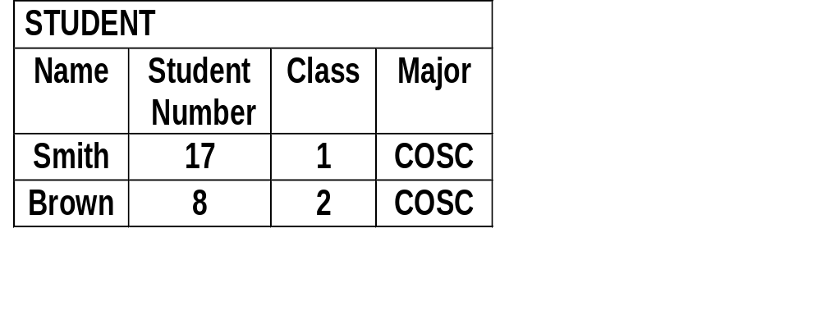
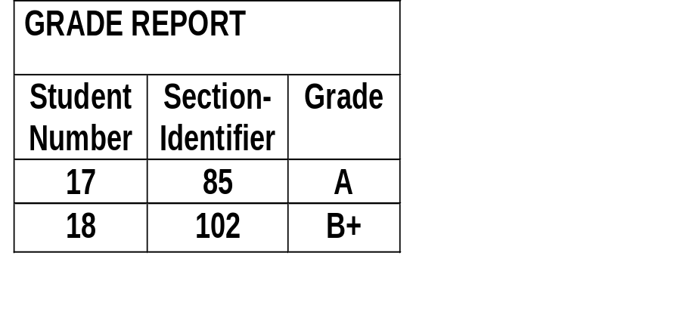

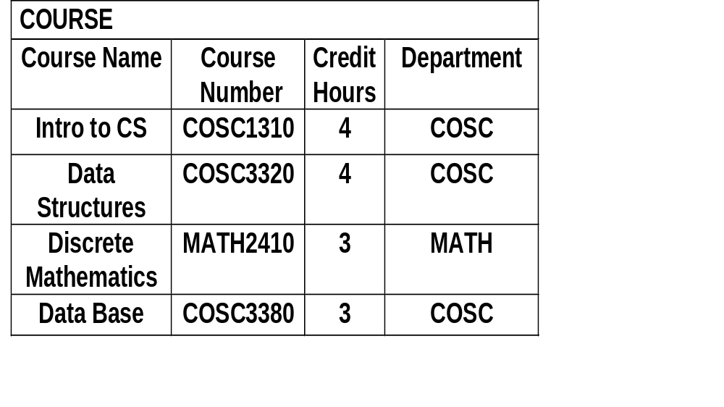
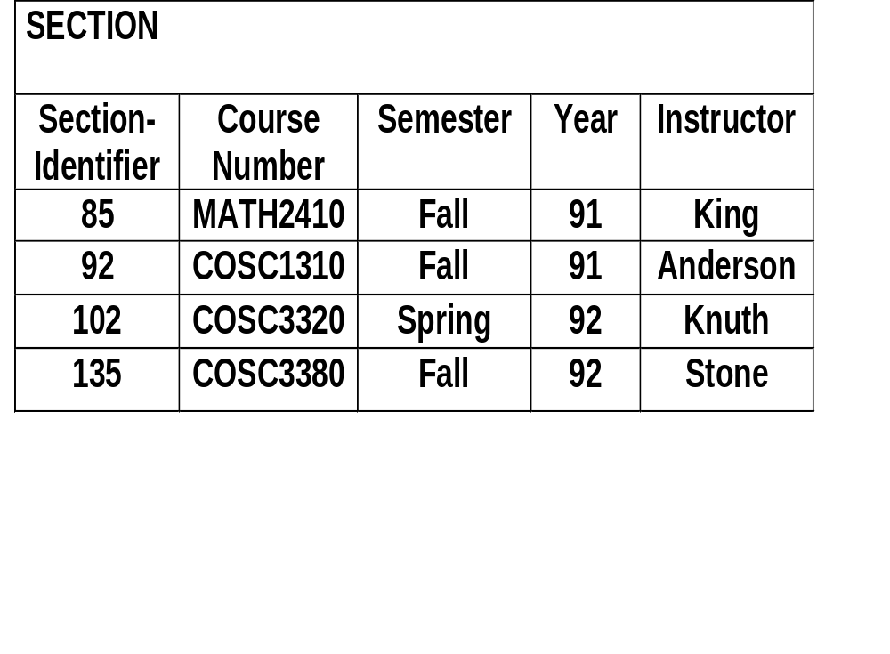
Example Database
Notes:
2
2
Connect to tutorial oriented presentation, and emphasize our approach

Slide 32
Three-Schema Architecture
Proposed to support DBMS characteristics of:
  Program-data independence.
  Support of multiple views of the data.

Slide 33
Three-Schema Architecture
Defines DBMS schemas at three levels:
  Internal schema at the internal level to describe physical storage structures and access paths. Typically uses a physical data model.
  Conceptual schema at the conceptual level to describe the structure and constraints for the whole database for a community of users. Uses a conceptual or an implementation data model.
  External schemas at the external level to describe the various user views. Usually uses the same data model as the conceptual level.

Slide 34
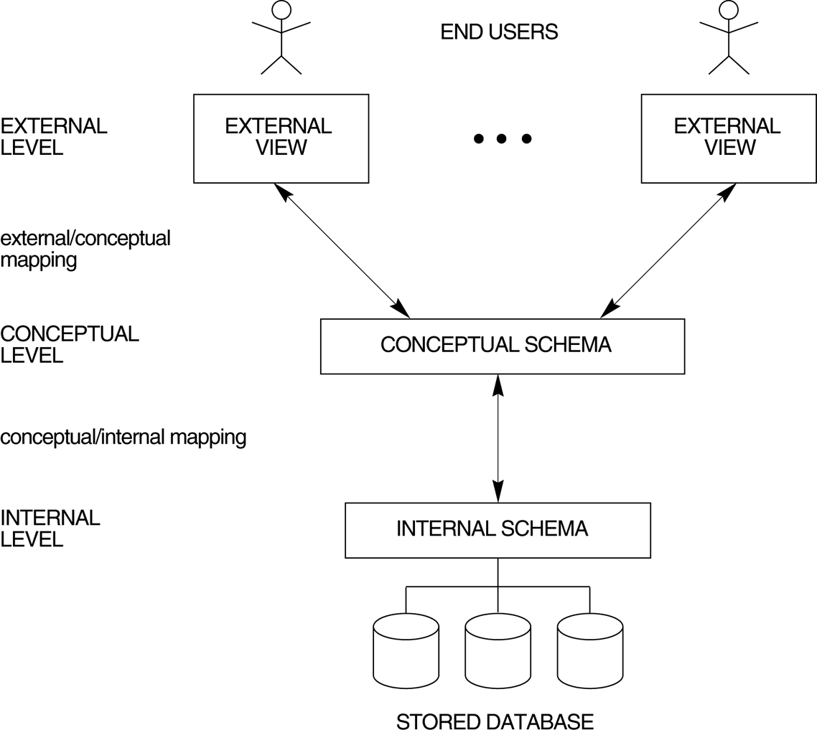
The three-schema architecture.

Slide 35
Three-Schema Architecture
Mappings among schema levels are needed to transform requests and data. Programs refer to an external schema, and are mapped by the DBMS to the internal schema for execution.

Slide 36
Data Independence
Logical Data Independence: The capacity to change the conceptual schema without having to change the external schemas and their application programs.
Physical Data Independence: The capacity to change the internal schema without having to change the conceptual schema.

Slide 37
Data Independence
When a schema at a lower level is changed, only the mappings between this schema and higher-level schemas need to be changed in a DBMS that fully supports data independence. The higher-level schemas themselves are unchanged. Hence, the application programs need not be changed since they refer to the external schemas.

Slide 38
DBMS Languages
Data Definition Language (DDL): Used by the DBA and database designers to specify the conceptual schema of a database. In many DBMSs, the DDL is also used to define internal and external schemas (views). In some DBMSs, separate storage definition language (SDL) and view definition language (VDL) are used to define internal and external schemas.

Slide 39
DBMS Languages
Data Manipulation Language (DML): Used to specify database retrievals and updates.
  DML commands (data sublanguage) can be embedded in a general-purpose programming language (host language), such as COBOL, C or an Assembly Language.
  Alternatively, stand-alone DML commands can be applied directly (query language).

Slide 40
DBMS Languages
High Level or Non-procedural Languages: e.g., SQL, are set-oriented and specify what data to retrieve than how to retrieve. Also called declarative languages.
Low Level or Procedural Languages: record-at-a-time; they specify how to retrieve data and include constructs such as looping.

Slide 41
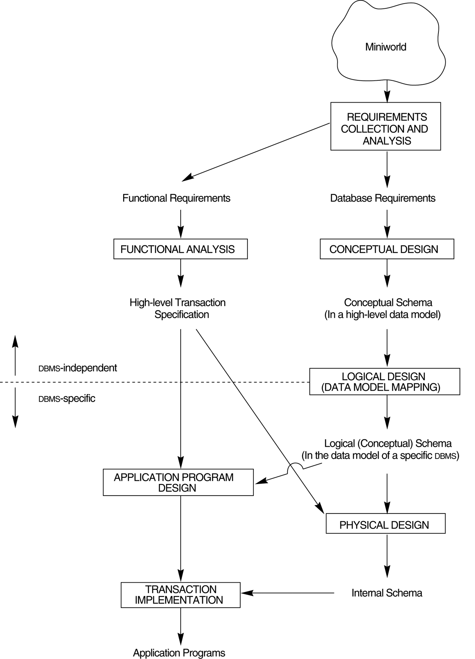
A simplified diagram to illustrate the main phases of database design.

Slide 42
ER Model
Fname
Minit
Lname
Salary
Address
Name
Age
EMPLOYEE
SSN
Bdate
Locations
StartDate
SUPERVISOR
SUPERVISEE
Number
Name
SUPERVISION
MANAGES
DEPARTMENT
ER Model

Slide 43
ER Diagram with Role Names and Structural Constraints
Number
Fname
Minit
Lname
Locations
Name
Address
(1,1)
WORKS_FOR
(4,N)
Name
Sex
Salary
employee
department
Ssn
EMPLOYEE
Startdate
Number Of Employees
DEPARTMENT
Bdate
(0,1)
(1,1)
Controlling-department
(0,N)
(0,N)
(0,1)
manager
MANAGES
Department- managed
CONTROLS
supervisor
supervisee
(1,N)
worker
Hours
Controlled-project
(1,1)
1
SUPERVISION
(0,N)
(1,N)
employee
WORKS_ON
project
PROJECT
Name
DEPENDENTS_OF
Location
Number
dependent
(1,1)
Company database
DEPENDENT
Name
Sex
Birthdate
Relationship
ER Model

Slide 44
Data Models
Hierarchical model
Network model
Relational model

Slide 45
Hierarchical Model
Basic Concepts
Tree-Structure Diagrams
Data-Retrieval Facility
Update Facility
Virtual Records
Mapping of Hierarchies to Files
The IMS Database System

Slide 46
Basic Concepts
A hierarchical database consists of a collection of records which are connected to one another through links.
  a record is a collection of fields, each of which contains only one data value.
  A link is an association between precisely two records.
The hierarchical model differs from the network model in that the records are organized as collections of trees rather than as arbitrary graphs.

Slide 47
Tree-Structure Diagrams
The schema for a hierarchical database consists of
  boxes, which correspond to record types
  lines, which correspond to links
Record types are organized in the form of a rooted tree.
  No cycles in the underlying graph.
  Relationships formed in the graph must be such that only
  one-to-many or one-to-one relationships exist between a parent and a child.

Slide 48
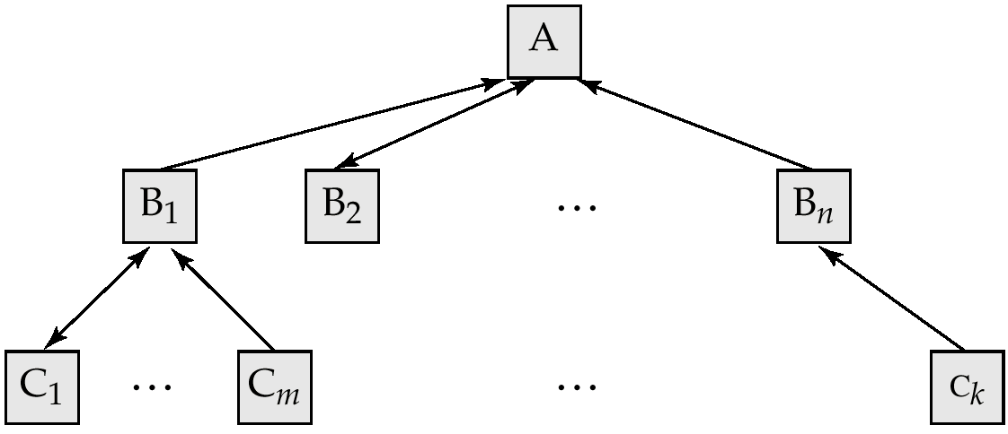
General Structure
A parent may have an arrow pointing to a child, but a child must have an arrow pointing to its parent.

Slide 49
Tree-Structure Diagrams (Cont.)
Database schema is represented as a collection of tree-structure diagrams.
  single instance of a database tree
  The root of this tree is a dummy node
  The children of that node are actual instances of the appropriate record type
When transforming E-R diagrams to corresponding tree-structure diagrams, we must ensure that the resulting diagrams are in the form of rooted trees.

Slide 50
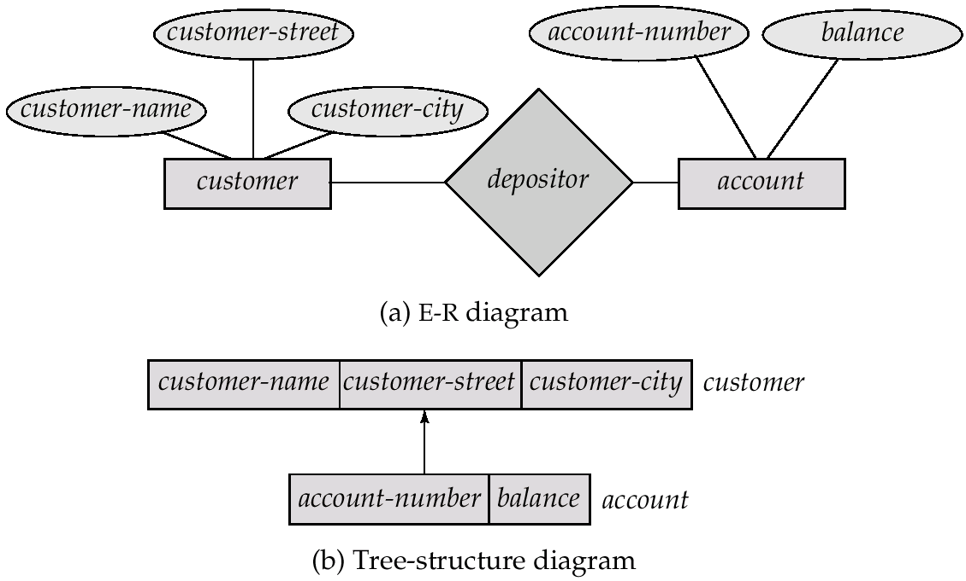
Single Relationships

Slide 51
Single relationships (Cont.)
Example E-R diagram with two entity sets, customer and account, related through a binary, one-to-many relationship depositor.
Corresponding tree-structure diagram has
  the record type customer with three fields: customer-name, customer-street, and customer-city.
  the record type account with two fields: account-number and balance
  the link depositor, with an arrow pointing to customer

Slide 52
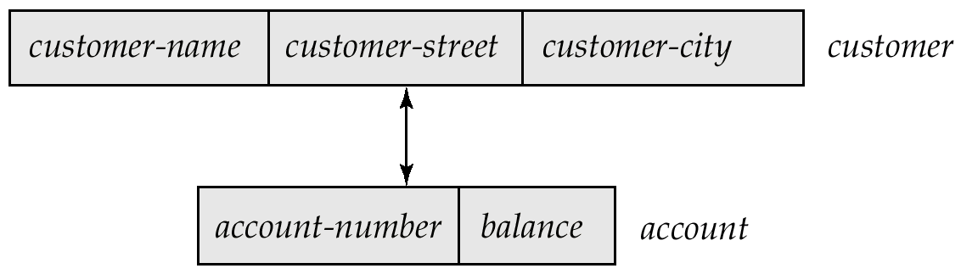
Single Relationships (Cont.)
If the relationship depositor is one to one, then the link depositor has two arrows.
Only one-to-many and one-to-one relationships can be directly represented in the hierarchical mode.

Slide 53
Transforming Many-To-Many Relationships
Must consider the type of queries expected and the degree to which the database schema fits the given E-R diagram.
In all versions of this transformation, the underlying database tree (or trees) will have replicated records.

Slide 54
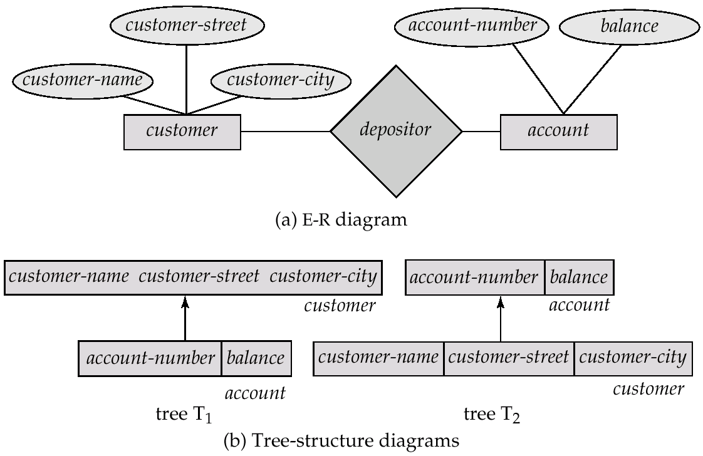
Many-To Many Relationships (Cont.)

Slide 55
Many-To-Many Relationships (Cont.)
Create two tree-structure diagrams, T₁, with the root customer, and T₂, with the root account.
In T₁, create depositor, a many-to-one link from account to customer.
In T₂, create account-customer, a many-to-one link from customer to account.

Slide 56
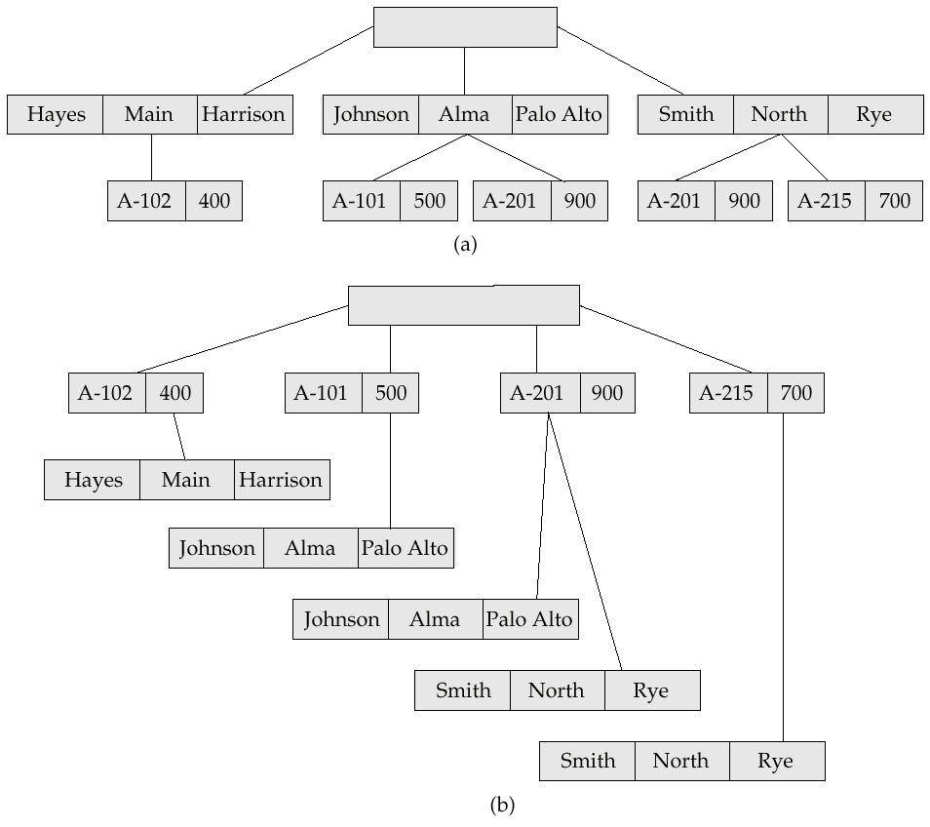
Sample Database

Slide 57
Network Model
Basic Concepts
Data-Structure Diagrams
The DBTG CODASYL Model
DBTG Data-Retrieval Facility
DBTG Update Facility
DBTG Set-Processing Facility
Mapping of Networks to Files

Slide 58
Basic Concepts
Data are represented by collections of records.
  similar to an entity in the E-R model
  Records and their fields are represented as record type
typecustomer = record type account = record
customer-name: string; account-number: integer;
customer-street: string; balance: integer;
customer-city: string;
end end
Relationships among data are represented by links
  similar to a restricted (binary) form of an E-R relationship
  restrictions on links depend on whether the relationship is many-many, many-to-one, or one-to-one.

Slide 59
Data-Structure Diagrams
Schema representing the design of a network database.
A data-structure diagram consists of two basic components:
  Boxes, which correspond to record types.
  Lines, which correspond to links.
Specifies the overall logical structure of the database.

Slide 60
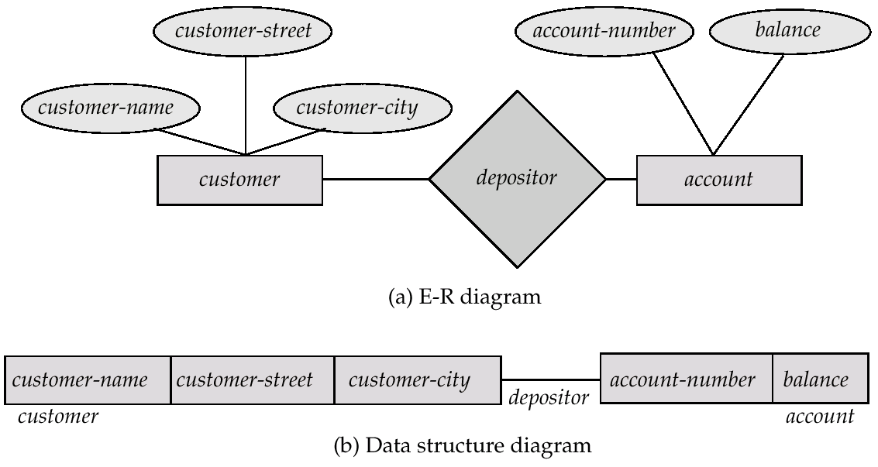
Data-Structure Diagrams (Cont.)
For every E-R diagram, there is a corresponding data-structure diagram.

Slide 61
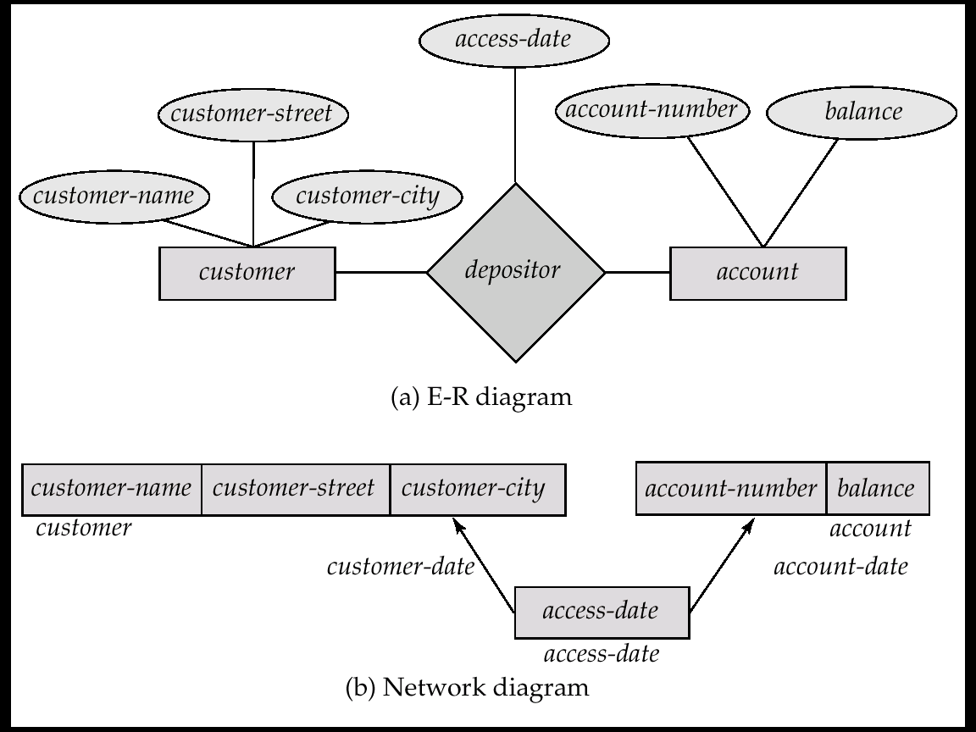
Data-Structure Diagrams (Cont.)
Since a link cannot contain any data value, represent an E-R relationship with attributes with a new record type and links.

Slide 62
General Relationships
To represent an E-R relationship of degree 3 or higher, connect the participating record types through a new record type that is linked directly to each of the original record types.
1. Replace entity sets account, customer, and branch with record types account, customer, and branch, respectively.
2. Create a new record type Rlink (referred to as a dummy record type).
3. Create the following many-to-one links:
  CustRlink from Rlink record type to customer record type
  AcctRlnk from Rlink record type to account record type
  BrncRlnk from Rlink record type to branch record type

Slide 63
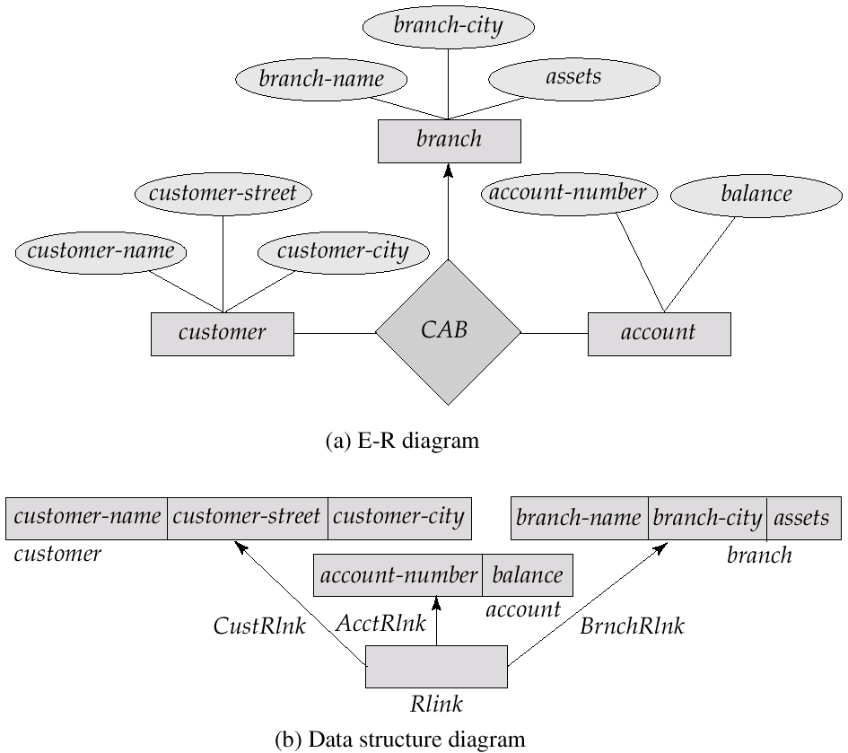
Network Representation of Ternary Relationship

Slide 64
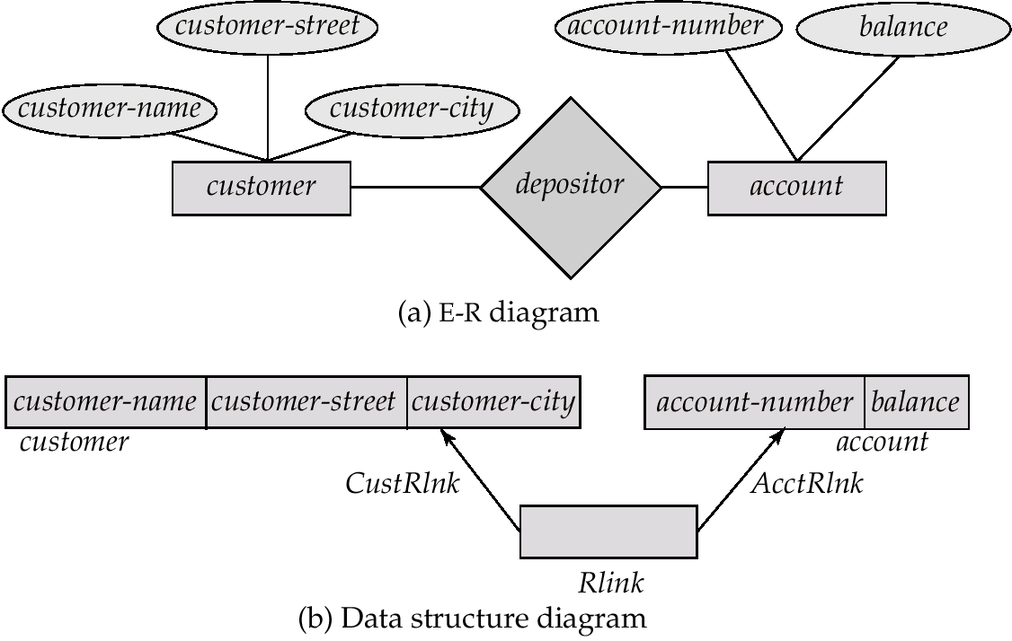
The DBTG CODASYL Model
All links are treated as many-to-one relationships.
To model many-to-many relationships, a record type is defined to represent the relationship and two links are used.

Slide 65
Relational Model Concepts
Relation (informally): A table of values. Each column in the table has a column header called an attribute. Each row is called a tuple.
Formal Relational Concepts
  Domain: A set of atomic (indivisible) values.
  Attribute: A name to suggest the meaning that a domain plays in a particular relation. Each attribute A_{i} has a domain dom(A_{i}).
  Relational Schema: A relation name R and a set of attributes A_{i} that define the relation.
Denoted by: R(A₁, A₂, ..., A_{n})
Example: STUDENT(Name, Student-id, Age,GPA)

Slide 66
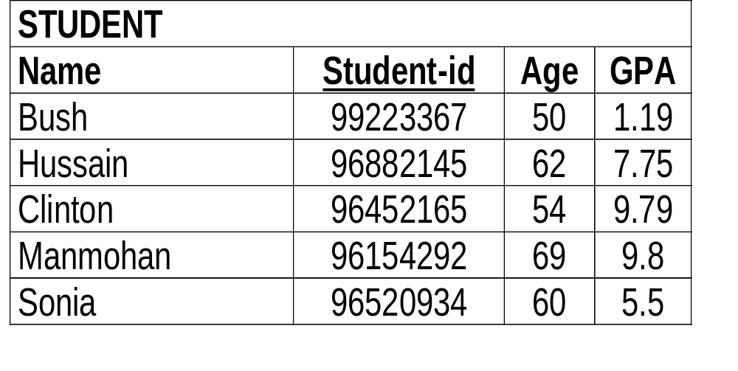
Example: Student Relation
Relation/Table Name
Attributes/Columns
Tuples/Rows

Slide 67
Integrity Constraints
Constraints are conditions that must hold on all valid relation instances. These constraints are Domain constraints, Key constraints, Entity integrity constraints, and Referential integrity constraints
Domain Constraints
Each attribute A must be an atomic value from the domain dom(A) for that attribute. The standard types of domain include integers, real numbers, characters, fixed length strings.

Slide 68
Relational Algebra
For those students who received Grade ‘A’ in a course, get the student name and course name
Answer:
Student name is in relation STUDENT, Course name is in relation COURSE, while grade is in relation GRADE-REPORT. For a student to retrieve the Course name, one has to join STUDENT with GRADE-REPORT to get Section number, and then with SECTION to get the course number, and then from COURSE the Course name. Since we want only those students who got grade ‘A’, a selection operation on relation GRADE-REPORT is needed. Since we want only student Name and Course Name (and not all attributes), a project operation is required.
  Π_{Name, Course Name}(σ_{Grade = `A’}(STUDENT*GRADE-REPORT *SECTION* COURSE))

Slide 69
Summary of SQL Queries
A query in SQL can consist of up to six clauses, but only the first two are mandatory
    SELECT <ATTRIBUTE LIST>
    FROM <TABLE LIST>
    [WHERE <CONDITION>]
    [GROUP BY <GROUPING ATTRIBUTES>]
    [HAVING <GROUP CONDITION>]
    [ORDER BY <ATTRIBUTE LIST>]
A query is evaluated by first applying the WHERE-clause, then GROUP BY and HAVING, and finally the SELECT-clause
SQL

Slide 70
UPDATE
Give all employees in the 'Research' department a 10% raise in salary.
    UPDATE EMPLOYEE
    SET SALARY = SALARY *1.1
    WHERE DNO IN (SELECT DNUMBER
        FROM DEPARTMENT
    WHERE DNAME='Research');
In this request, the modified SALARY value depends on the original SALARY value in each tuple. The reference to the SALARY attribute on the right of = refers to the old SALARY value before modification. The reference to the SALARY attribute on the left of = refers to the new SALARY value after modification.

Slide 71
Functional Dependencies
Constraints on the set of legal relations.
Require that the value for a certain set of attributes determines uniquely the value for another set of attributes.
A functional dependency is a generalization of the notion of a key.

Slide 72
Functional Dependencies
Let R be a relation schema
α ⊆ R and β ⊆ R
The functional dependency
α → β
holds on R if and only if for any legal relations r(R), whenever any two tuples t₁ and t₂ of r agree on the attributes α, they also agree on the attributes β. That is,
t₁[α] = t₂ [α] ⇒ t₁[β ] = t₂ [β ]
Example: Consider r(A,B ) with the following instance of r.
On this instance, A → B does NOT hold, but B → A does hold.
4
1 5
3 7

Slide 73
Inference Rules for FDs
F denotes the set of FDs specified for R
Other FDs may also hold on all legal instances that satisfy F
The set of all such FDs is called closure of F denoted by F⁺
A FD X→Y is inferred from F if X→Y holds in every legal instance r of R
  need a set of inference rules that can systematically infer new FDs from a given set of FDs
Reflexitivity, Augmentation, Transitivity
Notation:
F |= X →Y (F infers X → Y); {X,Y} → Z written as XY →Z;
and {X,Y,X} → {UV} written as XYZ →UV

Slide 74
Normalization
A systematic process of decomposing unsatisfactory relation schemas into smaller relations schemas that possess desirable properties.
Provides a series of tests for relation schemas
expressed in terms of normal forms
  first four: only use FDs
  additional: use other types of dependencies
Not necessary to normalize to highest form!
Normal forms do not guarantee good design
  also need to consider
    loss less join property
    dependency preserving property

Slide 75
Normalization
1 NF
2NF
3NF
BCNF

Slide 76
Summary
Normal Form | Test | Normalization (Remedy)
First (1NF) | Relation should have no non-atomic attributes or nested relations. | Form new relations for each non-atomic attribute or nested relation.
Second (2NF) | For relations where primary key contains multiple attributes, no non-key attributes should be functionally dependent on a part of primary key. | Decompose and set up a new relation for each partial key with its dependent attribute(s). Make sure to keep a relation with the original primary key and any attributes that are fully functionally dependent on it.
Third (3NF) | Relation should not have a non-key attribute functionally determined by another non-key attribute ( or by a set of non-key attributes.) That is, there should be no transitive dependency of a non-key attribute on the primary key. | Decompose and set up a relation that includes the non key attribute(s) that functionally determine(s) other non-key attribute(s).

Slide 77
Algorithm for computing X⁺
Algorithm: X⁺ (closure of X under F)
X⁺ := X;
while (changes to X⁺) do
for each FD Y → Z
begin
if Y ⊆ X⁺ ; then X⁺ = X⁺ ∪ Z
end

Slide 78
Lossless Join and Dependency Preserving 3NF algorithm
1. Find a minimal set (cover) of FDs G equivalent to F
2. For each X of an FD X → A in G
Create a relation schema R_{i} in D with the attributes {X ∪ A₁ ∪ A₂ ∪ ... ∪ A_{k}} where the A_{j}'s are all the attributes appearing in an FD in G with X as left hand side
3. If any attributes in R are not placed in any R_{i}, create another relation in D for these attributes
4 If none of them contain a candidate key K or R, create one more relation schema that contains attributes in K.
  Step 2 assures dependency preserving property
  Step 4 assures lossless join property

Slide 79
Lossless Join Decomposition into BCNF
1. set D:={R}
2. While there is a relation schema Q in D that is not in BCNF do
  choose a Q in D that is not in BCNF
  find a FD X → Y that violates BCNF
  replace Q in D by two relation schemas (Q - Y) and (X∪Y)

Slide 80
Conclusions
DBMS technology is one of the reliable technology and a core of several information system applications.
Relational model/SQL is one of the major innovation.
In this course, we will study how the query processor, recovery manager and transaction manager are being built.

