Slide 1
Crash Recovery
P.Krishna Reddy
(Chapter 8 of Database System Implementation by Hector Garcia-Molina, Jeffrey D. Ullman, Jennifer Widom)

Slide 2
Unsophisticated users (Customers,
Travel agents)
Sophisticated users, application
Programmers, DB Administrators
Application Front Ends
Web Forms
SQL Interface
SQL COMMANDS
Plan Executer
Parser
Query
Evaluation
Egine
Operator Evaluator
Optimizer
Transaction
Manager
Files and Access Methods
Recovery
Manager
Lock
Manager
Buffer Manager
Concurrency Control
Disk Space Manager
Architecture
Of
DBMS
Index Files
System Catalog
Data Files

Slide 3
Background
Controlling the access to data
  Data must be protected in the face of a system failure (Recovery Manager)
  Data must not be corrupted due to data modifications (Concurrency control )

Slide 4
Outline
Issues and Models for Resilient Operation
Undo logging
Redo logging
Undo/Redo logging
Protecting against media failures

Slide 5
Issues and Models for Resilient Operations
We focus on system failures

Slide 6
Failure Modes
Erroneous data entry
  Mistyping
    Put proper integrity constraints
Media failures
  Failures of disk
    Use one of the RAID scheme
    Maintain an archive with a tape or disk
    Keep redundant copies of the database online
Catastrophic failures
  Explosions or fires
    Keep redundant and distributed copies.

Slide 7
Failure modes: System failures
Transactions
  It is a process to Query and modify the database
  Sequence of modifications
  State of a transaction
    Current place the transaction is being executed and the values of local variables.
System failures
  Power outages, main memory is volatile
  Software error may erase the main memory
When main memory is lost the state of the transaction is lost.
  It is difficult to tell about the modifications
  Rerunning the transaction may not help
  Logging is the solution.

Slide 8
More about transactions
Transaction is a unit of database operations.
SQL
  Transaction starts as soon as operations are executed
  End with an explicit COMMIT or ABORT
Transaction manager assures that transactions are executed correctly.
  Issues signals to log manager
    To store the information in the log.
  Assuring that concurrently executing transactions do not interfere with each other in ways that introduce errors. (next chapter)

Slide 9
Log manager and Transaction manager
Transaction
Manager
Query
Processor
Log
Manager
Buffer
Manager
Recovery
Manager
data
log

Slide 10
The log manager and transaction manager
Transaction manager
  sends messages about the actions of transactions to the log manager, to the buffer manager when it is possible to copy the data to disk.
  To the query processor to execute the queries that comprise a transaction.
Log manager maintains the log
  It deals with the buffer manager
Recovery manager
  When there is a crash recovery manager is activated.
  It examines the log and uses it to repair the data
  Always access to disk is through buffer manager.

Slide 11
Correct Execution of Transactions
Database is composed of elements
Element
  Relations/class
  Disk blocks or pages
  Individual tuples of relation or objects.
We consider the elements as tuples.
  Disk blocks/pages are normally considered.
  Matches with the size of data transfer.
Consistent state
  is the value of each element and aatisfies all integrity constraints.

Slide 12
Assumptions about transactions
Correctness principle.
  If executed lone, it starts in a consistent state and leaves the database in a consistent state, when the transaction ends.
Transaction is atomic
  It must be executed as a whole or not at all.
Transactions execute concurrently may lead to inconsistent state, so control is needed. (Concurrency control)

Slide 13
Review: The ACID properties
Atomicity: All actions in the Xact happen, or none happen.
Consistency: If each Xact is consistent, and the DB starts consistent, it ends up consistent.
Isolation: Execution of one Xact is isolated from that of other Xacts.
Durability: If a Xact commits, its effects persist.
Question: which ones does the Recovery Manager help with?
Atomicity & Durability (and
also used for Consistency-related
rollbacks)

Slide 14
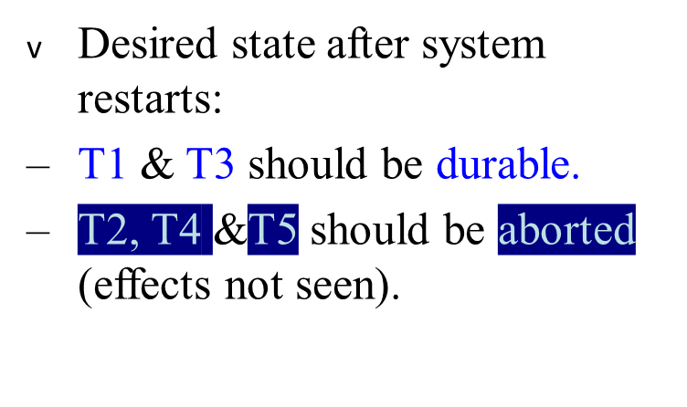
Motivation
Atomicity:
  Transactions may abort (“Rollback”).
Durability:
  What if DBMS stops running? (Causes?)
crash!
T1
T2
T3
T4
T5
Commit
Abort
Commit

Slide 15
Primitive Operations of Transactions
Transaction interact with the database
  The space of disk blocks holding the database elements
  Virtual or main memory address space managed by buffer manager
  The local address space of a transaction.
Reading
  Data is brought to main memory buffers, the buffer(s) can be read by transaction into its own address space.
Writing
  New value is created its own space.
  The value is copied to buffers

Slide 16
Primitive Operations of a Transaction
The buffers may not be copied immediately.
  The decision is the responsibility of buffer manager
  We must force the buffer manager to disk at appropriate time.
  May result into more disk I/Os!
To reduce the disk I/Os, database systems allow a change to exist only in a volatile main memory storage for a certain periods of time.

Slide 17
Primitives..
INPUT(X): Copy the disk block containing disk block X
READ(X,t): Copy the database element X to the transaction’s local variable t.
  Read(X,t) calls INPUT(X).
WRITE(X, t): Copy the value of local variable t to database element X in a memory buffer.
  WRITE(X,t) calls INPUT(X), if X is not in memory buffer.
OUTPUT(X): Copy the buffer containing to disk.
INPUT and OUTPUT operations are issued by buffer manager.
READ/WRITE are issued by transaction.
Assumption
  A database element is no larger than a single block.

Slide 18
Example
T1: Read (A,t); t ← t×2
Write (A,t);
Read (B,t); t ← t×2
Write (B,t);
Output (A);
Output (B);
A: 8
B: 8
A: 8
B: 8
memory
disk

Slide 19
Example
T1: Read (A,t); t ← t×2
Write (A,t);
Read (B,t); t ← t×2
Write (B,t);
Output (A);
Output (B);
A: 8
B: 8
A: 8
B: 8
16
16
memory
disk

Slide 20
Example
T1: Read (A,t); t ← t×2
Write (A,t);
Read (B,t); t ← t×2
Write (B,t);
Output (A);
Output (B);
failure!
A: 8
B: 8
A: 8
B: 8
16
16
16
memory
disk

Slide 21
Atomicity
Need atomicity: execute all actions of a transaction or none at all

Slide 22
One solution: undo logging (immediate
modification)

Slide 23
Outline
Issues and Models for Resilient Operation
Undo logging (Immediate Modification)
Redo logging (Delayed modification)
Undo/Redo logging (Combination)
Protecting against media failures

Slide 24
Logging
A log is a sequence of log records
  Each tells what a transaction has done.
When a system is crashed, log is consulted.
  Committed: new values are written into database
  Uncommitted: old values are restored into the database.

Slide 25
Log records
Log is a file opened for appending only
Log manager records each important event.
Log records are written into main memory soon as is feasible.
<START T>: Transaction T has begun
<COMMIT T>: T has completed successfully.
  Any changes to the database should appear on disk.
  But, it may not be. But, log manager should force.
<ABORT T>: T could not complete successfully.
  TM must ensure that such changes never appear on disk. Effect on disk has to be cancelled if they do.

Slide 26
Undo Logging
Uncommitted transaction effects are undone.

Slide 27
Undo logging rules
U1: If T modifies X, then write <T, X,v> to disk before the new value of X written to disk.
(write ahead logging: WAL)
U2: Before commit is flushed to log, all writes of transaction must be reflected on disk.
Summary
  Write the log records
  Write the data elements
  Write the COMMIT log record.

Slide 28
FLUSH Log Command
To force log records to disk, log manager issues a flush-log command.
  Tells the buffer manager to copy to disk any log blocks that have not previously been copied to disk or that have been changed since they were last copied.

Slide 29
Undo logging (Immediate modification)
T1: Read (A,t); t ← t×2 A=B
Write (A,t);
Read (B,t); t ← t×2
Write (B,t);
Output (A);
Output (B);
A:8
B:8
A:8
B:8
memory
disk
log

Slide 30
Undo logging (Immediate modification)
T1: Read (A,t); t ← t×2 A=B
Write (A,t);
Read (B,t); t ← t×2
Write (B,t);
Output (A);
Output (B);
<T1, start>
<T1, A, 8>
A:8
B:8
A:8
B:8
16
16
memory
disk
log

Slide 31
Undo logging (Immediate modification)
T1: Read (A,t); t ← t×2 A=B
Write (A,t);
Read (B,t); t ← t×2
Write (B,t);
Output (A);
Output (B);
<T1, start>
<T1, A, 8>
A:8
B:8
A:8
B:8
16
16
16
<T1, B, 8>
memory
disk
log

Slide 32
Undo logging (Immediate modification)
T1: Read (A,t); t ← t×2 A=B
Write (A,t);
Read (B,t); t ← t×2
Write (B,t);
Output (A);
Output (B);
<T1, start>
<T1, A, 8>
A:8
B:8
A:8
B:8
16
16
16
<T1, B, 8>
16
memory
disk
log

Slide 33
Undo logging (Immediate modification)
T1: Read (A,t); t ← t×2 A=B
Write (A,t);
Read (B,t); t ← t×2
Write (B,t);
Output (A);
Output (B);
FLUSH LOG
<T1, start>
<T1, A, 8>
A:8
B:8
A:8
B:8
16
16
16
<T1, B, 8>
16
<T1, commit>
memory
disk
log

Slide 34
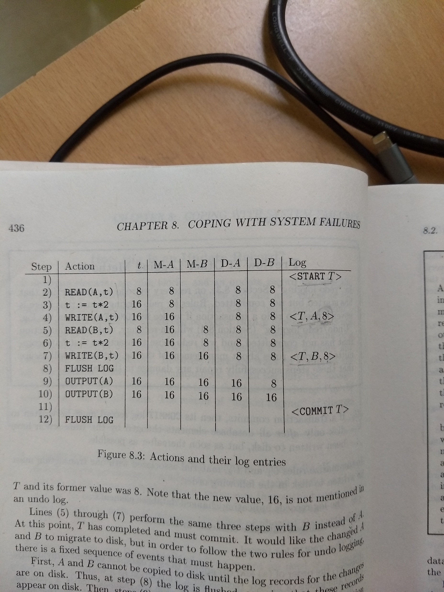

Slide 35
One “complication”
Log is first written in memory
Not written to disk on every action
memory
DB
Log
A: 8
B: 8
A: 8 16
B: 8 16
Log:
<T1,start>
<T1, A, 8>
<T1, B, 8>

Slide 36
One “complication”
Log is first written in memory
Not written to disk on every action
memory
DB
Log
A: 8
B: 8
16
A: 8 16
B: 8 16
Log:
<T1,start>
<T1, A, 8>
<T1, B, 8>
BAD STATE
# 1

Slide 37
One “complication”
Log is first written in memory
Not written to disk on every action
memory
DB
Log
A: 8
B: 8
16
A: 8 16
B: 8 16
Log:
<T1,start>
<T1, A, 8>
<T1, B, 8>
<T1, commit>
BAD STATE
# 2
...
<T1, B, 8>
<T1, commit>

Slide 38
Recovery rules: Undo logging
For every Ti with <Ti, start> in log: - If <Ti,commit> or <Ti,abort>
in log, do nothing
- Else For all <Ti, X, v> in log:
write (X, v)
output (X )
Write <Ti, abort> to log

Slide 39
Recovery rules: Undo logging
(1) Let S = set of transactions with <Ti, start> in log, but no
<Ti, commit> (or <Ti, abort>) record in log
(2) For each <Ti, X, v> in log,
in reverse order (latest → earliest) do:
- if Ti ∈ S then - write (X, v)
- output (X)
(3) For each Ti ∈ S do
- write <Ti, abort> to log

Slide 40
What if failure during recovery?
No problem!  Undo idempotent

Slide 41
Checkpointing
Recovery requires that entire log record is examined.
Deletion of log is not possible.
If we truncate the log after the commit of one transaction, log records of other transaction might be lost.
Solution: checkpoint the log periodically
  Stop accepting new transactions
  Wait until all currently active transactions commit.
  Flush the log to disk.
  Write the log record <CKPT>, and flush the log again.
  Resume accepting transactions

Slide 42
Recovery with Checkpoint
No need to scan beyond check point.

Slide 43
Nonquiescent Checkpointing
We must shut down the system while checkpoint is made
Complex technique: nonquiescent Checkpointing
  Write a log record <START CKPT(T1,…Tk)> and flush the log.
    T1,..,Tk are active transactions.
  Wait until all of T1..Tk commit or abort, but do not prohibit other transactions from starting.
  When all completed, write <END CKPT> record and flush the log.

Slide 44
Recovery with Nonquiescent Checkpointing
If we first meet the <END CKPT> record, we scan till <START CKP> record and start backwards; previous log is useless.
If we first meet <START CKPT(T1,..Tk)>, crash occurred during the check point. No need to scan earliest of these transactions.

Slide 45
Example
<START,T1>
<T1,A,5>
<START T2>
<T2, B, 10>
<START CKPT(T1,T2)>
<T2, C, 15>
<START T3>
<T1, D, 20>
<COMMIT T1>
<T3, E, 25>
CRASH
<START,T1>
<T1,A,5>
<START T2>
<T2, B, 10>
<START,T1>
<T1,A,5>
<START T2>
<T2, B, 10>
<START CKPT(T1,T2)>
<T2, C, 15>
<START T3>
<T1, D, 20>
<COMMIT T1>
<T3, E, 25>
<COMMIT T2>
<END CKPT>
<T3, F, 30>

Slide 46
Outline
Issues and Models for Resilient Operation
Undo logging
Redo logging
Undo/Redo logging
Protecting against media failures

Slide 47
REDO LOGGING
Problem with UNDO LOGGING
  We can not commit without first writing all its changed data to disk.
We can save disk I/Os if we keep the data as long as we can in the main memory with the ability to fix the things in case of crash.

Slide 48
Differences with redo and undo logging
During recovery
1
  Undo logging cancels the effect of incomplete transactions and ignores committed ones during recovery.
  Redo ignores incomplete transactions and repeats the changes made by committed transactions.
2
  UNDO logging requires us to write the changed database elements to disk before COMMIT record reaches disk.
  REDO logging requires that the COMMIT record appear on disk before any changed values reach disk
3.
  To recover, we need new values in REDO logging.

Slide 49
The REDO-logging rule
Every time T modifies a database element X, a record of the form <T,X,v> must be written to the log.
  Transaction T wrote a new value of “v” for X. No indication of old values.
Rule 1
  Before modifying any data element X on disk, it is necessary that all log records pertaining to this modification of X, including both the update record <T,X,v> and the <COMMIT T> record, must appear on disk.
Order of operations- REDO logging
  The log records indicating changed database elements
  The COMMIT record
  The changed database elements themselves.

Slide 50
Recovery with REDO
Identify committed transactions
Scan the log forward from the beginning. For each log record <T,X,v> encountered.
  (a) If T is not a committed transaction, do nothing.
  (b) If T is committed, write value v for X.
For each incomplete transaction T, write an <ABORT T> record to the log and flush the log.

Slide 51
Checkpointing a REDO log
Write all the actions of transactions which have committed and not written to disk.
  1. Write a log record <START CKPT<T1,..,Tk>, where T1,..Tk are all active transactionss. FLUSH the log.
  Write to DISK all databse elements that were written to buffers but not yet to disk by transactions that had already committed when the START CKPT record was written to the log.
  Write <END CKPT> record to the log and
  FLUSH the log.

Slide 52
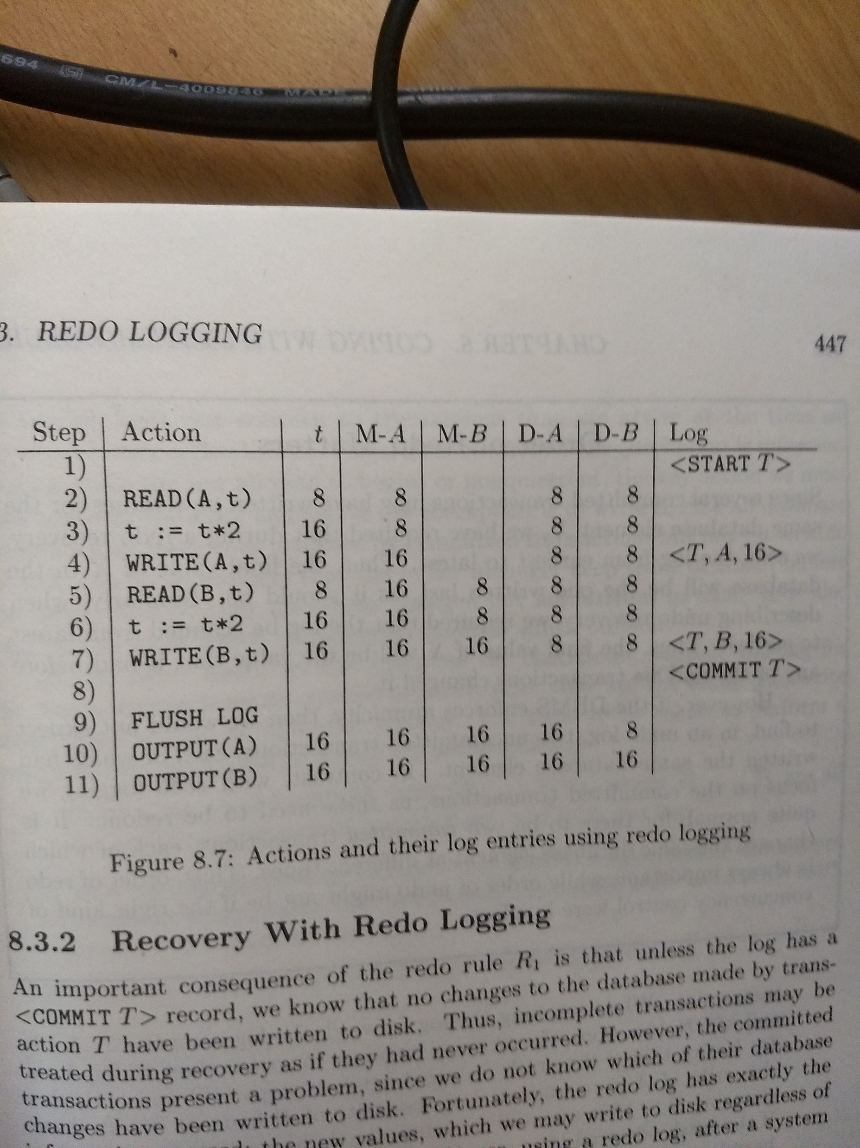

Slide 53
Recovery with a Checkpointed Redo Log
Suppose the last checkpoint record before crash is <END CKPT>.
  Every transaction before <START CKPT(T1,..,Tk)> has had its changes written to the disk so need not be recovered.
  Link the START records and redo the transactions.
Suppose last checkpoint record on the log is a <START CKPT<T1,..,Tk)> record.
  We are not sure that committed transactions are written to disk.
  REDO all the transactions by finding the START records through links.
All the records before START Ti can be deleted.

Slide 54
Outline
Issues and Models for Resilient Operation
Undo logging
Redo logging
Undo/Redo logging
Protecting against media failures

Slide 55
UNDO/REDO logging
UNDO logging requires that data to be written to disk immediately. Increases disk I/Os.
REDO logging requires us to keep all the modified blocks in buffers until the log records have been flushed. Increases the number of buffers.
REDO/UNDO logging provides more flexibility,

Slide 56
UNDO/REDO rules
Log record
  <T,X,v,w>, T has changed the values of X from v to w.
UR1
  Before modifying any database element X on disk because of changes made by T, it is necessary that update record <T,X,v,w> appears on disk.
  The COMMIT T record can precede or follow.

Slide 57
Recovery with UNDO/REDO Logging
Rules
  Redo all the committed transactions in the order earliest-first, and
  Undo all the incomplete transactions in the order latest-first.

Slide 58
Checkpointing an Undo/Redo log
It is simpler
  Write <START CKPT(T1,..Tk)> record in the log, where T1,..Tk are active transactions.
  Write to disk all he buffers that are dirty.
  Write <END CKPT> record in the log.

Slide 59
Outline
Issues and Models for Resilient Operation
Undo logging
Redo logging
Undo/Redo logging
Protecting against media failures

Slide 60
Protecting against media failures
Log can protect us from system failures when only main memory contents are lost.
We can also recover when disks crashes
  The log is maintained on other disk
  The log were never thrown away after a checkpoint, and
  The log is of redo or undo/redo type , so new values are stored on the log.
    It is not practical to keep the log as size of log is very large.

Slide 61
The archive
Archiving is the solution to media failures
  Maintaining a copy of the database separate from the database it self.
Shutdown the database and make a copy.
  Recovery: backup+log.
  Loosing a log
    Maintain online log at the remote place.
Writing a archive is a lengthy process.
  Full dump: entire database is dumped
  Incremental dump, only those elements changed since the previous full or incremental dump are copied.
    Level 0 dump, level “i” dump.

Slide 62
Nonquiescient Archiving
Database is shutdown for a certain period for normal dump.
Similar to nonquiescient checkpointing we can have nonquiescient archiving.
  Write a log record <SATRT DUMP>
  Perform checkpoint
  Perform full or incremental dump of data.
  Make sure that log is stored at remote and secure location.
  Write a log record <END DUMP>

Slide 63
Recovery Using an Archive and log
Restore the database from archive
  Find the recent full dump and reconstruct the database from it.
  If there are incremental dumps, modify the database according to each, earliest first.
  Modify the database using surviving log.
  Use the method of recovery appropriate to the logging method.

