Slide 1
Data Storage
Chapter 2

Slide 2
Introduction
DBMS deal with large amounts of data
  We cover the following issue in this chapter
    How does computer systems store and manage large amounts of data ?
    What representation and data structures best support efficient manipulation of data

Slide 3
Outline
Introduction
The memory hierarchy
  Cache
  Main memory
  Virtual memory
  Moor’s law
  Secondary Storage
  Tertiary storage
  Volatile and nonvolatile storage
Disks
  Mechanics of disks
  The disk controller
  Disk storage characteristics
  Disk access characteristics
  Writing blocks
  Modifying blocks
Simple file system
Using secondary storage efficiently
  The I/O model of computation
  Storing data in secondary storage
  Merge sort
  Two phase, multiway merge sort
  Extension of multiway to larger relations

Slide 4
Outline
Improving the access time of secondary storage
  Organizing data by cylinders
  Using multiple disks
  Mirroring disks
  Disk scheduling and elevator algorithm
  Prefetching and large-scale buffering
  Summary of strategies and tradeoffs
Disk failures
  Intermittent failures
  Checksums
  Stable storage
  Error handling capabilities of stable storage
  Recovery from disk crashes
  The failure model of disks
  Mirroring as a redundancy tencnique
  Parity blocks
  RAID 5
  Coping with multiple disk crashes

Slide 5
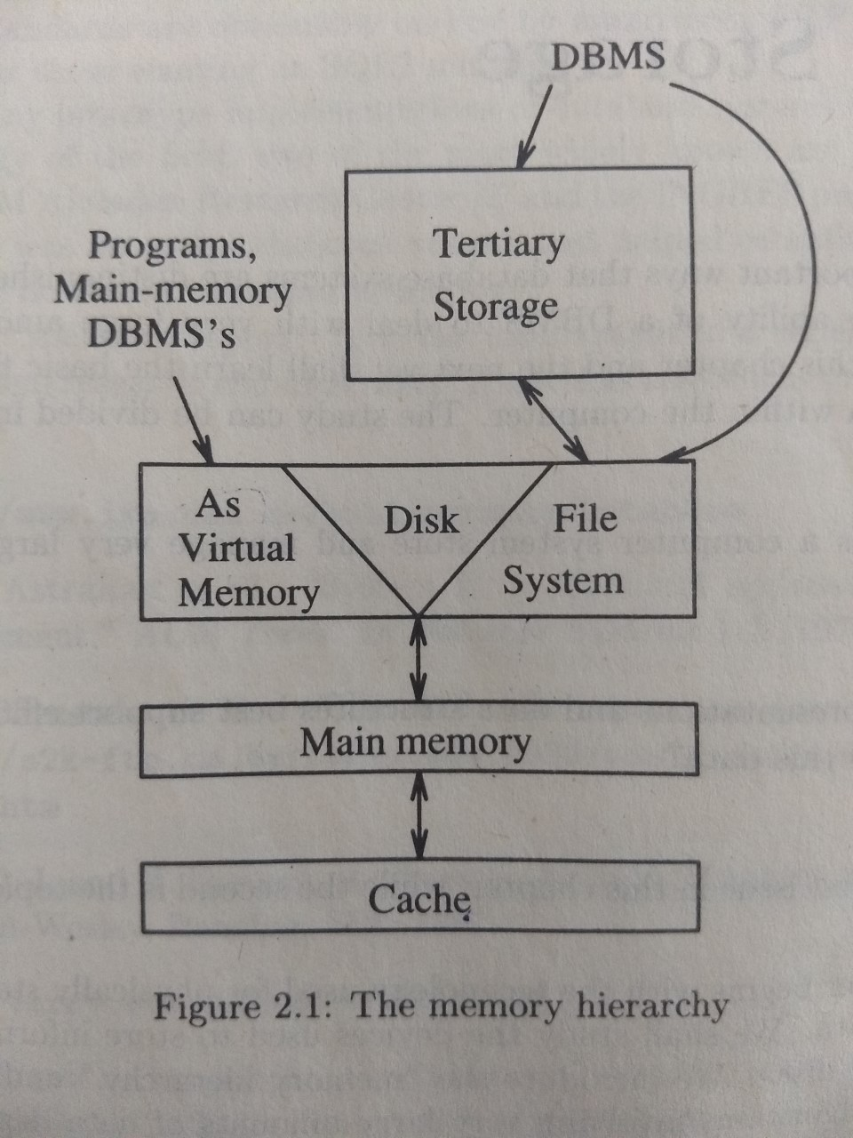
The memory hierarchy

Slide 6
Processor
Processor
  Fast, reduced instruction set, with cache, pipelined…
Speed: 100 → 500 → 1000 MIPS
Speed 10 nanoseconds
(10⁻⁸ seconds) or less

Slide 7
Cache
Copy of instructions in main memory
Unit of transfer is small number of bytes
  On board cache
  L2 cache
In a single computer, no need to update the main memory when a cache is modified
In case of muiltiprocessor system
  Update to cache should be reflected in main memory
Speed between cache and main memory 10 to 100 nano seconds (10⁻⁷ seconds)
Smallest capacity
  High Speed
  Highest cost per byte

Slide 8
Main memory
Important component
  100 MB and GB range are available
Random access
  One can obtain any byte in the same time
If the data is in main memory the access time is 10 to 100 nsec range.( 10⁻⁸ to 10⁻⁷ sec range.

Slide 9
Virtual Memory
The program/data ocupies virtual memory address space.
Many machines have 32 bit address space
  Can address 2³² or about 4 billion different addresses.
  So typical virtual memory is 4 GB.
Since virtual memory is much bigger than main memory most of the content is stored in disk.
Large scale database systems mange the data on disk.

Slide 10
Moore’s law
Integrated circuits are improving and performance doubles every 18 months
  Speed of processors
  Cost of main memory per bit
  Cost of disk per unit
The following parameters do not follow Moore’s law
  Speed of accessing data in main memory
  Speed of disk rotation
Processor computation time is reducing
Relatively the distance of disk from CPU is increasing.

Slide 11
Secondary Storage
Disk is used to store virtual memory and file system
Cheaper than main memory
Capacity is very high
When the file is open for reading, the OS reserves one block of man memory as a buffer for a file. After consuming the data in the block, another block is transferred.
DBMS manages the blocks itself.
It takes 10 to 30 msec to read or write the block on the disk

Slide 12
Tertiary Storage
There are databases bigger than disks
Teriary storage devices have been developed to hold data volumes measured in tera bytes.
Tertiary storage access times 1000 times slower than disk access times.
  Ad-hoc storage
    A person mounts the tape
  Optical/Disk Juke boxes
    Racks of CDROMS
    Bringing the disk through Robot
    Tape silos
      Racks of tapes, Robot searchers and places in the reader

Slide 13
Volatile and Nonvolatile Storage
Storage can be volatile or nonvolatile
  Volatile
    Forgets the data when the power goes-off
    Losing the information in case of a failure
    Main memory
  Nonvolatile
    Contents are intact when the power goes-off.
    Disk

Slide 14

Disks
Mechanics of Disks

Slide 15
Top View
tracks
Sector
Gap

Slide 16
Mechanics of Disks
Platter, Head, Actuator, Cylinder, Track, Sector (physical), Block (logical), Gap
Disk assembly
  Consists of one or more disk platters that rotate around a central spindle
Tracks
  Data are stored into tracks which are concentric circles on a single platter
  Tracks represent many points each represent a single bit by direction of magnetism
Sectors
  Tracks are organized into sectors
  The circle is separates by gaps
  It is an indivisible unit as far as reading or writing of disk is concerned.
  If the sector is corrupted, it can not be used.
Gaps represent 10 % of total area and help to identify the beginning of sectors.
Blocks of logical units of data consists of one or more sectors.

Slide 17
Mechanics of Disks
Head assembly holds disk heads
    One head for each surface
The disk controller is capable of
  Controls the mechanical actuator that moves head assembly. The tracks under the heads at the same time are said to form a cylinder
  Selecting the surface and a sector for read and write
  Transferring the bits read from the desired sector to the main memory and writing the main memory contents to the disk.

Slide 18
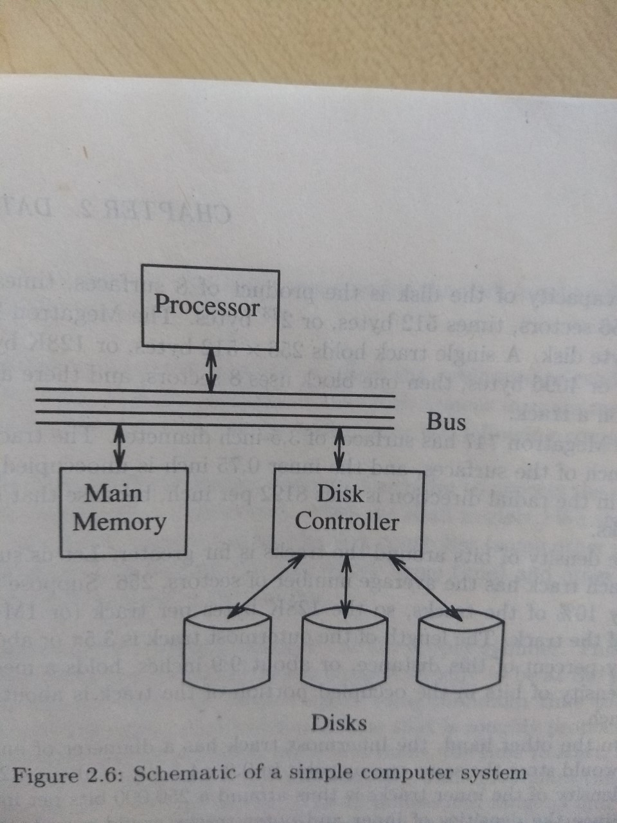

Slide 19
Disk Storage Characteristics
Measures associated with the disk
  Rotation speed of disk assembly
    5400 RPM, one rotation for every 11 msec.
  Number of platters per unit
    Typical disk has four to five platters
  Number of tracks per surface
    A surface may have 10,000 tracks
  Number of bytes per track
    10⁵ or more bytes per track.

Slide 20
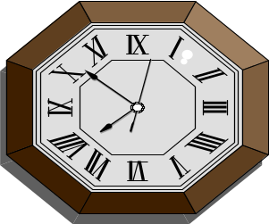
Data Access Characteristics
Disk Access Time
I want
block X
block x
in memory
?

Slide 21
Disk Access Time
Disk access time can be broken into two parts
  Processing time
  Seek time: moving head assembly at the proper cylinder
  Rotational latency: time for the disk to rotate to the first sector
  Transfer time:
    Less than msec
Time = Seek Time +
Rotational Delay +
Transfer Time +
Other

Slide 22
Seek Time
3 or 5x
Time
x
1
N
Cylinders Traveled

Slide 23
Average Random Seek Time
N
N
∑ ∑ SEEKTIME (i → j)
S =
N(N-1)
i=1
j=1
j≠i

Slide 24
Average Random Seek Time
N
N
∑ ∑ SEEKTIME (i → j)
S =
N(N-1)
i=1
j=1
j≠i
“Typical” S: 10 ms → 40 ms

Slide 25
Rotational Delay
Head Here
Block I Want

Slide 26
Average Rotational Delay
R = 1/2 revolution
“typical” R = 8.33 ms (3600 RPM)

Slide 27
Transfer Rate: t
“typical” t: 1 → 3 MB/second
transfer time: block size
t

Slide 28
Other Delays
CPU time to issue I/O
Contention for controller
Contention for bus, memory

Slide 29
Other Delays
CPU time to issue I/O
Contention for controller
Contention for bus, memory
“Typical” Value: 0

Slide 30
So far: Random Block Access
What about: Reading “Next” block?

Slide 31
If we do things right (e.g., Double Buffer, Stagger Blocks…)
Time to get = Block Size + Negligible
block t
- skip gap
- switch track
- once in a while,
next cylinder

Slide 32
Rule of Random I/O: Expensive
Thumb Sequential I/O: Much less
Ex: 1 KB Block
        Random I/O: ∼ 20 ms.
        Sequential I/O: ∼ 1 ms.

Slide 33
Cost for Writing similar to Reading
…. unless we want to verify!
need to add (full) rotation + Block size
t

Slide 34
To Modify a Block?

Slide 35
To Modify a Block?
To Modify Block:
(a) Read Block
(b) Modify in Memory
(c) Write Block
[(d) Verify?]

Slide 36
Block Address:
Physical Device
Cylinder #
Surface #
Sector

Slide 37

About Simple File System

Slide 38
Introduction
Simplified version of a typical UNIX file system
  Introduce some of the basic on-disk structures, access methods, and various policies that you will find in many file systems today.
  Other file systems
    AFS (the Andrew File System)
    ZFS (Sun’s Zettabyte File System)
Two aspects
  data structures of the file system.
    What types of on-disk structures are utilized by the file system to organize its
    data and metadata?
  access methods.
    How does it map the calls made by a process, such as open(), read(), write(), etc., onto its structures?
    Which structures are read during the execution of a particular system call? Which are written?
    How efficiently are all of these steps performed?

Slide 39
Outline
Explain about simple file system
i-node
Directory organization
Access paths

Slide 40
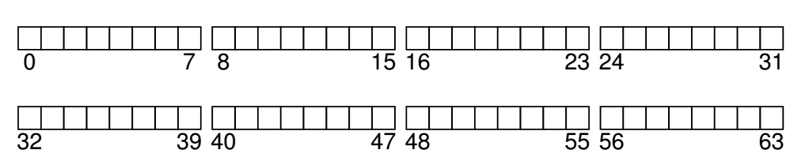
Overall Organization
Disk is divided into blocks
  For example, the block size is 4k.
Assume a small disk has 64 small blocks.

Slide 41
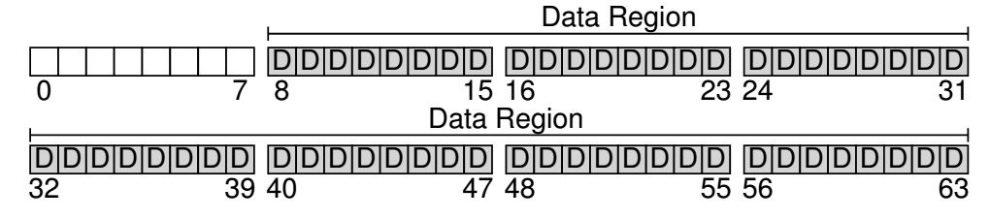
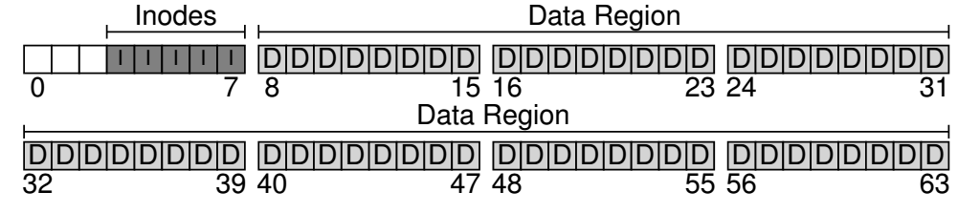
We will allocate 56 blocks for data
File system has to track information about files
To store this information i-nodes are used
Five blocks are assigned to i-nodes.
The inodes are typically not that big, for example 128 or 256 bytes.
Assuming 256 bytes per inode, a 4-KB block can hold 16 inodes, and our file system above contains 80 total inodes.

Slide 42
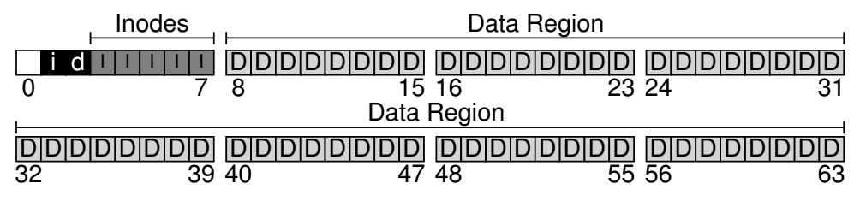
Tracking of Files: bit maps
We have to track whether inodes or data blocks are free or allocated.
  Bitmaps are used
    One for data region and one for inode region

Slide 43
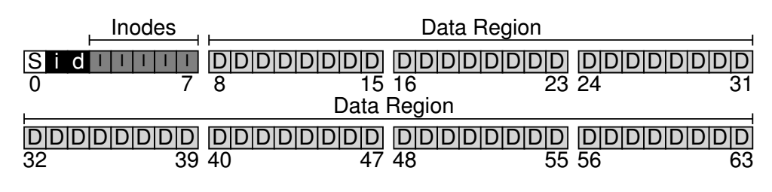
Super Block
The superblock contains information about this particular file system, including, for example, how many inodes and data blocks are in the file system (80 and 56, respectively in this instance), where the inode table begins (block 3), and so forth. It will likely also include a magic number of some kind to identify the file system type (in this case, vsfs).

Slide 44
Mounting of a File System
Reading of super block and initialize the parameters and attaching the volume to the file system tree

Slide 45
File Organization
i-node is the short form of index node
Each inode is implicitly referred to by a number (called the inumber), which we’ve earlier called the low-level name of the file.
In vsfs (and other simple file systems), given an i-number, you should directly be able to calculate where on the disk the corresponding inode is located.

Slide 46
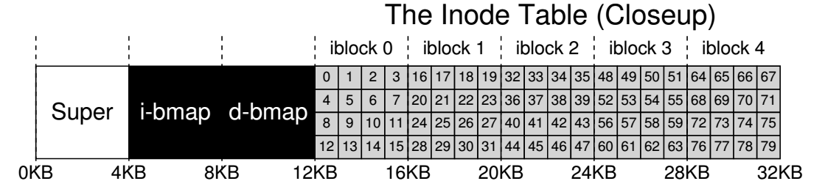
To read inode number 32, the file system would first calculate the offset into the inode region (32 · sizeof(inode) or 8192), add it to the start address of the inode table on disk (inodeStartAddr = 12KB), and thus arrive upon the correct byte address of the desired block of inodes: 20KB.
Recall that disks are not byte addressable, but rather consist of a large number of addressable sectors, usually 512 bytes. Thus, to fetch the block of inodes that contains inode 32, the file system would issue a read to sector 20×1024/ 512 , or 40, to fetch the desired inode block. More generally, the sector address iaddr of the inode block can be calculated as follows:
blk = (inumber * sizeof(inode_t)) / blockSize;
sector = ((blk * blockSize) + inodeStartAddr) / sectorSize;

Slide 47
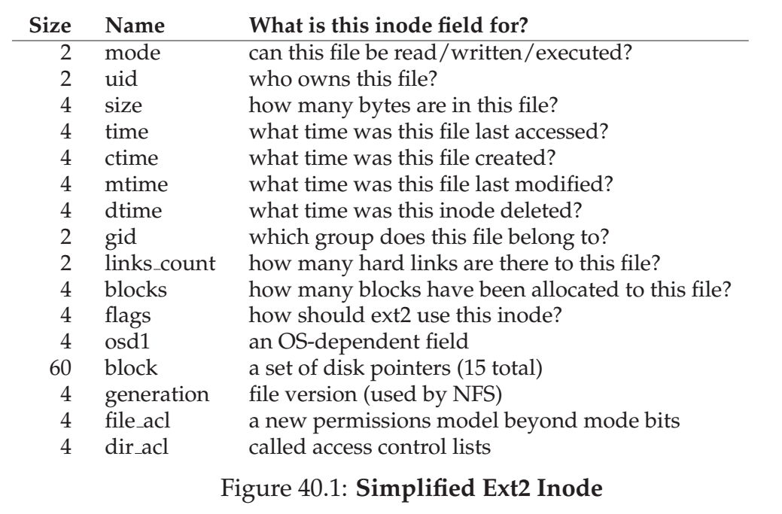

Slide 48
Supporting Big files
Multi-level index
Instead of pointing to data block, i-node points to block of pointers.
Notion of extents are used
  An extent is simply a disk pointer plus a length (in blocks); thus, instead of requiring a pointer for every block of a file, all one needs is a pointer and a length
  to specify the on-disk location of a file.
Link based approaches

Slide 49
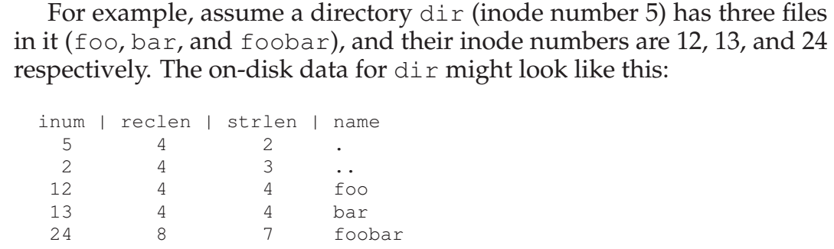
Directory Organization
A directory has list of pairs (entry name and i-node number)
File systems treat directories as special type of file.

Slide 50
Access Paths: Reading and Writing
Reading and writing require several I/Os

Slide 51
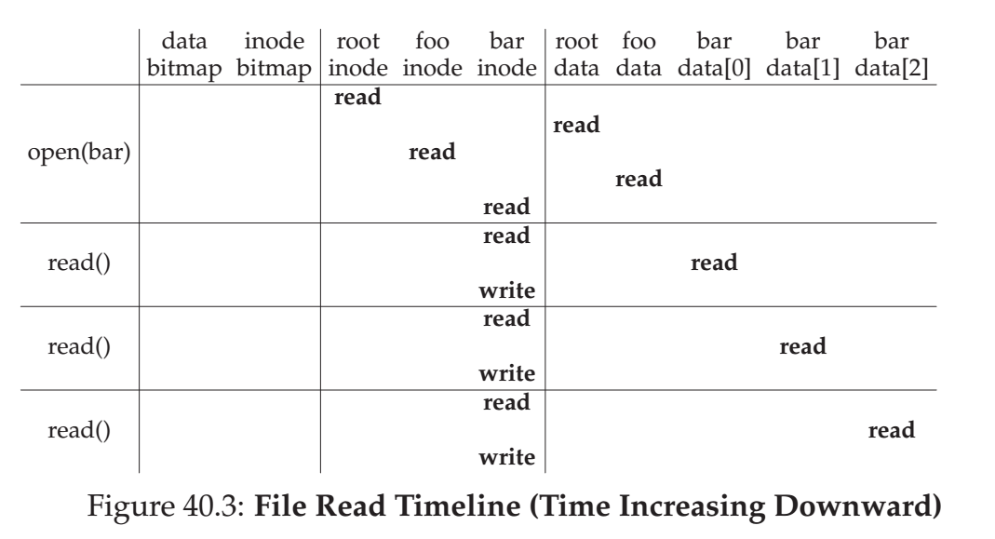

Slide 52
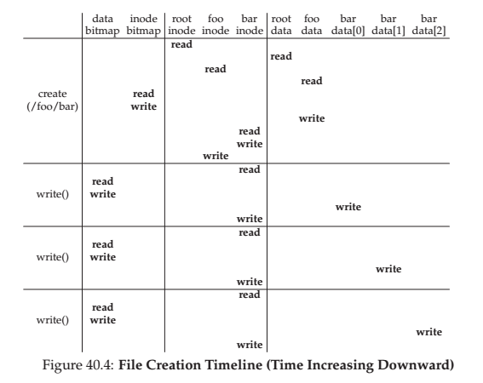

Slide 53
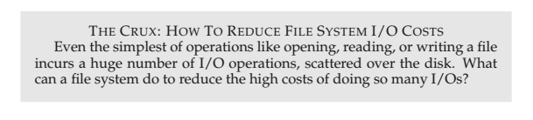

Slide 54
Techniques: Caching and buffering
Use caching or DRAM to cache important blocks

Slide 55
Using Secondary Storage Effectively
RAM model of computation
  In most algorithms it is assumed that data is in main memory
For DBMS we have to assume that data does not fit main memory.
  We have to consider use of disk and tertiary storage
Best algorithms for processing large amounts of data differ from main memory algorithms.
We have to design algorithms that limit disk accesses.
  The logic can be extended to any level

Slide 56
The I/O model of computation
I/O model of computation
  Data is in disk.
  Time taken to perform read or write is much larger than the time likely to used for manipulating data in main memory.
  I/O cost dominates the processing time.
  Good estimate: number of block accesses
It will take on the order of 15 msec to read block. Processing time is 1% percent and can be neglected safely.

Slide 57
Sorting the data in secondary storage
Merge sort
  If the data fits in main memory quick sort can be used.
    Classic merge-sort algorithm
      Divide the list arbitrarily into two lists
      Recursively sort the two lists.
      Merge the sorted lists.

Slide 58
Sorting the data in secondary storage
Two phase, Multiway merge sort is the preferred algorithm
  Phase 1: Sort main-memory sized pieces of data
  Phase 2: Merge the all the sorted lists into a single sorted list.

Slide 59
Phase1: Forming a sorted sub-list
Fill the available memory with blocks from the original relation.
Sort the records that are in main memory.
Write the sorted records from main memory onto new blocks of secondary memory, forming one sorted sub-list.

Slide 60
Phase 2: Merging the sorted lists
Merging by pairs results into 2log₂n times reading of data.
The following algorithm is followed
  Find the smallest key among the first remaining elements of the all the lists
    Linear search
  Move the smallest element to output list
  If the output block is full, re-initialize same buffer for the next output block
  If the input block is empty, get the next elements of the same sorted list, if there are no elements, leave it empty.

Slide 61
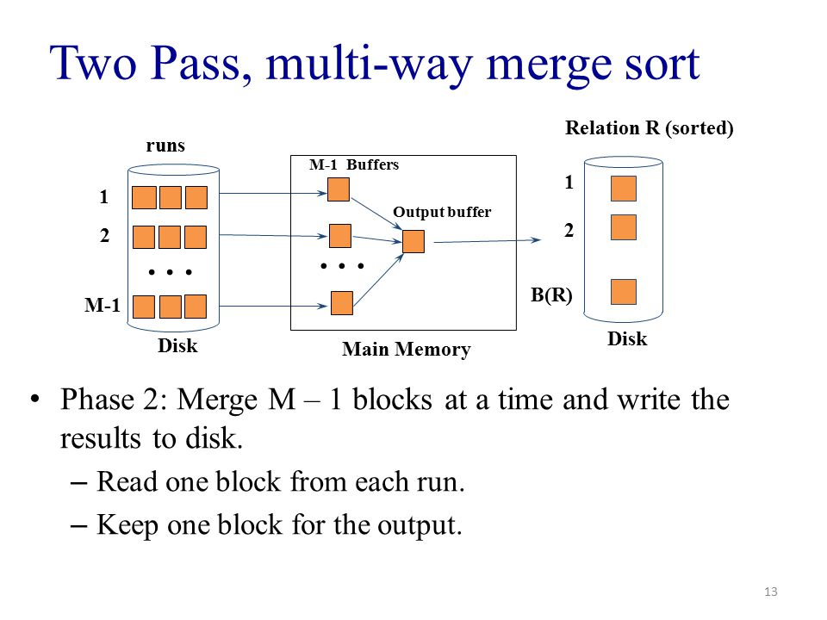

Slide 62
Extension of Multiway merging to Larger Relations
The two-phase multiway Merger-sort can be used to sort large number of records.
  Let the block size is B bytes
  Main memory available for buffering blocks is M bytes
  Record takes R bytes.
  The number of buffers available= M/B.
    One is for output buffer
  The number of sorted sub-lists= (M/B)-1
    Number of times we fill main memory with records to be sorted.
  Each time we fill the memory we sort M/R records.
  The total number of records we can sort is (M/R)((M/B)-1)= M²/RB records.
Suppose M=50,000,000, B=4096 and R=100 we can sort up to M²/RB=6.1 billion records, occupying six tenth of tera byte.
If we want to sort more records, we can add a third phase.
  What is the size ?
  75 trillion records

Slide 63
Time consumed for Phase 1 and Phase 2: Example
R consists of 10,000,000 tuples (10 million)
Main memory= 50MB (actual mainmemory is 64MB) ;
Disk block=4K (4096 bytes)
100 bytes for each record
40 tuples for each block
250,000 blocks.
The number of blocks in 50MB= 50*2^20/2^12=12,800 blocks
We will fill 20 times
Reading and writing a block= 15msec+15msec=30msec
7500 seconds for reading and writing=125 minutes
First phase: 125 minutes
Second phase=125 minutes

Slide 64
Improving the access time of secondary storage
If the blocks are placed randomly, it is good to execute small queries.
If the system is sorting a large relation, it is better to store the data in consecutive blocks.
Some strategies
  Place the blocks that are accessed together in the same cylinder
  Divide the data into several small disks rather than one.
  Mirror the disk
    Reliability and parallelism
  Use the disk scheduling algorithm
    OS, disk scheduler or DBMS should select the order in which several request bocks will be read or written.
  Pre-fetch the blocks to main memory in anticipation of their later use.
We discuss the following
  Dedicated case
  Multiple processes and mix of queries case.

Slide 65
Organizing data in cylinders
Seek time represents about half the average time to access the block.
If we choose to read all the blocks on a single track or cylinder, we can ignore the first seek time.
So, store the blocks in one cylinder
  If exceeds, store in adjacent cylinders.
First phase is reduced to 2.15 minutes
No help for second phase.

Slide 66
Using Multiple disks
Replace one disk with multiple disks, with heads locked together
Resulting effect
  All (reading, writing) times are divided by number of disks.
Speed-up factor of number of disks
If we have four disks
  Phase 1=1 minute
  Phase 2= 60 minutes (approximate, pessimistic)

Slide 67
Mirroring disks
Make disks to have identical copies of data
They do not speed-up writing.

Slide 68
Disk scheduling and
Elevator algorithm
Elevator algorithm
  Disk head makes sweeps across the disk, from innermost to outermost cylinder them back again.
  Like an elevator
If the average number of waiting for the disks increases, the elevator algorithm further improves the throughput.

Slide 69

C-LOOK (Cont.)

Slide 70
Pre-fetching and Large-scale buffering
Pre-fetching or double buffering
  In applications where we predict the order of blocks.
Fetch all the data
  Load all the buffers before they are needed.
Merge sort
  Read whole tracks or whole cylinders whenever we need some more records from a given list.
Requires extra memory buffers

Slide 71
Summary
Combination of tricks
  Reduced to 8.6 minutes from 4 hours

Slide 72
Disk Failures
Types of failures
  Intermittent failures
    Attempt to read/write a sector is unsuccessful, but repeated tries are able to read
  Media decay:
    Bits or bits are permanently corrupted.
  Write failure
    Unable to write, or unable to read the written data
  Disk crash
    Entire disk becomes unreadable.

Slide 73
Intermittent failures
Disk sectors store redundant bits
  Purpose of redundant bits
    To know whether written data is correct or not
A reading function returns a pair (w,s), where “w” is a data in the sector that is read and “s” is the status bit that tells whether the data read is correct or not.
In the intermittent failure the status is bad several times.
Checksums are used
  parity

Slide 74
Stable Storage
Checksum does not help in correcting the error
  What will happen if write the data and unable to read the data ?
  If we overwrite the data and unable to read the old and new data ?
Implement the stable storage on several sectors or several disks
Stable storage Idea
  Each sector is paired. Each pair represents one sector
    Left and right copies (XL and XR)
  Stable write
    (1)Write the value of X into XL.
      Repeat the write as long as status is returned as good
      Otherwise, select another sector in place of XL
    Repeat (1) for XR
  Stable read
    (2) if the status is bad, repeat the read the number of times.
    If we can not read XL,repeat (2) with XR.

Slide 75
Error handling capabilities of stable storage
Media failures
  If one of the sector fails, we can always read from the other
Write failures
  If the power fails while writing, one of the sector goes bad.
    We are able to determine the old value of sector.
  If the failure occurs after writing XL, new value can be read.

Slide 76
Recovery from Disk Crashes
(Head Crash)
Failure model of disks
Mean time to failure.
  It is a length of time by which 50% of a population of disks have failed catastrophically.
  about 10 years
Assuming linear assumption
  If 50 percent failed in 10 years, then 5 % fail in first year.
Disk crash does not mean data loss
  Alternative schemes are used for data.

Slide 77
Recovery from Disk crashes
Disk Mirroring
  One is data disk and another is mirror or redundant disk
  Referred as RAID-level 1
  Mean time to memory loss is very higher than mean time to disk failure
  If there is a disk crash which first disk is repaired or copied, there is a problem

Slide 78
Disk failure
Suppose, replacing a failed disk takes 3 hours (1/8 of a day or 1/2920 of a year).
Disk failure rate is 5%
The probability that mirror disk fails during copying is
  (1/20)*(1/2920) or one in 58, 400.
If the disk fails one in 10 years, one of the two disks will fail once in 5 years.
Mean time to failure is: 5*58,400=292,000 years.

Slide 79
RAID Structure
Refer Chapter 12 Mass-Storage Structure, pages 556-565
Operating Systems, Abraham, Silberschatz, Peter B Galvin, Gerg Gagne, Ninth edition, Wiley

Slide 80
RAID Structure
Problem with disk
  Data transfer rate is limited by serial access.
  Reliability
Solution to both problems: Redundant arrays of inexpensive disks (RAID)
In the past RAID (combination of cheap disks) is alternative for large and expensive disks.
Today: RAID is used for their higher reliability and higher data-transfer rate.
So the I in RAID stands for “independent” instead of ‘inexpensive”.
  So RAID stands for Redundant Arrays of Independent Disks.
RAID is arranged into six different levels.

Slide 81
RAID: Improvement of Reliability via Redundancy
The chance that some disk out of N disk fail is much higher than single disk.
Each failure of disk leads to loss of data
Solution: Redundancy.
  Store extra information which can be used in the event of failure.
Simplest: Mirrored disks
  Each logical disk consists of two physical disks.
  Read from any disk
  Write to both disks.

Slide 82
RAID: improvement in Performance via
Parallelism.
# of reads per unit time can be increased.
With multiple disks we can improve the transfer rate with data stripping.
Bit level Data stripping:
  Splitting the bits of each byte across multiple disks.
  If we have array of 8 disks, we write bit i of every byte to disk i.
  The array of eight disks can be treated as single disk that are eight time normal size and eight times the access rate.
  Every disk participates in the read.
  But each access can read eight times as many data.
Block level stripping: Blocks of files are stripped across multiple disks.
Two goals
  Increase the throughput of multiple small accesses.
  Reduce the response time of large accesses.

Slide 83
Bit-level data stripping
00010100
00011101
00110011
00001100
……..
……

Slide 84
Block-level stripping
Block-level stripping is the logical extension of bit-level stripping.
For example first block contains 1000 bytes. So it is a sequence of 7000 bits (ignoring 8th bit which is a parity bit). The first block is stored n Disk1. Similarly, another blocks are stored in Disk2, Disk3,..., Disk7 respectively. In Disk8, the parity of D1 to D7 blocks are stored.
Disk1: 7000 bits of block1
Disk2: 7000 bits of block2
Disk3: 7000 bits of block3
.
.
Disk7= 7000 bits of block7
D8= 7000 bit parity (parity of 7 bits (combination of first bit of each block) ).
So if any of the disk fails, we can easily recover the failed data by accessing other 7 disks.

Slide 85
RAID levels
RAID level 0: Disk arrays with stripping at the level of blocks, but without any redundancy (no mirroring and no parity)
  Block level stripping
RAID level1: Disk mirroring.
  Block level striping
RAID level2:
  Error detection with parity bits.
  Error correcting stores two or more parity bits.
  Data can be stripped among disks and parity bits are stored in other disks.
  Bit level stripping

Slide 86
RAID levels
RAID level 3: bit-interleaved parity organization
  Disk controllers can detect whether a sector has been read correctly.
  The bits of failed sector can be recovered by computing the parity of the remaining bits.
RAID Level 3 is similar to RAID level 2 but less expensive
  One disk overhead.
RAID level 2 is not used in practice.
Advantages of RAID level 3 over level 1 (mirroring)
  One parity disk is needed; reducing the storage overhead
  Transfer rate is same.
RAID 3 performance problem
  Computing and writing parity

Slide 87
RAID levels
RAID level 4: block-interleaved parity organization
  Uses block-level stripping
  Keeps parity block on separate disk
  If one disk fails the parity block and other blocks can be used to recover the failed disk.
A block read accesses only one disk
  Data transfer rate for each process is slower, However multiple read requests can be carried out in parallel.
  Write results into two writes: block and corresponding parity.
RAID level 5: Block interleaved distributed parity
  Parity is distributed among all N+1 disks.
  For each block one disk stores parity and others store data.
RAID level 6:
  Similar to RAID 5, but stores extra redundant information to guard against multiple disk failures.
RAID 0+1 and RAID 1+0
  Combination of RAID levels 0 and 1

Slide 88

RAID Levels

Slide 89
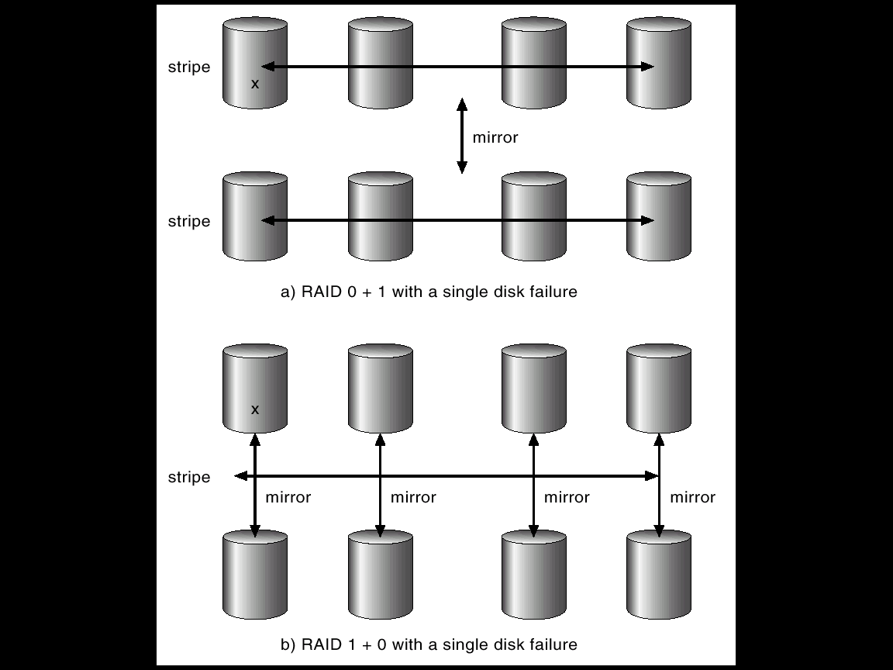
RAID (0 + 1) and (1 + 0)

Slide 90
Selecting a RAID level
In case of a failure, the time to rebuild data vary with the RAID level.
RAID level 0: used for high performance applications where data loss is not critical.
RAID level 1: Popular for applications that require high reliability with fast recovery.
RAID 0+1 and 1+0 are used where performance and reliability are important.
  RAID 1+0 fault tolerance is more
RAID level 5 is used to store large volume of data.
RAID level 6 is not supported.
Hot spare disks can be used to reduce human intervention.
The concepts of RAID can be generalized to other systems
  Arrays of tapes
    Recovery of damaged tape
  Broadcast of data over wireless systems.
    Receiver can reconstruct the information with parity information.

Slide 91
Multiple disk crashes
Use more redundant disks

