Slide 1
Lower latency means higher sales for Internet enterprises
  Amazon found every 100 ms of cost them 1% in sales.
  Google found an extra 0.5 seconds in search page generation time dropped traffic by 20%.

Slide 2
Index Structures
Chapter 4

Slide 3
Outline
Indexes on sequential files
Secondary indexes
B-Trees
Hash Tables

Slide 4
Introduction
SELECT * FROM R
  Examine every block in the storage system
  Enough information on block headers to identify where in the block records begin
  Enough information in record headers to tell what relation the record belongs to
Better organization
  Reserve some blocks, several cylinders for a given relation
Suppose we want to answer the following query
  SELECT* FROM MovieStar WHERE name=`Jim Carrey’
    Scan all the blocks on which MovieStar tuples could be found.
To execute the query quickly, we create one or more indexes.

Slide 5

Index Structures: Lecture 1

Slide 6
Indexes on Sequential Files
A sorted file is called the sequential file
Index contains two columns (key-pointer pairs): one column is the key and another column is the pointer.
  A search key K in the index file is associated with a pointer to a data-file record that has search key K.

Slide 7
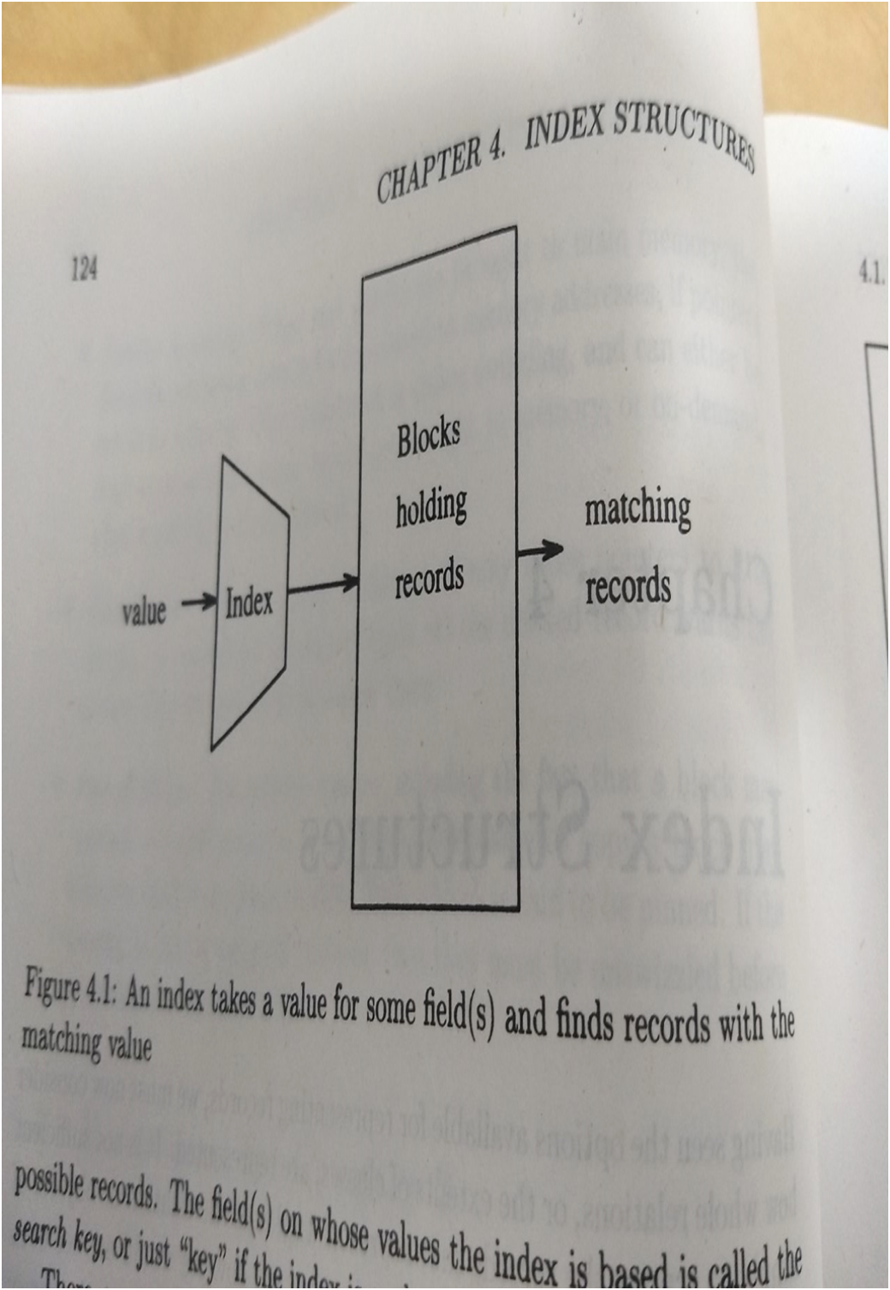

Slide 8
Sequential files
Sequential file: Data file is sorted based on the attributes of the index.

Slide 9
Dense and Sparse Indexes
Dense index
Sparse index

Slide 10
Dense Indexes
There is an entry in the index file for every record in the data file.
Every key in the data file is represented in the index.
The order is similar to the order of the file
  The keys and pointers take less space than the data file and can fit in main memory
    Normally, data file does not fit in main memory.

Slide 11
Sequential File
10
20
30
40
50
60
70
80
90
100
Assumption: Each block has two records.
Sequential file: Sorted based on the attributes of index

Slide 12
Dense Index
Sequential File
10
10
20
20
30
30
40
40
50
60
50
70
60
80
70
90
80
100
90
110
100
120
Dense index and sequential data file

Slide 13
About Dense Index
The dense index supports queries that ask for records with a given search key value.
The index-based search is efficient
  Number of index blocks is usually small compared with the number of data blocks
  We can use binary search log₂n of them
  The index is small enough to be kept permanently in main memory buffers.
    So requires only main memory accesses

Slide 14
Example
Consider R of 1,000,000 tuples and 10 tuples fit in 4096 block.
Total space required is 400 megabytes.
Suppose key is 30 bytes and pointer is 4 bytes, we can store 100 key-pointer pairs iin one block.
So, dense iindex requires 10,000 blocks or 40MB.
Number of block accesses log(10,000)= about 13.

Slide 15
About Sparse Indexes
If a dense index is too large, we can use similar structure called a sparse index
  Uses less space but requires some more time to find a record.
  A sparse index holds only one key-pointer to the first record on the block

Slide 16
Sparse Index
Sequential File
10
10
30
20
50
30
70
40
90
110
50
130
60
150
70
170
80
190
90
210
100
230

Slide 17
Example
Since we have 100,000 data blocks and 100 key-pointer pairs fit in one index block, we need only 1000 index blocks if a sparse index is used which is equal to 4MB.

Slide 18
Retrieving a record using sparse index
To retrieve a record with key K, given sparse index, we search the iidex for the largest key less than or equal to K.
  We may use binary search to find the key (in main memory)
We follow associated pointer to a data block and we must search the block.

Slide 19
Multiple-levels of index
As index can cover several blocks, search is required
By putting index on index we can make first level index more efficient.
First level index may be sparse or dense.
Second and higher levels of index must be sparse.

Slide 20
Sparse 2nd level
Sequential File
10
10
10
90
30
20
170
50
30
250
70
40
90
330
50
110
410
60
130
490
150
570
70
170
80
190
90
210
100
230

Slide 21
Indexes with duplicate search keys
So far, search key is the key of the relation.
Indexes can be used on non-key attributes.
  More than one record has the same key value
Have a dense index with one entry with key K for each record of the data file that has search key K.

Slide 22
Duplicate keys
10
10
10
20
20
30
30
30
40
45

Slide 23
Dense index, one way to implement?
Duplicate keys
10
10
10
10
10
10
10
10
10
10
10
10
20
20
20
20
20
20
20
20
30
30
30
30
30
30
30
30
30
30
30
30
40
40
45
45

Slide 24
Duplicate keys
Dense index, better way?
10
10
10
20
30
10
40
20
20
30
30
30
40
45

Slide 25
Duplicate keys
* First search key on the each block of data file
Sparse index, one way?
10
10
10
10
20
10
30
20
20
30
30
30
Finding the records
We first find the last entry E1 less than or equal to K
Move to the front
  Either find the first
  Find E2 with a key strictly less than K
40
45

Slide 26
Managing Indexes During Data Modifications
Records will be inserted, deleted and sometimes updated.
  As a result the sequential file will evolve.
Solution:
  Create overflow blocks
    Do not have entries in sparse index
  Insert new blocks in the sequential order
    New block needs an entry in the sparse index
  If there is no space, slide tuples to adjacent blocks.
    There will be changes into index

Slide 27
Index modifications
Creating or deleting overflow block
  has no effect on dense index or sparse index as index is created on primary blocks
Creating or destroying blocks of the sequential file
  has no effect on dense index because the index refers to records not blocks. It does effect a sparse index, since we must insert or delete an index entry for the block created or destroyed.
Inserting or deleting records
  has the same action on a dense index as a key-pointer pair for that record is inserted or deleted. But there is no effect of sparse index; if it is the first record of the block then the corresponding key value in the sparse index must be updated.
Sliding a record
  Within a block or among the blocks, results in updating to the corresponding entry of dense index.
  Sparse index is updated if the moved record is the first record.

Slide 28
Index Modifications
When changes occur to data file, we must often change the index to adapt.
Strategy
  An index file is an example of a sequential file; the key-pointer pairs can be treated as records sorted by the value of search key.
    Same strategies adapted for data files can be used
Action | Dense Index | Sparse Index
Create empty overflow block | none | None
Delete empty overflow block | None | None
Create empty sequential block | None | Insert
Delete empty sequential block | None | Delete
Insert record | Insert | Update (?)
Delete record | Delete | Update (?)
Slide record | update | Update (?)

Slide 29
Deletion from dense index
10
10
20
20
30
30
40
40
50
50
60
60
70
70
80
80

Slide 30
Deletion from dense index
  delete record 30
10
10
20
20
30
30
40
40
50
50
60
60
70
70
80
80

Slide 31
Deletion from dense index
  delete record 30
10
10
20
20
30
30
40
40
40
50
50
60
60
70
70
80
80

Slide 32
Deletion from dense index
  delete record 30
10
10
20
20
40
30
30
40
40
40
50
50
60
60
70
70
80
80

Slide 33
Deletion from sparse index
10
10
20
30
50
30
70
40
50
90
60
110
130
70
150
80

Slide 34
Deletion from sparse index
  delete record 40
10
10
20
30
50
30
70
40
50
90
60
110
130
70
150
80

Slide 35
Deletion from sparse index
  delete record 40
10
10
20
30
50
30
70
40
50
90
60
110
130
70
150
80

Slide 36
Deletion from sparse index
  delete record 30
10
10
20
30
50
30
70
40
50
90
60
110
130
70
150
80

Slide 37
Deletion from sparse index
  delete record 30
10
10
20
40
30
50
30
40
70
40
50
90
60
110
130
70
150
80

Slide 38
Deletion from sparse index
  delete records 30 & 40
10
10
20
30
50
30
70
40
50
90
60
110
130
70
150
80

Slide 39
Deletion from sparse index
  delete records 30 & 40
10
10
20
30
50
30
70
40
50
90
60
110
130
70
150
80

Slide 40
Deletion from sparse index
  delete records 30 & 40
10
10
20
50
30
70
50
30
70
40
50
90
60
110
130
70
150
80

Slide 41
Insertion, sparse index case
10
10
20
30
40
30
60
40
50
60

Slide 42
Insertion, sparse index case
  insert record 34
10
10
20
30
40
30
60
40
50
60

Slide 43
Insertion, sparse index case
  insert record 34
10
10
20
30
40
30
60
34
40
50
our lucky day!
we have free space
where we need it!
60

Slide 44
Insertion, sparse index case
  insert record 15
10
10
20
30
40
30
60
40
50
60

Slide 45
Insertion, sparse index case
  insert record 15
10
10
20
15
20
30
40
30
20
60
30
40
50
60

Slide 46
Insertion, sparse index case
  insert record 15
10
10
20
15
20
30
40
30
20
60
30
40
50
Illustrated: Immediate reorganization
Variation:
  insert new block (chained file)
  update index
60

Slide 47
Insertion, sparse index case
  insert record 25
10
10
20
30
40
30
60
40
50
60

Slide 48
Insertion, sparse index case
  insert record 25
10
25
10
20
30
40
30
overflow blocks
(reorganize later...)
60
40
50
60

Slide 49
Insertion, dense index case
Similar
Often more expensive . . .

Slide 50
Secondary Indexes
Primary indexes
  Underlying file was sorted on the search key.
But we need a several indexes in the relation
In a MovieStar relation we declare name as a primary key
We may want to search on birth dates
  We need a secondary index on birth date.

Slide 51
Secondary Indexes
A secondary index facilitates finding records given a value for one or more fields.
The secondary index does not determine the placement of records in a data file.
So, there is no sense to talk of sparse, secondary index
  Since secondary index does not influence location, we could not use it to predict the location of any record whose key was not mentioned in the index file explicitely.
  So secondary index is always dense.

Slide 52
Secondary indexes
Sparse index
Sequence
field
30
30
50
20
80
20
100
70
90
80
...
40
100
10
90
60

Slide 53
Secondary indexes
Sparse index
Sequence
field
30
30
50
20
80
20
100
70
90
80
...
40
100
10
does not make sense!
90
60

Slide 54
Secondary indexes
Dense index
Sequence
field
30
50
20
70
80
40
100
10
90
60

Slide 55
Secondary indexes
Dense index
Sequence
field
10
30
20
50
30
40
20
70
50
80
60
40
70
...
100
10
90
60

Slide 56
Design of Secondary Indexes
The keys in the index file are sorted.
The points in one index block can go to many different data blocks.
  Using secondary index may result in many more disk I/Os.
It is possible to add a second level of index

Slide 57
Secondary indexes
Dense index
Sequence
field
10
30
20
50
10
30
40
20
50
70
90
...
50
80
60
sparse
high
level
40
70
...
100
10
90
60

Slide 58
Clustered File Structure
Two or more relations are stored with their records intermixed.
Consider the following two relations
  Movie(title, year, length, studioName)
  Studio(name, address, president)
Consider the following query
  SELECT title, year
  FROM Movie
  WHERE studioName=‘zzz’;
If the above is typical query we can order the tuples with studioName
We can put a primary index on studioName

Slide 59
Clustered File Structure
Consider the following query
  SELECT president
  FROM Movie, Studio
  WHERE title=‘Star Wars’ AND Movie.studioName=Studio.name;
If we are sure that joins are common, we can make those joints efficient by chossing a clustered file structure.
  Movie tuples are placed with Studio tuples in the same sequence of blocks.
    We place for each studio tuple, all the movie tuples for the movies made by that studio.
Studio
1
Studio
1
Movies by
studio1
Movies by
studio1

Slide 60
Indirection in Secondary Indexes
Significant amount of space is wasted
  If the search key value appears n times in the data file, the value is written n times in the index file.
Solution
  Use the indirection called buckets between secondary index file and the data file

Slide 61
Duplicate values & secondary indexes
20
10
10
20
30
20
40
40
50
10
60
40
...
10
40
30
40
buckets

Slide 62
Advantages of bucket idea
We can use the pointers in the buckets to answer the queries

Slide 63
Why “bucket” idea is useful
Indexes Records
Name: primary EMP (name,dept,floor,...)
Dept: secondary
Floor: secondary

Slide 64
Query: Get employees in
(Toy Dept) ^ (2nd floor)
Dept. index EMP Floor index
Toy
2nd

Slide 65
Query: Get employees in
(Toy Dept) ^ (2nd floor)
Dept. index EMP Floor index
Toy
2nd
→ Intersect toy bucket and 2nd Floor
bucket to get set of matching EMP’s

Slide 66
IR QUERIES
Find articles with “cat” and “dog”
Find articles with “cat” or “dog”
Find articles with “cat” and not “dog”

Slide 67
IR QUERIES
Find articles with “cat” and “dog”
Find articles with “cat” or “dog”
Find articles with “cat” and not “dog”
Find articles with “cat” in title
Find articles with “cat” and “dog” within 5 words

Slide 68
Common technique: more info in inverted list
Inverted Index for documents
type
position
location
cat
d₁
Title
5
Author
10
Abstract
57
d₃
d₂
dog
Title
100
Title
12

Slide 69
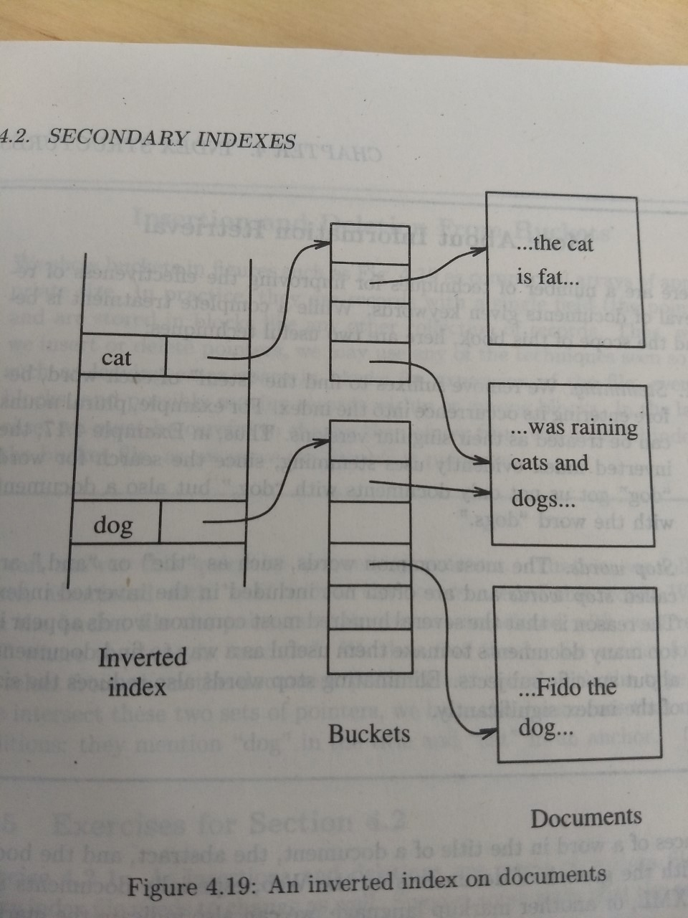

Slide 70
Posting: an entry in inverted list.
Represents occurrence of term in article
Size of a list: 1 Rare words or
(in postings) miss-spellings
10⁶ Common words
Size of a posting: 10-15 bits (compressed)

Slide 71
IR DISCUSSION
Stop words
Truncation
Thesaurus
Full text vs. Abstracts
Vector model

Slide 72
Vector space model
w1 w2 w3 w4 w5 w6 w7 …
DOC = <1 0 0 1 1 0 0 …>
Query= <0 0 1 1 0 0 0 …>

Slide 73
Vector space model
w1 w2 w3 w4 w5 w6 w7 …
DOC = <1 0 0 1 1 0 0 …>
Query= <0 0 1 1 0 0 0 …>
PRODUCT = 1 + ……. = score

Slide 74
Tricks to weigh scores + normalize
e.g.: Match on common word not as useful as match on rare words...

Slide 75
How to process V.S. Queries?
w1 w2 w3 w4 w5 w6 …
Q = < 0 0 0 1 1 0 … >

Slide 76
Lecture 2

Slide 77
Conventional indexes
Advantage:
- Simple
- Index is sequential file
good for scans
Disadvantage:
- Inserts expensive, and/or
- Lose sequentiality & balance

Slide 78
Example Index (sequential)
continuous
free space
10
20
30
40
50
60
70
80
90

Slide 79
Example Index (sequential)
continuous
free space
10
20
39
30
31
33
35
36
40
50
60
32
38
34
70
80
90
overflow area
(not sequential)

Slide 80
B-trees
It is a general multi-level structure
B-tree is a family of data structures
  B+-tree is often used
B-trees automatically maintain as many levels of index as in appropriate for a file.
Every block is used between half and completely full.
  No overflow blocks are needed

Slide 81
Structure of Btree
The tree is balanced
  All paths from root to a leaf have the same length
Three layers
  The root
  Intermediate layer
  and leaves
The parameter “n” is associated with each B-tree index
  Each block has a layout for “n” keys and “n+1” pointers

Slide 82
Rules of Btree
At the root there are at least two pointers
  All pointers point to B-tree blocks at the level below
At the leaf, one last pointer points to the next leaf block to the right (to the block with next higher keys)
  At least └ n+1/2 ┘ pointers are used and point to data records.
  Unused pointers may be thought of null and do not point any where.

Slide 83
Rules of Btree
At an interior node, all n+1 pointers can be used to point to B-tree blocks at the next lower level.
  At least ┌ n+1/2┐ of them are actually used (for the root only two pointers are used)
  If j pointers are used then there will be j-1 keys.
    The first pointer points to part of Btree where some of the records less than k1 will be found.
    The second pointer goes to that part of the tree where all records with keys that are at least K1, but less than K2 will be found.
    The jth pointer points to the part of BTree where some of the records greater than Kj-1 are found.

Slide 84
Sample non-leaf
to keys to keys to keys to keys
< 57 57≤ k<81 81≤k<95 ≥95
57
81
95

Slide 85
B+Tree Example n=3
Root
100
30
120
150
180
3
5
11
30
35
100
101
110
120
130
150
156
179
180
200

Slide 86
Sample leaf node:
From non-leaf node
to next leaf
in sequence
57
81
95
To record
with key 57
To record
with key 81
To record
with key 85

Slide 87
In textbook’s notation n=3
Leaf:
Non-leaf:
30
35
30
35
30
30

Slide 88
Size of nodes: n+1 pointers
n keys
(fixed)

Slide 89
Don’t want nodes to be too empty
Use at least
  Non-leaf: ⎡(n+1)/2⎤ pointers
  Leaf: ⎣(n+1)/2⎦ pointers to data

Slide 90
n=3
Full node min. node
Non-leaf
Leaf
120
150
180
30
3
5
11
30
35
counts even if null

Slide 91
B+tree rules tree of order n
(1) All leaves at the same lowest level (balanced tree)
(2) Pointers in leaves point to records except for “sequence pointer”

Slide 92
(3) Number of pointers/keys for B+tree
Max Max Min Min
ptrs keys ptrs→data keys
Non-leaf
(non-root)
n+1
n
⎡(n+1)/2⎤
⎡(n+1)/2⎤- 1
Leaf
(non-root)
n+1
n
⎣(n+1)/2⎦
⎣(n+1)/2⎦
Root
n+1
n
1
1

Slide 93
The value of “n” is picked as follows.
  Let block size =4096 bytes
    Integer=4bytes, pointer 8 bytes
    4n+8(n+1) <= 4096
    The value oof n=340

Slide 94
Applications of B-trees
B-tree is a powerful tool for building indexes
The search key is the primary key for the data file and index is dense, there is a leaf pointer for every entry. The data file may not be sorted by primary key.
If the data file is sorted by primary key, the B+tree is a sparse index with key-pointer pair at the leaf for each block of the data file.
There is a variant of Btree for multiple occurrences of search key.
  Refer text book.

Slide 95
Lookup in Btree
Find a record with search-key value K
If we are at the leaf, look among the keys. If the ith leaf is K, ith pointer will take us to the desired record.
Follow the rules of Btree and reach the leaf node.

Slide 96
Range queries
SELECT *
FROM R
WHERE R.k >40
Or
SELECT *
FROM R
WHERE R.k >= 10 and R.k <= 25;

Slide 97
Insertion into Btree
We try to find a place
If there is no room in the leaf, we split the leaf into two and divide the keys into two nodes, so each is half full or just over half full.
The splitting of nodes lead to inserting a new key-pointer pair at a higher level.
  Apply this strategy recursively at higher levels.
We try to insert at the root. If there is no room we try to split the root and create a new root.

Slide 98
Insert
Suppose N is a leaf node with n keys
  We trying to insert “n+1” key and a pointer
  Create a new node M, which will be a sibling of N, immediately to its right
    The first (n+1)/2 (high) key-pointer pairs in the sorted order will be with N. The other key pointer pairs move to M
  Both will have at least (n+1)/2 (low) key pointer pairs.

Slide 99
Insert
Suppose N is an interior node with n keys and n+1 pointers.
  Create a new node M which will be a sibling of N, immediately to its right.
    The first (n+2)/2 (high) pointers pairs in the sorted order will be with N and move M other (n+2)/2(low) pointers.
  The n/2 (high) keys stay with N, and last n/2 (low) keys move to M.
  There is a one key left over key K, it is the smallest key reachable via M children.
    K will be used as a parent of N and M to divide the searches between those two nodes.

Slide 100
Insert into B+tree
(a) simple case
  space available in leaf
(b) leaf overflow
(c) non-leaf overflow
(d) new root

Slide 101
(a) Insert key = 32
n=3
100
30
3
5
11
30
31

Slide 102
(a) Insert key = 32
n=3
100
30
3
5
11
30
31
32

Slide 103
(a) Insert key = 7
n=3
100
30
3
5
11
30
31

Slide 104
(a) Insert key = 7
n=3
100
30
3
5
3
5
11
30
31
7

Slide 105
(a) Insert key = 7
n=3
100
30
7
3
5
3
5
11
30
31
7

Slide 106
(c) Insert key = 160
n=3
100
120
150
180
150
156
179
180
200

Slide 107
(c) Insert key = 160
n=3
100
120
150
180
150
156
179
160
179
180
200

Slide 108
(c) Insert key = 160
n=3
100
120
150
180
180
150
156
179
160
179
180
200

Slide 109
(c) Insert key = 160
n=3
100
160
120
150
180
180
150
156
179
160
179
180
200

Slide 110
(d) New root, insert 45
n=3
10
20
30
1
2
3
10
12
20
25
30
32
40

Slide 111
(d) New root, insert 45
n=3
10
20
30
1
2
3
10
12
20
25
30
32
40
40
45

Slide 112
(d) New root, insert 45
n=3
10
20
30
40
1
2
3
10
12
20
25
30
32
40
40
45

Slide 113
(d) New root, insert 45
n=3
30
new root
10
20
30
40
1
2
3
10
12
20
25
30
32
40
40
45

Slide 114
Deletion from B+tree
(a) Simple case - no example
(b) Coalesce with neighbor (sibling)
(c) Re-distribute keys
(d) Cases (b) or (c) at non-leaf

Slide 115
Delete from BTree
Locate that record (lookup)
If after the deletion, the tree has minimum number of records, nothing to be done.
Move the key from one of the sibling and adjust the parents.
Hard case: no sibling has extra key
  Merge the nodes by deleting one of them.
  Adjust the keys at the parent.
  If the parent is not full, we recursively continue the deletion process.

Slide 116
(b) Coalesce with sibling
  Delete 50
n=4
10
40
100
10
20
30
40
50

Slide 117
(b) Coalesce with sibling
  Delete 50
n=4
10
40
100
10
20
30
40
50
40

Slide 118
(c) Redistribute keys
  Delete 50
n=4
10
40
100
10
20
30
35
40
50

Slide 119
(c) Redistribute keys
  Delete 50
n=4
10
40
100
35
10
20
30
35
40
50
35

Slide 120
(d) Non-leaf coalese
  Delete 37
n=4
25
10
20
30
40
25
26
1
3
10
14
20
22
30
37
40
45

Slide 121
(d) Non-leaf coalese
  Delete 37
n=4
25
10
20
30
40
25
26
1
3
10
14
20
22
30
37
40
45
30

Slide 122
(d) Non-leaf coalese
  Delete 37
n=4
25
10
20
30
40
40
25
26
1
3
10
14
20
22
30
37
40
45
30

Slide 123
(d) Non-leaf coalese
  Delete 37
n=4
25
new root
10
20
30
40
25
40
25
26
1
3
10
14
20
22
30
37
40
45
30

Slide 124
Efficiency of Btrees
Very few disk I/Os per file operation
Splitting and merging blocks occur rarely
Keep the root in the main memory

Slide 125
B+ Trees in Practice
Typical order: 100. Typical fill-factor: 67%.
  average fanout = 133
Typical capacities:
  Height 4: 133⁴ = 312,900,700 records
  Height 3: 133³ = 2,352,637 records
Can often hold top levels in buffer pool:
  Level 1 = 1 page = 8 Kbytes
  Level 2 = 133 pages = 1 Mbyte
  Level 3 = 17,689 pages = 133 MBytes

Slide 126
Lecture 3

Slide 127
Hash Tables
A hash function takes a search key as an argument and computes an integer range 0 to B-1, where B is a number of buckets.
  A bucket array, which is an array indexed from 0 to B-1, holds headers of B linked lists, one for each bucket of the array.
  If the record has a search key K, we store the record by linking it to the bucket list for the bucket numbered h(K), where h is the hash function.
Common hash function
  Remainder of K/B

Slide 128
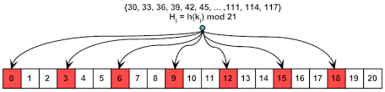

Slide 129
Secondary Storage Hash Tables
Bucket contains sequence of blocks
First block can be found given “i”.
If a bucket overflows, a chain of overflow blocks are added.

Slide 130
Bucket
Bucket is a logical concept
  It is the concept of hashing
  Physically implemented as a sequence of blocks
  Ideal= 1 block

Slide 131
Insertion into a Hash Table
When a new record with search key K must be inserted, we compute h(K).
If the bucket number h(K) has the space, we insert the record into the block for this bucket or into one of the chain of blocks.
If there is no space, we add extra block.

Slide 132
Hash-table deletion
Go to the bucket number h(K) and search for records with that search key. Delete if we find any data.
  Consolidate (optional)

Slide 133
Hashing
key → h(key)
<key>
Buckets
(typically 1
disk block)
.
.
.

Slide 134
Two alternatives
.
.
.
(1) key → h(key)
records
.
.
.

Slide 135
Two alternatives
record
(2) key → h(key)
key 1
Index

Slide 136
Two alternatives
record
(2) key → h(key)
key 1
Index
Alt (2) for “secondary” search key

Slide 137
Example hash function
Key = ‘x1 x2 … xn’ n byte character string
Have b buckets
h: add x1 + x2 + ….. xn
  compute sum modulo b

Slide 138
☒ This may not be best function …
☒ Read Knuth Vol. 3 if you really need to select a good function.

Slide 139
☒ This may not be best function …
☒ Read Knuth Vol. 3 if you really need to select a good function.
Good hash  Expected number of
function: keys/bucket is the
same for all buckets

Slide 140
Within a bucket:
Do we keep keys sorted?
Yes, if CPU time critical
& Inserts/Deletes not too frequent

Slide 141
Next: example to illustrate inserts, overflows, deletes
h(K)

Slide 142
EXAMPLE 2 records/bucket
INSERT:
h(a) = 1
h(b) = 2
h(c) = 1
h(d) = 0
0
1
2
3

Slide 143
EXAMPLE 2 records/bucket
INSERT:
h(a) = 1
h(b) = 2
h(c) = 1
h(d) = 0
0
1
2
3
d
a
c
b
h(e) = 1

Slide 144
EXAMPLE 2 records/bucket
INSERT:
h(a) = 1
h(b) = 2
h(c) = 1
h(d) = 0
0
1
2
3
d
a
e
c
b
h(e) = 1

Slide 145
EXAMPLE: deletion
Delete:
e
f
0
1
2
3
a
b
d
c
e
f
g

Slide 146
EXAMPLE: deletion
Delete:
e
f
0
1
2
3
a
b
d
c
c
e
f
maybe move
“g” up
g

Slide 147
EXAMPLE: deletion
Delete:
e
f
0
1
2
3
a
b
d
c
d
c
e
f
maybe move
“g” up
g

Slide 148
Rule of thumb:
Try to keep space utilization
between 50% and 80%
Utilization = # keys used
total # keys that fit

Slide 149
Rule of thumb:
Try to keep space utilization
between 50% and 80%
Utilization = # keys used
total # keys that fit
If < 50%, wasting space
If > 80%, overflows significant depends on how good hash function is & on # keys/bucket

Slide 150
Efficiency of hash table indexes
Typical lookup takes only one disk I/O
Insertion/deletion takes only two disk I/Os.
  Better than sparse or dense indexes
  Btree
If the file grows, there will be many blocks in the chain for a typical bucket and taking one disk I/O per block
  So it is better to keep number of blocks per bucket low.

Slide 151
Dynamic hash tables
So far we have discussed static hash tables
  The number of buckets never changes.
  Overflow problems
There are several kinds of dynamic hash tables, where number of buckets (B) is allowed to vary.
  Extensible hashing
  Linear hashing

Slide 152
Extensible Hash Tables
There is a level of indirection introduced for the buckets
An array of pointers to blocks represents the buckets instead of the array consisting of the data blocks themselves.
The array of pointers can grow. The length is always a power of two
  The number of blocks doubles
There need not be data block for each bucket; certain buckets can share a block if the total number of records in those buckets can fit in the block
The hash function computes a sequence of k-bits for some large k,
  However, the bucket numbers will at all times use some smaller number of bits, say “i” bits from the beginning of sequence.
  The bucket array will have 2^{i} entries when i is the number of bits used.
Each data block has nub (value j) which appears in the block header, indicates the number of bits used to determine the membership of records in the block.

Slide 153
Insertion into Extensible Hash Tables
To insert a record with search key K, we compute h(K), take the first “i” bit sequence and go to the entry of the bucket array indexed by these “i” bits.
Follow the pointer
  If there is a room insert
  If there is no room, determine the number of bits (the value of j) to determine used to determine membership in block B.
    If j<i nothing needs to be done to bucket array
      Split block B into two
      Distribute records in B to the new blocks based on j+1 bit.
        If all records go to the same block, we have to increment “j”
      Put j+1 in each blocks nub to indicate the number of bits used to determine the membership
      Adjust the pointers in the bucket array so entries that formerly pointed to B now point either to B or the new block depending on the j+1 bit.
Here, j = how many bits of hash are used to determine the membership of the block

Slide 154
Insertion into Extensible Hash Tables
Note:
  During distribution, if all records of B may go into one of the two blocks into which it was split. Then, we have to repeat the process.
If j=i
  Increment i by 1.
  Double the length of the bucket array, so it now has 2^{i+1} entries.
  Two new entries share the block.
  Go to first step, since i>j.

Slide 155
Extensible hashing: two ideas
(a) Use i of b bits output by hash function
b
h(K) →
use i → grows over time….
00110101

Slide 156
(b) Use directory
h(K)[i ] to bucket
.
.
.
.
.
.

Slide 157
Example: h(k) is 4 bits; 2 keys/bucket
1
i =
1
0001
1
1001
1100
Insert 0001, 1001,1100

Slide 158
Example: h(k) is 4 bits; 2 keys/bucket
1
i =
1
0001
1
1001
1010
1100
1
Insert 1010
1100

Slide 159
Example: h(k) is 4 bits; 2 keys/bucket
i =
2
1
00
01
10
11
i =
1
0001
1
2
1001
1010
1100
2
New directory
1
Insert 1010
1100

Slide 160
Example continued
i =
2
00
01
10
11
1
0001
2
1001
1010
Insert:
0111
0000
2
1100

Slide 161
Example continued
0000
i =
2
0001
00
01
10
11
1
0001
0111
0111
2
1001
1010
Insert:
0111
0000
2
1100

Slide 162
Example continued
2
0000
i =
2
0001
00
01
10
11
1
2
0001
0111
0111
2
1001
1010
Insert:
0111
0000
2
1100

Slide 163
Example continued
0000
2
i =
2
0001
00
01
10
11
0111
2
1001
2
1010
Insert:
1001
1100
2

Slide 164
Example continued
0000
2
i =
2
0001
00
01
10
11
0111
2
1001
1001
1010
1001
2
1010
Insert:
1001
1100
2

Slide 165
Example continued
i =
3
0000
2
000
001
010
011
100
101
110
111
i =
2
0001
00
01
10
11
0111
2
1001
3
1001
1010
1001
2
3
1010
Insert:
1001
1100
2

Slide 166
Extensible hashing: deletion
No merging of blocks
Merge blocks
and cut directory if possible
(Reverse insert procedure)

Slide 167
Deletion example:
Run thru insert example in reverse!

Slide 168
Note: Still need overflow chains
Example: many records with duplicate keys
insert 1100
if we split:
2
1
1101
1100
2
1100
1100

Slide 169
Solution: overflow chains
insert 1100
add overflow block:
1
1
1101
1101
1100
1100
1101

Slide 170
Extensible hashing
Summary
Can handle growing files
- with less wasted space
- with no full reorganizations
+
Indirection
(Not bad if directory in memory)
Directory doubles in size
(Now it fits, now it does not)
-
-

Slide 171
Linear Hashing
Advantages of extensible hashing
  we need to search only one data block
  We have to examine the bucket array
    But if the bucket is small to fit in main memory, there is no disk I/O.
Problems with extensible hash
  Doubling requires substantial work when “i” is large.
    Interrupts access to data file
  If it does not fit in main memory, may push other data that may be needed.
    As a result the system may perform many disk I/Os
  If the number of records per block is small, one block may be split multiple times.
    There might be million bucket entries and the small number of data entries.
LINEAR HASHING allows growth of number of blocks very slowly.

Slide 172
Linear Hashing: Strategy
The number of buckets n is equal to a fraction of number average number of records per block.
Since blocks can not always split, overflow blocks are allowed
The number of bits used to number of entries of bucket array is ⎡log₂n⎤, n is the number of buckets. The bits are always taken from lower order side.
Suppose with “i” bits of the hash function, record with K is intended for bucket a1, a2,…,ai; that is a1,a2,…,ai are the last i bits of h(k). Then a1, a2,…,ai be m, treated as i-bit binary number.

Slide 173
If m<n, then the bucket numbers “m” exists. And we place the record in that bucket.
If n <= m <= 2^{i}, the bucket “m” does not yet exist, so we place the record in bucket “m-2^{i-1}”, that is the bucket we could get if we changed a1 (which must be 1) to 0.

Slide 174
Linear hashing
Another dynamic hashing scheme
Two ideas:
(a) Use i low order bits of hash
b
01110101
grows
i

Slide 175
Linear hashing
Another dynamic hashing scheme
Two ideas:
(a) Use i low order bits of hash
b
01110101
grows
i
(b) File grows linearly

Slide 176
Example
n is number of blocks= 2
Hash function h produces four bits
`i’ is number of bits in hash function
n is number of current buckets
r is number of records in a table
The ratio of r/n will be limited to number of records in a block
In this case we ensure r <=1.7*n.
So average occupancy of a bucket can not exceed 85%.
0
0000
i=1
1010
n=2
1111
r=3
1

Slide 177
Insertion
Rule
If h(k)[i ] ≤ n, then
look at bucket h(k)[i ]
else, look at bucket h(k)[i ] - 2^{i -1}
Compute h(k), where k is the key of the record
Determine the correct number of bits at the end of bit sequence to use as the bucket number
  We put the record either in that bucket or in the bucket with the leading bit changed from 1 to 0.
  If there is no room in the bucket we create a overflow block.
Each time we insert
  Compute ratio r/n
  If it exceeds predetermined ratio (1.7 in this case), add a new bucket.
If n exceeds 2^{i}, “i” is incremented by one. All existing blocks get “0” in front of their bit sequences.

Slide 178
Example (contd.)
Add 0101
  It goes to “1” bucket.
  However the ration r/n exceeds 1.7, so add another bucket. Increment “i”.
0000
i=2
00
n=3
0101
r=4
01
1111
10
1010

Slide 179
Example (contd.)
Add 0001
  Last two bits are 01
  However the 01 bucket is full, so add an over flow block.
  Since ration of r/n is less than 1.7 it is OK
0000
i=2
00
n=4
1111
0001
r=5
01
0101
10
1010

Slide 180
Example (contd.)
Add 0111
  Last two bits are 11
  The bucket does not yet exist. So redirect this record to 01, whose number differs having a 0 in the first bit. The new record fits in the overflow bucket.
  Since ration of r/n exceeded 1.7, we have to create a new bucket.
0000
i=2
00
n=4
0001
r=6
01
0101
10
1010
11
0111
Next time, we insert
a new record, we exceed
The ratio, so “i” should be
Incremented.
1111

Slide 181
 When do we expand file?
Keep track of: # used slots
total # of slots
= U

Slide 182
 When do we expand file?
Keep track of: # used slots
total # of slots
= U
If U > threshold then increase m
(and maybe i )

Slide 183
Linear Hashing
Summary
Can handle growing files
- with less wasted space
- with no full reorganizations
No indirection like extensible hashing
+
+
Can still have overflow chains
-

Slide 184
Example: BAD CASE
Very full
Very empty Need to move
m here…
Would waste
space...

