Slide 1
Introduction to DBMS Implementation
Chapter 1

Slide 2
Outline
Introduction
Megatron 2000
  Implementation Details
  How Megatron 2000 executes queries
  What is wrong with Megatron 2000
Overview of DBMS
  DDL commands
  Overview of query processing
  Main memory buffer and the buffer manager
  Transaction processing
  The query processor
Course outline
Research paper: Relational model… by E.F.Codd

Slide 3
Introduction
Databases are essential to every business
A DBMS is a powerful tool for creating and managing large amounts of data
  Efficient and persistent manner
    Flexibility: more data structures for accessing data
    Process independent
Capabilities of DBMS
  Persistent storage
    Like a file system, data is independent of processes
  Programming interface
    Provides access to powerful programming language
  Transaction management
    Supports concurrent access to data
  Resiliency
    Recover from failures

Slide 4
Introducing the
Megatron 2000
Database Management System
The latest from Megatron Labs
Incorporates latest relational technology
UNIX compatible

Slide 5
Megatron 2000 Implementation Details
Relations stored in files (ASCII)
e.g., relation R is in /usr/db/Students
Schema students(name. id, dept)
Smith # 123 # CS
Johnson # 522 # EE
.
.
.

Slide 6
Megatron 2000 Implementation Details
Database schema is stored in a special file named /usr/db/Schema
Students#name#STR#id#INT#Dept#STR
Depts#Name#STR#office#STR
.
.
.

Slide 7
Megatron 2000
Sample Sessions
% MEGATRON2000
Welcome to MEGATRON 2000!
&
& quit
%
.
.
.

Slide 8
Megatron 2000
Sample Sessions
& select *
from Students #
Name id dept
SMITH 123 CS
Johnson 522 EE
&

Slide 9
Megatron 2000
Sample Sessions
& select *
from Students
where id >=500 | HighId #
&
Creates a new file /usr/db/HighId in which there is only one line
Johnson#522#EE

Slide 10
Megatron 2000
To execute “select * from R where condition”:
(1) Read dictionary to get R attributes
(2) Read R file, for each line:
(a) Check condition
(b) If OK, display

Slide 11
Megatron 2000
To execute “select * from R
where condition | T”:
(1) Process select as before
(2) Write results to new file T
(3) Append new line to dictionary

Slide 12
Megatron 2000
Sample Sessions
& select office
from Students, Depts
where Students.name = `Smith’ AND Students.dept = Depts.name #
&
for (each tuple s in Students)
for(each tuple d in Depts)
if (s and d satisfy the WHERE-condition)
display the office value from Depts

Slide 13
What’s wrong with the Megatron 2000 DBMS?

Slide 14
What’s wrong with the Megatron 2000 DBMS?
Tuple layout on disk (No flexibility)
e.g., - Change string from ‘Cat’ to ‘Cats’ and we have to rewrite file
- ASCII storage is expensive
- Deletions are expensive
Every subsequent character has to be moved by one position.

Slide 15
What’s wrong with the Megatron 3000 DBMS?
Search expensive; no indexes
e.g., - Cannot find tuple with given key quickly
- Always have to read full relation

Slide 16
What’s wrong with the Megatron 2000 DBMS?
Brute force query processing
e.g., select office
from Students, Depts
where Students.dept = Depts.name and Students.name = `Smith’ #
Query processing is “brute force”
- Do select first?
- More efficient join?

Slide 17
What’s wrong with the Megatron 2000 DBMS?
No buffer manager
All the data comes from the disk
e.g., Need caching

Slide 18
What’s wrong with the Megatron 2000 DBMS?
No concurrency control
  Several users can modify the file with unpredictable results

Slide 19
What’s wrong with the Megatron 2000 DBMS?
No reliability
e.g., - Can lose data
- Can leave operations half done

Slide 20
What’s wrong with the Megatron 2000 DBMS?
No security
e.g., - File system insecure
- File system security is coarse
- at file level
- can not restrict at attribute level

Slide 21
What’s wrong with the Megatron 2000 DBMS?
No Application programming interface (API)
Can not interact with other DBMSs
Poor dictionary facilities
No GUI

Slide 22
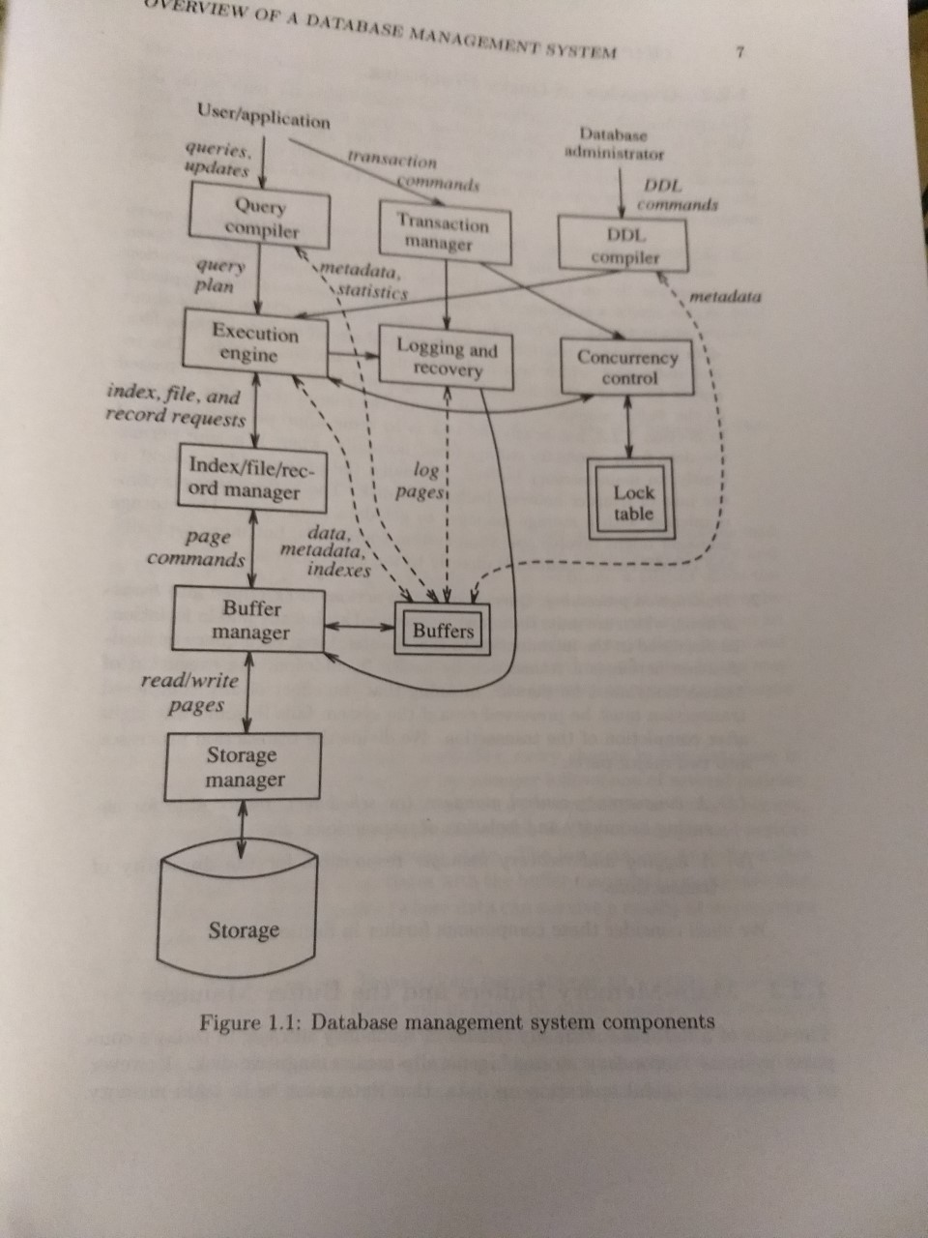

Slide 23
Overview of Database Management Systems
Users
  Conventional users ask for data or modify data
  DBA is responsible for the structure or schema of the database
    DDL commands
      Issued by DBA
        Structures and constraints

Slide 24
Overview of Database Management Systems
Overview of query processing
  Answering the query
    Query is parsed and optimized by a query compiler
    The result is query plan
    Query plan is passed to execution engine
    The execution engine issues small requests (records) to resource manager
    The requests are translated to page requests and transferred to buffer

Slide 25
Overview of Database Management Systems
Overview of Query Processing
  Answering the query:…
  Transaction processing
    Queries and other actions are grouped into transactions that can be executed in isolation.
    It has two parts
      CC manager (scheduler) is responsible for assuring isolation property of transactions
      A logging and recovery manager for assuring atomicity and durability of transactions.

Slide 26
Main-Memory Buffers and
The Buffer Manager
Data resides in secondary storage (disk)
Data should be in main memory for processing
A DBMS component buffer manager is responsible for partitioning the main memory into buffers
The DBMS components interact with buffers or buffer manager directly or through execution engine.
The other components may need
  Data
  Meta data (schema information)
  Statistics
  indexes

Slide 27
Transaction Processing
The transaction manager accepts transaction commands from an application and performs the following tasks
  Logging:
    Every change is logged to secondary disk
    Recovery manager will recover the database to consistent state after the failure.
  Concurrency control
    Transactions should execute in isolation.

Slide 28
ACID properties of transactions
A stands for atomicity
  All or nothing execution of transactions
C stands for consistency
  Must obey consistent constraints.
I stands for Isolation
  Each transaction must appear to be executed as if no other transaction is executing at the same time.
D means durability
  After the completion, the database of transaction is never be lost.

Slide 29
The query processor
Main component of DBMS
  Query compiler transforms query to internal form called query plan (which is a sequence of operations on data)
    Query compiler consists of three major units
      A query parser
        Builds a tree structure from the textual form of the query
      A query preprocessor
        Performs semantic checks (ensures that all relations indeed exists)
      A query optimizer
        Which transforms the initial query plan into the best available sequence of operations on the actual data.
  The execution engine
    It has the responsibility for executing each of the steps in the chosen query plan.
    It interacts with most of the other components either directly of through buffers
      Gets the data to buffers
      Interacts with the scheduler to avoid the accessing of locked data
      With the log manager to make sure that all database changes are properly logged.

Slide 30
Review of Database Models and Languages
Relational model (Refer other presentation)
SQL (will be covered in a tutorial)

Slide 31
Course Overview
Storage management
  File & System Structure
Records in blocks, dictionary, buffer management,…
  Indexing & Hashing
B-Trees, hashing,…
Query Processing
Query costs, join strategies,…
Transaction Processing
  Crash Recovery
Failures, stable storage,…

Slide 32
Course Overview
  Concurrency Control
Correctness, locks,…
  Transaction Processing
Logs, deadlocks,…
Distributed Databases
Distributed locking, distributed recovery,…
NOSQL, CAP theorem, Bigdata, and data systems

Slide 33
Review of Database Models and Languages
Relational model (Refer other presentation)
SQL (will be covered in a tutorial)

