Slide 1
Multidimensional Indexes
Chapter 5

Slide 2
Search Key
Retrieve all the records with search key consists of values from multiple attributes.
Search key is (F1, F2, ..Fk)
  Separated by special markers.
  Example
    If F1=abcd and F2=123, the search key is “abcd#123”
Indexes on sequential files and Btrees both take advantage of having the keys in sorted order.
Hash table requires that each key should be known for any lookup
Number of applications require query support for two or n dimensional space.

Slide 3
Outline
Applications
Hash-like structures
Tree-like structures
Bit-map indexes

Slide 4
Applications: GIS
Geographic Information Systems
  Objects are in two/three dimensional space
  The objects may be points or shapes
  Objects may be houses, roads, bridges, pipelines and many other physical objects.
Query types
  Partial match queries
    Specify the values for one or more dimensions and look for all points matching those values in those dimensions.
  Range queries
    Set of shapes within the range
  Nearest neighbor queries
    Closest point to a given point.
      Example: Find the city of 10000 population closest to a given city.
  Where-am-I queries
    When you click a mouse, the system determines which of the displayed elements you were clicking.

Slide 5
Applications: Data Cubes
Data warehousing
Data exists in high dimensional space
A chain store may record each sale made, including
  The day and time
  The store in which the sale was made
  The item purchased
  The color of the item
  The size of the item
Attributes are seen as dimensions multidimensional space, data cube.
Typical query
  Give a class of pink shirts for each store and each month of 1998.

Slide 6
Multidimensional queries in SQL
Represent points as a relation Points (x,y)
Query
  Find the nearest point to (10, 20)
  Compute the distance between (10,20) to every other point.

Slide 7
Rectangles
Rectangles(id, x11, y11, xur, yur)
If the query is
  Find the rectangles enclosing the point (10,20)
SELECT id
FROM Rectangles
WHERE x11 <= 10.0 AND y11 <= 20.0 AND xur >=10.0 AND yur >=20.0;

Slide 8
Data Cube
Fact table
  Sales(day,store, item. color, size)
Query
  Summarize the sale of pink shirts by day and store
SELECT day, store, COUNT(*) AS totalSales
FROM Sales
WHERE item=‘shirt’ AND color=‘pink’
GROUP BY day, store;

Slide 9
Executing range queries in Conventional Indexes
Motivation: Find records where
DEPT = “Toy” AND SAL > 50k
Strategy 1: Use “Toy” index and check salary
Strategy II: Use “Toy” index and SAL index and intersect.
  Complexity
    Toy index: number of disk accesses = number of disk blocks
    SAL index: number of disk accesses= number of records
So conventional indexes of little help.

Slide 10
Executing nearest-neighbor queries using conventional indexes
There might be no point in the selected range
  Repeat the search by increasing the range
The closest point within the range might not be the closest point overall.
  There is one point closer from outside range.

Slide 11
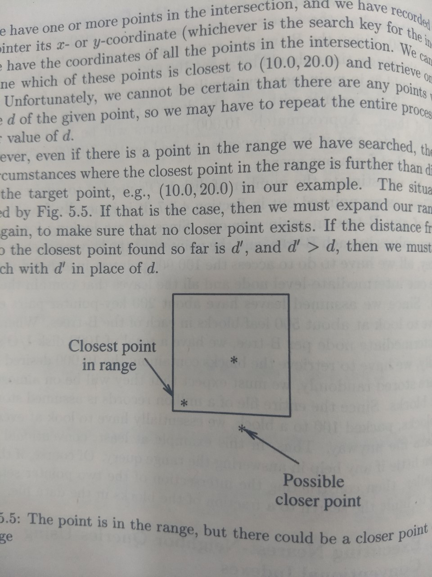

Slide 12
Other Limitations of Conventional Indexes
We can only keep the file sorted on only attribute.
If the query is on multiple dimensions
  We will end-up having one disk access for each record
It becomes too expensive

Slide 13
Overview of Multidimensional Index Structures
Hash-table-like approaches
Tree-like approaches
In both cases, we give-up some properties of single dimensional indexes
Hash
  We have to access multiple buckets
Tree
  Tree may not be balanced
  There may not exist a correspondence between tree nodes and disk blocks
  Information in the disk block is much smaller.

Slide 14
Hash like structures: GRID Files
Each dimension, grid lines partition the space into stripes,
  Points that fall on a grid line will be considered to belong to the stripe for which that grid line is lower boundary
  The number of grid lines in each dimension may vary.
  Space between grid lines in the same dimension may also vary

Slide 15
Grid Index
Key 2
X1 X2 …… Xn
V1
V2
Key 1
Vn
To records with key1=V3, key2=X2

Slide 16
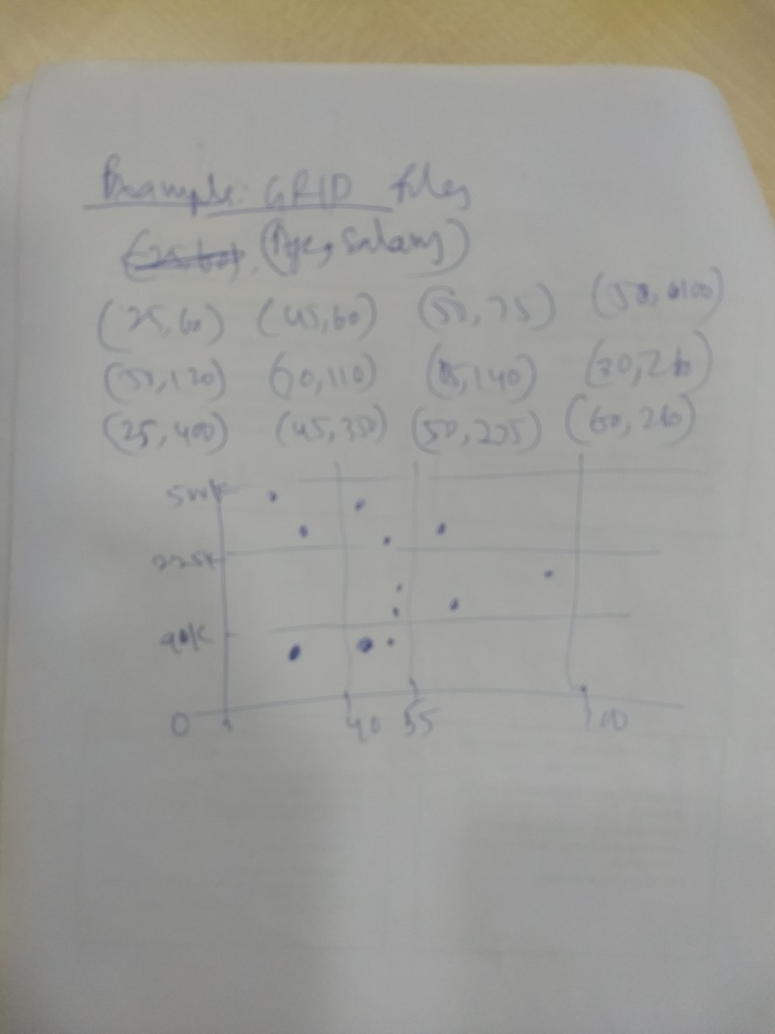

Slide 17
CLAIM
Can quickly find records with
  key 1 = V_{i} ∧ Key 2 = X_{j}
  key 1 = V_{i}
  key 2 = X_{j}

Slide 18
CLAIM
Can quickly find records with
  key 1 = V_{i} ∧ Key 2 = X_{j}
  key 1 = V_{i}
  key 2 = X_{j}
And also ranges….
  E.g., key 1 ≥ V_{i} ∧ key 2 < X_{j}

Slide 19
 But there is a catch with Grid Indexes!
How is Grid Index stored on disk?
V1 V2 V3
Like
Array...
X1
X3
X2
X4
X1
X2
X3
X4
X1
X2
X3
X4

Slide 20
 But there is a catch with Grid Indexes!
How is Grid Index stored on disk?
V1 V2 V3
Like
Array...
X1
X3
X2
X4
X1
X2
X3
X4
X1
X2
X3
X4
Problem:
Need regularity so we can compute position of <Vi,Xj> entry

Slide 21
Solution: Use Indirection
Buckets
V1
V2
V3 *Grid only
V4 contains
pointers to
buckets
Buckets
X1 X2 X3
--
--
--
--
--
--
--
--
--
--
--
--
--
--
--

Slide 22
With indirection:
Grid can be regular without wasting space
We do have price of indirection

Slide 23
Can also index grid on value ranges
Salary Grid
0-20K
1
20K-50K
2
50K-
3
8
Linear Scale
1
2
3
Toy
Sales
Personnel

Slide 24
Performance of GRID files
Lookup: require one disk I/O
  Insert/delete: one additional disk I/O
Partial match queries:
  We need to look all buckets in a row or column. The number of disk I/Os can be quite high.
Range queries:
  We have to examine limited number of blocks
Nearest neighbor
  May have to search several buckets.

Slide 25
Grid files
+ve Good for multiple-key search (lookup)
-ve Space, management overhead
(nothing is free)
-ve Need partitioning ranges that evenly split keys

Slide 26
Partitioned Hash Functions
Design a hash function so that it produces number of bits which are divided among attributes.

Slide 27
Partitioned hash function
Idea:
Key1 Key2
010110 1110010
h1
h2

Slide 28
EX:
h1(toy) =0 000
h1(sales) =1 001
h1(art) =1 010
. 011
.
h2(10k) =01 100
h2(20k) =11 101
h2(30k) =01 110
h2(40k) =00 111
.
.
<Fred,toy,10k>,<Joe,sales,10k>
<Sally,art,30k>
Insert

Slide 29
EX:
h1(toy) =0 000
h1(sales) =1 001
h1(art) =1 010
. 011
.
h2(10k) =01 100
h2(20k) =11 101
h2(30k) =01 110
h2(40k) =00 111
.
.
<Fred,toy,10k>,<Joe,sales,10k>
<Sally,art,30k>
<Fred>
<Joe><Sally>
Insert

Slide 30
h1(toy) =0 000
h1(sales) =1 001
h1(art) =1 010
. 011
.
h2(10k) =01 100
h2(20k) =11 101
h2(30k) =01 110
h2(40k) =00 111
.
.
Find Emp. with Dept. = Sales ∧ Sal=40k
<Fred>
<Joe><Jan>
<Mary>
<Sally>
<Tom><Bill>
<Andy>

Slide 31
h1(toy) =0 000
h1(sales) =1 001
h1(art) =1 010
. 011
.
h2(10k) =01 100
h2(20k) =11 101
h2(30k) =01 110
h2(40k) =00 111
.
.
Find Emp. with Dept. = Sales ∧ Sal=40k
<Fred>
<Joe><Jan>
<Mary>
<Sally>
<Tom><Bill>
<Andy>

Slide 32
h1(toy) =0 000
h1(sales) =1 001
h1(art) =1 010
. 011
.
h2(10k) =01 100
h2(20k) =11 101
h2(30k) =01 110
h2(40k) =00 111
.
.
Find Emp. with Sal=30k
<Fred>
<Joe><Jan>
<Mary>
<Sally>
<Tom><Bill>
<Andy>

Slide 33
h1(toy) =0 000
h1(sales) =1 001
h1(art) =1 010
. 011
.
h2(10k) =01 100
h2(20k) =11 101
h2(30k) =01 110
h2(40k) =00 111
.
.
Find Emp. with Sal=30k
<Fred>
<Joe><Jan>
<Mary>
<Sally>
<Tom><Bill>
<Andy>
look here

Slide 34
h1(toy) =0 000
h1(sales) =1 001
h1(art) =1 010
. 011
.
h2(10k) =01 100
h2(20k) =11 101
h2(30k) =01 110
h2(40k) =00 111
.
.
Find Emp. with Dept. = Sales
<Fred>
<Joe><Jan>
<Mary>
<Sally>
<Tom><Bill>
<Andy>

Slide 35
h1(toy) =0 000
h1(sales) =1 001
h1(art) =1 010
. 011
.
h2(10k) =01 100
h2(20k) =11 101
h2(30k) =01 110
h2(40k) =00 111
.
.
Find Emp. with Dept. = Sales
<Fred>
<Joe><Jan>
<Mary>
<Sally>
<Tom><Bill>
<Andy>
look here

Slide 36
GRID files and Partitioned Hash functions: Comparison
Partitioned hash functions are quite useless for nearest neighbor queries
Occupation
  A well chosen hash function may occupy buckets well.
  GRID files may leave many buckets empty or nearly so.
Applications
  For partial match queries, hash method outperforms the grid file.
  If we need nearest neighbor queries or range queries frequently, GRID file is preferred.

Slide 37
Tree-like Structures
Multiple-key indexes
kd-trees
Quad trees
R-trees

Slide 38
Multiple-key indexes
Several attributes representing dimensions of data points
Multiple key index is an index of indexes in which the nodes at each level are indexes for one attribute.
The index can be B-ree or hash.

Slide 39
Strategy:
Multiple Key Index
One idea:
Second attribute
First attribute

Slide 40
Example
10k
Example
Record
Dept
Index
Salary
Index
15k
Art
17k
Sales
21k
Toy
Name=Joe
DEPT=Sales
SAL=15k
12k
15k
15k
19k

Slide 41
For which queries is this index good?
Find RECs Dept = “Sales” SAL=20k
Find RECs Dept = “Sales” SAL > 20k
Find RECs Dept = “Sales”
Find RECs SAL = 20k

Slide 42
Performance
Partial match
  If the attribute is specified, it is efficient
  Otherwise, it is time consuming
Range queries
  Works well, provided that individual idenxes support range query
Nearest-neighbor
  Implement the algorithm by searching by fixing the range.

Slide 43
kd-trees
K-dimensional tree is generalizing binary search tree into multi-dimensional data.
A kd tree is a binary tree in which interior nodes have an associated attribute “a” and a value “v” that splits data into two parts.
The attributes at different levels of a tree are different, and levels rotating among the attributes of all dimensions.

Slide 44
Interesting application:
Geographic Data
  DATA:
<X1,Y1, Attributes>
<X2,Y2, Attributes>
y
x
. . .

Slide 45
Queries:
What city is at <Xi,Yi>?
What is within 5 miles from <Xi,Yi>?
Which is closest point to <Xi,Yi>?

Slide 46
Example
a
i
e
d
h
b
n
f
l
o
c
j
g
k
m

Slide 47
Example
a
i
e
d
h
10 20
b
n
f
l
o
c
j
g
k
m
10 20

Slide 48
Example
40
a
i
e
d
h
30
b
10 20
n
f
20
l
o
c
25
15 35
20
10
j
g
k
m
10 20

Slide 49
Example
40
a
i
e
d
h
30
b
10 20
n
f
20
l
o
c
25
15 35
20
10
j
g
k
m
10 20
5
15
15

Slide 50
Example
40
a
i
e
d
h
30
b
10 20
n
f
20
l
o
c
25
15 35
20
10
j
g
k
m
10 20
5
h i
g
f
d e
c
a b
15
15
j k
l
m
n o

Slide 51
Example
40
a
i
e
d
h
30
b
10 20
n
f
20
l
o
c
25
15 35
20
10
j
g
k
m
10 20
5
h i
g
f
d e
c
a b
15
15
Search points near f
Search points near b
j k
l
m
n o

Slide 52
Queries
Find points with Yi > 20
Find points with Xi < 5
Find points “close” to i = <12,38>
Find points “close” to b = <7,24>

Slide 53
Quad trees
Divides multidimensional space into quadrants and divides the quadrants same way if they have too many points.
If the number of points in a square
  fits in a block, it is a leaf node
  no longer fits in a block, it becomes an interior node, four quadrants are its children.

Slide 54
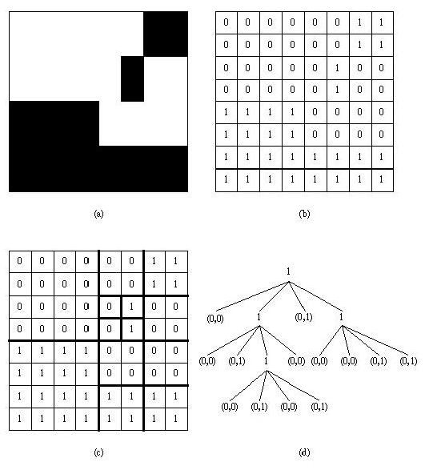
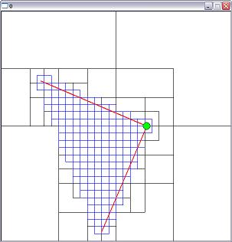
Quad tree pictures

Slide 55
R-tree
Captures the spirit of B-tree for multidimensional data.
Represents a collection of regions by grouping them into a hierarchy of larger regions.
Data is divided into regions.
Interior node is corresponds to interior region
  region can be of any shape
    Rectangular is popular
  Children corresponds to sub-regions.

Slide 56
About MBR
Suppose we have a cluster of points in 2-D space...
We can build a “box” around points. The smallest box (which is axis parallel) that contains all the points is called a Minimum Bounding Rectangle (MBR)
MBR = {(L.x,L.y)(U.x,U.y)}
Note that we only need two points to describe an MBR, we typically use lower left, and upper right.

Slide 57
The formula for the distance between a point and the closest possible point within an MBR
MBR = {(L.x,L.y)(U.x,U.y)}
Q = (x,y)
MINDIST(Q,MBR)
if L.x < x < U.x and L.y < y < U.y then 0
elseif L.x < x < U.x then min( (L.y -y)² , (U.y -y)² )
elseif ….

Slide 58
Two examples of MINDIST(point, MBR), calculations…
MINDIST(point, MBR) = 5
MINDIST(point, MBR) = 0

Slide 59
We have seen the formula for the distance between two points. We will find it useful to have a formula for the distance between a point and the closest possible point within an Minimum Bounding Rectangle MBR…
Suppose we have a query point Q and one known point R
Could any of the points in the MBR be closer to Q than R is?
R = (1,7)
Q = (3,5)
MBR = {(6,1),(8,4)}

Slide 60
We can visualize the locations of interest simply as points in space...

Slide 61
We can group clusters of datapoints into “boxes”, called Minimum Bounding Rectangles (MBRs).
Each MBR can be represented with just two points. The lower left corner, and the upper right corner.
We can further recursively group MBRs into larger MBRs….
R1
R4
R2
R5
R3
R6
R9
R7
R8

Slide 62
…these nested MBRs are organized as a tree (called a spatial access tree or a multidimensional tree).
R10
R11
R10 R11 R12
R1 R2 R3
R4 R5 R6
R7 R8 R9
R12
Data nodes containing points

Slide 63
R10
{(1,0),(7,9)}
R1 R2 R3
R12
{(1,3),(5,4)} {(2,0),(7,9)} {(1,1),(7,8)}
At the leave nodes we have the location, and a pointer to the record in question.
At the internal nodes, we just have MBR information.
(3,4) 77
(1,3) 88
(2,3) 22
(5,4) 13
(2,2) 47
(3,0) 86
(7,9) 52
(5,1) 32
(1,4) 45
(5,6) 27
(7,8) 73
Data nodes

Slide 64
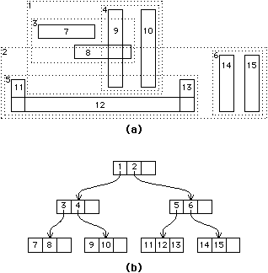
R-tree: Example

Slide 65
R-Trees
R-trees are a N-dimensional extension of B⁺-trees, useful for indexing sets of rectangles and other polygons.
Supported in many modern database systems, along with variants like R⁺ -trees and R*-trees.
Basic idea: generalize the notion of a one-dimensional interval associated with each B+ -tree node to an
N-dimensional interval, that is, an N-dimensional rectangle.
Will consider only the two-dimensional case (N = 2)
  generalization for N > 2 is straightforward, although R-trees work well only for relatively small N

Slide 66
R Trees (Cont.)
A rectangular bounding box is associated with each tree node.
  Bounding box of a leaf node is a minimum sized rectangle that contains all the rectangles/polygons associated with the leaf node.
  The bounding box associated with a non-leaf node contains the bounding box associated with all its children.
  Bounding box of a node serves as its key in its parent node (if any)
  Bounding boxes of children of a node are allowed to overlap
A polygon is stored only in one node, and the bounding box of the node must contain the polygon
  The storage efficiency or R-trees is better than that of k-d trees or quadtrees since a polygon is stored only once

Slide 67
Search in R-Trees
To find data items (rectangles/polygons) intersecting (overlaps) a given query point/region, do the following, starting from the root node:
  If the node is a leaf node, output the data items whose keys intersect the given query point/region.
  Else, for each child of the current node whose bounding box overlaps the query point/region, recursively search the child
Can be very inefficient in worst case since multiple paths may need to be searched
  but works acceptably in practice.
Simple extensions of search procedure to handle predicates contained-in and contains

Slide 68
Insertion in R-Trees
To insert a data item:
  Find a leaf to store it, and add it to the leaf
    To find leaf, follow a child (if any) whose bounding box contains bounding box of data item, else child whose overlap with data item bounding box is maximum
  Handle overflows by splits (as in B+ -trees)
    Split procedure is different though (see below)
  Adjust bounding boxes starting from the leaf upwards
Split procedure:
  Goal: divide entries of an overfull node into two sets such that the bounding boxes have minimum total area
    This is a heuristic. Alternatives like minimum overlap are possible
  Finding the “best” split is expensive, use heuristics instead
    See next slide

Slide 69
Splitting an R-Tree Node
Quadratic split divides the entries in a node into two new nodes as follows
  Find pair of entries with “maximum separation”
    that is, the pair such that the bounding box of the two would has the maximum wasted space (area of bounding box – sum of areas of two entries)
  Place these entries in two new nodes
  Repeatedly find the entry with “maximum preference” for one of the two new nodes, and assign the entry to that node
    Preference of an entry to a node is the increase in area of bounding box if the entry is added to the other node
  Stop when half the entries have been added to one node
    Then assign remaining entries to the other node
Cheaper linear split heuristic works in time linear in number of entries,
  Cheaper but generates slightly worse splits.

Slide 70
Deleting in R-Trees
Deletion of an entry in an R-tree done much like a B⁺-tree deletion.
  In case of underfull node, borrow entries from a sibling if possible, else merging sibling nodes
  Alternative approach removes all entries from the underfull node, deletes the node, then reinserts all entries
  As always, deletion tends to be rarer than insertion for many real world databases.

Slide 71
Curse of Dimensionality
Search performance degrades as number of dimensions increases.

Slide 72
Summary of the Tree Indexing Techniques
Index | Disk-based / In-memory | Balanced | Efficient query type | Dimensionality | Comments
R-tree | Disk-based | Yes | Point, window, kNN | Low | Disadvantage is overlap
K-d-tree | In-memory | No | Point, window, kNN(?) | Low | Inefficient for skewed data
Quad-tree | In-memory | No | Point, window, kNN(?) | Low | Inefficient for skewed data
Z-curve + B⁺-tree | Disk-based | Yes | Point, window | Low | Order of the Z-curve affects performance
iDistance | Disk-based | Yes | Point, kNN | High | Not good for uniform data in very high-D
VA-File | Disk-based |  | Point, window, kNN | High | Not good for skewed data

Slide 73
Index Implementations in major DBMS
SQL Server
  B+-Tree data structure
  Clustered indexes are sparse
  Indexes maintained as updates/insertions/deletes are performed
Oracle
  B+-tree, hash, bitmap, spatial extender for R-Tree
  Clustered index
  Index organized table (unique/clustered)
  Clusters used when creating tables
DB2
  B+-Tree data structure, spatial extender for R-tree
  Clustered indexes are dense
  Explicit command for index reorganization

Slide 74
Recommended Readings and References
Survey on multidimensional indexing techniques
  Christian Böhm, Stefan Berchtold, Daniel A. Keim. Searching in high-dimensional spaces: Index structures for improving the performance of multimedia databases. ACM Computing Surveys 2001.
  Volker Gaede, Oliver Günther. Multidimensional Access Methods. ACM Computing Surveys 1998
Mapping based indexing
  Rui Zhang, Panos Kalnis, Beng Chin Ooi, Kian-Lee Tan. Generalized Multi-dimensional Data Mapping and Query Processing. ACM Transactions on Data Base Systems (TODS), 30(3), 2005.
Space-filling curves
  H. V. Jagadish. Linear Clustering of Objects with Multiple Atributes . ACM SIGMOD Conference (SIGMOD) 1990.
iDistance
  H.V. Jagadish, Beng Chin Ooi, Kian-Lee Tan, Cui Yu, Rui Zhang. iDistance: An Adaptive B+-tree Based Indexing Method for Nearest Neighbor Search. ACM Transactions on Data Base Systems (TODS), 30(2), 2005.
R-tree
  Antonin Guttman. R-Trees: A Dynamic Index Structure for Spatial Searching . ACM SIGMOD Conference (SIGMOD) 1984.
Quad-tree
  Hanan Samet. The Quadtree and Related Hierarchical Data Structures . ACM Computing Surveys 1984.
VA-File
  Roger Weber, Hans-Jörg Schek, Stephen Blott. A Quantitative Analysis and Performance Study for Similarity-Search Methods in High-Dimensional Spaces. International Conference on Very Large Data Bases (VLDB) 1998.

Slide 75
Bitmap indexes
Assume that records have permanent numbers
A bit-map index is a collection of bit vectors of length n, one for each value may appear in the field F.
The vector for value v has 1 in position i if the i’th record has v in field F, and it has 0 there if not.
Example for F and G fields:
  (30, foo), (30,bar), (40, baz), (50, foo), (40, bar), (30, baz)
  Bit index for F, each of 6 bits. For 30, it is 110001, for 40, it is 001010, and for 50, it is 000100.
  Bit index for G also have three vectors. For “foo” it is, 100100, for “bar” it is 010010, and for “baz” it is 001001.

Slide 76
Bit map indexes: Partial match
Bit maps allow answering of partial match queries quickly and efficiently.
Example:
  Movie(title, year, length, studioName)
  SELECT title
  FROM Movie
  WHERE studioName= ‘Disney’ and Year=1965;
If we have bitmap for studioName and year, then intersection or AND operation will give the result.
Bit vectors do not occupy much space.

Slide 77
Bitmap indexes: range queries
Example: consider the gold jewelry data of twelve points
  1 (25,60), 2(45,60), 3(50,75), 4(50,100), 5(50,120), 6(70, 110), 7(85,140), 8(30,260), 9(25,400), 10(45,350), 11(50,275), 12(60,260)
Age has seven different values
  25(100000001000), 30(000000010000), 45(010000000100), 50(001110000010), 60(000000000001), 70(000001000000)
  85(000000100000)
Salary has 10 different values
  60(000000000000), 75(001000000000), 100(000100000000)
  110(000001000000), 120(000010000000), 140(000000100000)
  260(000000010001), 275(000000000010), 350(000000000100)
  400(000000001000),

Slide 78
Example continued
Find the jewelry buyers with an age range 45-55 and salary in the range 100-200
Find the bit vectors of for the age values in the range and take OR
  010000000100 (for 45) and 001110000010 (for 50)
  Result: 011110000110
Find the bit vectors of salaries between 100 and 200 thousand.
  There are four: 100,110,120, and 140, their bitwaise OR is 000111100000
Take AND of both bit vectors
  000110000000
  Find two records (50,100) and (50,120) are in the range.

Slide 79
Compressed bitmaps
If number of different values is large, then number of 1 is rare.
Run-length coding is used
  Sequence of 0’s followed by 1.
  Example: 000101 is two runs, 3 and 1. the binary representation is 11 and 1. So it is decoded as 111.
To save space, the bitmap indexes tend to consist of vectors with very few 1’s are compressed using run-length coding.

Slide 80
Finding bit vectors
Use any index technique to find the values.
From the values to bit vectors.
B-tree is a good choice.

