Slide 1
Query Execution
Chapter 6

Slide 2
Plan
Assign one research paper to each student
  Latest trends in big data systems
Next lab is on R-tree

Slide 3
Outline
Introduction
An algebra for queries
Introduction to physical query plan operators
One pass algorithms for Database Operations
Nested-loop joins
Two-pass algorithms Based on Sorting
Two-pass algorithms based on hashing
Index-based algorithms
Buffer Management
Overview of parallel algorithms

Slide 4
Introduction
Previous chapters
  Finding tuples given a search key
How to answer queries ?
  This chapter and next chapter
Query processor
  Converts queries into a sequence of operations on the database and executes the same.
  Naïve conversion may require more time.

Slide 5
Query Processor
Query
Query compilation
  Chapter 7
Query execution
  Chapter 6
Query
Compilation
Meta data
Query
Execution
data

Slide 6
Overview of Query Compilation
Three major steps
  Parsing
    Query and its structure is constructed
  Query rewrite
    Parse tree is converted to initial logical query plan (lqp)
    Algebraic representation of a query
  Physical plan generation
    Selecting algorithms for each operations
    Selecting the order of operations
Query rewrite and physical plan generation are called query optimizer.
Choice depends on meta data
  Which plan is efficient?
  Which algorithm has to be used for each operation?
  How should operations should pass data?

Slide 7
SQL query
parse
parse tree
convert
answer
logical query plan
execute
apply laws
statistics
Pi
“improved” l.q.p
pick best
estimate result sizes
l.q.p. +sizes
{(P1,C1),(P2,C2)...}
consider physical plans
estimate costs
{P1,P2,…..}

Slide 8
About this chapter
Methods of execution of operations of relational algebra
The methods differ with respect to
  Scanning
  Hashing
  Sorting
  Indexing
Map-Reduce
They also differ based on the available main memory

Slide 9
Query Execution
Execution of relational algebra operations
  Union
  Intersection
  Difference
  Selection
  Projection
  Joins
  sorting

Slide 10
An algebra for queries
SQL operators for Union, intersect and difference
  UNION, INTERSECT and EXCEPT
Selection:
  Where clause
Projection
  SECLECT clause
Product
  Relations are FROM clause, whose products forms he relation with condition of WHERE clause and projection of SELECT clause.
JOIN
  JOIN, NATURAL JOIN, OUTER JOIN
Duplicate elimination
  DISTINCT
Grouping
  GROUP BY clause
Sorting
  ORDER BY clause

Slide 11
UNION, INTERSECTION and DIFFERENCE
Differences between relations and sets
  (a) Relations are bags
  (b) Relations have schemas, a set of attributes that name their columns
Due to (b) schemas of two argument relations must be the same.
R U S: t appears as many times it is in R plus it is in S.
R ∩ S: t appears in the result the minimum number of times it is in R and S
For R-S: number of times in R minus number of times in S.
By default, duplicates are eliminated
We can use the key word ALL (for example UNION ALL) to take the bag versions
The bag versions are followed by duplicate elimination.

Slide 12

SELECTION
R(a,b)
σ_{C}(R) takes a relation R and a condition C. The condition C may involve
  Arithmetic
  Comparison
  Boolean
Result of σ_{a>=1}(R)
a | b
0 | 1
2 | 3
3 | 5
2 | 3
0
2 | 3
3 | 5
2 | 3

Slide 13
PROJECTION
∏_{L}(R) projection R in list L.
L can have the following elements
An expression x→y, where x and y are names for attributes.
An expression E→z, where E is an expression involving attributes of R, constants, arithmetic operators and string operators and z is a new names of the attribute.

Slide 14
The Product of Relations
R X S
  Schema consists of attributes of R and attributes of S.
  If a tuple r appears m times in R and a tuple s appears s times in S, then the tuple rs appears nm times.

Slide 15
Joins
Natural join (R JOIN S)
  ∏_{L}(σ_{C}(R X S))
    C is the condition that equates all the pairs of R and S that have the same name
    L is a list of all the attributes of R and S, except one copy of each pair of attributes is omitted.
Theta join
  σ_{C}(R X S), where condition C is of the form like x any condition y.
Equijoin
  σ_{C}(R X S), where condition C is of equal form like x = y.

Slide 16
Outer join
  Adding dangling tuples from R and S
Left outer join
  Only dangling tuples of the left argument are added
Right outer join
  Only dangling tuples of right argument S are added.

Slide 17
Outer Join – Example
Relation loan
loan Borrower
loan-number
branch-name
amount
loan-number
branch-name
amount
customer-name
L-170
L-230
L-260
Downtown
Redwood
Perryridge
3000
4000
1700
L-170
L-230
Downtown
Redwood
3000
4000
Jones
Smith
Left Outer Join
loan Borrower
Relation borrower
customer-name
loan-number
loan-number
branch-name
amount
customer-name
Jones
Smith
Hayes
L-170
L-230
L-155
L-170
L-230
L-260
Downtown
Redwood
Perryridge
3000
4000
1700
Jones
Smith
null
Full Outer Join
loan borrower
Right Outer Join
loan borrower
loan-number
branch-name
amount
customer-name
L-170
L-230
L-260
L-155
Downtown
Redwood
Perryridge
null
3000
4000
1700
null
Jones
Smith
null
Hayes
loan-number
branch-name
amount
customer-name
L-170
L-230
L-155
Downtown
Redwood
null
3000
4000
null
Jones
Smith
Hayes

Slide 18
Duplicate Elimination
Δ(R ) returns one copy of each tuple.

Slide 19
Grouping and Aggregation
Aggregate operators
  AVG, SUM, COUNT, MIN, and MAX
Group By
  The relation is grouped according to the value of the attribute
Having
  Provides a condition the group must satisfy
Grouping and having should be implemented together

Slide 20
Sorting operator
We use the operator τ to sort a relation
SQL ORDER BY
τ_{L}(R), L is a list of attributes (a1, a2,…, an)
  Ties are broken as per a2…
  They agree till “an”, the tuples are sorted arbitrarily.
  Default is ascending order, can be changed using DESC
  The result is list of tuples. So it is he last operator.
    If this operator is applied, the notion of set is disturbed.

Slide 21
Expression Trees
Leaves are relations and interior nodes are operators.
Schema
  MovieStar(name, address, gender, birthdate)
  StarsIn(title, year, starName)
Query
  Select title, birthdate
  From MovieStar, StarsIn
  Where Year = “1996” ∧ gender = F∧ starName=name

Slide 22
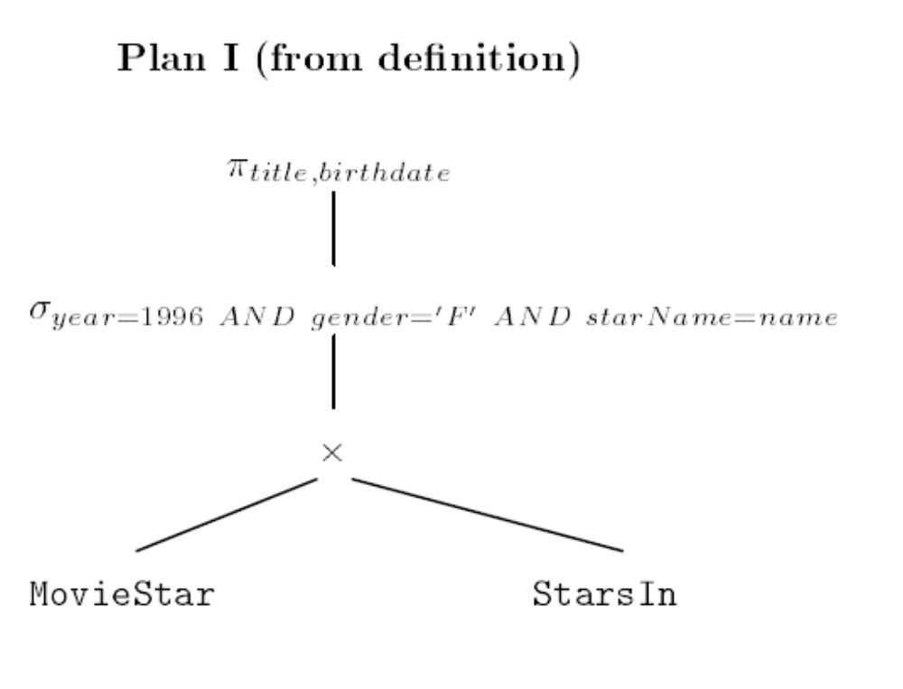
Expression Tree 1

Slide 23
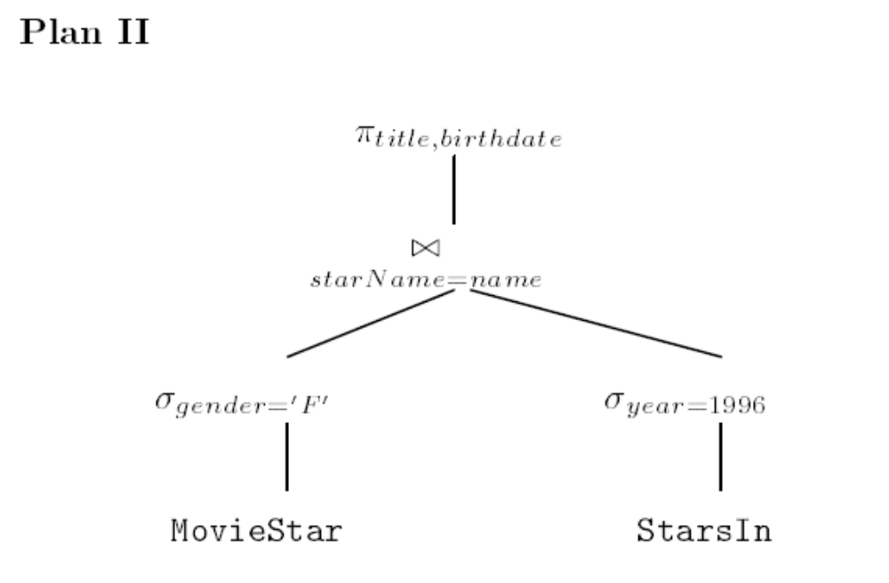
Another logical query plan

Slide 24
Introduction to Physical
Query Plan Operators
Physical plans
  Built-in operators
  Physical plans are implementation for one of the operations of relational algebra.
Scan: Scanning tables
  Read the entire contents of R.
  Two basic operators
    Table scan: Get the blocks one by one
    Index scan: Use index to get all the tuples of R
      Index scan
      Use index to get few tuples.

Slide 25
Sort-scan: Sorting While Scanning Tables
The operator sort-scan takes a relation R and a specification of attributes on which the sort is to be made, and produces R in that sorted order.
Ways to implement sort-scan
  If we are to produce a relation R sorted by attribute “a”, and there is a Btree index on “a”, simple scan produces sorted file.
  If R fits in main memory, we can retrieve tuples using index scan or table scan and use main memory sorting algorithms.
  If R is too large to fit in main memory, follow multi-way merging approach.

Slide 26
Model of Computation of Physical Operators
Query consists of several operations of relational algebra and corresponding physical query plan is composed of several physical operators.
  Operations like scanning are invisible in relational algebra.
Physical plan operators should be chosen wisely.
Number of disk I/O’s is the measure.
Assumption:
  Arguments can be fund on the disk and the result of the operation is in the main memory.

Slide 27
Parameters to measure the cost
M denotes the number of main memory buffers available.
  Input and intermediate results
  M is much smaller than the main memory
  Note: this is an estimate. If it is wrong, thrashing may occur.
B(R)- number of blocks that hold R
T(R) - number of tuples in R
V(R,a) – number of distinct values of the column for “a” in R.

Slide 28
I/O cost for Scan Operators
If R is clustered the number of disk I/O’s = B.
If R fits in main memory, B I/O’s.
If R is clustered but requires a tw-phase multi-way merge sort we require 3B disk I/O’s
If R is not clustered, the number of disk I/Os is much higher.
If R is distributed among the tuples of other relations, the I/O cost is T.
IF R is not clustered and requires a two-way merge sort it requires: T+2B.
Index scan
  Fewer than B(R) blocks

Slide 29
Iterators for Implementation for Physical Operators
Iterator
  Getting one tuple at a time.
Three functions
  Open:
    Starts the process of getting tuples, but does not get a tuple. It initializes any data structures needed to perform the operation and calls Open for any orguments of the operation.
  GetNext
    The function returns the next tuple in the result and adjusts data structures as necessary to allow subsequent tuples to be obtained. It returns null, if there are no more tuples produced.
  Close
    The function ends iteration after all tuples, or all the tuples the consumer wanted, have been obtained.
(Refer Figure 6.8 for table scan operator)

Slide 30
Iterator for Table Scan
Open(R){
  b:= the first block of R;
  t:= the first tuple of block b;
  found := true;
  }
GetNext {
  IF(t is past the last tuple on block b) { increment b to the next block;
  IF(there is no next block) {Found:=FALSE; RETURN;}
  ELSE /* b is a new block */
    t:= first tuple on bock b;
    Oldt:=t;
    Increment t to the next tuple of b;
    RETURN oldt;
    }
CLOSE(R) {}

Slide 31
Iterator for sort-scan
The open function read all the tuples in main-memory sized chunks, sort them and stores them on the disk
Initialize the data structure for the second merge phase, load the first block of each sublist into main-memory structure.

Slide 32
Iterators
Iterators can be combined by calling other iterators.
Open(R,S){ R.open(); CurRel:=R;}
GetNext(R,S) { IF CurRel=R {t=R.GetNext() IF (Fund) RETURN t ELSE S.open(); CurRel=S;}} Return S.GetNext();
Close(R,S){ R.Close(); S.Close();}

Slide 33

Next Class

Slide 34
Algorithms For Database Operations
How to execute each individual steps
  Join and selection
  Selecting a choice of an algorithm
Three categories
  Sorting-based methods
  Hash-based methods
  Index-based methods
One pass algorithms
  Requires reading only once from the disk
  At least one of the arguments fits in the memory
Two pass algorithms
  Too large to fit in the memory but not the largest.
  Requires two readings
    First read and process and write back.
    Read again for further processing
Multi pass algorithms
  No limit on the size of data
  Recursive generalizations of two pass algorithms

Slide 35
Three types of operators
Tuple at a time, unary operations
  Selection and projection
  Do not require entire relation.
Full relation
  Seeing all the tuples in memory once
Full-relation, binary operations
  Union, intersection, joins, products

Slide 36
One pass algorithms for tuple at a time Operations
σ(R), ∏(R),
  Read the blocks of R one at a time into input buffer and move the tuples to output buffer.
  Complexity is B, if R is clustered and T if R is not clustered.
  If the condition variable has an Index, it affects the performance.

Slide 37
One Pass algorithms for Unary and Full Relation Operations
Duplicate elimination and grouping
For each tuple
  If we have seen it first time, write it to output buffer
  If the tuple is seen before, do not output this tuple.
    For this we have to keep one copy of every tuple we have seen.
    One memory buffer holds the block of R’s tuples, the remaining M-1 blocks can be used to hold a single copy of every tuple seen so far.

Slide 38
One pass algorithms…
Each new tuple takes processor time proportional to n.
  Complete operation takes n² processor time.
  If n is large, it becomes significant.
The main memory data structure to allow
  Add a new tuple
  Tell a whether a given tuple is already there.
Use hash tables or binary search tree
Assumption: no extra space is required
If B(δ(R)) <=M, it is OK, otherwise thrashing might occur.

Slide 39
Grouping
The grouping operation γ_{L} gives zero or more grouping attributes and one or more aggregated attributes.
For each of grouping attribute create one entry for each value and scan each block at a time
  For a MIN(a) or MAX(a) aggregate, record min and max value, respectively and change min or maximum whenever each time a tuple of a group seen
  For COUNT, add one to the corresponding group
  For SUM(a), add the value of “a” to the accumulated sum.
  AVG(a): maintain two accumulations: count and sum of values.
Until all the tuples are seen, we can not output the result.
Entire grouping is done in OPEN function.
Hash tables and balanced trees are used to find the entry in each group.
The number o I/Os is B.
Number of disk I/Os needed for one pass algorithm is B

Slide 40
One pass Algorithms for Binary Operations
Set Union
  Read S into M-1 buffers of main memory and build a search structure where the search key is the entire tuple. All the tuples are copied to the output
  Read R into mth buffer, one at a time. If “t” is in S, skip “t”, otherwise write “t” to output.
Set Intersection
  Read S into M-1 buffers and build a search structure with full tuples as search key. Read each block of R, for each “t” of R, see if t is also in S. If so, copt t to the output. If not, ignore it.
Set difference
  Assume R is larger relation. Read S to M-1 buffers and build a search structure with full tuple as a search key.
  R-S
    Read each block of R. IF t is in S, ignore t; if it is not in S, copy t to the output
  S-R
    Read each block of R. Examine t; if it is in S, delete “t” from the copy of S. If “t” is not in S we do nothing. After completing R, output the remaining S tuples.
Approximate requirement
  Min(B(R), B(S))<=M-1

Slide 41
Bag intersection and Bag difference
Bag intersection
  We read S into M-1 buffers, we associate each distinct tuple a count, which measures the number of times the tuple appears in S.
  Read each block of R whether t occurs in S. If not, ignore “t”. If it appears, if the count is positive, output t and decrement the count by one. If t appears in S and count is zero, we do not out put t.
Bag difference
  Similar.. (Check the book)

Slide 42
Product
Product
  Read S into M-1 buffers. Read each block of R. For each tuple of R, concatenate t with each tuple of S. Output concatenated file.

Slide 43
Natural Join
Natural join
  R(X,Y) being joined with S(Y,Z)
  Read all the tuples of S into M-1 blocks.
  Read each block of R. For each t of R, find the tuples that agree with all the attributes of Y. For each matching tuple of S, form a tuple by joining it with t, and move the resulting tuple to the output.
  Takes B(R)+B(S) disk I/Os
  Min(B(R),B(S))<=M

Slide 44
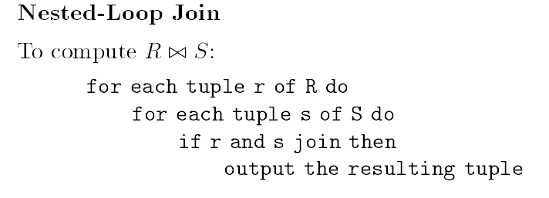
Nested Loop Joins
Tuple-based Nested loop join
  Used for relation of any sizes.
  One and half passes
  One argument is read only once and another argument is read repeatedly
  Complexity: T(R)T(S) disk I/Os.

Slide 45
Nested Loop Joins
To lower the cost
  Use the index
  Storage organization
If we are careless about how we buffer the blocks, the alg could require T(R)*T(S) disk I/Os

Slide 46
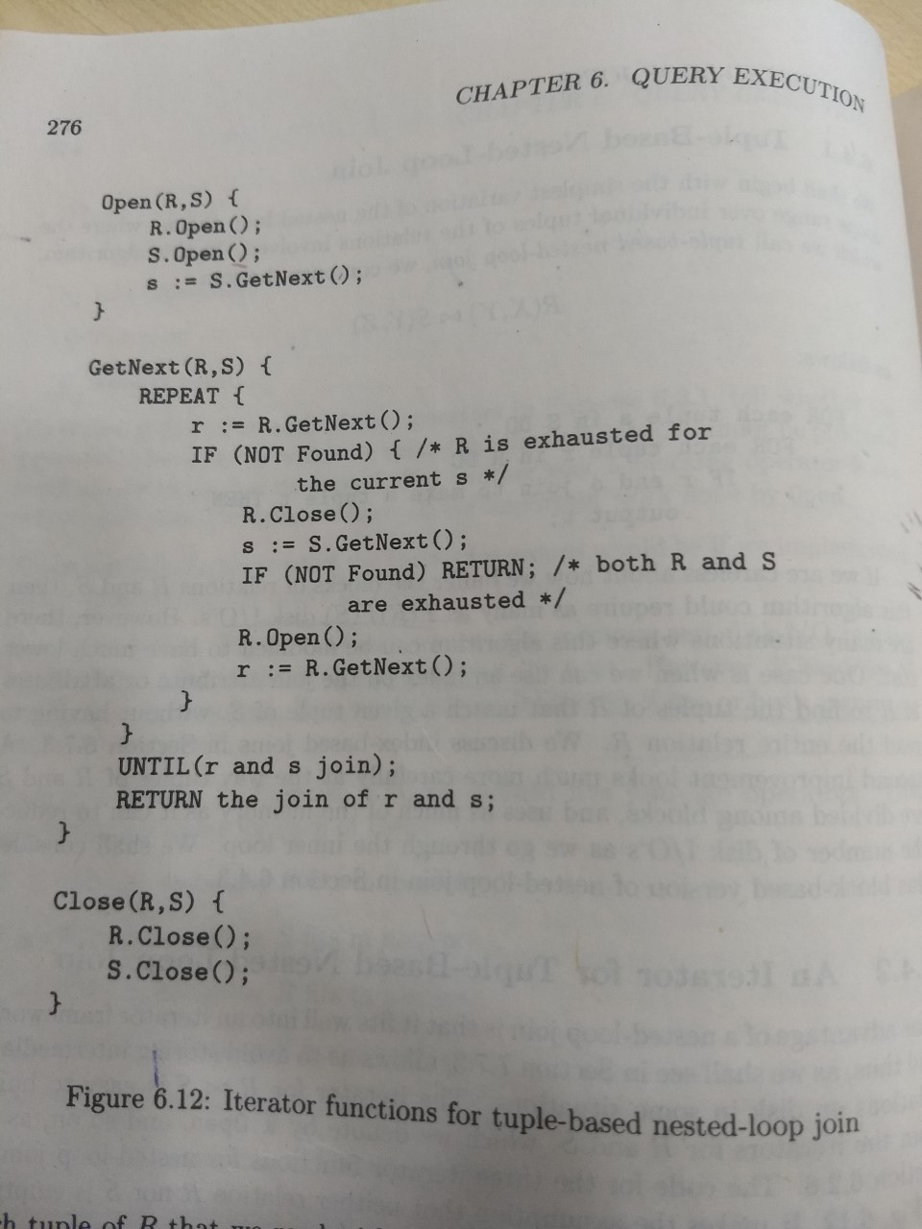
Iterator for Tuple-based Nested
Loop Join

Slide 47
A block-based Nested Loop Join
Organize the access to both relations by blocks.
Using as much memory, store the tuples of S.

Slide 48
Nested Block Join
FOR each chunk of M-1 blocks of S DO BEGIN
read these blocks into main memory buffers;
Organize their tuples into a search tree structure whose search key
is the common attributes of R and S;
FOR each block b of R DO BEGIN
read b into memory;
FOR each tuple t of b DO BEGIN
find the tuples of S in main memory that
join with t;
output the join of t with each of these tuples;
END;
END;
END;
Assumption: B(S) <B(R) and B(S) >M

Slide 49
Example
B(R)=1000 and B(S)=500 and let M=101.
We use 100 blocks of memory for S
  Outer loop iterates five times
  Each iteration we have 100 disk I/Os
  Second loop we must read entire R.
    1000 I/Os
  5500 I/Os
If we reverse the role of R and S
  6000 I/Os

Slide 50
Analysis of Nested –Loop Join
Iterations of outer nested loop B(S)/(M-1)
For each iteration we read M-1 blocks of S and B(R) blocks of R.
The number of disk I/Os
  (B(S)/(M-1)) (M-1+B(R))
  B(S)+ B(S)B(R)/(M-1)
  B(S)B(R )/M
Nested loop join was employed in early systems.

Slide 51
Summary
Operators | Approximate M Required | Disk I/O
σ, π | 1 | B
γ, δ | B | B
U, ∩, ─, ×, Join | Min(B(R),B(S)) | B(R )+B(S)
Join | Any M ≥ 2 | B(R)B(S)/M

Slide 52
Two-pass Algorithms Based on Sorting
Two pass algorithms are sufficient.
It can be generalized into higher passes
If we have large relation R
  Read M blocks into main memory
  Sort these M blocks
  Write sorted list into M blocks of disk
  Execute the desired operator on the sorted lists

Slide 53
Duplicate Elimination Using Sorting
Hold the first block from each of the sorted sublist.
Consider first unconsidered tuple from each block, make copy of t to the output. Remove from the fronts of various input blocks all copies of t.
If the block is exhausted, bring new block of that sorted sub-list.

Slide 54
Complexity
Ignore the writing of output
  B(R) to read each block of R when creating sorted sublists
  B(R) to write each of sublists to disk
  B(R) to read each block from sublist.
  Total =3*B(R)
Memory requirement
  B ≤ M² is required for the two pass algorithm to be feasible
  (for one pass B<= M)
  δ (R ) requires √B(R ) blocks of memory
    (for one pass B=M)

Slide 55
Grouping and Aggregation
The algorithm for γ(R ) is similar to δ (R).
Read R, M blocks at a time. Sort each blocks grouping attributes of R as the sorted key. Write each sorted sublist to disk.
Use the one memory buffer for each sublist, load the first block of each sublist into its buffer
Repeatedly find the least value in the available sub-buffers. This value, v, becomes the next value
  Prepare to compute all the aggregates on list L for this group
  Examine each of the tuples with sort key v, and accumulate the needed aggregates.
  If a buffer becomes empty, replace it with the next block from the same list.
Complexity is similar to δ
  B ≤ M² is required for the two pass algorithm to be feasible
  δ (R ) requires √B(R ) blocks of memory

Slide 56
Sort-based Union Algorithm
One-pass algorithm works, if at least one relation is in main memory.
Two pass algorithm
  Create sorted sublists of R of size M.
  Create sorted sublists of S of size M.
  Use one main-memory buffer for each sublist of R and S. Initialize with first block of each R and S.
  Repeatedly find the first remaining tuple t among all the buffers. Copy t to the output and remove from all the copies of t.
  If the buffer becomes empty read the next block in the sublist.
Total cost= 3(B(R )+B(S))
  Each tuple is read twice in main memory: Once when sublists are being created and the second time as a part of one f the sublists.
  Each tuple is written once
  The size of two relations should not exceed M².
    That is, B(R)+ B(S) ≤ M²

Slide 57
Sort-based Algorithms for
Intersection and Difference
Same as union
Set intersection:
  Output t, if t appears in both R and S.
Bag intersection
  Output t the minimum number of times t appears in R and in S.
R-S (set)
  Output t, if only it appears in R but not in S.
R-S (bag)
  Output t the number of times it appears in R minus the number of times it appears in S. If both occur at equal number of times, we do not output any tuples.
Analysis
  3(B(S)+B(S)) disk I/Os.
  B(R)+B(S) ≤ M² for the algorithm to work.

Slide 58
Simple Sort-based Joining Algorithm
Sort R, with mupli-way merge sort, with Y as the sort key.
Sort S similarly.
Merge the sorted R and S. Use only two buffers contains current blocks of R and S respectively.
  Find least value y that is currently in front of the blocks for R and S.
  If y does not appear in front of other relation, remove tuples with sort key “y”.
  Otherwise, identify all the tuples from both relations having sort key y. read blocks from R and S, until no more keys. Use M buffers for this purpose.
  Output all such tuples.
  If either relation has no more unconsidered tuples in main memory, reload the buffer for that relation.

Slide 59
Simple Sort join: modification for the worst case
If Y-is the key for R or S no problem arises.
If the tuples from one of the relations, say R, that have Y-value y fit in to M-1 buffers, do one pas join
  load these blocks of R into buffers and read the blocks of S that hold tuples with y, one at a time into remaining buffer.
If neither relation has sufficiently few tuples with Y-value y that they all fit into M-1 buffers, do nested-loop join
  Use M buffers to perform nested loop join on the tuples with Y-value y from both relations.

Slide 60
Analysis of Simple Sort-based Join
Analysis
  We shall not run out of buffers, if the tuples in common y value can not fit in buffers.
  5(B(R)+B(S)) disk I/Os.
  B(R) ≤ M² and B(S)≤M²

Slide 61
A More Efficient Sort-based Join
Second phase of join and sorting can be combined. It is called sort-join, sort-merge-join, merge join.
  Create sorted sublists on R and S using Y.
  Bring the first block of each sublist into buffer (No more than M sublists)
  Repeatedly, find the least Y-value y among the first available tuples of all the sublists. Identify all the tuples of both relations that have Y-value y, using some of the available M buffers. Output the join of all tuples from R with all tuples from S that share this common Y-value. If the buffer of one sublist exhausted, replenish it from disk.
Analysis
  3(B(R)+B(S)) disk I/Os.
  (B(R)+B(S)) ≤ M² is sufficient.

Slide 62
Problem of many tuples with Y-value
Problem may not arise
  Y is the key of R
If B(R) + B(S) is much less than M*M, use many unused buffers.
In the worst case, follow nested loop join.

Slide 63
Summary of Sort-based algorithms
Operators | Approximate M Required | Disk I/O
γ, δ | √B | 3B
U, ∩, ─ | √(B(R)+B(S)) | 3(B(R )+B(S))
Join | √max(B(R),B(S)) | 5(B(R )+B(S))
Join | √(B(R)+B(S) | 3(B(R )+B(S))

Slide 64
Two-Pass Algorithms Based on Hashing
Basic idea
  If the data is too big to store in main-memory buffers, hash all the tuples of the argument or arguments using an appropriate hash key.
  If M buffers are available, we can pick M as number of buckets.
  We can gain a factor of M similar to sort-based algorithms, but different means.

Slide 65
Partitioning Relations Using Hashing
Let hash function be “h”
Associate one buffer with each bucket.
Partition R into M-1 buckets.
Read R in to Mth buffer
Each tuple is hashed to M-1 buckets and copied to appropriate buffer.
  If the buffer is full, write it to disk and initialize another block.
Bucket size is bigger than buffers.

Slide 66
A hash-based Algorithm for Duplicate Elimination
δ(R)
  Hash R to M-1 buckets.
  Two copies of the same tuple are hashed to the same bucket.
  Eliminate one bucket at a time.
  One pass algorithm can be used.
It works if individual Ri’s fits into main memory.
  Each Ri is equal to B(R)/(M-1) blocks in size.
  If the number of blocks no longer than M, i.e., B(R)≤M(M-1), two pass hash based algorithm works.
  B(R) ≤ M² (same as sort-based algorithm for duplicate elimination)

Slide 67
Hash-based algorithm for grouping and aggregation
γ_{L}(R)
  Chose the hash function on the grouping attributes of list L.
  Hash all the tuples of R into M-1 buckets
  Use one pass algorithm
  We can process provided that B(R) ≤ M²
  Number of disk I/Os = 3B(R)

Slide 68
Hash-based algorithms for U,∩, and ─
Binary operation
Use the same hash function to hash tuples of both arguments.
R Us S
  Hash both R and S to R₁, R₂, …,R_{M-1} and S₁, S₂,…,S_{M-1}.
  Take set union of R_{i} and S_{i}, for all i and output the result.
Intersection or difference
  Apply appropriate one pass algorithm
  (B(R) + B(S)) I/Os.
Summary
  Total 3(B(R)+B(S)) I/Os
  The algorithms work iff Min(B(R), B(S)) ≤ M²

Slide 69
Hash Join Algorithm
Compute R(X,Y) join S(Y,Z)
Use the hash key for the join attributes.
  If tuples join they will wind up in corresponding Ri and Si for some i.
  One pass join of all pairs of corresponding buckets.
Summary
  Total 3(B(R)+B(S)) I/Os
  The algorithms work iff Min(B(R), B(S)) ≤ M²

Slide 70
Hybrid Hash Join:
Saving some disk I/Os
Use several blocks for each bucket and write them out in a group , in consecutive blocks of disk.
Hybrid hash join
  Use several tricks to avoid writing of some of the blocks.
  Suppose S is a smaller relation. We have to create “k” buckets, k<M.
  Keep all “m” of “k” buckets in main memory and keep one block for each remaining bucket.
  (m*(B(S)/k)+k-m ≤ M
    B(S)/k is the expected size of bucket.
“m” buckets of S are not written into memory
One block for each (k-m) buckets of R whose corresponding buckets of S were written to disk.
In the second pass, R and S can be joined as usual, Actually, there is no need to join.

Slide 71
Saving some disk I/Os
Saving disk I/Os equal to two for every blocks of S and corresponding R buckets. Note that m/k buckets are in main memory
  Savings= 2(m/k)(B(R)+B(S))
  Intuition: k should be as small as possible to maximize savings.
  Buckets are equal to M, so k=B(S)/M and m=1
  Savings= (2M/B(S))(B(R)+B(S))
  Total cost (3-(2M/B(S)))(B(R )+B(S))

Slide 72
Summary of Hash-based Join algorithms
Operators | Approximate M Required | Disk I/O
γ, δ | √B | 3B
U, ∩, ─ | √B(S) | 3(B(R )+B(S))
Join | √B(S) | 5(B(R )+B(S))
Join | √B(S) | (3-2M/B(S))(B(R )+B(S))
Assume B(S) ≤ B(R)

Slide 73
Sort-based and Hash-based algorithms
Size
  Hash depends on smaller relation size
  Sort depends on sum of two relation sizes.
Sort order
  Sort algorithms produce sorted order
  Hash algorithms not
Size of buckets
  Hash depends on buckets of equal size. It is not possible to use buckets that occupy M blocks
In sort-based algorithms, sorted sub-lists can be written in consecutive blocks of disk. Rotational and seek latency can be reduced
In hash-based algorithms also, we can write several blocks of buckets at once.

Slide 74
Index-based Algorithms
Index is available on one or more attributes of a relation

Slide 75
Clustering and non-clustering indexes
All the relations are clustered
  If the tuples are packed roughly as few blocks as can possibly hold those tuples.
Clustering idexes
  Indexes on an attribute or attributes such that all the tuples with a fixed value for the search key of this index appear roughly as few blocks that hold them
  Only clustered relations have clustered index.
σ

Slide 76
Notions of clustering
Clustered file organization
  Tuples of two relations are placed together in the same block based on certain value.
Clustered relation
  One block contains the tuples of one relation.
Clustered index
  Tuples having given search key value are stored together.

Slide 77
Index-based Selection
σ
  If there are no indexes on R, one has to read all the tuples of R
    Number of disk I/Os=B(R) or t(R )
  If the search key is equal a=v, and a is an attribute for which an index exists and v is a value.
  We can use index and get the pointers.
  If index is clustered the number of disk I/Os=B(R )/V(R,a).
    Actual number might be higher
      Disk I/Os are needed to support index lookup
      The tuples can be spread over several blocks
      The tuples can spread several blocks.
  If the index is non-clustered, we must access T(R)/V(R,a) tuples.
    The number might be higher because, we might read some index blocks. (sometimes lower also)

Slide 78
Example
Example: B(R)=1000, T(R)=20000, Each block contains 20 tuples
σa=0 (R)
  If R is clustered and do not use index=1000 I/Os
  If R is not clusters=20,000 I/Os
  If V(R,a)=100 and index is clustering =1000/100=10 disk I/Os
  If V(R,a)=100 and index is not clustering=20,000/100=2000 I/Os
  If V(R,a)=20,000 and “a” is the key= 1 disk I/O

Slide 79
Joining by Using an Index
Suppose S has an index on attributes Y
Examine each block of R, identify tuples that match y, use index to find all tuples of S that have ty in their Y-components.
Disk I/Os
  Reading R
    If R is clustered, we have to read B(R) blocks.
    If R is not clustered, upto T(R) blocks
  Reading S
    For each tuple t of R, we must read an average of T(S)/V(S,Y) tuples of S.
    S has non clustered index on Y, the number of disk I/Os required is T(R) T(S)/V(S,Y) disk I/O’s
    If the index is clustered we only need T(R )B(S)/V(S,Y) disk I/Os office.
  Regardless of R is clustered or not, the cost of accessing tuples of S dominates
    So we take T(R) T(S)/V(S,Y) or T(R )(max(1,B(S)/V(S,Y))) for clusted or non-clustered indexes, respectively.

Slide 80
Advantages of Index Join
R is very small compared with S and V(S,Y) is large.
If we select before join, most of the S tuples will not be examined.
Both sort/hash based methods examine every tuple of S at least once.

Slide 81
Joins using Sorted Index
If we have a sorting idexes on Y for both R and S we have to perform only the final step of the simple sorted-based join.

Slide 82
Buffer Management
Value of M vary depending on system conditions
Buffer manager allocates buffers to processes such that delay is minimized.

Slide 83
Research Paper
Operating System Support for Database Management
Michael Stonebraker
University of California, Berkely
Instructor: P.Krishna Reddy

Slide 84
Introduction
What do Operating Systems do that force DBMS designers to start from scratch? Can the OS take over some of this stuff?
Note: Some of these gripes have been fixed in commercial OS'es. Some in research OS'es. Many remain as artifacts of the distinction between OS'es and DBMSs.

Slide 85
Introduction…
DBMS provide higher level user support than conventional OSs.
Different OSs are designed for different use.
We discuss several OS services and indicate whether they are appropriate for DBMS.
  Conclusion: Wrong service is provided or severe performance problems exists.
  Some suggestions are provided.

Slide 86
Outline
Examples are drawn from UNIX, but the points raised have a general applicability.
Several popular OS services are examined.
  Buffer pool management
  The file system
  Scheduling
  Inter-process communication
  Consistency control
Conclusions

Slide 87
Buffer Pool Management
Read X
Many OSs provide main memory cache for the file system.
  Example: UNIX provides a buffer pool whose size is set when the OS is compiled.
  A file-read returns data directly from a block in the cache, otherwise, the block is pushed to the disk and replaced by desired block.
  Conceptually it is desirable because, the blocks of locality-of-reference remain in the disk.
  However, several problems are encountered in case of DBMS.
    Performance, replacement policy control, pre-fetch and crash recovery
Main memory
Y
1
2
X
disk
Structure of a cache

Slide 88
Buffer Pool…
Performance problems
  getting a page from the OS to user space is a system call (process switch) and a copy
  Cost to fetch 512 bytes exceeds 5,000 instructions.
  Many DBMSs (System R and Ingres) constructed their own buffer pool to reduce overhead.
  OS should cut this overhead to few hundred instructions.

Slide 89
Buffer Pool…
Replacement policy control
  LRU is a good tactic for buffer management in OSs.
  Database access in INGRES is a combination of
    Sequential access to blocks which will not be referenced.
    Sequential access to blocks which will cyclically referenced.
    Random access to blocks which will not be referenced again;
    Random access to blocks for which there is a nonzero probability of reference.
  Although LRU works well for the fourth one, it is a bad strategy for other situations.
  Since a DBMS knows which blocks are in each category, a composite strategy may be good.
  For case 4, it can use LRU, and for others it can use toss-immediate strategy.
  Some means should be provided so that OS can accept an advice from application program concerning the replacement policy.
  DBMS knows access pattern in advance - should dictate policy
  This is a major OS/DBMS distinction!

Slide 90
Buffer Pool…
Pre-fetch:
  Although UNIX correctly pre-fetches pages when a sequential access is detected, on several instances it fails.
  In INGRES, the examination of a block knows the next block to be accessed. Unfortunately it may not be the next one in logical file order.
Crash Recovery:
  DBMS should provide recovery from hard and soft crashes..
  The unit of work may be big.
  DBMS provide this service with intention lists.
  The page for which commit flag is set must be forced to disk after all pages in the intentions list.
  So the service required from OS buffer manger is a selected force out.
  Requires page-level control of flushing.

Slide 91
File System
UNIX supports files of character arrays of dynamically varying size.
On top of this abstraction, DBMS can provide different abstractions.
Second approach is to provide record management by OS.
  Structured files are provided.
The second service provided by DBMS may not be efficient on top of character arrays.

Slide 92
File System…
Physical contiguity
  Character array block is expanded one block at a time. Next logical block is not physically close to the previous block.
  Since DBMS does considerable sequential access, the result is considerable disk arm movement.
  lack of clustering (translate: block granularity problem.)
Multiple trees: (dir, file, database). Unify?
  UNIX implements two services by means of data structures.
    The blocks in a given file are kept track of in a tree, pointed by i-node block.
    The files in a mounted file system have a user visible hierarchical structure.
    DBMS adds a third tree (B-tree)
One tree may be efficient than three trees!

Slide 93
Scheduling, IPC
Simplest way is one process per user.
  System R and UNIX follow this method.
Alternative: allocate a one run-time database process which acts as a server.
However, the design of OS favors the first one.
There are two problems with the process per user approach.
  Performance and critical section

Slide 94
Scheduling, IPC…
Performance problem:
  When the page is not found in the main memory, DBMS suspends the process and another process is run.
  Task switch is expensive in many OSs as there is a lot of state information.
  There is a high price to pay for a buffer pool miss.

Slide 95
Scheduling, IPC ..
Critical sections (Convoys)
  DBMS processes have critical sections.
    Buffer pool is a critical section.
  System R sets short term locks.
  Problem occurs when OS deschedules process which holding short-term lock.
  This convoy effect has a devastating effect on the performance.

Slide 96
Scheduling, IPC…
Over process-per-user model other model may be good
Server model
  It is viable if OS provides a facility to allow multiple processes to send a message to single process.
  Such a server should do own scheduling and multi tasking.
  Also, server can avoid multi-tasking by resorting to FCFS.
  I/O process model
  Expensive messages?
    The cost of round-trip message is 5000 instructions.
    Care must be exercised
  Some systems do this now & get good performance.
User1
……
User1
User1
User1
DBMS
process
……
DBMS
process
DBMS
process
disk
disk
Process per user structure
Server DBMS structure

Slide 97
Summary
Both server model and process per user model seems unattractive.
Problem is the overhead for task switches and messages.
OS should provide fast path functions for DBMS consumers.
Otherwise, DBMS users will implement their own multitasking, scheduling, and message systems.
  Mini OS running in user space.
Solution: OS should create a special scheduling class for DBMS.
  Processes in this class would never forcibly de-scheduled but might voluntarily relinquish the CPU.
  It will solve the convoy problem.
Fast path through task switch/scheduler loop to pass control to one of their sibling processes.
  Passing control with less overhead.

Slide 98
Consistency/Locking
OS locking granularity fixed (pages or pages)
Few OSs support finer granularity of locks.
Byte-level recover doesn't help with transactions
Sometimes it is suggested that both CC and recovery should be provided by the OSs.
  However, problem comes with the buffer management as locking, recovery & buffer management interact
  e.g.: must write log pages in order, so must be able to flush individual pages. can't release locks until commit is logged.
  if any of these is missing from OS, DBMS must implement all of them to avoid duplication.

Slide 99
Paged virtual memory
Bind files in user’s paged virtual memory address space.
Such files can be referenced by the program.
No need of doing explicit reads and writes;
  He can depend on paging facilities of OS.
  There are some problems with this approach.
Large files:
  Paging hardware creates 4 bytes per 4K page.
  100M-byte fiile will have an overhead of 100 K bytes.
  So there will be a paging for a page table.
    So each I/O operation causes two page faults: one for the page containing the page table and one on the data itself. address space big enough?

Slide 100
Conclusion
Bottom line
  OS services in many existing OSs are either too slow or inappropriate.
  Current DBMS usually provide their own and make little or no use of those offered by OS.
  A DBMS would prefer small efficient oS with only desired services.
  Real-time operating systems may be ideal
  General purpose OSs offer all things to all people at much higher overhead.

Slide 101
Last Slide of the research paper
Operating System Support for Database Management
Michael Stonebraker
University of California, Berkely

Slide 102
Buffer Management Architecture
It controls main memory directly, or
Buffer manager allocates buffers in virtual memory, allowing OS to decide which buffers are actually in main memory at any time.
Should avoid thrashing.

Slide 103
Buffer Management Strategies
If buffers are full, it has to decide which block has to throw out to create space for new block.
LRU
  Throw out the block which has not been used for a longer period of time.
FIFO
  Throw out the bock which has stayed for longer time.
CLOCK algorithm
  Approximation of LRU
  Buffers are arranged in a circle.
  When the block is read it is set to 1. When the contents are accessed it is set to 1.
  Buffer manager replaces a block with 0. If it finds 1, it sets to 0.
System control
  Take advice from query processor about the algorithm and pinned blocks.

Slide 104
Pinned blocks
The blocks can not be moved with out modifying other blocks that point to it.
Buffer manager avoid expelling pinned blocks.
If the block is pinned, it will remain in memory
  Root block of B-tree is pinned
  Pin the blocks of smaller relation in the join

Slide 105
Relation between Physical Operator Selection and Buffer Management
Query optimizer selects some operators
Each operator assumes availability of some buffers
Buffer manager may not guarantee
So,
  Can the algorithm of physical operator adapt changes to M ?

Slide 106
Observations
If we use sort-based algorithm, it is possible to adapt to changes to M.
  If M shrinks, we can change the size of sublist.
If the algorithm is hash-based, we can reduce the number of buckets if M shrinks as long as buckets do not become so large they do not fit in allotted main memory.

Slide 107
Algorithms with more than two passes
Generalization of two pass algorithm.
  Sorting-based
  Hash-based

Slide 108
Parallel Algorithms
Database operations can profit from parallel processing

Slide 109
Models of parallelism
Shared memory
  Each processor can access all the memory of all the processors.
  Single physical address space
Shared disk
  Every processor has its own memory and not accessible by other processors
  Disks are accessible by every processor through network
Shared nothing
  Each processor has its own memory and disk
  Communication is through network

Slide 110
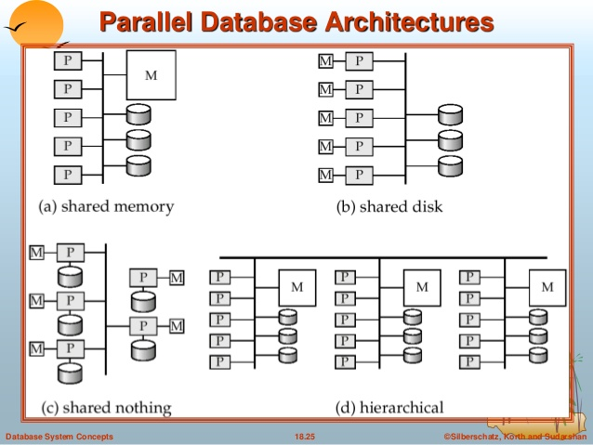

Slide 111
Shared Nothing
Tuple-at-a time operations in parallel
If there are P processors, divide R’s tuples evenly among the P processors.
Send the selection and projection to the processors.

Slide 112
Full Relation Operations
Use hash to distribute the tuples
Apply grouping operation in parallel.
For union, intersection and subtraction use the same hash function to distribute R.

Slide 113
Performance
Number of disk I/Os do not change
Time = 1/p of time + cost of shipping
Shipment over network is cheaper than disk utilization.

Slide 114
Research Paper
MapReduce:
Simplified Data Processing on Large Clusters
These are slides from Dan Weld’s class at U. Washington
(who in turn made his slides based on those by Jeff Dean, Sanjay Ghemawat, Google, Inc.)

Slide 115
Motivation
Large-Scale Data Processing
  Want to use 1000s of CPUs
    But don’t want hassle of managing things
MapReduce provides
  Automatic parallelization & distribution
  Fault tolerance
  I/O scheduling
  Monitoring & status updates

Slide 116
Map/Reduce
Map/Reduce
  Programming model from Lisp
  (and other functional languages)
Many problems can be phrased this way
Easy to distribute across nodes
Nice retry/failure semantics

Slide 117
Map in Lisp (Scheme)
Unary operator
(map f list [list₂ list₃ …])
(map square ‘(1 2 3 4))
  (1 4 9 16)
(reduce + ‘(1 4 9 16))
  (+ 16 (+ 9 (+ 4 1) ) )
  30
(reduce + (map square (map – l₁ l₂))))
Binary operator

Slide 118
Map/Reduce ala Google
map(key, val) is run on each item in set
  emits new-key / new-val pairs
reduce(key, vals) is run for each unique key emitted by map()
  emits final output

Slide 119
count words in docs
  Input consists of (url, contents) pairs
  map(key=url, val=contents):
    For each word w in contents, emit (w, “1”)
  reduce(key=word, values=uniq_counts):
    Sum all “1”s in values list
    Emit result “(word, sum)”

Slide 120
Count,
Illustrated
  map(key=url, val=contents):
    For each word w in contents, emit (w, “1”)
  reduce(key=word, values=uniq_counts):
    Sum all “1”s in values list
    Emit result “(word, sum)”
  see 1
  bob 1
  run 1
  see 1
  spot 1
  throw 1
  bob 1
  run 1
  see 2
  spot 1
  throw 1
  see bob throw
  see spot run

Slide 121
Grep
  Input consists of (url+offset, single line)
  map(key=url+offset, val=line):
    If contents matches regexp, emit (line, “1”)
  reduce(key=line, values=uniq_counts):
    Don’t do anything; just emit line

Slide 122
Reverse Web-Link Graph
Map
  For each URL linking to target, …
  Output <target, source> pairs
Reduce
  Concatenate list of all source URLs
  Outputs: <target, list (source)> pairs

Slide 123
Inverted Index
Map
Reduce

Slide 124
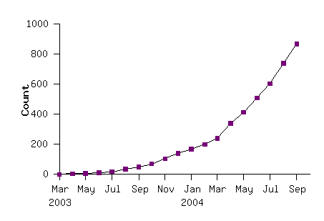
Model is Widely Applicable
MapReduce Programs In Google Source Tree
Example uses:
distributed grep |  | distributed sort |  | web link-graph reversal
term-vector / host |  | web access log stats |  | inverted index construction
document clustering |  | machine learning |  | statistical machine translation
... |  | ... |  | ...

Slide 125
Implementation Overview
Typical cluster:
      100s/1000s of 2-CPU x86 machines, 2-4 GB of memory
      Limited bisection bandwidth
      Storage is on local IDE disks
      GFS: distributed file system manages data (SOSP'03)
      Job scheduling system: jobs made up of tasks, scheduler assigns tasks to machines
Implementation is a C++ library linked into user programs

Slide 126
Execution
How is this distributed?
  Partition input key/value pairs into chunks, run map() tasks in parallel
  After all map()s are complete, consolidate all emitted values for each unique emitted key
  Now partition space of output map keys, and run reduce() in parallel
If map() or reduce() fails, reexecute!

Slide 127
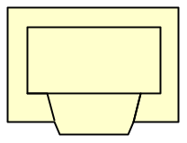
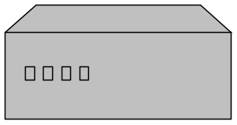

Job Processing
TaskTracker 0
TaskTracker 1
TaskTracker 2
JobTracker
TaskTracker 3
TaskTracker 4
TaskTracker 5
“grep”
Client submits “grep” job, indicating code and input files
JobTracker breaks input file into k chunks, (in this case 6). Assigns work to ttrackers.
After map(), tasktrackers exchange map-output to build reduce() keyspace
JobTracker breaks reduce() keyspace into m chunks (in this case 6). Assigns work.
reduce() output may go to NDFS

Slide 128
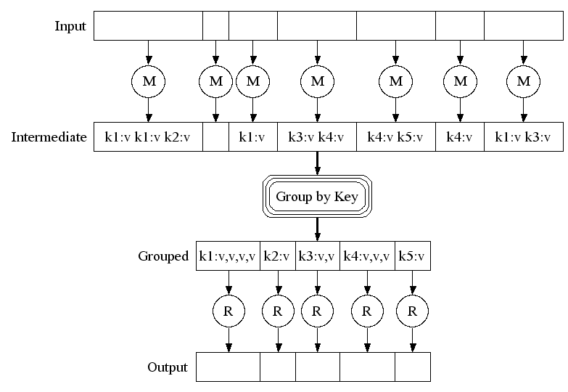
Execution

Slide 129
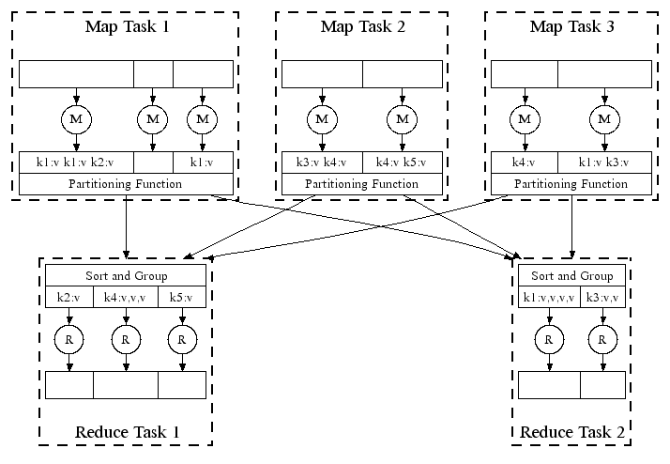
Parallel Execution

Slide 130
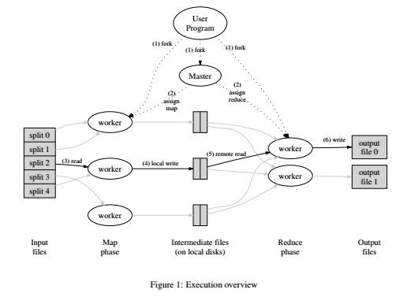

Slide 131
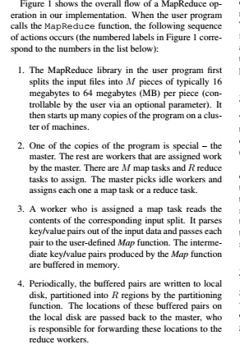
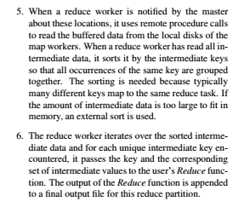


Slide 132
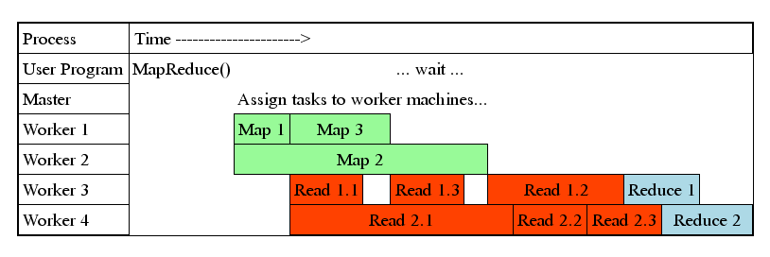
Task Granularity & Pipelining
Fine granularity tasks: map tasks >> machines
  Minimizes time for fault recovery
  Can pipeline shuffling with map execution
  Better dynamic load balancing
Often use 200,000 map & 5000 reduce tasks
Running on 2000 machines

Slide 133
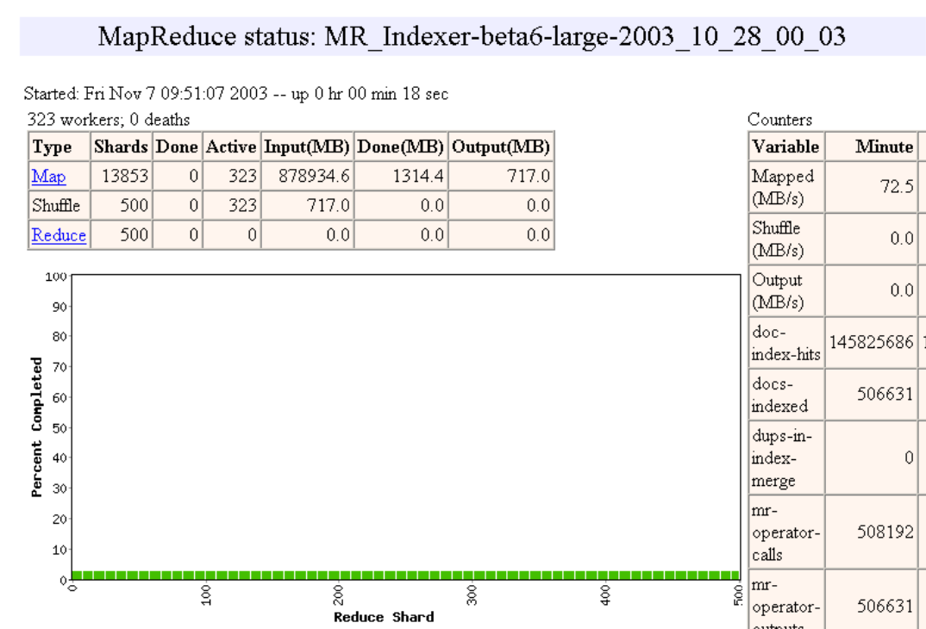

Slide 134
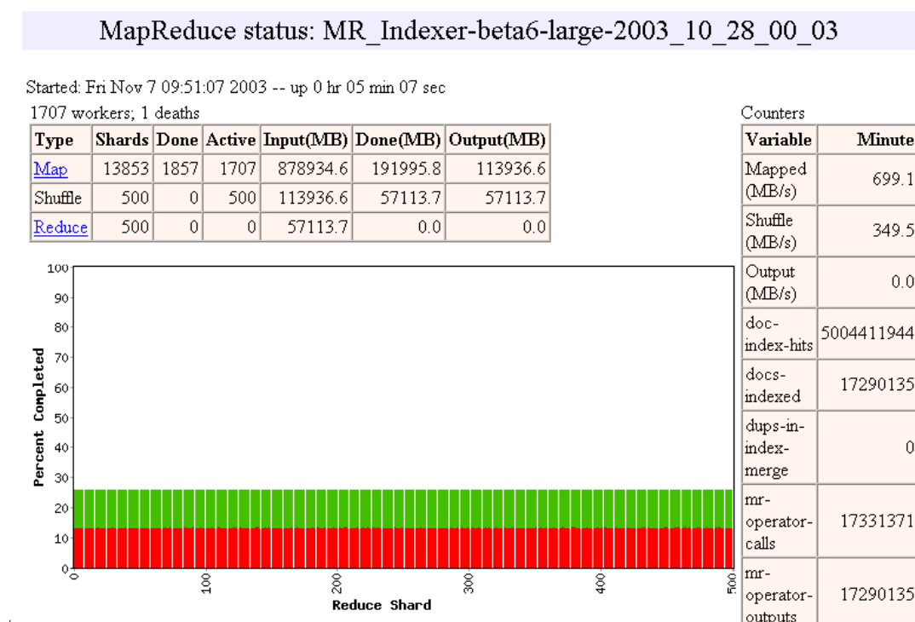

Slide 135
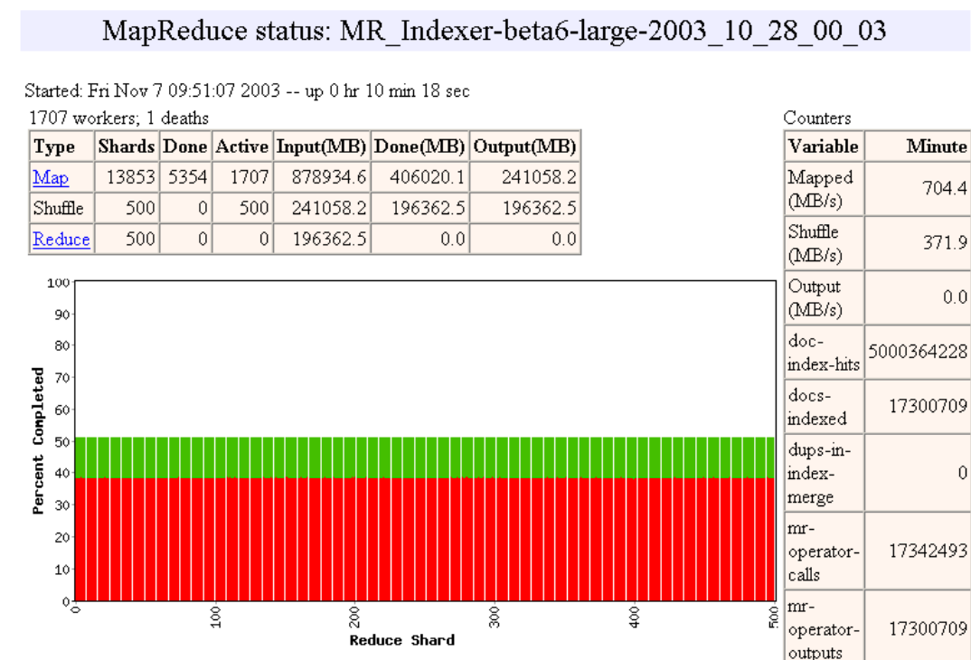

Slide 136
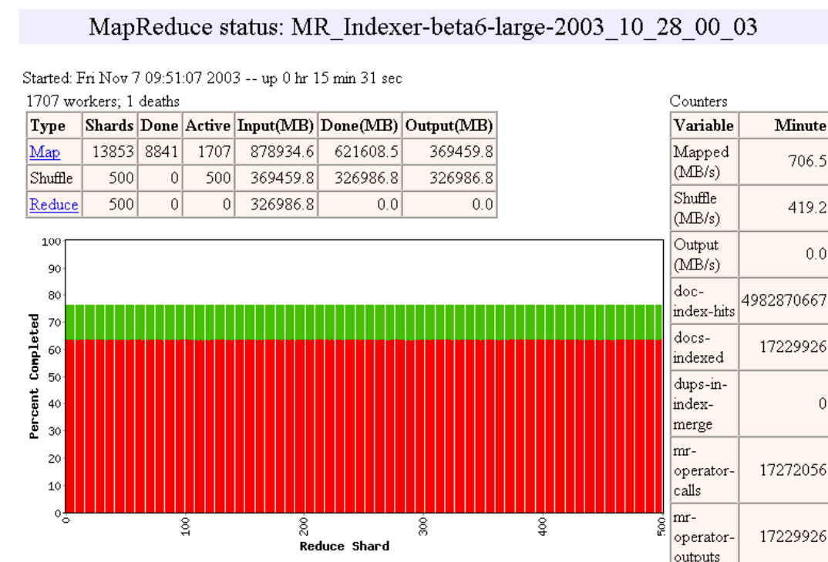

Slide 137
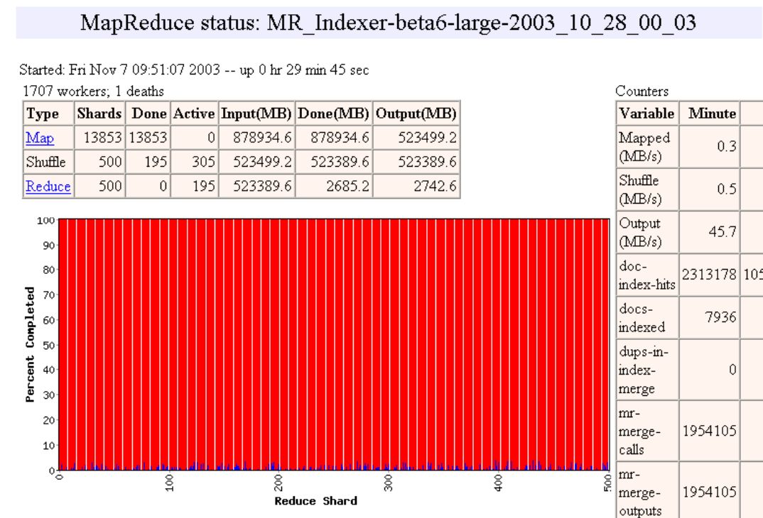

Slide 138
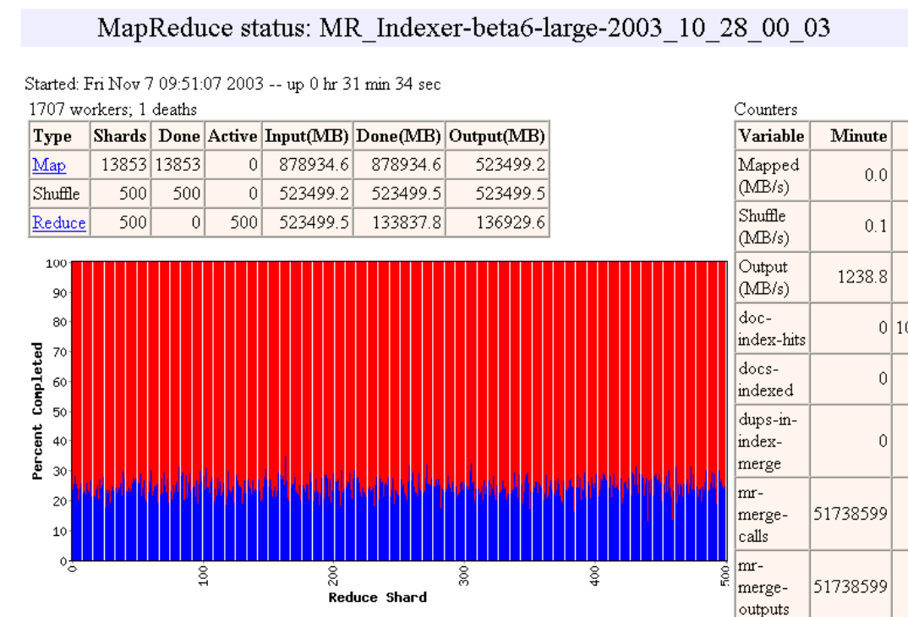

Slide 139
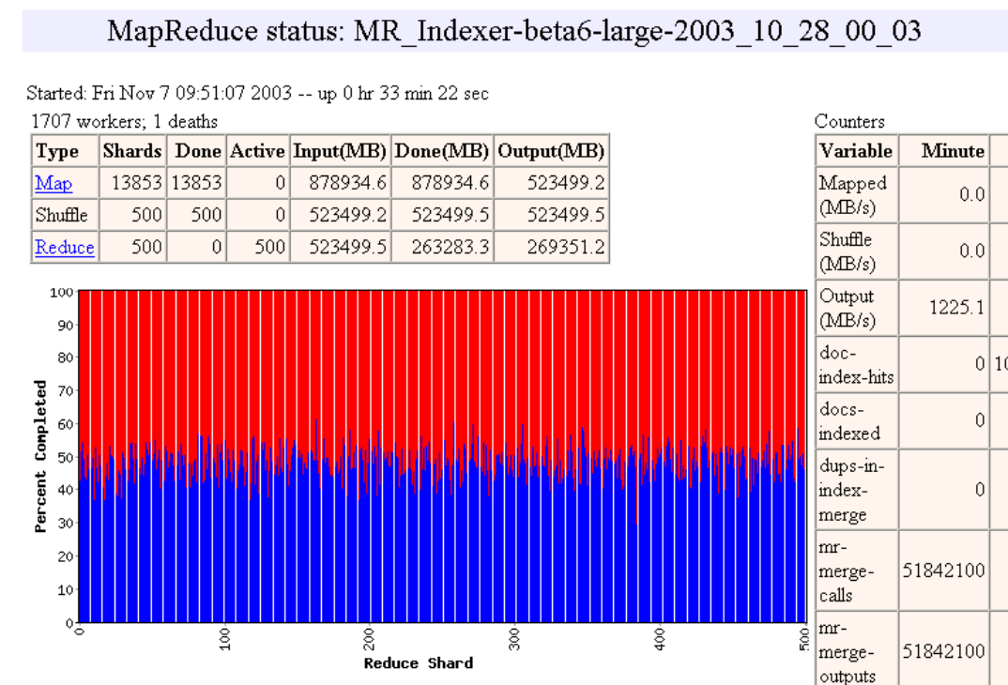

Slide 140
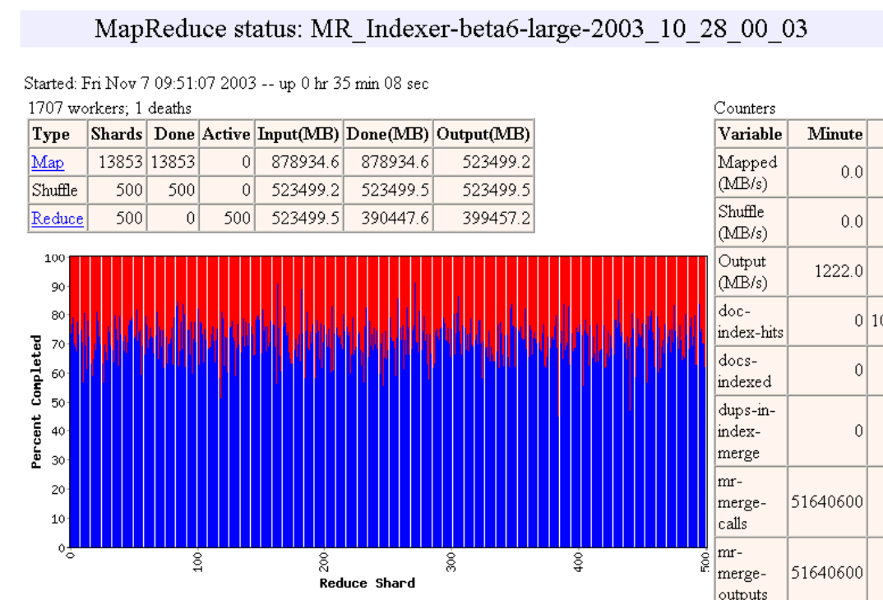

Slide 141
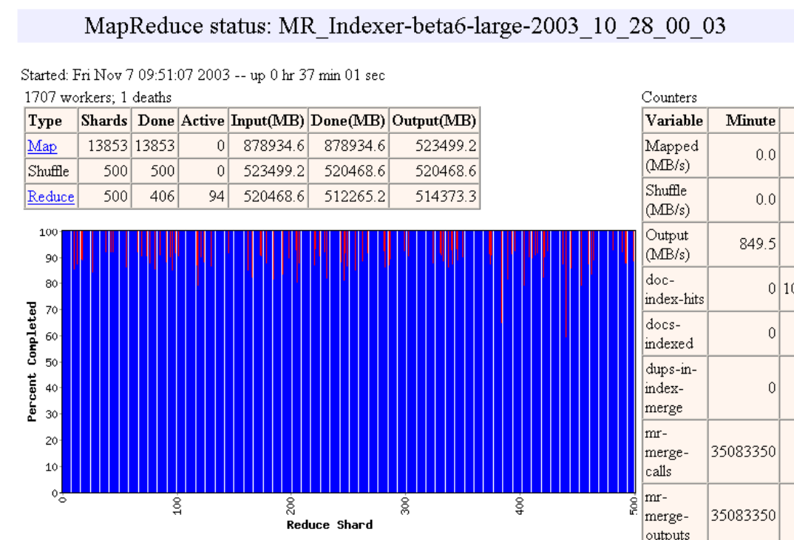

Slide 142


Slide 143


Slide 144
Fault Tolerance / Workers
Handled via re-execution
  Detect failure via periodic heartbeats
  Re-execute completed + in-progress map tasks
    Why????
  Re-execute in progress reduce tasks
  Task completion committed through master
Robust: lost 1600/1800 machines once → finished ok
Semantics in presence of failures: see paper

Slide 145
Master Failure
Could handle, … ?
But don't yet
  (master failure unlikely)

Slide 146
Refinement:
Redundant Execution
Slow workers significantly delay completion time
  Other jobs consuming resources on machine
  Bad disks w/ soft errors transfer data slowly
  Weird things: processor caches disabled (!!)
Solution: Near end of phase, spawn backup tasks
  Whichever one finishes first "wins"
Dramatically shortens job completion time

Slide 147
Refinement:
Locality Optimization
Master scheduling policy:
  Asks GFS for locations of replicas of input file blocks
  Map tasks typically split into 64MB (GFS block size)
  Map tasks scheduled so GFS input block replica are on same machine or same rack
Effect
  Thousands of machines read input at local disk speed
    Without this, rack switches limit read rate

Slide 148
Refinement
Skipping Bad Records
Map/Reduce functions sometimes fail for particular inputs
  Best solution is to debug & fix
    Not always possible ~ third-party source libraries
  On segmentation fault:
    Send UDP packet to master from signal handler
    Include sequence number of record being processed
  If master sees two failures for same record:
    Next worker is told to skip the record

Slide 149
Other Refinements
Sorting guarantees
  within each reduce partition
Compression of intermediate data
Combiner
  Useful for saving network bandwidth
Local execution for debugging/testing
User-defined counters

Slide 150
Performance
Tests run on cluster of 1800 machines:
  4 GB of memory
  Dual-processor 2 GHz Xeons with Hyperthreading
  Dual 160 GB IDE disks
  Gigabit Ethernet per machine
  Bisection bandwidth approximately 100 Gbps
Two benchmarks:
MR_GrepScan 1010 100-byte records to extract records matching a rare pattern (92K matching records)
MR_SortSort 1010 100-byte records (modeled after TeraSort
benchmark)

Slide 151
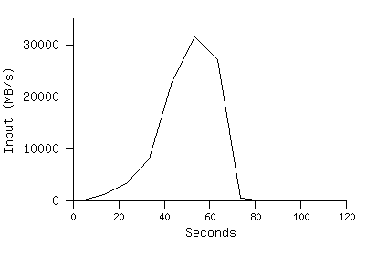
MR_Grep
Locality optimization helps:
1800 machines read 1 TB at peak ~31 GB/s
W/out this, rack switches would limit to 10 GB/s
Startup overhead is significant for short jobs

Slide 152
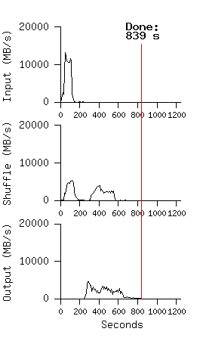
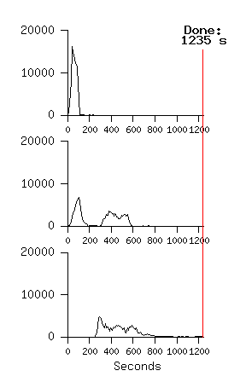
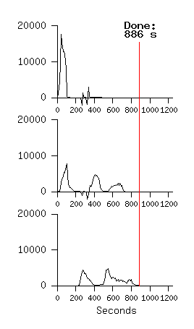
MR_Sort
Normal No backup tasks 200 processes killed
Backup tasks reduce job completion time a lot!
System deals well with failures

Slide 153
Experience
Rewrote Google's production indexing
System using MapReduce
  Set of 10, 14, 17, 21, 24 MapReduce operations
  New code is simpler, easier to understand
    3800 lines C++ → 700
  MapReduce handles failures, slow machines
  Easy to make indexing faster
    add more machines

Slide 154
Usage in Aug 2004
Number of jobs 29,423
Average job completion time 634 secs
Machine days used 79,186 days
Input data read 3,288 TB
Intermediate data produced 758 TB
Output data written 193 TB
Average worker machines per job 157
Average worker deaths per job 1.2
Average map tasks per job 3,351
Average reduce tasks per job 55
Unique map implementations 395
Unique reduce implementations 269
Unique map/reduce combinations 426

Slide 155
Related Work
Programming model inspired by functional language primitives
Partitioning/shuffling similar to many large-scale sorting systems
  NOW-Sort ['97]
Re-execution for fault tolerance
  BAD-FS ['04] and TACC ['97]
Locality optimization has parallels with Active Disks/Diamond work
  Active Disks ['01], Diamond ['04]
Backup tasks similar to Eager Scheduling in Charlotte system
  Charlotte ['96]
Dynamic load balancing solves similar problem as River's distributed queues
  River ['99]

Slide 156
Conclusions
MapReduce proven to be useful abstraction
Greatly simplifies large-scale computations
Fun to use:
  focus on problem,
  let library deal w/ messy details

