Slide 1


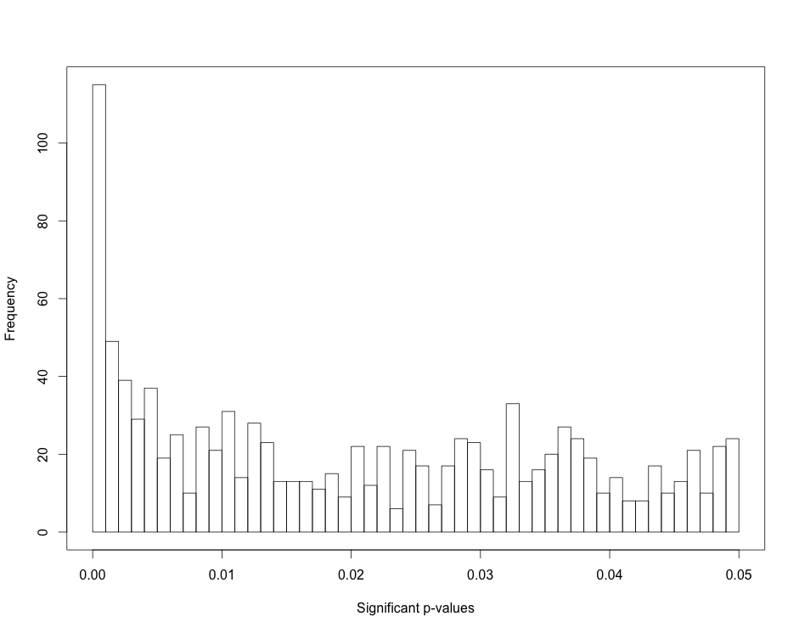
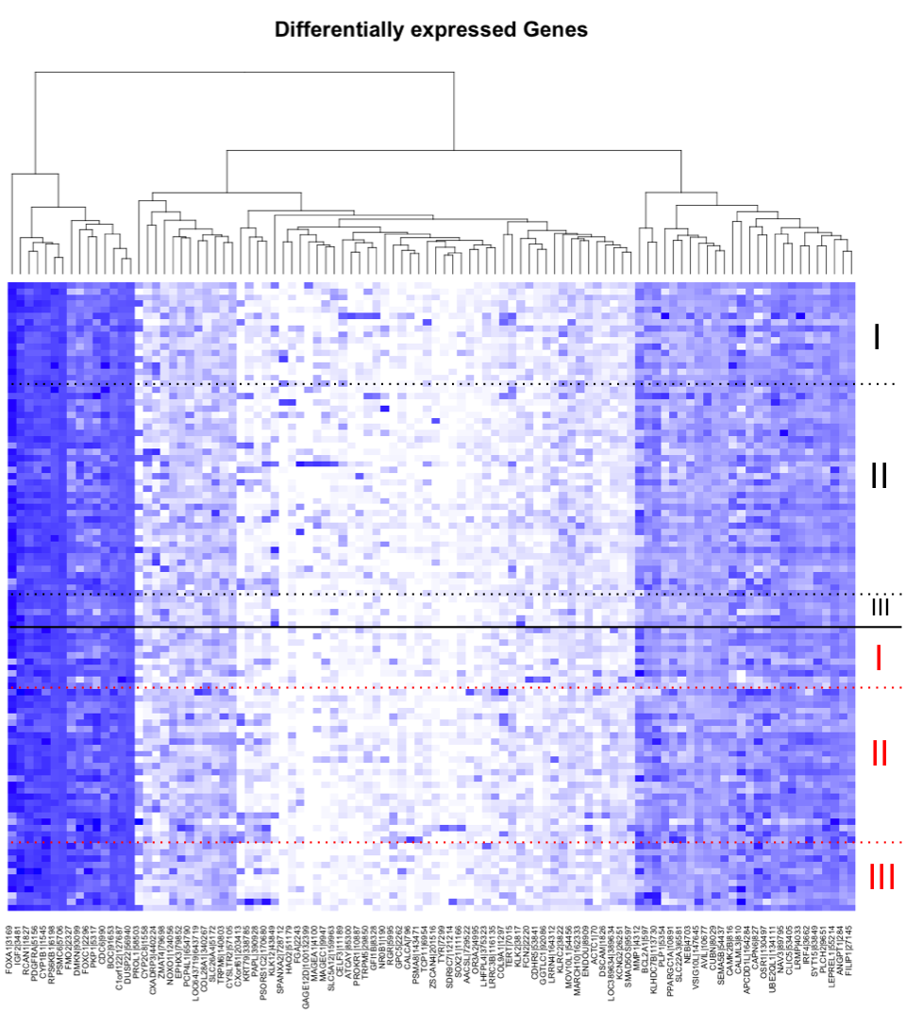
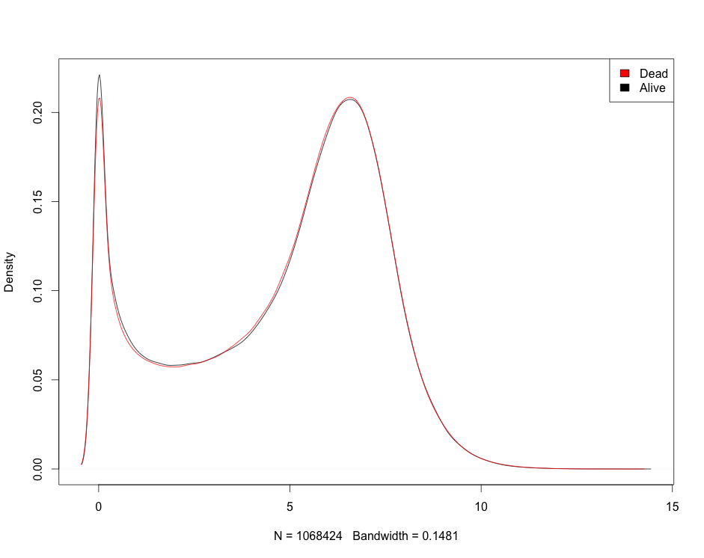
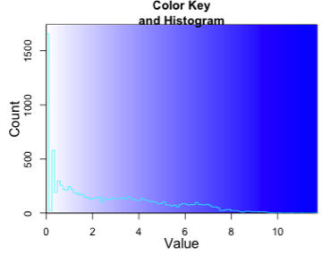
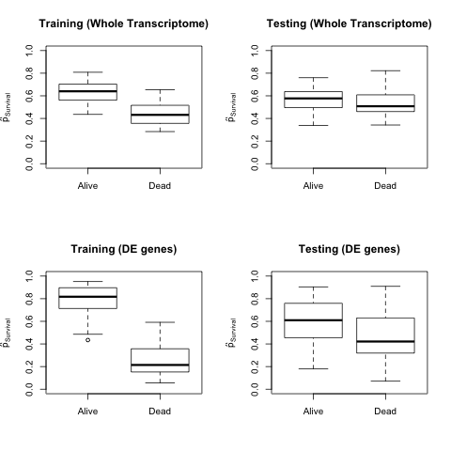
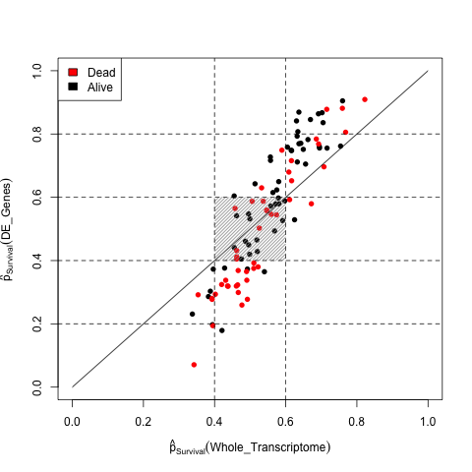
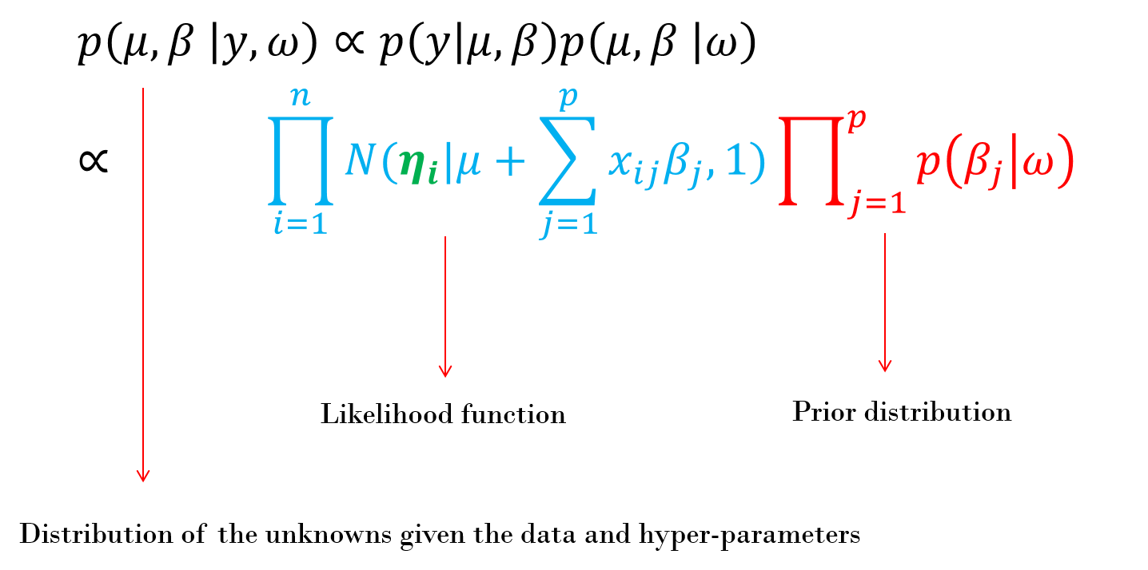
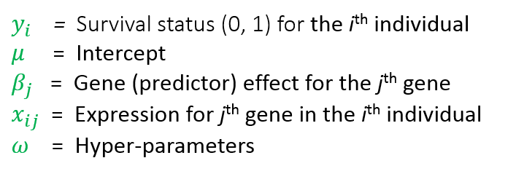
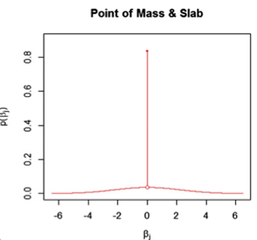
Bayesian predictive models for breast invasive carcinoma using gene expression data from The Cancer Genome Atlas
Yogasudha Veturi¹, Howard W. Wiener², Gustavo de los Campos¹, and Ana I. Vazquez¹
¹Department of Biostatistics, University of Alabama at Birmingham
²Department of Epidemiology, University of Alabama at Birmingham
INTRODUCTION: Breast cancer (BC) is the second leading cause of cancer death among women and about 40,000 US women are estimated to die from BC in 2014¹. However, 80% of BC patients are administered adjuvant therapy, which means that a potentially large number of patients are over-treated² with cytotoxic therapies that can lead to severely detrimental side effects such as heart damage, secondary non-breast cancers, permanent infertility, and deaths from non-cancer causes. Accurate prediction of BC progression could help determine which patients are most likely to benefit from adjuvant therapy. The patterns of gene expression at the tumor cell hold information³ that could be important for this purpose. Existing methods to predict prognosis associate clusters of differentially expressed (DE) genes with survival. Unfortunately, despite advances in prediction of prognosis, key inter-individual differences in BC progression are still lost⁴. In this study, we formulated transcriptomics-based models in a Bayesian framework for predicting seven-year survival of BC patients using high throughput RNA-Seq data from The Cancer Genome Atlas (TCGA). As compared to cluster analysis, this approach enabled better modeling of molecular targets that are strongly associated with aggressive cancers.
APPROACH
Cluster analysis : We identified DE genes between seven-year survivors and non-survivors and used the top 100 DE genes to classify patients into different stages of cancer.
Bayesian models :
RESULTS
Cluster analysis
1,046 genes
(a) whole-transcriptome
all gene expression profiles
We formulated prediction models (that apply variable selection and shrinkage) for seven year survival using
(b) DE genes
gene expressions of significant DE genes
Fig. 3. Distribution of significant p-values from negative binomial regressions after multiple correction using FDR
DATA AND METHODS
Table 1. Classification of clinical data variables by survival status
Variable | Level | Survival
 |  | Yes | No
 |  | 56 | 46
Race | Black | 12 | 10
 | White | 42 | 34
 | Other | 58 | 47
Menopause status | Pre | 8 | 5
 | Post | 29 | 21
 | Unknown | 19 | 20
Margin status | Negative | 39 | 29
 | Positive | 5 | 3
 | Close | 5 | 0
 | Unknown | 7 | 14
Molecular subtype | Luminal A | 13 | 8
 | Luminal B | 0 | 5
 | Her2-Neu | 0 | 4
 | Triple Negative | 7 | 5
 | Unknown | 36 | 24
 | T1 | 18 | 13
Tumor size | T2 | 26 | 27
 | T3 | 10 | 5
 | Unknown | 2 | 1
 | I | 14 | 6
Cancer stage | II | 34 | 25
 | III | 6 | 11
 | Unknown | 2 | 4
Fig. 4. Heat Map of log transformed gene expression values with the top 100 significant genes on the X axis and individuals on the Y axis. Individuals are grouped by survival status: survivors (black) and non-survivors (red). Individuals within each group are further classified by stage of cancer.
19,064 genes
Fig. 1. Distribution of log-transformed gene expression counts for survivors and non-survivors
Bayesian models
Cluster analysis
19,064 negative binomial regressions were run with gene expression counts as the response and survival status as the predictor (R package MASS⁵)
DE genes were obtained
Multiple correction was performed with false discovery rates (FDR⁶) (R package EMA⁷)
Cluster analysis with top 100 DE genes was then used as a classifier of survival.
Table 2. Number of predictors and sample size
Total sample size | 102
Total number of genes | 19,064
Bayesian models
Fig. 5. Estimated probabilities of survival using BayesB for the whole transcriptome (top) and the significant DE genes (bottom) as predictors with leave-one-out cross validation
Fig. 6. Comparison of estimated probabilities of seven-year survival for survivors (black) and non survivors (red) in the testing dataset between the model considering the whole transcriptome (X axis) and only the significant DE genes (Y axis).
Leave-one out cross validation (CV) was performed for the models (a) and (b)
102 CV sets each for (a) and (b) (101 training,1 testing)
For model (b) the 1st four steps of cluster analysis were first performed for each CV set to obtain reduced sets of genes
Since the number of parameters (p) exceeds the number of observations (n), a shrinkage estimation method (Bayes B)⁸ was performed (R package BGLR⁹) for each CV set in (a) and (b) to estimate predicted probabilities of survival.
CONCLUSIONS AND DISCUSSION
Cluster analysis was not conclusive as a classifier of survival in this set of patients.
Bayesian prediction models applying variable selection and shrinkage were better classifiers of survival using both sets of predictors 1) whole-transcriptome, 2) pre-selected significant genes from single marker regressions.
The Bayesian model with DE genes has better prediction accuracy than the whole transcriptome model, especially for non-survivors.
Small sample size may be limiting the ability of the Bayesian models to “learn” more effectively.
Improving our ability to predict BC outcomes is necessary for the implementation of precision medicine.
ACKNOWLEDGEMENTS
AI Vazquez acknowledges financial support from the Back Of The Envelope 2014 competition by SOPH
NIH R01 grant (R01GM099992-01A1) Factors Affecting Prediction Accuracy of Complex Human Traits and Diseases. PI: G. de los Campos. August-2012/July-2016
NIH R01 grant (R01GM101219-01) Statistical Tools for Whole-Genome Prediction of Complex Traits and Diseases. PI: G. de los Campos. Period: March-2012/Jan-2015.
Table 3. Parameters for MCMC in BGLR
¹www.cancer.org
²Weigelt B et al. (2009) Nature reviews cancer. 2005;5(8):591–602
³TCGA. Impact on Precision Medicine - TCGA.
⁴Sorlie et al. Proceedings of the National Academy of Sciences. 2001;98(19):10869–10874
⁵Venables, W. N. & Ripley, B. D. (2002) Modern Applied Statistics with S. ISBN 0-387-95457-0
⁶Storey, J.D.; Tibshirani, R (2003). Proceedings of the National Academy of Sciences 100 (16): 9440–9445
⁷Servant et al. EMA - An R package for easy Microarray data analysis BMC Res Notes, 3:277.
⁸de los Campos et al. 2013. Genetics 2: 327-345.
⁹de los Campos G, Perez P. 2013. BGLR: Bayesian Generalized Linear Regression.
Iterations | 40000
Burn-in | 10000
π | Beta(10,0.5)
d.f. | 5
S | See [9]
Fig. 2. Distribution of estimated effects using Bayes B⁸.
17th Annual Research Retreat – UAB Comprehensive Cancer Center - Oct 6, 2014

