Slide 1

Pennant Technologies Private Limited
Abstraction in Java

Slide 4
ABSTRACTION
Abstraction is a process of hiding the implementation details and showing only functionality to the user.
Data abstraction is the process of hiding certain details and showing only essential information to the user.
The abstract keyword is a non-access modifier, used for classes and methods:
Abstract class: is a restricted class that cannot be used to create objects (to access it, it must be inherited from another class).
Abstract method: can only be used in an abstract class, and it does not have a body. The body is provided by the subclass (inherited from).
There are two ways to achieve abstraction in java
Abstract class
Interface

Slide 5
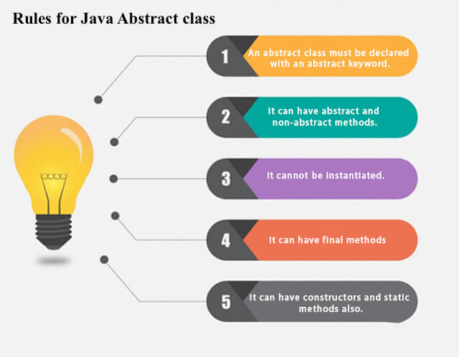
ABSTRACT CLASS
A class which contains the abstract keyword in its declaration is known as abstract class.

Slide 6
ABSTRACT CLASS
An abstract class can have both abstract and regular methods
The abstract keyword is a non-access modifier, used for classes and methods:
Abstract class: is a restricted class that cannot be used to create objects (to access it, it must be inherited from another class).
Syntax:
abstract class_name{ }
Abstract method: can only be used in an abstract class, and it does not have a body. The body is provided by the subclass (inherited from).
Syntax:
abstract type method_name(paramenter_list);
no method body

Slide 7
abstract class Figure
{
int dim1,dim2;
Figure(int d1, int d2)
{
dim1=d1;
dim2=d2;
}
void display()
{
System.out.println(“Area is: “);
}
abstract void area(); //abstract method
}
class Rectangle extends Figure
{
Rectangle(int a, int b)
{
super(a,b);
}
void area() //overriding abstract method
{
System.out.println(dim1*dim2);
}
}
class Example32{
public static void main(String args[])
{
Rectangle r=new rectangle(10,20);
Figure f;
f=r;
f.display();
f.area();
}
}
Any subclass of an abstract class must either implement all of the abstract methods of super class or be declared itself aabstract

Slide 8
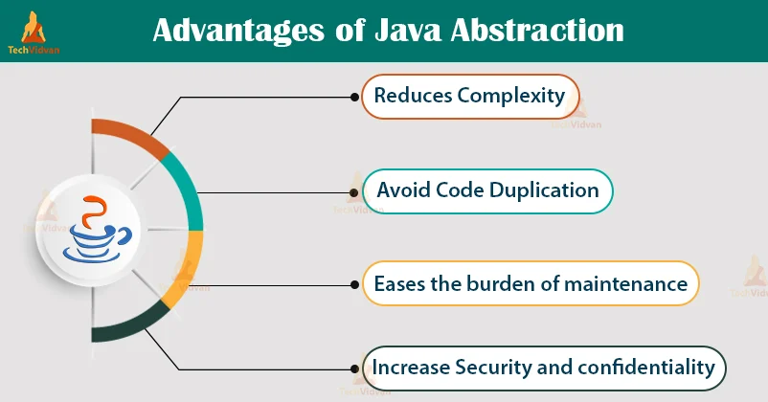

Slide 9
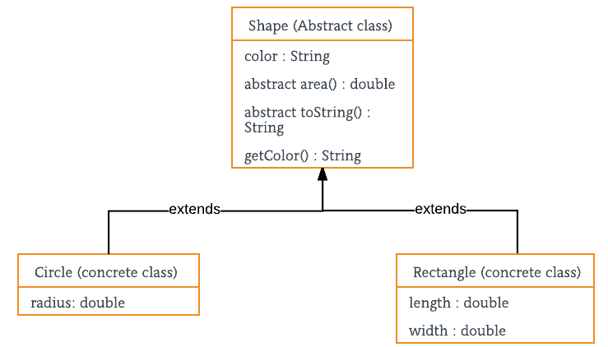

Slide 10


Slide 11
INTERFACE
An interface is a fully abstract class. It includes a group of abstract methods (methods without a body).
We use the “interface” keyword to create an interface in Java
Uses:
It is used to achieve abstraction.
By interface, we can support the functionality of multiple inheritance.
Syntax:
interface <interface_name>{
// declare constant fields
// declare methods that abstract
// by default.
}

Slide 12
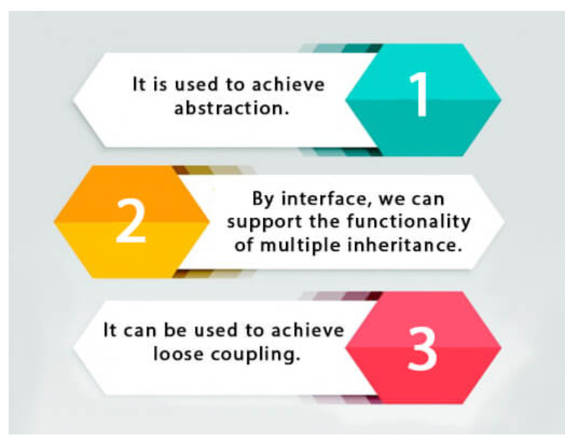
Uses of Interfaces

Slide 13
interface Polygon
{
void getArea(int length, int breadth);
}
class Rectangle implements Polygon
{
public void getArea(int length, int breadth)
{
System.out.println("The area of the rectangle is " + (length * breadth));
}
}
A class that implements an interface must implement all the methods declared in the interface.
class Example{
public static void main(String[] args) {
Rectangle r1 = new Rectangle();
r1.getArea(5, 6);
}
}

Slide 14
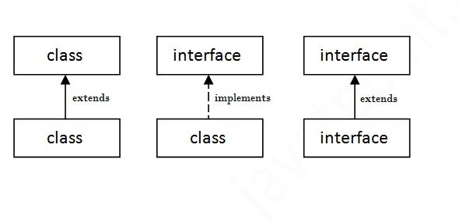
INTERFACE
The relationship between classes and interfaces

Slide 15
Interfaces
if any class implements Polygon, it should provide implementations for all the abstract methods of both Line and Polygon.
Extending an Interface
Implementing Multiple Interfaces
interface A {
// members of A
}
interface B {
// members of B
}
class C implements A, B {
// abstract members of A
// abstract members of B
}
interface Line {
// members of Line interface
}
// extending interface
interface Polygon extends Line {
// members of Polygon interface
// members of Line interface
}

Slide 16
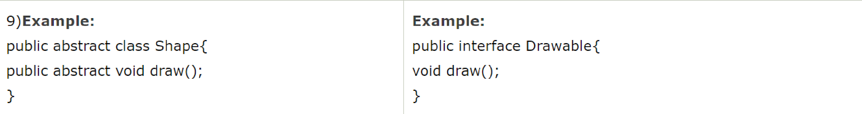

Slide 17
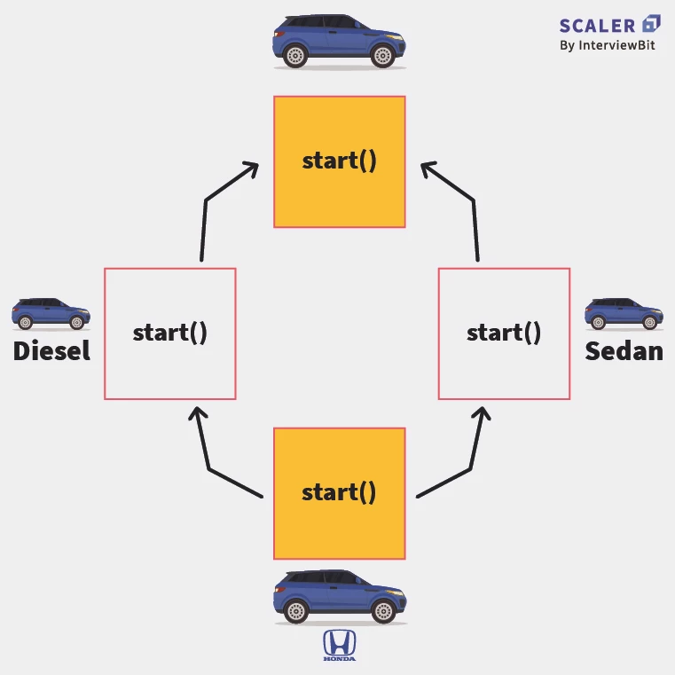
Realtime Example of Interface

Slide 18
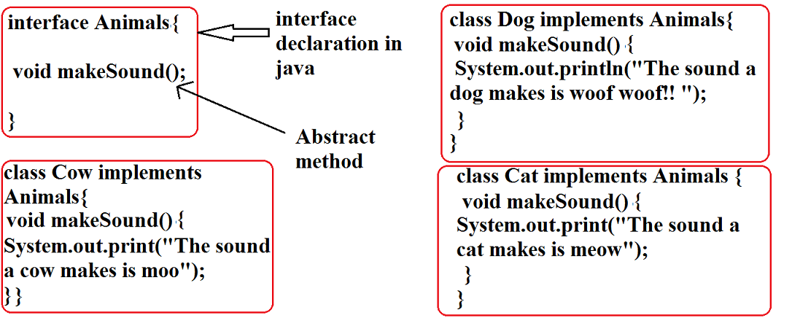
Examples on Interfaces

Slide 19
