Slide 1

Pennant Technologies Private Limited
Inheritance in Java

Slide 4
INHERITANCE
Inheritance can be defined as the process where one class acquires the properties (methods and fields) of another.
Reusability is achieved by INHERITANCE
Java classes Can be Reused by extending a class. Extending an existing class is nothing but reusing properties of the existing classes.
The class whose properties are extended is known as super or base or parent class.
The class which extends the properties of super class is known as sub or derived or child class
A class can either extends another class or can implement an interface

Slide 5
DEFINING A SUBCLASS
extends keyword signifies that properties of the super class are extended to sub class
Sub class will not inherit private members of super class
Syntax : class <subclass name> extends <superclass name>
{
variable declarations;
method declarations;
}

Slide 6
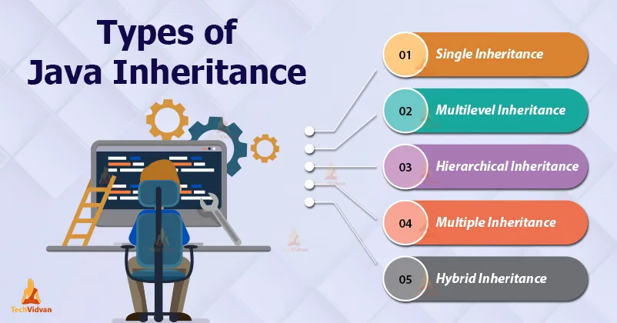

Slide 7
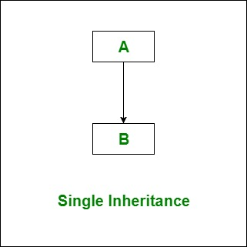
INHERITANCE
class B extends A { ….. }
A super class
B sub class
class B implements A { ….. }
A interface
B sub class

Slide 8
Single Inheritance
class A
{
int i,j;
void showij()
{
System.out.println(“i and j : “+i+j);
}
}
class B extends A
{
int k;
void showk()
{
System.out.println(“k : “+k);
}
void sum()
{
System.out.println(“i+j+k: “+(i+j+k));
}
}
class Example
{
public static void main(String args[])
{
A a = new A();
B b = new B();
a.i=10;
a.j=20;
System.out.println(“contents of a:”);
a.showij();
b.i=1;
b.j=2;
b.k=3;
System.out.println(“contents of b:”);
b.showij();
b.showk();
System.out.println(“sum of i,j,k of b:”);
b.sum();
}
}

Slide 9
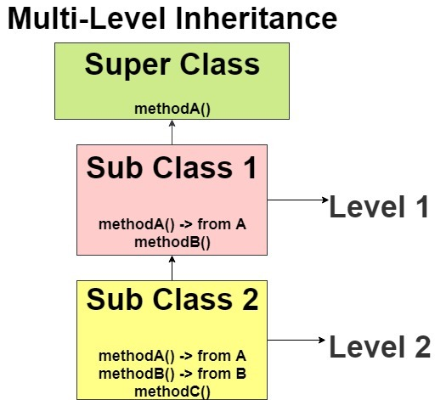

Slide 10
Multilevel Inheitance
class C extends B
{
int k;
void showk()
{
System.out.println(“k : “+k);
}
void sum()
{
System.out.println(“i+j+k: “+(i+j+k));
}
}
class Example
{
public static void main(String args[]) {
C c=new C();
c.i=10;
c.j=20;
c.k=30;
c.sum()
}}
class A
{
int i;
void showij()
{
System.out.println(“i :”+i);
}
}
class B extends A
{
int j;
void showj()
{
System.out.println(“j : “+j);
}
}

Slide 11
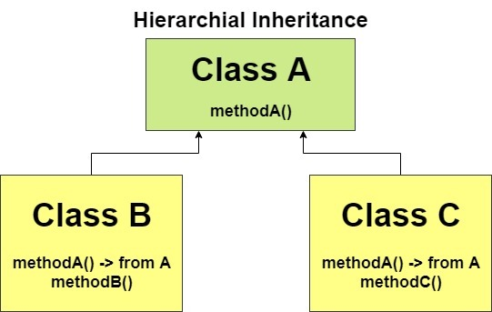

Slide 12
HIERARCHICAL INHERITANCE
class A
{
int i;
void showij()
{
System.out.println(“i :”+i);
}
}
class B extends A
{
int j;
void showj()
{
System.out.println(“j : “+j);
}
void sum()
{
System.out.println(“i+j: “+(i+j));
}
}
class C extends A{
int k;
void showk()
{
System.out.println(“k : “+k);
}
void sum()
{
System.out.println(“i+k: “+(i+k));
}
}
class Example
{
public static void main(String args[]) {
C c=new C();
c.i=10;
c.k=30;
c.sum()
}}

Slide 13
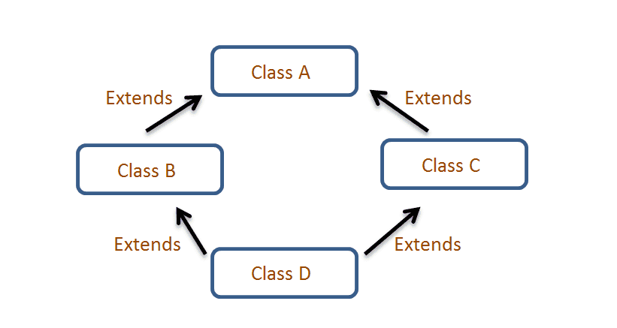
Multiple Inheritance

Slide 14
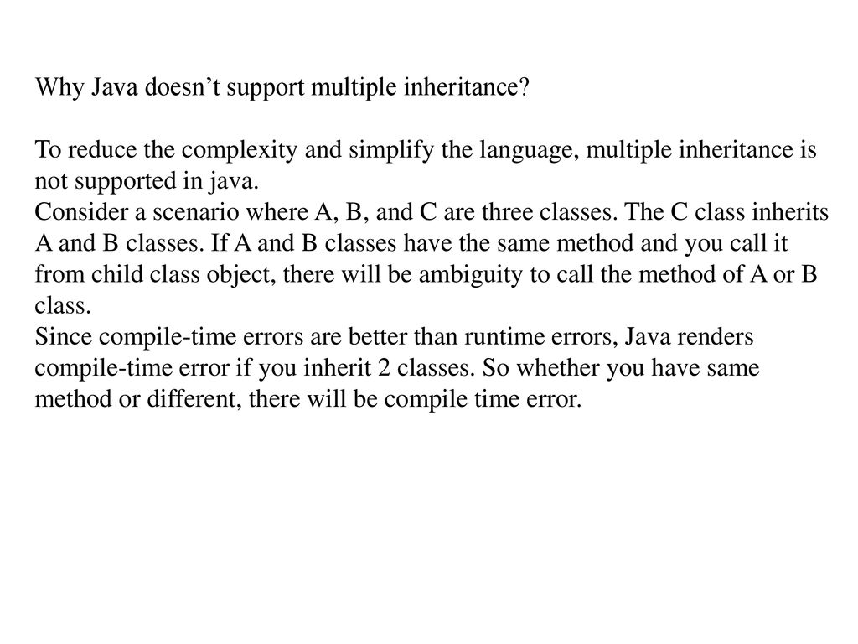

Slide 15
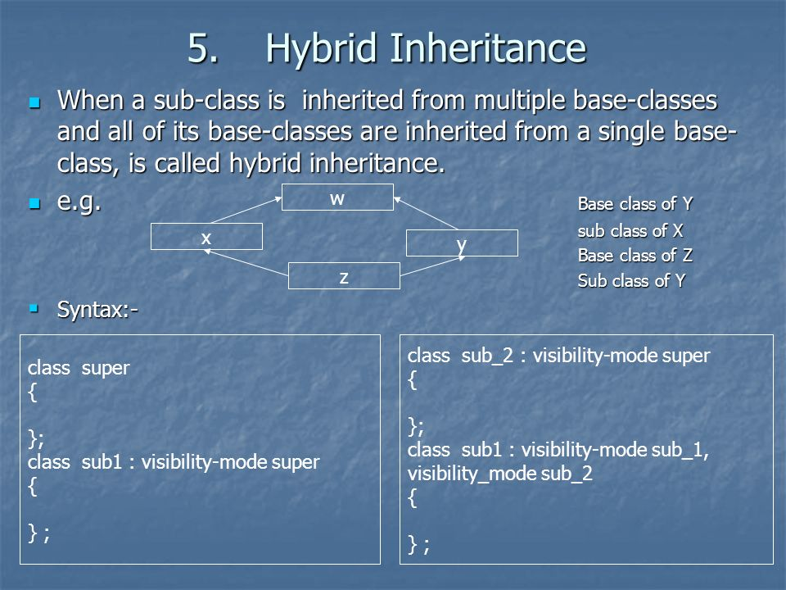

Slide 16
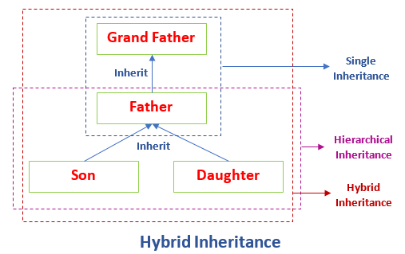

Slide 17
SUPER KEYWORD
The super keyword in Java is used in subclasses to access superclass members (attributes, constructors and methods).
Can be used to call super class constrctor
1. super()
2. super(<parameter-list>)
Can refer to super class instance variables/Methods
3. super . <super class instance variable/Method>

Slide 18
USE OF SUPER KEYWORD FOR CONSTRUCTORS
Whenever a sub class object is created ,super class constructor is called first.
If super class constructor does not have any constructor of its own OR has an unparametrized constructor then it is automatically called by Java Run Time by using call super()
If a super class has a parameterized constructor then it is the responsibility of the sub class constructor to call the super class constructor by call
super(<parameters required by super class>)
Call to super class constructor must be the first statement in sub class constructor

Slide 19
1. WHEN SUPER CLASS HAS A UNPARAMETRIZED CONSTRUCTOR
class A
{
A()
{
System.out.println("This is constructor of class A");
}
} // End of class A
class B extends A
{
B()
{
super();
System.out.println("This is constructor of class B”);}
} // End of class B
class inhtest
{
public static void main(String args[])
{
B b1 = new B();
}
}
OUTPUT
This is constructor of class A
This is constructor of class B

Slide 20
File Name is inherit1.java
class A
{
A()
{
System.out.println("This is class A");}}
class B extends A
{
B()
{
System.out.println("This is class B");}}
class inherit1
{
public static void main(String args[])
{
B b1 = new B(); }}
Output:
This is class A
This is class B
1. When super class has a Unparametrized constructor

Slide 21
class A
{
private A()
{
System.out.println("This is class A");}}
class B extends A
{
B()
{
System.out.println("This is class B");}}
class inherit2
{
public static void main(String args[])
{
B b1 = new B();}}
1. When super class has a Unparametrized constructor
Output:
Error: A() has private access in A

Slide 22
class A
{
private A()
{
System.out.println("This is class A");
}
A()
{
System.out.println("This is class A");}}
class B extends A
{
B()
{
System.out.println("This is class B");}}
class inherit2
{
public static void main(String args[])
{
B b1 = new B();} }
Output:
A() is already defined in A
A() has private access in A
2 errors
1. When super class has a Unparametrized constructor

Slide 23
class A
{
int a;
A( int a1)
{
a =a1;
System.out.println("This is constructor of class A");}}
class B extends A
{
int b;
double c;
B(int b1,double c1)
{
b=b1;
c=c1;
System.out.println("This is constructor of class B");} }
2. When super class has a parametrized constructor
B b1 = new B(10,8.6);
D:\java\bin>javac inhtest.java
inhtest.java:15: cannot find symbol
symbol : constructor A()
location: class A
{
^
1 errors

Slide 24
class A
{
int a;
A( int a1)
{
a =a1;
System.out.println("This is constructor of class A");} }
class B extends A
{
int b;
double c;
B(int a2,int b1,double c1)
{
super(a2);
b=b1;
c=c1;
System.out.println("This is constructor of class B");} }
2. When super class has a parametrized constructor
B b1 = new B(8,10,8.6);
OUTPUT
This is constructor of class A
This is constructor of class B

Slide 25
3. Refer to super class instance variables/Methods
class A
{
int a;
A( int a)
{
this.a =a;
System.out.println("This is constructor of class A");
}
void print()
{
System.out.println("a="+a);
}
void display()
{
System.out.println("hello This is Display in A");
}
} // End of class A
class B extends A
{
int b;
double c;
B(int a,int b,double c)
{
super(a);
this.b=b;
this.c=c;
System.out.println("This is constructor of class B");
}
void show()
{
print();
System.out.println("b="+b);
System.out.println("c="+c);
}
} // End of class B

Slide 26
3. Refer to super class instance variables/Methods
class inhtest1
{
public static void main(String args[])
{
B b1 = new B(10,8,4.5);
b1.show();
}
}
OutPut
D:\java\bin>java inhtest1
This is constructor of class A
This is constructor of class B
a=10
b=8
c=4.5

Slide 27
METHOD OVERRIDING
If subclass (child class) has the same method as declared in the parent class, it is known as method overriding in Java.
Uses:
Method overriding is used to provide the specific implementation of a method which is already provided by its superclass.
Method overriding is used for runtime polymorphism
Rules for Java Method Overriding
The method must have the same name as in the parent class
The method must have the same parameter as in the parent class.

Slide 28
METHOD OVERRIDING
class Vehicle
{
void run()
{
System.out.println("Vehicle is running");
}
}
class Vehicle
{
void run()
{
System.out.println("Vehicle is running");
}
}
class Bike extends Vehicle
{
public static void main(String args[])
{
Bike obj = new Bike();
obj.run();
}
}
class Bike extends Vehicle
{
public static void main(String args[])
{
Bike obj = new Bike();
obj.run();
}
void run()
{
System.out.println("Bike is running safely");
}
}
Output:
Vehicle is running
Output:
Bike is running safely

Slide 29
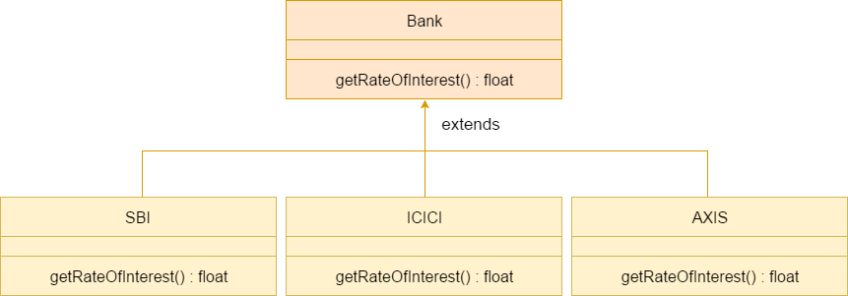
METHOD OVERRIDING REALTIME EXAMPLE

Slide 30
METHOD OVERRIDING
Note:
A method declared as static method cannot be overridden
Main method cannot be overridden
A method declared final cannot be overridden.
Constructors cannot be overridden.

Slide 31
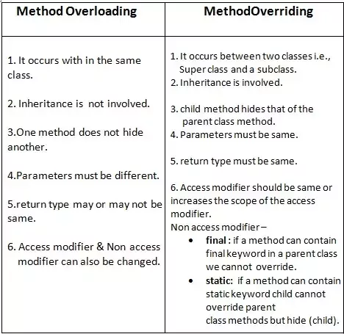
Difference between method overloading and method overriding

Slide 32
DYNAMIC METHOD DISPATCH
Dynamic method dispatch is a mechanism by which a call to an overridden method is resolved at runtime.
This is how java implements runtime polymorphism.
When an overridden method is called by a reference, java determines which version of that method to execute based on the type of object it refer to.
In simple words the type of object which it referred determines which version of overridden method will be called.

Slide 33
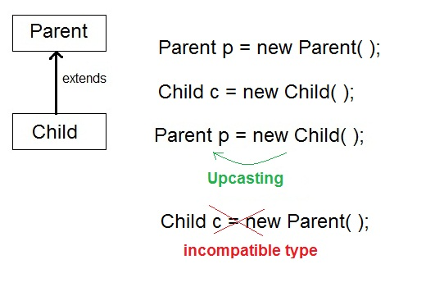

Slide 34
EXAMPLE
class Game{
public void type(){
System.out.println("Indoor & outdoor"); }
}
Class Cricket extends Game {
public void type(){
System.out.println("outdoor game");
}
public static void main(String[] args){
Game gm = new Game();
Cricket ck = new Cricket();
gm.type();
ck.type();
gm = ck; //gm refers to Cricket object
gm.type(); //calls Cricket's version of type}
}
Output:
Indoor & outdoor
Outdoor game
Outdoor game

Slide 35
DIFFERENCE BETWEEN STATIC BINDING AND DYNAMIC BINDING IN JAVA?
Static binding in Java occurs during compile time while dynamic binding occurs during runtime.
Static binding uses type(Class) information for binding while dynamic binding uses instance of class(Object) to resolve calling of method at run-time.
Overloaded methods are bonded using static binding while overridden methods are bonded using dynamic binding at runtime.
In simpler terms, Static binding means when the type of object which is invoking the method is determined at compile time by the compiler.
While Dynamic binding means when the type of object which is invoking the method is determined at run time by the compiler.

Slide 36
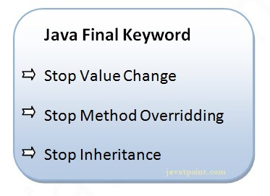
“FINAL” KEYWORD
The final keyword in java is used to restrict the user
final can be:
variable
method
class

Slide 37
JAVA FINAL VARIABLE
If you make any variable as final, you cannot change the value of final variable(It will be constant).
class Bike
{
final int speedlimit=90;//final variable
void run()
{
speedlimit=400; // error
}
public static void main(String args[])
{
Bike obj=new Bike();
obj.run();
}
}//end of class
class FinalVariable
{
final int var = 50;
var = 60 // error
}
compile-time errors

Slide 38
JAVA FINAL METHOD
If you make any method as final, you cannot override it.
class Bike
{
final void run()
{
System.out.println("running");
}
}
class Honda extends Bike
{
void run()
{System.out.println("running safely with 100kmph");}
public static void main(String args[])
{
Honda honda= new Honda();
honda.run();
}
}
compile-time errors

Slide 39
“FINAL” KEYWORD
uninitialized final variable:
A final variable that is not initialized at the time of declaration is known as blank final variable.
It can be initialized only in constructor.
Ex: PANCARD NUMBER
class Bike{
final int speedlimit;//blank final variable
Bike()
{
speedlimit=70;
System.out.println(speedlimit);
}
public static void main(String args[])
{
Bike b1=new Bike();
}
}

Slide 40
“FINAL” KEYWORD
final parameter
If you declare any parameter as final, you cannot change the value of it.
class Bike
{
int cube(final int n)
{
n=n+2;//can't be changed as n is final
n*n*n;
}
public static void main(String args[])
{
Bike b=new Bike();
b.cube(5);
}
}
compile-time errors

Slide 41
