Slide 1

Pennant Technologies Private Limited
ZK Framework

Slide 4
What is a ZUL file?
A file with .zul extension is a web file created with the User Interface Markup Language (ZUML) and contains definitions for user interface elements.
Ajax and Java classes support using the XML-based ZUML for developing server side files.
ZUL file format was developed by ZK, a UI framework that enables you to build web and mobile applications without the knowledge of JavaScript or AJAX.
ZK is a UI framework influential in building fantastic web and mobile applications without having to learn JavaScript or AJAX.
It is an open-source ajax based web application that is written in Java.
ZK empowers the creation of GUI for web application with very minimal programming knowledge.

Slide 5
ZUL File Format and Example
ZUL files are XML-based, consisting of different elements to construct user interface.
The ZK loader uses each XML element to create a component. The overall processing of the page elements such as page title, description, etc. are described by each XML processing instruction of ZUML.
In the following example of ZUML code, the first line specifies the page title, the second line creates a root component with title and border, and the third line creates a button with label and an event listener.
<?page title="Super Application"?>
<window title="Super Hello" border="normal">
<button label="hi" onClick='alert("hi")'/>

Slide 6
ZK: History & Architecture
ZK has been renowned for its “Ajax without JavaScript” approach since 2005, enabling developers to build rich internet applications transparently, without any knowledge of Ajax and JavaScript.
The client engine and update engine in ZK play the roles of pitcher and catcher, rendering Ajax communication transparent to developers.
Events triggered by users are encapsulated and marshaled to event listeners running at the server.
In 2010, ZK introduced Server+client Fusion architecture which combines the server-centric approach with optional client-side control.
The server-centric solution to Ajax brings a productivity boost, robustness, and security to Web application development; while client side solutions endow Web applications with greater controllability, and the ability to leverage client side resources.
Throughout the years, ZK has provided developers which a highly productive way of building Java based web applications.
The best way to show ZK’s power is to introduce a non-trivial example of working with ZK. The next section introduces an example application in digestible chunks.

Slide 7
ZK MVC Model
ZK supports the Model-View-Controller (MVC) design pattern that allows developers to effectively gain full control of UI components' state and behaviour using a CSS like selector mechanism.
This pattern divides an application into three parts.
The Model consists of application data and business rules.
The View means user interface.
The zul page which contains ZK components represents this part.
A user's interaction with components triggers events to be sent to controllers.
The Controller plays the coordinator between View and Model.
It receives events from View to update Model and retrieve data to change View's presentation.

Slide 8
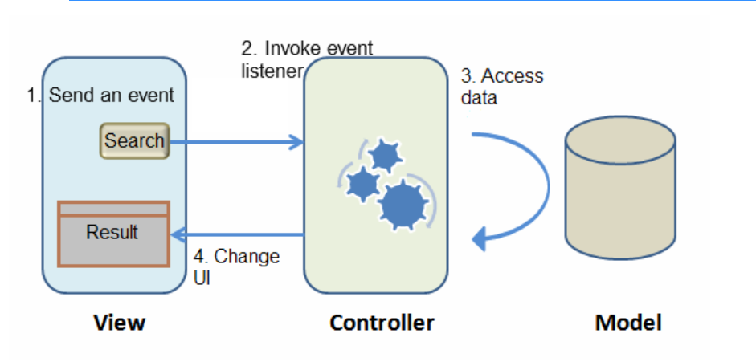
MVC Model

Slide 9
Wire a Controller:
A controller is a Java class which extends org.zkoss.zk.ui.select.SelectorComposer
public class SearchController extends SelectorComposer<Component> {
...}
Associate Controller to View :
To associate a controller to a view, you just specify full-qualified class name in target component's "apply"" attribute.
<window apply="demo.getting_started.mvc.SearchController">
...
</window>
Listen to Component Events:
To listen to component events, you create a listener method and then add a @Listen annotation on that method. In the annotation, you have to register an event of a target component by [EVENT_NAME] = #[COMPONENT_ID] syntax.

Slide 10
Listen to Component Events:
public class SearchController ...{
@Listen("onClick = #searchButton")
public void search(){
...} }
Wire Components:
To wire components into a controller, you declare member fields with corresponding component type and then add @Wire annotation on the member fields, by default, the field name is the same as the component's id in the view.
public class SearchController ...{
@Wire
private Listbox carListbox;
@Wire
private Textbox keywordBox;
}

Slide 11
Implementing a ZK Application
This example application follows the MVC architectural pattern, separating business logic from the user interface, enabling the separation of user interfaces (contained in zul files) from java business logic. This separation of concerns leads to cleaner and more maintainable code. The attached example contains numerous files. The table below categorizes these files with respect to the MVC pattern:
Model: Employee.java, EmployeeService.java
View: index.zul
Controller: EmployeeController.java

