Slide 1

T.V.SURI AppaRao Assistant Professor Department of EECE GITAM Institute of Technology(GIT) Visakhapatnam-530045 Email: vtanakal@gitam.edu
UNIT-2 :Data Transmissions

Slide 2

Syllabus
Unit I: Data communication, Data networking and the Internet: A communication model, data communications, networks, the Internet. Protocol Architecture: Need for protocol architecture, TCP/IP protocol architecture, OSI model, TCP/IP Vs OSI model.
Unit II: Data transmission: Concepts and terminology, analog and digital data transmission, transmission impairments, channel capacity. Transmission Media: Guided and unguided
Unit III: Signal encoding techniques: Digital data to digital signals, digital data to analog signals, analog data to digital signals, analog data to analog signals.
Unit IV: Digital Data Communication Techniques: Asynchronous and synchronous transmission, types of errors, error detection techniques, error correction techniques (single bit)
Data link control protocols: Flow control, error control, high level data link control (HDLC) protocol.
Unit V: Multiplexing: Frequency division multiplexing, characteristics, synchronous time division multiplexing, characteristics. statistical time division multiplexing, characteristics.
Text Book(s): 1 William Stallings, Data and Computer Communications, 8/e, Pearson Education., 2013.
References:
1. Fred Harshall, Data Communications, Computer Networks and Open systems,4/e, Pearson Education, 2005.
2. Behrouz A Forouzan, Data Communications and Networking, 4/e, McGraw Hill, 2012.

Slide 3
DATA TRANSMISSION
Concepts and Terminology
Analog and Digital Data Transmission
Transmission Impairments
Channel Capacity
Transmission Media: Guided and unguided

Slide 4

Introduction: . All the forms of information Eg : Voice, Data , Image, Video can be represented by EM signals . Electromagnetic (EM) signals in the form of analog or digital can be used to convey the information. . It is made up of a number of constituent frequencies. . An important parameter that characterizes the signal is Bandwidth. . Bandwidth is the width of the range of frequencies that comprises the signal. . Greater the bandwidth of the signal, greater is the information carrying capacity. . Major difficulty in designing a communications facility is Transmission Impairment.

Slide 5
. The most significant impairments are :
(i) Attenuation
(ii) Attenuation Distortion
(iii) Delay Distortion
(iv) Various types of Noise
. Various types of Noise include,
(i) Thermal Noise
(ii) Intermodulation Noise
(iii) Crosstalk
(iv) Impulse Noise

Slide 6
• For analog signals, transmission impairments introduce random effects that degrade the quality of the received
information and may affect intelligibility
. For digital signals, transmission impairments may cause bit errors at the receiver.
. The designer of a communications facility deals with 4 factors :
(i) Bandwidth of the signal
(ii) Data rate
(iii) Amount of noise and other impairments
(iv) Acceptable error rate

Slide 7
. The successful transmission of data depends primarily on 2 factors : (i) Quality of signal being transmitted (ii) Characteristics of the transmission medium

Slide 8
Concepts & Terminology : . In this we will see few terms and understand what they mean A - Transmission Terminology : . Data transmission occurs between transmitter and receiver over some transmission medium . Transmission medium can be classified as, (i) Guided – Waves are guided along a physical path (ii) Unguided - Waves are not guided along a physical path . Examples of guided media are Twisted pair , Coaxial cable, Optical fiber . Examples of Unguided media are propagation through air, vacuum and sea water

Slide 9
. Direct Link : It refers to the transmission path between 2 devices in which signals propagate directly from transmitter to receiver with no intermediate devices in between them. . Point to Point : A guided transmission medium is point to point if it provides a direct link between 2 devices & those are the only 2 devices sharing the medium . Multi Point : In this, more than 2 devices share the same medium . A transmission medium may be, (i) Simplex (ii) Half- Duplex (iii) Full- Duplex

Slide 10
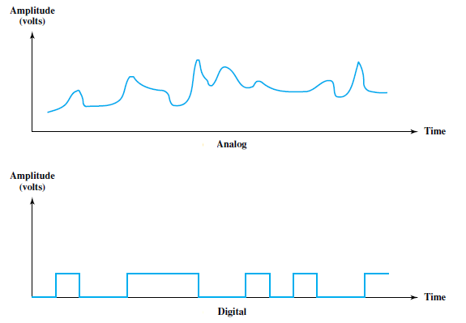
Fig : Analog & Digital Waveforms

Slide 11
.Time Domain – Viewed as a function of time, an EM signal can be either Analog or Digital . Analog signal – Varies in a smooth fashion over time No breaks / discontinuities in the signal . Digital Signal – Signal intensity maintains a constant level for one period of time & abruptly changes to another constant level. . Periodic signal – Same signal pattern repeats over time In mathematical form, a signal s(t) is periodic if and only if, s ( t + T ) = s(t) , - ∞ < t < + ∞ where, T = Period of the signal

Slide 12
. The sine wave is the fundamental periodic signal . A general sine wave can be represented by 3 parameters : (i) Amplitude (A) (ii) Frequency (f) (iii) Phase (ø) . Peak Amplitude : Maximum value or strength of the signal over time. . Frequency : It is the rate ( in cycles/sec, or Hertz (Hz) at which the signal repeats ) . Time period (T) : Amount of time it takes for one repetition Therefore , T = 1 / f

Slide 13
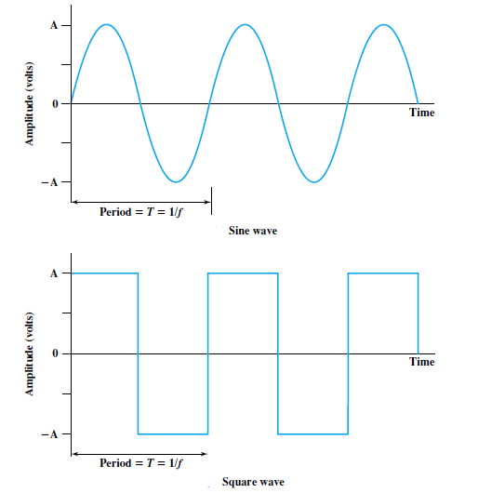
Fig : Examples of Periodic signals

Slide 14
. Phase : It is a measure of the relative position in time within a single period of a signal . General sine wave pattern can be written as, . Wavelength : It is the distance occupied by a single cycle. . DC component : If a signal includes a component of Zero frequency, that component is a direct current (dc) or constant component It has frequency f = 0 & non-zero average amplitude

Slide 15
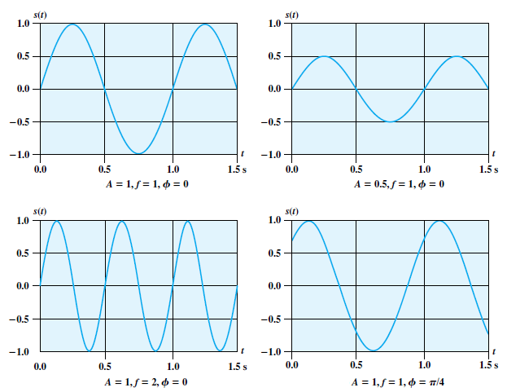
Fig : Graphs that display the value of signal at a given point

Slide 16
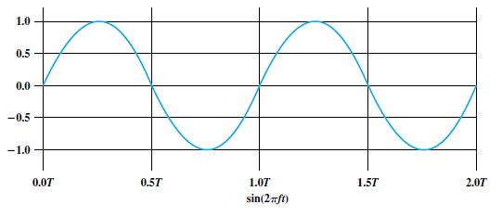
. Frequency Domain concept : An EM signal will be made up of many frequencies Examples :

Slide 17
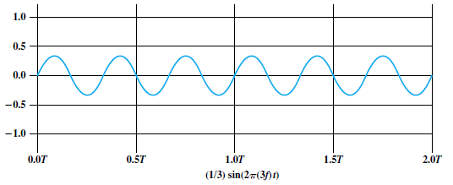
. Frequency Domain concept : Examples :

Slide 18
Analog and Digital Data Transmission : . Data- Entities that convey meaning or information . Signals – Electric or Electromagnetic representations of data . Signalling – Physical propagation of the signal along a suitable medium . Transmission – Communication of the data by the propagation and processing of signals . Analog data take on continuous values in some interval Eg : Voice & Video are continuously varying patterns of intensity Data collected by sensors, such as temperature and pressure, are continuous valued . Digital data takes on discrete values Eg: Text, Integers

Slide 19
. Most familiar example of analog data is Audio, which is in the form of acoustic sound waves . Frequency components of typical speech, 100 Hz - 7000 Hz . Another example of analog data is Video . To produce a picture on the screen, an electron beam scans across the surface of the screen from left to right and top to bottom

Slide 20
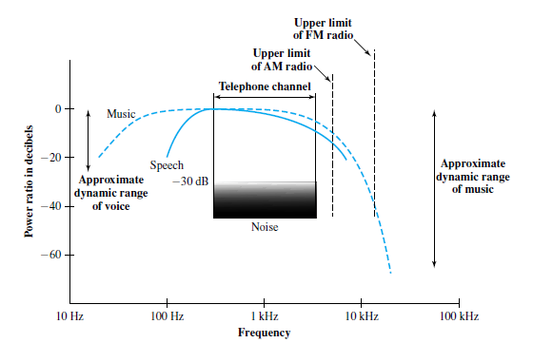
Fig : Acoustic Spectrum of speech and music

Slide 21
. For a black & white TV, the amount of illumination produced at any point is proportional to the intensity of the beam as it passes that point . At any instant of time, the beam takes an analog value of intensity to produce the desired brightness at that point on the screen . Therefore, as the beam scans, analog value changes and the video image is a time-varying analog signal

Slide 22
Scanning Process : . At the end of each scan line, the beam is swept rapidly back to the left .This is known as Horizontal Retrace . When the beam reaches the bottom, it is swept rapidly back to the top . This is known as Vertical Retrace . The beam is turned off i.e; blanked out during retrace intervals . To achieve good resolution , the beam produces a total of 483 horizontal lines at a rate of 30 scans/sec . Practically, this rate will Produce Flicker. . To avoid this Flicker, new method of scanning is introduced known as Interlaced Scanning. . In this ,the total number of lines are divided into 2 fields, (i) Odd Field (ii) Even Field . The odd numbered scanned lines & even numbered scanned lines are scanned separately.

Slide 23
. Odd Field : Scan from A to B . Even field : Scan from C to D . Therefore, the screen is refreshed 60 times/sec rather than 30 times/sec. . An example of digital data is Text and are transmitted in a binary fashion . These characters are represented by a sequence of bits . The most commonly used text code is the International Reference Alphabet (IRA) . Each character in this code is represented by a unique 7 bit pattern (128 characters can be represented) . The 8th bit is a parity bit used for Error detection

Slide 24
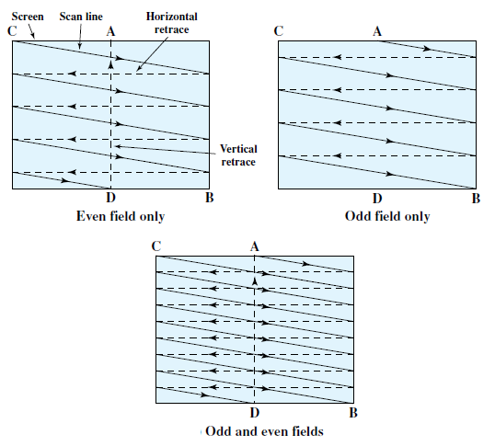
Fig : Acoustic Spectrum of speech and music

Slide 25
Analog & Digital Signals : . In a communications system, data are propagated from one point to another by means of EM signals . An analog signal is a continuously varying EM wave that can be propagated over a variety of media depending on the spectrum. Eg : Wire media – Twisted pair , Coaxial cable , Fiber optic cable Unguided media – Space propagation . A digital signal is a sequence of voltage pulses transmitted over a medium . Advantage of digital signaling over analog signaling is, (i) Economical (ii) Less susceptible to noise interference

Slide 26
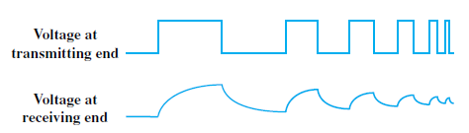
. Disadvantage of digital signaling over analog signaling is that digital signals suffer from more attenuation than analog signals Fig : Attenuation of Digital Signals . The figure shows a sequence of voltage pulses generated by a source using 2 voltage levels . Due to the attenuation, the pulses become rounder and smaller

Slide 27
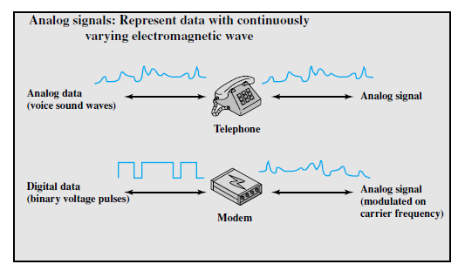
Data and Signals : . Analog data are a function of time & occupy a limited frequency spectrum . Digital data can be represented by digital signals, with a different voltage level for each of the 2 binary digits Fig: Analog Signaling of Analog and Digital Data

Slide 28
. Digital data can be represented by analog signals by the use of Modem . Modem stands for Modulator- Demodulator . Modem converts a series of binary voltage pulses into an analog signal by encoding the digital data onto a carrier frequency . At the other end of the line, another modem demodulates the signal to recover the original data .

Slide 29
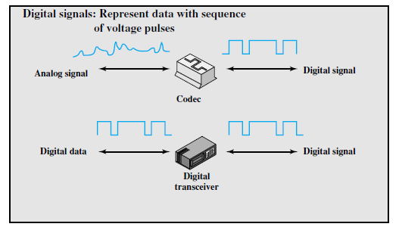
Fig: Analog Signaling of Analog and Digital Data

Slide 30
. In an operation similar to modem, analog data can be represented by digital signals . The device that performs this function for voice data is a Codec . Codec stands for Coder - Decoder . Codec takes an analog signal that directly represents the voice data & approximates that signal by a bit stream . At the receiving end, the bit stream is used to reconstruct the analog data .

Slide 31
Analog and Digital Transmission : . Both analog and digital signals are transmitted on suitable transmission media . The way these signals are treated is a function of the transmission system . Analog transmission is a means of transmitting analog signals without regard to their content i . e ; the signal may represent analog data ( in terms of voice ) or digital data ( binary data pass through the modem ) . In both the cases, the analog signal gets attenuated . To achieve longer distances, transmission system introduces amplifiers that boost the energy in the signal . Unfortunately, the noise signal also gets amplified

Slide 32
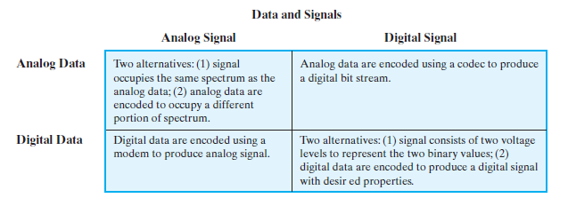

Slide 33
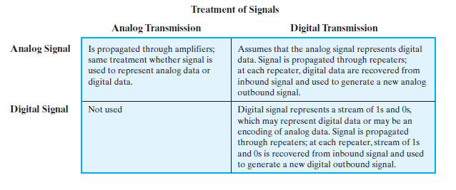

Slide 34
. For analog data such as voice , little distortion is tolerated and the data remain intelligible . For digital data, cascaded amplifiers will introduce errors . Digital transmission in contrast, assumes a binary content to the signal . Digital signal can be transmitted smaller distances without attenuation . To achieve greater distances, Repeaters are used . A repeater receives the digital signal, recovers the patterns of 1s & 0s and retransmits a new signal . Therefore, Attenuation is overcome. . The same technique may be applied for an analog signal if it is assumed that the signal carries digital data . At appropriately spaced points, the transmission system has repeaters . Repeater recovers the digital data from the analog signal and generates a new, clean analog signal . Therefore the noise is not cumulative.

Slide 35
Telecommunication facilities have move to digital because of the following reasons, (i) Digital Technology : Because of LSI, VLSI , the cost is reduced and device has become more compact (ii) Data integrity : Integrity of data is achieved by using repeaters (iii) Capacity Utilization : Economical to build transmission links of very high bandwidth with optical fiber and this is achieved by digital ( Time division Multiplexing ) (iv) Security and Privacy : Using Encryption techniques this can be achieved (V) Integration : Economies of scale and convenience can be achieved by integrating voice, video and digital data

Slide 36
Transmission Impairments : The most significant impairments are, (i) Attenuation & Attenuation distortion (ii) Delay Distortion (iii) Noise Attenuation : . The strength of a signal falls off with distance over any transmission medium . For guided media, attenuation varies exponentially and is expressed in decibels. . For unguided media, attenuation is a more complex function of the distance & the makeup of the atmosphere

Slide 37
. Attenuation introduces 3 considerations for the transmission engineer, . First, a received signal must have sufficient strength so that the electronic circuitry in the receiver can detect the signal . Secondly, it must have a good SNR . Attenuation varies with frequency . First and second problems can be solved by attention to the signal strength and by using Repeaters . Third problem can be solved by Equalization . .

Slide 38
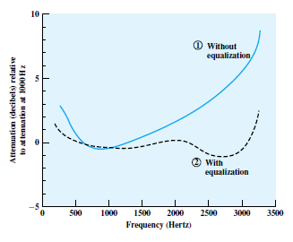
Fig: Attenuation curve for a voice channel .

Slide 39

. The figure shows the Attenuation Vs Frequency for a typical leased line . A 1 KHz tone of a given power level is applied to output & the power P₁₀₀₀ is taken at the output . Relative attenuation in dB is given as, . The frequency components a the upper end of the voice band are attenuated much more than that of lower frequencies. .Therefore, it results in a distortion in the received speech signal . The dashed line shows the effect of Equalization . Flattened response curve improves the quality of voice signals . Attenuation distortion can present less of a problem with digital signals. .

Slide 40
Delay Distortion : . Delay Distortion occurs because the velocity of propagation of a signal through a guided medium varies with frequency . For a bandlimited signal, the velocity tends to be highest near the center frequency and fall off toward the two edges of the band . Therefore, various frequency components of a signal arrive at the receiver at different times resulting in phase difference between different frequencies . This effect is known as Delay Distortion as the received signal is distorted due to various delays experienced at its constituent frequencies

Slide 41
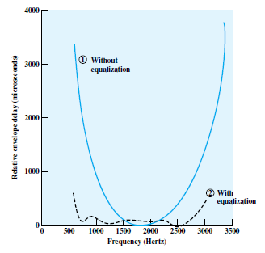
Fig: Delay Distortion curve for a voice channel .

Slide 42
. Attenuation introduces 3 considerations for the transmission engineer, . First, a received signal must have sufficient strength so that the electronic circuitry in the receiver can detect the signal . Secondly, it must have a good SNR . Attenuation varies with frequency . First and second problems can be solved by attention to the signal strength and by using Repeaters . Third problem can be solved by Equalization .

Slide 43
Noise : . Undesired signals are referred to as Noise . Noise is the major limiting factor in communications systems reference . Noise is divided into 4 categories, (i) Thermal Noise (ii) Intermodulation Noise (iii) Crosstalk (iv) Impulse Noise . Thermal noise is due to thermal agitation of electrons . Thermal agitation of electrons is the random movement of free electrons in a conductor producing noise signals. . Thermal noise is a function of temperature

Slide 44


. Thermal noise is uniformly distributed across the bandwidths, so it is referred to as White Noise . Thermal noise is significant for satellite communication as the received signal strength is less . The amount of Thermal noise to be found in a bandwidth of 1 Hz is given by, where, . Thermal noise power density at room temperature is 4 x 10⁻²¹ Hz or - 204 dBW/Hz

Slide 45
. Noise is assumed to be independent of frequency N = KTB . N( in dBW ) = 10 log K + 10 log T + 10 log B = -228.6 dBW + 10 log T + 10 log B . Given a receiver with effective noise temperature of 294 K and 10 MHz bandwidth. Determine the thermal noise level at the receiver’s output ? . N = -228.6 dBW + 10 log ( 294 ) + 10 log (10⁷ ) N = -228.6 + 24.7 + 70 N = -133.9 dBW

Slide 46
. Intermodulation (IM) noise may occur when signals at different frequencies share the same transmission medium . The effect of IM noise is to produce signals at a frequency that is sum / difference or product of those frequencies. . IM noise is produced by nonlinearities in the transmitter , receiver ,transmission medium . Ideally these components are linear but in real time the output is more complex function of input . Excessive nonlinearity can be caused by component malfunction or from overload. . Cross talk may occur by electrical coupling between nearby twisted pairs, etc . Crosstalk can also occur when microwave antenna picks up unwanted signals . Typically, crosstalk is of the same order of magnitude or less than thermal noise . Impulse noise is non-continuous , consisting of irregular pulses or noise spikes of short duration and of relatively high amplitude

Slide 47
. It occurs from a variety of causes such as electromagnetic disturbances ( eg: Lightning, faults and flaws in the communication system

Slide 48
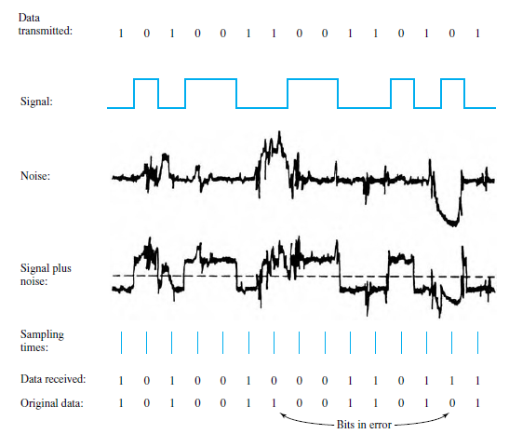
Fig: Effect of Noise on a Digital signal

Slide 49
Channel Capacity : . Channel capacity is defined as the maximum rate at which the data can be transmitted over a given communication path, or channel , under given conditions. . Data Rate – The rate, in bits per second (bps) , at which data can be communicated . Bandwidth – The bandwidth of the transmitted signal as constrained by the transmitter and the nature of the transmission medium expressed in cycles/sec, or Hertz . Noise – The average level of noise over the communications path . Error rate – The rate at which the error occurs , where an error is the reception of 1 when a 0 was transmitted or the reception of 0 when a 1 was transmitted

Slide 50
Nyquist Bandwidth : . Consider the channel as Noise free . Therefore, the limitation of data rate is nothing but the bandwidth of the signal . A formulation of this limitation, due to Nyquist states that, If the rate of signal transmission is 2B, then a signal with frequencies no greater than B is sufficient to carry the signal rate or vice versa. . This limitation is due to the effect of ISI . ISI stands for Inter Symbol Interference .This is useful in the development of digital-to-analog encoding schemes . If the signals to be transmitted are binary , then the data rate that can be supported by B Hz is 2B bps . Binary supports 2 voltage levels . If 4 possible voltage levels are used as signals ,then each signal element can represent 2 bits

Slide 51
. With multi level signaling, the Nyquist formulation is, C = 2B log₂ M where, M = Number of discrete signal or voltage levels B = Bandwidth C = Nyquist capacity . Therefore, for a given bandwidth the data rate can be increased by increasing the number of different signal elements . But doing this , there will be an increased burden on the receiver . Consider a voice channel being used for a modem to transmit digital data. Given Bandwidth is 3.1 KHz & M =8. Determine the Channel capacity ?

Slide 52
C = 2B log₂ M C = 2 x 3100 x log₂ 8 C = 2 x 3100 x log₂ 2³ C = 2 x 3100 x 3 x log₂ 2 C = 2 x 3100 x 3 x 1 C = 18600 bps (or) 18.6 Kbps Shannon Capacity Formula : . Nyquist’s formula is based on noise free environment. So, doubling the bandwidth doubles the data rate . The presence of noise can corrupt one or more bits . If the data rate is increased, the bits become shorter and therefore more bits are affected by noise . The above diagram represents the scenario

Slide 53

. All of these factors are included in the formula developed by Shannon . Higher the data rate, the more the noise . Therefore, for a given level of noise, a greater signal strength will improve the ability to receive the data correctly in the presence of noise . The key parameter that describes this is, Signal-to-Noise ratio ( SNR) . SNR is defined as the ratio of Signal power to the Noise power . SNR (in dB) , can be represented as , . Higher the SNR, better is the quality of the signal

Slide 54
. All of these factors are included in the formula developed by Shannon . Higher the data rate, the more the noise . Therefore, for a given level of noise, a greater signal strength will improve the ability to receive the data correctly in the presence of noise . The key parameter that describes this is, Signal-to-Noise ratio ( SNR) . SNR is defined as the ratio of Signal power to the Noise power . SNR (in dB) , can be represented as , . Higher the SNR, better is the quality of the signal

Slide 55
. The maximum channel capacity (in bps) is given as, Where, C = Channel capacity ( in bits per sec (or) bps) B = Bandwidth SNR = Signal to Noise ratio . By using this formula, we can get theoretical maximum values, but practically the values will be lesser than this . The reason is, this formula includes only thermal noise i.e ; White Noise Attenuation distortion, delay distortion, impulse noise are not included

Slide 56
. Consider an example which relates Nyquist and Shannon relation . Given the spectrum of a channel is in between 3 MHz and 4 MHz & SNR = 24 dB Therefore, Bandwidth = 4 - 3 = 1 MHz SNR = 24 dB 10 log SNR = 24 log SNR = 24/10 = 2.4 SNR = 10 ^{2.4} SNR = 251.188

Slide 57
Using Shannon’s formula, C = B log ₂ ( 1 + SNR) C = 10 ⁶ x log ₂ ( 1 + 251.188 ) C = 10 ⁶ x log ₂ (252.188 ) C = 10 ⁶ x 7.9783 C (Approx.) = 8 Mbps Using Nyquist’s formula, C = 2 x 10 ⁶ log₂ M 8 x 10 ⁶ = 2 x 10 ⁶ log₂ M log₂ M = 4 M = 2 ⁴ = 16

Slide 58
Expression E_{b} / N_{o} : . The parameter E_{b} / N_{o} is a quality measure for determining the digital communication system performance . This parameter is used to measure digital data rates and error rates . E_{b} / N_{o} parameter is the ratio of signal energy per bit to noise power density per Hz . Consider a signal that contains binary digital data transmitted at a rate R . The energy per bit in a signal is given as, E_{b} = S T_{b} where, S = Signal power T_{b} = Time required to send one bit

Slide 59
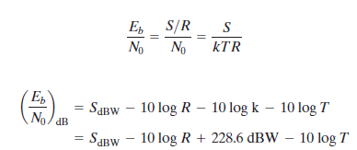
. The data rate R is , R = 1/ T_{b} . E_{b} / N_{o} is given as,

Slide 60

. For BPSK, E_{b} / N_{o} = 8.4 dB is required for a bit error rate of 10⁻ ⁴ . If the effective noise temperature is 290 K and the data rate is 2.4 Kbps . Determine the received signal level ? 8.4 = S (in dBW) – 10 log 2400 + 228.6 – 10 log 290 8.4 = S (in dBW) – 33.802+ 228.6 – 24.623 S (in dBW) = -161.774 . E_{b} / N_{o} can be related to SNR as, Where , N_{o} = Noise power density ( in Watts / Hz)

Slide 61



. Therefore, Noise in a signal with bandwidth B is N = N_{o}B . After substituting, . E_{b} / N_{o} is related to spectral efficiency as, . Equating R with C,

Slide 62
. Determine the minimum E_{b} / N_{o} required to achieve a spectral efficiency of 6bps/Hz ? E_{b} / N_{o} = 1/6 ( 2 ⁶ - 1) = 10.5 E_{b} / N_{o} = 10 log 10.5 =10.212 dB

Slide 63
Guided & Unguided Transmission Media : . Transmission media that are used to convey the information may be classified as, (i) Guided media – Uses Twisted pair, coaxial cable or optical fiber (ii) Unguided media – Uses an antenna for transmitting through air, vacuum, or water . Number of design factors relating to the transmission medium and the signal determine the data rate and distance: (i) Bandwidth – Greater the bandwidth of a signal, the higher the data rate that can be achieved ( Assuming that other factors are constant ) (ii) Transmission Impairments – Impairments such as attenuation limit the distance Eg: Twisted pair > Coaxial cable > Optical fiber (iii) Interference - In Guided media , it can be caused by emanations from nearby cables In Un-guided media, it can be caused from overlapping frequency bands

Slide 64
. Number of Receivers – Guided medium can be used to construct a point to point link or a shared link with multiple attachments. Each attachment introduces some attenuation limiting the distance and/or data rate.

Slide 65
. Guided Transmission Media : . In this, the transmission capacity ( in terms of either Data rate or Bandwidth ) depends critically on the distance & the medium ( Point - to - Point or Multi point) . The three guided media commonly used for transmission are, (i) Twisted pair (ii) Coaxial cable (iii) Optical fiber

Slide 66
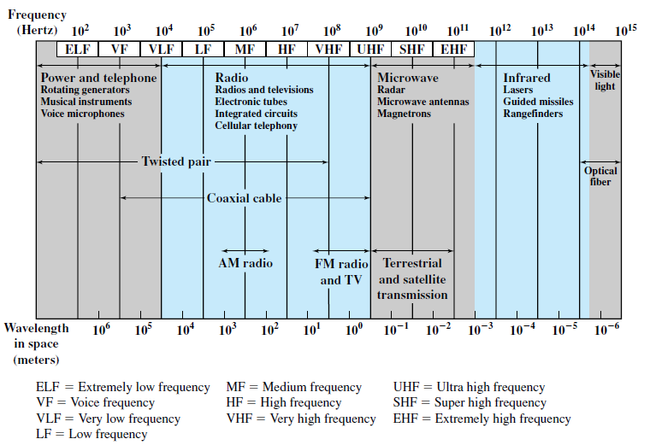
Fig : Electromagnetic (EM) Spectrum for Telecommunications

Slide 67
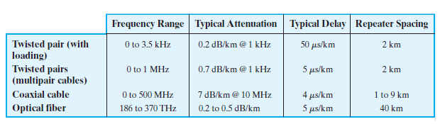
Fig : Point-to-Point transmission characteristics of Guided media

Slide 68
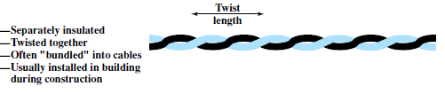
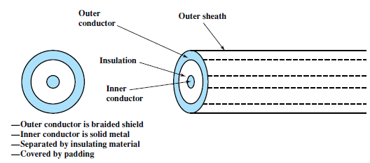
Fig : Twisted Pair Fig : Coaxial cable

Slide 69
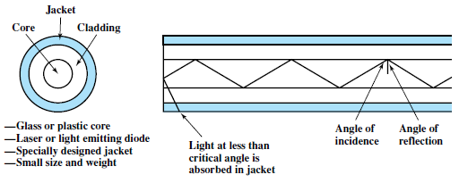
Fig : Optical Fiber

Slide 70
Twisted Pair : . It is the least expensive and mostly used guided transmission media . It consists of 2 insulated copper wires arranged in a regular spiral pattern and this wire pair acts as a single communication link . Over long distance, cables may contain hundreds of pairs . The twisting tends to decrease the crosstalk interference between adjacent pairs in a cable . Over long distance links, the twist length varies from 5-15 cm & the wires in a pair have thickness from 0.4- 0.9mm

Slide 71
Applications : . It is used in the telephone network and is the workhorse for communications within buildings . In the telephone system, individual residential telephone sets are connected to the local telephone exchange or end office by this twisted pair and are referred to as Subscriber loops . Within an office building, each telephone is connected to the twisted pair which goes to the in-house PBX ( Private Branch Exchange) and are used to support voice traffic ( Using Analog signaling ) . By using a Modem, these can handle digital data traffic at modest data rates . It can be commonly used within a building for LAN’s ( Local Area Network ) supporting PC’s ( Personal Computer) . Twisted pair is less expensive when compared with other guided transmission media.

Slide 72
Transmission characteristics : . Twisted pair is used to transmit both analog and digital data transmission . For Analog signals – Amplifiers are used . For Digital signals – Repeaters are used . Compared to the other guided transmission media , Twisted pair is limited in distance, bandwidth and data rate . Impulse noise easily intrudes into twisted pair . It is quite susceptible to interference and noise because of its easy coupling with EM (Electro-Magnetic) fields . Shielding the wire with metallic braid or sheathing reduces interference . Twisting of the wire reduces low-frequency interference. . Use of different twist lengths in adjacent pairs reduces crosstalk

Slide 73
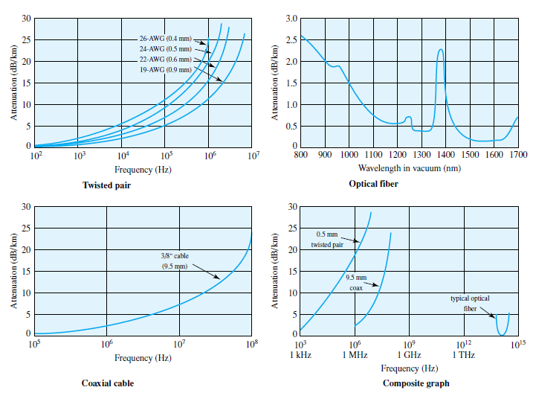
Fig : Attenuation of typical Guided media

Slide 74
Unshielded and Shielded Twisted pair : . Twisted pair is in 2 variants, (i) Shielded Twisted pair (STP) (ii) Unshielded Twisted pair (UTP) . UTP is an ordinary telephone wire. It is less expensive of all the transmission media commonly used for LAN’s and easy to work with and easy to install . UTP is subject to external EM interference . It can be improved by proper shielding with a metallic braid or sheathing which reduces the interference . STP provides better performance but is more expensive & is more expensive to work with than UTP

Slide 75
Category 3 & Category 5 UTP : . In the year 1991, EIA ( Electronic Industries Association ) published standard EIA-568, Commercial Building Telecommunication Cabling Standard. . It specifies the use of UTP and STP for in-building data applications . EIA-568-A recognizes 3 categories of UTP cabling as, (i) Category 3 – UTP cables & associated hardware whose transmission characteristics are specified upto 16 MHz (ii) Category 4 - UTP cables & associated hardware whose transmission characteristics are specified upto 20 MHz (iii) Category 5 - UTP cables & associated hardware whose transmission characteristics are specified upto 100 MHz . Out of these Category 3 & 5 found LAN applications . Over limited distance , Category 3- Up to 16 Mbps, Category 5 – Up to 100Mbps . Key difference between Category 3 & 5 is the number of twists in the cable per unit distance

Slide 76
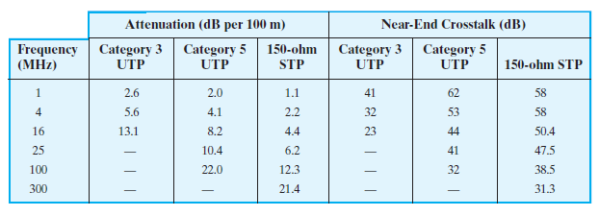
Fig : Comparison of STP & UTP

Slide 77
Category 3 & Category 5 UTP : . For a guided media, attenuation is generally exponential and expressed as a constant no. of decibels per unit distance . Near end cross talk occurs when there is coupling of the signal from one pair of conductors to another pair . These conductors may be the metal pins in a connector or wire pairs in a cable

Slide 78
Coaxial Cable : . It operates over a wide range of frequencies . It consists of a hollow outer cylindrical conductor that surrounds a single inner wire conductor Inner conductor – Regularly spaced insulating rings or a solid dielectric material Outer conductor – Covered with a jacket or shield . A single coaxial cable has a diameter of 1 - 2.5 cm . It can be used over longer distances and support more stations Applications: Used in, . Television distribution . Long-distance telephone distribution . Short-run computer system links . LAN’s ( Local Area Networks )

Slide 79
Coaxial Cable : . Coaxial cable is an important part of the long distance telephone network . Now-a-days it faces increasing competition from optical fiber, terrestrial microwave and satellite . Using FDM ( Frequency Division Multiplexing ), a coaxial cable can carry 10,000 voice channels simultaneously . Coaxial cable is commonly used for short range connections between devices . Using digital signaling, coaxial cable can provide high speed I/O channels on computer systems Transmission Characteristics : . It can transmit both analog & digital signals . Coaxial cable works better than twisted pair as it operates at higher frequencies . It is much less susceptible to interference & crosstalk due to its shielded, concentric construction . The main constraints on its performance are Attenuation, Thermal Noise and Inter-modulation (IM) Noise

Slide 80
Optical Fiber : . An optical fiber is a thin, flexible medium capable of guiding an optical ray. . Glass , Plastic can be used to make optical fibers . Less losses are obtained using fibers of Ultrapure fused Silica but it is difficult to manufacture . Higher-loss multicomponent glass fibers are more economical and provide good performance . Plastic fibers are even less costly and is used for short-haul links . Optical fiber cable has a cylindrical shape and consists of 3 concentric sections, They are, (i) Core (ii) Cladding (iii) Jacket

Slide 81
Fig : Optical Fiber

Slide 82
. Core – It is the inner most section and consists of one or more very thin strands, or fibers , made of glass or plastic. It has a diameter of 8-50 µm. . Cladding – Optical fiber is surrounded by cladding (Glass/Plastic coating that has different optical properties from that of core ). It has a diameter of 125 µm. . Jacket – It is the outermost layer surrounding one or a bundle of cladded fibers to protect against moisture, abrasion, crushing, etc Applications : . Greater Capacity – The potential bandwidth and hence high data rate of optical fiber is immense ( Data rates of hundreds of Gbps over tens of kilometers is achieved ) . Smaller Size & Lighter weight – Are considerably thinner compared with others . Attenuation – Significantly lower than coaxial cable and twisted pair

Slide 83
. Electromagnetic (EM) Isolation – Not affected by external EM fields. Therefore, the system is not vulnerable to interference, impulse noise or crosstalk. Fibers don’t radiate energy, so there is little interference with other equipment & there is a high degree of security from eavesdropping . Greater Repeater spacing - Fewer repeaters mean lower cost and less error. Repeater spacing is more in optical fiber when compared with twisted pair and coaxial cable 5 categories of applications have become popular for optical fiber, (i) Long- haul trunks (ii) Metropolitan trunks (iii) Rural exchange trunks

Slide 84
(iv) Subscriber loops (v) Local Area Networks (LAN’s) . Long- haul Trunks – Long-haul fiber transmission has become increasingly common in the telephone network. These systems compete economically with microwave. Undersea optical fibers are also used more. . Metropolitan Trunks – Most facilities are installed in under ground conditions and are repeater-less joining a telephone exchange in a metropolitan area . Rural Exchange Trunks – Have circuit lengths ranging from 40-160 Km and link towns and villages. Technology used in these applications competes with microwave facilities . Subscriber loop circuits – Are fibers that run directly from the central exchange to a subscriber. These facilities are beginning to displace twisted pair and coaxial cable links as telephone networks now are capable of not only handling voice, data but also image and video

Slide 85
. Local Area Networks (LAN’s) - Standards have been developed and have total capacity of 100 Mbps to 10Gbps can support more number of stations or offices Transmission characteristics : . Optical fiber transmits a signal-encoded beam of light by means of Total Internal Reflection (TIR) . TIR can occur in any transparent medium that has a higher index of refraction than the surrounding medium . Optical fiber acts as a waveguide for frequencies in the range of 10¹⁴ to 10¹⁵ Hz . Rays at shallow angles are reflected and propagated along the fiber and other rays are absorbed by the surrounding material. This is referred to as Step index multi mode . Graded index mode is possible by varying the refractive index. . Light in the core curves helically because of graded index, reducing its travel distance

Slide 86
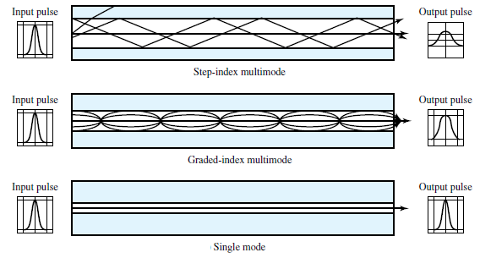
Fig : Optical fiber Transmission modes

