Slide 1

T.V.Suri AppaRao Assistant Professor Department of EECE GITAM Institute of Technology(GIT) Visakhapatnam-530045 Email: vtanakal@gitam.edu
Topic : Datalink control protocols –High Level Datalink Control (HDLC)
Unit IV : Digital Data Communication Techniques

Slide 2

Introduction: . The most fundamental requirement in the transmission of bits is Synchronization . The receiver must know the rate at which the bits are received, so that it can sample at required intervals . This can be classified in 2 ways, (i) Asynchronous Transmission (ii) Synchronous Transmission . In Asynchronous Transmission , each character of data is treated independently . In Synchronous Transmission , each block of data is transmitted as a Frame

Slide 3
Asynchronous and Synchronous Transmission :
. In this Serial transmission of data is considered.
. Serial transmission of data implies that signaling elements are sent down the line one at a time.
. Each signaling element can be of,
(i) Less than one bit : Eg- with Manchester coding
(ii) One bit : Eg- NRZ-L (Non Return to Zero Level) for Digital, FSK (Frequency Shift Keying) for Analog
(iii) More than one bit : Eg- QPSK (Quadrature Phase Shift Keying)

Slide 4
• Reception of digital data involves sampling the incoming signal once per bit time to determine the binary value
. Transmission impairments can corrupt the signal
. In order to receive the sample correctly by the receiver, it must know the arrival time and duration of each bit.
. If the transmitter and receiver clocks are not properly aligned then the problem arises
. Eg: If the data is transmitted at 1Mbps, then one bit will be transmitted for every 1/10⁶ i.e; 1µsec
. If there is a drift of 1%, then the first sampling will be 0.01 of a bit time or 0.01µsec away from the center of the bit
. After 50 samples , it will be away from 50 x 0.01µsec = 0.5 µsec.

Slide 5
• For these type of small timing differences, the error would occur later .
. But, when it sends long stream of bits, Synchronization is necessary

Slide 6
Asynchronous Transmission :
. In this, the strategy is to avoid the timing problem by not sending long, uninterrupted streams of bits
. Here in this, the data is transmitted one character at a time where each character is 5-8 bits long.
. Timing / Synchronization must be maintained within each character ; the receiver has the opportunity to
resynchronize at the beginning of each new character.

Slide 7
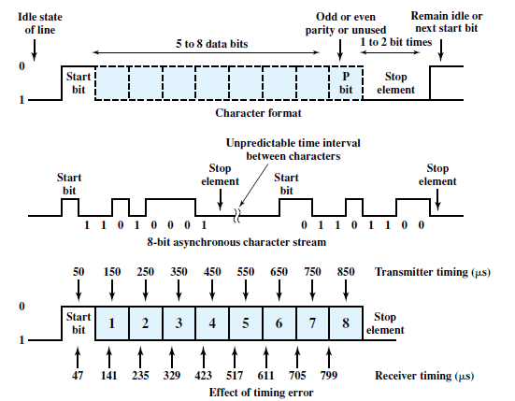
Fig : Asynchronous Transmission

Slide 8
. When no character is transmitted, the line between transmitter and receiver will be in Idle state . Definition of Idle is equal to the signaling element for binary 1. . For NRZ-L signaling, idle would be the presence of a negative voltage on the line. . The beginning of a character is signaled by a Start bit with a value of binary 0. . The data bits are followed by a parity bit , which is in the MSB ( Most Significant Bit ) position. . The parity bit is set by the transmitter. . If the total number of bits including the parity bit is even , then it is Even parity. . If the total number of bits including the parity bit is odd , then it is Odd parity. . This is useful in Error Detection.

Slide 9
. The final element is a Stop element , which is a binary 1. . A minimum length for the stop element is specified and it is 1,1.5 or 2 times the duration of an ordinary bit. . Stop element is the same as the Idle state. Therefore, transmitter will continue to transmit the stop element until it is ready to send the next character. . In this example, we assume a data rate of 10 kbps, therefore each bit is of 100 µsec duration. . Assume the receiver is fast by 6 %, i.e ; 6 µsec per bit time. Therefore, the receiver samples the incoming character every 94 µsec based on the transmitter’s clock . For eg: if bit 7 is 1 and bit 8 is a 0, bit 8 could be mistaken for a start bit. This condition is known as Framing Error . Frame is the combination of start bit, stop bit , character bit. . Framing error can also occur if some noise condition causes the false appearance of a start bit during the idle state

Slide 10
. Asynchronous transmission is simple and cheap but requires an overhead of 2-3 bits per character . The percentage overhead can be reduced by sending larger blocks of bits between the start bit and stop bit element . Larger the block of bits, the greater the cumulative timing error. . To achieve greater efficiency , Synchronous transmission is used.

Slide 11
Synchronous Transmission: . In this, block of bits is transmitted in a steady stream without start and stop bits . To prevent timing drift between transmitter and receiver, their clocks must be synchronized . One way of Synchronization is to provide a separate clock line between transmitter and receiver. . One side pulses the line regularly with one short pulse per bit time . The other side uses these regular pulses as a clock . This technique works well for short distances but over longer distances the pulses are subject to transmission impairments and timing errors will occur. . The other way is to embed the clocking information in the data signal . For digital signals, this can be done using Manchester encoding or Differential Manchester encoding . For analog signals, carrier frequency can be used to synchronize the receiver based on the phase of carrier

Slide 12
. With Synchronous Transmission, another level of synchronization required to allow the receiver to determine the beginning and end of a block of data. . To achieve this, (i) Each block begins with – Preamble bit pattern (ii) Each block ends with - Postamble bit pattern . Other fields such as control information is also added. . The data plus preamble, postamble and control information is called a Frame. . Exact format of frame depends on the data link control procedure being used.

Slide 13

Fig : Synchronous Frame Format

Slide 14
. It is a typical format of Synchronous Transmission . The frame starts with a Preamble called a Flag which is 8 bits long . Same flag is used as Postamble . For sizable blocks of data, Synchronous transmission is far more efficient than asynchronous . Asynchronous transmission requires more than 20% overhead

Slide 15
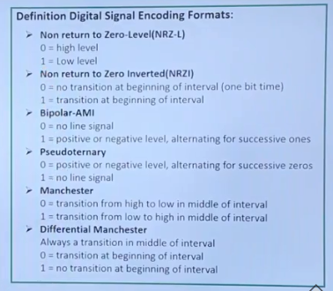
Fig : Encoding Formats

Slide 16
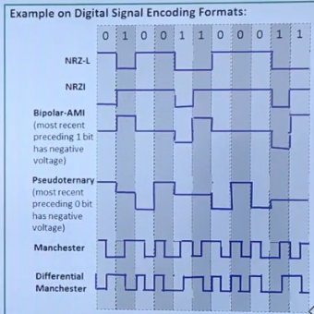

Slide 17
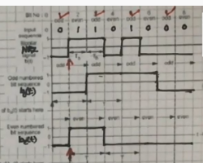
Fig : QPSK (Quadrature Phase Shift Keying ) Input

Slide 18
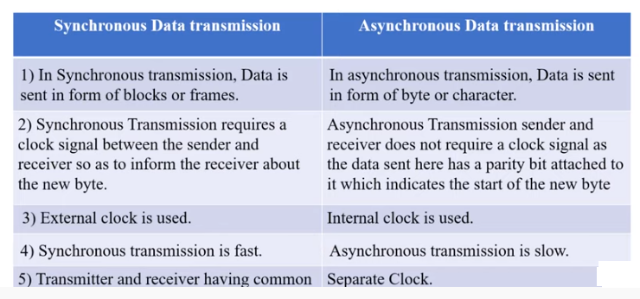
Fig : Differences between Synchronous and Asynchronous Transmission

Slide 19
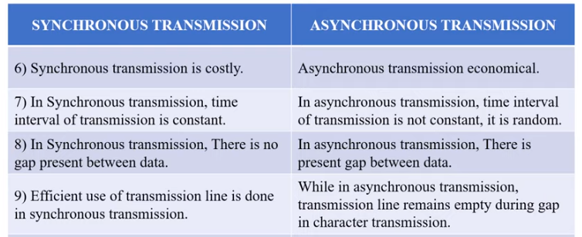
Fig : Differences between Synchronous and Asynchronous Transmission

Slide 20
Types of Errors : . Errors can be classified into 2 types, (i) Single bit error (ii) Burst error . Single bit error – Isolated error condition that alters one bit but does not affect nearby bits . Burst error – First and last bits and any number of intermediate bits are received in this error. . A single bit error can occur in the presence of White Noise. . Burst error can be caused by Impulse Noise. . Effect of Burst error is more at higher data rates.

Slide 21
Error Detection : 3 Techniques, (i) General Error Detection process (ii) Parity check (iii) CRC (Cyclic Redundancy Check) . Assume that data are transmitted as one or more contiguous sequence of bits, called Frames. . Probabilities w.r.to errors are defined as , (i) P_{b} : Probability that a bit is received in error also known as Bit Error Rate (BER) (ii) P₁: Probability that a frame arrives with no bit errors (iii) P₂ : Probability that, with an error detecting algorithm in use, a frame arrives with one or more undetected errors

Slide 22
(iv) P₃ : Probability that, with an error detecting algorithm in use, a frame arrives with one or more detected bit errors but no undetected bit errors . First consider the case in which no means are taken to detect errors . Therefore, P₃ = 0 . To express the remaining probabilities, assume that P_{b} is constant and independent for each bit P₁ = (1- P_{b})^{F} P₂ = 1 – P₁ where, F = Number of bits per frame . Probability that a frame arrives with no bit errors decreases when the probability of a single bit error increases . Probability that a frame arrives with no bit errors decreases with increasing frame length. .

Slide 23
. Longer the frame, the more bits it has and the higher the probability that one of these is in error. . For a given frame of bits, additional bits that constitute an error detecting code are added by the transmitter. . This code is calculated as a function of the other transmitted bits . For a data block of k bits, the error detecting algorithm yields an error detecting code of (n-k) bits, where (n-k) < k . The error detecting code also referred to as check bits, is appended to the data block to produce a frame of n bits which is then transmitted. . The receiver separates the incoming frame into the k bits of data and (n-k) bits of the error detecting code . The receiver performs the same error detecting calculation on the data bits and compares with the incoming error detecting code. . Detected error occurs only if there is a mismatch.

Slide 24
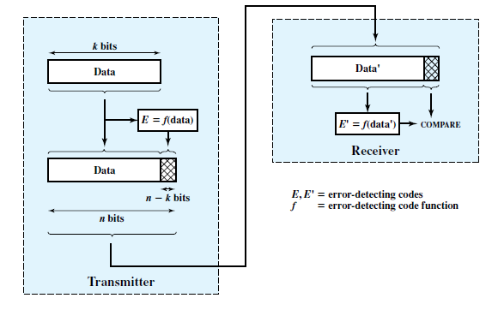
Fig : Error Detection process .

Slide 25
Parity Check : . It is the simplest error detecting scheme . It is done by appending a parity bit to the end of a block of data . The value of bit is selected so that the character has, (i) Even parity - Even number of 1’s (ii) Odd parity - Odd number of 1’s . If two bits are inverted due to error , an undetected error occurs . Generally, (i) Even parity is used for synchronous transmission (ii) Odd parity is used for asynchronous transmission

Slide 26
Cyclic Redundancy Check (CRC) : . CRC is the most powerful Error detecting code . Given a k-bit block of bits, or message, the transmitter generates an (n-k) bit sequence, known as a Frame Check Sequence (FCS) . Resulting bit consisting of n-bits is exactly divisible by some pre-determined number . The receiver then divides the incoming frame by that number, and if there was no remainder, assumes there was no error. . The procedure can be explained in 3 ways, (i) Modulo 2 Arithmetic (ii) Polynomials (iii) Digital Logic

Slide 27
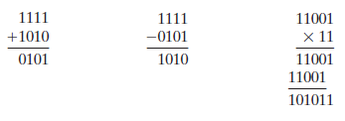
Modulo 2 Arithmetic : . Modulo 2 Arithmetic uses, (i) Binary addition with no carries, which is just the XOR operation. (ii) Binary subtraction with no carries, which is just the XOR operation. . For eg :

Slide 28


. Now define, T – n- bit frame to be transmitted D – k-bit block of data or message, the first k bits of T F – (n-k) bit FCS, the last (n-k) bits of T P – Pattern of (n-k+1) bits : This is Pre-determined divisor . T/P should have no remainder, So → 1 . Divide by 2 ^{n-k} D by P, → 2 .>

Slide 29


. Here Q stands for Quotient and R stands for Remainder . As the division is Modulo 2, the remainder is always 1 bit shorter than the divisor. . We will use this remainder as Frame Check Sequence (FCS) . Divide the equation by P so that we can see whether there is a remainder or not. . Substitute the above value in equation 2, .

Slide 30

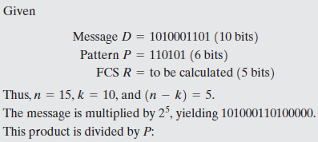
. Here there is no remainder. . Therefore, T is exactly divisible by P. . Thus, the FCS is easily generated.

Slide 31
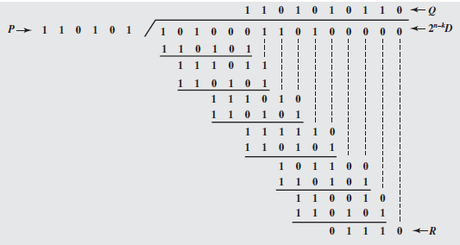

Slide 32

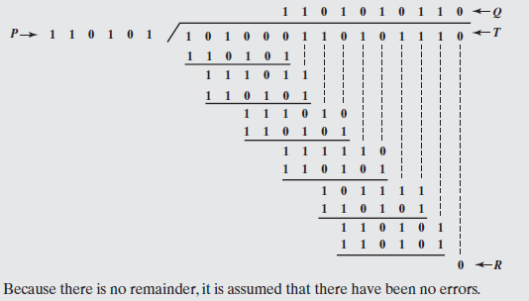

Slide 33

Polynomials : . This is another method to express all values as variables in a dummy variable X with binary coefficients . The coefficients correspond to the bits in a binary number . Thus for D = 110011, D (X) = X ⁵ + X ⁴ + X + 1 . For P = 11001, P (X) = X ⁴ + X ³ + 1 . It can be expressed as,

Slide 34
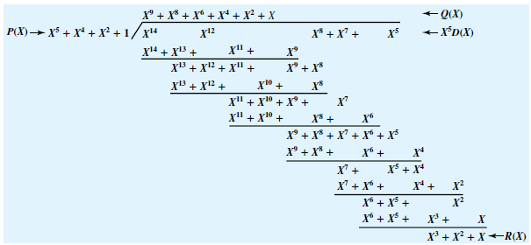

Slide 35
. An error E(X) will only be undetectable if it is divisible by P(X) . It can be shown that all of the following errors are not divisible by a suitably chosen P(X) and hence they are detectable. . All single bit errors , if P(X) has more than one non zero term . All double bit errors, as long as P(X) is a special type of polynomial, called a primitive polynomial, with maximum component L , and the Frame length < 2^{L} -1 . Any odd number of errors as long as P(X) contains a factor (X +1) . Any burst error for which the length of the burst is <= n-k (or) length of the FCS . A fraction of error bursts of length n- k +1 ; the fraction equals 1- 2 ^{- (n-k-1)} . A fraction of error bursts of length > n- k +1 ; the fraction equals 1- 2 ^{- (n-k)} .

Slide 36
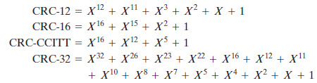
. Four versions of P(X) are widely used, . CRC-12 system is used for transmission of streams of 6-bit characters and generates 12 bit FCS (Frame Check Sequence). . CRC-16 & CRC-CCITT systems are used for transmission of streams of 8-bit characters and generates 16 bit FCS (Frame Check Sequence). . CRC -32 is used in IEEE 802 LAN Standards .

Slide 37
Digital Logic : . CRC process can be implemented as a dividing circuit consisting of XOR gates & a shift register . The shift register is a string of 1 bit storage device . Each device has an output line, which indicates the value currently stored, and an input line. . At discrete time instants, known as clock times, the value in the storage device is replaced by the value indicated by its input line . The entire register is clocked simultaneously. . It results in causing a 1-bit shift along the entire register. . The Digital Logic circuit is implemented as follows : (i) Register contains (n-k) bits equal to the length of the FCS (ii) There are upto (n-k) XOR gates .

Slide 38

. The presence or absence of a gate corresponds to the presence or absence of a term in the divisor polynomial P(X) excluding 1 & X ^{n-k} . Consider an example, Data D : 1010001101 Divisor P : 110101 Then , . The process begins with shift register cleared . The message is entered, one bit at a time starting with the MSB . The Truth table shows the step-by-step operation as the input is applied one bit at a time .

Slide 39
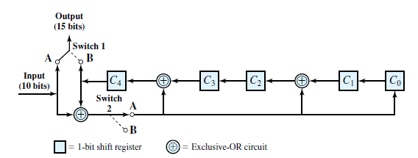
Fig : Shift Register Implementation .

Slide 40
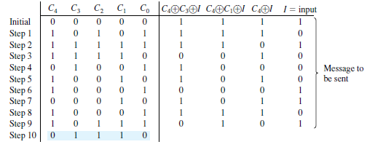
Fig : Shift Register Truth Table for the given example .

Slide 41
. Here the XOR operation is identical to the binary long division process . To produce proper output, 2 switches are used. . Initially both switches are fed at A position . After the last data bit is processed, the shift register contains the remainder as FCS . As soon as the last data bit is provided to the shift register, both switches are fed to B position This has 2 effects, (i) All of the XOR gates become simple pass-throughs , i.e ; no bits are changed (ii) As the shifting process continues, the 5 CRC bits are output . At the receiver, the same logic is used .

Slide 42
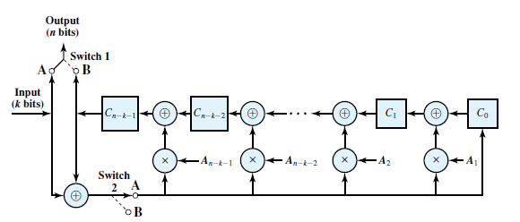
Fig : General CRC Architecture to Implement Divisor .

Slide 43
Error Correction : . Error detection is a useful technique found in , (i) Data link control protocols such as HDLC (High level Data Link Control) (ii) Transport protocols such as TCP (Transmission Control Protocol) . However, correction of errors using an error detecting code, requires that block of data be retransmitted . For wireless applications, this process does not hold good for the following reasons, (i) BER on a wireless link can be quite high, resulting in a large number of retransmissions (ii) In satellite links, Propagation delay > Transmission time of a single frame. This results in an inefficient system. with a long data link, an error in a single frame necessitates retransmitting many frames Instead, it is desirable to enable the receiver to correct errors in an incoming transmission on the basis of bits in that transmission.

Slide 44
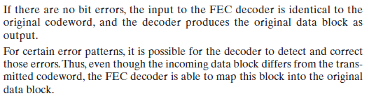
. At the transmitter, each k-bit block of data is mapped into an n-bit block (n > k ) called a Code word using a FEC encoder. . The code word is then transmitted . During transmission, the signal may subject to impairments, which may produce bit errors in the signal . At the receiver, the signal is demodulated to produce a bit string that is similar to the original code word but may contain bit errors . This block is passed through FEC decoder with one of the four possible outcomes. (i) (ii)

Slide 45
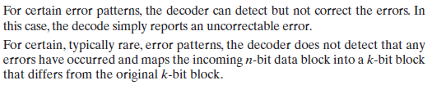
(iii) (iv) . Error correction works by adding redundancy to the transmitted message. . In this, we use a error correcting code known as Block error correcting code

Slide 46
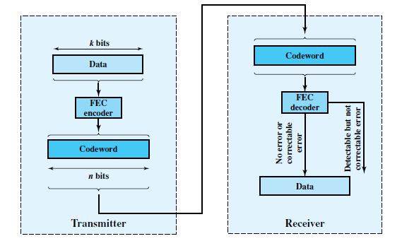
Fig : Error Correction Process .

Slide 47
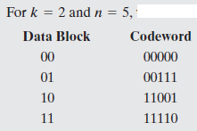
Block code principles : . The Hamming distance d (v₁,v₂) between two n-bit binary sequences v₁ and v₂ is the number of bits in which v₁ and v₂ disagree. . For example , if v₁ = 011011 and v₂ = 110001 then d (v₁,v₂) = 3 . Problem : ..

Slide 48
. Suppose a code word block is received with the pattern 00100. . This is NOT a valid code word. Therefore, the receiver will detect an error. . Hamming distance is, d(00000,00100) = 1 → Single bit change d(00111,00100) = 2 → Two bit change d(11001,00100) = 4 → Four bit change d(11110,00100) = 3 → Three bit change . If an invalid code word is received , then the valid code word that is closest to it i.e; Minimum distance is selected. . There are 2⁵ = 32 possible code words out of which 4 are valid, leaving 28 invalid code words . For the invalid code words we have the following, .

Slide 49
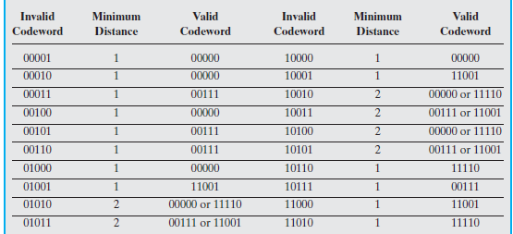

.

Slide 50
. Here, there are 8 cases in which an invalid code word at a distance 2 from two different valid code words . So, here the error is detected but not corrected as the error is of 2 bits. . This code is capable of correcting all single bit errors but cannot correct double bit errors. Properties : . An (n , k) block code encodes k data bits into n-bit code words. . With an (n , k) block code , there are 2^{k} valid code words out of a total of 2^{n} possible code words . Redundancy is defined as the ratio of redundant bits to data bits Redundancy = (n-k) / k . Code rate is defined as the ratio of data bits to total bits Code rate = k/n

Slide 51

. Code rate is a measure of how much additional bandwidth is required to carry at the same data rate as without the code . Maximum number of guaranteed correctable errors per code word satisfies, . If we are concerned only with error detection and not error correction , then the number of errors, ‘t’ that can be detected satisfies, . The design of a block code involves, (i) For a given values of n and k, we would like the largest possible value of d_{min} (ii) The code should be relatively easy to encode and decode , requiring minimal memory and processing time

Slide 52
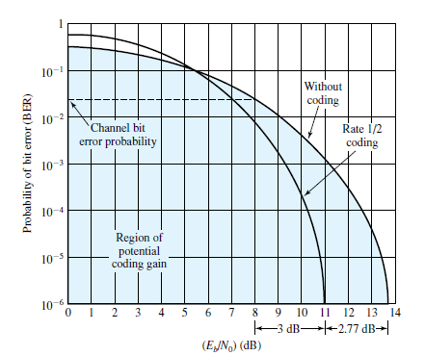
(iii) We would like the number of extra bits, (n-k), to be small , to reduce bandwidth (iv) We would like the number of extra bits, (n-k), to be large , to reduce the error rate . (iii) and (iv) objectives are in conflict and tradeoffs must be made . Coding can be used to reduce the required value to achieve a given BER. . A smaller BER is achieved for a given , and conversely, for a given BER, a smaller is required. . F Fig : How coding improves system performance .

Slide 53
Line Configurations : . Data link configurations are divided based on, (i) Topology (ii) whether link is Half Duplex or Full Duplex . Topology - Topology of a datalink refers to the physical arrangement of stations on a transmission medium . Depending on the number of stations, the links are classified into 2 types, (i) Point-to-Point link – There are only 2 stations (ii) Multi point link – There are more than 2 stations .

Slide 54
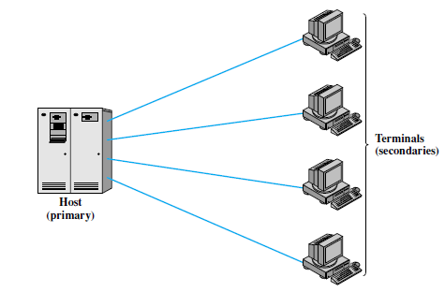
Fig : Point-to-Point link

Slide 55
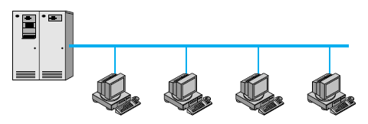
Fig : Multi point link

Slide 56
Half Duplex & Full Duplex : . Data exchanges over a transmission line can be classified as, (i) Half Duplex (ii) Full Duplex . In a Half Duplex transmission, only one of two stations on a point - to - point link may transmit at a time. . This mode is also referred to as Two way alternate suggestive of the fact that 2 stations must alternate in transmitting. . Eg : Terminal-to-computer interaction . For Full Duplex transmission, two stations can simultaneously send and receive data from each other. . This mode is also referred to as Two way simultaneous suggestive of the fact that 2 stations can simultaneously transmit. . Eg : Computer-to-computer data exchange

Slide 57
. With digital signaling, → Full Duplex operation requires 2 separate transmission paths. → Half Duplex operation requires 1 transmission path. . For analog signaling, it depends on frequency. . It is possible to transmit digital signals simultaneously in both directions on a single transmission line using Echo Cancellation.

Slide 58
Data link control Protocols : . Data link control protocol has a control in each communicating device . It provides functions such as Flow control, Error detection & Error control . Flow control enables a receiver to regulate the flow of data from a sender . Error control is achieved by retransmission of damaged frames that have not been acknowledged or for which the other side requests a retransmission . HDLC (High-level data link control). It contains virtually all of the features found in other data link control protocols . When a data link control protocol is used, the transmission medium between systems is referred to as a Data link

Slide 59
. The objectives for effective data communication between two directly connected transmitting-receiving stations are, (i) Frame Synchronization – Data are sent in blocks called Frames. The beginning and end of each frame must be recognizable (ii) Flow control – The sending station must not send frames at a rate faster than the receiving station can absorb them (iii) Error control – Bit errors introduced by the transmission system should be corrected (iv) Addressing – On a shared link, such as LAN , the identity of two stations involved in a transmission must be specified (v) Control and data on same link - It is not desirable to have a separate physical path . The receiver must be able to distinguish control information from the data being transmitted.

Slide 60
. Link Management – The initiation, maintenance and termination of a sustained data exchange require a fair amount of coordination and cooperation among stations.

Slide 61
FLOW CONTROL : . Flow control is a technique for assuring that that a transmitting entity doesn’t overwhelm a receiving entity with data . In the absence of Flow control, the receiver’s buffer may fill up and overflow while it is processing old data . A simple model of Frame transmission is shown. . Each arrow represents a single frame transiting a datalink between 2 stations. . The data is sent in a sequence of Frames. . Each frame consist a portion of data and control information . Transmission Time : The time it takes for a station to emit all of the bits of a frame onto the medium . Propagation Time : The time it takes for a bit to traverse the link between source and destination

Slide 62
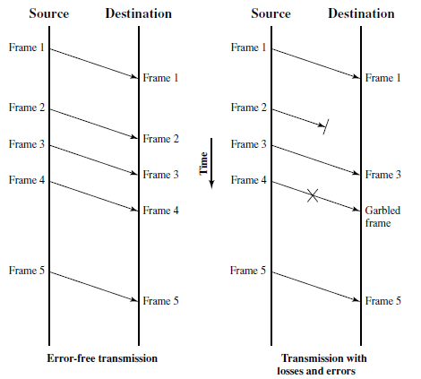
Fig : Model of Frame Transmission

Slide 63
Flow control can be explained using 2 methods, (i) Stop-and-wait Flow control (ii) Sliding Window Flow control Stop-and-wait Flow control : . The simplest form of Flow control is the Stop-and-wait Flow control . A source entity transmits a Frame. After the destination entity receives a frame, it indicates its willingness to accept another frame by sending an Acknowledgement (ACK) . Therefore, the destination can stop the flow of data simply by withholding acknowledgment. . Source will breakup a large block of data into smaller blocks and transmit the data in many frames because of the following reasons,

Slide 64

(i) The buffer size of the receiver may be limited (ii) The longer the frame, the more likely there will be an error and retransmission is to be done. Error will be detected quickly incase of small frames, and therefore a small amount of frame can be retransmitted easily (iii) On a shared medium such as LAN , it is not desirable to permit one station to occupy the medium for an extended period thus causing long delays at the other sending stations . With the use of multiple frames for a single message , the stop-and-wait control doesn’t work well. . Bit length of a link is given by, where, B → Length of a link in bits V → Velocity of Propagation in bps R → Data rate of the link , in bps d → Length, or distance, of the link in meters

Slide 65
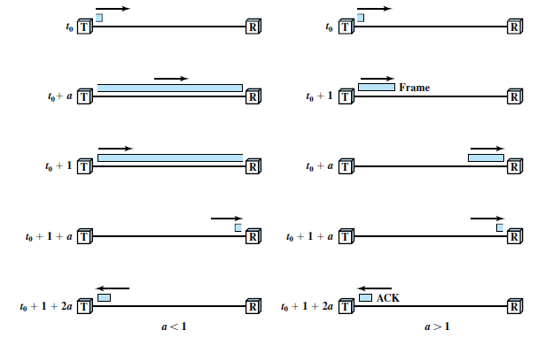
. When Bit length of the link > Frame length, serious inefficiencies result and is explained using the following figure. . Fig : Stop-and-wait link Utilization

Slide 66

. Transmission time is normalized to 1 and Propagation delay (a) is given by, where, L → Number of bits in the frame . When a < 1 ; Propagation time < Transmission time . Frame is sufficiently long, that the first bits of the frame have arrived at the destination before the source has completed the transmission of the frame. . When a > 1 ; Propagation time > Transmission time . The sender completes the transmission of the entire frame before the leading bits of that frame arrive at the receiver . In the figure, the first four indicates the process of transmitting a frame containing data & the last one shows the return of a small ACK frame

Slide 67
. For a > 1 : The line is always under utilized . For a < 1 : In this case also the line is inefficiently utilized . Therefore, for very high data rates , for very long distances between sender and receiver, stop-and-wait flow control provides inefficient utilization. . To overcome this problem and to increase the efficiency , Sliding-Window Flow control is use

Slide 68
Sliding window Flow control : . This protocol is used to improve the efficiency by allowing multiple frames to be in transit at the same time . This is explained as follows: . Consider 2 stations A & B operated through a full-duplex link. . Station B allocates buffer space for W frames . Therefore, B can accept W frames & A is allowed to send W frames without waiting for any acknowledgement . This method is used to acknowledge multiple frames. . For Eg : B could receive frames 2,3,4 but withhold acknowledgement until frame 4 has arrived . By then returning an acknowledgment with sequence no. 5, B acknowledges frames 2,3,4 at one time

Slide 69
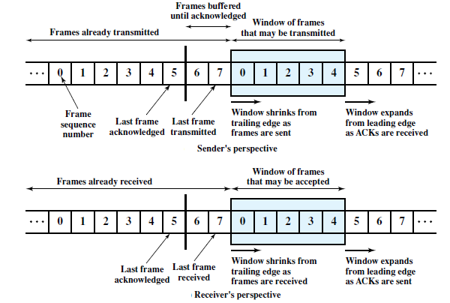
.. Fig : Sliding Window Depiction

Slide 70
. ‘A’ maintains a list of sequence numbers that is allowed to send and ‘B’ maintains a list of sequence numbers that is prepared to receive . Each of these lists can be thought of as a window of frames. This is referred to as Sliding-window Flow control . Most datalink control protocols allows a station to cut off the flow of frames from the other side by sending a RNR (Receive Not Ready) message which acknowledges former frames but forbids transfer of future frames . If 2 stations exchange data, it should have 2 windows , one for transmit and other to receive and each side needs to send data and acknowledgements to the other. . To provide efficient support for this, Piggybacking is used

Slide 71
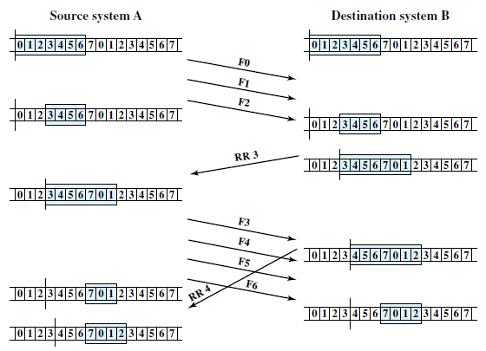
.. Fig : Sliding Window Protocol

Slide 72
. Each data frame includes a field that holds the sequence number of that frame plus a field that holds the sequence number used for acknowledgment. . A station sends together in one frame saving communication capacity . If a station has an acknowledgment but no data to send , it sends a separate acknowledgment frame such as RR or RNR. . If a station has data to send but no new acknowledgment to send , it must repeat the last acknowledgment sequence number that it sent . When a station receives a duplicate acknowledgment , it simply ignores it

Slide 73
ERROR CONTROL : . Error control refers to mechanisms to detect and correct errors that occur in the transmission of frames . There is a possibility of 2 types of errors : (i) Lost frame – A frame fails to arrive at the other side. For Eg : Noise burst may damage a frame to the extent that the receiver is not aware that a frame has been transmitted (ii) Damaged frame – A recognizable frame does arrive with some bits in error. . The most common control techniques for error control are based on some or all of the following (i) Error Detection (ii) Positive Acknowledgment- The destination returns a positive acknowledgment to successfully received error-free frames

Slide 74
(iii) Retransmission after timeout : The source retransmits a frame that has not been acknowledged after a predetermined amount of time (iv) Negative Acknowledgment & retransmission : Destination returns a negative acknowledgment to frames in which an error is detected and the source retransmits such frames . Collectively all these mechanisms are referred to as Automatic Repeat Request (ARQ) . The effect of ARQ is to turn an unreliable datalink into a reliable one

Slide 75
. 3 versions of ARQ are standardized : (i) Stop-and-wait ARQ (ii) Go-back-N ARQ (iii) Selective-reject ARQ . All these are based on the use of flow control techniques which are already discussed. STOP-AND-WAIT ARQ : . Stop-and-wait ARQ is based on the stop-and-wait flow control technique . The source station transmits a single frame and then must await an Acknowledgment (ACK) . 2 types of error occurs by this . First, the frame that arrives at the destination could be damaged . Second, is a damaged acknowledgment

Slide 76
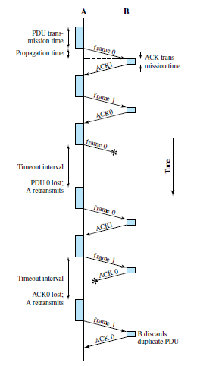
Fig : Stop-and-wait ARQ

Slide 77
. The figure shows the transmission of a sequence of frames from source A to destination B . The figure describes the 2 types of errors . The third frame transmitted by A is lost/damaged , therefore B does not return an Acknowledgment (ACK) . ‘A’ times out and retransmits the frame . Later ‘A’ transmits a frame labeled 1 but the ACK0 for that frame is lost . ‘A’ times out and retransmits the same frame . When ‘B’ receives 2 frames in a row with the same label, it discards the 2nd frame but sends back an ACK0 to each . The main advantage of Stop-and-Wait ARQ is its simplicity and its disadvantage is, it is an inefficient mechanism . To overcome this disadvantage, Sliding window Flow control is used and is sometimes referred to as Continuous ARQ

Slide 78
Go-Back-N ARQ : . Go-Back-N ARQ is based on Sliding window Flow control . A station may send a series of frames sequentially numbered modulo some maximum value . Number of unacknowledged frames outstanding is determined by the window size . If no error occurs : Acknowledgment is as usual i.e ; RR = Receive Ready . If error occurs : Negative Acknowledgment is sent. i.e ; REJ = Reject . Consider 2 stations A and B . After each transmission, ‘A’ sets an acknowledgment timer for the frame just transmitted . Suppose that ‘B’ has previously successfully received frame (i-1) and A has just transmitted frame i. .

Slide 79

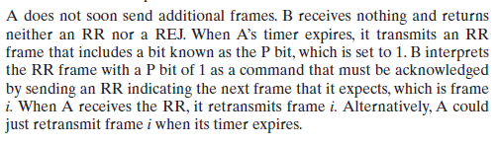
. Go-Back-N takes into account the following conditions : . Damaged Frame: If the received frame is invalid, ‘B’ discards the frame . There are 2 subcases : (i) (ii)

Slide 80
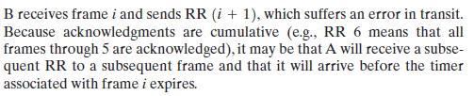
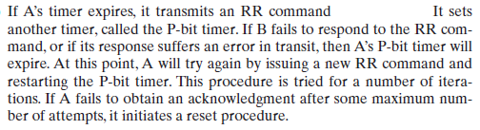
. Damaged RR : There are 2 subcases (i) (ii) . Damaged REJ : If a REJ is lost, this is equivalent to case (Y) .

Slide 81
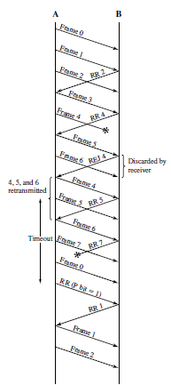
Fig : Sliding Window ARQ protocols (Go-back-N ARQ)

Slide 82
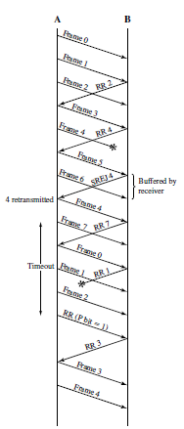
Fig : Sliding Window ARQ protocols (Selective Reject ARQ)

Slide 83
Selective Reject ARQ : . In this, the only frames retransmitted are those that receive a negative acknowledgment (SREJ), or those that has time out . Efficiency of Selective reject > Go-back-N as it minimizes the amount of retransmission . Although it is highly efficient , but it is less used due to the following reasons, (i) Receiver must maintain a buffer large enough to save post SREJ frames until the retransmission is done & should contain some logic for reinserting the frame in the proper sequence (ii) The transmitter also requires more complex logic to be able to send a frame out of sequence . This technique is quite useful in satellite links as long propagation delay is involved . The window size limitation is more restrictive for Selective Reject than Go-back-N

Slide 84
High Level Datalink Control (HDLC) : . HDLC define 3 types of stations, 2 link configurations & 3 data transfer modes of operation . 3 stations are, (i) Primary station - Controls the operation of the link. Frames issued are called commands (ii) Secondary station - Operates under the control of the primary station. Frames issued are called Responses (iii) Combined station – Combines the features of both primary and secondary Frames issued are called Commands & Responses

Slide 85
. 2 link configurations are, (i) Unbalanced Configuration : Consists of 1 primary and one or more secondary stations Supports both Full duplex and Half Duplex transmission (ii) Balanced Configuration : Consists of two combined stations Supports both Full duplex and Half Duplex transmission . 3 data transfer modes are, (i) Normal Response Mode (NRM) : Used with an Unbalanced configuration Primary may initiate data transfer to a secondary Secondary may only transmit data in response to a command from the primary

Slide 86
(ii) Asynchronous Balanced Mode (ABM) : Used with a Balanced configuration Either combined station may initiate transmission without receiving permission from the other combined station (iii) Asynchronous Response Mode (ARM) : Used with an Unbalanced configuration Secondary may initiate transmission without explicit permission of primary . NRM is used on point-to-point links, multi drop lines . ABM is the most widely used mode as it makes more efficient use of full duplex point-to-point link . ARM is rarely used mode

Slide 87
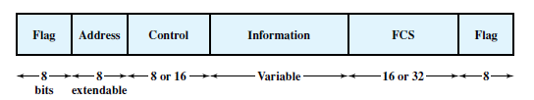
. Frame structure – HDLC uses synchronous transmission All transmissions are in the form of Frames and a single format is for all types of data and control exchanges Fig : Frame Format . Flag, Address Field, Control Field → Header . FCS, Flag → Trailer

Slide 88

. Flag Fields – It will delimit the frame at both ends with the unique pattern 01111110. A single flag may be used as closing flag for one frame and the opening flag for the next But there is no guarantee that the pattern 01111110 will not appear somewhere inside the frame thus destroying Synchronization To avoid this , Bit Stuffing is used Transmitter will insert inserts an extra ‘0’ bit after occurrence of five 1’s in the frame Fig : Bit stuffing

Slide 89
. After detecting a starting flag, the receiver monitors the bit stream . If the 6th bit is 0 → it is deleted . If the 6th bit is 1 & 7th bit is 0 → combination is accepted as a flag . If the 6th bit is 1 & 7th bit is 1 → Sender indicates an abort condition .With the use of Bit stuffing, arbitrary patterns can be inserted into the data field of the frame. This property is known as Data Transparency Address Field : . This field identifies the secondary station that is transmitted or received . It is 8 bits long . An extended format can be used

Slide 90

Fig : Extended address Field Control Field : . HDLC defines 3 types of frames: (i) Information Frames (I-Frames) – Carry the data to be transmitted for the user Flow and error control data using the ARQ mechanism are piggybacked on this (ii) Supervisory Frames (S-Frames) – Provide the ARQ mechanism when the piggybacking is not used (iii) Unnumbered Frames (U-Frames) – Provide supplemental link control functions . All of the control field formats contains the P/F (Poll/Final) bit and its use depends on the context . Typically, in command frames : P is used & in response frames : F is used

Slide 91
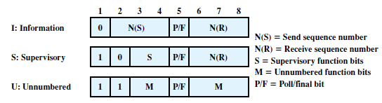
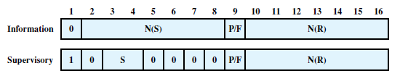
Fig : 8 bit control field format Fig : 16 bit control field format

Slide 92
Information Field : . It is present in I-frames and some U-frames . It can contain any sequence of bits but it should be of an integral number of octets . Length is variable up to some system defined maximum Frame Check Sequence Field (FCS) : . It is an Error detecting code calculated from the remaining bits of the frame exclusive of flags .

Slide 93
Operation: . HDLC operation consists of the exchange of I-frames, S-frames and U-frames . Operation of HDLC involves 3 phases : (i) First, one side or another initializes the datalink so that the frames may be exchanged in an order (ii) Second, the two sides exchange user data and the control information to exercise flow control and error control (iii) Third, one of the two sides signals the termination of the operation Initialization : . Either side may request initialization by issuing one of the six set commands . This command serves 3 purposes : (i) it signals the other side that initialization is requested (ii) it specifies which mode is requested (iii) it specifies whether 3 or 7 bit sequence numbers are to be used .

Slide 94
Operation: . If the other side accepts the request : HDLC will transmit an Unnumbered Acknowledgment (UA) frame back to the initiating side . If the request is Rejected : Disconnected mode (DM) frame is sent Data Transfer : . N(S) and N(R) fields of the I-frame are sequence numbers that support Flow control and Error control . S-frames are also used for Error control and Flow control Disconnect : . HDLC issues a disconnect by sending a DISC frame . .

Slide 95
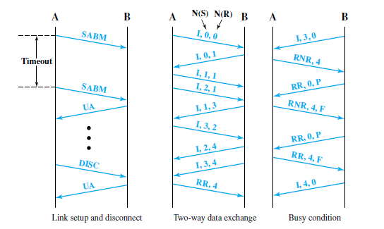
.

Slide 96
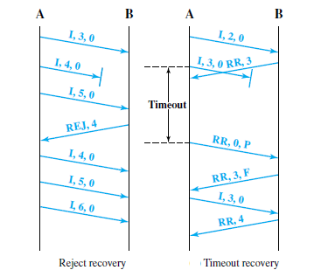
.

Slide 97



