Slide 1

Mr. T.V.Suri Apparao Assistant Professor Department of EECE GITAM Institute of Technology(GIT) Visakhapatnam-530045 Email: vtanakal@gitam.edu
Unit V : Multiplexing

Slide 2
Unit V: Multiplexing:
Frequency division multiplexing,characteristics
synchronous time division multiplexing,characteristics
statistical time division multiplexing, characteristics.

Slide 3
Types of Multiplexing Techniques:
1. Frequency Division Multiplexing (FDM)
2. Synchronous Time Division Multiplexing(TDM)
3. Statistical Time Division Multiplexing(TDM)

Slide 4
Multiplexing Functionality:

Slide 5
FREQUENCY DIVISION MULTIPLEXING

Slide 6
FDM is possible when the useful bandwidth of the transmission medium exceeds the required bandwidth of signals to be transmitted.
A number of signals can be carried simultaneously if each signal is modulated onto a different carrier frequency and the carrier frequencies are sufficiently separated that the bandwidths of the signals do not significantly overlap.

Slide 7
Six signal sources are fed into a multiplexer, which modulates each signal onto a different frequency f1 , , f6.
Each modulated signal requires a certain bandwidth centered on its carrier frequency, referred to as a channel.
To prevent interference, the channels are separated by guard bands, which are unused portions of the spectrum.

Slide 8
Generic Representation of an FDM system:

Slide 9
Frequency Division Multiplexing (FDM)
A number of analog or digital signals [mi(t), i = 1, n] are to be multiplexed onto the same transmission medium.
Each signal mi(t) is modulated onto a carrier fi; because multiple carriers are to be used, each is referred to as a subcarrier.
Any type of modulation may be used. The resulting analog, modulated signals are then summed to produce a composite baseband signal mb(t).

Slide 10
the spectrum of signal mi (t) is shifted to be centered on fi,
fi must be chosen so that the bandwidths of the various signals do not significantly overlap. Otherwise, it will be impossible to recover the original signals.

Slide 12

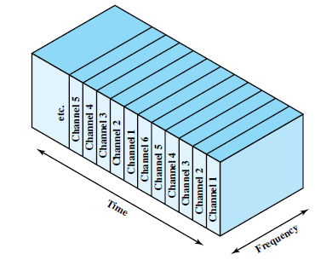
Synchronous Time Division Multiplexing : . Synchronous time division multiplexing is possible when the achievable data rate of the medium exceeds the data rates of the digital signals to be transmitted. . Multiple digital signals can be carried on a single transmission path by interleaving portions of each signals in time . The interleaving can be in a bit level or in blocks of bytes, etc. Fig : Time Division Multiplexing .

Slide 13
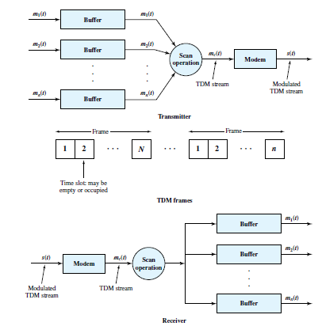
Fig : Synchronous TDM

Slide 14
. A number of signals [m_{i}(t), i =1,n] are to be multiplexed on the same transmission
medium
. The incoming data from each source are buffered
. Each buffer is typically one bit in length (or) one character in length
. The buffers are scanned sequentially to form a composite digital data stream m_{c}(t).
. Data rate of m_{c}(t) must be equal to the sum of data rates of m_{i}(t)
. m_{c}(t) is passed through Modem such that an analog signal is transmitted
. The data are organized into Frames.
. Each frame contains a cycle of time slots
. The sequence of slots dedicated to one source from frame to frame is called a Channel.
. Start and stop bits of each character are eliminated before transmission and reinserted by the receiver .
. Therefore, the efficiency will be improved
. Slowest input device will be assigned one slot per cycle while faster devices are assigned multiple slots per cycle

Slide 15
TDM Link control :
. Here, for the multiplexer and de-multiplexer , flow control is not needed
. Data rate on multiplexed line is fixed ,and the multiplexer and de-multiplexer are designed to operate at that rate
. Same case with error control also
. Flow control and error control can be provided on a per channel basis by using a data link control protocol
such as HDLC on a per channel basis
. This is explained by using one example
. Here, 2 data sources are present
. Transmitting a stream of HDLC frames containing three octets of data & four octets of data respectively
. The octets of the HDLC frames from the 2 sources are shuffled together for transmission over the multiplexed line
. Although the FCS is not in one piece, the pieces are reassembled correctly before they are seen by the device
on the other end of the HDLC protocol

Slide 16
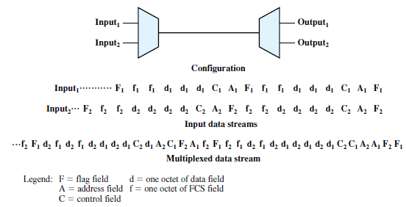
Fig : Use of Datalink control on TDM channels

Slide 17
. One change is to be made to the mentioned . Both ends of the line need to be a combination multiplexer/de-multiplexer with a full duplex line in between . Then, each channel consists of 2 sets of slots, one travelling in each direction Framing : . As flag or SYNC characters are not provided, there should be some means to assure frame synchronization . Framing synchronization is important because if the source and destination are out of step, data on all channels are lost . The most common mechanism for framing is known as Added-digit framing . One control bit is added to each TDM frame . An identifiable pattern of bits, from frame to frame is used as a “ Control channel “

Slide 18
Pulse Stuffing : . The difficulty in the design of a synchronous time division multiplexer is that of synchronizing the various data sources . If each source has a separate clock, any variation among clocks could cause loss of synchronization . The data rates of the input data streams are not related by a simple rational number . To overcome these problems, a technique known as Pulse stuffing is used . With pulse stuffing, the outgoing data rate of the multiplexer, excluding framing bits is higher than the sum of the maximum instantaneous incoming rates . The extra capacity is used by stuffing extra dummy bits or pulses into each incoming signal until its rate is raised to that of a locally generated clock signal

Slide 19
. The stuffed pulses are inserted at fixed locations in the multiplexer frame format so that they may be identified and removed at the de-multiplexer Digital carrier systems : .The long distance carrier system was designed to transmit voice signals over high capacity transmission links such as coaxial fiber, optical fiber and microwave . The basis of the TDM hierarchy is the DS-1 transmission format which multiplexes 24 channels . Each frame contains 8 bits/channel and a framing bit . So , Total bits = 24 x 8 +1 = 193 bits . With a frame length of 193 bits, data rate of 8000 x 193 = 1.544 Mbps is provided .

Slide 20
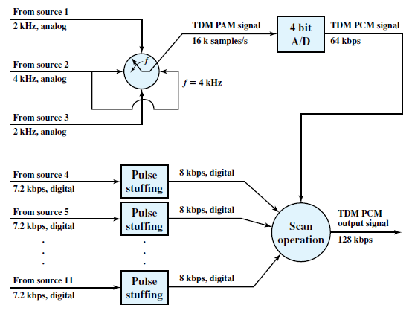
Fig : TDM of analog and digital sources

Slide 21
. For five of every 6 frames, 8-bit PCM samples are used . For every 6th frame, each channel contains a 7 bit PCM word plus a signaling bit . The signaling bits form a stream for each voice channel that contains network control and routing information . The same DS-1 format is used to provide digital data service also. . In this case, 23 channels of data are provided . The 24th channel position is reserved for a special sync byte which allows faster and more reliable reframing. .

Slide 22
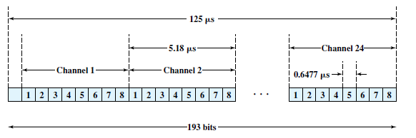
Fig : DS-1 Transmission Format

Slide 23
SONET/SDH : . SONET/SDH stands for Synchronous Optical Network/Synchronous Digital Hierarchy . SONET is an optical transmission interface proposed by Bell core & standardized by ANSI ( American National Standards Institute) . A compatible version is referred to as Synchronous Digital Hierarchy (SDH) and has been published by ITU-T (International Telecommunications Union -Telecommunication) Signal Hierarchy : . SONET specification defines a hierarchy of standardized digital rates . The lowest level is referred to as STS-1 (Synchronous Transport Signal Level 1) or OC-1 (Optical Carrier Level 1) . For ITU-T SDH , the lowest rate is 155.52 Mbps which is designated as STM-1 (Synchronous Transport Module Level 1)

Slide 24
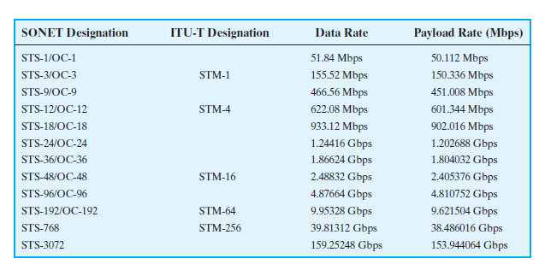
Fig : SONET/SDH Signal Hierarchy

Slide 25
Frame Format : . The basic SONET building block is the STS-1 frame , which consists of 810 octets & is transmitted once every 125 µsec for an overall data rate of 51.84 Mbps . The frame is a matrix of 9 rows of 90 octets each with transmission being one row at a time , from left to right and top to bottom . The 1st three columns (3 octets x 9 rows = 27 octets) of the frame are devoted to overhead octets . 9 Octets – Section related overhead 18 Octets – Line overhead . The remainder of the frame is the Payload

Slide 26
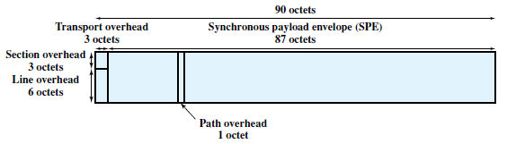
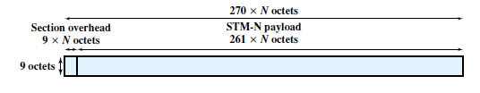
Fig : STS-1 Frame Format Fig : STM-N Frame Format

Slide 27
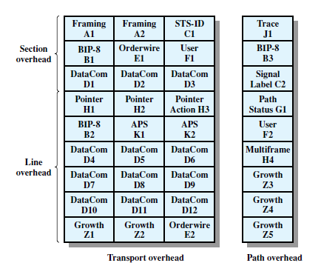
Fig : SONET STS-1 Overhead Octets

Slide 28
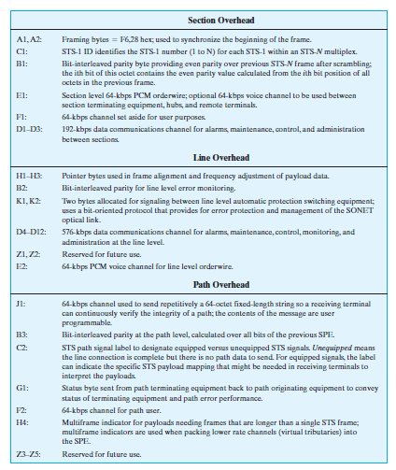
Fig : STS-1 Overhead Bits

Slide 29
Statistical Time Division Multiplexing : . In Synchronous TDM, many time slots in a frame are wasted . To avoid this, Statistical TDM is used . In Statistical TDM, data transmission is done by dynamically allocating slots on demand . Statistical TDM takes the advantage that : the data rate on the multiplexed line is less than the sum of the data rates of the attached devices . If a Statistical multiplexer & a Synchronous multiplexer both use a link on the same data rate : Statistical multiplexer can support more devices . Overhead per slot will be more for Statistical TDM because each slot carries an address as well as data . Efficiency can be increased by allowing multiple data sources to be packaged in a single frame . Address field can be reduced by using Relative addressing

Slide 30
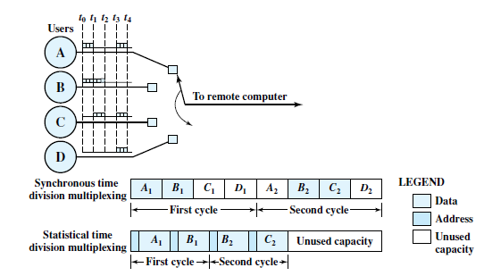
Fig : Synchronous TDM compared with Statistical TDM .

Slide 31
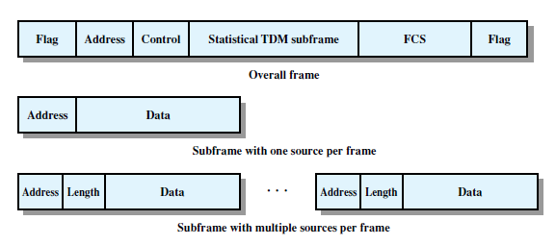
Fig : Statistical TDM Frame Formats

Slide 32
Performance : . Data rate of the output of a Statistical multiplexer is less than the sum of the data rates of the inputs . Problem may arise in the case that : While the average aggregate input may be less than the multiplexed line capacity, there may be peak periods when the input exceeds the capacity . The solution to this problem is to include a buffer in the multiplexer to hold temporary excess input . There is a tradeoff between the size of the buffer used and the data rate of the line . Approximate measures that examine this tradeoff are provided by assuming some parameters : I → No. of i/p sources R → Data rate of each source , bps

Slide 33
M → Effective capacity of multiplexed line α → Mean fraction of time each source is transmitting : 0 < α < 1 . Parameter K is a measure of compression achieved by the multiplexer K = M / IR . K = 0.25 : Indicates that there are 4 times as many devices being handled by a Synchronous time division multiplexer using the same link capacity . Value of K can be bounded as α < K < 1 . Value of K =1 corresponds to Synchronous time division multiplexer . If K < α : The input will exceed the multiplexer’s capacity

Slide 34

. The delay incurred by a customer is : Time spent waiting in the queue + Time for the service . The delay depends on the pattern of arriving traffic & the characteristics of the server . Average arrival rate (λ) in bps is the total potential input (IR) times the fraction of time (α ) that each source is transmitting . Service time (T_{s}) is given by , T_{s} = 1/M where M → Capacity . Utilization factor is given as,

Slide 35
. Utilization factor is expressed as a percentage of total link capacity . As the Utilization rises , so do the buffer requirements and delay . Utilization above 80 % is undesirable Cable Modem : . To support data transfer to and from a cable modem, a cable TV provider dedicates 2 channels, one for transmission in each direction . Typically, a form of Statistical TDM is used . In the downstream direction, cable headend to subscriber , a cable scheduler delivers data in the form of small packets . As the channel is shared by a number of subscribers , if more than one subscriber is active, each subscriber gets only a fraction of the downstream capacity . When a subscriber has data to transmit, it must first request time slots on the shared upstream channel . Each subscriber is given dedicated time slots for this request response

Slide 36
. The headend scheduler responds to a request packet by sending back an assignment of future time slots to be used by this subscriber . Thus, a number of subscribers can share the same upstream channel without conflict

