Slide 1

Chapter 2 Boolean Algebra
Prepared by
M. Ramesh
Faculty
Dept. of EECE
GITAM

Slide 2
Boolean Algebra
Network
.
.
.
.
.
.
Outputs
Inputs
Boolean Algebra is used to describe the relationship between inputs and outputs
Boolean Algebra is the logic mathematics used for understanding of digital systems

Slide 3
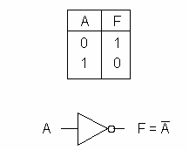
Basic Operations
COMPLEMENT (INVERSE)
0 is low voltage
1 is high voltage

Slide 4
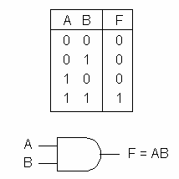
Basic Operations
AND
F is 1 if and only if
A and B are both 1

Slide 5
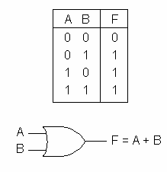
Basic Operations
OR
F is 1 if and only if
A or B (or both) are 1

Slide 6
Basic Theorems
Let’s prove each one

Slide 7
Simplification Theorems

Slide 8
Proof 6.
R.H.S. = X+Y
= X(Y+Y’)+Y(X+X’)
= XY+XY’+XY+X’Y
= XY+XY’+X’Y
= (X+X’)Y+XY’
= Y+XY’
= L.H.S.

Slide 9
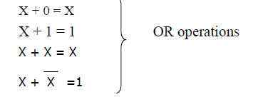
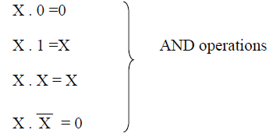
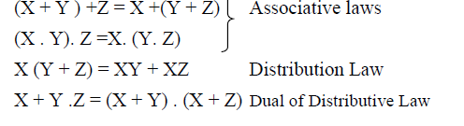
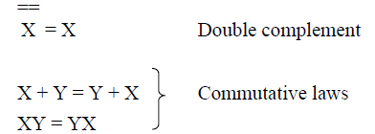


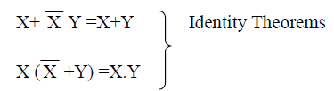

Slide 10




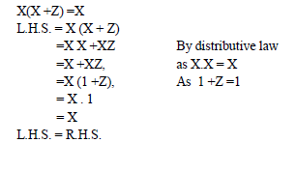
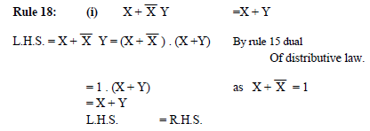

Slide 11

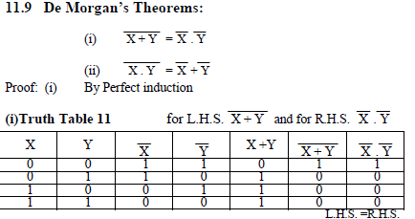

Slide 12
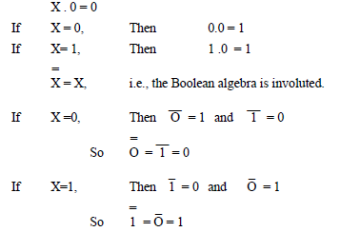
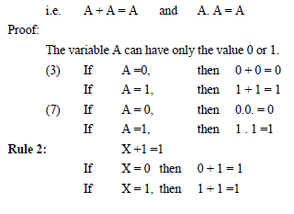

Slide 13
Theorem 3
Boundedness: For all elements a in B, a+1=1; a*0=0.
Proof: a+1 = 1 *(a+1) (Postulate 3) = (a + a')*(a+1) (Postulate 4) = a + a'*1 (Postulate 2) = a + a' (Postulate 3) = 1 (Postulate 4)
Comments:
'1' dominates as input in OR gates.
’0' dominates as input in AND gates.

Slide 14
Theorem 4
Statement:
The complement of element 1 is 0 and vice versa, i.e.
0' = 1, 1' = 0.
Proof:
0 + 1 = 1 and 0 * 1 = 0 (Postulate 3)
Thus 0’= 1, 1’= 0 (Postulate 4 and
Theorem 2)

Slide 15
Theorem 5: Idempotent Laws
Statement: For every a in B,
a + a = a and a * a = a.
Proof:
a + a = (a + a) * 1 (Postulate 3) = (a + a) * (a + a') (Postulate 4) = a + (a*a') (Postulate 2) = a + 0 (Postulate 4) = a (Postulate 3)

Slide 16
Truth Table
It can represent a boolean function
For possible input combinations it shows the output value
There are rows (n is the number of input variables)
It ranges from 0 to

Slide 17
Examples
Show the truth table for
Show the followings by constructing truth tables

Slide 18
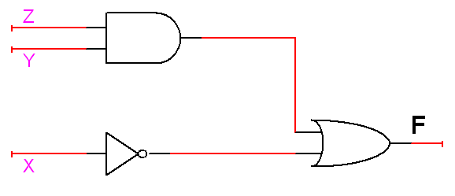
Example
Draw the network diagram for

Slide 19
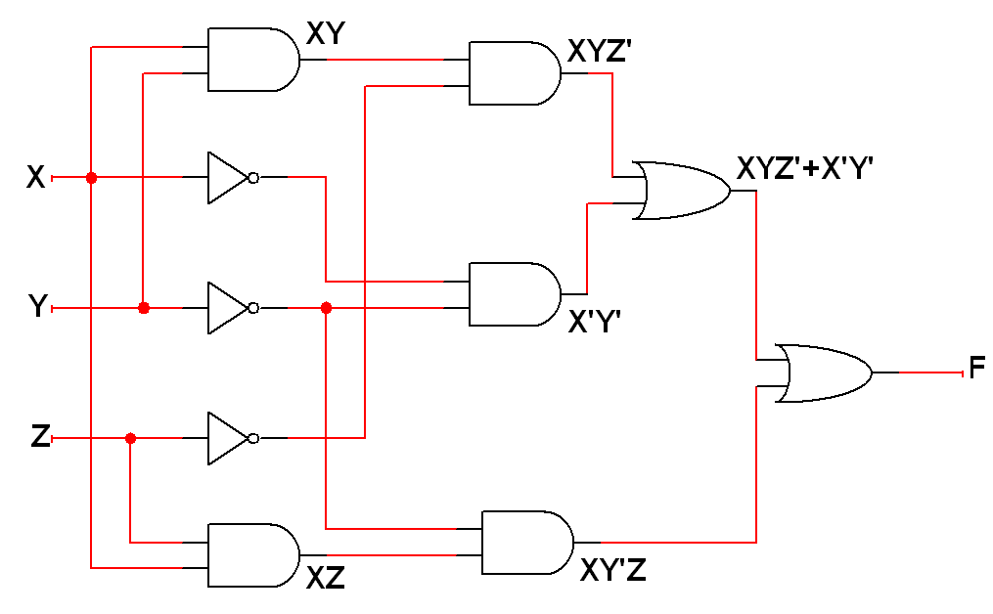
Example
Draw the network diagram for

Slide 20
Operator Precedence
Parenthesis
NOT
AND
OR

Slide 21
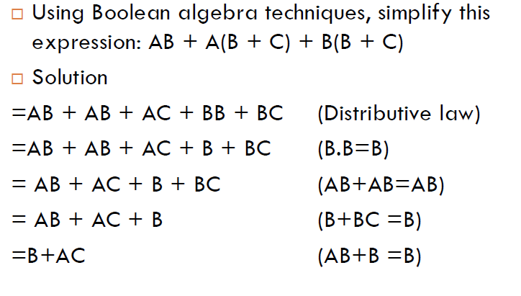

Slide 22
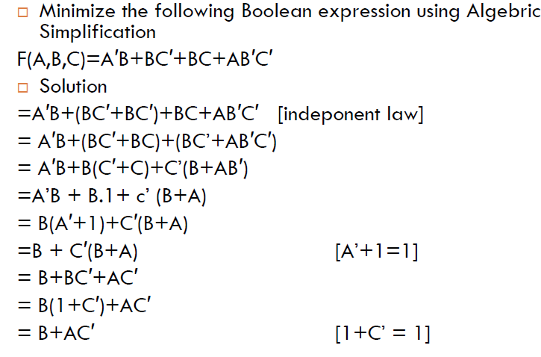

Slide 23
Study Problems
1. Draw a network to realize the following by using only one AND gate and one OR gate
2. Draw a network to realize the following by using two OR gates and two AND gates
3. Prove the following equations using truth table

Slide 24
Solution of problem 2
L.H.S.=(V+X+W)(V+X+Y)(V+Z)
=[(V+X)+W(V+X)+Y(V+X)+WY](V+Z)
=[(V+X)(1+W+Y)+WY](V+Z)
=(V+X+WY)(V+Z)
This can be implemented by two OR gates and two AND gate.

Slide 25
Minterms
Consider variables A and B
Assume that they are somehow combined with AND operator
There are 4 possible combinations
Each of those terms is called a minterm (standard product)
In general, if there are n variables, there are minterms

Slide 26
Exercise
List the minterms for 3 variables
A | B | C | Minterm | Designation
0 | 0 | 0 | A ' B ' C'
0 | 0 | 1 | A ' B ' C
0 | 1 | 0 | A ' B C'
0 | 1 | 1 | A ' B C
1 | 0 | 0 | A B ' C'
1 | 0 | 1 | A B ' C
1 | 1 | 0 | A B C'
1 | 1 | 1 | A B C

Slide 27
Maxterms
Consider variables A and B
Assume that they are somehow combined with OR operator
There are 4 possible combinations
Each of those terms is called a maxterm (standard sums)
In general, if there are n variables, there are maxterms

Slide 28
Exercise
List the maxterm for 3 variables
A | B | C | Maxterm | Designation
0 | 0 | 0 | A+B+C
0 | 0 | 1 | A+B+C'
0 | 1 | 0 | A+B'+C
0 | 1 | 1 | A+B'+C'
1 | 0 | 0 | A'+B+C
1 | 0 | 1 | A'+B+C'
1 | 1 | 0 | A'+B'+C
1 | 1 | 1 | A'+B'+C'

Slide 29
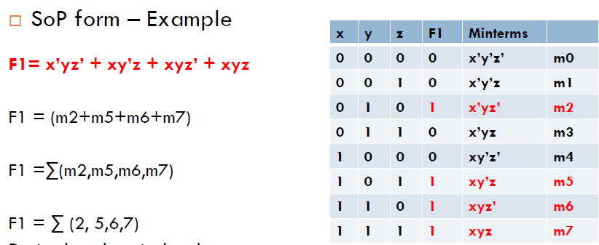
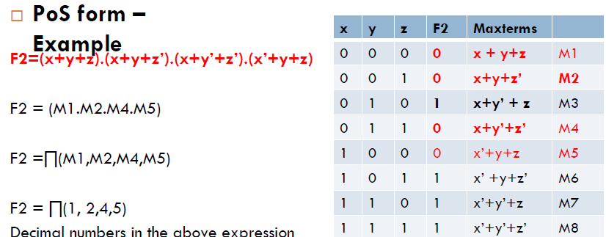

Slide 30
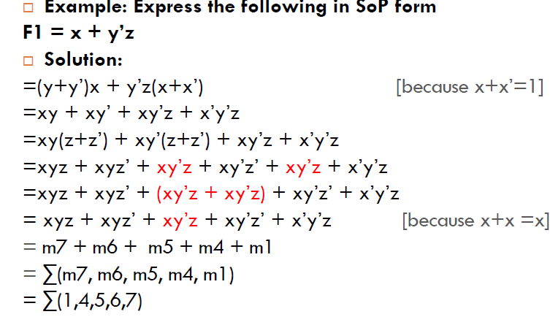

Slide 31
Example
Express F in the sum of minterms and product of maxterms formats

Slide 32
Sum-of-Products
All products are the product of single variable only
YES
YES
NO

Slide 33
Sum-of-Products
One or more AND gates feeding a single OR gate at the output

Slide 34
Product-of-Sums
All sums are the sums of single variables
YES
YES
NO

Slide 35
Product-of-Sums
One or more OR gates feeding a single AND gate at the output

Slide 36
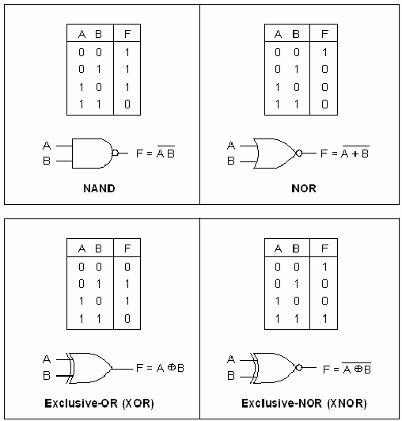
Logic Gates

Slide 37
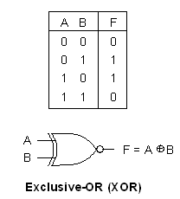
Exclusive-OR

Slide 38
Equivalence
Equivalence is the complement of exclusive-OR
A
B
Simplify it…

