Slide 1
Sequential Logic & The Flip-Flop
Inputs
.
.
Combinational
Logic Gates
.
.
Outputs
Memory Elements
(Flip-Flops)
Clock
Notes:
Definition of sequential logic. Sequential logic can have one or more, inputs and one or more outputs. However, the outputs are a function of both the present value of the inputs and also the previous output values. Thus, sequential logic requires memory to store these previous outputs values.

Slide 2
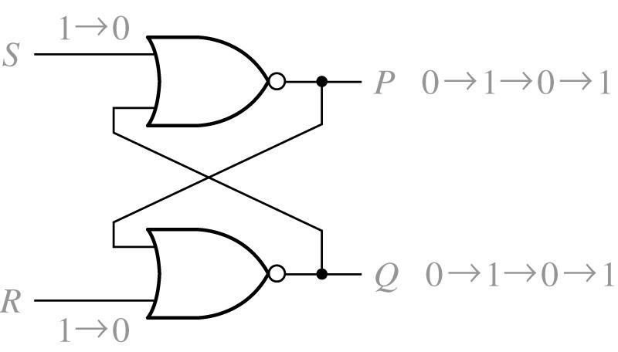
S-R Latch (cont.)
When S=R=1, the S-R latch will not operate properly. (Is it a stable state, if S=R=1?)
Q an P are not complementary.
If S=R=1 changed to S=R=0, then the network will oscillate assuming both gates have the same delay. (Critical race occurs)

Slide 3
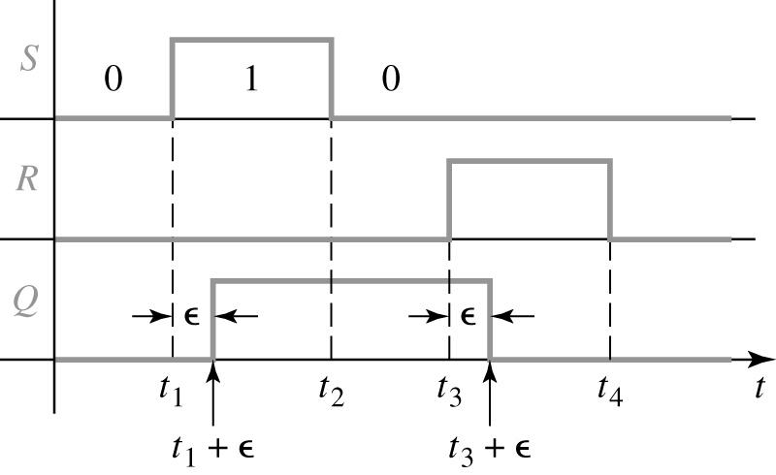
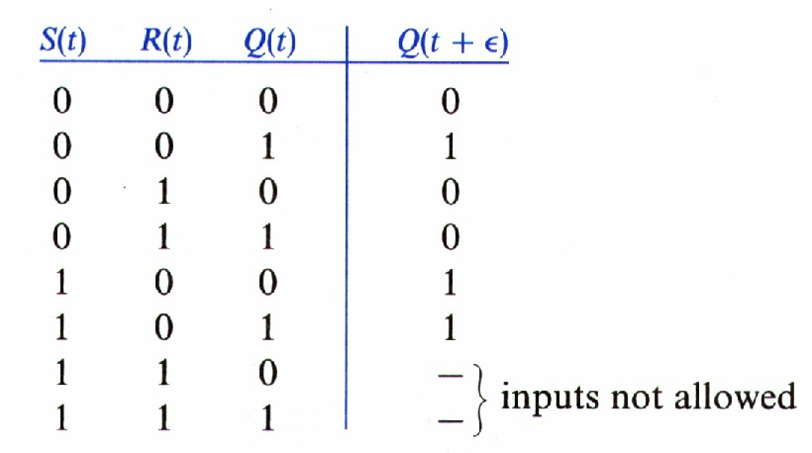
S-R Latch Timing and State
S duration > delay time
S-R latch behavior
Present state
The state of Q output at the time the input signals are applied.
Next state
The state of Q output after the latch has reacted to the input signals.

Slide 4
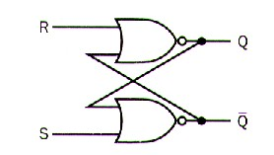
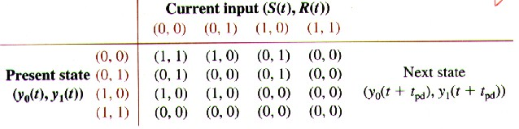
S R latch Analysis
Total state table
If next state = present state, stable
0
1
y₁(t)
y₀(t)
0
y₁(t)
1
y₀(t)
0
1

Slide 5
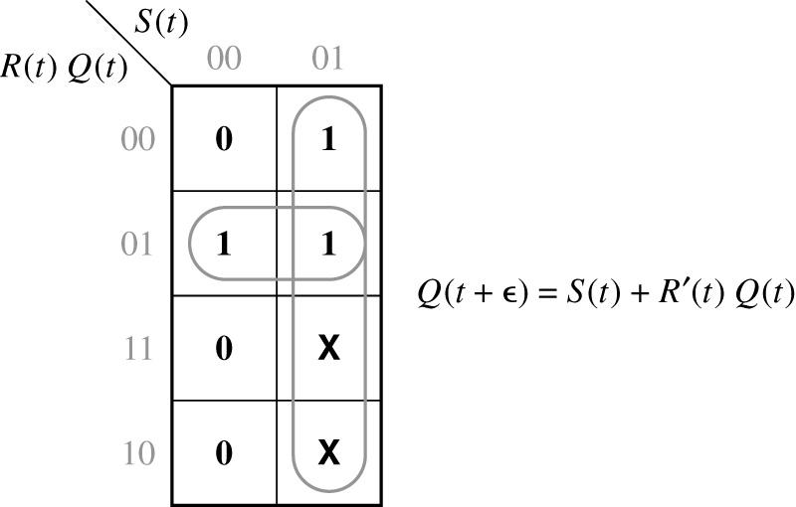
K-map for Q(t+ε)
Q⁺ = S + R’Q (SR=0)
S and R can not be 1 at the same time.
Q: present state
Q⁺: next state
Next state equation or characteristic equation.

Slide 6
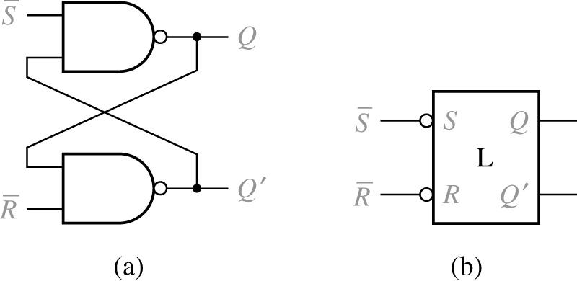
S-R Latch using NAND gates
S#-R# Latch, when S#= 0 sets Q = 1 and R#=0 resets Q = 0
S# R# Q Q+
1 0 0
1 1 1 1
1 0 0 0
1 0 1 0
0 1 0 1
0 1 1 1
0 0 0 -
0 0 1 -

Slide 7
Flip-Flop Vs. Latch
The primary difference between a D flip-flop and D latch is the EN/CLOCK input.
The flip-flop’s CLOCK input is edge sensitive, meaning the flip-flop’s output changes on the edge (rising or falling) of the CLOCK input.
The latch’s EN input is level sensitive, meaning the latch’s output changes on the level (high or low) of the EN input.
Notes:
This slide details the primary difference between the often confused D flip-flop and D latch.

Slide 8
Clock Edges
Positive Edge Transition
1 0
1 0
Negative Edge Transition

Slide 9
POS & NEG Edge Triggered D
Positive Edge Trigger
D | CLK
0 | ↑ | 0 | 1
1 | ↑ | 1 | 0
↑ : Rising Edge of Clock
D
Q
CLK
Negative Edge Trigger
D | CLK
0 | ↓ | 0 | 1
1 | ↓ | 1 | 0
↓ : Falling Edge of Clock
D
Q
CLK
Notes:
Schematic symbol and excitation table for the positive edge triggered and negative edge triggered D flip-flops

Slide 10
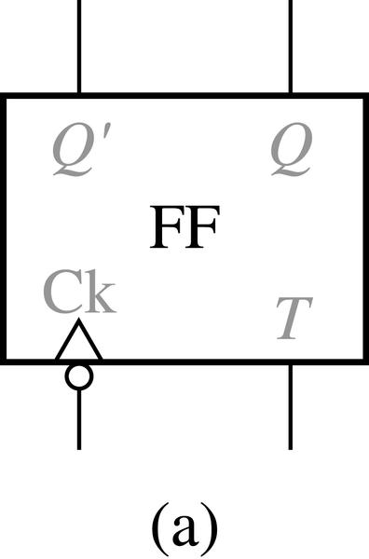
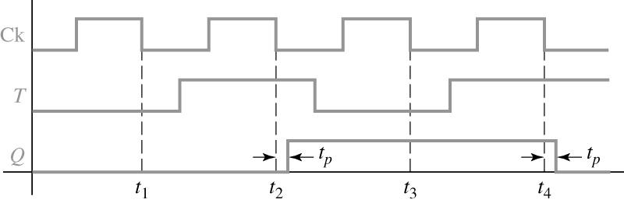
Toggle FF
T flip-flop
Single input
When T = 1, at clock edge, T FF changes state. If T = 0, no state changes.
T Q Q⁺
0 0 0 Q⁺ = T’Q + TQ’ = T xor Q
0 1 1
1 0 1
1 1 0

Slide 11
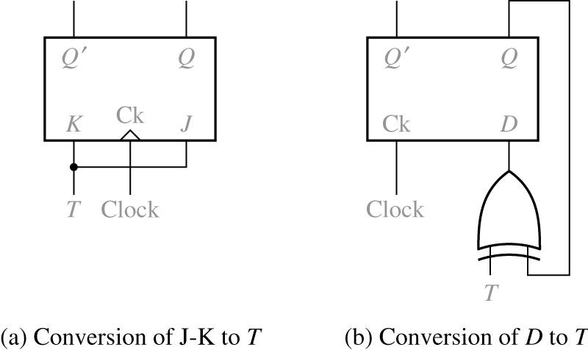
T FF
T flip-flop
Converted from D to T
Q⁺ = D = Q xor T= TQ’ + T’Q
T Q Q⁺
0 0 0 Q⁺ = T’Q + TQ’ = T xor Q
0 1 1
1 0 1
1 1 0

Slide 12
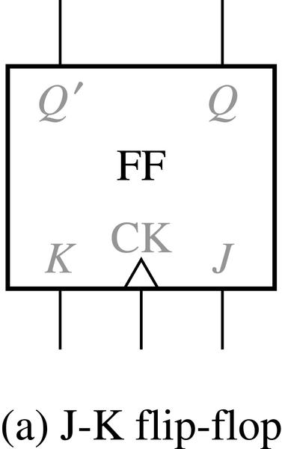
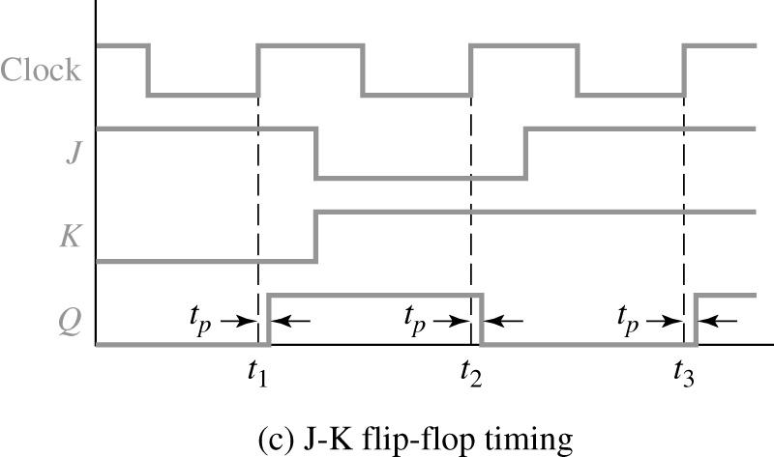
J-K Flip Flop
J-K FF = S-R FF + T FF.
Allow J = K = 1. This case works like a T FF.
Split T to J and K
J K Q Q ⁺ = JQ’ + K’Q
0 0 0 0
0 0 1 1
0 1 0 0
0 1 1 0
1 0 0 1
1 0 1 1
1 1 0 1
1 1 1 0

Slide 13
T Flip-Flop Implementation
Conversion
Using a J-K FF
Using a D FF

Slide 14
D Flip-Flop: Excitation Table
D | CLK
0 | ↑ | 0 | 1
1 | ↑ | 1 | 0
↑ : Rising Edge of Clock
D
Q
CLK
Notes:
Schematic symbol and excitation table for the D flip-flop.

Slide 15
D Flip-Flop: Example Timing
Q=D=1
Q=D=0
Q=D=0
No Change
Q=D=1
Q=D=1
No Change
Q=D=0
Q=D=0
No Change
Q
D
CLK
Notes:
Timing diagram example for a D flip-flop.

Slide 16
J/K Flip-Flop: Excitation Table
J | K | CLK
0 | 0 | ↑ |  | No Change
0 | 1 | ↑ | 0 | Clear
1 | 0 | ↑ | 1 | Set
1 | 1 | ↑ |  | Toggle
↑ : Rising Edge of Clock
J
Q
CLK
K
Notes:
Schematic symbol and excitation table for the J/K flip-flop.

Slide 17
J/K Flip-Flop: Example Timing
NO
CHANGE
NO
CHANGE
SET
TOGGLE
TOGGLE
CLEAR
SET
Q
J
K
CLK
Notes:
Timing diagram example for a J/K flip-flop.

Slide 18
POS & NEG Edge Triggered J/K
Positive Edge Trigger
J | K | CLK
0 | 0 | ↑
0 | 1 | ↑ | 0
1 | 0 | ↑ | 1
1 | 1 | ↑
↑ : Rising Edge of Clock
J
Q
CLK
K
Negative Edge Trigger
J | K | CLK
0 | 0 | ↓
0 | 1 | ↓ | 0
1 | 0 | ↓ | 1
1 | 1 | ↓
↓ : Rising Edge of Clock
J
Q
CLK
K
Notes:
Schematic symbol and excitation table for the positive edge triggered and negative edge triggered J/K flip-flops

Slide 19
Transparent D-Latch
EN | D
0 | X
1 | 0 | 0 | 1
1 | 1 | 1 | 0
D
Q
EN
EN: Enable
Notes:
Schematic symbol and excitation table for the D latch.

Slide 20
Transparent D-Latch: Example Timing
“Latched”
Q=0
“Transparent”
Q=D
“Latched”
Q=1
“Transparent”
Q=D
“Latched”
Q=0
“Transparent”
Q=D
Q
D
EN
Notes:
Time diagram example for a transparent D-latch.

Slide 21
Asynchronous Inputs
Asynchronous inputs (Preset & Clear) are used to override the clock/data inputs and force the outputs to a predefined state.
The Preset (PR) input forces the output to:
The Clear (CLR) input forces the output to:
PR
D
Q
CLK
CLR
PR PRESET | CLR CLEAR | CLK CLOCK | D DATA
1 | 1 | ↑ | 0 | 0 | 1
1 | 1 | ↑ | 1 | 1 | 0
0 | 1 | X | X | 1 | 0 | Asynchronous Preset
1 | 0 | X | X | 0 | 1 | Asynchronous Clear
0 | 0 | X | X | 1 | 1 | ILLEGAL CONDITION
Notes:
Definition for the PR (preset) and CLR (clear) Asynchronous input for a D flip-flop.

Slide 22
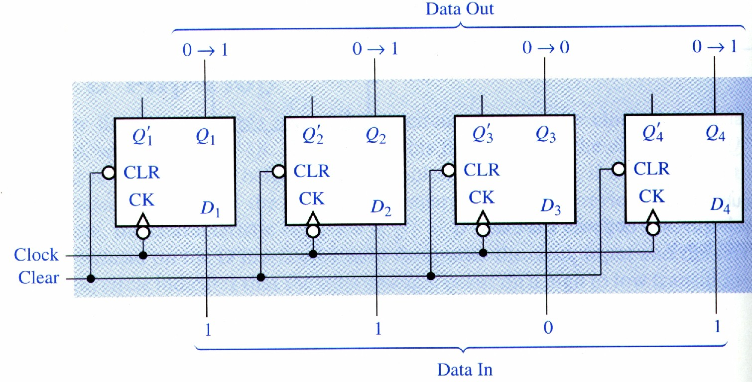
D FF Register
Register = many clocked D FFs
Q⁺ = D

Slide 23
OVERVIEW OF COUNTERS
Counter-by definition
One input (clock)
Outputs follow defined sequence
Common tasks of counter
Count up or down
Increment or decrement count
Sequence events
Divide frequency
Address memory
As memory

Slide 24
CHARACTERISTICS OF COUNTERS
Number of bits (4-bit, 8-bit, etc.)
Maximum count
4 bit = 2⁴ = 0000 to 1111 in binary
8 bit = 2⁸ = 0000 0000 to 1111 1111 in binary
Modulus of counter-number of states
Decade counter
4-bit
8-bit
Up or down counter
Asynchronous or synchronous counter
Presettable counter
Self-stopping counter

Slide 25
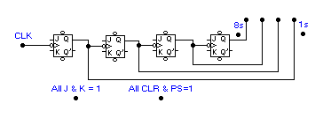
RIPPLE COUNTER
Binary Output
Clock Input
0 0 0 0
0 0 1 0
0 0 1 1
0 1 1 0
0 1 1 1
1 0 0 0
0 0 0 1
0 1 0 0
0 1 0 1
Pulse 1
Pulse 2
Pulse 3
Pulse 4
Pulse 5
Pulse 6
Pulse 7
Pulse 8
This 4-bit counter has 16 states and
will count from binary 0000 through 1111
and then reset back to 0000.
The counter has a modulus of 16.
On the next clock pulse (8) all FFs
will toggle because each will receive
a H-to-L pulse- one after another.
Watch the count ripple thru the counter.
PS and CLR input
are
INACTIVE
All J-K flip-flops
in the
TOGGLE MODE

Slide 26
RIPPLE COUNTER WITH WAVEFORMS
Binary Output
Clock Input
0 0 1 1
0 1 0 0
0 0 0 1
0 0 1 0
0 1 0 1
0 0 0 0
Pulse 1
Pulse 2
Pulse 3
Pulse 4
Pulse 5
Clock input
FFs triggered on
H-to-L pulse.
CLK toggles 1s FF.
1s FF toggles 2s FF.
2s FF toggles 4s FF.
1s output
2s output
4s output

Slide 27

DECADE COUNTER
Initial count at 0111
Binary Output
Clock Input
0 1 1 1
1 0 0 0
1 0 0 1
0 0 0 0
0 0 0 1
0 0 1 0
0 0 1 1
0 1 0 0
0 1 0 1
Pulse 1
Pulse 2
Pulse 3
Pulse 4
Pulse 5
Pulse 6
Pulse 7
Pulse 8
Short negative pulse
To clear input
of each FF
All J & K inputs = 1
All PR inputs = 1
Count is at 1001.
Next clock pulse will increment counter for a
short time to 1010 which will activate the NAND gate
and reset the counter to 0000.
To change mod-16 counter to decade counter:
Reset count to 0000 after 1001 (9) count.
When count hits 1010 reset to 0000.
See added 2-input NAND gate that clears all
JK FFs to 0 when count hits 1010.

Slide 28
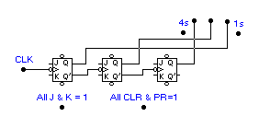
DOWN COUNTER
Initial count
set at
binary 111
1 1 1
1 1 0
1 0 1
1 0 0
0 1 1
0 1 0
Pulse 4
Pulse 2
Pulse 1
Pulse 3
Pulse 5
Changes from Ripple Up Counter are
wiring from Q’ outputs (instead of Q outputs)
to the CLK input of the next FF.

Slide 29
COUNTER USED FOR FREQUENCY DIVISION
÷ 4
200 Hz
÷ 8
100 Hz
400 Hz
50 Hz
÷ 2
÷ 16
Clock Input
800 Hz

Slide 30
Classifications of Counters
Asynchronous Counters
Only the first flip-flop is clocked by an external clock. All subsequent flip-flops are clocked by the output of the preceding flip-flop.
Asynchronous counters are slower than synchronous counters because of the delay in the transmission of the pulses from flip-flop to flip-flop.
Asynchronous counters are also called ripple-counters because of the way the clock pulse ripples it way through the flip-flops.
Synchronous Counters
All flip-flops are simultaneously clocked by an external clock.
Synchronous counters are faster than asynchronous counters because of the simultaneous clocking.
Synchronous counters are an example of a state machines design.

Slide 31
Counters

Slide 32
Ripple Counter

Slide 33
Ripple Counter (Continued)

Slide 34
Ripple Counter (Continued)

Slide 35
Synchronous Counters (Continued)

Slide 36
Synchronous Counters (Continued)

Slide 37
Synchronous Counters – Serial Gating
When a two-input AND gate is used for each stage of the counter with a “ripple-like” carry, this is referred to as serial gating.
As the size of the counter increases the delay through the combinational logic increases roughly in proportion to n, the number of stages.

Slide 38
Synchronous Counters – Parallel Gating
When a multiple-input ( >2) AND gates are used for each stage of the counter with logic dedicated to each stage or to a group of stages, this is referred to as parallel gating. It resembles carry lookahead in an adder.
As the size of the counter increases the delay through the combinational logic increases roughly in proportion to n/m, the number of stages/the group size.

Slide 39
Design: Synchronous BCD

Slide 40
Synchronous BCD (Continued)
Use K-Maps to minimize the next state function:
T₈
Q₂
T₄
Q₂
1
0
1
3
2
0
1
3
2
1
1
4
5
7
6
Q₄
4
5
7
6
Q₄
x
x
x
x
x
x
x
x
Q₈
12
13
15
14
Q₈
12
13
15
14
1
x
x
x
x
8
9
11
10
8
9
11
10
Q₁
Q₁
T₂
Q₂
T₁
Q₂
1
1
1
1
1
1
0
1
3
2
0
1
3
2
1
1
1
1
1
1
4
5
7
6
Q₄
4
5
7
6
Q₄
x
x
x
x
x
x
x
x
Q₈
12
13
15
14
Q₈
12
13
15
14
x
x
1
1
x
x
8
9
11
10
8
9
11
10
Q₁
Q₁

Slide 41
Synchronous BCD (Continued)
The minimized circuit:
"1"
T
Q
Q₁
CP
Q
T
Q
Q₂
Q₈*Q₁
Q
T
Q
Q₄
Q₂*Q₁
Q
Q₄*Q₂*Q₁
T
Q
Q₈
Q₈*Q₁
Q

Slide 42
Timing Sequences

Slide 43
Ring Counter

Slide 44
Johnson Counter (Switch-Tail)
B‾C

Slide 45
OVERVIEW OF SHIFT REGISTERS
A shift register is a sequential logic device made up of flip-flops that allows parallel or serial loading and serial or parallel outputs as well as shifting bit by bit.
Common tasks of shift registers:
Serial/parallel data conversion
UART (an example)
Time delay
Ring counter
Twisted-ring counter or Johnson counter
Memory device

Slide 46
SERIAL/PARALLEL DATA CONVERSION
Shift registers can be used to convert from serial-to-parallel or the reverse from parallel-to-serial.
Parallel out
Parallel out
Serial out
1 0 1 0 1 1 1 1
1 0 1 0 1 1 1 1
Serial out
Serial in
Serial in
1 0 1 0 1 1 1 1
1 0 1 0 1 1 1 1
Parallel in
Parallel in

Slide 47
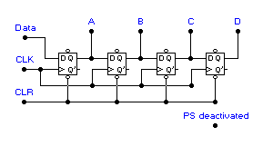
SERIAL LOAD SHIFT REGISTER
Parallel outputs here.
Order= A B C D
0 0 0 0
1 0 0 0
1 1 0 0
0 1 1 0
0 0 1 1
0 0 0 1
1 0 0 0
0 1 0 0
Data = 1
Data = 1
Data = 1
Data = 0
Data = 0
Data = 1
Data = 0
Data = 0
Inputs here:
(1) Data
(2) Clock
(3) Clear
4-bit
serial-in
parallel out
shift right
shift register
Clock input:
Positive-edge
triggering
Clock Pulse 2
Clock Pulse 1
Clock Pulse 3
Clock Pulse 4
Clock Pulse 6
Clock Pulse 7
Clock Pulse 5
Clock Pulse 8
Clear input:
Active = 0
Deactivated = 1
Clear = 1
Clear = 0
Clear = 1
Clear = 1
Clear = 1
Clear = 1
Clear = 1
Clear = 1
Note the use of D FFs.
Clock (CLK) inputs wired in parallel.
Clear (CLR) inputs can be activated with LOW
or disabled with HIGH.
Preset (PS) inputs deactivated.

Slide 48
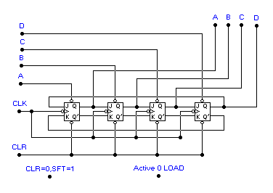
PARALLEL LOAD SHIFT REGISTER
Outputs here.
Order= A B C D
Parallel data
inputs
(Active LOW)
Recirculating
lines:
Pass data from
FFD to FFA
on each
clock pulse.
Clock input- H-to-L
Note the
recirculating
lines.
Clear input- Active LOW
Note the use of J-K FFs.
Clock (CLK) inputs wired in parallel.
Clear (CLR) input activated with LOW.
Parallel load inputs (A,B,C,D) are active LOW.

Slide 49
Counters
In digital logic and computing, a counter is a device which stores (and sometimes displays) the number of times a particular event or process has occurred, often in relationship to a clock signal.

Slide 50
Electronic counters
In electronics, counters can be implemented quite easily using register-type circuits such as the flip-flop, and a wide variety of classifications exist:
1. Asynchronous (ripple) counter – changing state bits are used as clocks to subsequent state flip-flops
2. Synchronous counter – all state bits change under control of a single clock
3. Decade counter – counts through ten states per stage

Slide 51
Electronic counters(continued)
4. Up/down counter – counts both up and down, under command of a control input
5. Ring counter – formed by a shift register with feedback connection in a ring
6. Johnson counter – a twisted ring counter
7. Cascaded counter

Slide 52
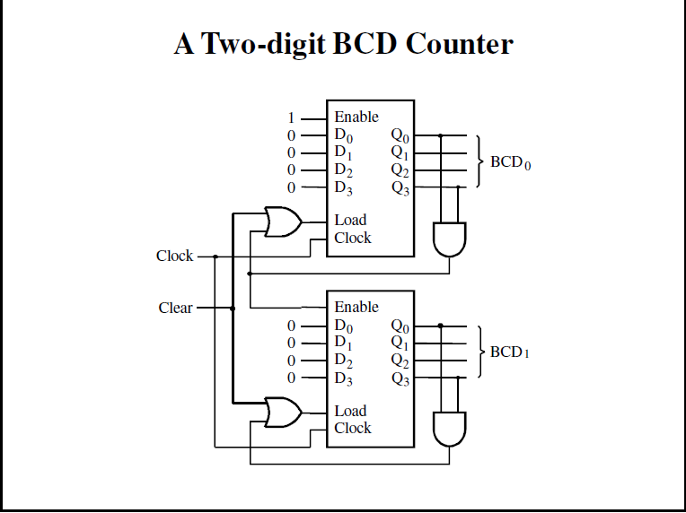
Binary-coded-decimal(BCD) counters

Slide 53
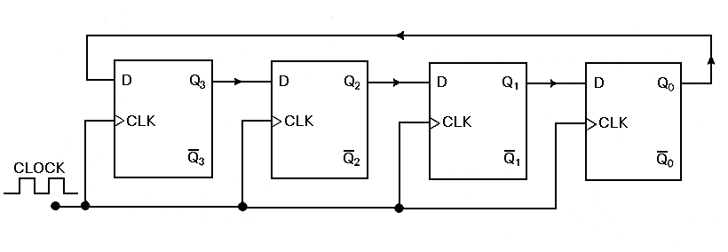
Ring counters are implemented using shift registers. It is essentially a circulating shift register connected so that the last flip-flop shifts its value into the first flip-flop. There is usually only a single 1 circulating in the register, as long as clock pulses are applied. (Starts 1000->0100->0010->0001 repeat)
Ring Counter

Slide 54
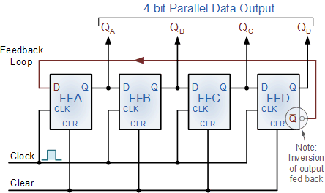
Johnson Counter
The Johnson counter, also known as the twisted-ring counter, is exactly the same as the ring counter except that the inverted output of the last flip-flop is connected to the input of the first flip-flop.
Let’s say, starts from 000, 100, 110, 111, 011 and 001, and the sequence is repeated so long as there is input pulse.

