Slide 1
MACHINE LEARNING • SMART PARKING
Parking Space
Availability Prediction
Using Machine Learning
From historical parking patterns to actionable availability intelligence.
PARKING AVAILABILITY AI
FINAL REVIEW PRESENTATION
22
Machine Learning
slides
Notes:
Opening: This project focuses on predicting the number of available parking spaces using supervised machine learning. The goal is not just a model, but an end-to-end system that connects historical parking patterns, model evaluation and a Flask-based interactive application. Transition: First, I will explain the parking problem and why prediction is useful.

Slide 2
01 • PROBLEM
02
The parking problem
Availability changes with time, location and recent demand.
High demand
Few free spaces
Search time
Congestion
Core question
Can machine learning predict the number of available parking spaces from historical and contextual information?
• Parking demand varies by hour and day.
• Recent availability contains useful predictive context.
• A numerical prediction can support occupancy and congestion insights.
PARKING AVAILABILITY AI
Machine Learning • Final Review
Notes:
Say: Parking availability is dynamic. The project frames this as a prediction problem: instead of only saying whether a car park is full, the model predicts a numerical number of available spaces. That output can then be translated into occupancy, availability and congestion indicators. Transition: To solve this, we first need to understand the data and the features that represent parking behavior.

Slide 3
02 • MOTIVATION
03
Why predict parking availability?
The model connects historical behavior with a usable decision layer.
TIME
LOCATION
RECENT STATE
Hour • Day • Month • Weekend
Parking site identity and capacity
Previous • lag • rolling availability
PROJECT VALUE
Turn historical parking data into a numerical availability estimate that can be consumed by a web application.
PARKING AVAILABILITY AI
Machine Learning • Final Review
Notes:
Say: The project uses three types of information: time context, parking-location context and recent availability history. This is important because parking behavior is not random; recent availability and temporal patterns provide useful predictive signals. Transition: These inputs become a supervised regression pipeline.

Slide 4
03 • OBJECTIVES
04
Project objectives
A complete ML lifecycle from data preparation to deployment.
01
Prepare
Create a model-ready parking dataset.
02
Explore
Use EDA to understand distributions, trends and relationships.
03
Engineer
Create temporal, lag and rolling-availability features.
04
Compare
Train three ensemble regression approaches.
05
Deploy
Expose the selected model through Flask and an interactive UI.
PARKING AVAILABILITY AI
Machine Learning • Final Review
Notes:
Say: The project objectives cover both machine learning and application engineering. We prepare and explore the data, engineer temporal features, compare regression models, select a final model and then deploy it as a usable prediction application. Transition: The next slide shows the full pipeline end to end.

Slide 5
04 • SYSTEM
05
End-to-end system architecture
One pipeline connects data engineering, ML evaluation and the web application.
Parking Dataset
Preparation
Feature Engineering
Train / Validate / Test
Model Comparison
Extra Trees
best_parking_prediction_model.pkl
Flask API
Web Dashboard
LIVE OUTPUT
Predicted free spaces • Occupancy % • Availability % • Congestion level
PARKING AVAILABILITY AI
Machine Learning • Final Review
Notes:
Say: This is the complete system. The dataset is prepared, features are engineered, three models are trained and compared, and the selected Extra Trees model is serialized. Flask loads the saved model and exposes prediction and analytics endpoints to the web interface. Transition: Now I will break down the data and model inputs.

Slide 6
05 • DATA
06
Dataset & 11 model features
Curated and cleaned parking-availability data for supervised regression.
TRAINING ROWS
VALIDATION ROWS
TEST ROWS
MODEL FEATURES
24,779
5,310
5,310
11
LOCATION
CAPACITY
SystemCodeNumber
Capacity
TIME
RECENT AVAILABILITY
Hour • Day • Month • DayOfWeek • IsWeekend
Previous_Availability • Lag_2_Availability • Lag_3_Availability • Rolling_Average_Availability
PARKING AVAILABILITY AI
Machine Learning • Final Review
Notes:
Say: The final model uses 11 inputs. They cover parking location, capacity, time context and recent availability history. The supplied model report uses 24,779 training rows, 5,310 validation rows and 5,310 test rows. Transition: The most important engineering idea is the temporal availability features.

Slide 7
06 • FEATURE ENGINEERING
07
Recent availability becomes predictive context
Lag and rolling features represent the recent state of a parking site.
Previous
Availability
Lag 2
Availability
Lag 3
Availability
Rolling Average
Availability
FEATURE GROUP
Recent availability features give the regression models a representation of what the parking site has been doing recently.
Important distinction
Feature importance describes model usage, not causation.
PARKING AVAILABILITY AI
Machine Learning • Final Review
Notes:
Say: The model is not limited to the current hour or capacity. It also receives recent availability information through previous, lagged and rolling-average features. These features provide temporal context. When we later discuss feature importance, we should say the model uses these features strongly; we should not claim they cause availability. Transition: Before model training, EDA helps us understand the data.

Slide 8
07 • EDA
08
Exploratory data analysis
The project includes a visual EDA suite for distributions, trends, relationships and errors.
Occupancy distribution
Available-space distribution
Hourly occupancy trend
01_occupancy_distribution.png
02_available_spaces_distribution.png
03_hourly_occupancy_trend.png
Busiest parking locations
Correlation heatmap
Boxplots
04_top_busy_parking_locations.png
05_correlation_heatmap.png
06_boxplot_*.png
Note: this deck references the actual project EDA assets rather than inventing new measurements.
PARKING AVAILABILITY AI
Machine Learning • Final Review
Notes:
Say: The project contains a dedicated EDA set covering occupancy, available spaces, hourly trends, busy locations, correlations and boxplots. In the final submission, these are the project's own visual assets. I would use the actual images from the project folder rather than inventing a new chart. Transition: The target variable determines why regression is the correct ML formulation.

Slide 9
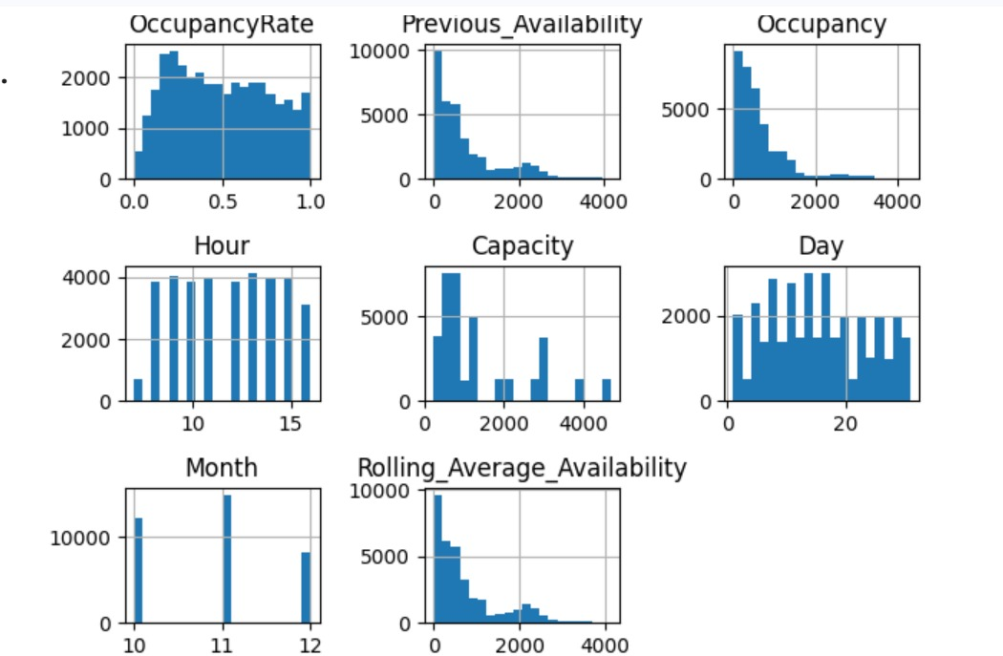
Notes:
Say: The project contains a dedicated EDA set covering occupancy, available spaces, hourly trends, busy locations, correlations and boxplots. In the final submission, these are the project's own visual assets. I would use the actual images from the project folder rather than inventing a new chart. Transition: The target variable determines why regression is the correct ML formulation.

Slide 10
08 • ML FORMULATION
09
Why this is a regression problem
The target is a continuous number of available parking spaces.
INPUTS
REGRESSION
OUTPUT
• Location
Extra Trees
Random Forest
Gradient Boosting
Available
Parking Spaces
• Capacity
• Time
• Recent availability
Numerical prediction
The application then derives occupied spaces, occupancy %, availability % and congestion.
PARKING AVAILABILITY AI
Machine Learning • Final Review
Notes:
Say: The target is not a class label. It is the number of available spaces, which is continuous numerical output. That makes this a supervised regression problem. The website then uses that numerical prediction to derive occupancy, availability and congestion indicators. Transition: Three ensemble regression models were compared.

Slide 11
09 • MODEL STRATEGY
10
Why compare three ensemble regressors?
Each model captures nonlinear relationships through a different ensemble strategy.
EXTRA TREES
RANDOM FOREST
GRADIENT BOOSTING
Randomized decision trees
+ ensemble aggregation
Multiple decision trees
+ averaged predictions
Sequential trees
+ error correction
Compare → evaluate → select
Compare → evaluate → select
Compare → evaluate → select
Selection principle
Use MAE, RMSE and R² together — not a single “accuracy” number.
PARKING AVAILABILITY AI
Machine Learning • Final Review
Notes:
Say: The project compares three ensemble regressors. Extra Trees uses randomized trees, Random Forest averages multiple trees, and Gradient Boosting builds trees sequentially to correct errors. We compare them using MAE, RMSE and R². Transition: I will now show the selected Extra Trees model.

Slide 12
10 • FINAL MODEL
11
Extra Trees Regressor
The selected model captures nonlinear relationships through an ensemble of randomized decision trees.
Many randomized trees
ENSEMBLE OUTPUT
Predicted
Available Spaces
Tree
Tree
Tree
Tree
Tree
TEST MAE
TEST RMSE
TEST R²
VALIDATION R²
27.642978
70.938246
0.991116
0.992369
lower is better
lower is better
higher is better
PARKING AVAILABILITY AI
Machine Learning • Final Review
Notes:
Say: Extra Trees is the final selected model. Its test MAE is 27.642978, test RMSE is 70.938246 and test R² is 0.991116. The validation R² is 0.992369. These are regression metrics, so I will not call them accuracy. Transition: The other two models provide the comparison baseline.

Slide 13
11 • COMPARISON
12
Random Forest Regressor
A multi-tree ensemble that averages predictions from independent trees.
Parking features
TREE
TREE
TREE
Average prediction
MAE
RMSE
R²
25.939283
85.443267
0.987131
Role in the study: a strong ensemble benchmark against which the selected model is evaluated.
PARKING AVAILABILITY AI
Machine Learning • Final Review
Notes:
Say: Random Forest provides a second ensemble strategy. It combines multiple decision trees and averages their predictions. The supplied comparison metrics are MAE 25.939283, RMSE 85.443267 and R² 0.987131. Transition: Gradient Boosting uses a different sequential learning strategy.

Slide 14
12 • COMPARISON
13
Gradient Boosting Regressor
Sequential trees focus on reducing prediction error step by step.
Tree 1
Tree 2
Tree 3
Tree 4
Initial prediction
→ errors
→ next tree corrects
→ refined prediction
MAE
RMSE
R²
45.439595
88.046843
0.986334
PARKING AVAILABILITY AI
Machine Learning • Final Review
Notes:
Say: Gradient Boosting builds trees sequentially. Each new tree focuses on reducing the errors left by earlier trees. In the supplied comparison it has MAE 45.439595, RMSE 88.046843 and R² 0.986334. Transition: Now we can compare all three models on the same metrics.

Slide 15
13 • MODEL EVALUATION
14
Model comparison
Lower MAE/RMSE and higher R² indicate stronger regression performance.
R² comparison
MODEL
MAE
RMSE
R²
Extra Trees
23.577503
65.383930
0.992464
Extra Trees
0.9925
Random Forest
25.939283
85.443267
0.987131
Random Forest
0.9871
Gradient Boosting
0.9863
Gradient Boosting
45.439595
88.046843
0.986334
Selection: Extra Trees
PARKING AVAILABILITY AI
Machine Learning • Final Review
Notes:
Say: This table is the controlled model comparison. Extra Trees has the lowest MAE and RMSE and the highest R² in the supplied model_comparison.csv. Random Forest is the next benchmark, while Gradient Boosting has the largest errors among the three. Transition: We then evaluate the selected model on validation and test data.

Slide 16
14 • FINAL EVALUATION
15
Validation vs. final test
The final test set is reported separately from validation.
VALIDATION
FINAL TEST
MAE
RMSE
R²
MAE
RMSE
R²
23.634440
65.794838
0.992369
27.642978
70.938246
0.991116
Used during model development / selection.
Held-out evaluation reported for the final model.
Final model: Extra Trees Regressor • 11 features
PARKING AVAILABILITY AI
Machine Learning • Final Review
Notes:
Say: The model report separates validation from the final test evaluation. Validation MAE is 23.634440, RMSE 65.794838 and R² 0.992369. The final test values are MAE 27.642978, RMSE 70.938246 and R² 0.991116. This distinction matters because validation supports development, while the test set is used for final reported evaluation. Transition: Next is feature importance.

Slide 17
15 • INTERPRETABILITY
16
Feature importance: what the model uses
The supplied model assigns high predictive importance to recent availability features.
Previous_Availability
0.3218
Rolling_Average_Availability
0.2302
Lag_2_Availability
0.1875
Capacity
0.1186
Lag_3_Availability
0.1108
Hour
0.0159
Interpretation: feature importance indicates model usage; it does not establish causation.
PARKING AVAILABILITY AI
Machine Learning • Final Review
Notes:
Say: Previous_Availability has the highest supplied feature importance at 0.321757, followed by Rolling_Average_Availability at 0.230188 and Lag_2_Availability at 0.187518. Capacity is also important at 0.118623. The safe interpretation is that the trained model relies heavily on recent availability-related information. Feature importance is not causal evidence. Transition: We can also inspect how predictions compare with observed values through residual analysis.

Slide 18
16 • ERROR ANALYSIS
17
Actual vs. predicted and residual analysis
The project includes dedicated final evaluation plots for prediction fit and residual behavior.
Actual vs Predicted
Residual Distribution
Residual Scatter
12_final_actual_vs_predicted.png
13_final_residual_distribution.png
14_final_residual_scatter.png
The slide identifies the project's supplied evaluation assets; replace the schematic frames with the actual PNGs in the final deck if desired.
PARKING AVAILABILITY AI
Machine Learning • Final Review
Notes:
Say: The project contains three final evaluation visualizations: actual versus predicted, residual distribution and residual scatter. These are useful because metrics alone do not show the shape of the errors. In this generated deck I have reserved clean frames for the actual project PNGs so the final version can use the original assets without fabricating a plot. Transition: The next step is deployment.

Slide 19
17 • DEPLOYMENT
18
Parking Availability AI: web deployment
The saved model is exposed through a Python Flask backend and browser interface.
HTML / CSS / JavaScript
Frontend
Flask + Python
Backend API
Joblib model
best_parking_prediction_model.pkl
Prediction + Analytics
JSON responses
INFERENCE ONLY • NO RETRAINING ON CLICK
PARKING AVAILABILITY AI
Machine Learning • Final Review
Notes:
Say: The actual application uses HTML, CSS and JavaScript on the frontend and Flask on the backend. The saved Extra Trees model is loaded from a Joblib file. The website sends inputs to Flask, receives JSON results and updates the dashboard. The application performs inference; it does not retrain the model when the user clicks Predict. Transition: Here is the live prediction flow.

Slide 20
18 • LIVE DEMO
19
Predictor Engine: from input to decision
The web UI converts user-selected context into an ML prediction and application-level parking insights.
Parking Availability AI / Predictor Engine
INPUTS
PREDICTION OUTPUT
Parking Location
Predicted Free Spaces
Occupied Spaces
Capacity
ML output
Derived
Day / Date / Hour
Occupancy %
Availability %
Previous availability
Derived
Derived
Lag values
Congestion
Application logic
Rolling average
Changing the inputs changes the prediction request and dashboard output.
PARKING AVAILABILITY AI
Machine Learning • Final Review
Notes:
Say: In the Predictor Engine, the user selects a parking location and supplies the contextual and recent-availability inputs. JavaScript creates a JSON payload and sends it to /api/predict. Flask builds the model input and the saved Extra Trees model predicts available spaces. The application then derives occupied spaces, occupancy percentage, availability percentage and a congestion level. Faculty question: Does the model predict congestion? Answer: No. It predicts available spaces; congestion is application-level logic based on occupancy percentage.

Slide 21
19 • ANALYTICS
20
Application analytics
The deployed application exposes analytics through Flask and visualizes them in the browser.
Hourly Occupancy Trend
Busiest Parking Locations
Project analytics view
Project analytics view
Occupancy Load Distribution
Actual vs Predicted Free Spaces
Project analytics view
Project analytics view
PARKING AVAILABILITY AI
Machine Learning • Final Review
Notes:
Say: The application includes an Analytics Charts section with hourly occupancy trend, busiest parking locations, occupancy load distribution and actual-versus-predicted free spaces. These are supplied by the Flask analytics layer and visualized on the frontend. I would replace these clean chart frames with the actual project screenshots or PNGs in the final deck. Transition: The final application section is the model-performance dashboard.

Slide 22
20 • MODEL DASHBOARD
21
Model Performance inside the application
The website brings evaluation artifacts into the deployed interface.
EXTRA TREES R²
TEST MAE
TEST RMSE
FEATURES
0.991116
27.642978
70.938246
11
final test
MODEL COMPARISON
FEATURE IMPORTANCE
Extra Trees
R² 0.9925
MAE 23.58
Previous_Availability
0.322
Rolling_Average_Availab
0.230
Random Forest
R² 0.9871
MAE 25.94
Lag_2_Availability
0.188
Gradient Boosting
R² 0.9863
MAE 45.44
Capacity
0.119
PARKING AVAILABILITY AI
Machine Learning • Final Review
Notes:
Say: The Model Performance section exposes the evaluation inside the application. The final test R² is 0.991116, with test MAE 27.642978 and RMSE 70.938246. The dashboard also presents model comparison and feature importance. This connects the research evaluation to the deployed system without retraining the model. Transition: I will conclude with the overall contribution and future scope.

Slide 23
21 • CONCLUSION
From historical parking data to intelligent availability prediction
DATA
EDA
FEATURES
ML
MODEL
APP
Parking records
Trends + relationships
Temporal context
3 regressors
Extra Trees
Flask dashboard
FINAL MODEL
FUTURE SCOPE
Extra Trees Regressor
Sensors • real-time feeds • streaming • maps • mobile • cloud
Test R² = 0.991116
Future work — not currently implemented.
THANK YOU
Questions?
PARKING AVAILABILITY AI
Machine Learning • Final Review
Notes:
Say: The project demonstrates a complete ML lifecycle: data preparation, EDA, feature engineering, regression-model comparison, final model evaluation, feature importance and Flask deployment. Extra Trees is the selected model with a final test R² of 0.991116. Future scope includes live sensor integration, real-time feeds, streaming, maps, mobile and cloud deployment; these are future ideas, not current features. Close by inviting questions.

