Slide 1

Parking Space Availability Prediction Using Random Forest and Time-Series Models
COURSE : Machine learning
COURSE CODE: 25SC2107E
SECTION: 4
Branch: CSE
GUIDED BY: JYOTHSNA DATTI(Assistant professor)
2520030018 - p. Laxmikanth reddy
2520030470 – k. sudheer
2026-2027

Slide 2
CONTENTS
ABSTRACT
INTRODUCTION
REQUIREMENT ANALYSIS
20 LITERATURE PAPERS IN TABLE FORMAT
DATASET DESCRIPTION

Slide 3
ABSTRACT
The increasing number of vehicles in urban areas has made parking management a significant challenge, resulting in traffic congestion, fuel wastage, environmental pollution, and inconvenience to drivers searching for available parking spaces. This project proposes a machine learning-based approach for predicting parking space availability by combining Random Forest and Time-Series models to provide accurate and reliable parking occupancy predictions. The Random Forest model is used to learn the relationship between parking occupancy and influencing factors such as date, time, day of the week, weather conditions, holidays, and previous occupancy records, while the Time-Series model captures temporal patterns to forecast future parking availability. The proposed system is trained and evaluated using the Parking Occupancy Detection dataset obtained from Kaggle, which contains historical parking occupancy information collected over different time intervals. Data preprocessing techniques, including missing value handling, feature selection, categorical encoding, and normalization, are applied before training the prediction models to improve performance and reliability. The developed system aims to provide users with real-time parking availability predictions, thereby reducing parking search time and improving the utilization of available parking spaces. The performance of the proposed model is evaluated using accuracy, precision, recall, F1-score, ROC-AUC, confusion matrix, mean absolute error (MAE), and root mean square error (RMSE), providing a comprehensive assessment of both classification and forecasting performance under different parking scenarios.

Slide 4
INTRODUCTION
The rapid growth of urbanization and the continuous increase in the number of vehicles have created serious parking challenges in modern cities. Drivers often spend a considerable amount of time searching for vacant parking spaces, which contributes to increased traffic congestion, unnecessary fuel consumption, environmental pollution, and delays in reaching their destinations. Existing parking systems generally provide only the current occupancy status and do not assist users in predicting future parking availability. Motivated by these challenges and the growing need for intelligent transportation systems, this project focuses on developing a smart parking prediction system capable of providing accurate parking availability information before a driver reaches the parking location. Machine learning has become an effective solution for solving prediction problems by learning patterns from historical data. Random Forest is widely used because of its high prediction accuracy, robustness, and ability to handle complex relationships among multiple features, while Time-Series analysis is effective in identifying temporal trends and forecasting future occupancy based on historical observations. This project integrates both techniques into a unified prediction framework that analyzes historical parking occupancy data together with features such as date, time, day of the week, weather conditions, holidays, and previous occupancy records. The complete machine learning lifecycle, including data collection, preprocessing, feature engineering, model training, evaluation, deployment, and monitoring, is followed to develop a practical parking prediction system capable of supporting smart parking management and improving urban transportation efficiency.

Slide 5
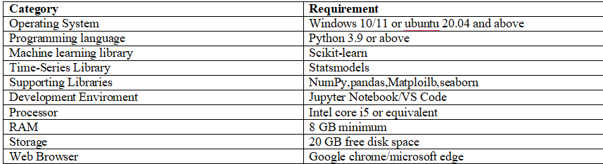
REQUIREMENT ANALYSIS
The proposed parking space prediction system is implemented using a Python-based machine learning environment supported by data processing, visualization, and web application development tools. The development environment provides facilities for preprocessing the parking occupancy dataset, training and evaluating prediction models, visualizing the obtained results, and deploying the trained model as a simple web application for real-time prediction. A standard computer with sufficient processing capability and memory is adequate for developing, testing, and deploying the proposed system. The software and hardware requirements used for the project are summarized below.

Slide 6
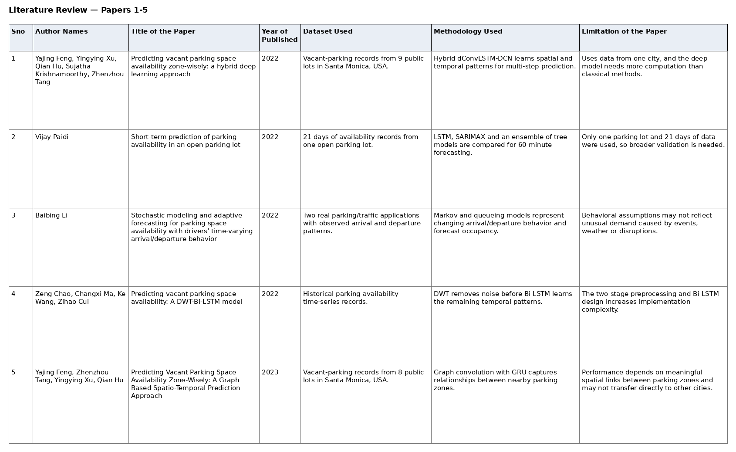
20 Literature papers (1 – 5)

Slide 7
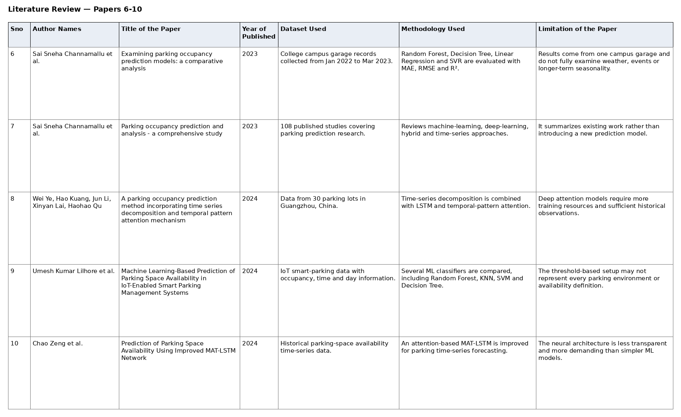
20 Literature papers (6 – 10)

Slide 8
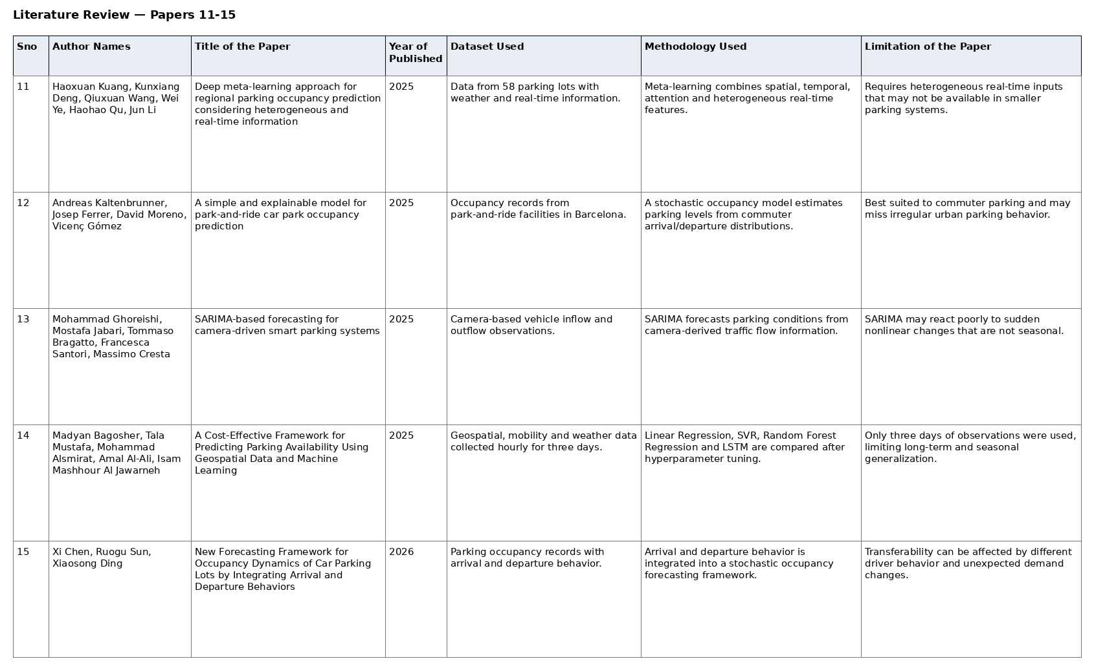
20 Literature papers (11 – 15)

Slide 9
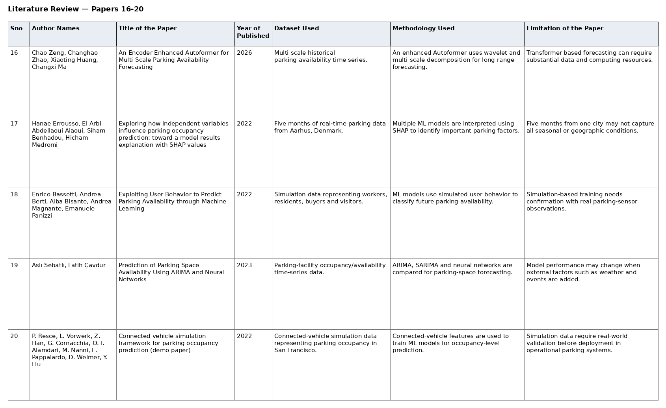
20 Literature papers (16 – 20)

Slide 10
DATASET Description
The Smart_Parking_Dataset_project.csv dataset contains 200,000 hourly observational records collected across 15 distinct attributes, spanning the full calendar year from January 1, 2025, to December 31, 2025. It tracks parking occupancy metrics across eight primary urban facilities—Tech Park, Hospital, Central Mall, Bus Station, City Center, Railway Station, University, and Airport—with capacities ranging from 100 to 400 spaces. Each entry incorporates temporal parameters (date, hour, day of the week, weekend status, and holiday tags) alongside environmental factors (weather conditions like sunny, cloudy, rainy, or foggy, and temperatures between 18°C and 40°C) to contextualize utilization patterns. Across all facilities, the dataset records an average occupancy rate of 52.3% (ranging from a minimum of 15% to 100% capacity) and includes categorical status indicators marking whether a lot is available or full. With zero missing values, this dataset serves as a complete foundation for predictive modeling, peak-demand forecasting, dynamic pricing strategies, and analyzing the impact of weather and time on urban parking behavior.

Slide 11
THANK YOU

