Slide 1
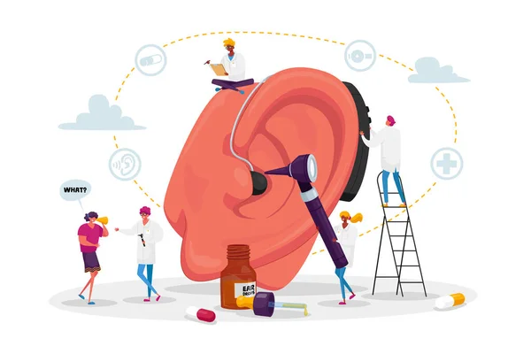
Team : S34M

Slide 2
PROBLEM STATEMENT
Existing solutions for individuals within the old age group and children with visual impairments or hearing aid problems lack affordability and comprehensive functionality.
These individuals face barriers to communication, independence, and accessing information.
There is a need for an inclusive, affordable, and user-friendly solution that seamlessly integrates with existing assistive technologies. This solution should provide real-time audio amplification, noise cancellation, and the option for real-time subtitles.
Additionally, it should offer remote monitoring and assistance for caregivers while respecting users' privacy and independence.

Slide 3
OUR SOLUTION
Hardware Attachment:
Easily attachable hardware for glasses or any desired location.
Simplified setup process.
Audio Enhancement:
Seamless integration with any earphone.
Enables clear audio perception of surroundings.
Noise cancellation and adjustable amplification for personalized experience.
Real-time Subtitles:
Option for real-time subtitles in the web app.
Facilitates communication for individuals with hearing impairments.

Slide 4
Dedicated Web/Mobile App:
Allows streaming of user's perspective.
Enables remote monitoring for caregivers or family members.
Simple login/signup process for ease of use.
Multi-functional Use:
Can be utilized for reading books.
Enhances familiarity with the environment.
Privacy and Comfort:
Creates a comfortable and private space for users.
Ensures security of user's private space and surroundings.

Slide 5
KEY FEATURES
Enhanced Accessibility:
Enables individuals with visual impairments or hearing aid problems to engage with their environment effectively.
Affordability:
Offers an affordable solution compared to existing alternatives.
Ease of Use:
Simplified setup and user-friendly interface for seamless integration into daily routines.
Privacy:
Respects user privacy while providing essential assistance.
Comprehensive Functionality:
Combines audio enhancement, real-time subtitles, and remote monitoring features for comprehensive support.

Slide 6
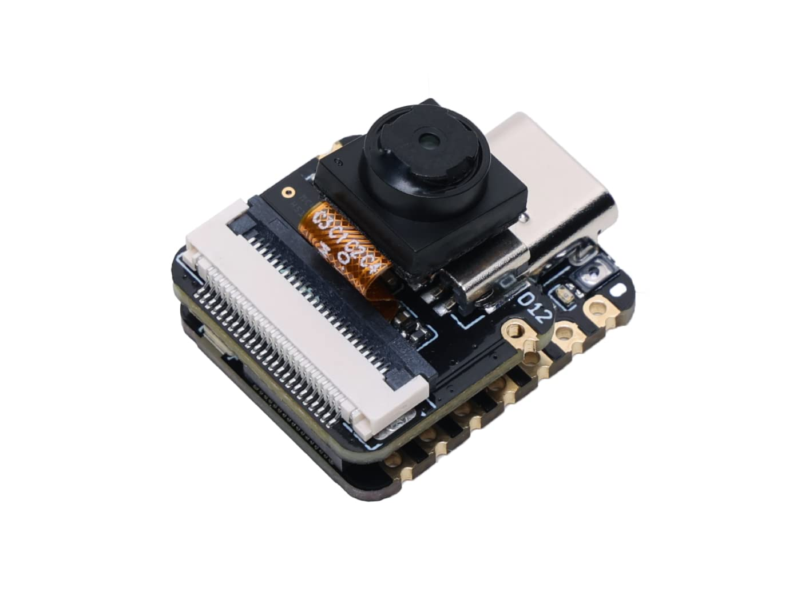
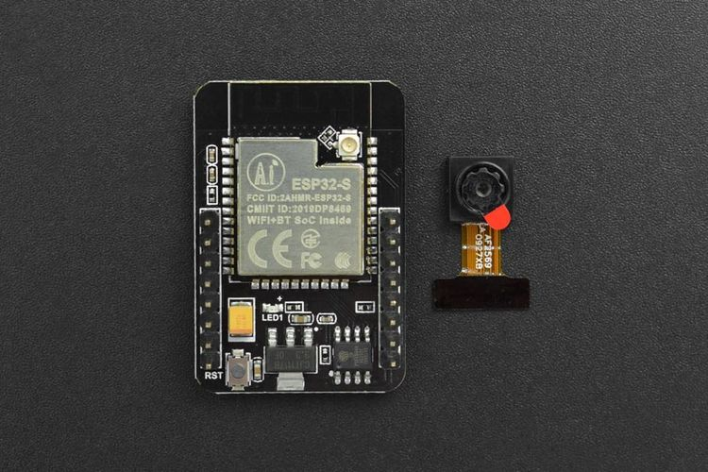
HARDWARE USED
XIAO ESP32S3 Sense - Tiny ESP32 Camera
ESP32-CAM Development Board

Slide 7
TECH STACK
Backend
Node.js
Express.js
Computer vision Model
For processing incoming videos and images

Slide 8
HOW IT WORKS
1. How I Connect Wi-Fi to My Device:
Method 1: Web App Setup
Setting up Web App: We created a web application that allows me to configure my device's Wi-Fi settings.
WiFiManager Integration: Upon connecting to the device's access point, I'm redirected to a configuration page using the WiFiManager library's Captive Portal feature.
Frontend-Backend Communication: After entering my Wi-Fi credentials, the web app sends a request to the backend server to store them in the device's memory.
Wi-Fi Connection: With my credentials stored, my device attempts to connect to the specified Wi-Fi network, enabling its operation.

Slide 9
Method 2: My Device Setup
Device Requirements: I need a Wi-Fi-capable smartphone, tablet, or laptop.
Wi-Fi Connection: I access my device's Wi-Fi network from my device's settings.
Captive Portal Detection: My device detects no internet access and prompts opening of a Captive Portal.
Captive Portal Page Access: I access the Captive Portal page served by my device to input my Wi-Fi credentials.
Credential Entry: I input my Wi-Fi credentials on the Captive Portal page.
Wi-Fi Configuration: My device captures and stores my credentials for future use.
Connection to External Wi-Fi: After restarting, my device attempts connection to an external Wi-Fi network.
Device Accessibility: Once connected, my device is accessible over the network for my interaction.

Slide 10
Video Streaming
2. How Video Streams on Web App:
Local Streaming Setup: I configure my ESP32S3 board with a camera module to stream video to a local IP address.
Web Server Creation: A web server (using Node.js, Express.js, etc.) is set up to handle video stream requests.
User Authentication: User authentication is implemented to restrict video stream access to authenticated users.
Video Streaming Implementation: In web app, We use HTML5 video elements and JavaScript to fetch and display the video stream.
Secure Connection: HTTPS is utilized for secure communication between devices, web server, and web app.
Performance Optimization: We can optimize the video stream for bandwidth and latency requirements.

Slide 11
Text to Speech
How I Hear Streamed Audio:
Video Analysis: Computer vision algorithms analyze the video stream in real-time.
Text Generation: Text descriptions of detected objects or events in the video stream are generated.
Text-to-Speech Conversion: Generated text descriptions are converted into speech using a text-to-speech engine. We are using
Speech Overlay: Synthesized speech is overlaid on the video stream for me to hear detected information.

Slide 12
Market
WHO estimates that in India there are approximately 63 million people, who are suffering from Significant Auditory Impairment. Early identification of hearing loss and ear diseases is key to effective management.
This requires systematic screening for detection of hearing loss and related ear diseases in those who are most at risk:
Newborn babies and infants
Pre-school and school-age children
People exposed to noise or chemicals at work
People receiving ototoxic medicines
Older adults

Slide 13
Product Comparison

