Slide 1
Amazon Web Services – Virtual Private Cloud (VPC)
TechUp Cloud
Session 5
PART.1 Date: 11-06-2024
PART.2 Date: 16-07-2024
PART.3 Date: 20-08-2024
Presenter: Sai Sudheer

Slide 2

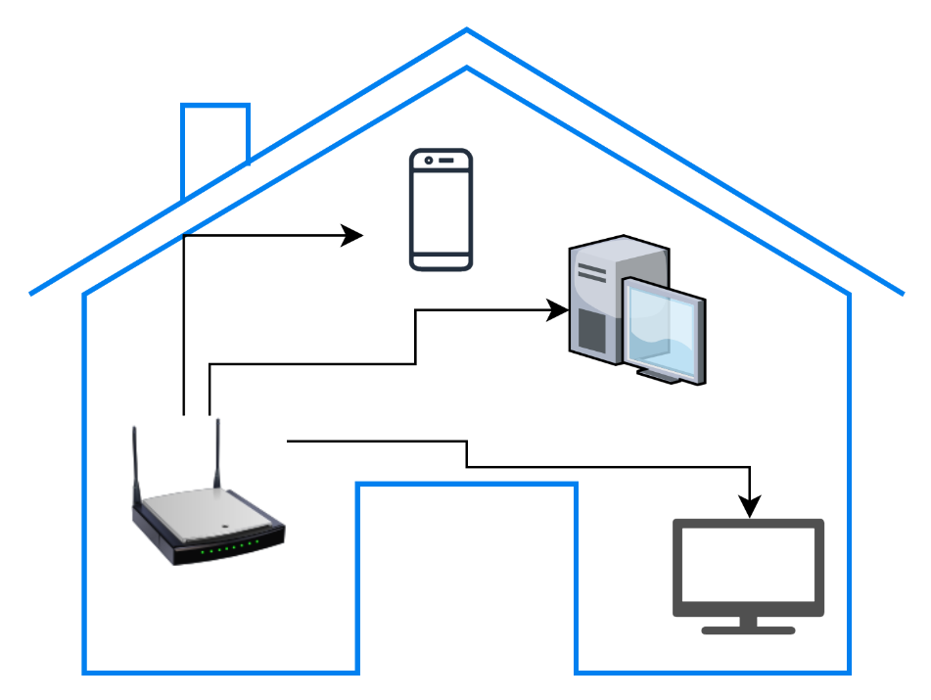
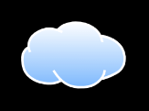
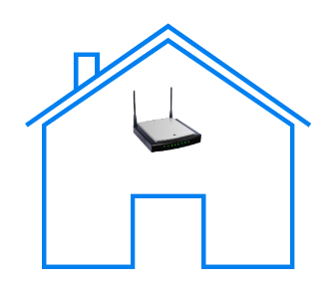
Amazon Virtual Private Cloud (VPC)
VPC is like a Home Network
unauthorized
Internet
Your neighbors

Slide 3
Amazon Virtual Private Cloud (VPC)
An Amazon VPC is an isolated portion of the AWS cloud. You use Amazon VPC to create a virtual network topology for your Amazon EC2 resources.
You have complete control over your virtual networking environment, including selection of your own IP address range, creation of subnets, and configuration of route tables and network gateways.
You can create a public-facing subnet for your webservers that has access to the Internet, and place your backend systems such as databases or application servers in a private-facing subnet with no Internet access

Slide 4
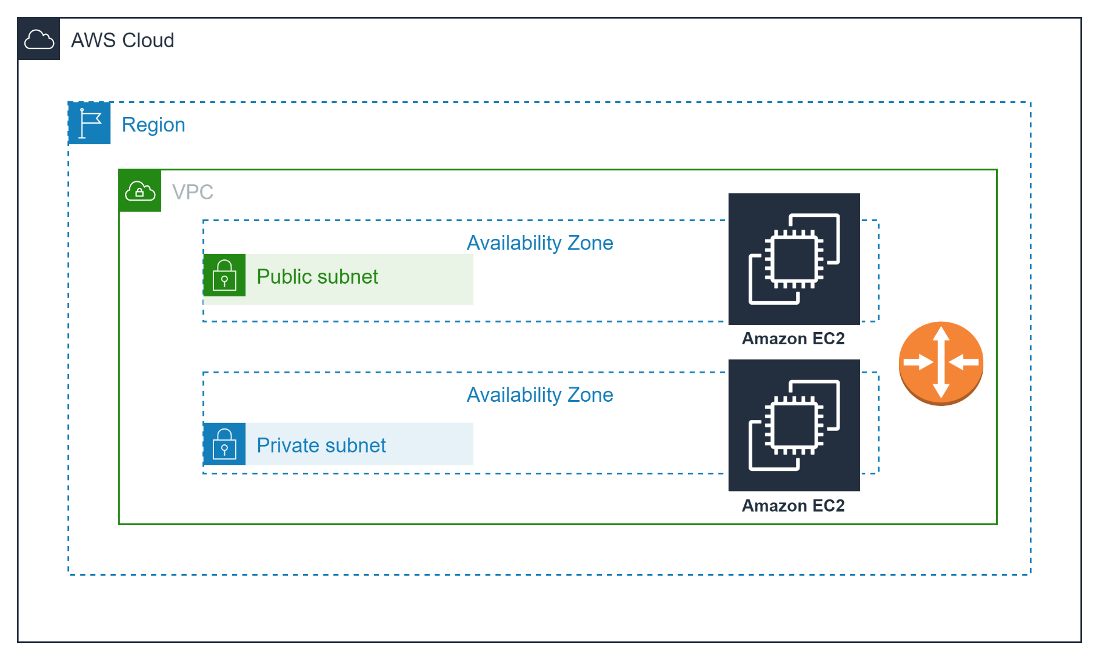
Amazon Virtual Private Cloud (VPC)

Slide 5




Amazon Virtual Private Cloud (VPC)
Provision a private, isolated virtual network on the AWS cloud.
You can create multiple VPCs inside a region (limit: 5 per region)
Each VPC has a different block of IP addresses, Each VPC has a separate CIDR block.
A default VPC is created (by AWS) in each region with a subnet in each AZ.
Amazon VPC

Slide 6
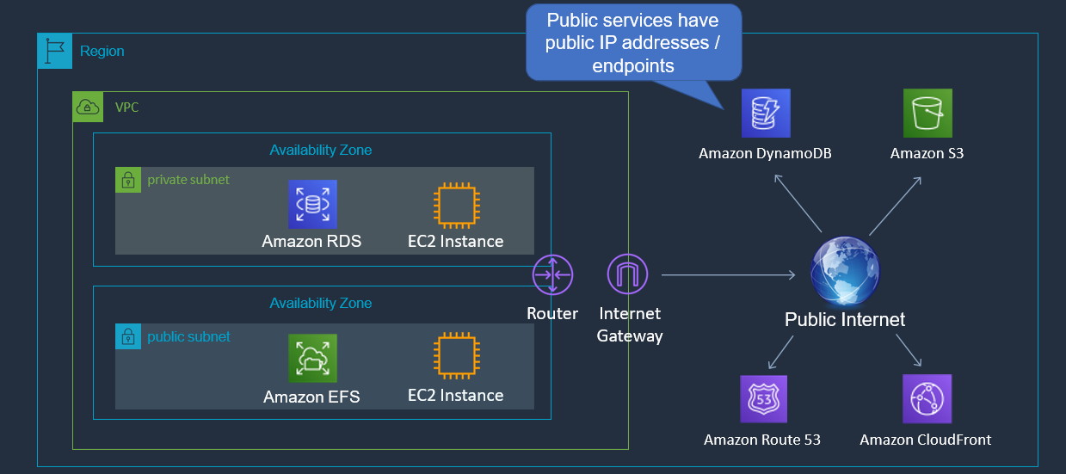
Amazon Virtual Private Cloud (VPC)
Router is not visible, but it takes care of routing within the VPC and external access

Slide 7























AWS Infrastructure Patterns
VPC pattern
Shared Services
Amazon VPC
Development
Amazon VPC
Test
Amazon VPC
Production
Amazon VPC
Account pattern
Shared Services
AWS Account
Development
AWS Account
Test
AWS Account
Production
AWS Account

Slide 8
VPCs and subnets
VPC is private, so only private IP CIDR ranges are used for internal communication within a VPC.
A subnet defines a range of IP addresses in your VPC.
You can launch AWS resources into a subnet that you select.
A private subnet should be used for resources that won’t be accessible over the Internet.
A public subnet should be used for resources that will be accessed over the Internet.
You can create up to 200 Subnets per VPC, but this limit can be increased by requesting a quota increase from AWS.
Each subnet must reside entirely within one Availability Zone and cannot span zones.
One Availability Zone can contain multiple subnets.

Slide 9






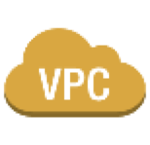
















VPC example
Internet
Customer Network
Internet Gateway
Virtual Private Gateway
R
Web Server
VPC NAT
Gateway
App Server
DB Server
Web Server
App Server
DB Server
Public Subnet
Private Subnet
VPN Only Subnet
Virtual Private Cloud
AWS Cloud
Public Subnet: Instances in a public subnet can directly access the internet.
Private Subnet: Instances in a private subnet do not have direct access to the internet, they can access internet through a NAT Gateway or NAT instance placed in a public subnet.
VPN Only Subnet: a subnet within a VPC that doesn’t have direct access to internet and is designed to communicate exclusively via a VPN connection.

Slide 10
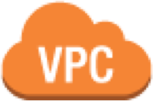











































Security in your VPC
Security groups
Network access control lists (ACLs)
Key Pairs
instance
instance
instance
instance
Security Group
Security Group
Security Group
Security Group
Subnet 10.0.0.0/24
Subnet 10.0.1.0/24
Network ACL
Network ACL
Routing Table
Routing Table
VPC Router 10.0.0.0/16
VPN Gateway
Internet Gateway
Internet Gateway (IGW): Enables your VPC to communicate with the internet, allowing instances to send and receive traffic.
VPN Gateway (VGW): Used for secure, encrypted connections between your VPC and your on-premises network or another cloud environment,

Slide 11
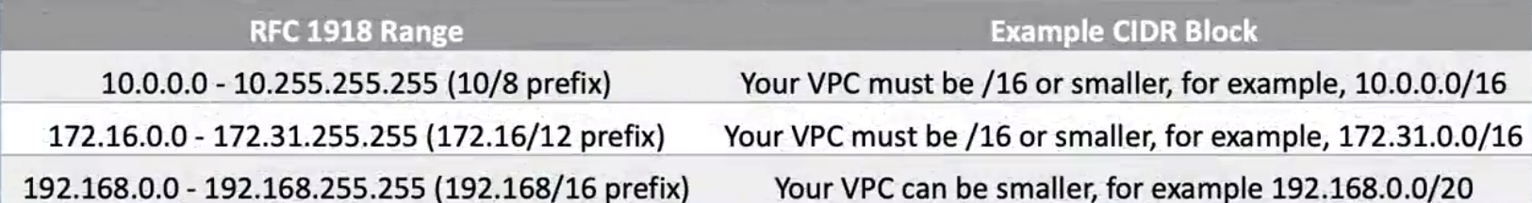
VPCs And IP Addresses
When you create your VPC, you specify its set of IP addresses with CIDR notation
Classless Inter-Domain Routing (CIDR) notation is a simplified way to show a specific range of IP addresses
Example: 10.0.0.0/16 = all IPs from 10.0.0.0 to 10.0.255.255
You can not increase or decrease size of an existing CIDR block.
AWS Recommend you to use CIDR blocks from the RFC1918 ranges to avoid routing conflicts with public IP addresses. (non-RFC1918 CIDR block (e.g., 198.51.100.0/24))

Slide 12
VPCs and IP Addresses
AWS VPCs can use CIDR ranges between
/16 and /28.
For every one step a CIDR range increases, the total number of IPs is cut in half:
CIDR / Total IPs
/16 | /17 | /18 | /19 | /20 | /21 | /22
65,536 | 32,768 | 16,384 | 8,192 | 4,096 | 2,048 | 1,024
/23 | /24 | /25 | /26 | /27 | /28
512 | 256 | 128 | 64 | 32 | 16

Slide 13
What Are Subnets?
A Subnet is range or partition of IP addresses in your VPC, they are by divided by CIDR range. Subnet divide the VPC’s IP address range into smaller, manageable segments and can be designated as either public or private.
When you provision an Amazon VPC, all subnets can communicate with each other by default.
For IPv6, the subnet size is fixed to be a /64.
Example:
1024
A VPC with CIDR /22 includes 1,024 total IPs
1024 / 4 subnets
= 256 IPs for each subnet
Subnet 1
251
Subnet 2
251
Subnet 4_{IPs}Subnet 3
251 251
Note: In every subnet, the first four and last one IP addresses are reserved for AWS use.

Slide 14
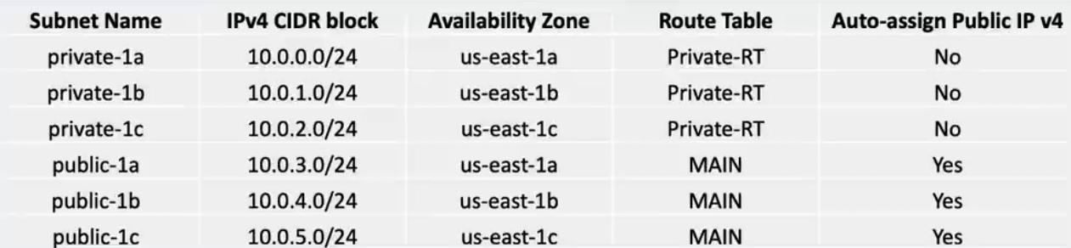
Subnet Sizes
Recommendation: Consider larger subnets over smaller ones (/24 and larger).
Simplifies workload placement:
Less likely to waste or run out of IPs:
Choosing where to place a workload among 10 small subnets is more complicated than with one large subnet.
If your subnet runs out of available IPs, you can't add more to that subnet.
Example: If you have 251 IPs in a subnet that's using only 25 of them, you can't share the unused 226 IPs with another subnet that's running out.
Notes:
https://www.davidc.net/sites/default/subnets/subnets.html

Slide 15

Subnet Types
Which subnet type (public or private) should you use for these resources ?
Public
Private
✓
✓
✓
✓ ✓
Datastore instances
Batch processing instances
Back-end instances
Web application instances

Slide 16
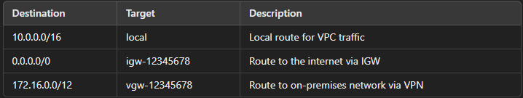
Route Tables
Route Tables are a key component in AWS VPC that control the routing of network traffic within the VPC and between the VPC and other networks.
Key Points:
Routes: Each route table contains a set of rules, called routes, that determine where network traffic from your subnets is directed.
Main Route Table: Every VPC has a main route table that is automatically created. You can also create custom route tables and associate them with specific subnets.
Route Destinations: Routes can direct traffic to various destinations, such as:
Local VPC (default route for internal traffic within the VPC).
Internet Gateway (for internet-bound traffic).
Virtual Private Gateway (for VPN connections).
NAT Gateway (for internet access from private subnets).
Peering Connection (for communication with another VPC).

Slide 17
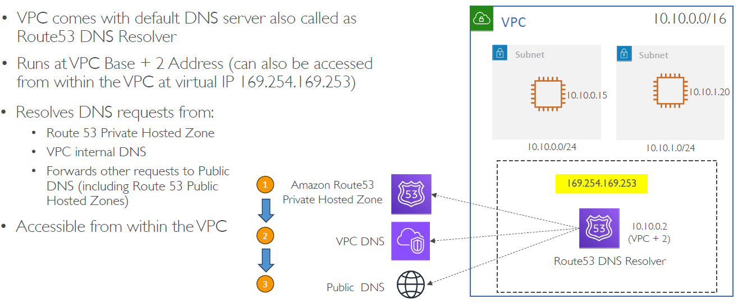
Amazon DNS Server

Slide 18
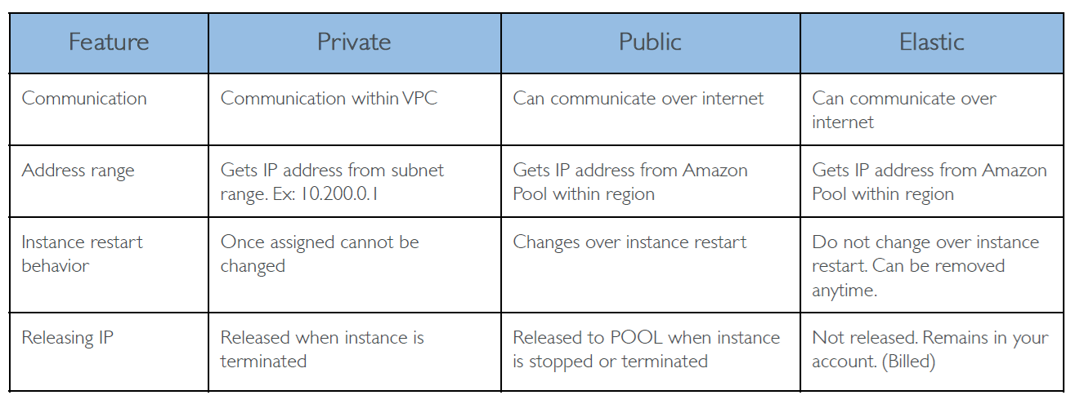
Private, Public vs Elastic IP

Slide 19
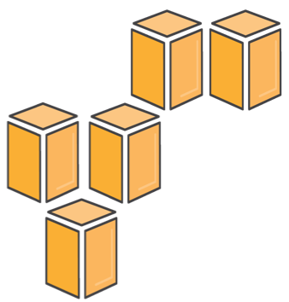
Demo
Create VPC
Name: MyVPC
IPv4 CIDR Block: 10.0.0.0/16
Enable DNS hostnames
Create Subnets
Public-1a 10.0.1.0/24 + Auto assign IP
Public-1b 10.0.2.0/24 + Auto assign IP
Private-1a 10.0.3.0/24
Private-1b 10.0.4.0/24
Create Private route table
Name: Private-RT
VPC: MyVPC
Subnet Associations: Private-1a, Private-1b
Rename Default RT to MAIN
Create Internet Gateway
Name: MyIGW
Attach to VPC: MyVPC
Edit routes of MAIN route : Insert 0.0.0.0/0 to target MyIGW
Launch Instance
Name: MyEC2
VPC: MyVPC ..etc

Slide 20
Demo …
Login to EC2 instance
Verify internet connectivity (outbound)
Install httpd
Apache Httpd is basically a web server used for handling requests and delivering static content. (consider nginx for ubuntu OS)
sudo yum install -y httpd
sudo systemctl start httpd
sudo systemctl enable httpd
Verify inbound traffic to Instance
Using Public IPv4 DNS

Slide 21
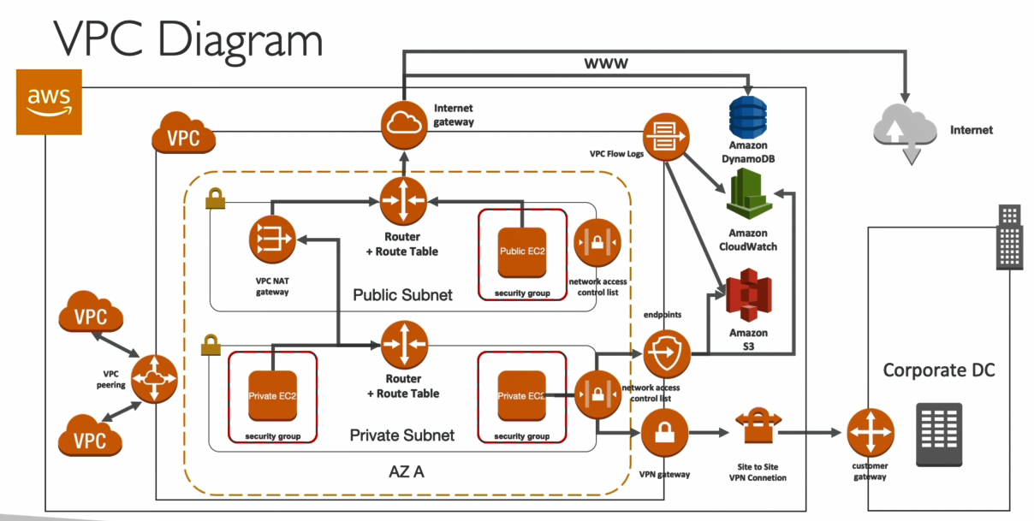
VPC session-2

Slide 22
Security Groups / NACL
Security group:
Operates at the instance level (specifically at N/W interface level)
Supports allow rules only
Is stateful: Return traffic is automatically allowed, regardless of any rules
We evaluate all rules before deciding whether to allow traffic (there is no rule order unlike in NACL)
Applies to an instance only if someone specifies the security group when launching the instance, or associates the security group with the instance later on
Network ACL:
Operates at the subnet level
Supports allow rules and deny rules for specific IP addresses. (10.0.0.1/32 CIDR -- is a single IP range i.e., 10.0.0.1)
Is stateless: Return traffic must be explicitly allowed by rules
It has RULE numbers, and priority takes from lowest one.
We process rules in order, starting with the lowest numbered rule, when deciding whether to allow traffic. (if the first rule satisfies, traffic is allowed/denied regardless of next similar rule)
Automatically applies to all instances in the subnets that it's associated with (therefore, it provides an additional layer of defense if the security group rules are too permissive)
Default Rule *
Implicit Deny: The rule with the number * is not explicitly visible in the NACL configuration, but it exists by default.
Highest Precedence: It is implicitly considered to have the highest rule number (32767), meaning it is evaluated last.
Function: This rule denies any traffic that hasn't been allowed by a lower-numbered rule.

Slide 23
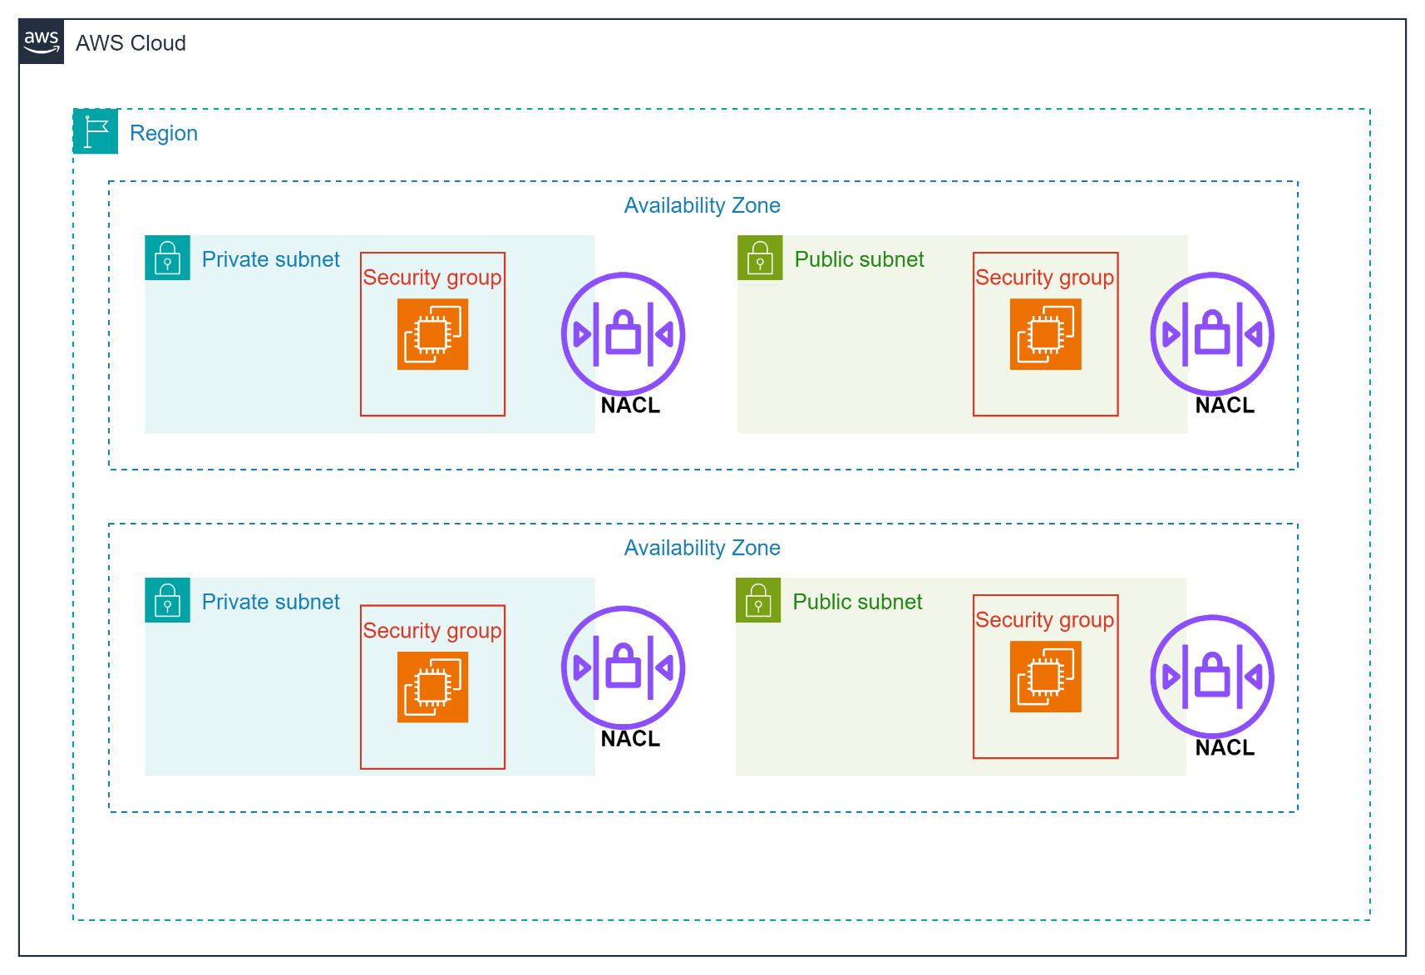
Security Groups / NACL

Slide 24
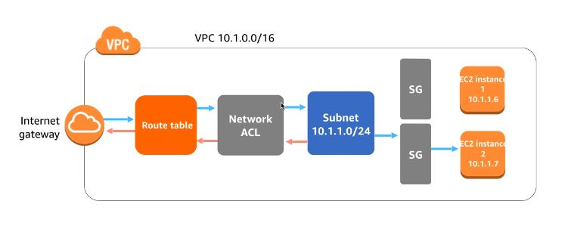
Security Groups / NACL
Security group rules per application tier
AWS customers typically leverage security groups as their primary method of network packet filtering since they are more versatile than network ACLs due to their ability to perform stateful packet filtering and utilize rules that reference other security groups.
However, network ACLs can be effective as a secondary control for denying a specific subset of traffic or providing high-level guard rails for a subnet.

Slide 25
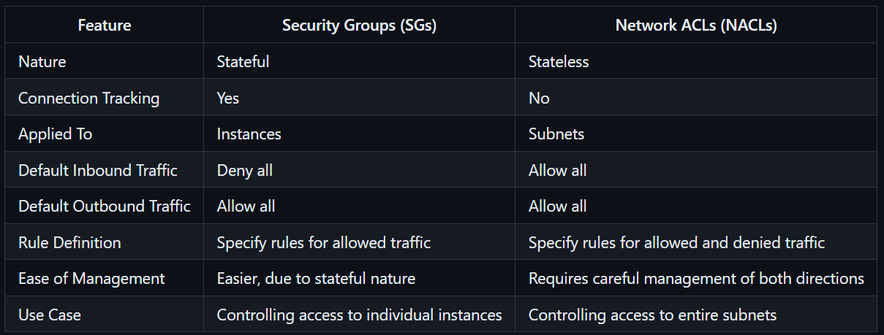
Security Groups / NACL
Statefull vs Stateless
Security group:
Stateful Nature: Security groups are stateful. This means that if you allow an inbound request, the response traffic is automatically allowed, regardless of outbound rules, and vice versa.
NACL:
Stateless Nature: Network ACLs are stateless. This means they evaluate each request or response against their rules independently, without keeping track of connections.

Slide 26
Directing Traffic To Your VPC
To enable access to or from the Internet for instances in a VPC subnet, you must:
Attach an Internet gateway to your VPC
Ensure that your subnet's route table points to the Internet gateway
Ensure that instances in your subnet have public IP addresses or Elastic IP addresses
Ensure that your NACLs and security groups allow the relevant traffic to flow to and from your instance

Slide 27









Internet gateway
Directing Traffic To Your VPC
users
Provides target in your VPC route tables for internet routable traffic.
Perform network address translation for interfaces that have been associated public IPv4 addresses.
Are horizontally scaled, redundant, and highly available by default.
Provide a target in your VPC route tables for Internet-routable traffic.
10.0.0.0/16
Internet gateway
Instance A with public IP
10.0.10.0/24
Public Subnet

Slide 28
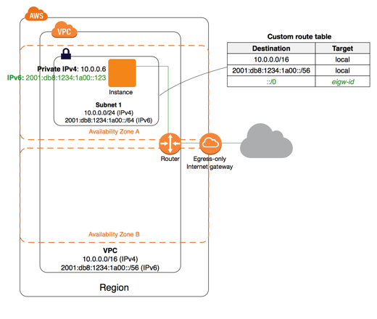
Egress only Internet Gateway
An Egress-Only Internet Gateway (EIGW) is a VPC component in AWS designed to allow outbound-only internet access for IPv6 traffic. It prevents any inbound traffic from the internet to your VPC, thereby enhancing security for IPv6-enabled instances.
Outbound only: An Egress-Only Internet Gateway allows IPv6 traffic to leave the VPC and access the internet but blocks all inbound traffic initiated from the internet.
It is specifically designed for IPv6 addresses. For IPv4 addresses, a standard NAT Gateway or NAT Instance would be used to provide similar functionality.
By ensuring no inbound traffic is allowed, it helps maintain a secure network environment while allowing instances to download updates, patches, or connect to external services as needed.

Slide 29
NAT Instance
A NAT instance is a customer-managed instance that is designed to accept traffic from instances within a private subnet, translate the source IP address to the public IP address of the NAT instance, and forward the traffic to the IGW. In addition, the NAT instance maintains the state of the forwarded traffic in order to return response traffic from the Internet to the proper instance in the private subnet.
Managed by you
Scale up manually and use enhanced networking
No HA - scripted / auto scaled. HA is possible by using multiple NAT for multiple subnets.
Need to assign Security Group.
Can use as a bastion host (through SSH)
Can use Elastic IP address or public IP address with NAT Instance.
Can implement port forwarding through manual customization.

Slide 30












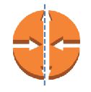




Outbound Traffic From Private Instances?
Network Address Translation services:
Enable instances in the private subnet to initiate outbound traffic to the Internet or other AWS services.
users
Internet gateway
Prevent private instances from receiving inbound traffic from the Internet.
10.0.0.0/16
NAT instance with public IP
Destination | Target
10.0.0.0/16 | local
0.0.0.0/0 | NAT
10.0.10.0/24
Public subnet
Two primary options:
Amazon EC2 instance set up as a NAT in a public subnet
Private instance with private IP
10.0.20.0/24
Private subnet
VPC NAT Gateway

Slide 31
NAT Gateway
A NAT gateway is an AWS-managed service that has outbound access only to Internet gateway. use a network address translation (NAT) gateway to enable instances in a private subnet to connect to the internet or other AWS services, but prevent the internet from initiating a connection with those instances. You are charged for creating and using a NAT gateway in your account. NAT gateways are not supported for IPv6 traffic.
Public: A public NAT gateway uses an Elastic IP address and is routable over the internet. Instances in private subnets can use the public NAT gateway to connect to the internet while keeping their private IP addresses hidden.
Private: A private NAT gateway does not use an Elastic IP address and cannot be directly accessed from the internet. It is used for routing traffic between private subnets within a VPC or to other VPCs via VPC peering, transit gateways, or AWS Direct Connect.

Slide 32





Outbound Traffic From Private Instances ?
Network Address Translation services:
Enable instances in the private subnet to initiate outbound traffic to the Internet or other AWS services.
users
Internet gateway
10.0.0.0/16
Prevent private instances from receiving inbound traffic from the Internet.
VPC NAT
gateway
10.0.10.0/24
Public subnet
Two primary options:
Amazon EC2 instance set up as a NAT in a public subnet
Private instance with private IP
10.0.20.0/24
Private subnet
VPC NAT Gateway

Slide 33
Bastion Hosts
A bastion host (also known as a jump box) is a special-purpose server used to securely access and manage instances in a private network (such as a VPC) that are not directly accessible from the internet. It acts as a gateway or intermediary, allowing administrators to connect to instances in private subnets securely.
Key Characteristics
Single Point of Access: Bastion hosts provide a controlled and secure access point for instances in private subnets.
Security Hardened: Bastion hosts are typically hardened and monitored to provide a secure entry point. This includes using strong authentication methods, limiting access to specific IP addresses, and keeping the host up to date with security patches.
Audit and Monitoring: Bastion hosts are often monitored and logged extensively to track access and actions taken, providing an audit trail for security and compliance purposes.

Slide 34
Demo
Create NAT Gateway
Name: MyNATGw
Subnet: Any Public Subnet
Update Private RT
0.0.0.0/0 -- MyNATGw
Launch EC2 instance in Private Subnet
Name: Private-Ec2
VPC: MyVPC
Subnet Associations: Private Subnet only
Auto Assign Public IP: disable
KeyPair for logic: Key
Launch Bastion Host instance in Public Subnet
Name: Bastion-Ec2
VPC: MyVPC
Subnet Associations: Public Subnet only
Auto Assign Public IP: enable
KeyPair for logic: Key
Access Bastion Host EC2 instance
Upload the key used for private subnet EC2
Change permissions.
chmod 400 key.pem
Access Private EC2 instance.
ssh –I key.pem ubuntu@172.0.0.2
Check access to internet from private EC2 instance.
ping www.google.com

Slide 35
Network Interfaces & Adaptors
Elastic Network Interface:
ENI is a virtual network interface that you can attach to an instance in an Amazon Virtual Private Cloud (VPC). ENIs are an essential component of AWS networking, providing flexible networking capabilities for EC2 instances.
Multiple ENIs per Instance: An instance can have multiple ENIs attached, each with its own set of private and public IP addresses, security groups, and MAC addresses.
Primary and Secondary ENIs: The primary ENI is created when an instance is launched and cannot be detached. Secondary ENIs can be attached, detached, and moved between instances.
Persistent ENIs: ENIs persist independently of the instance lifecycle. If an instance is stopped or terminated, the attached ENIs can be detached and re-attached to another instance.
Security Groups: Each ENI can be associated with different security groups, providing fine-grained control over network traffic.

Slide 36
Network Interfaces & Adaptors
Elastic Network Adapter (ENA) ENA is designed to provide high-performance network capabilities for EC2 instances. It supports high throughput and low latency, making it suitable for a wide range of applications.
High Bandwidth: Supports network bandwidth up to 100 Gbps.
Enhanced Networking: Reduces latency and jitter, improves packet per second (PPS) performance.
Standard Networking: Works with standard networking protocols and can be used with all EC2 instance types that support enhanced networking.
Use cases:
General-purpose high-performance applications.
Big data and analytics.
High-performance computing (HPC) applications that do not require the specialized features of EFA.
Distributed computing applications requiring high throughput.

Slide 37
Network Interfaces & Adaptors
Elastic Fabric Adapter (EFA) EFA is designed to accelerate high-performance computing (HPC) and machine learning (ML) applications that require high levels of inter-node communication.
Low-Latency Interconnect: Provides low-latency and high-throughput networking, specifically optimized for tightly coupled HPC and ML workloads.
OS Bypass: Allows applications to communicate directly with the network interface, bypassing the operating system kernel to reduce latency.
Libfabric API: Integrated with the libfabric API, which is commonly used in HPC and ML frameworks.
Use cases:
High-performance computing (HPC) applications, such as computational fluid dynamics, seismic analysis, and weather modeling.
Machine learning applications that require distributed training with low-latency inter-node communication.
Applications using MPI (Message Passing Interface) for tightly coupled parallel processing.

Slide 38
VPC Endpoints
A VPC endpoint enables you to privately connect your VPC to supported AWS services and VPC endpoint services powered by AWS PrivateLink without requiring an internet gateway, NAT device, VPN connection, or AWS Direct Connect connection.
Instances in your VPC do not require public IP addresses to communicate with resources in the service.
Traffic between your VPC and the other service does not leave the Amazon network.
Think of a secret tunnel where you dont have to leave the aws n/w.
VPC End points allow you to privately connect your VPC to another AWS services and VPC end point services.
Instances in the VPC do not require a public IP address to communicate with services resources.
Traffic between VPC and other services does not leave the AWS N/w.
Horizontally scalable, redundant and highly available VPC component.
Allows secure communication between instances and services without adding availability risks or bandwidth constraints on your traffic.

Slide 39
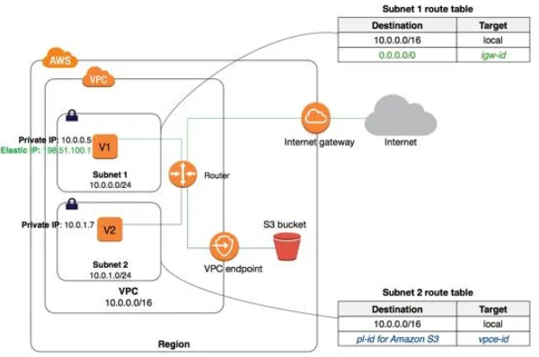
VPC Endpoints

Slide 40
VPC Endpoints
There are 3 types of VPC End points.
1 – Gateway endpoints
2 - Gateway Load Balancer endpoints
3 – Interface endpoints
Gateway Endpoint
Interface Endpoint
supported AWS services: Amazon S3, DynamoDB
You can also create multiple endpoints for a single service, and use different route tables to enforce different access policies from different subnets to the same service.
Endpoints are supported within the same Region only. You cannot create an endpoint between a VPC and a service in a different Region.
Endpoints support IPv4 traffic only.
Demo:
It is an elastic network interface with a private IP address from the IP address range of your subnet.
It serves as an entry point for traffic destined to a supported AWS service or a VPC endpoint service.
Each Interface endpoint can connect to one of many AWS services, or you can connect to an AWS PowerLink powered service.
For each interface endpoint, you can choose only one subnet per Availability Zone.
An interface endpoint supports TCP traffic only. Endpoints are supported within the same Region only.
You cannot create an endpoint between a VPC and a service in a different Region. Endpoints support IPv4 traffic only.

Slide 41
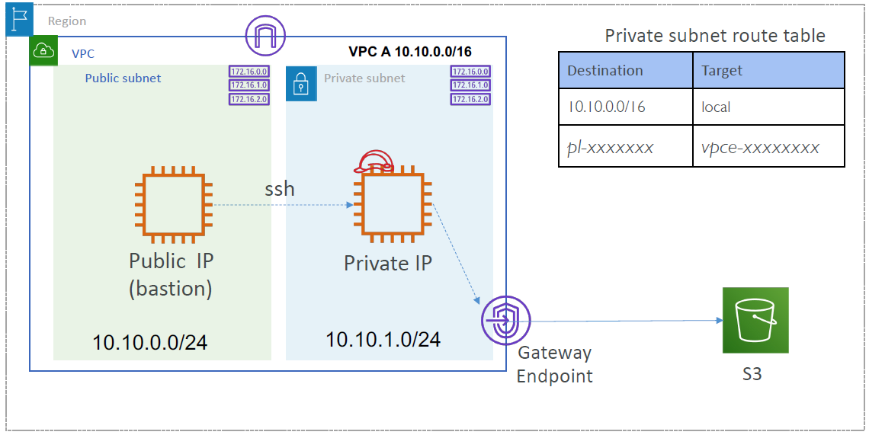
VPC Gateway Endpoint

Slide 42
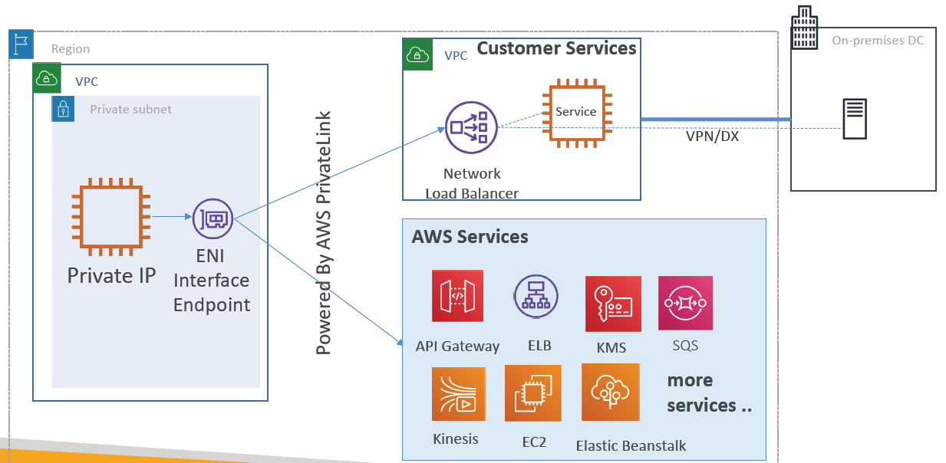
VPC Interface Endpoint
If you have multiple VPCs that need to access a specific service, you can set up an Interface Endpoint in each VPC, ensuring private and secure connectivity without the need for VPC peering or transit gateways. Interface Endpoints can be used to access third-party services offered by AWS partners via AWS PrivateLink

Slide 43
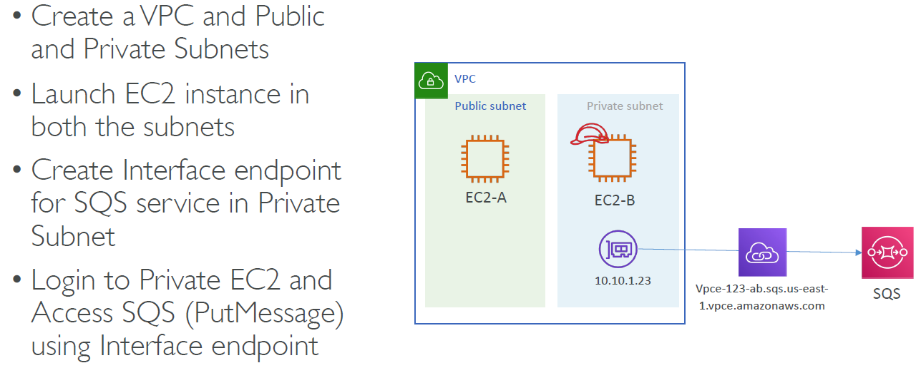
VPC Interface Endpoint -- Demo

Slide 44
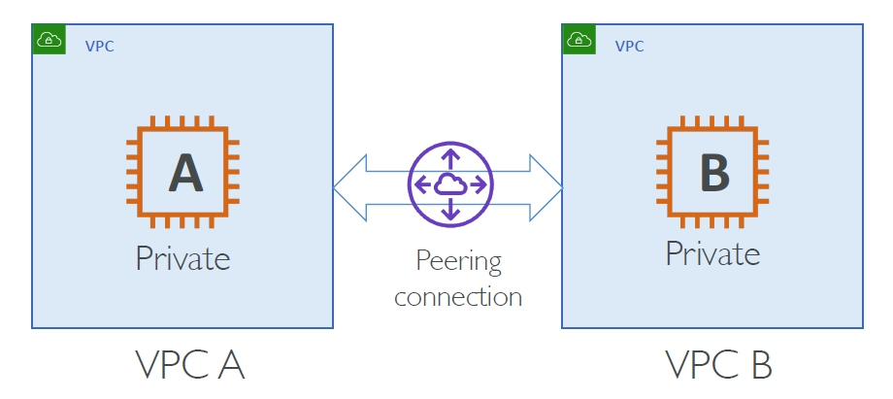
VPC Peering
Connect two VPC, privately using AWS’ network
Make them behave as if they were in the same network
Peered VPCs can be in same AWS region or across AWS regions
You can do VPC peering with another AWS account
VPC CIDRs should be non-overlapping
You must update route tables in each VPC’s subnets to ensure instances
can communicate across VPC
VPC-A to VPC-C is not transitive via VPC-B

Slide 45
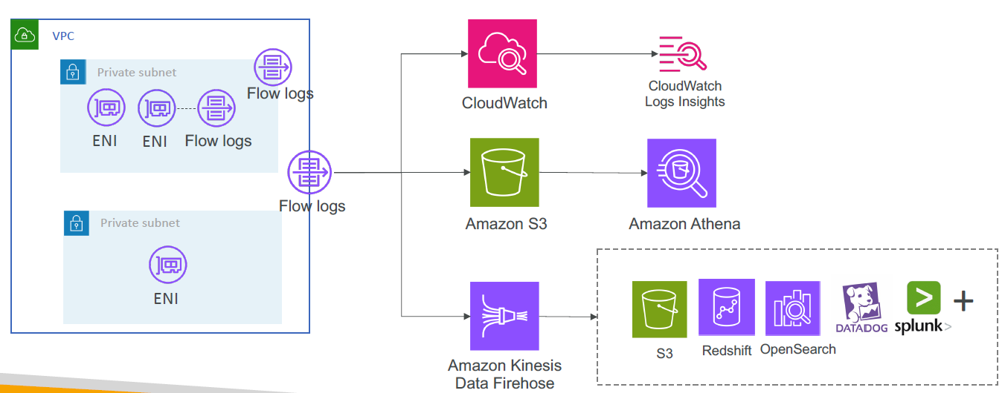
VPC Flow Logs
• Mirrors the traffic flowing in/out of VPC and routes it to network analysis tools to detect the potential network & security anomalies
• Mirror source is ENI
• Mirror target could be another ENI or Network Load Balancer (UDP - 4789)
• Mirror Filter – To capture only the traffic you are interesting in
• Filter the traffic by specifying Protocols, Source/Destination port ranges, and CIDR Blocks
• Define rules (numbered) to send the traffic to respective destination
• The traffic mirror source and the traffic mirror target (monitoring appliance) can be in the same VPC or they can be in a different VPC connected via intra-Region VPC peering or a transit gateway
• Source and Destination can be in different AWS accounts
• Default format: <version> <account-id> <interface-id> <srcaddr> <dstaddr> <srcport> <dstport> <protocol> <packets> <bytes> <start> <end> <action> <log-status>
Notes:
fields @timestamp, @message
| sort @timestamp desc
| limit 10
stats sum(packets) as packetsTransferred by srcAddr, dstAddr
| sort packetsTransferred desc
| limit 15
fields @timestamp, interfaceId, srcAddr, dstAddr, action
| filter (interfaceId = 'eni-xxxxxxxxx' and action = 'REJECT')
| sort @timestamp desc
| limit 5
fields @timestamp, srcAddr, dstAddr
| sort @timestamp desc
| limit 5
| filter srcAddr like "172.31."
fields @timestamp, @message
| stats count(*) as records by dstPort, srcAddr, dstAddr as Destination
| filter dstPort="80" or dstPort="443" or dstPort="22" or dstPort="25"
| sort HitCount desc
| limit 10
fields @timestamp, @message
| stats count(*) as records by dstPort, srcAddr, dstAddr as Destination
| filter dstPort="80" or dstPort="443" or dstPort="22" or dstPort="25"
| sort HitCount desc
| limit 10

Slide 46
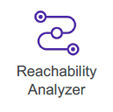
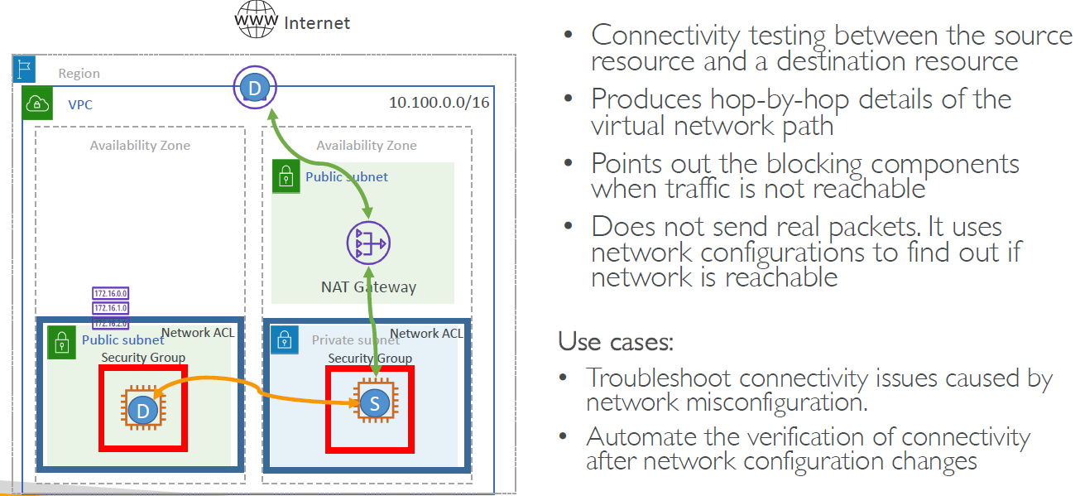
VPC Reachability Analyzer

Slide 47
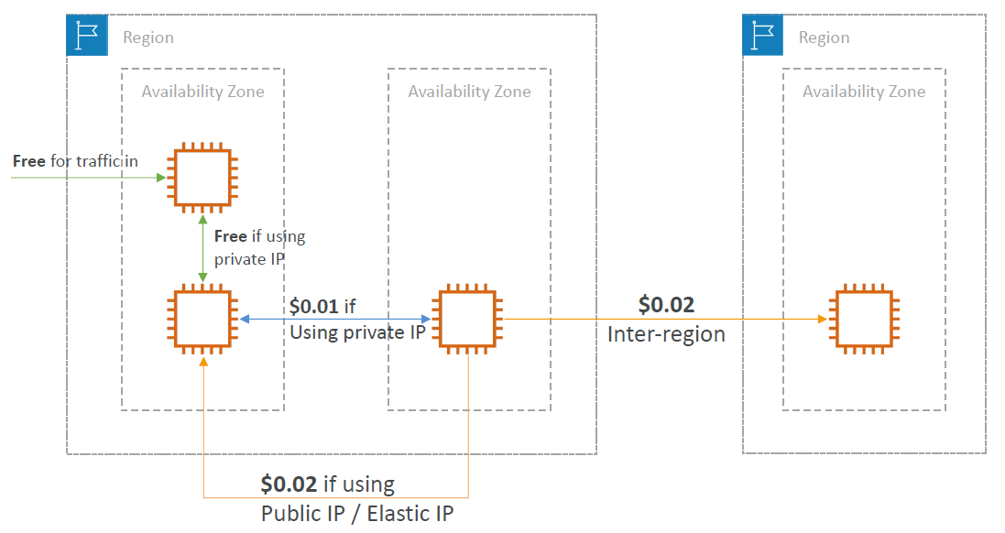
VPC Costs
Costs nothing -- VPC’s, ENI, Route Tables, NACLs, Internet Gateway, Security groups, and subnets, VPC Peering.
Costs something – Elastic IP, NAT Gateway, VPC end point, VPN gateway, customer gateway, transit gateway, etc

