Slide 1

Group Members- K.D.V.C Jayasinghe -AS2021434
P.G.K Sewwandi -AS2021587
M.N.P Wathsala -AS2021551
J.R Jayasinghe -AS2021627
N.T Liyanage -AS2021681
S.M Pawuluwage -AS2021649
K.T Sanchana -AS2021655
J.H.G.S Tharushika -AS2021520
K.N Sathsarani -AS2021511
Y.M.P.N Karunasena -AS2021463
P.W.A.N Dharmarathna -AS2021922

Slide 2
From Grapes to Glass
This project analyzes data from various wine brands across countries to uncover insights about wine ratings, pricing, and customer preferences. It demonstrates the application of data science techniques to a real-world industry problem. The dataset includes statistics from 8 CSV files for different countries and a separate file containing 500 customer reviews
Objectives:
Clean and prepare data for analysis.
Classify data using NLP techniques to identify actionable awareness.
Create an interactive dashboard to visualize and narrate the story hidden in the data.
Tasks were done as:
Maintain a GitHub repository for collaboration and version control.
Data preparation and transformation.
NLP-based classification of customer reviews.
Build a Plotly Dash-based interactive dashboard.
Analysis Done using: Python, GitHub,Pandas,Hugging face
Data Preparation
8 CSV files were used which are included with 500 customer reviews, were merged and identified and removed duplicates and irrelevant records by using Python libraries: Pandas for data manipulation,
NumPy (handling missing data & outliers).

Slide 3
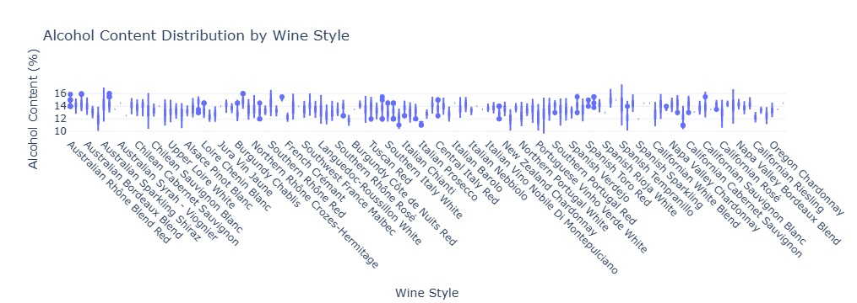
This chart illustrates the amount of missing or irrelevant data removed during the data preparation phase. Each bar represents a specific dataset, with the height corresponding to the number of records eliminated. It highlights the effectiveness of cleaning processes in ensuring data accuracy and completeness.

Slide 4
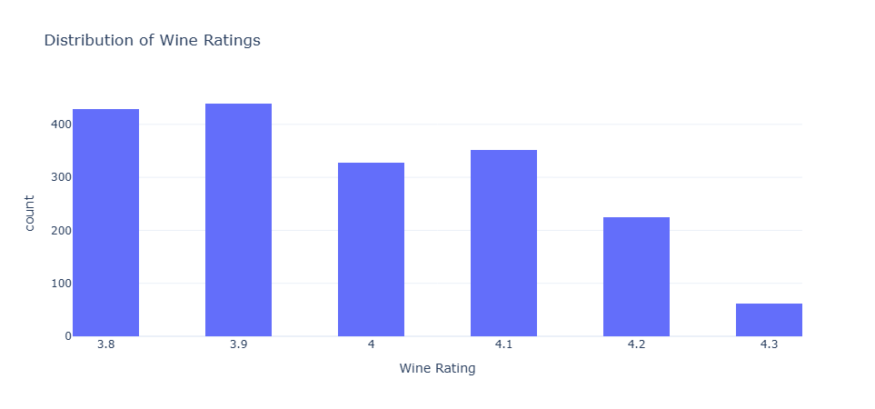
This visualization classifies customer reviews into categories such as "Taste," "Food Pairings," and "Value for Money." Each bar shows the number of reviews within each category, providing insights into the most discussed aspects of wine preferences, with "Taste" often being the most dominant.

Slide 5
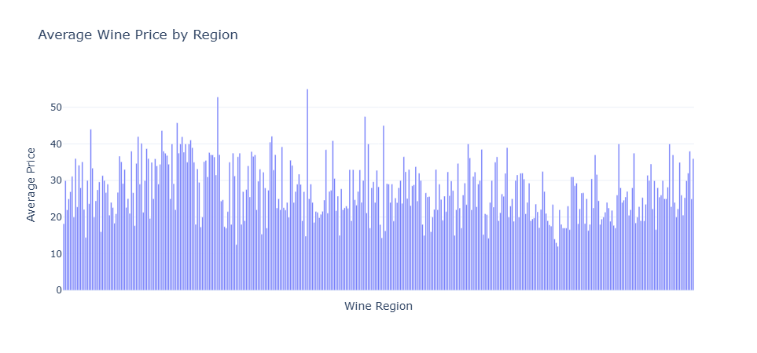
The heatmap visualizes alcohol content trends across different wine-producing regions. Colors represent average alcohol levels, with warmer hues indicating higher percentages. This allows comparison of regional styles and boldness levels, appealing to specific customer preferences.

Slide 6
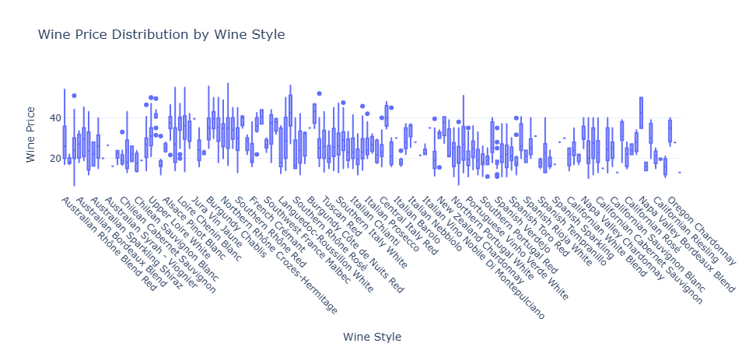
This chart shows the percentage of wines by style (e.g., red, white, rosé) in the dataset. It provides an overview of the most common wine styles, offering insights into the market's diversity and potential gaps in production or consumption trends.

Slide 7
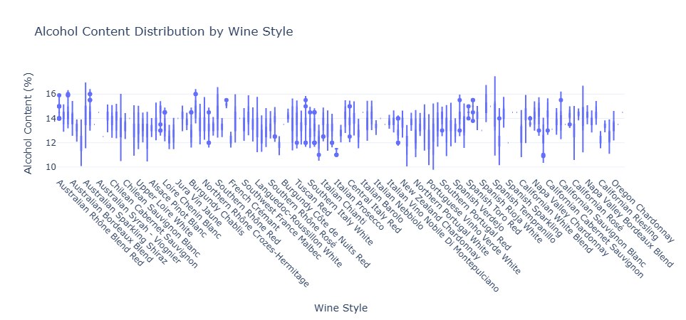
This chart highlights popular food pairings for various wine types. Each group represents a wine type (e.g., red, white), with bars showing the frequency of specific food pairings. It provides practical insights into how customers enjoy their wines with meals.

Slide 8
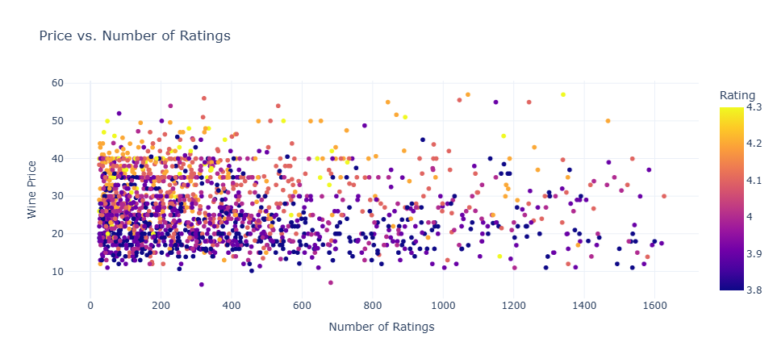
This scatter plot maps wine prices against their average customer ratings. Clusters may show price ranges with high ratings, revealing trends such as value-for-money wines or premium wines consistently rated well. Outliers might suggest overpriced wines with lower ratings.

Slide 9
Conclusion
Summary of Key Outcomes
• The successful integration of data preparation, NLP, and visualization to uncover meaningful insights from wine data.
• Highlights:
• Cleaned and merged datasets to identify trends in wine ratings, prices, and regions.
• NLP-based classification of customer reviews into actionable categories.
• Creation of an interactive dashboard for effective storytelling and analysis.
The model that we used:”facebook/bart-large-mnli”
2. Impact of the Project
• Showcased the practical application of data science in solving real-world problems.
• Provided insights that could support strategic decision-making in the wine industry.
3. Challenges Faced
• Handling missing and inconsistent data across multiple files.
• Selecting an optimal NLP model for review classification.
• Designing a dashboard that is both insightful and user-friendly.
4. Future Work and Recommendations
• Extend the dataset to include more countries and wine types for broader analysis.
• Explore advanced machine learning models for predictive analysis, such as predicting wine ratings or pricing.
• Incorporate sentiment analysis for deeper insights into customer opinions
• Enhance dashboard features with real-time data updates and advanced interactivity.
5. Acknowledgments
• Acknowledge team members, facilitators, and any resources used (e.g., GitHub, Hugging Face, Plotly).You can add visual elements like a team photo, icons representing tools (GitHub, Python, Plotly), or a chart summarizing a key insight for greater engagement.

