Slide 1

React
Team 5
Section-03

Slide 2




Meet the TEAM (https://github.com/sudheera96/React---Workshop--Team5)
Harika Kulkarni | Pruthvi Naskanti | Sri Sudheera Chitipolu | Deekshith Maram
Subtopics- What is React, Why use React. | Subtopics- Important Terminologies, Rendering Elements , JSX , Components and Props. | Subtopics – React Life Cycle. | Subtopic – Demo.
https://github.com/KHARIKA17 | https://github.com/pruthvi-naskanti | https://github.com/sudheera96 | https://github.com/Dixith1196

Slide 3
What is React?
React also known as ReactJS.
React is a Open source JavaScript library for building user interfaces.
It is developed and maintained by Facebook and community.
It is used for handling the view layer for web and mobile apps.
V part of MVC (Model View Controller)
Harika Kulkarni

Slide 4
Why use React?
Simple and easy to implement. The component-based approach, well-defined lifecycle, and use of JSX(JavaScript+HTML) make React very simple to learn and implement.
React allows us to create reusable UI components (extensive code reusability is supported).
ReactJS applications are super easy to test. React views can be treated as functions of the state, So we can manipulate with the state we pass to the ReactJS view and take a look at the output.
Harika Kulkarni

Slide 5
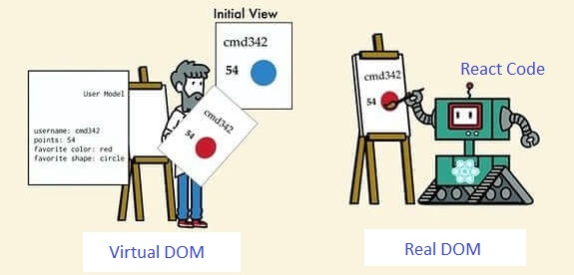
Why use React?
It uses Virtual DOM that makes the app fast.
Virtual DOM (vDOM), as the name suggests, is not a real DOM but its virtual representation.
Whenever any element of a website is modified, a vDOM is updated. The updated VDOM is then compared against a real DOM. This process is used to calculate the minimal set of changes to be applied to the actual DOM.
Rather than update dozens of elements whenever a change is made, ReactJS updates only a single element that was just modified
Harika Kulkarni

Slide 6
Important Terminologies
Rendering Elements
JSX
Components
Props
States
Pruthvi Naskanti

Slide 7
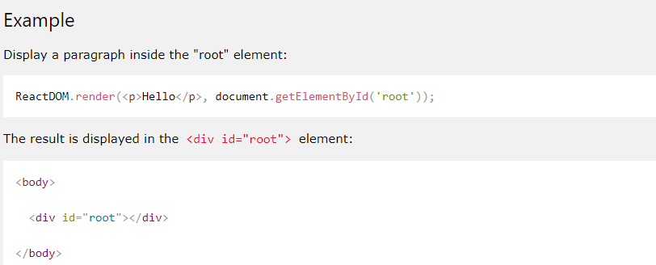
Rendering Elements
Elements are the smallest building blocks of React apps.
React's goal is in many ways to render HTML in a web page.
React renders HTML to the webpage by using a function called ReactDOM.render
The ReactDOM.render() function takes two arguments , HTML code and HTML element
The root node is the HTML element
where you want to display the result.
It is like a container for content managed by React.
Pruthvi Naskanti

Slide 8
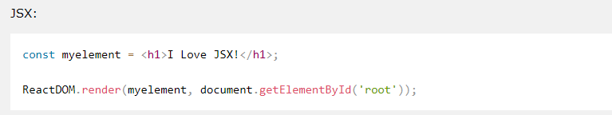
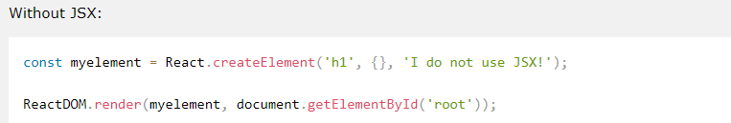
JSX
JSX stands for JavaScript XML.
JSX allows us to write HTML in React.
JSX makes it easier to write and add HTML in React.
Example: with JSX and without JSX
Pruthvi Naskanti

Slide 9
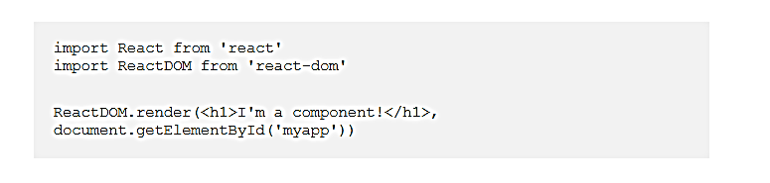
Components & Props
Components in React are independent, reusable pieces of UI.
Components is like JavaScript functions.
Props get passed to the components.
Function parameters.
Props are immutable.
Props- Functional Components
this.props – Class Components
Pruthvi Naskanti

Slide 10
What is React Lifecycle?
React lifecycle is the name given to the set of actions a react component goes through throughout its existence.
SRI SUDHEERA CHITIPOLU

Slide 11
The 3 categories of component actions
MOUNTING
Added to DOM
UPDATING
Rendered
UNMOUNTING
Removed from the DOM
SRI SUDHEERA CHITIPOLU

Slide 12
How many lifecycle methods are there?
MOUNTING | UPDATING | UNMOUNTING
Constructor | 5.componentWillReceiveProps | 9.ComponentWillMount
2.ComponentWillMount | 6.shouldcomponentUpdate
3. Render | 7.ComponentWillUpdate
4.ComponentDidMount | Render
 | 8.ComponentDidUpdate
SRI SUDHEERA CHITIPOLU

Slide 13
React Lifecycle
ComponentDidUpdate
(prev Props, prev State)
START
ComponentWillReceiveProps
(next Props)
ComponentWillUpdate
(next Props, next State)
render
CONSTRUCTOR
(Props)
WAITING
ShouldComponentUpdate
(next Props, next State)
ComponentWillMount
render
ComponentDidMount
ComponentWillUnmount
END
SRI SUDHEERA CHITIPOLU

Slide 14
REFERENCES
https://reactjs.org/
https://www.tutorialspoint.com/reactjs/index.htm
https://www.altexsoft.com/blog/engineering/the-good-and-the-bad-of-reactjs-and-react-native/

Slide 15
ANY QUERIES?

