Slide 1
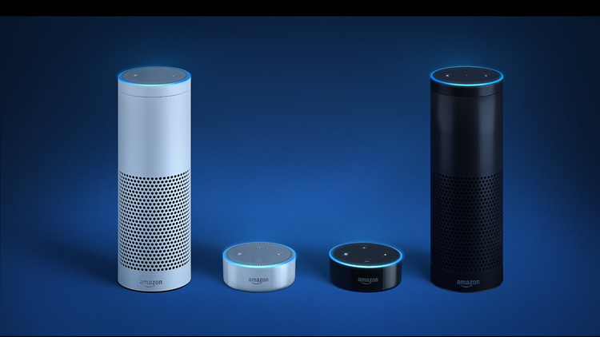
Amazon Alexa
3

Slide 2
Development flow
Introduction to Alexa
Amazon Developer Account
Amazon Web Services
4

Slide 3
Introduction to Alexa
Alexa is a virtual personal assistant designed to compete with the likes of Apple's Siri, Google Home, and others.
Alexa, which was designed by Amazon's secretive Lab126 which can listen to your voice commands and respond with contextual responses to help you get the job done.
Alexa can help you listen to tracks on Spotify, create to-do lists, shop, and even control your smart home products, like Google's Nest thermostat or the Philips Hue.
5

Slide 4
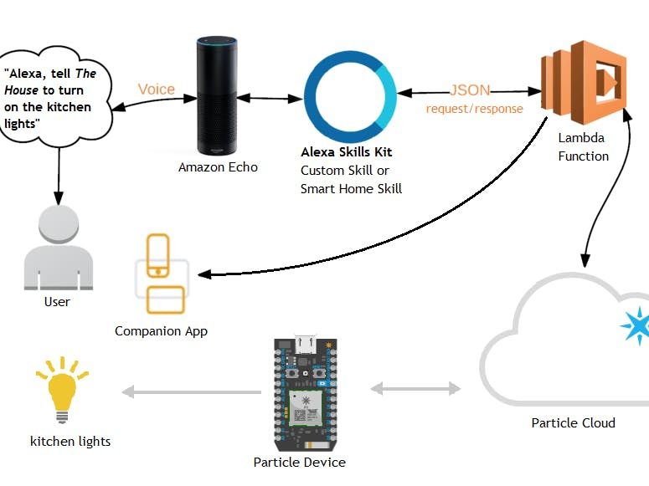
Working Flow
6

Slide 5
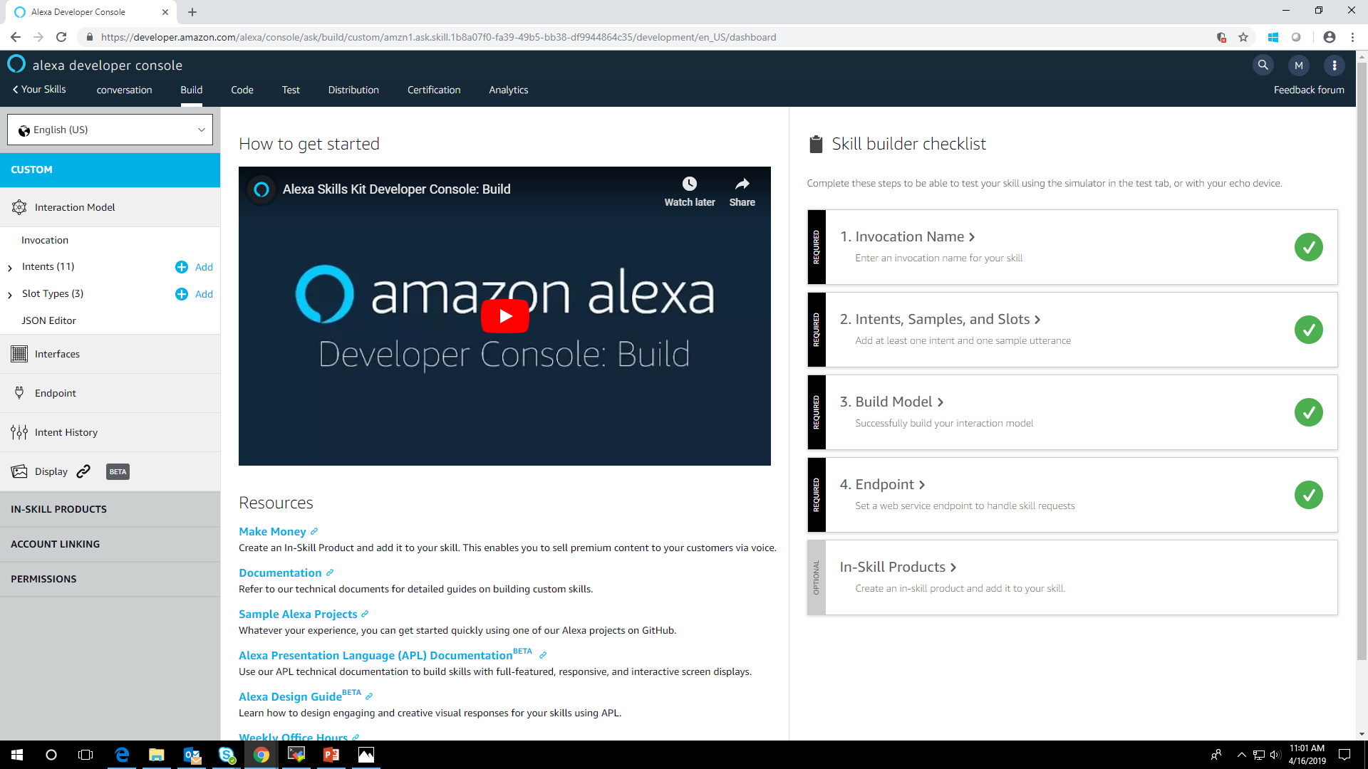
Users say a skill's invocation name to begin an interaction with a particular custom skill.
Intents can optionally have arguments called slots.
An intent represents an action that fulfills a user's spoken request.
The skill service can be either a user implemented web service or the AWS service. This is configured in the “Endpoints”.
7

Slide 6
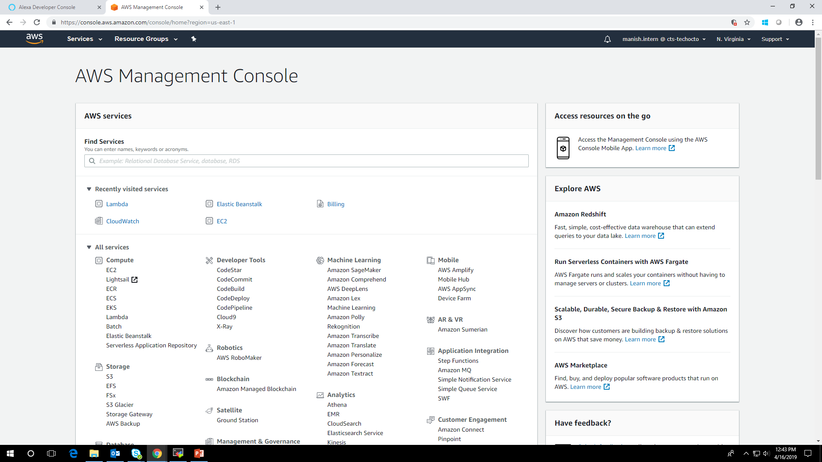
AWS Lambda is a compute service that lets you run code without provisioning or managing servers. AWS Lambda executes your code only when needed and scales automatically, from a few requests per day to thousands per second.
8

Slide 7
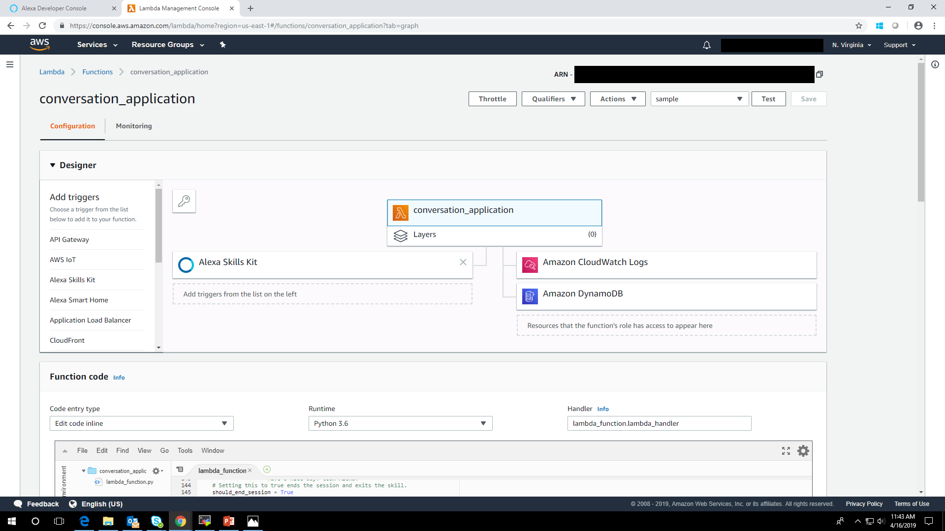
A trigger is required to grant Alexa necessary innovation permission for the created function. A function will be invoked only if the skill ID in the Alexa Skills Kit request matches the skill ID configured in the trigger.
Amazon CloudWatch logs are used to monitor, store, and access your log files from Amazon Elastic Compute Cloud (Amazon EC2) instances, AWS CloudTrail, Route 53, and other sources.
9

Slide 8
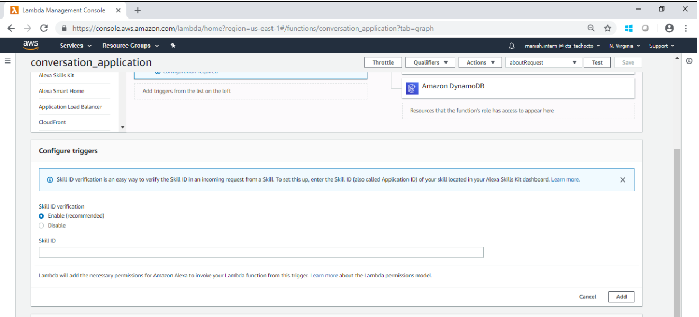
The Skill Id from amazon developer account is Pasted here

Slide 9
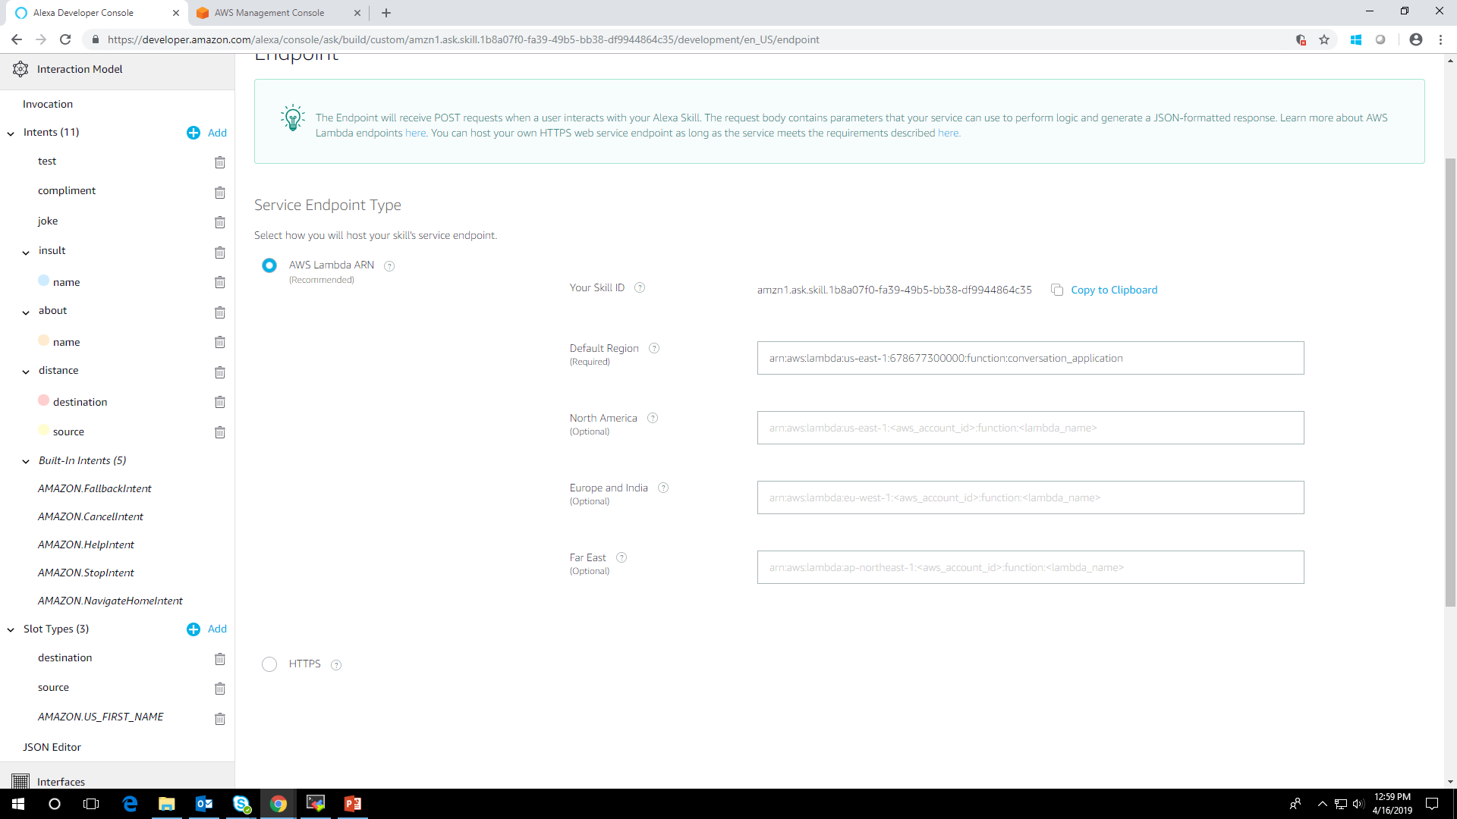
10

Slide 10
Thank you
11

