Slide 1

WhatsApp Order & Booking System
Orders, appointments
& payments on WhatsApp
Built for India’s small local businesses.
No app download for your customers.
Food · shops · clinics · home services
Illustrated pitch · 2026

Slide 2

The problem
Phone calls and messy WhatsApp chats don’t scale
Missed messages
Orders and booking requests get buried.
No structure
No menu, slots, payment trail, or status.
Aggregator tax
Food brands lose 18–30% on apps.
Hard to build alone
Official WhatsApp API is not DIY.
WhatsApp Order & Booking System · Confidential
2 / 15

Slide 3

The solution
Your WhatsApp number becomes the storefront / booking desk
Customer chats → picks items or a time slot → pays (UPI/Razorpay) → you get a clear ops board.
Official Meta WhatsApp Cloud API only. Two product lines: Order (menu + cart) and Booking (appointments / slots).
WhatsApp Order & Booking System · Confidential
3 / 15

Slide 4
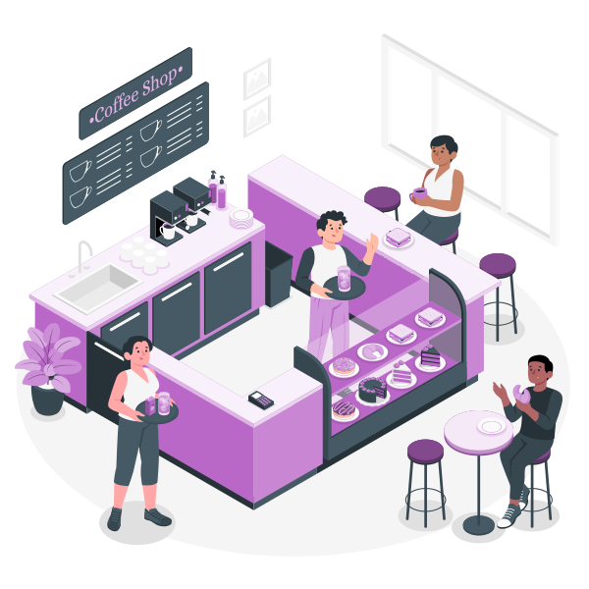


Who this is for
Small local businesses already living on WhatsApp
Order-first
Restaurants, tiffin, bakery, meat, flower, kirana (phase 2)
Booking-first
Clinics, dental, salons, tuition slots, auto service, studios
Repeat-service
Laundry, water can, AC service, pest control, cleaning, tailor
WhatsApp Order & Booking System · Confidential
4 / 15

Slide 5
What you get
Not just a chatbot greeting — a working ops system
WhatsApp storefront
Payments
Ops dashboard
Buttons, lists, cart / slots, confirmations
UPI QR + Razorpay checkout (where needed)
Orders / bookings board, status, CSV export
Customer memory
Alerts
Hosting included
Saved address / last booking, re-order / re-book
Staff notifications + optional kitchen/desk voice alerts
Shared VPS + SSL on All-in Hosted plans
WhatsApp Order & Booking System · Confidential
5 / 15

Slide 6

Plans for small businesses (India)
All-in Hosted · GST extra · Meta marketing messages billed separately
Starter
Growth
Business
Setup (one-time)
₹4,999
₹7,999
₹12,999
Monthly (hosted)
₹1,499
₹2,499
₹3,499
Per paid order / booking
₹8
₹6
₹5
Catalog / menu items*
Up to 40
Up to 100
Up to 250
Go-live
7–10 days
10–14 days
2–3 weeks
Custom plans for bigger businesses (retail 250+ SKUs, multi-outlet, multi-doctor clinics, ERP) — contact us.
*Booking: “items” = services / doctors / rooms. Hosted = shared VPS + SSL. Meta marketing & Maps add-ons extra.
WhatsApp Order & Booking System · Confidential
6 / 15

Slide 7
Why plans cost more as you go up
Price follows complexity — not a random jump
Catalog size
Order / booking volume
Payment & offers
More items = more categories, stock rules, testing, and WhatsApp list design.
Higher traffic needs stronger hosting share, monitoring, and support response.
UPI-only is simple; Razorpay + offers + reminders add build and ops work.
Staff & locations
Custom rules
Support depth
1 phone vs multi-staff / multi-counter needs roles, alerts, and training.
Cutoffs, advance pay, doctor-wise slots, delivery zones — each rule is extra build.
Starter = email/WhatsApp help; Business includes faster response + more changes.
WhatsApp Order & Booking System · Confidential
7 / 15

Slide 8
Plan limits at a glance
So you can match your shop size to a plan
Limit
Starter
Growth
Business
Menu / service items
40
100
250
Categories
5
10
20
Staff WhatsApp admins
1
3
6
Locations / counters
1
1
Up to 3
Razorpay checkout
Add-on / UPI
Included
Included
Offers / broadcasts*
Basic
Yes
Yes + priority
Training sessions
1
2
3
Hypercare after go-live
7 days
14 days
21 days
*Broadcasts use Meta marketing rates (client-paid). Item limits keep WhatsApp UX usable and setup effort predictable.
WhatsApp Order & Booking System · Confidential
8 / 15

Slide 9
What’s included vs extra cost
No surprises after you say yes
Included in All-in Hosted
Extra / client-paid
▸ Shared VPS hosting + SSL
▸ Meta message fees (esp. marketing)
▸ WhatsApp Cloud API setup help
▸ Own custom domain (optional)
▸ Menu / services load (within plan limit)
▸ One-page website if you don’t have one
▸ UPI payment path
▸ Google Maps auto-distance
▸ Admin dashboard
▸ Items beyond plan limit
▸ Basic training + go-live support
▸ Custom workflows / integrations
WhatsApp Order & Booking System · Confidential
9 / 15

Slide 10

Booking businesses (clinics & more)
Same WhatsApp channel — slots instead of a food menu
Patient / client picks doctor or service → date/time slot → optional advance pay → reminder.
Clinics
Diagnostics
GP, dental, physio — cut front-desk phone load
Lab booking + report-ready update
Salons / spas
Coaching
Stylist + slot + festival advance
Demo class / batch seat booking
Workshops
Service bays
Limited seats, waitlist, reminders
Car service appointment windows
WhatsApp Order & Booking System · Confidential
10 / 15

Slide 11
Case study: Amma Chethi Ruchulu
Live reference — food ordering on official WhatsApp
Tenali home-cooked Andhra food brand — production WhatsApp ordering
Lunch/dinner cutoffs, multi-cook menu, Razorpay/UPI, kitchen dashboard, delivery status — running on Meta Cloud API (order.ammachethiruchulu.co.in).
▸ Proof that the stack works in a real kitchen — not a slideware demo
▸ Your business gets a white-label version matched to your menu or booking rules
▸ Live demo shown on the discovery call (we do not publish the ACR order number in the deck)
WhatsApp Order & Booking System · Confidential
11 / 15

Slide 12
How we engage
From first call to first paid order / booking
01
Discovery
Menu or services, volumes, staff, website status
02
Plan match
Starter / Growth / Business / Custom using your limits
03
WhatsApp setup
WABA, number, Meta verification support
04
Configure & train
Load catalog/slots, dry-run with staff
05
Go live
Hypercare window based on plan
WhatsApp Order & Booking System · Confidential
12 / 15

Slide 13
What we need from you
Same checklist we use for official WhatsApp + online payments (India)
Business registration
WhatsApp / Meta
Payments (Razorpay / PhonePe)
• Udyam certificate (PDF) — MSME
• Dedicated +91 mobile number
• Business / current bank account
• PAN (proprietor / business)
• Number free for Cloud API OTP
• Cancelled cheque or bank proof
• GSTIN if you have it
• Business email + phone
• Aadhaar (prop.) if gateway asks
• Shop & Establishment (optional)
• Website or we build one-pager
• Business proof (Udyam / GST)
• Legal name + address (exact match)
• Privacy policy URL (required)
• UPI VPA if starting UPI-only
Names/address must match across Udyam, Meta, website, and payment gateway. We guide uploads; approval is by Meta / Razorpay / PhonePe.
Also share: menu or service list, delivery/booking rules, staff WhatsApp numbers for admin alerts.
WhatsApp Order & Booking System · Confidential
13 / 15

Slide 14
Optional add-ons
Buy only what you need
Meta-ready one-page website
Own domain connect
Google Maps distance
₹2,999 – ₹4,999
₹999 + domain cost
₹999/mo or ₹0.50–1/order
If you don’t have a site yet
Brand URL instead of subdomain
Auto km fee instead of zone buttons
Extra items pack (+50)
Extra training session
Custom workflow
₹1,499 one-time
₹999
₹1,500 – ₹2,500 / hour
When you outgrow plan catalog
New staff / festival rush
Special rules beyond template
WhatsApp Order & Booking System · Confidential
14 / 15

Slide 15
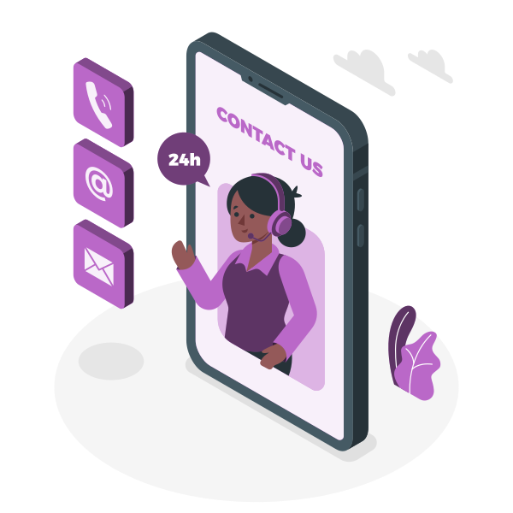

Ready to run orders or bookings on WhatsApp?
Share your menu size or appointment volume — we’ll map you to
Starter, Growth, Business, or a Custom plan.
Book a discovery call
+91 80552 92935
Scan to WhatsApp
Demo on discovery call · ACR case study
Illustrations: Storyset by Freepik (storyset.com) — free use with attribution

