Slide 1
RAG Ingestion and Query Pipeline in AWS
Demo — June 04, 2026
Sudheer Cherukuri
S3
SQS
Lambda
Detect
Parse
Chunk
Embed
OpenSearch

Slide 2
Architecture Overview — Ingestion Pipeline
📁
S3
Upload
📨
SQS
Queue
⚡
Lambda
Function
🔍
Detect
File Type
📄
Parse
PDF
✂️
Semantic
Chunk
🧠
Embed
+ HyQ
🗄️
OpenSearch
+ DynamoDB
Duplicate Check
Magic Bytes
Chunking Params
Storage
SHA-256 hash
→ DynamoDB GSI
%PDF, PK, D0CF
→ File type
MAX=448 tokens
OVERLAP=64
Vectors → OpenSearch
Meta → DynamoDB
AWS Services Used: S3 · SQS · Lambda · DynamoDB · OpenSearch · Bedrock (Titan + Nova)
⚠️ Production Pattern:
SQS has a Dead Letter Queue (DLQ) — failed messages land here after 3 retries. This prevents data loss silently. SQS Visibility Timeout = 300s (must match Lambda timeout).

Slide 3
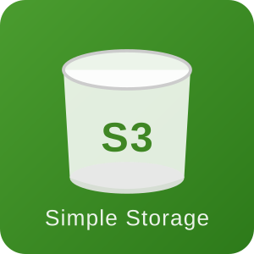

S3 – Simple Storage Service
S3 is a shared storage – like a network drive
Any user or system with right permissions can read from it and upload files to it.
ECM Case Jacket already uses S3 to store legal documents — RAG pipeline does the same, storing uploaded PDFs here as the starting point.
Files are durable – AWS guarantees the file won't be lost
Every file has a unique path — bucket name + file name
S3 is smart — when a new file arrives, it automatically notifies other systems. No manual trigger needed.
AWS S3
S3 Upload
Our Bucket: rag-raw-911414006786 — where uploaded PDFs land

Slide 4
S3 Upload — How Files Enter the Pipeline
🖥️ Console Upload
⚡ CLI / SDK (Production)
• Drag & drop files in AWS Console
• Great for demos and one-off uploads
• Instant visual feedback
• No CLI setup needed
aws s3 cp file.pdf s3://rag-raw-911414.../
• Used in CI/CD pipelines
• Can batch upload entire folders
• Pre-signed URLs – used in regulated industries like health care, legal, and finance
🏭 Production Approach
In real enterprise systems, uploads come from:
Applications (e.g. document management system auto-syncs to S3) Batch Jobs (nightly ETL drops thousands of PDFs) Human Review Portals (intake forms that upload directly to S3 via pre-signed URLs)
Bucket: rag-raw-911414006786

Slide 5

SQS – Simple Queue Service
SQS is a message queue — holds notification tickets until a processor picks them up
S3 Upload triggers an event and creates a queue entry in SQS.
Pega Queue Processor picks up items one by one — Lambda does exactly this with SQS messages
When a PDF lands in S3, SQS receives a ticket — file name, bucket name, timestamp. Lambda picks it up immediately.
If processing fails, ticket stays in queue and retries automatically — no silent failures
After max retries, message moves to Dead Letter Queue (DLQ) — inspect and replay (covered in detail on next slide)
SQS Queue
Our Queue: rag-ingestion-queue – where S3 drops tickets on new PDF upload

Slide 6
Sample SQS Event
{
"source": "SQS — rag-ingestion-queue",
"event": "S3 Upload Detected",
"bucket": "rag-raw-911414006786",
"file": “CourtCase.docx",
"size_bytes": 31626,
"size_readable": "30.9 KB",
"event_time": "2026-05-17T22:06:49.837Z"
}

Slide 7

Lambda – Serverless Computing
•
Lambda is a program that runs automatically when triggered — no server to manage, no always-on process waiting
•
Pega Agent runs background processing when invoked — Lambda does the same, but triggered by an SQS message instead of a Pega schedule
•
No file sits idle — the moment Lambda picks up the SQS ticket, it starts processing the PDF immediately
•
Lambda runs only when needed and stops when done — you pay only for the seconds it runs, not 24/7
•
If Lambda fails, SQS keeps the ticket and retries automatically — same safety net as Pega’s retry mechanism
•
Our Lambda: rag-document-processor — picks up SQS tickets and runs the full ingestion pipeline

Slide 8
S3 → SQS — Why Not Trigger Lambda Directly?
S3
Upload
S3 Event
Notification
SQS
Queue
Lambda
Trigger
Process
File
🔁 Automatic Retry
🛡️ Dead Letter Queue
If Lambda fails, SQS redelivers the message automatically up to 3 times — no manual intervention.
After 3 failures, message goes to DLQ. Nothing is lost silently. You can inspect and replay.
🚦 Rate Control
🔌 Decoupling –Separation of concerns
SQS acts as a buffer. If 100 files arrive at once, Lambda processes them at a safe rate — no throttling.
S3 doesn't know about Lambda. Swap Lambda for AWS Batch tomorrow — S3 doesn't change at all.
Real Bug We Hit
Default SQS Visibility Timeout = 30s | Lambda took ~35s → SQS thought Lambda failed → Redelivered → Duplicate processing! Fix: set to 300s

Slide 9
Lambda Limits — When to Switch to AWS Batch
⚡ AWS Lambda
🏗️ AWS Batch
✅ Max timeout: 15 minutes
✅ Max RAM memory: 10 GB
✅ Package size : 50 MB direct upload,
250 MB through S3,
10 GB through Container Image
✅ Great for: small–medium PDFs (<100 pages)
✅ Scales instantly, pay-per-invocation
❌ Fails: 1,000-page PDF takes 20–30 min
✅ No timeout — runs as long as needed
✅ Fully managed container (Docker)
✅ Right-size CPU/RAM per job
✅ Spot instances = 70–90% cost savings
⚙️ Trade-off: cold start 1–2 min overhead
❓ Why AWS Batch over Step Functions?
Step Functions orchestrates workflow steps but each step still runs inside Lambda — so the 15-min limit still applies per step. AWS Batch runs full containerized jobs without any time limit. For long-running CPU/GPU processing, Batch is the right tool. Step Functions can CALL Batch to get the best of both.

Slide 10
Lambda + AWS Batch — Hybrid Architecture
S3 Upload
SQS Queue
Router Lambda
(checks size)
Lambda
≤ 100 MB
AWS Batch
> 100 MB
routes by size
⚡ Lambda — Small Files (≤ 100 MB)
🖥 AWS Batch — Large Files (> 100 MB)
Starts instantly — no cold start delay
Runs in ~35 seconds for legal PDFs
Pay only for seconds it runs
Auto-scales per file — no config needed
Handles 80% of org data (small PDFs)
15-min timeout — well within limit
Package: ZIP file (50MB zip / 250MB unzipped)
Runtime: AWS provides Python automatically
No timeout — runs as long as needed
Full Docker container — same code, more power
Right-size CPU & RAM per job
Spot instances = 70–90% cost savings
Handles 20% of org data (large PDFs)
Trade-off: 1–2 min cold start overhead
Package: Docker image (no size limit)
Runtime: You include Python in container
80% of files
handled by Lambda
20% of files
routed to AWS Batch
Same business logic
different runtime

Slide 11
Duplicate Detection — SHA-256 Content Hash
Download file
to /tmp/
SHA-256
hash bytes
Query DynamoDB
GSI
Duplicate?
Skip!
New file?
Process
🔐 What is SHA-256?
Example Hash Output:
A cryptographic function that produces a 64-character hex fingerprint of any file's raw bytes. Same content = same hash always. Even 1 byte different = completely different hash.
We hash the FILE BYTES — not the filename. Renaming "contract.pdf" to "final_v2.pdf" does NOT fool it.
a3f9d72c1b84e65d
02ca7f3b91e48d2a
7c305f6e8b12a94d
1fe76c2d30849b5e
❓ Re-upload same file?
❓ Upload modified file?
Hash matches DynamoDB → skip entirely. No reprocessing, no duplicates in OpenSearch.
Hash is different → delete old chunks from OpenSearch → reprocess fresh. No stale data.

Slide 12

DynamoDB — Metadata Store & GSI Explained
Table Schema: rag-metadata
🗂 What is a GSI?
Field | Type | Role
document_id | String (PK) | S3 key — primary lookup
content_hash | String (GSI) | SHA-256 — duplicate check
file_type | String | pdf / docx / unknown
blocks | Number | Paragraphs parsed
chunks | Number | Chunks created
status | String | completed / failed
timestamp | String | ISO datetime
GSI = Global Secondary Index
DynamoDB's primary key is document_id (filename). But we need to search by content_hash.
Without GSI: Full table scan = slow + expensive
With GSI: Instant lookup on content_hash field
GSI records are stored internally — won't appear like a regular DB Index.
Think of it as:
PK → "give me metadata for this file"
GSI → "has this content been seen before?"
💡 Why DynamoDB for Metadata?
Millisecond reads at any scale. No schema migrations. Pay-per-request at POC scale = ~$0/month. Stores processing results (blocks, chunks, status) as an audit trail — if Lambda fails, you know exactly where it stopped.

Slide 13
Magic Bytes — Detecting File Type the Right Way
🔍 What are Magic Bytes?
Why ignore extensions?
The first few raw bytes of a file contain a unique signature the OS uses to identify its true type. File extensions can be renamed or faked — magic bytes cannot. We read the actual binary content, not the filename.
Rename malicious.exe → report.pdf and the extension check passes. Magic bytes won't lie — .exe starts with MZ, never %PDF.
PDF
DOCX / XLSX
Legacy XLS
25 50 44 46 → "%PDF"
50 4B 03 04 → "PK\x03\x04"
D0 CF 11 E0 → "ÐÏ.à"
PNG
JPEG
ZIP
89 50 4E 47 → "\x89PNG"
FF D8 FF → "\xFF\xD8\xFF"
50 4B 05 06 → "PK\x05\x06"
🚨 What Happens if Magic Byte Check Fails?
Unknown type detected → File saved as 'rejected' in S3 → DynamoDB status = 'rejected' → Lambda returns cleanly (no crash, no infinite retry).
Invalid file uploaded → Same path. The file never reaches the parser. Your pipeline stays clean.

Slide 14
PDF Parsing — From Raw Bytes to Structured Blocks
CHOSEN
pypdf ✅
pdfplumber
PyMuPDF
✅ No heavy dependencies. Pure Python. No cryptography package conflict.
✅ Extracts tables and layout info accurately.
✅ Very fast, rich layout data.
❌ Single \n between lines (no paragraph breaks natively).
❌ Requires cryptography package — caused pip dependency conflict in Lambda.
❌ C extension — harder to package for Lambda.
Before Fix: Page-Level Parsing
After Fix: Paragraph-Level Parsing
• 23 large page-level blocks
• One chunk = entire page
• Context lost — no section awareness
• Poor retrieval quality
• 75 paragraph-level blocks
• Headings detected via short titlecase
• Section name tracked per block
• 56 precise chunks → better retrieval
📊 Test File: johnson_v._superior_court_1.pdf (CT legal case) → 75 blocks · 56 chunks · 168 HyQ questions

Slide 15
Semantic Chunking — Split by Meaning, Not by Size
What is Semantic Chunking?
Instead of slicing every 500 tokens blindly, we embed each paragraph and measure how similar adjacent paragraphs are. When topics change (low similarity), we start a new chunk. Result: each chunk is topically coherent.
📖 Simple Example
⚙️ Parameters
✂️ Split Triggers
P1: 'The plaintiff filed a motion...'
MAX tokens
448
1. Cosine similarity
drops below 0.75
P2: 'The court reviewed the motion...'
OVERLAP
64
↔ sim: 0.92 → SAME CHUNK
Final max
512
2. Token budget
exceeds 448
P3: 'The defendant's attorney argued...'
↔ sim: 0.88 → SAME CHUNK
Split threshold
0.75
P4: 'Court costs are calculated by...'
↔ sim: 0.41 → NEW CHUNK ✂️
Embed model
Titan v1
3. New section
heading detected
P5: 'Attorney fees under Rule 11...'
↔ sim: 0.85 → SAME CHUNK
Merge Approach:
Paragraphs accumulate in a group until a split trigger fires. The last group is always flushed after the loop (otherwise the final chunk is never emitted). 64-token overlap is carried into the next chunk for context continuity.

Slide 16
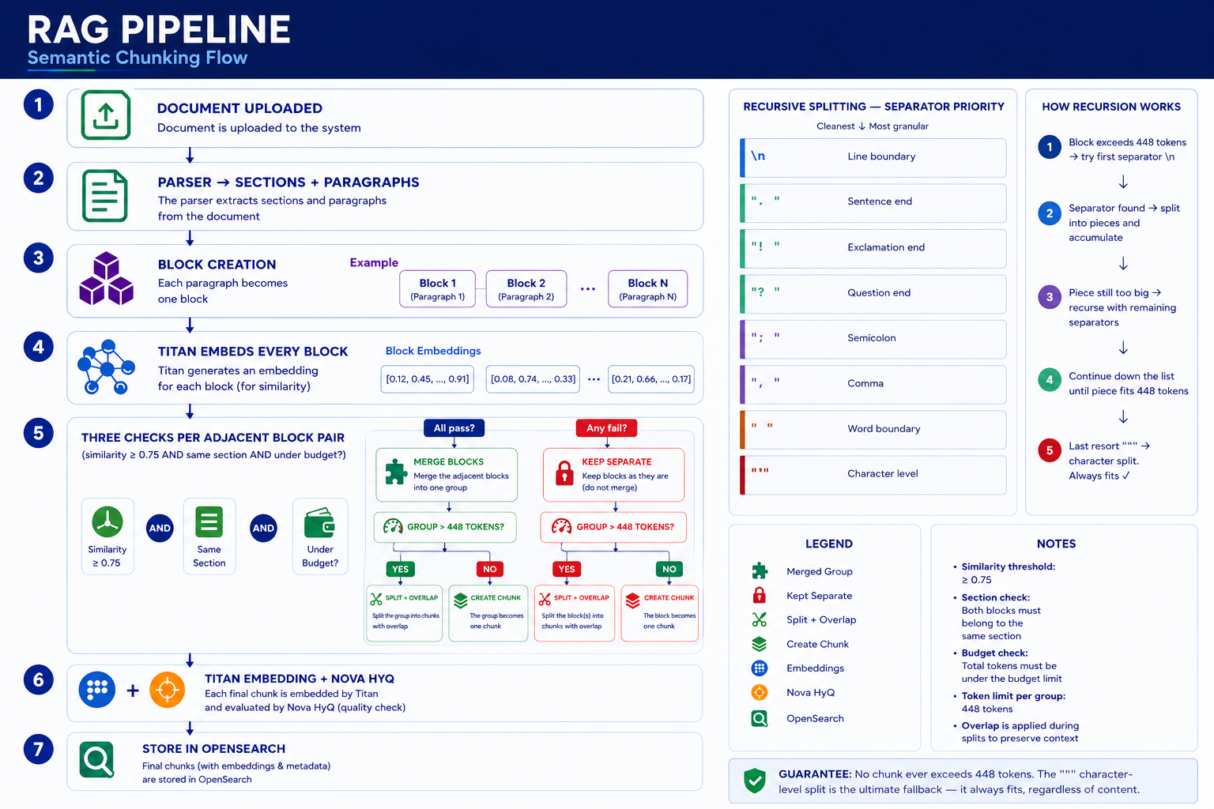

Slide 17
Compressed vs Spread Embedding Models
Compressed: small city — everyone lives close together. Spread: large country — different topics live in clearly separate regions.
 | Compressed (Titan v1, Ada-002) | Spread (text-embedding-3-large, Cohere v3)
How vectors are distributed | Tightly packed together | Spread across full vector space
Same topic similarity | 0.90 – 0.98 | 0.85 – 0.95
Related but different topic | 0.60 – 0.75 ← scores HIGH | 0.35 – 0.55 ← scores LOW
Completely different topic | 0.30 – 0.50 | 0.05 – 0.25
Good split threshold | 0.70 – 0.75 | 0.50 – 0.60
Example: "Court filed" vs "Court costs calculated" | sim = 0.62 → threshold 0.75 catches split ✅ | sim = 0.45 → threshold 0.75 over-splits ❌
Rule: Calibrate threshold per model. Test known similar and dissimilar paragraph pairs. Find where similarity naturally drops off for that model — set threshold just above that floor.

Slide 18
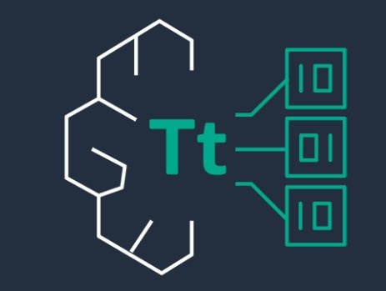



Titan Embeddings — Making Chunks Searchable
Each chunk → Bedrock Titan → 1,536-dimension vector (a list of 1,536 numbers capturing semantic meaning)
Similar Topics Cluster Together
Enables KNN Search
One Embedding Per Chunk
Chunks about court motions land near each other in vector space. Chunks about weather land far away. Meaning drives proximity.
At query time — embed the question, find the nearest chunk vectors. Find by meaning, not just keywords.
K-NN – find K number of Nearest Neighbors.
FAISS – Facebook AI Similarity Search Library.
FAISS library uses HNSW - Hierarchical Navigable Small World – this is indexing technique for find ANN
Generated once at ingestion. Stored in OpenSearch. Reused for every query. No re-embedding cost at query time.
Powered by AWS Titan
Chunk Text
→
Bedrock Titan
→
1,536 floats
→
OpenSearch
rag-chunks index

Slide 19

HyQ — Hypothetical Questions at Ingestion
For each chunk, Nova Micro generates 3 questions the chunk could answer. Stored as plain text in OpenSearch alongside the chunk.
💬 HyQ Example — Legal Document Chunk
Chunk text: "The plaintiff argued that the court lacked jurisdiction over the matter..."
aws
Nova
HyQ 1: "What did the plaintiff argue?"
HyQ 2: "On what grounds did the plaintiff challenge jurisdiction?"
HyQ 3: "What legal argument was raised about court authority?"
3
56
168
×
=
HyQ questions
per chunk
chunks in
johnson_v_superior_court.pdf
HyQ questions
total
Why it works: User questions match pre-generated questions far better than raw chunk text. Question-to-question matching beats question-to-document matching.

Slide 20
Why Store HyQ as Text — Not Embeddings?
✅ Current Approach
HyQ as Text (BM25)
⚠️ Alternative
HyQ as Embeddings (KNN)
BM25 keyword search on question text
2× weight on HyQ fields in hybrid search
User types 'plaintiff argued' → exact keyword match
Fast, zero extra Bedrock API cost
Gets 90% of the benefit
Embed each HyQ → KNN semantic search
Finds semantically similar questions
More powerful — catches paraphrases
3× embedding cost at ingestion
Separate KNN index + added query latency
VS
Decision: Text BM25 gets 90% of the benefit at a fraction of the cost. For a POC, this is the right trade-off. Production upgrade path: add HyQ embeddings when retrieval quality needs to improve.

Slide 21

OpenSearch Storage
AWS OpenSearch
Index Structure & KNN
📋 Index: rag-chunks — Fields
🔍 Why KNN? How Does It Work?
text
Chunk paragraph text (BM25 searchable)
KNN = K-Nearest Neighbours
At query time:
embedding
1536-dim Titan vector (KNN searchable)
1. User question → embed → 1536-dim vector
hyq_questions
3 generated questions (BM25, 2× weight)
2. Find the K closest stored vectors (cosine similarity)
3. Return those chunks — semantically similar even if no keyword overlap
source_key
S3 filename — for attribution
Engine: FAISS + HNSW graph (fast approximate search)
FAISS – Facebook AI Similarity Search Library. HNSW - Hierarchical Navigable Small World
Similarity: Cosine (angle between vectors — ignores magnitude)
page
Page number from PDF
Dimensions: 1,536 (Titan v1)
section
Detected section heading
⚡ Hybrid Search: BM25 + KNN Combined
chunk_index
Position within the document
BM25 catches exact keyword matches ("plaintiff argued"). KNN catches semantic matches ("what the claimant claimed"). min_max normalization makes scores comparable. arithmetic_mean combines them. Either alone misses valid results.
Note: CloudWatch monitoring not added in this POC — planned for Month 4 post-demo roadmap.

Slide 22
🛡️ Security — How Lambda Accesses AWS Services
🛡️ IAM Role: rag-document-processor-role
🔑 How STS Works
Service
boto3 / Client
What Lambda Does
No passwords. No API keys.
No secrets stored anywhere.
S3
boto3.client('s3')
Download PDF, save chunks JSON
1. Lambda starts → AWS auto-attaches IAM Role
DynamoDB
boto3.resource('dynamodb')
GSI duplicate check, write metadata
Bedrock
boto3.client('bedrock-runtime')
Titan embed, Nova HyQ+HyDE+answer, Cohere rerank
2. boto3 silently calls STS → gets temp credentials (expire ~1hr)
SQS
boto3.client('sqs')
Read messages, delete after success
3. Every API call is signed with those credentials
CloudWatch
LambdaBasicExecutionRole
Write logs automatically
OpenSearch
AWS4Auth (requests)
Sign HTTP requests via STS. Endpoint from SSM Parameter Store
4. Each service checks IAM policy → allows or denies
💡 Production Security Pattern
One IAM Role unlocks all services via STS temp credentials — no passwords stored anywhere. OpenSearch URL in SSM Parameter Store. OpenSearch admin creds in Secrets Manager (dashboard only — Lambda never touches them). Zero hardcoded credentials.

Slide 23
Reupload & Reprocessing — What Happens?
📄 Scenario 1: Same File Re-Uploaded
✏️ Scenario 2: Updated File Re-Uploaded
1. File arrives at Lambda via SQS
1. File arrives at Lambda via SQS
2. SHA-256 hash computed from bytes
2. SHA-256 hash computed from bytes
3. GSI query on DynamoDB → MATCH found
3. GSI query on DynamoDB → NO match
4. Lambda logs: "Duplicate detected"
4. Full pipeline runs (detect → parse → chunk)
5. Returns immediately — zero processing
5. delete_old_chunks() removes stale OpenSearch docs
6. No new OpenSearch documents
6. New chunks + embeddings indexed fresh
7. No DynamoDB update
7. DynamoDB record updated with new hash
✅ Result: No duplicates. Idempotent pipeline.
✅ Result: Old data removed. Fresh data indexed. No stale chunks.
🔑 Key Function:
delete_old_chunks(source_key)
— queries OpenSearch by source_key, deletes all matching docs before re-indexing. Prevents the same file from accumulating duplicate vectors over multiple uploads.

Slide 24
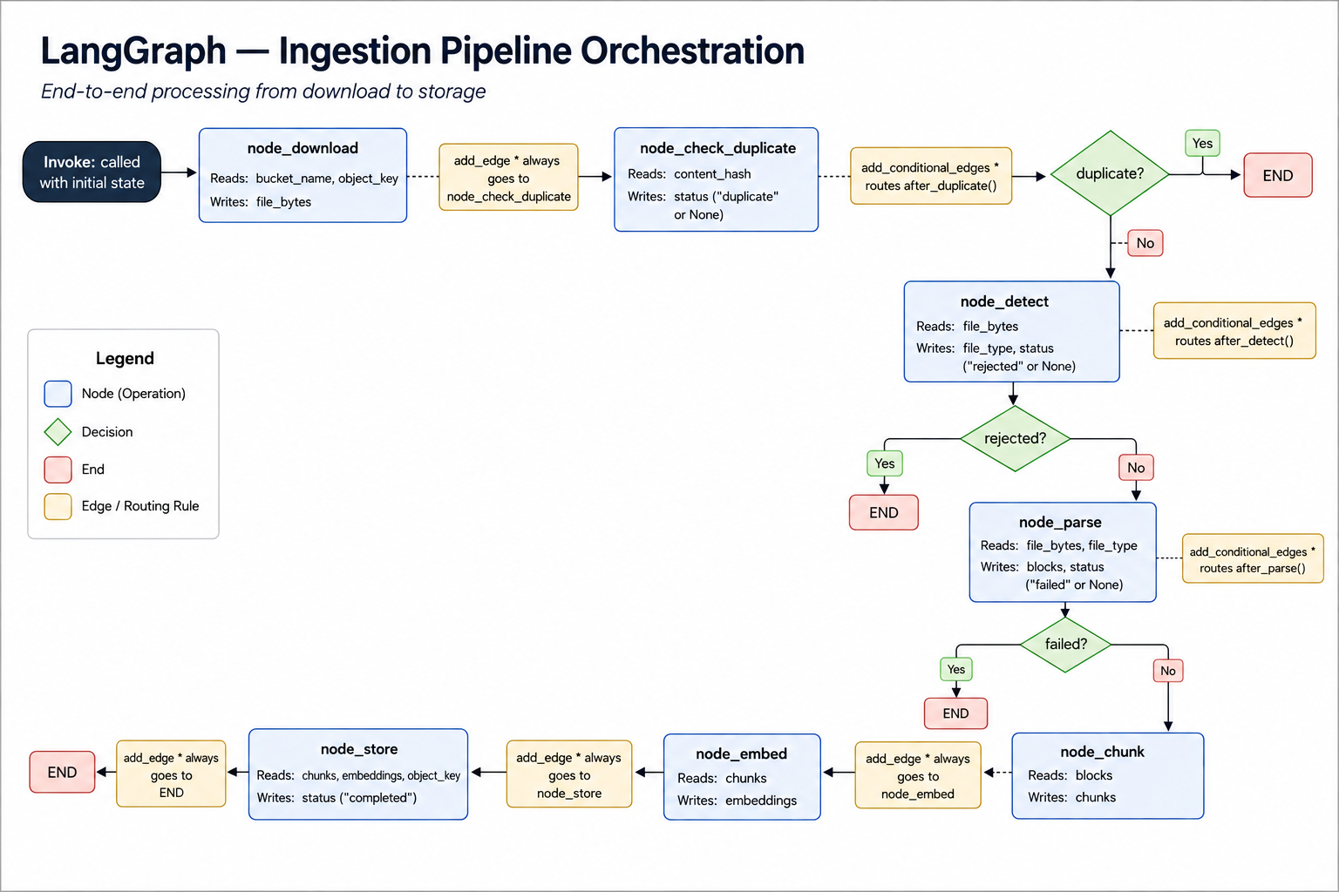

Slide 25
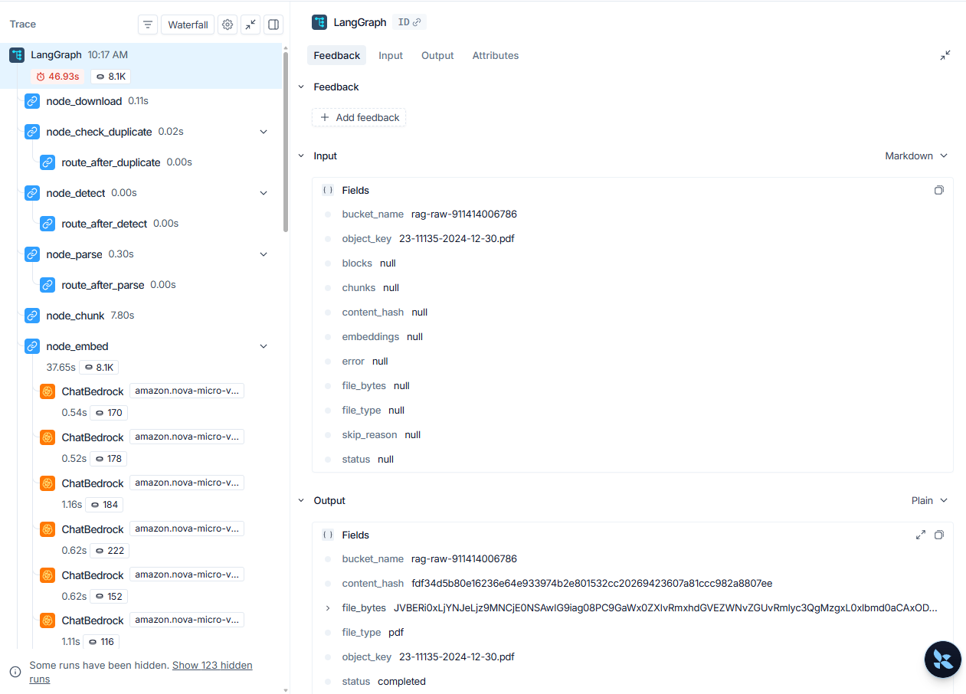
LangGrapha Tracing in LangSmith

Slide 26
Query Pipeline Architecture
🖥️ React UI
🔐 Cognito Auth
🚪 API Gateway
⚡ Lambda
CloudFront HTTPS
JWT Token
API Key + JWT
rag-query
1
2
3
4
5
💡 HyDE
🔀 Hybrid Search
🏆 Cohere Rerank
🔁 Dedup Page
🤖 Nova Answer
Nova → hypothetical
answer → Titan embed
BM25 (text+HyQ 2×)
+ KNN → top 10
Cross-encoder
rescores → top 5
Remove overlapping
page results
Grounded answer
from top chunks
📤 JSON Response
answer · page · section · relevance score
HyDE
BM25 + KNN
Cohere Rerank
Nova Micro
Embed answer, not question
Keyword + semantic search
Cross-encoder precision
Grounded generation
Full deep-dive coming June 4 — today was the foundation that makes this possible

Slide 27
HyDE — Hypothetical Document Embedding
Why questions and answers live in different vector spaces
❌ The Problem
✅ HyDE Solution
User question: "What was Johnson convicted of?"
→ Short, sparse, interrogative style
→ Vector lands in
QUESTION space
→ Far from stored legal paragraphs
HyDE passage: "Johnson was convicted of flag
desecration under Texas Penal Code §42.09..."
→ Long, dense, declarative style
→ Vector lands in
ANSWER space → Close to stored chunks
Live Example Flow
Question
"What was Gregory Johnson convicted of?"
Nova Micro
Generates
"Johnson was convicted of flag desecration under Texas Penal Code
§42.09(a)(3), arising from burning an American flag during a 1984 protest."
Titan Embeds
[0.0231, -0.0847, 0.1203, ...] — 1536 float values → used for KNN search
⚠️ HyDE Hallucination Safety: If the HyDE passage is wrong, KNN still finds semantically similar chunks — wrong facts won't corrupt search direction. Fallback: use raw question if HyDE LLM fails.

Slide 28
HyDE — How It Improves Retrieval
Example Query: "Was Johnson punished for what he did?"
❌ Without HyDE
• Query is vague and sparse
• Uses 'punished' while chunk says 'convicted'
• Poor vector similarity
• Wrong chunks returned
✅ With HyDE
• Nova generates: "Johnson was found guilty of flag desecration
and sentenced under Texas state law..."
• Adds words: guilty / convicted / sentenced / Dallas
• Vector lands in answer space — close to stored chunks
• Search retrieves the correct chunk
Note: The HyDE passage is never shown to the user.
It is discarded after retrieval. Faithfulness = 1.00.
🔑 Key Insight
HyDE improves retrieval by converting a short vague question into answer-like semantic language.
"A compass, not a GPS."
HyDE does NOT need to be factually correct — it needs to point the vector in the right direction.
Runs at: Query time only
HyDE runs only at query time. The generated passage is used for vector search and discarded afterward. It never appears in the final answer.

Slide 29
HyQ — Making Chunks Searchable by Questions
Same Example Query: "Was Johnson punished for what he did?"
❌ Without HyQ
• BM25 relies on exact word overlap
• 'punished' doesn't match 'convicted'
• Relevant chunk ranks low — may never reach top 10
✅ With HyQ
Generated at ingestion time (3 questions per chunk):
• "What was Johnson convicted of?"
• "What sentence did Johnson receive?"
• "What crime did Johnson commit?"
These questions are stored in OpenSearch alongside the chunk.
BM25 searches them with weight 2x — question matches question.
Chunk BM25 score jumps from low to high — surfaces in top 10.
⚡ Why It Works
HyQ improves lexical recall by storing question-shaped metadata alongside every chunk at ingestion.
No extra query-time cost.
HyDE vs HyQ:
HyDE fixes the query side at runtime (KNN).
HyQ fixes the
document side at ingestion (BM25).
Together they attack the same retrieval gap from both ends.
HyDE improves the query side (semantic/KNN). HyQ improves the document side (BM25). Together they improve recall and answer quality.

Slide 30
Hybrid Search — BM25 + KNN
Two complementary signals combined via min-max normalization
BM25 — Keyword Search
KNN — Vector Search
Input: Raw user question
Searches: text field (weight 1.0)
hyq_questions (weight 2.0)
Scores: TF × IDF with saturation
Good for: Exact legal terms
"flag desecration", "§42.09", "Texas statute"
Input: HyDE vector (1536-dim)
Searches: embedding field
Engine: FAISS / HNSW graph
Similarity: Cosine (0→1)
Good for: Semantic meaning even when
"convicted" ≈ "found guilty" ≈ "sentenced"
Why hyq_questions weight 2.0? These 3 questions per chunk were purpose-built at ingestion to mirror real user queries. A question→question match is a far stronger signal than question→paragraph.
Min-Max Normalization + Final Score Example
Chunk | Raw BM25 | Raw KNN | Norm BM25 | Norm KNN | Hybrid Score
Chunk A — flag desecration §42.09 | 18.4 | 0.91 | 1.00 | 1.00 | 1.00 ← #1
Chunk B — protest in Dallas 1984 | 12.1 | 0.83 | 0.66 | 0.84 | 0.75
Chunk C — First Amendment rights | 4.2 | 0.76 | 0.23 | 0.69 | 0.46

Slide 31
HyDE — What If It Hallucinates?
HyDE only needs directional accuracy — not factual correctness. Wrong facts, right neighborhood = useful KNN search.
⚠️ What If HyDE Hallucinates?
Why hallucination is tolerated:
How to detect HyDE hallucination:
HyDE only needs directional accuracy — the vector needs to land in roughly the right semantic neighborhood, not be factually correct.
• LangSmith traces HyDE output — inspect what Nova generated
• context_precision score drops (wrong chunks returned)
• answer_correctness drops while faithfulness stays 1.0
Example: Nova says "set fire to a building" instead of "burned a flag" → vector still lands in LEGAL CONVICTION space → retrieves relevant legal chunks
Fallback (implemented): If HyDE LLM call fails entirely → use raw question as KNN query. This is safe because correctness failure is better than pipeline crash.
Wrong facts, right neighborhood = useful KNN search

Slide 32
Cohere Reranking
Why OpenSearch scoring isn't good enough on its own
OpenSearch KNN
Cohere Rerank
Question → Embedding Model(Titan) → Vector A
Chunk → Embedding Model(Titan) → Vector B
Compare vectors separately
Problem: Q and chunk NEVER see each other during encoding. Attention is limited within one text at a time.
"breach" in Q + "breach" in chunk → high score
even if chunk is about copyright breach, not contract breach
[Question + Chunk together] → Cross-Encoder → Score
Every word in the question attends to every word in the chunk simultaneously
Result: Reads that chunk is about confidentiality breach, not contract remedies → correctly scores lower
Why not use cross-encoder everywhere?
Running on 10,000 chunks = minutes. Solution: OpenSearch finds top 10 fast → Cohere deeply judges those 10.
Live Reranking Example — Johnson Question
Rank | Chunk Text (truncated) | OpenSearch Hybrid Score | Cohere Score | Movement
#1 → #1 | Johnson convicted under §42.09(a)(3), flag desecration... | 1.00 | 0.98 | ✅ Confirmed
#3 → #2 | Texas Penal Code venerated objects statute text... | 0.76 | 0.91 | ⬆ Promoted
#2 → #3 | First Amendment protest rights general overview... | 0.84 | 0.72 | ⬇ Demoted
#5 → #4 | Dallas 1984 protest, political demonstration context... | 0.68 | 0.65 | Stable
#7 → #5 | Supreme Court reversal on First Amendment grounds... | 0.55 | 0.61 | ⬆ Promoted

Slide 33
Token Budget + Answer Generation
Controlled context assembly → grounded answer via Nova Micro
Dedup
Token Budget
Nova Micro — Answer
5 chunks in
Removes same page duplicates
seen_pages = set()
Keeps first chunk per unique page
INPUT — Context to Nova
Cap: 2000 tokens (≈8000 chars)
if count + chunk > 2000: break
OUTPUT — Nova's answer
Cap: 512 tokens
max_tokens=512 in get_llm()
Why: Bounded cost + latency,
no prompt explosion
Prompt: "Answer using ONLY the
context below. If not found,
say I cannot find this."
Why Nova Micro not Pro?
Grounded Q&A over short
context → Micro is sufficient.
~10x cheaper.
Returns: answer + sources
Context input: 2000 tokens cap (CONTEXT_TOKEN_BUDGET) Answer output: 512 tokens cap (max_tokens in get_llm()) Both controlled explicitly in code
Example — Full Answer Response
Answer:
"Gregory Johnson was convicted of flag desecration under Texas Penal Code §42.09(a)(3), which prohibited the desecration of venerated objects. His conviction stemmed from burning an American flag during a 1984 political protest in Dallas, Texas."
Sources:
• johnson_v_superior_court_1.pdf, page 3
• johnson_v_superior_court_1.pdf, page 7
Grounded Answer Properties:
✅ Every claim from chunks
✅ Source + page cited
✅ Faithfulness = 1.00
✅ No invented facts
If not in context →
"I cannot find this
information in the documents"

Slide 34
Two-Layer Observability
"CloudWatch tells me my infra is healthy. LangSmith tells me what my AI did with that time."
CloudWatch Dashboard
LangSmith
Infrastructure Health
AI Application Behavior
"Is the system up and healthy?"
"What did each AI step do and how well?"
Lambda Invocations — request volume
Lambda Errors — error rate trending
Duration p50/p99 — latency percentiles
Throttles — rate limit hits
DLQ Depth — ingestion failures queued
run_hyde: 1.42s (first Bedrock call)
run_answer: 0.63s (reuses connection)
Token counts per step
Input/output at each node
4 evaluation metrics + scores
5 widgets rebuilt before demo
AI-layer observability — unique to LLM apps
Together: CloudWatch alerts you something is wrong → LangSmith shows what the AI did inside that service

Slide 35
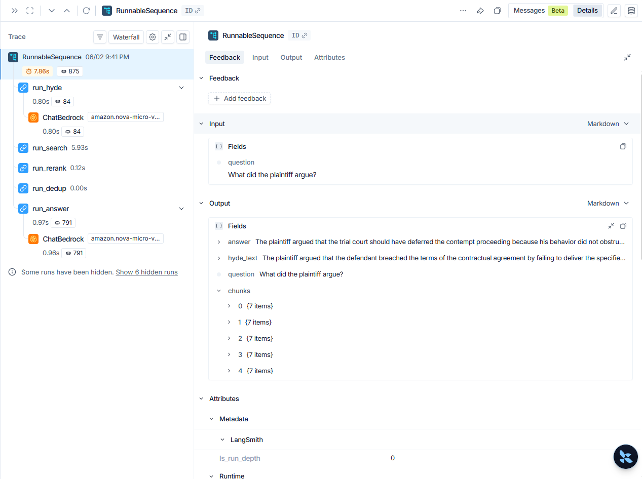
LangSmith – Tracing – Query pipieline

Slide 36
RAG Evaluation Metrics — What They Mean
5 measurements across retrieval layer, generation layer, and end-to-end quality
faithfulness
Generation
answer_relevance
Generation
answer_correctness
End-to-End
Did Nova hallucinate?
Checks every claim in the answer against the retrieved chunks. If the claim appears in chunks → faithful. If invented → not faithful.
Needs: question + chunks + answer
Score: 1.00 ✅
Did the answer address the question?
Checks if the answer is topically on-target. An answer can be relevant but incorrect (right topic, wrong facts) — this metric only checks relevance.
Needs: question + answer
Score: 0.62
Was the answer factually right?
Compares pipeline answer against hand-written expected answer. Nova judges semantic match — not exact string. Depends entirely on ground truth quality.
Needs: question + answer + expected
Score: 0.50
context_precision
Retrieval
latency
Infrastructure
Did OpenSearch return the right chunks?
Loops through each chunk individually, Nova judges each one. Score = fraction of chunks that were actually useful for answering the question.
Needs: question + chunks
Score: 0.45
How long did the full pipeline take?
Not measured by evaluators — LangSmith automatically times call_rag_pipeline(). Shows end-to-end wall-clock time including all Bedrock and OpenSearch calls.
Needs: automatic (LangSmith)
Score: ~6.3s

Slide 37
LangSmith Evaluation Results
Experiment: johnson-eval-60622841 · Dataset: johnson-v-superior-court-eval · 8 Q&A pairs
1.00
0.62
0.50
0.45
faithfulness
answer_relevance
answer_correctness
context_precision
Nova never hallucinated
Topically on-target
Factually correct answers
Chunks were useful
Per Question Breakdown
Question | Correctness | Faithfulness | Relevance | Ctx Precision
Court response to incompetency | 1.00 ✅ | 1.00 ✅ | 1.00 ✅ | 0.67
Sentence imposed | 0.00 ❌ | 1.00 ✅ | 1.00 ✅ | 0.00
Judge personally embroiled | 0.00 ❌ | 1.00 ✅ | 0.00 ❌ | 0.80
Practice Book section 1-17 | 1.00 ✅ | 1.00 ✅ | 1.00 ✅ | 0.75
Reduce from four to three | 0.00 ❌ | 1.00 ✅ | 0.00 ❌ | 0.20
Outcome of writ of error | 1.00 ✅ | 1.00 ✅ | 1.00 ✅ | 0.25
Gregory Johnson convicted of | 1.00 ✅ | 1.00 ✅ | 1.00 ✅ | 0.60
Attorney Barlow reason | 0.00 ❌ | 1.00 ✅ | 0.00 ❌ | 0.33

Slide 38
What I'd Do Next — RAG System Evaluation
The pipeline is built. Now: which combination of models and techniques produces the best answers?
🔷 Embedding Model
🔶 Reranking Model
Current: Titan v1 (1536-dim, score-bunched)
Evaluate:
Titan v2 · Cohere Embed v3 · text-embedding-3-large
Impact:
Score spread → threshold recalibration → better chunking splits
Current: Cohere Rerank 3.5
Evaluate:
No reranker · Cohere v2 · Amazon Rerank
Impact:
context_precision and answer_correctness scores
🟢 LLM
🔵 Retrieval Ablation
Current: Nova Micro (~10× cheaper than Pro)
Evaluate:
Nova Lite · Nova Pro · Claude Haiku
Impact:
answer_correctness and faithfulness scores
With HyDE vs Without HyDE
With HyQ vs Without HyQ
Hybrid vs BM25-only vs KNN-only
Impact: context_precision and answer_correctness
⚡ Already built: LangSmith evaluation harness (8 Q&A pairs, 4 metrics) is in place. Each experiment = swap model client + re-run langsmith_eval.py. No pipeline changes needed.

