Slide 1
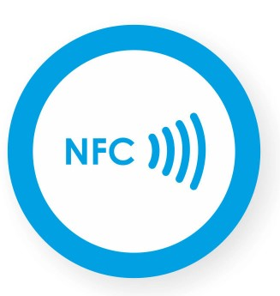
NFC
Near Field Communication

Slide 2
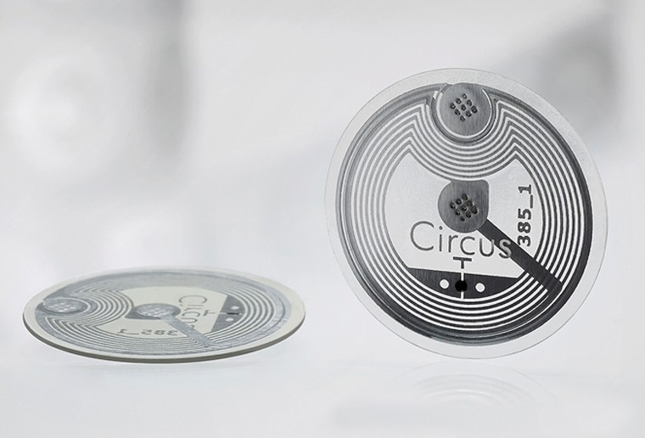
Near Field Communication(NFC)
Near field communication or NFC technology was originally developed in the late 1800’s when Thomas Edison was experimenting with radio
Its roots goes back to radio-frequency identification (RFID). It can be defined as a short-range wireless communication technology.
Near field communication began in the early 1980s and is regarded the natural evolution of radio frequency identification or RFID.
This technology enables the user to send radio information to a receiver in order to be identified for tracking purposes and for security

Slide 3
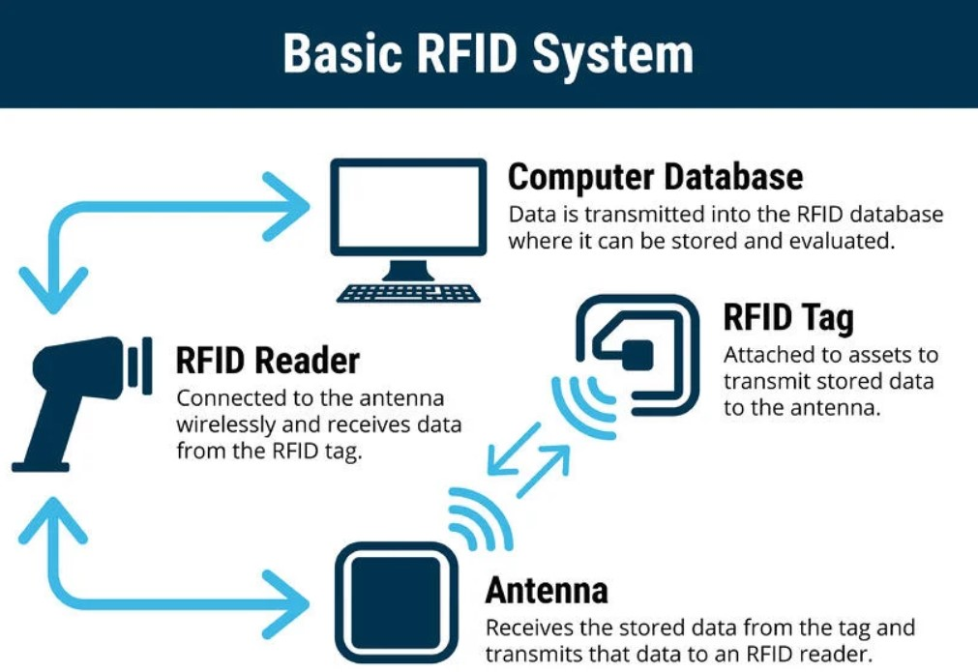
What is RFID(Radio Frequency Identification)
Radio Frequency Identification (RFID) refers to a wireless system comprised of two components: tags and readers. The reader is a device that has one or more antennas that emit radio waves and receive signals back from the RFID tag

Slide 4
Near Field Communication(NFC)
Charles Walton is the inventor of NFC and got the first recorded patent for an object utilizing the RFID technology in 1983.
Actually, Sony and a company named NXP Semiconductors invented the new NFC technology in 2002.
By 2004, huge cellular telephone companies like Nokia, Sony, and Philips had committed to the idea of integrating near field communication into their production to promote security and ease of use.
Though the NFC Forum was formed in 2004, it wasn’t until 2006 that companies produced the first set of NFC tags.
They are basically tiny small objects, like a sticker, that contain information that an NFC compatible device, such as a smart phone, can exchange data when passed over.

Slide 5
Near Field Communication(NFC)
Throughout the years, more specifications surfaced and the technology grew from just payment methods to sharing videos, links, and game invites between smart phones and other NFC devices.
It enables user to share all sort of information from music to photos.
Usually the information on the tag is read-only, but some tags enable the device reading it to write new data or even change old information.

Slide 6
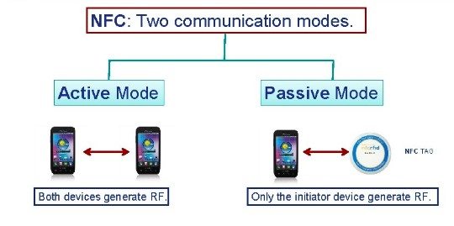
Types of NFC devices
There are two main types of NFC devices:
Passive communication NFC devices and active communication NFC devices.
Passive devices have no power source and can only connect to active devices.
Active devices have a power source and can send and receive data by switching between the normal active (transmitting) state and a passive (receiving) state.
In a typical NFC system, there is an active NFC device, passive NFC device, and a host computer or application.
Unlike a UHF RFID system that requires both a reader and a tag, active NFC devices can communicate with other active NFC devices by switching between the active state and the passive state. An example of this is using NFC devices or smartphones for the exchange of data.

Slide 7
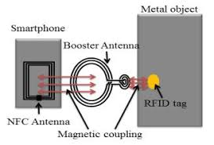
Magnetic Coupling in NFC
NFC technology uses magnetic coupling to send and receive signals. When two NFC enabled devices are close enough (from touch to 10 cm), they create an electromagnetic field between them.
That electromagnetic field allows the active NFC device to power up and communicate with the passive NFC device.
The active NFC device then picks up on variations in signal levels specific to the passive device and reads those variations as a signal.
A detector and decoder circuit in the active NFC device is then used to comprehend the passive NFC signal and extract the relevant information.
The host computer or application can then understand the information and take any relevant next steps.

Slide 8
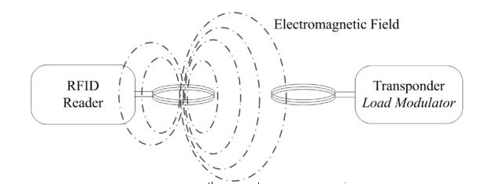

Slide 9
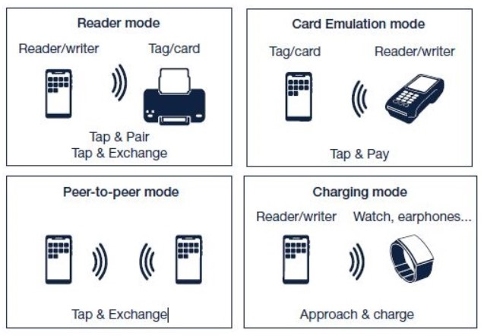
Modes of Operation
Peer-to-peer mode – Active NFC devices exchange information by switching between passive and active states. 2.Read/write mode – Active NFC device reads or writes information from/on a passive NFC device. 3.Card emulation – An Active NFC device used for contactless payment.

Slide 10
Security Risks
Security risks exist when using NFC technology as a payment form. Since all the parts in an NFC system needs to be within 10 cm to enable the technology to transfer the data, eavesdropping with another NFC device is fairly difficult without being noticed, but can be done.
There are other, more complex ways that thieves are trying to steal NFC data through data corruption, interception devices, or just theft of the NFC device. While new ways are coming out to try and defeat NFC security, new security measures are being put in place.

Slide 11
Applications
NFC technology is typically used for payments and marketing applications today, but many other applications are slowly adopting NFC.
Because programming is usually needed to bridge the gap between reading the tag and any action items associated, there are a few apps available to make some of these NFC uses come true. Below are a few examples of creative ways to use NFC tags.
NFC can provide a phone with the ability to change settings depending on what tag is tapped.
Placing a passive NFC tag on a desk at work and tapping it with an active NFC smartphone can (with the help of the right app) turn Wi-Fi on, Bluetooth off, or turn the ringer volume down.
Other abilities include setting timers, calling specific contacts, saving battery power, or opening apps. To read more about these clever applications check out NXP’s 20 Creative Uses for NFC Technology and CNET’s Practical and Creative Ways to Use NFC.

Slide 12

THANK YOU

