Slide 1
GIT

Slide 2
Table of Content
What is GIT?
GIT Commands
Branching Techniques
Cloning the Project

Slide 3
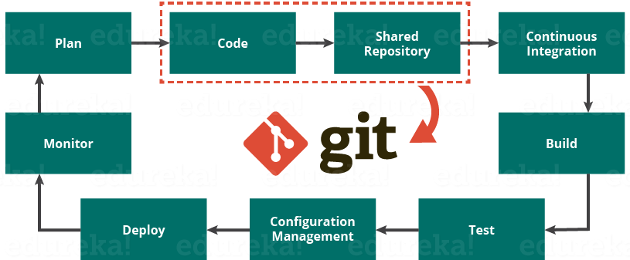
WHAT IS GIT?
GIT is a distributed version-control system for tracking changes in source code during software development. It is designed for coordinating work among programmers, but it can be used to track changes in any set of files. Its goals include speed, data integrity, and support for distributed, non-linear workflows.
Frictionless Context Switching. Create a branch to try out an idea, commit a few times, switch back to where you branched from, apply a patch, switch back to where you are experimenting, and merge it in.
Role-Based Codelines. Have a branch that always contains only what goes to production, another that you merge work into for testing, and several smaller ones for day to day work.
Feature Based Workflow. Create new branches for each new feature you're working on so you can seamlessly switch back and forth between them, then delete each branch when that feature gets merged into your main line.
Disposable Experimentation. Create a branch to experiment in, realize it's not going to work, and just delete it - abandoning the work—with nobody else ever seeing it (even if you've pushed other branches in the meantime).

Slide 4

GIT COMMANDS
Some handy commands for GIT are as given below:-
Create a branch and switch to it - git checkout -b mybranch
view local branch - git branch
clone repository - git clone git@cvs:express
delete local & remote branch - git branch -rd mybranch
commit with comment - git commit -m “comments”
Pushing the code - git push origin my branch
Pulling the code - git pull origin masterbranchname
Git add commands - git add filepath
©2016 Xactly Corporation. All rights reserved. Proprietary & Confidential.

Slide 5
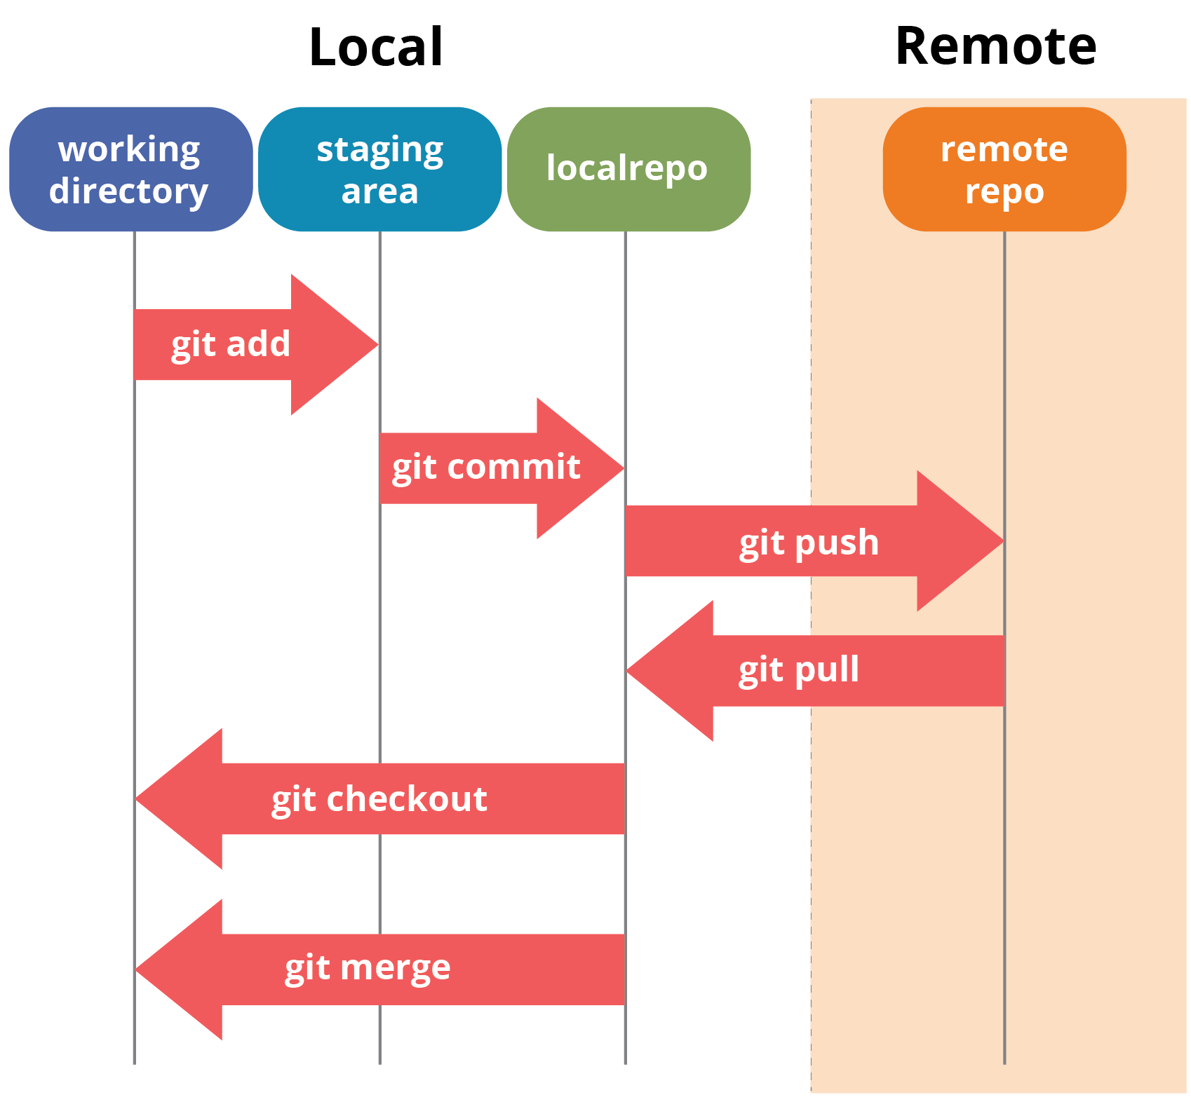
Branching the techniques
Below is the git branching model and recommended branching practices:
Our local master will always be updated with remote master(origin/master)
Should create a branch from local master with Whatever feature we are working on with that particular name
Once scripting is done will push the code to the remote feature branch and will create pull request against master branch.

Slide 6
Cloning The Project
Cloning the test infrastructure
Cloning CICD framework
(With reference to XSP)
For cloning a project follow below command :-
git clone “repositoryUrl”
Common-automation
Incent-pageobjects
XSP-automation-client
XSP-automation

