Slide 1
MAVEN

Slide 2
What is a Build Tool?
What is Maven?
What Maven can do?
Advantages over ANT
Maven-Core Concepts
Project Object Model (pom.xml)
Archetypes
Dependencies
Snapshots
Repositories
Plugins
Build Life Cycles
Profiles
Properties
Build
Agenda

Slide 3
A build tool is a tool that automates everything related to the software project. Building a software project typically includes one or more of these activities:
Generating source code
Generating documentation from the source code
Compiling source code
Packaging compiled code into JAR files or ZIP files
Installing the packaged code on a server, in a repository or somewhere else.
The Advantages of automating the build process is that you minimize the risk of humans making errors while building the software manually. Additionally, an automated build tool is typically faster than a human performing the same steps manually.
What is a build tool?

Slide 4
Apache Maven is a software project management and comprehension tool. Based on the concept of a Project Object Model (POM), Maven can manage a project’s build, reporting and documentation from a central piece of information.
“But it is not a mere build tool”
What is Maven?

Slide 5

Model our software project
Centralize our project information
Manage our build process
Gather data about our software project and the build itself
Document the software and our project
What Maven Can do?

Slide 6
Eliminate the hassle of maintaining complicated scripts
All the functionality required to build your project, i.e., clean, compile, copy resources, install, deploy, etc is build right into the maven
Cross project Reuse - Ant has no convenient way to reuse target across projects, but maven does provide the functionality
Logic and looping - Maven provides conditional logic, looping constructs reuse mechanisms which were missing in ANT
Advantages over ANT

Slide 7
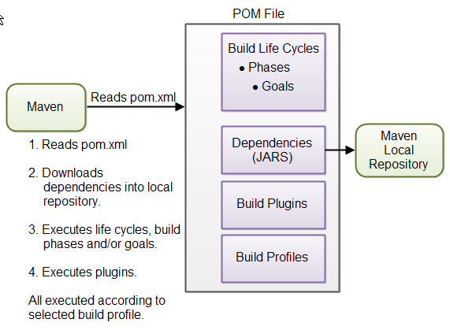
Maven - core concepts

Slide 8
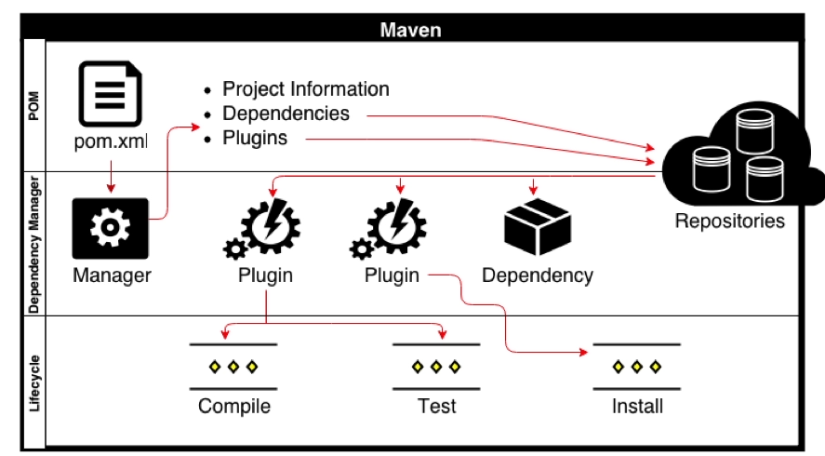
Maven - core concepts

Slide 9
Fundamental unit of work in Maven
It is an XML file that contains information about the project and configuration details used by Maven to build the project
project.xml in Maven 1(Version)
pom.xml in Maven 2 and onwards
Build directory, source directory, the test source directory and so on
The goals or plugins
Project Co-ordinates(GAV)
Build Phases
Project Type(Packaging-JAR, WAR, EAR)
Dependencies
Minimal pom.xml should have below lines
<project>
<modelVersion>4.0.0</modelVersion>
<groupId>com.mycompany.app</groupID>
<artifactId>my-app</artifactId>
<version>1</version>
</project>
Project object model - pom

Slide 10
Sample pom.xml
<project xmlns = "http://maven.apache.org/POM/4.0.0" xmlns:xsi = "http://www.w3.org/2001/XMLSchema-instance" xsi:schemaLocation = "http://maven.apache.org/POM/4.0.0 http://maven.apache.org/xsd/maven-4.0.0.xsd">
<modelVersion>4.0.0</modelVersion>
<groupId>com.mycompany.app</groupId>
<artifactId>my-app</artifactId>
<packaging>jar</packaging>
<version>1.0.0-SNAPSHOT</version>
<name>Maven Quick Start Archetype</name>
<url>http://maven.apache.org</url>
<dependencies>
<dependency>
<groupId>junit</groupId>
<artifactId>junit</artifactId>
<version>4.8.2</version>
<scope>test</scope>
</dependency>
</dependencies>
</project>
Project object model - Cont’d

Slide 11
In general - a primitive type or an original model or pattern from which all other things of same kind are made.
For Maven - a template of a project which is combined with some user input to produce a working Maven project that has been tailored to the user’s requirements
There are hundreds of archetypes to help us get started
To create a standard Maven project through terminal/command line tool:
mvn archetype:generate
-DgroupId = com.xactly
-DartifactId = common-automation
-DarchetypeArtifactId = maven-archetype-quickstart
-DinteractiveMode = false
groupId -> a unique base name of the company or group that created the project
artifactId -> a unique name of the project
version -> a version of the project
packaging -> a packaging method
The first 3 of these(groupId:artifactId:version) combine to form the unique identifier and are the mechanism by which you specify which versions of external libraries your project will use
Archetypes

Slide 12
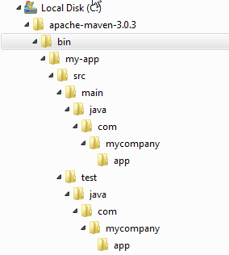
Standard directory layout
src/main/java | Application/Library sources
src/main/resources | Application/Library resources
src/main/filters | Resource filter files
src/main/assembly | Assembly descriptors
src/main/config | Configuration files
src/main/scripts | Application/Library scripts
src/main/webapp | Web application sources
src/test/java | Test sources
src/test/resources | Test resources
src/test/filters | Test resource filter files
src/site | Site
LICENSE.txt | Project's license
NOTICE.txt | Notices and attributions required by libraries that the project depends on
README.txt | Project's readme

Slide 13
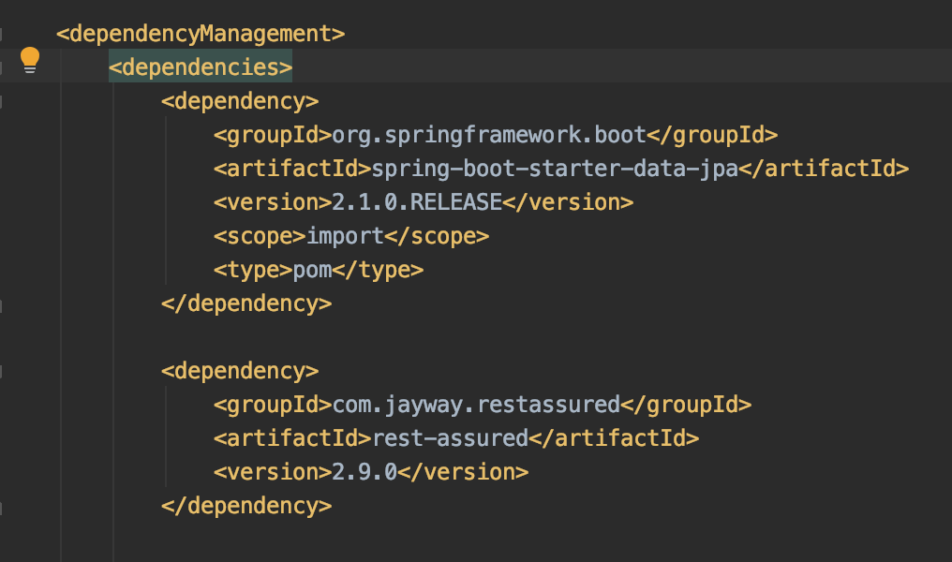
Those external libraries that a project uses are called dependencies. The dependency management feature in Maven ensures automatic download of those libraries from a central repository, so you don’t have to store them locally.
In order to declare a dependency on an external library, you need to provide the groupId, artifactId, and the version of the library.
Dependencies

Slide 14
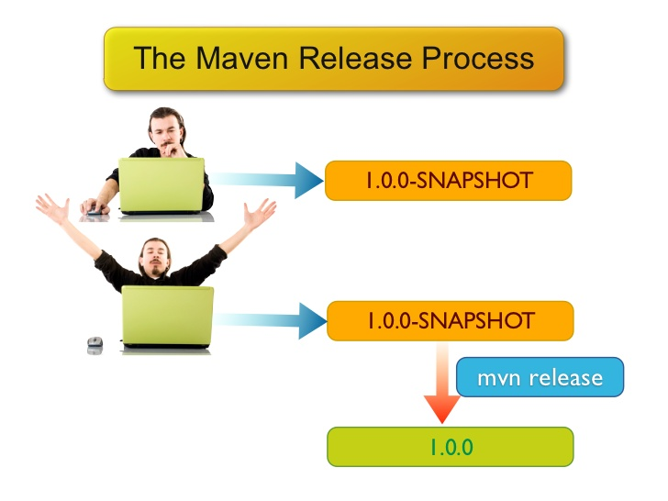
A snapshot version in Maven is one that has not been released.
The difference between a “real” version and a snapshot version is that snapshots might get updates. That means that downloading 1.0-SNAPSHOT today might give a different file than downloading it yesterday or tomorrow.
Usually, snapshot dependencies should only exist during development and no released version (i.e. no non-snapshot) should have a dependency on a snapshot version.
The snapshot is not necessarily more stable: it is just the latest build. The snapshot precedes the actual release, it does not come after it. Indeed, version numbers typically do not refer to branches
Snapshots

Slide 15
A maven repository is a directory of packaged JAR file with pom.xml file. Maven searches for dependencies in the repositories.
A repository in Maven is used to hold build artifacts and dependencies of varying types. The default local repository is located in the .m2/repository folder under the home directory of the user.
If an artifact or a plug-in is available in the local repository, Maven uses it. Otherwise, it is downloaded from a central repository and stored in the local repository. The default central repository is Maven Central.
Some libraries, such as JBoss server, are not available at the central repository but are available at an alternate repository. For those libraries, you need to provide the URL to the alternate repository inside pom.xml file:
Repositories

Slide 16
There are 3 types of maven repository:
Local Repository
Central Repository
Remote Repository
Maven searches for the dependencies in the following order:
Local repository -> Central repository -> Remote repository.
If dependency is not found in these repositories, maven stops processing and throws an error.
Types of Repositories

Slide 17
A plugin provides a set of goals that can be executed to perform a task
There are Maven plugins for building, testing, source control management, running a web server, generating eclipse project files, and much more
Some basic plugins are included in every project by default, and they have sensible default settings.
A goal is like an ant target
We can write our own plugins with goals or use those provided by Maven
For example, a Java project can be compiled with the compiler plugin’s compile - goal by running mvn compiler:compile
Plugins and goals

Slide 18
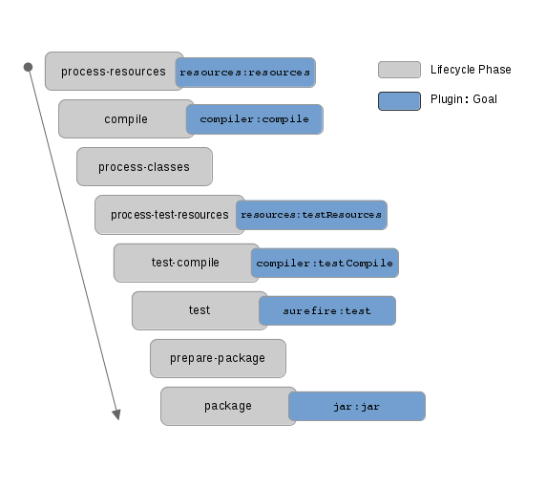
Plugins and goals

Slide 19
Every Maven build follows a specified lifecycle. You can execute several build lifecycle goals, including the ones to compile the project’s code, create a package, and install the archive file in the local Maven dependency repository.
Lifecycle and its Phases
A build lifecycle is an organized sequence of phases that exist to give order to a set of goals. Those goals are chosen and bound by the packaging type of the project being acted upon. There are 3 standard lifecycles in Maven:
Clean
Default(Sometimes called Build)
Site
Build life cycles

Slide 20
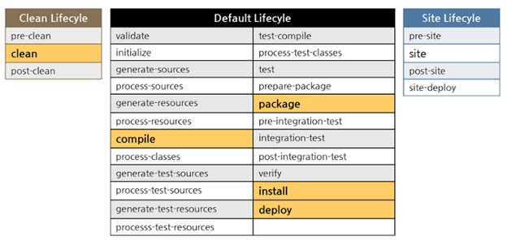
The following list shows the most important Maven Build lifecycle phases:
validate – checks the correctness of the project
compile – compiles the provided source code into binary artifacts
test – executes unit tests
package – packages compiled code into an archive file
integration-test – executes additional tests, which require the packaging
verify – checks if the package is valid
install – installs the package file into the local Maven repository
deploy – deploys the package file to a remote server or repository
Build life cycles

Slide 21
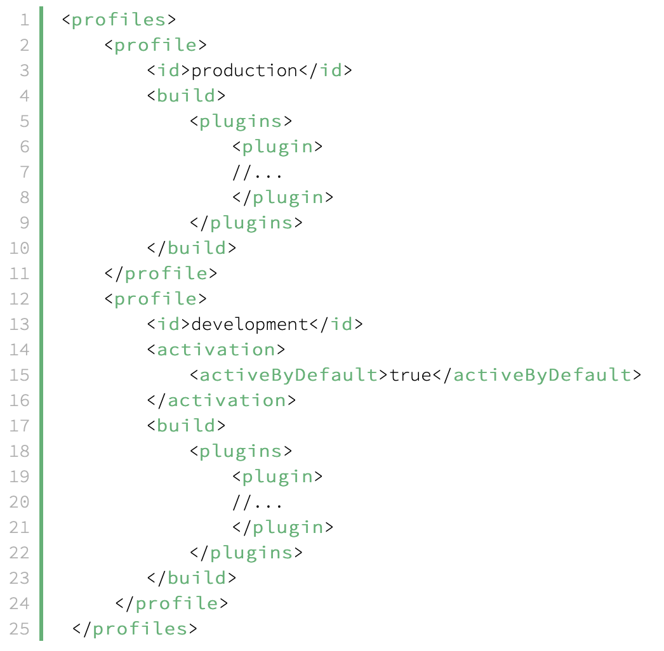
Another important feature of Maven is its support for profiles. A profile is basically a set of configuration values. By using profiles, you can customize the build for different environments such as Production/Test/Development:
As you can see in the example below, the default profile is set to development. If you want to run the production profile, you can use the following Maven command: mvn clean install -Pproduction
Profiles

Slide 22
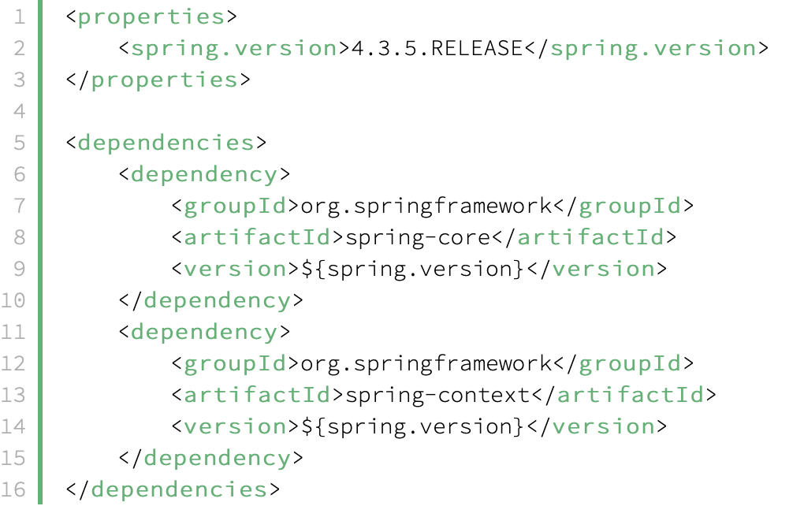
Custom properties can help to make your pom.xml file easier to read and maintain. In the classic use case, you would use custom properties to define versions for your project’s dependencies.
Maven properties are value-placeholders and are accessible anywhere within a pom.xml by using the notation ${name}, where name is the property.
Now if you want to upgrade Spring to a newer version, you only have to change the value inside the<spring.version> property tag and all the dependencies using that property in their <version> tags will be updated.
Properties

Slide 23
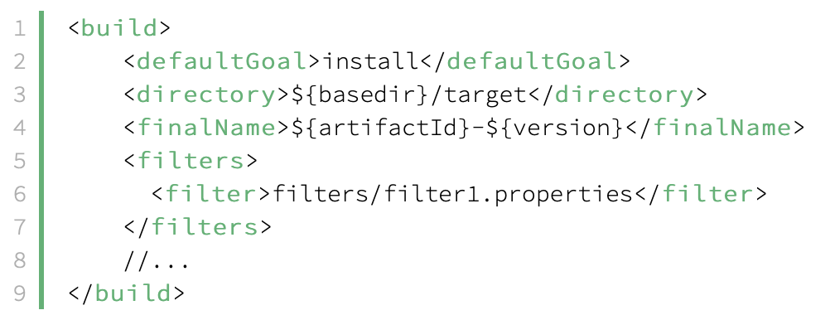
The build section is also a very important section of the Maven POM. It provides information about the default Maven goal, the directory for the compiled project, and the final name of the application.
The default output folder for compiled artifacts is named target, and the final name of the packaged artifact consists of the artifactId and version, but you can change it at any time.
The default build section looks like this:
Build

