Slide 1
Java
sudheer

Slide 2
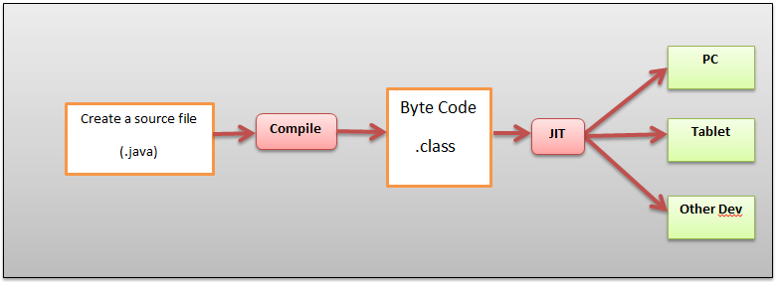
Java Overview
Java is a Object Oriented Programming Languages
It is developed by Sun Micro Systems later in 2010 acquired by Oracle Corporation.

Slide 3
Java Features
Simple
Object-Oriented
Platform independent
Secured
Robust
Architecture neutral
Portable
Dynamic
Interpreted
High Performance
Multithreaded
Distributed

Slide 4
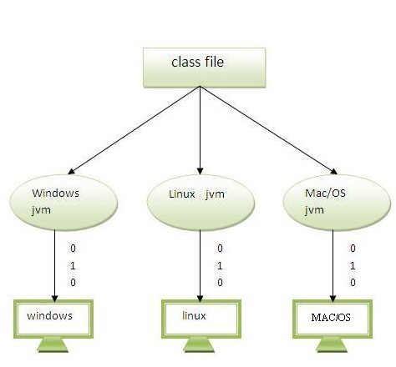
Java Features Continuation…
Simple:- No Pointers, Easy Syntax
Object-Oriented:- Software is organized as a combination of different types of objects that incorporates both data and behaviour.
Platform Independent:-Java code is compiled by the compiler and converted into byte code. This byte code is a platform independent code because it can be run on multiple platforms i.e. Write Once and Run Anywhere(WORA).
A platform is the hardware or software environment in which a program runs. There are two types of platforms software-based and hardware-based. Java provides software-based platform. The Java platform is a software-based platform that runs on top of other hardware-based platforms. It has two components:
Runtime Environment
API(Application Programming Interface)

Slide 5
Java Features Continuation…
Robust:- Robust simply means strong. Java uses strong memory management. There are lack of pointers that avoids security problem. There is automatic garbage collection in java. There is exception handling and type checking mechanism in java. All these points makes java robust.
Portable:- Java byte code can be carried to any platform for execution.
Distributed:- We can create distributed applications in java. RMI and EJB are used for creating distributed applications. We may access files by calling the methods from any machine on the internet.
Multi-threaded:-A thread is like a separate program, executing concurrently. We can write Java programs that deal with many tasks at once by defining multiple threads. The main advantage of multi-threading is that it shares the same memory. Threads are important for multi-media, Web applications etc.
Secure:-
Java program always runs in JRE with almost null interaction with system OS, hence it is more secure.
No explicit pointer

Slide 6
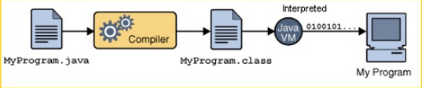
Java Features Continuation…
Architectural Neutral:- Compiler generates byte codes, which have nothing to do with a particular computer architecture, hence a Java program is easy to interpret on any machine.
Interpreted:- The Java compiler generates byte-codes, rather than native machine code. To actually run a Java program, you use the Java interpreter to execute the compiled byte-codes. Java byte-codes provide an architecture-neutral object file format. The code is designed to transport programs efficiently to multiple platforms.

Slide 7
Java Features Continuation…
Dynamic
Java is dynamic language
Java is capable of dynamically linking new
Class libraries
Methods
Objects
Java Programs supports functions written C and C++ , these functions are known as “native methods”.

Slide 8
Installing Java
Download and install the java
Set Environment variables for java.
Java –version
Javac
java
Download and use Eclipse IDE.

Slide 9
Class and Object
In real time everything we can see and touch can be call it as Object.
Ex:- Car, Dog, Laptop, Pen, Chair
Every object has certain properties.
Ex:- car has color, model, manufacturer
In java , Object is an instance of class.
Class is a blueprint.

Slide 10
Class Structure
package com.java;
import com.lang.Math;
public class <ClassName>
{
variables
constructors
methods
}

Slide 11
Create a HelloWorld Program + Run From Command Line

Slide 12
Java Keywords
abstract | boolean | break | byte | case | catch | char
class | const | continue | default | do | double | else
extends | final | finally | float | for | goto | if
implements | import | instanceof | int | interface | long | native
new | package | private | protected | public | return | short
static | strictfp | super | switch | synchronized | this | throw
throws | transient | try | void | volatile | while | assert

Slide 13
Identifiers
Identifiers must start with a letter, a currency character ($), or a connecting character such as the underscore _.
Identifiers cannot start with a number.
After the first character, identifiers can contain any combination of letters, currency characters, connecting characters, or numbers.
There is no limit to the number of characters an identifier can contain.
You can't use a Java keyword as an identifier.
Identifiers in Java are case-sensitive; foo and FOO are two different identifiers.
A legal identifier for a variable is also a legal identifier for a method or a class.
Examples:
While //is not valid
$sudheer //valid
_Sudheer123 //valid
$_Sudh$_123 //valid
12sudheer //Not valid

Slide 14
Modifiers - Class
public
Class can be accessed from any other class present in any package
default
Class can be accessed only from within the same package. Classes outside the package in which the class is defined cannot access this class
final
This class cannot be sub-classed, one cannot extend this class
abstract
Class cannot be instantiated, need to sub-classs/extend.
strictfp
Conforms that all methods in the class will conform to IEEE standard rules for floating points

Slide 15
Modifiers - Introduction
Modifiers are keywords that you add to those definitions (variables, methods, and classes) to change their meanings. The Java language has a wide variety of modifiers.

Slide 16
Modifiers - Variables
public
Attribute can be accessed from any other class present in any package
private
Attribute can be accessed from only within the class
protected
Attribute can be accessed from all classes in the same package and sub-classes.
default
Attribute can be accessed only from within the same package.
final
This value of the attribute cannot be changed, can assign only 1 value
transient
The attribute value cannot be serialized
volatile
Thread always reconciles its own copy of attribute with master.
static
Only one value of the attribute per class

Slide 17
Modifiers - Methods
public
Method can be accessed from any other class present in any package
private
Method can be accessed from only within the class
protected
Method can be accessed from all classes in the same package and sub-classes.
default
Method can be accessed only from within the same package.
final
The method cannot be overridden
abstract
Only provides the method declaration
strictfp
Method conforms to IEEE standard rules for floating points
synchronized
Only one thread can access the method at a time
native
Method is implemented in platform dependent language
static
Cannot access only static members.

Slide 18
Variables
Variables are used to store values; each variable in java has specific type which determines size and values to be stored in variable.
Local Variables
Instance Variables
Class Variables/ Static Variables
Examples:-
int x=10; //declare and initialize variables
Int z;
Z= 20;

Slide 19
Variables Continuation
Local Variables | Instance Variables | Class Variables
declared within methods, constructors, or blocks | Inside class, but outside methods, constructors, or blocks. | Class variables also known as static variables are declared with the static keyword in a class, but outside a method, constructor or a block.
These are created when the method, constructor or block is entered and the variable will be destroyed once it exits the method, constructor or block. | When a space is allocated for an object in the heap, a slot for each instance variable value is created, and destroyed when the object is destroyed. | Static variables are created when the program starts and destroyed when the program stops
Access modifiers cannot be used for local variables. | Access modifiers can be given for instance variables. | Access modifiers can be used.
visible only within the declared method, constructor or block. | The instance variables are visible for all methods, constructors and block in the class. | Visibility is similar to instance variables
No default value, so before using this variable those must be initialized. | Instance variables have default values | Default values are same as instance variables.
Local variables are used with the method where it's declared. | Instance variables can be accessed directly by calling the variable name inside the class. However within static methods and different class. ObjectReference.VariableName. | Static variables can be accessed by calling with the class name. ClassName.VariableName.

Slide 20
DataTypes

Slide 21
Types of Operators
Assignment Operators
Increment Decrement Operators
Arithmetic Operators
Bitwise Operators
Relational Operators
Logical Operators
Ternary Operators
Comma Operators
Instanceof Operators

Slide 22
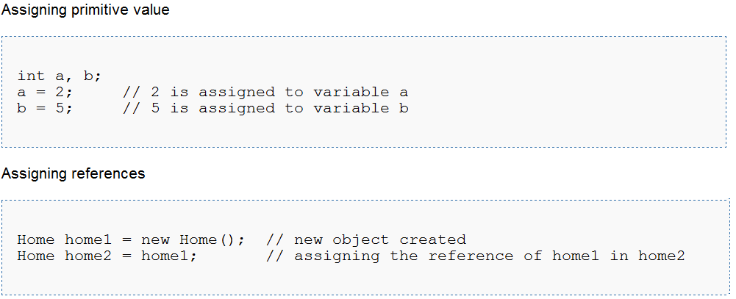
Assigning values Example

Slide 23
Increment and Decrement operators ++ and --
The increment(++) operators add an integer variable value by one.
Pre fix (++var)
Post fix (var++)
The Decrement(--) operators add an integer variable value by one.
Pre fix (--var)
Post fix (var--)

Slide 24
Arithmetic Operators
Operator | Result | A is 10, and B is 20
+ | Addition | A+B = 30
- | Subtraction (also unary minus) | A-B = -10
* | Multiplication | A*B = 200
/ | Division | B/A = 2
% | Modulus | B%A = 0
++ | Increment | A++ = 11
+= | Addition assignment | A -= B ,
-= | Subtraction assignment
*= | Multiplication assignment
/= | Division assignment
%= | Modulus assignment
-- | Decrement

Slide 25
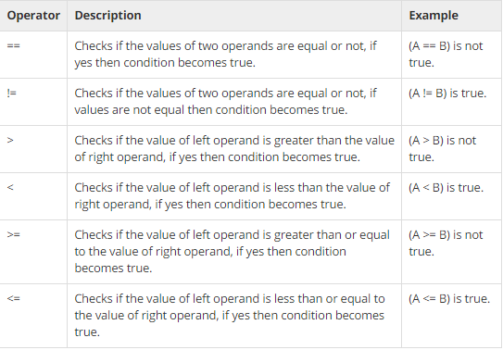
Relational Operators

Slide 26
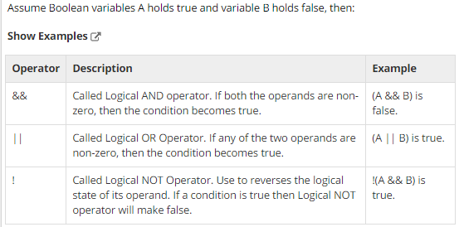
Logical Operators

Slide 27
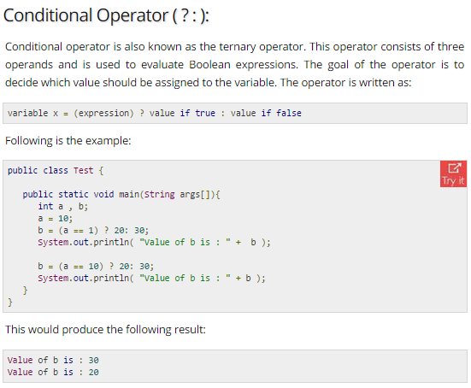
Conditional or Ternary Operators

Slide 28
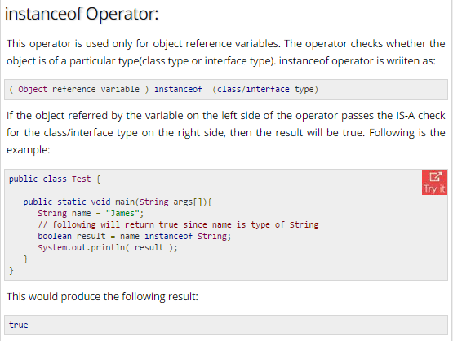
Instance Of Operators

Slide 29
Increment, Decrement - Examples
public class Example
{
public static void main(String[] args)
{
}
}
int j, p, q, r, s;
j = 5;
p = ++j; // j = j + 1; p = j;
System.out.println("p = " + p);
q = j++; // q = j; j = j + 1;
System.out.println("q = " + q);
System.out.println("j = " + j);
r = --j; // j = j -1; r = j;
System.out.println("r = " + r);
s = j--; // s = j; j = j - 1;
System.out.println("s = " + s);
> java example
p = 6
q = 6
j = 7
r = 6
s = 6
>

